Slide 1


SIES GRADUATE SCHOOL OF TECHNOLOGY / MAJOR PROJECT REVIEW · 2026
eBPF-LSM Shield
Kernel-Level Anti-Evasion
Ransomware Detection
MAJOR PROJECT REVIEW–2 · PHASE I
PROJECT TEAM
123AX017
Suraj Gore
123AX019
Abuzar Hajwane
123AX038
Rushika Poojari
123AX059
Vivek Sangem
Project Guide: Prof. Ashwini Khillari
Computer Science Engineering · IoT & Cyber Security
LINUX KERNEL TELEMETRY
Behavioral detection · Audit-first design

Slide 2

Project Overview
A Linux-focused behavioral detection prototype for suspicious file-system activity.
Uses kernel tracepoint telemetry and a BPF LSM audit hook as the monitoring foundation.
Combines file-centric identity, multiple behavioral indicators, temporal persistence, and canary tripwires.
Designed to detect suspicious transformations while avoiding alerts based on file-operation volume alone.
Current posture: audit and alert; active in-kernel blocking remains future work.
KERNEL-LEVEL VISIBILITY
CURRENT POSTURE
Audit + alert. Active in-kernel blocking remains future work.
eBPF LSM Shield | Major Project
02

Slide 3
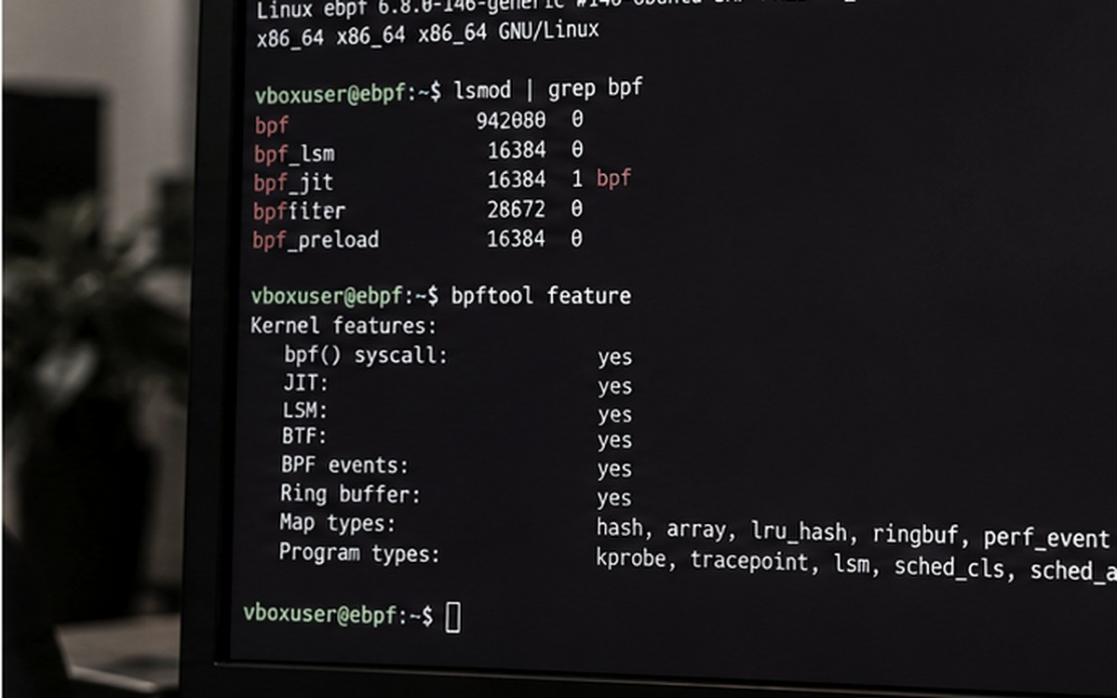
Problem Statement
User-space security agents can be weakened or bypassed by privileged malware.
Per-process thresholds can miss coordinated activity when encryption work is split across worker processes.
Fast in-place transformations and less-common write operations can evade narrow telemetry coverage.
Simple syscall-rate thresholds also flag legitimate workloads such as builds, copies, and archive extraction.
The challenge is to correlate file behavior and distinguish suspicious transformation patterns from benign high activity.
LINUX MONITORING CONTEXT
CORE CHALLENGE
Correlate file behavior instead of relying on syscall volume alone.
eBPF LSM Shield | Major Project
03

Slide 4
Objectives
Collect file-system activity from Linux kernel tracepoints.
Correlate activity by file identity instead of relying only on process ID or pathname.
Measure modification breadth, throughput, rename/write behavior, and temporal persistence.
Use canary files as a high-confidence tripwire for suspicious interaction.
Evaluate detection behavior using benign and simulated adversarial workloads.
Keep the current prototype audit-first to reduce risk to the host system.
OBJECTIVE FLOW
01
02
Collect
Correlate
Kernel tracepoints
File identity
03
04
Measure
Validate
Behavior + persistence
Benign and simulated tests
eBPF LSM Shield | Major Project
04

Slide 5
Threat Model and Detection Challenge
Threat / Challenge | Why it matters | Design response
User-space evasion | Agents and hooks may be tampered with | Kernel-level telemetry foundation
Multi-process splitting | Each PID may remain below a local threshold | Cross-process, file-centric aggregation
Non-standard writes | Narrow write hooks can miss transformations | Broader POSIX modification telemetry
Benign high throughput | Builds and archive tasks modify many files | Multi-indicator rules and persistence
Fast attacks | A multi-window confirmation can add delay | Canaries provide immediate escalation
eBPF LSM Shield | Major Project
05

Slide 6
System Architecture
KERNEL TELEMETRY: tracepoints observe open, write, copy, truncate, rename, unlink, and close activity.
EVENT STREAM: compact events carry process, operation, path / inode context, and byte information where available.
USER-SPACE ENGINE: resolves file identity, aggregates events into 2-second windows, and calculates behavioral features.
DETECTION STATE MACHINE: LOW / BENIGN → SUSPICIOUS → HIGH RISK, with a canary override.
OUTPUT: explainable terminal alerts and measurements for testing.
DETECTION PIPELINE
01
02
03
04
05
Kernel
telemetry
›
Event
stream
›
Identity +
windowing
›
Risk state
evaluation
›
Explainable
alert
eBPF LSM Shield | Major Project
06

Slide 7

Phase 1 — File-Centric Identity
A process ID is not a reliable unit for detecting coordinated multi-process activity.
The design correlates activity using a file identity tuple: (device, inode, generation).
Events from multiple worker processes can therefore contribute to one view of file transformations.
This addresses threshold splitting: several low-volume workers may collectively reveal a broad attack.
Multi-process coordination is an escalation signal, not a standalone reason to declare an attack.
CROSS-PROCESS CORRELATION
FILE IDENTITY TUPLE
(device, inode, generation)
eBPF LSM Shield | Major Project
07

Slide 8
Phase 2 — Telemetry Completeness
Core operations include open/openat, write, copy_file_range, rename, unlink, and close.
Expanded coverage in the reference design includes pwrite64, writev, pwritev, truncate, ftruncate, and fallocate.
Track both operation counts and byte throughput where the event source provides sufficient information.
Broader coverage reduces dependence on a single syscall pattern.
Implementation note: verify that each listed probe is present in the actual code before describing it as implemented.
TELEMETRY COVERAGE
CORE OPERATIONS
open / openat
write
copy_file_range
rename
unlink
close
EXPANDED REFERENCE COVERAGE
pwrite64
writev
pwritev
truncate
ftruncate
fallocate
eBPF LSM Shield | Major Project
08

Slide 9
Phase 3 — Entropy as Supporting Evidence
Shannon entropy estimates the distribution of byte values in sampled data.
High output entropy alone is not enough: compressed archives, images, and video can also be high-entropy.
The reference design considers a read-to-write entropy ratio rather than raw entropy alone.
Bounded prefix sampling is intended to limit overhead.
Treat entropy as supporting evidence and confirm that this phase is implemented and measured before claiming results.
ENTROPY AS SUPPORTING EVIDENCE
CONCEPTUAL BYTE-DISTRIBUTION SKETCH
Lower spread
Higher spread
INTERPRETATION
High entropy alone is not a verdict.
eBPF LSM Shield | Major Project
09

Slide 10
Phase 4 — Canary / Decoy Tripwires
Decoy files imitate common document, spreadsheet, database, key, and ledger formats.
The engine records canary inode identities so renaming a decoy does not lose its identity.
A canary modification can trigger immediate HIGH RISK escalation without waiting for three windows.
The reference test path is /tmp/ebpf_shield_canaries.
Use isolated test directories and synthetic data; confirm the actual paths and behavior in the implementation.
CANARY / DECOY EXAMPLES
DOC
XLS
DB
Document
Spreadsheet
Database
KEY
LED
Key file
Ledger
TRIPWIRE RESPONSE
Any tracked canary touch → HIGH RISK
Reference test path: /tmp/ebpf_shield_canaries
eBPF LSM Shield | Major Project
10

Slide 11
Detection Logic and Risk Rules
Indicator | Reference threshold / rule | Purpose
Modified-file breadth | ≥ 20 unique modified files | Avoid overreacting to localized edits
Rename / write ratio | ≥ 0.50 | Identify write-then-rename behavior
Modification rate | ≥ 10 files/sec | Measure sustained activity
Persistence | 3 consecutive 2-second windows | Filter short benign bursts
Canary interaction | Any tracked canary touch | Immediate escalation
eBPF LSM Shield | Major Project
11

Slide 12
Evaluation Results — Benign Workloads
Workload | Modified files/sec | Rename/write ratio | Reported state
Idle baseline | 0.00 | 0.0000 | LOW / BENIGN
High-volume creation | 42.50 | 0.0000 | LOW / BENIGN
Large file copy | 40.25 | 0.0000 | LOW / BENIGN
Archive extraction | 60.50 | 0.0000 | LOW / BENIGN
Git branch checkout | 5.50 | 0.4286 | LOW / BENIGN
Multi-file GCC build | 121.00 | 0.0210 | LOW / BENIGN
121.00
0.0000
LOW / BENIGN
Highest modified files/sec · Multi-file GCC build
Rename/write ratio · For creation, copy and extraction
Reported state · All listed benign workloads
eBPF LSM Shield | Major Project
12

Slide 13
Evaluation Results — Simulated Threats
Scenario | Modified files/sec | Rename/write ratio | Reported outcome
Single-process simulation | 25.00 | 1.0000 | HIGH RISK — streak
Multi-process evasion | 25.00 | 1.0000 | HIGH RISK — inode aggregation
Canary tripwire breach | 1.00 | 1.0000 | HIGH RISK — immediate
The supplied reference reports 11 evaluation workloads across four architectural phases.
Treat the figures as project-reported measurements and retain test logs to support them during review.
eBPF LSM Shield | Major Project
13

Slide 14
Demonstration and Current Limitations
Demo scenarios: benign GCC baseline, bulk transformation simulation, multi-process simulation, canary tripwire, and live console monitor.
Run demonstrations only in an isolated lab directory with synthetic test data.
The supplied reference describes the BPF LSM hook as audit-only; it does not actively block processes.
The reference also identifies user-space aggregation and migration to libbpf/CO-RE and ring-buffer processing as future work.
Confirm all scripts, hook names, metrics, and test outcomes match the repository before the final presentation.
LIVE CONSOLE MONITORING
SAFETY BOUNDARY
Audit-only hook; demonstrate in an isolated lab directory.
eBPF LSM Shield | Major Project
14

Slide 15
Conclusion and Future Scope
The project uses kernel telemetry and explainable behavioral features to identify suspicious file transformations.
File-centric aggregation is intended to expose coordinated activity across multiple processes.
Canary tripwires provide a separate high-confidence route to immediate escalation.
Reported tests illustrate why file-operation volume alone is insufficient for classification.
Future work: validate wider workloads, improve telemetry portability with libbpf/CO-RE, move aggregation toward BPF ring buffers, and assess enforcement only after safety testing.
KERNEL-LEVEL OBSERVABILITY
FUTURE SCOPE
libbpf / CO-RE · BPF ring buffers · safety-tested enforcement
eBPF LSM Shield | Major Project
15

