Slide 1
PayPoint
Data Exploration

Slide 2
The collected data is of one day transactions
15-05-2022

Slide 3
34 States-UT
Unique Transactions 141k
632 Cities
7 Services
40 Domains
843 Products
15k Active Business
90 Operators

Slide 4
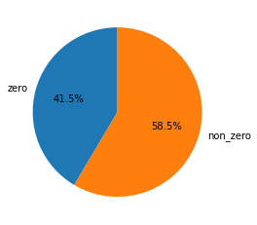
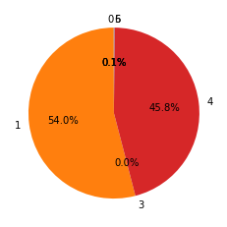
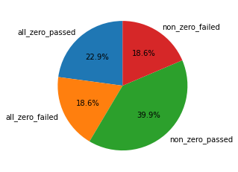
Business_Catalog:
It is the retailer account status. 0 = Inactive, 1 = Active, 2 = Dormant, 3 = Suspended, 4 = Incomplete, 5 = Closed, 6 = Fraud
Paid vs unpaid transaction:

Slide 5
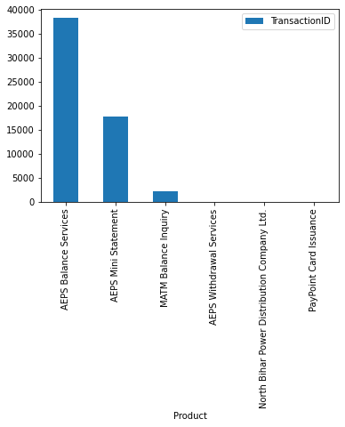
No. of Transactions per Product For all zero amount transaction
>>>>
Most of the zero transactions consists of Enquiry

Slide 6
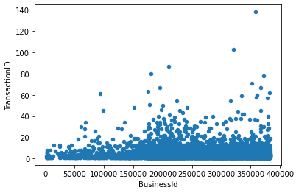
Failed transaction(status = 3) per businessid out of all_zero amount trxns(mostly enquiries)

Slide 7
Paid Transaction Based Stats

Slide 8
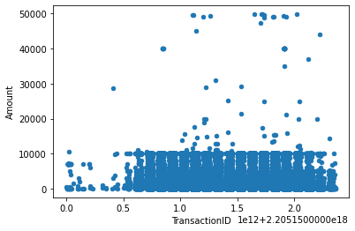
Amount Scatter plot for paid trnxs
Paid Trnxs = Non_Zero not failed trnxs
>>>>>
Most of the transaction lie in 1-10000 range
<10000 = 54065
>10000 & <20000 = 40
>20000 = 43

Slide 9
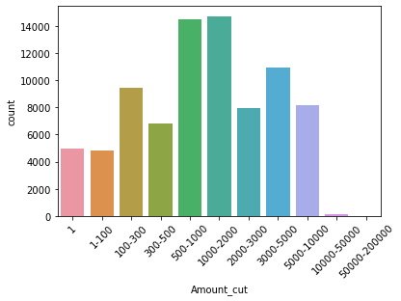
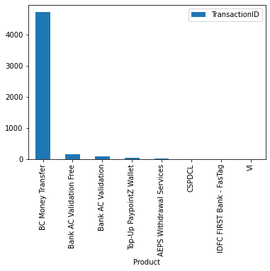
Amount wise number of transactions
>>>>>>
1 rs transaction !!!!!
To check whether balance transfer is working ??

Slide 10
Business Based Stats

Slide 11
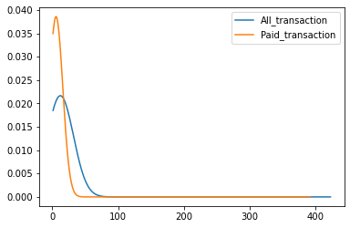
Number of Paid_trnxs vs all_transaction per business
99% of all businesses lie below 55 count for all_transactions
99% of all businesses lie below 30 count for only paid_transactions

Slide 12
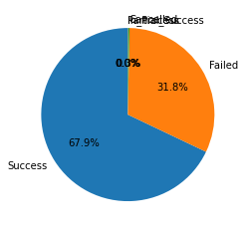
Non_zero transactions stats

Slide 13
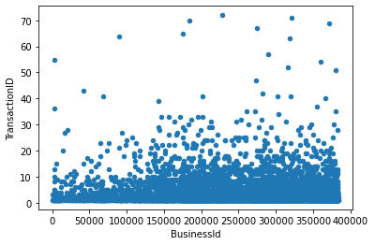
business having total failed transaction out of non_zero amount transactions.
>>>>>>
>30 = 40
>20 & <30 = 85
<20 = 5713

Slide 14
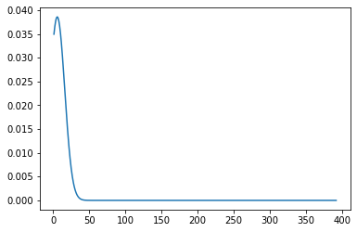
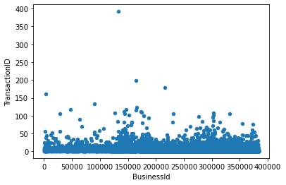
Business distribution having total paid transactions (not failed)
99% of businesses are doing around 30
non-failed Paid transactions.
No. of Transaction

Slide 15
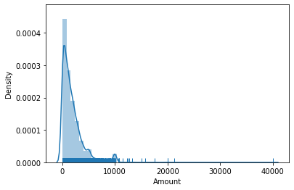
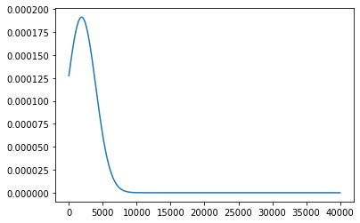
Average Amount wise Business distribution
99 % of Businesses lies below avg amount of 7000

Slide 16
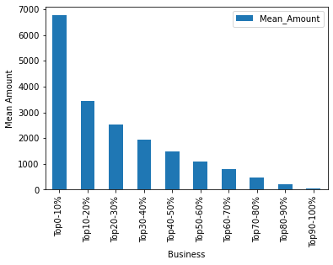
business
mean amount where available businesses are divided into 10 equal part

Slide 17
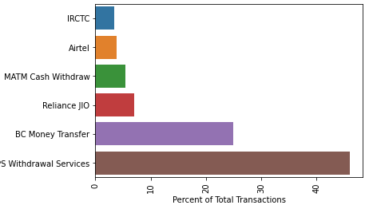
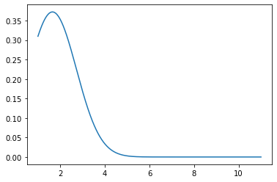
Products Insights
Money Withdrawal & Transfer, TV Mobile Recharge, Ticket booking, Electricity Payments are most in demand
Distribution of Businesses based on number of products used
Above 6 services accounts for 90% of transaction
99% are having less than 4 products associated

Slide 18
Product Based Stats

Slide 19
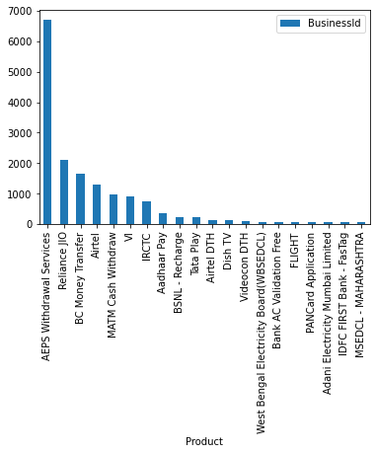
Top 20 products with highest businesses involved

Slide 20
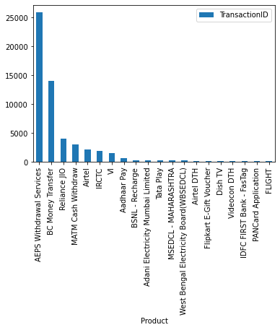
Top products with highest Transactions involved

Slide 21
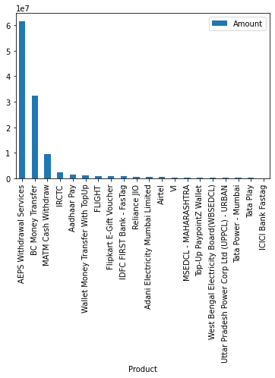
Top products with highest Total(sum) Amount involved

Slide 22
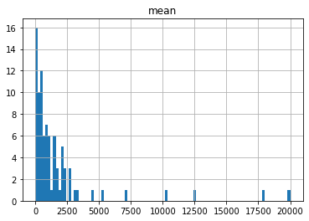
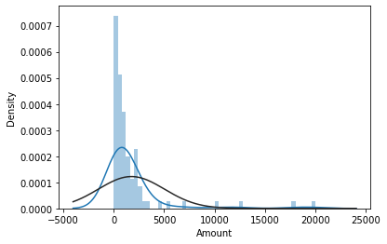
Average(mean) amount wise per Product distribution
>>>>
Most products lie in average amount of 4000-6000
Distribution does not seem normal

Slide 23
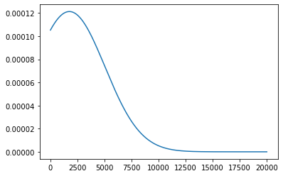
Product
99 % of products lies below mean amount of 9398.62

Slide 24
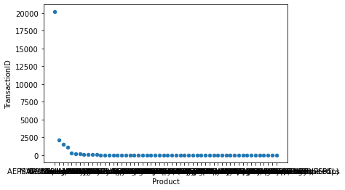
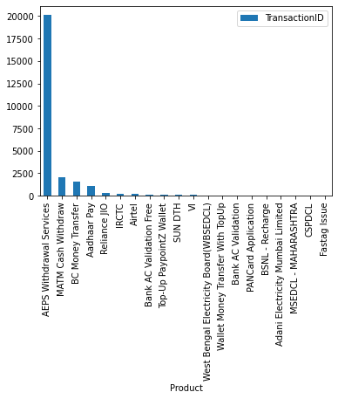
Product wise non_zero_amount but failed trnxs
>>>>>>

Slide 25
Service Type

Slide 26
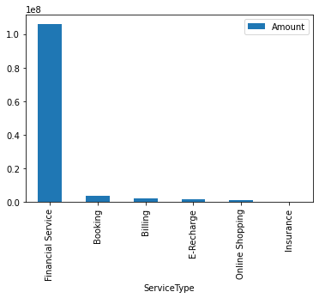
Total amount per service type

Slide 27
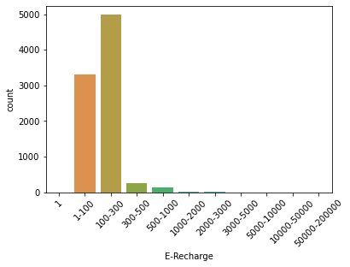
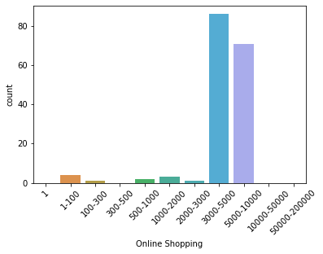
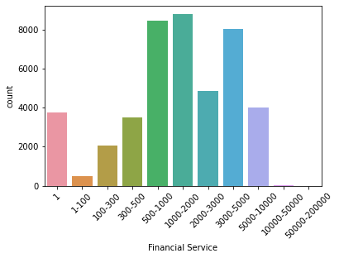
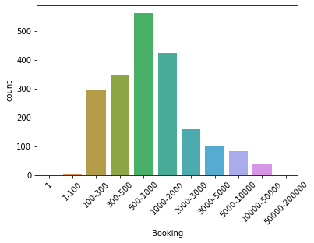
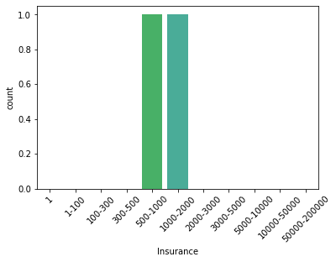
Amount cut per service type

Slide 28
Online Shopping
Insurance
Only 0.3% of transactions are of online shopping.
Insurance service though in low demand. There demand may rise in future.
From 80+ options for online shopping (most products are e-gift cards), Flipkart E-Gift Voucher Subscription were in demand on given date.

Slide 29
Domain Based Stats

Slide 30
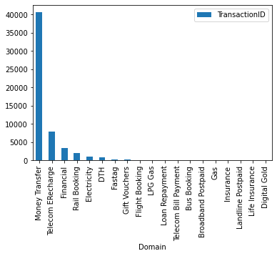
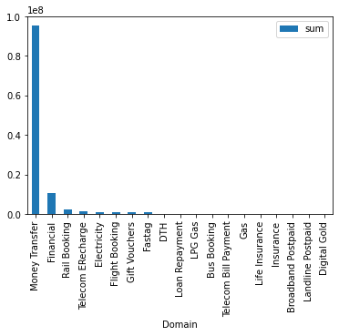
1
Domain wise number of trnxs
Domain wise amount sum

Slide 31
Address Based Stats

Slide 32
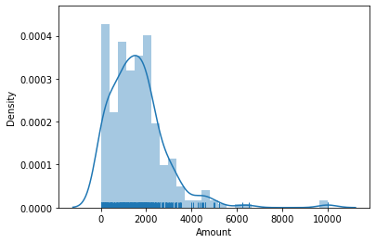
1
Distribution of cities based on mean amount

Slide 34
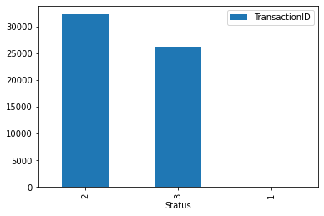
Status Code, ( 1 = InProcess, 2 = Success, 3 = Failed, 4 = Rejected, 5 = Partial Success, 6 = Cancelled)
For all_zero trnxs, passed(2) vs failed(3) status

