Slide 1
EXCEL PROJECT

Slide 2
TEAM MEMBERS
Soumyadeepa Malakar (AF0406036)
Tanvir Ahammed (AF0408393)
Ranjan Das (AF0407618)
Surajit Gharami (AF0406773)
1
2
3
4

Slide 3
Problem Statement
Nitin works as a Graphic Designer in a new company. He earns Rs 15,000/- per month. He is planning to buy a scooter for his daily commute to the office.
For the last couple of months, Nitin is not able to save at all for his scooter. His friend Ayush told him that he needed to figure out where most of the money goes and cut down that expense.
Help Nitin increase his savings by removing some unnecessary expenses.

Slide 4
PART 1

Slide 5
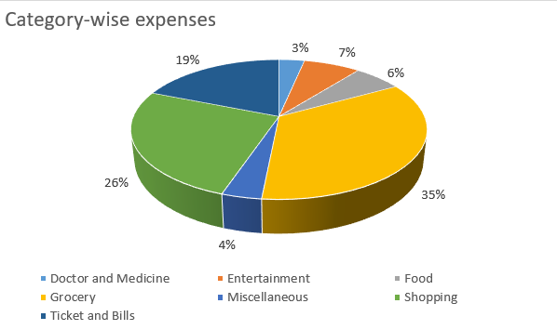
TASK 1
Performed by: Soumyadeepa Malakar
How much is spent for each category (Pivot Table)
Visually represent the amount spent against each category is what percentage of the total expense amount (Pivot Chart)
Solution:

Slide 6
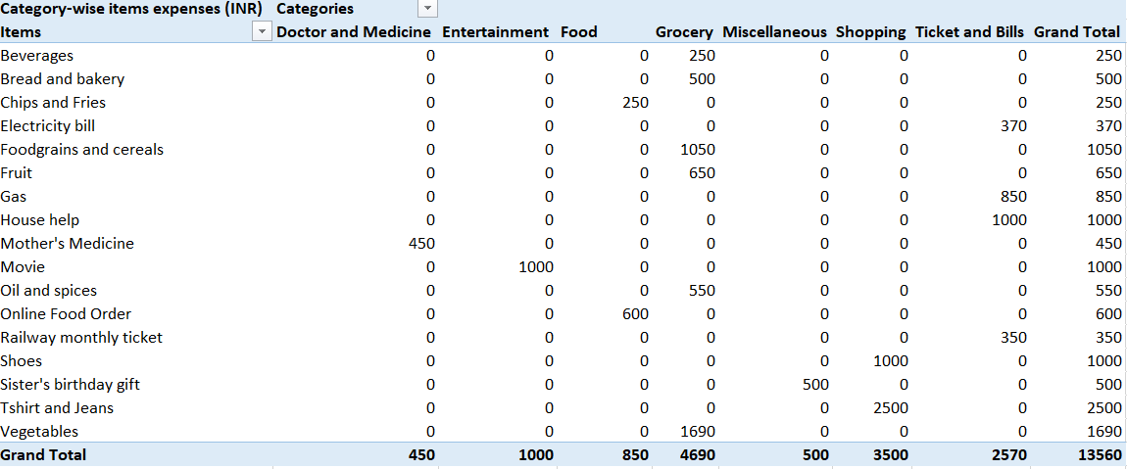
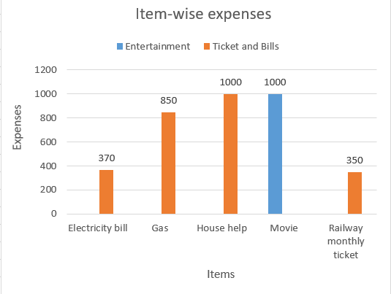
TASK 2
Performed by: Tanvir Ahammed
How much is spent on different items of each category (Pivot Table)
Visually represent the amount spent on different items of Entertainment and Tickets and bills category (Pivot Chart)
Solution:

Slide 7
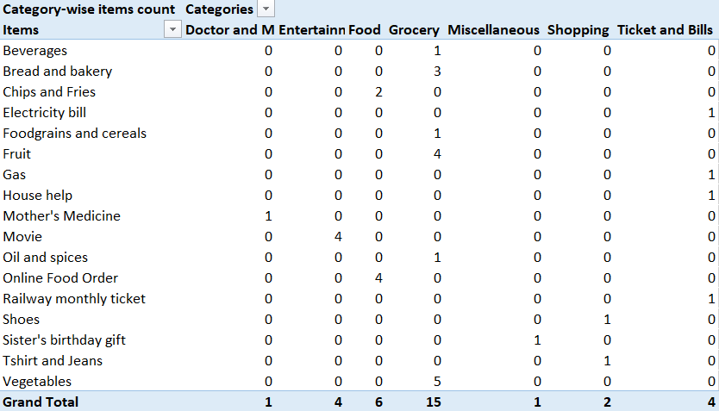
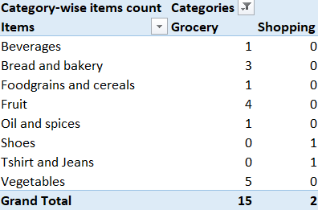
TASK 3
Performed by: Ranjan Das
How many times money has been spent against different items of each category (Pivot Table)
Filter the data to display the data for Grocery items and Shopping items
Solution:

Slide 8
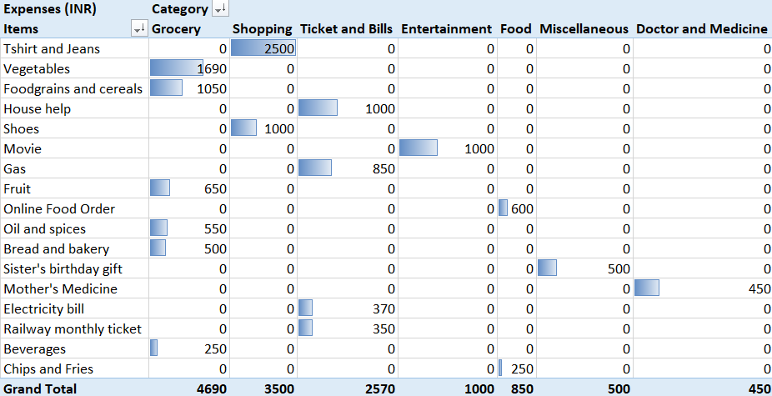
TASK 4
Performed by: Surajit Gharami
What amount is spent on each item of the categories with highest and 2nd highest expense amount (Pivot Table)
Visually represent the data with data bars (Conditional formatting)
Solution:

Slide 9
FINDINGS
The category with the highest expense amount: Grocery
Total expense amount against entertainment and shopping:
Entertainment: Rs. 1000
Shopping: Rs. 3500
Number of times Nitin has ordered food online and the amount spent for it: 4 & Rs. 600
Number of times Nitin has watched a movie: 4
The less essential category that Nitin may remove to increase his savings: Movie
1
2
3
4
5

Slide 10
PART 2

Slide 11
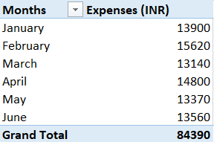
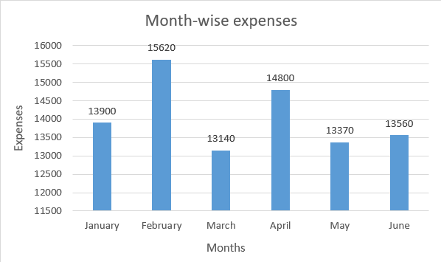
TASK 1
Performed by: Ranjan Das
Month-wise trend of expenses (Pivot table and chart)
Find out the month Nitin spent the most
Solution:
Findings: Nitin spent most in February month

Slide 12
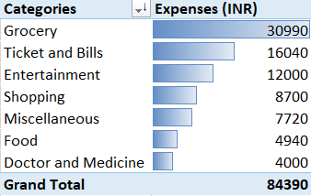
TASK 2
Performed by: Surajit Gharami
Category wise expenses (Pivot table)
Visually represent it with data bars to display categories with the highest and lowest expense amount
Solution:
Findings:
Highest – Grocery
Lowest – Doctor and Medicine

Slide 13
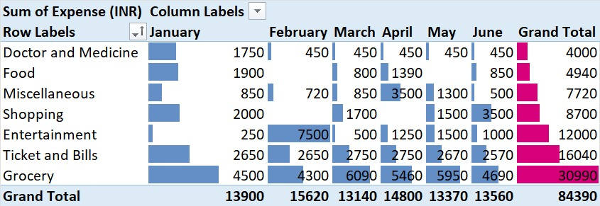
TASK 3
Performed by: Soumyadeepa Malakar
Month-wise expense of each category (Pivot table)
Find out 2 categories with higher expenses for each of the 6 months
Solution:

Slide 14
TASK 3
Performed by: Soumyadeepa Malakar
Findings: Two categories with higher expenses for each of the 6 months are –
January: Grocery, Ticket and bills
February: Entertainment, Grocery
March: Grocery, Ticket and bills
April: Grocery, Miscellaneous
May: Grocery, Ticket and bills
June: Grocery, Shopping

Slide 15
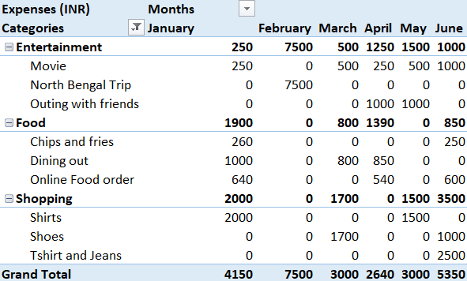
TASK 4
Performed by: Tanvir Ahammed
How much is spent in each month against different items of Entertainment, Food and Shopping categories (Pivot table)
Find out which months have the highest amount spent for movies and dining out
Solution:

Slide 16
TASK 4
Performed by: Tanvir Ahammed
Findings: Months which have the highest amount spent for Movie and Dining out are –
Movie – June
Dining out – January

Slide 17
Actionable Insights
Performed by: All
Essential Items:
Doctor and Medicine: Necessary for health and well-being.
Grocery (Food grains, Vegetables, Fruit): Essential for daily sustenance.
Ticket and Bills (Electricity, Gas): Essential for maintaining household operations.
Transport (Railway Monthly Ticket): Necessary for commuting to work.
Non-essential Items:
Dining out, Online Food Orders: These can typically be reduced by cooking at home.
Shopping (Shirts, Shoes, etc.): While necessary occasionally, can be minimized.
Entertainment (Movies, Outings): Can be reduced or substituted with lower-cost activities.
Miscellaneous Expenses (Gifts, Fees): Evaluate necessity and prioritize.

Slide 18
Actionable Insights
Performed by: All
Recommendations to increase savings:
Budgeting: Nitin should create a monthly budget allocating a specific amount for essential expenses first.
Cutting Non-Essentials: Identify and reduce spending on less essential items like dining out, entertainment, and unnecessary shopping.
Meal Planning: Cooking at home can significantly reduce food expenses compared to dining out or ordering food online.
Transport Optimization: Evaluate cheaper transportation options or carpooling to reduce travel costs.
Review Monthly Expenses: Regularly review expenses to identify areas where further savings can be made.

Slide 19
Actionable Insights
Performed by: All
By focusing on reducing discretionary spending while maintaining essential expenditures, Nitin can gradually increase his savings towards buying a scooter. It's important for him to prioritize and plan his expenses effectively to achieve his goal within a reasonable timeframe.

Slide 20
THANK YOU

