Slide 1

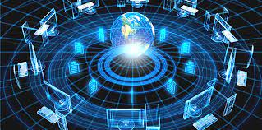
Computer Networks (21CS45)
DR. MINAL MOHARIR

Slide 2
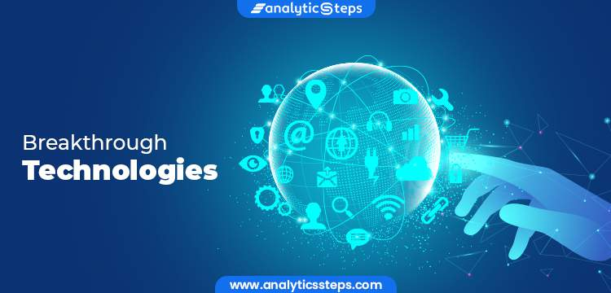
Most revolutionary/Breakthrough technology
ChatGPT: AI/ML
IoT: Internet: Network
BlockChain
3D Printing
Renewable Energy Technologies
Drones

Slide 3
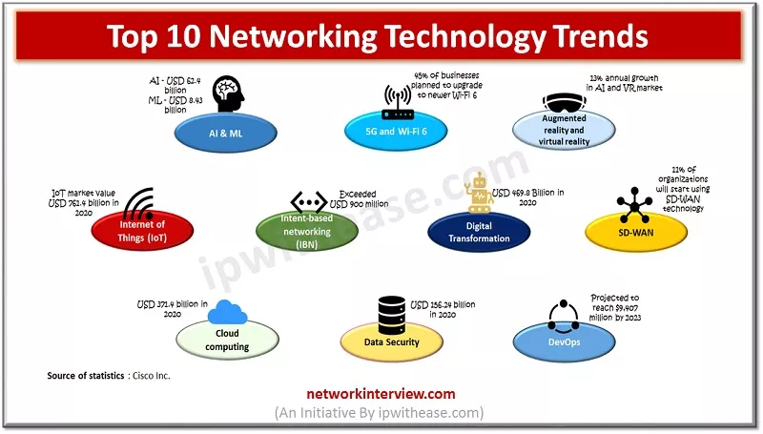
Trends in Computer Networks
Software-Defined Networking (SDN)
5G Networks
CyberSecuirty
Network Automation and Orchestration
Edge Computing
Intent-Based Networking (IBN)
Network Function Virtualization (NFV)

Slide 4
Trends in Computer Networks
The network is my computer
The network is computer

Slide 5
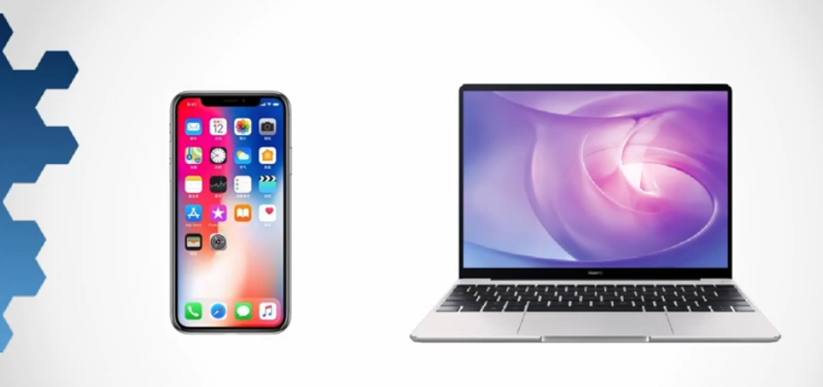
Trends in Computer Networks
Data Collector
No laptop: My

Slide 6
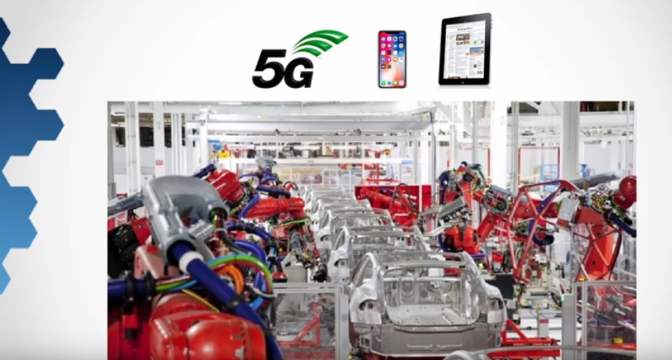
Trends in Computer Networks

Slide 7
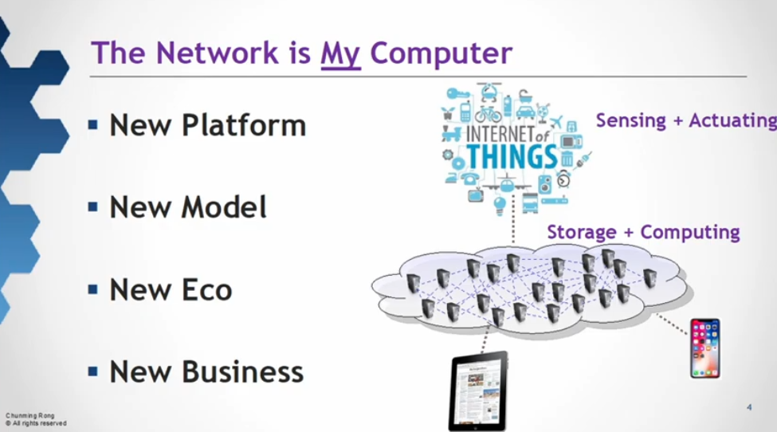
Trends in Computer Networks

Slide 8
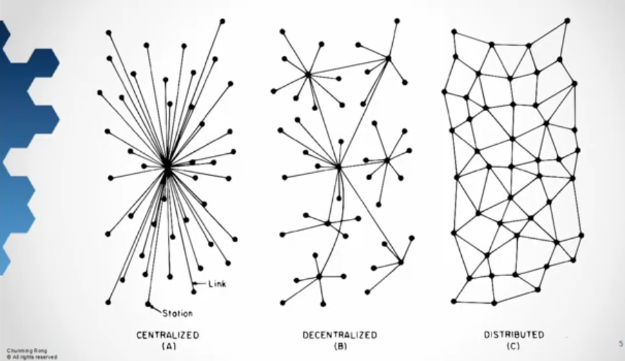
Trends in Computer Networks
Single point Failure, Monopoly

Slide 9
Trends in Computer Networks

Slide 10
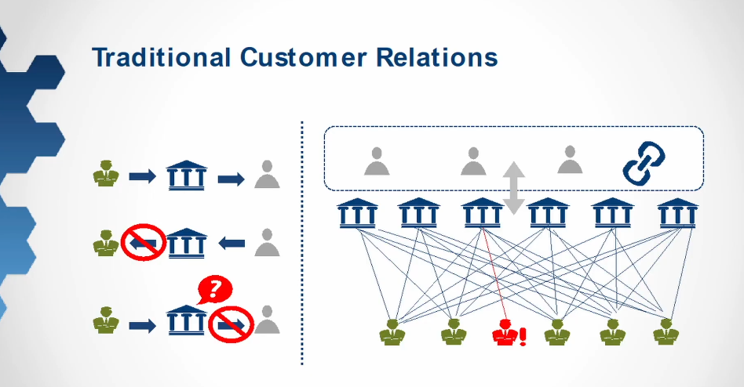
Trends in Computer Networks

Slide 11
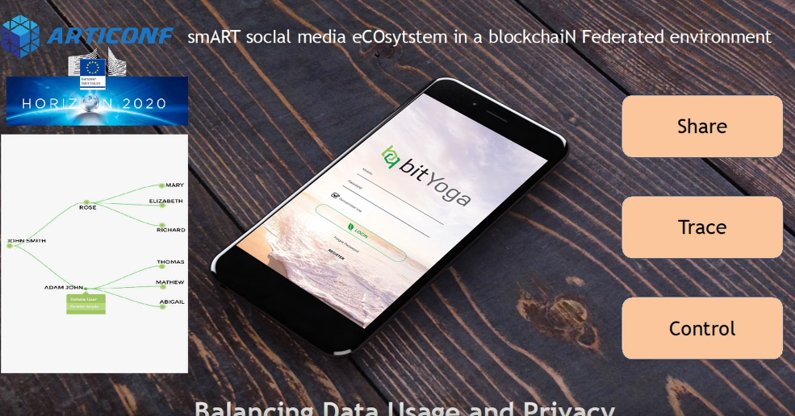
Trends in Computer Networks
Controlling Digital Copy

Slide 12
Trends in Computer Networks
Controlling Digital Copy

Slide 13
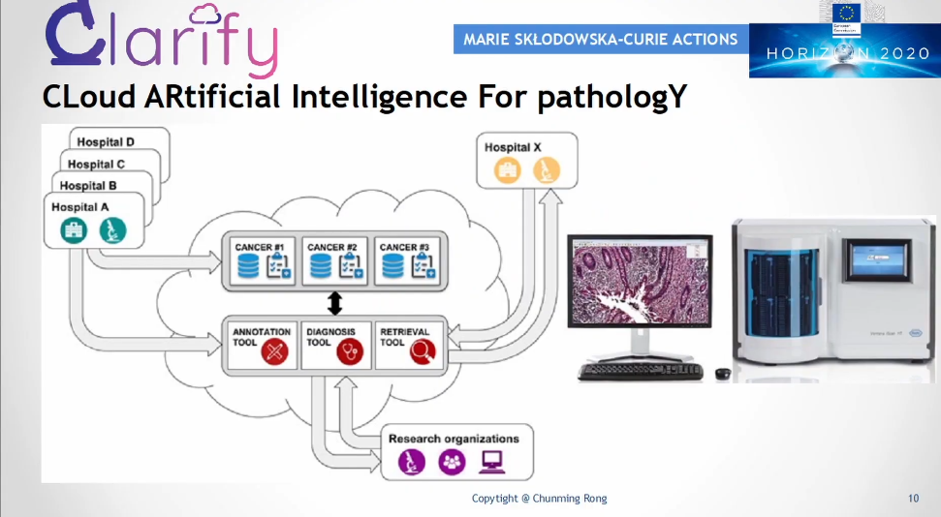
Trends in Computer Networks

Slide 14
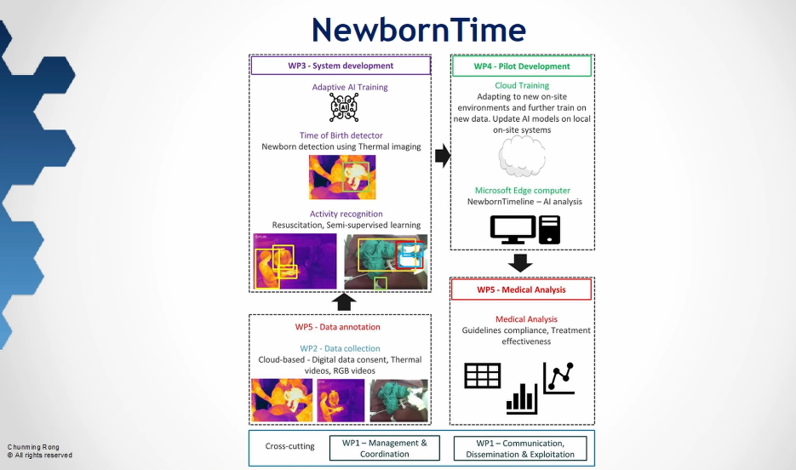
Trends in Computer Networks

Slide 15
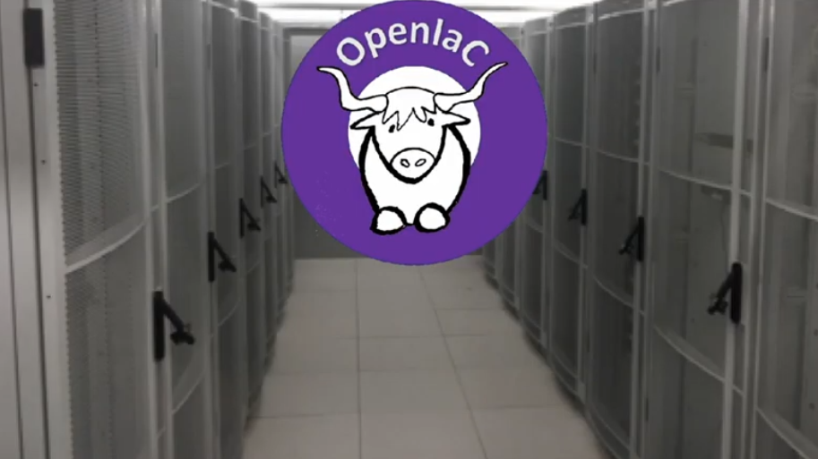
Trends in Computer Networks

Slide 16
THANK YOU

