Slide 1

Go, change the world
RV College of
Engineering
Course Code:CS344AI
IOT and Embedded Computing
Programming LPC 2148 PWM,DC Motor Speed Control

Slide 2

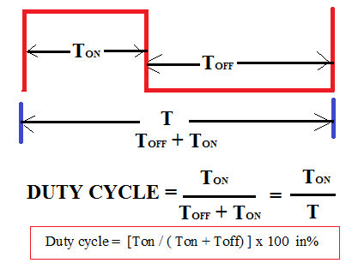
Go, change the world
RV College of
Engineering
What is PWM..
Pulse rate / Pulse Period
Period of one cycle- Ton + Toff time
Pulse Width
Ton - (On time)
Varying Duty Cycle
By Programming Pule Period and Pulse width, hence achieving different duty cycles ( ratio of ON time to ON+OFF time.

Slide 3
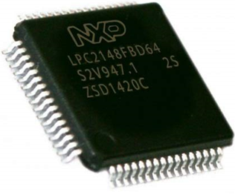
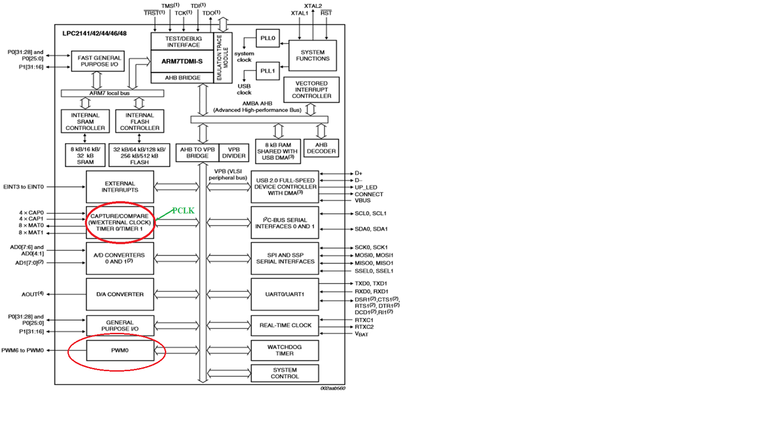
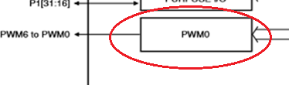
Go, change the world
RV College of
Engineering
LPC 2148 PWM Unit...

Slide 4
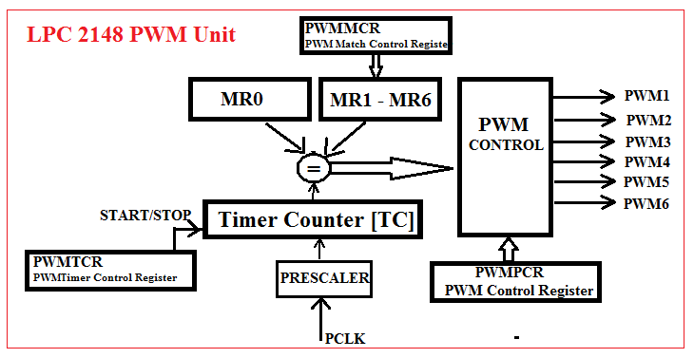

Go, change the world
RV College of
Engineering
PWM Block Diagram ...

Slide 5
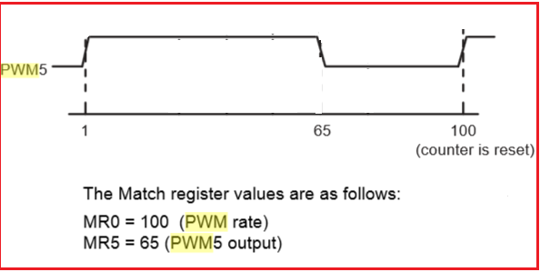
Go, change the world
RV College of
Engineering
Defining Pule Period & Pulse Width
Pulse period and width can be any number of timer counts and all PWM outputs will occur at the same repetition rate.
Meaning of MR0:
One Match Register is required to define the number of PCLK cycles required to make one T, Pulse period (Ton + Toff), MR0 is used to define this value.
(Pulse period and width can be any number of timer counts and all PWM outputs will occur at the same repetition rate.)
Meaning Of MR1-MR6 :
To define, different pulse periods for six different PWM channels, PWM1 TO PWM6, six Match Registers are provided, MR1 to MR6. The number, which is loaded into these registers, define number of PCLK cycles will constitute Ton time.

Slide 6
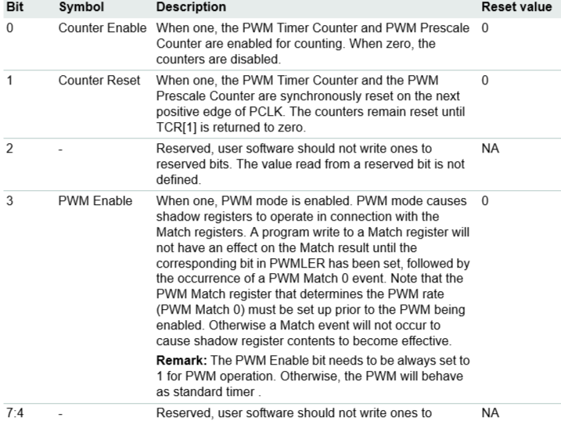
Go, change the world
RV College of
Engineering
PWM Registers..
PWMTCR - PWM Timer Control Register
PWMPCR – PWM control register
used to selectively enable / disable PWM channels PWM1 – PWM6. Also this register is used to configure the PWM channels as
a) single edge
b) double edge.
Bits: D15 D14 D13……D9.. D6 D5 …..D2 D1 D0
( Bits D9 to D14 are used to enable the channels PWM1 to PWM6)
PWMLER – PWM Latch Enable Register,
Bits: D7 D6 D5 D4 D3 D2 D1 D0
MR6 MR5 MR4 MR3 MR2 MR1 MR0
‘1’ – Writing 1 to this bit allows the last value written to the Match register to become effective, when the timer is next by a PWM Match event.
.

Slide 7
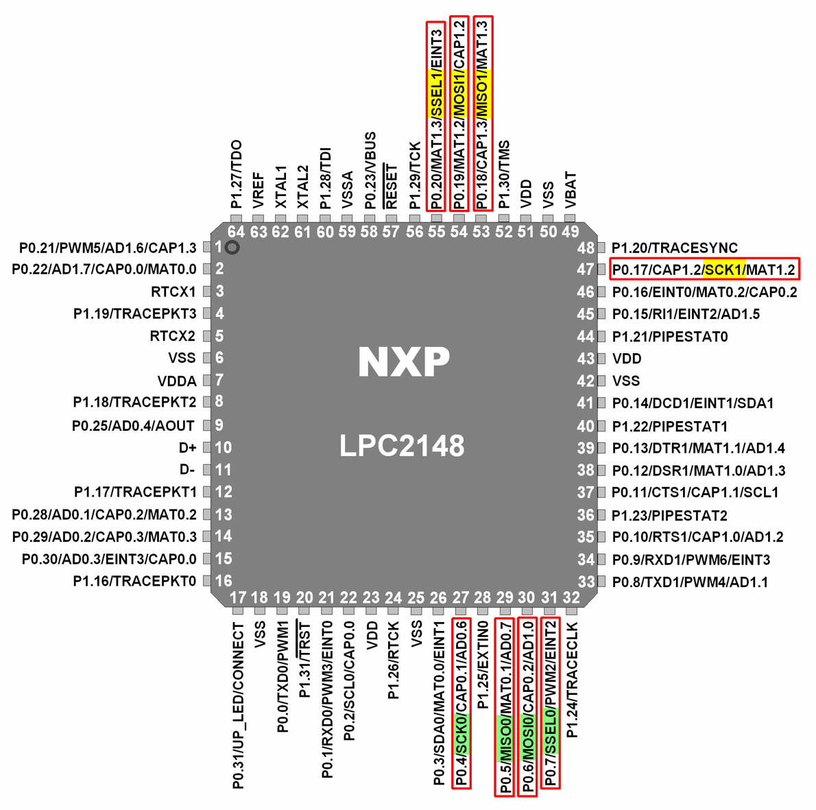
Go, change the world
RV College of
Engineering

Slide 8
Go, change the world
RV College of
Engineering
Generate the PWM waveform of
25% duty cycle at the PWM channel 3
#include <LPC214x.h>
int main()
{
PWM_Init();
while(1)
{
PWMMR3 = 500; // value which decides pulse ON time, ¼ of 2000
PWMLER = 0X08;
}
}

Slide 9
Go, change the world
RV College of
Engineering
void PWM_Init(void)
{
  //P0.1 pin has second alternate function as PWM3 channel, so using PINSEL0 register
  // Select P0.1 as PWM output , bits D2 & D3 are for P0.1
  PINSEL0 |= 0x00000008;
  //load the value to MR0 to fix the pulse rate
  PWMMR0 = 2000; // any other value, I could have taken
  //Configure PWM channel 3 as single edge type and enable the channel
  //bit D3 to select single edge(make it 0), bit D11 is for enabling PWM3 channel(make it 1)
  PWMPCR = 0x00000800;
  // enable PWM unit of LPC2148 and start the timer
  PWMTCR = 0x00000009; // bit D3 = 1 (enable PWM), bit D0=1 (start the timer)
}

Slide 10
Go, change the world
RV College of
Engineering
Calculation of duty cycle in the above program:
if PCLK is 15MHz, then T= 0.067µsec,
Pulse rate/Period, T = ON+OFF = 2000 * T
Puse width, Ton = 500 * T
Duty cycle = Ton/T = 500*T/2000*T = ¼= 0.25 x 100 = 25 %

Slide 11
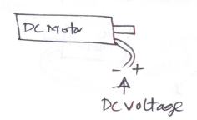
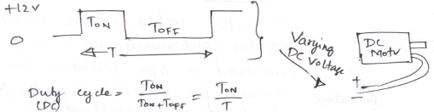
Go, change the world
RV College of
Engineering
DC Motor Speed Control
Effective DC Voltage Applied to DC Motor
= (Ton/T) x Supply voltage (say 12V)
If Ton = T, Full Power i.e 12V
If Ton = T/2, 50 % DC (1/2 Power)

Slide 12
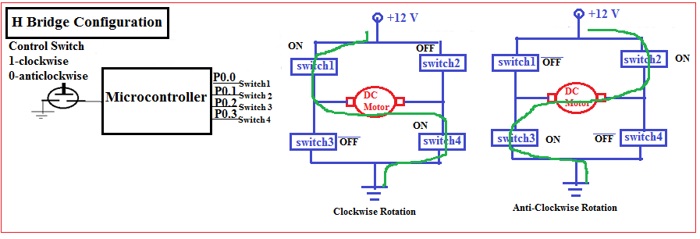
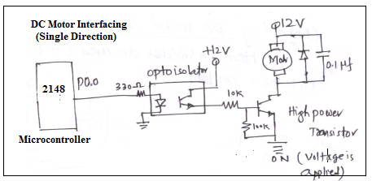
Go, change the world
RV College of
Engineering
H Bridge arrangement
To Drive DC Motor

Slide 13
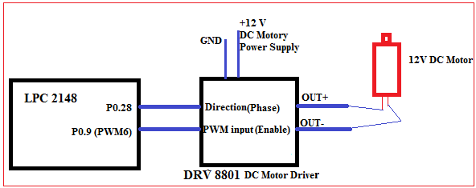
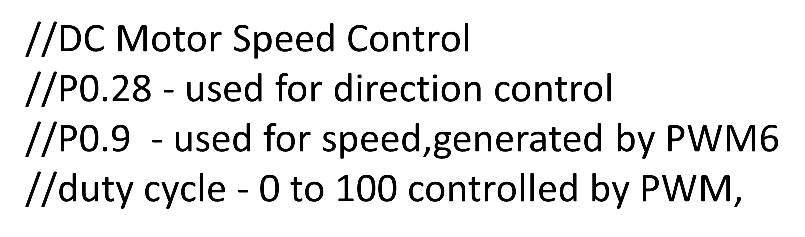
Go, change the world
RV College of
Engineering
Interface DC Motor to LPC 2148 and write an Embedded C program to
generate PWM wave to control speed of DC motor.

Slide 14
Go, change the world
RV College of
Engineering
#include <lpc214x.h>
void runDCMotor(int direction, int dutycycle) ;
int main()
{
IO0DIR |= 1U << 28; //set P0.28 as output pin
PINSEL0 |= 2 << 18; //select P0.9 as PWM6 (option 2)
runDCMotor(2,10); // run at 10% duty cycle
while(1); // do other jobs
}

Slide 15
Go, change the world
RV College of
Engineering
void runDCMotor(int direction, int dutycycle)
{
if (direction == 1)
IO0SET = 1 << 28; //set to 1, to choose anti-clockwise direction
else
IO0CLR = 1 << 28; //set to 0, to choose clockwise direction
PWMMR0 = 1000; // set PULSE rate to value suitable for DC Motor operation
PWMMR6 = (1000U*dutycycle)/100; // set PULSE period
PWMPCR = (1 << 14); // enable PWM6 channel
PWMTCR = 0x00000009; // bit D3 = 1 (enable PWM), bit D0=1 (start the timer)
PWMLER = 0X70; // load the new values to PWMMR0 and PWMMR6 registers
}

Slide 16
Go, change the world
RV College of
Engineering
//Control the duty cycle by analog input fed from potentiometer.
//Duty cycle - 0 to 100 controlled by PWM, fed from Potentiometer connected to ADC
#include <lpc214x.h>
void runDCMotor(int direction,int dutycycle);
unsigned int adc(int no,int ch); // refer UNIT 4 Notes, for this function implementation
int main()
{
  int dig_val;
  IO0DIR |= 0x00FF0000 | 1U << 30; // to set P0.16 to P0.23 as o/ps
  do{
    dig_val = adc(1,2) / 10;
    if(dig_val > 100) dig_val =100;
    runDCMotor(1,dig_val); // run at 10% duty cycle
  }
  while(1);
}

