Slide 1

Go, change the world
RV College of
Engineering
Course Code:18CS44
Microcontrollers & Embedded Systems
Programming LPC 2148 Timers
(C)CopyRights,Dr K Badari Nath 2020

Slide 2

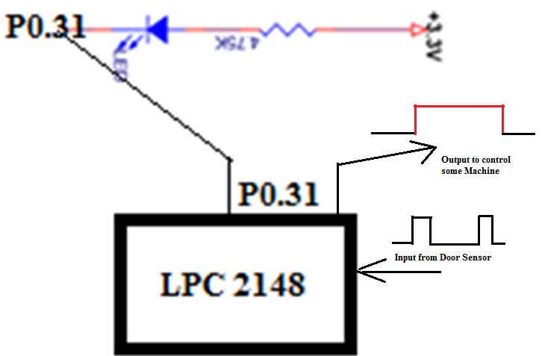
Go, change the world
RV College of
Engineering
Necessity of Timers..
int main( )
{
IO0DIR = 1U << 31;
while(1)
{
IO0CLR = 1U << 31; //LED_ON
delay_ms(500);
IO0SET = 1U << 31; //LED_OFF
delay_ms(500);
}
}
void delay_ms(unsigned int j)
{
unsigned int x, i;
for(i=0; i<j; i++)
{
for(x=0; x<10000; x++); }
}
* To avoid, CPU getting engaged in execution (blocked).
* Producing accurate delays, counting events…
(C)CopyRights,Dr K Badari Nath 2020

Slide 3
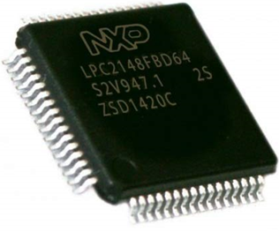
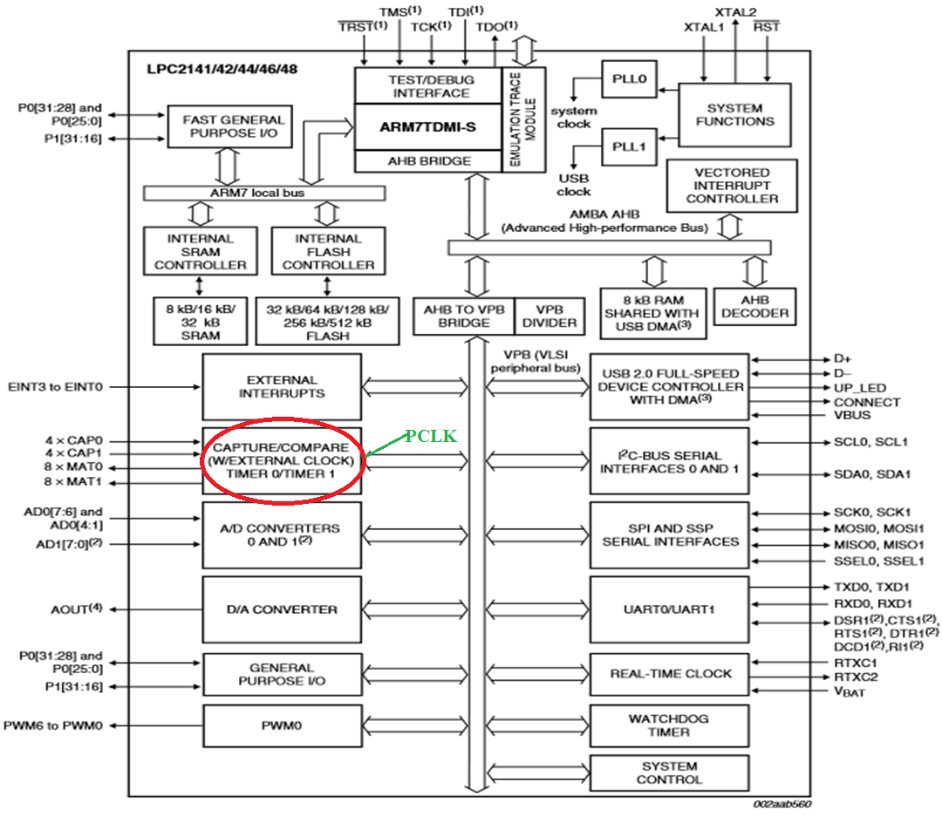
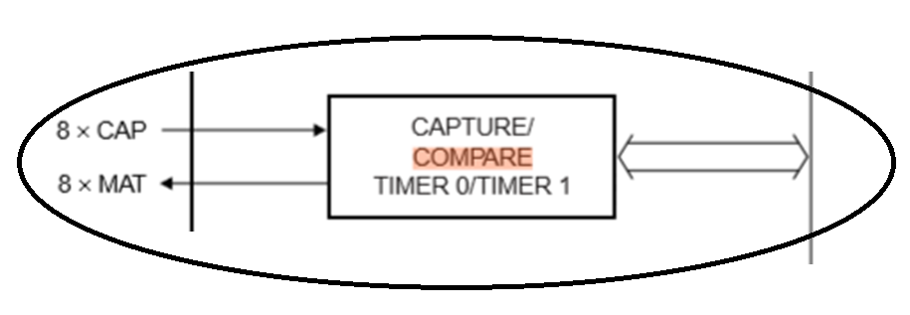
Go, change the world
RV College of
Engineering
LPC 2148 Timers...
(C)CopyRights,Dr K Badari Nath 2020

Slide 4

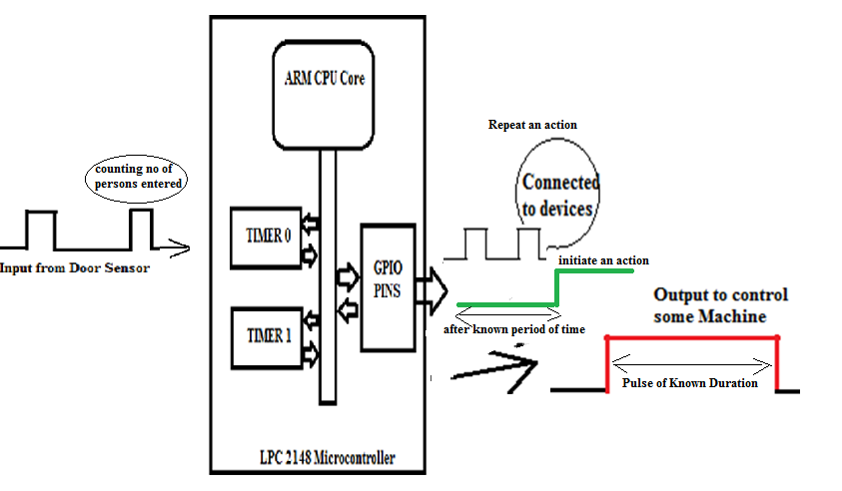

Go, change the world
RV College of
Engineering
LPC 2148 Timers...
(C)CopyRights,Dr K Badari Nath 2020

Slide 5
Go, change the world
RV College of
Engineering
Applications of Timers...
To generate precise delays, Interval timer for counting internal events
To repeat an action after a known period of time
To initiate an action after a known period of time
To generate precise pulse of given duration, to trigger external time critical events
Operating systems use a timer to schedule the different processes/threads/tasks.
As a waveform generator, to generate a PWM signal to drive the servo-motor or a dc-motor.
If timers are used as counters: It can be used as pulse counter , Pulse width Demodulator
(C)CopyRights,Dr K Badari Nath 2020

Slide 6
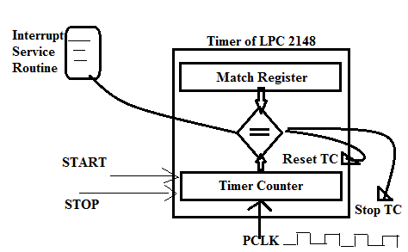
Go, change the world
RV College of
Engineering
Working of Timers…
Time taken for counting one PCLK cycle (TC=1)
T = 1 / PCLK = 1 / (15MHz) = 0.067 micro seconds
Similarly, if TC = 15000(i.e counted 15000 PCLK pulses),
time taken by timer is 15000 x T = 15000 x [ 1/(15MHz)] = 1 milli seconds.
What is Timer/Counter
Difference between Timer and Counter
(C)CopyRights,Dr K Badari Nath 2020

Slide 7
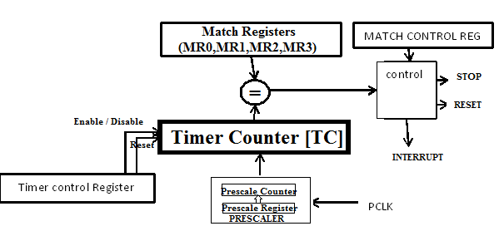
Go, change the world
RV College of
Engineering
Programming TIMER Unit of LPC 2148
(C)CopyRights,Dr K Badari Nath 2020

Slide 8
Go, change the world
RV College of
Engineering
Registers of TIMER Unit of LPC 2148
TC – [ Timer Counter ] : counts from 00000000h to FFFFFFFFH. The 32 bit TC is incremented every PR+1 cycles of PCLK. The TC is controlled through the TCR.
TCR- [ Timer Control Register] , 8 bits, used to enable/disable and/or reset timer (TC).
D7 D6 D5 D4 D3 D2 D1 D0
R E
E (D0 bit) =1 to enable the timer , =0 to disable the timer.
R (D1 bit) =1 to reset the TC to zero
MR0,MR1,MR2,MR3 – 4 Match Registers, 32 bits, whose values are compared with TC value, on match certain action is performed based on the MCR (match control register)
MCR – Match Control Register, 16 bits, 3 bits for each Match register:
D15 D11 D10 D9 D8 D7 D6 D5 D4 D3 D2 D1 D0
S R I S R I S R I S R I
MR3 MR2 MR1 MR0
I - When ‘1’ , an interrupt is activated when match occurs, ‘0’ interrupt is disabled
R- When ‘1’, the timer count register is reset when match occurs
S- When ‘1’ , the timer count and the pre-scale counter will be stopped
(C)CopyRights,Dr K Badari Nath 2020

Slide 9
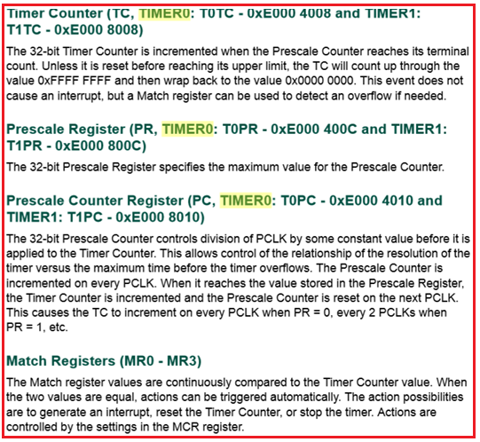
Go, change the world
RV College of
Engineering
Registers of TIMER Unit of LPC 2148
(C)CopyRights,Dr K Badari Nath 2020

Slide 10
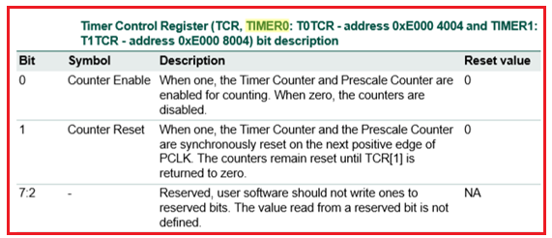
Go, change the world
RV College of
Engineering
Registers of TIMER Unit of LPC 2148
(C)CopyRights,Dr K Badari Nath 2020

Slide 11
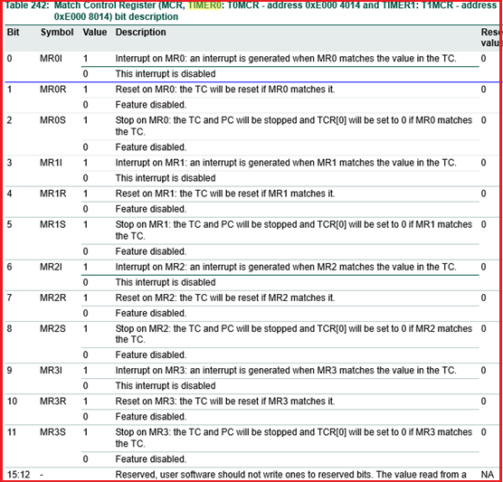
Go, change the world
RV College of
Engineering
Registers of TIMER Unit of LPC 2148
(C)CopyRights,Dr K Badari Nath 2020

Slide 12
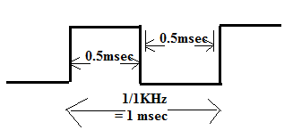
Go, change the world
RV College of
Engineering
Generate the square wave of frequency 1KHz using the timer, on P1.16pin using timers.
(C)CopyRights,Dr K Badari Nath 2020

Slide 13
Go, change the world
RV College of
Engineering
Time Calculaton
Calculate the number/count to be loaded in match register, MR0
Let us assume PCLK = 15 MHz , (PLL enabled, VPBDIV=0), T0PR = 0
Count = Td / T
=Time period of required output(1KHz) / time period of input frequency(PCLK)
Td = 1/1KHz = 1 msec , half of it is 0.5msec;
T = 1/15MHz = 0.067µsec
= 0.5 msec / 0.067µsec = 7462 (TC counting this many times produces 0.5msec)
(C)CopyRights,Dr K Badari Nath 2020

Slide 14
Go, change the world
RV College of
Engineering
Steps to Program the Timer
Load this number into MR0, MR0 = 7462
Load the MCR for stopping the timer on match & disable the interrupt
Start the timer, by enabling the ‘E’ bit in TCR
Now TC starts counting, when it matches with the MR value, it stops counting
Stop the timer
(C)CopyRights,Dr K Badari Nath 2020

Slide 15
Go, change the world
RV College of
Engineering
void delay(void)
{
T0TCR = 1; //start the timer
while (!(T0TC == T0MR0));
T0TCR = 2; // reset the counter and stop the timer
}
int main(void)
{
T0MR0 = 7462; //use the Timer0 and load the MR0 with count
T0MCR = 0X0004; // 0000….100 – Stop the timer, after match
I0DIR1 = 0X00010000; //make P1.16 as output
while(1) // program to produce square waveform of 1 KHz
{
I0SET1 = 1 << 16; //set P1.16 to 1
delay( );
I0CLR1 = 1 <<16; //clear P1.16 to 0
delay( );
}
}
(C)CopyRights,Dr K Badari Nath 2020

Slide 16
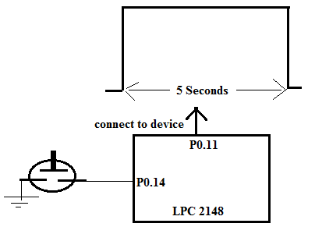
Go, change the world
RV College of
Engineering
Interface one AC gadget (say bulb or some machine) to LPC 2148. Write a program to make it on for 5seconds, each time a key is pressed using the timers.
Assumptions:
P0.11 is connected to AC gadget through the RELAY, P0.14 is connected to switch (if switch is pressed it generates logic ‘0’, else logic ‘1’ , Let us use Timer0 to produce 5 sec delay.
(C)CopyRights,Dr K Badari Nath 2020

Slide 17
Go, change the world
RV College of
Engineering
Delay Calculation:
Assume CCLK = 60MHZ, PCLK = 60MHz (PLL enabled, VPBDIV=1), Let us use Pre-scaler
If Prescaler (T0PR) is loaded with 99, it will increment TC by 1,
for every,PR0+1 => 99+1=100 PCLK clock cycles.
Now, Load PR = 60000-1 = 59999, it will increment TC by 1,
after PR0+1 => 59999+1 = 60000 PCLK clock cycles. Time period of PCLK = 1 / 60MHz
Hence Pre-scaler increments TC for every = 60000 x ( 1 / 60MHz) = 1msec
so every count of TC means, 1msec is over, if TC=1000, means delay produced = 1000 x 1msec= 1sec
Required Delay = 5sec = 5000 milli-seconds.
Total Count = 5000 milli-seconds / 1milli-second = 5000 (load this to MR0)
(C)CopyRights,Dr K Badari Nath 2020

Slide 18
Go, change the world
RV College of
Engineering
delayHW(void)
{
T0PR = 60000-1; // produces 1msec delay
T0MR0 = 5000; // produces 5000 x 1msec delay = 5seconds
T0TCR = 1; // Start the timer
while (!(T0TC == T0MR0)); // wait for TC to reach MR0
T0TCR = 2; // Stop the timer, reset the TC,PC
}
(C)CopyRights,Dr K Badari Nath 2020

Slide 19
Go, change the world
RV College of
Engineering
#include <LPC214x.h>
#define SW2 (IO0PIN & (1 << 14))
int main(void)
{
IODIR0 = (1<<11); // P0.11 as OUTPUT
while(1)
{
if(!SW2) // wait for key press, if yes produces 5 sec pulse
{
I0SET0 = 1 << 10; //set P0.10 to 1
delayHW( );
I0CLR0 = 1 <<10; //clear P0.10 to 1
}
}
}
(C)CopyRights,Dr K Badari Nath 2020

Slide 20
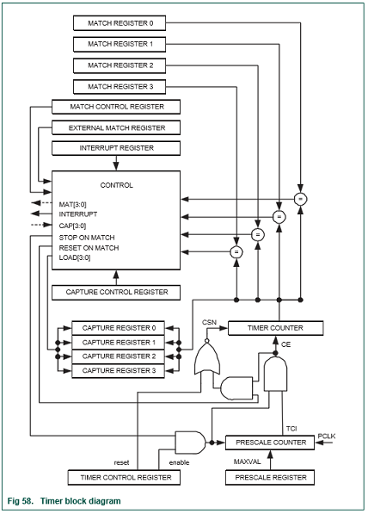
Go, change the world
RV College of
Engineering
Extra Information (Not in syllabus):Other Features/Registers of Timers
(C)CopyRights,Dr K Badari Nath 2020

Slide 21
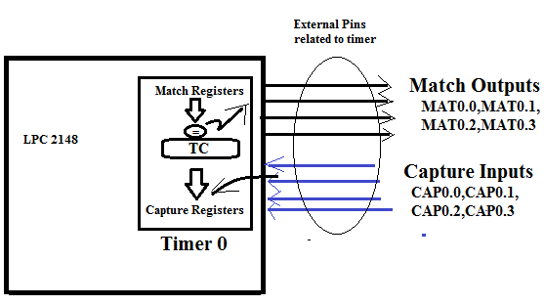
Go, change the world
RV College of
Engineering
Capture Signals/Pins : Each timer is provided with four capture pins. A transition on a capture pin can be configured to load one of the capture registers with the value in the timer counter (TC) and optionally generate an interrupt. CAP0.0,CAP0.1,CAP0.2,CAP0.3 are the pins for timer0 and CAP1.0, CAP1.1, CAP1.2, CAP1.3 are the pins for timer1. Ex: CAP0.0 is P0.2 pin.
Capture Registers (T0CR0 – TCR3 , T1CRO – T1CR3)
Each capture register is associated with a device pin and may be loaded with the TC value when a specified event occurs on that pin. The settings in the capture control register determine whether the capture function is enabled and whether a capture event happens on the rising edge of the associated pin, the falling edge, or both edges.
Capture Control Register (T0CCR,T1CCR)
The capture control register is used to control whether one of the four Capture Registers is loaded with the value in the TC when the capture event occurs, and whether an interrupt is generated by the capture event. Setting both the rising and falling bits at the same time is a valid configuration, resulting in a capture event for both edges.
(C)CopyRights,Dr K Badari Nath 2020

Slide 22
Go, change the world
RV College of
Engineering
Match Outputs : (External Match outputs ) When a match register equals the timer counter (TC), this output can either toggle, go low, go high, or do nothing. The EMR controls the functionality of this output. MAT0.0,MAT0.1,MAT0.2,MAT0.3 are the match output pins for timer0 and MAT1.0,MAT1.1,MAT1.2,MAT1.3 are the match output pins for timer1. Ex: MAT0.0 is P0.3.
External Match Register [T0EMR,T1EMR] : The external match register provides both control and status of the external match pins MAT(0-3). Ex: Bit[0] –External Match0 bit reflects the state of output MATn.0, whether or not this output is connected to its pin. When a match occurs between the TC and MR0, this output of the timer is can either toggle, go low, go high, or do nothing. Bits [5:4] control the functionality of this output [ 00-do nothing, 01-set the output, 10-clear the output,11-toggle the output]
IR Register : Interrupt register. This provides which of the eight possible interrupt sources are pending. This can be written to clear interrupts. The interrupt register consists of four bits for the match interrupts and four bits for the capture interrupts. If an interrupt is generated then the corresponding bit in the IR will be high. Otherwise, the bit will be low. Writing a logic ‘1’ to the corresponding IR bit will reset the interrupt.
(C)CopyRights,Dr K Badari Nath 2020

Slide 23

Go, change the world
RV College of
Engineering
Course Handling faculty
Name | Dr. Badari Nath K.
Mobile | 9945124747
Email | badarinath.kb@rvce.edu.in
(C)CopyRights,Dr K Badari Nath 2020

