Slide 1
MCES: Unit-3
By
Prof srividya m s,
dept of cse, rvce

Slide 2
Necessity of Hardware Timers:
Writing delay programs using for/while loops involve CPU getting engaged in execution (blocked).
Producing accurate delays, requires proper calculation of number of iterations the loop should run. It depends on the compiler and CPU clock (CCLK), any change requires re-calculation.
Hence, timing related tasks like delay programs, generating waveforms, timing the events, counting the events can be delegated to timers
The advantage:
accuracy, easy of programming and avoiding the blocking of CPU.

Slide 3
What is Timer/Counter :
Timer/counter is programmable independent hardware block present inside the microcontroller [Programmable -> meaning the working of this timer circuit is configurable, based on the programmer requirements.].
The timer hardware can be used as timers or counters.
Programmers can use the timers and GPIO pins to generate/time external events.
LPC 2148 provides two independently working timers, timer0 and timer1

Slide 4
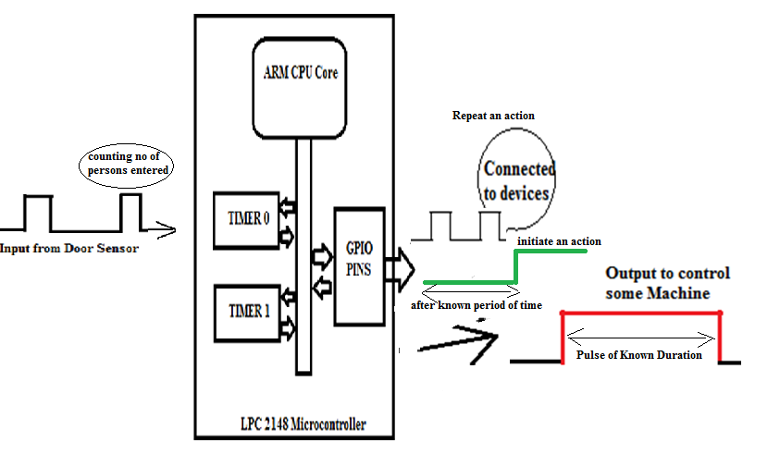
Timer/counter starts counting the clocks 0,1,2.. to N-1
For 8 bit timer it counts from 00 to FF (255),once it reaches FF, overflows to 0 and again continue counting from 0.
LPC 2148 provides 32 bit timers, hence counts from 00000000H to FFFFFFFFH.

Slide 5
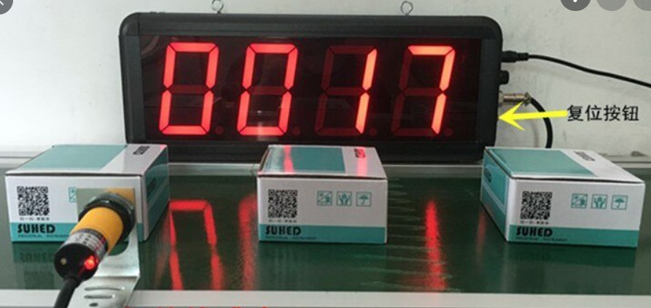
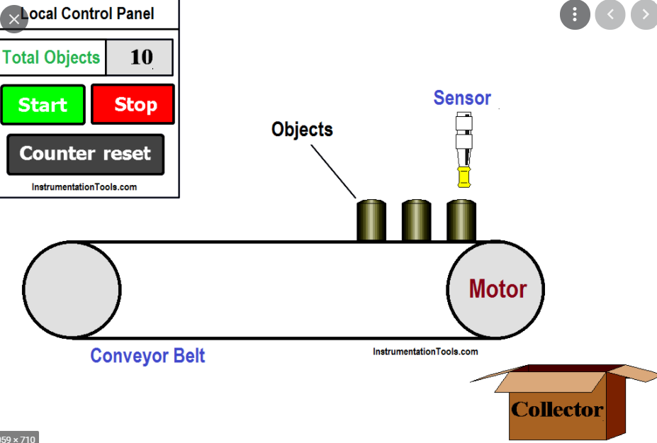
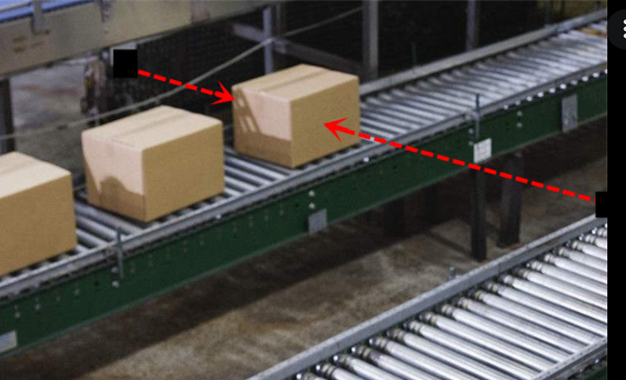
Clock to the timer/counter hardware can be given from two sources. Based on the source of the clock they function as timer or counter
Timer : the clock source is, the internal clock (PCLK)
Counter: the clock source is external (from any other external circuit/ peripheral/ device).

Slide 6
A Timer is used for producing precise time delays, used to repeat or initiate an action after a known period of time.
A Counter is used to count the events happening outside the microcontroller.
Applications of Timers and Counters
To generate precise delays, Interval timer for counting internal events
To repeat an action after a known period of time
To initiate an action after a known period of time
To generate precise pulse of given duration, to trigger external time critical events
Operating systems use a timer to schedule the different processes/threads/tasks.
As a waveform generator, to generate a PWM signal to drive the servo-motor or a dc-motor.
If timers are used as counters: It can be used as pulse counter

Slide 7
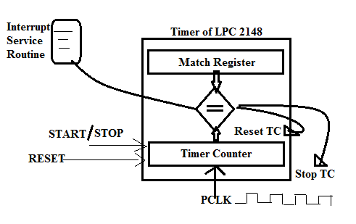
Working Principle of LPC 2148 Timers:
ARM LPC 2148 has two 32 bit timers.
The basic block of timer is TC (TimerCounter). It works as up-counter, counting from 00000000h to FFFFFFFFh, for every clock cycle, supplied by PCLK internally.
The timer can be enabled (START) or disabled (STOP) or RESET (TC=0) through the bits provided in the TCR (Timer Control Register ). Hence called Programmable Timers.

Slide 8
For 12MHz crystal,
CCLK = 60MHz (PLL is enabled),
PCLK = 15MHz (default value VPB divider)
Time taken for counting one PCLK cycle (TC=1)
T = 1 / PCLK = 1 / (15MHz) = 0.067 micro seconds
Similarly, if TC = 15000 (i.e counted 15000 PCLK pulses), time taken by timer is
= 15000 x T = 15000 x [ 1 / (15MHz) ] = 1 milli seconds.
MR is initially loaded with the value/number by the programmer, indicating the number of clock cycles, TC should count.
When, the TC reaches the MR value (TC=MR), an action is initiated by the timer.
Make TC stops counting
Make TC get reset
Generate an Interrupt to execute the required task/program.

Slide 9
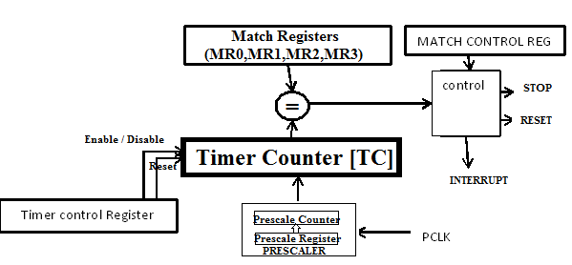
Programming LPC 2148 Timers:
LPC 2148, has two 32 bit timer/counters named, Timer0 and Timer1.
When used as Timer PCLK is used for its counting
When used as a counter it uses external clock source for its counting.
PCLK is fed to Timer Counter through the programmable 32 bit pre-scaler, to further divide PCLK, to realise larger delays.
By loading, value 0 to pre-scaler is equivalent to PCLK given directly to TC.

Slide 10
Each timer has following registers for its working:
TC – [Timer Counter]: It is a 32 bit register, counts from 00000000h to FFFFFFFFH. The 32 bit TC is incremented every PR+1 cycles of PCLK. (T0TC-for Timer0, T1TC-for Timer1)
Pre-scaler: The pre-scaler is used to further divide the PCLK, to realise higher delays.
The pre-scaler has PC and PR, they work as follows
PC ( Pre-scaler Counter ) – The 32 bit PC is a counter like TC, which gets incremented for every clock cycle and when it reaches the value in PR, the next clock increments TC by 1, and clears the PC. This process continues.
PR Register ( Pre-scaler Register ) – It holds the maximum value, the PC can reach.
Hence TC gets incremented for every PR+1 cycles of PCLK. By default, on reset, PR is loaded with 0, meaning PCLK is directly fed to TC (pre-scaler is disabled).
( T0PC,T0PR for Timer0 and T1PC,T1PR for Timer1 )

Slide 11
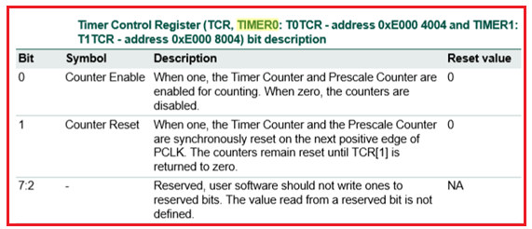
TCR- [ Timer Control Register] , 8 bits, used to enable / disable and/or reset timer (TC).
D7 D6 D5 D4 D3 D2 D1 D0
R E
E (D0 bit) = writing ‘1’ to this bit, enable the timer , =0 to disable the timer.
R (D1 bit) = writing ‘1’ to this bit reset the TC to zero, (after resetting, write ‘0’)
(TOTCR for Timer0 and T1TCR for Timer1)

Slide 12
MR0,MR1,MR2,MR3 – 4 Match Registers, 32 bits, whose values are compared with TC value, on match certain action is performed based on the MCR (Match Control Register).
MCR – Match Control Register, 16 bits, 3 bits for each Match register:
D15 D11 D10 D9 D8 D7 D6 D5 D4 D3 D2 D1 D0
S R I S R I S R I S R I
MR3 MR2 MR1 MR0
The lowest three bits (D2,D1,D0) are for controlling the operations related to the Match register 0, next three for MR1, MR2 and MR3, in that order. The meaning of the bits is explained below,
I - When ‘1’ , an interrupt is activated when match occurs, ‘0’ interrupt is disabled
R- When ‘1’, the timer count register is reset when match occurs,’0’-feature disabled
S- When ‘1’ , the TC and PC will be stopped when match occurs, also timer is disabled.
Hence, four 32 - bit match registers (MR0-3) allows:
Continuous operation with optional interrupt generation on match.
Stop timer on match with optional interrupt generation.
Reset timer on match with optional interrupt generation.

Slide 13
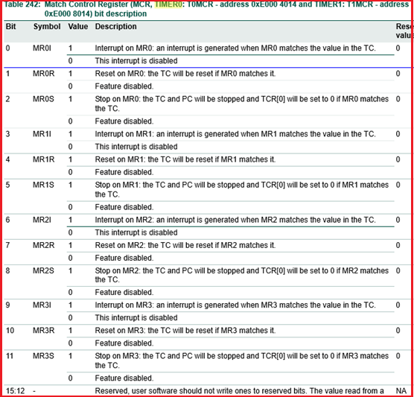

Slide 14
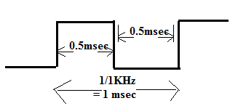
Example: Generate the square wave of frequency 1KHz using the timer, on P1.16pin using timers. (By connecting Buzzer to this pin, we can here the beep sound)
Steps to implement the Delay Program using Timer:
Calculate the number/count to be loaded in match register, MR0
Let us assume PCLK = 15 MHz & Prescaler is loaded with Zero (T0PR = 0)
(For crystal frequency= 12MHz, CCLK - 60MHz if PLL enabled and default value of VPBR (=0) gives PCLK = CCLK / 4 = 60MHz/4 = 15MHz)
count = Td / T
= Time period of required output(1KHz) / time period of input frequency(PCLK)
Td = 1/1KHz = 1 msec , half of it is 0.5msec;
T = 1/15MHz = 0.067µsec
= 0.5 msec / 0.067µsec = 7462 (TC counting this many times produces 0.5msec)
Load this number into MR0, MR0 = 7462
Load the MCR for stopping the timer on match & disable the interrupt
Start the timer, by enabling the ‘E’ bit in TCR
Now TC starts counting, when it matches with the MR value, it stops counting
Stop the timer

Slide 15
//Program to generate 1KHz on P1.16 using delay produced by the timer
#include <LPC214x.h>
void delay(void)
{
T0TCR = 1; //start the timer
While (!(T0TC == T0MR0));
T0TCR = 2; // reset the counter and stop the timer
}
int main(void)
{
T0MR0 = 7462; //use the Timer0 and load the MR0 with count
T0MCR = 0X0004; // 0000….100 – Stop the timer, after match
I0DIR1 = 0X00010000; //make P1.16 as output
while(1) // program to produce square waveform of 1 KHz
{
I0SET1 = 1 << 16; //set P1.16 to 1
delay( );
I0CLR1 = 1 <<16; //clear P1.16 to 0
delay( );
}
}

Slide 16
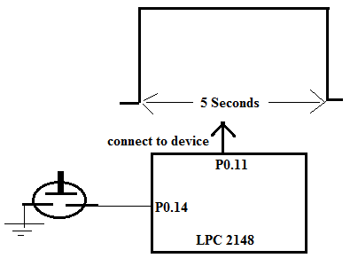
Question: Interface one AC gadget (say bulb or some machine) to LPC 2148. Write a program to make it on for 5seconds, each time a key is pressed using the timers. (OR question can be as follows)
Generate a 5 second pulse on P0.11 pin of LPC 2148
Assumptions:
P0.11 is connected to AC gadget through the RELAY, P0.14 is connected to switch (if switch is pressed it generates logic ‘0’, else logic ‘1’
Assume CCLK = 60MHZ, PCLK = 60000 (PLL enabled, VPBDIV=1)
Delay Calculation:
Timer0 is used to produce 5 sec delay. If Prescaler (T0PR) is loaded with 99, it will generate one clock cycle for every 99+1=100 PCLK clock cycles.
Now for CCLK of 60MHz, Load PR = 60000-1 = 59999.
Total time delay produced by Prescaler = 60000 x ( 1 / 60MHz) = 1msec
(for every 1msec, prescaler produces 1 clock pulse to TC, so every count of TC means, 1msec is over, if TC=1000, means delay produced = 1000 x 1msec= 1sec)
Required Delay = 5sec = 5000 milli-seconds.
Total Count = 5000 milli-seconds / 1milli-second = 5000 (load this to MR0)

Slide 17
int main(void)
{
IODIR0 = (1<<11); // P0.11 as OUTPUT
while(1)
{
if(!SW2) // wait for key press, if yes produces 5 sec pulse
{
I0SET0 = 1 << 10; //set P0.10 to 1
delayHW( );
I0CLR0 = 1 <<10; //clear P0.10 to 1
}
}
}
#include <LPC214x.h>
#define SW2 (IO0PIN & (1 << 14))
delayHW(void)
{
T0PR = 60000-1; // produces 1msec delay
T0MR0 = 5000; // produces 5000 x 1msec delay = 5seconds
T0TCR = 1; // Start the timer
while (!(T0TC == T0MR0)); // wait for TC to reach MR0
T0TCR = 2; // Stop the timer, reset the TC,PC
}

