Slide 1
Introduction to Embedded Systems
By,
Prof. M S Srividya,
Assistant Professor, Department of CSE
RVCE

Slide 2
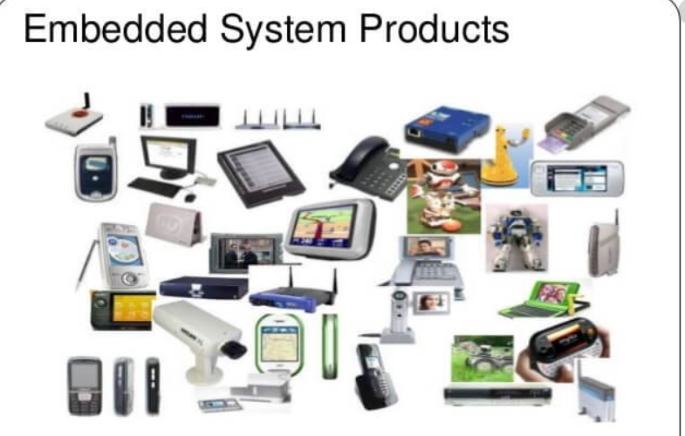
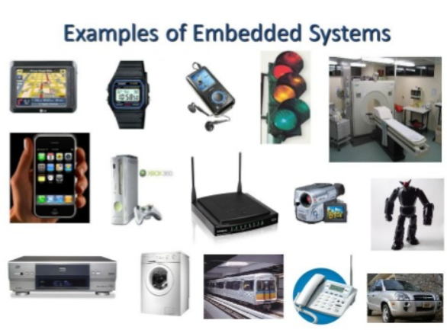

Slide 3
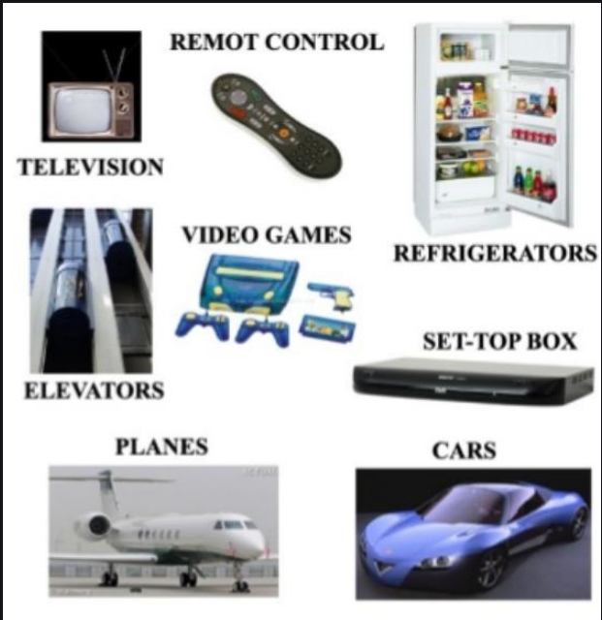
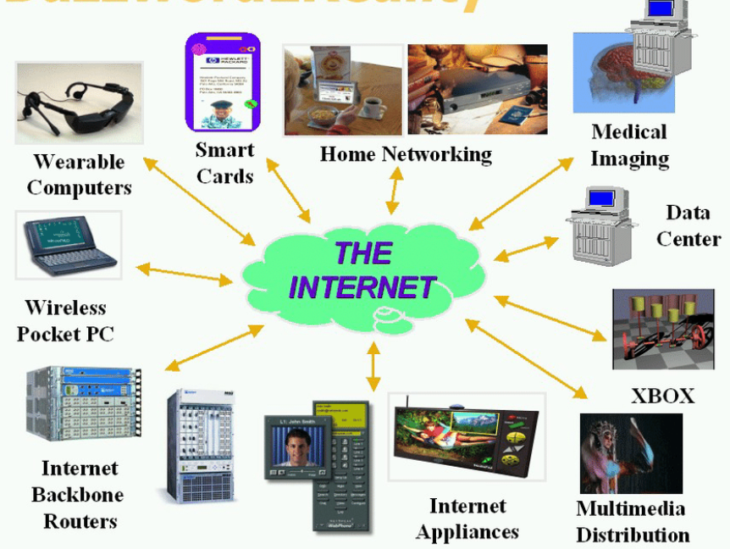

Slide 4
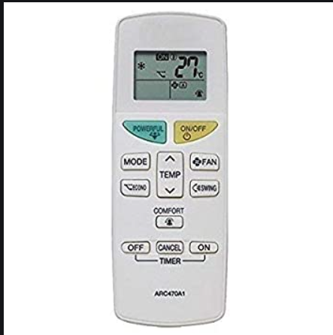
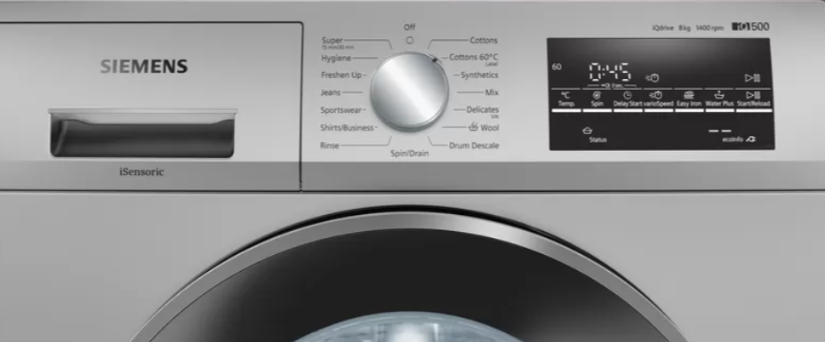

Slide 5
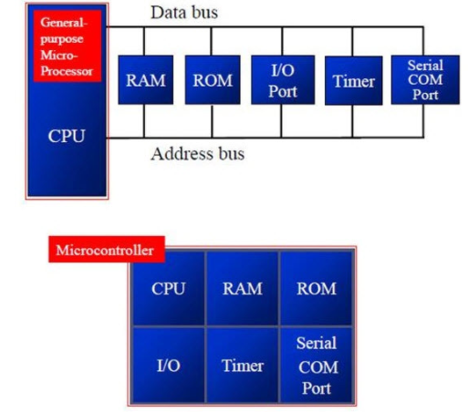
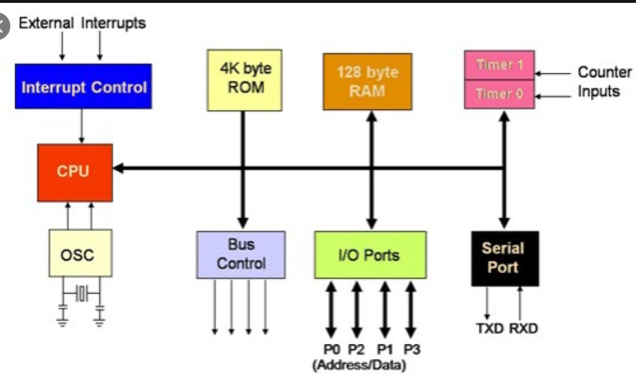

Slide 6
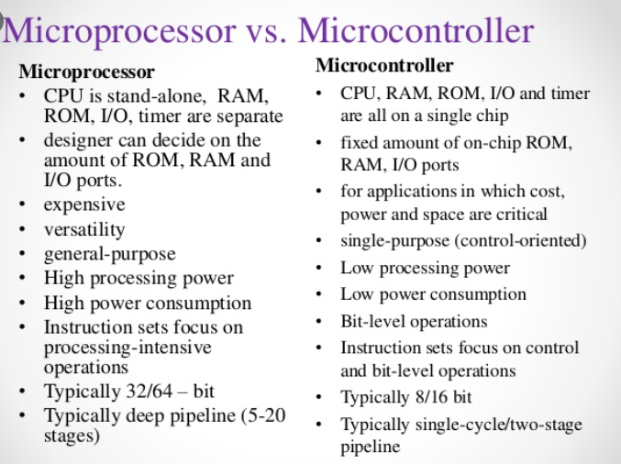

Slide 7
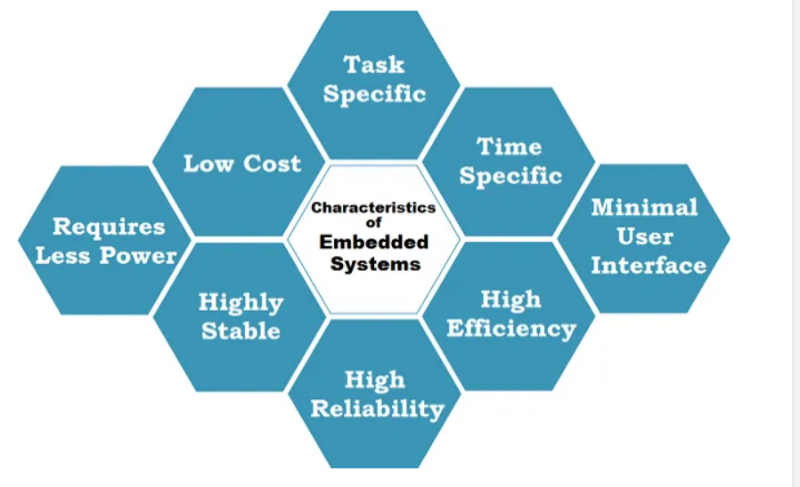
Characteristics of embedded systems

Slide 8
Some of the key characteristics of Embedded Systems are as mentioned below.
All Embedded Systems are task specific. They do the same task repeatedly /continuously over their lifetime. An mp3 player will function only as an mp3 player.
Embedded systems are created to perform the task within a certain time frame. It must therefore perform fast enough. A car’s brake system, if exceeds the time limit, may cause accidents.
They have minimal or no user interface (UI). A fully automatic washing machine works on its own after the program is set and stops once the task is over.
Some embedded systems are designed to react to external stimuli and react accordingly. A thermometer, a GPS tracking device.
Embedded systems are built to achieve certain efficiency levels. They are small sized, can work with less power and are not too expensive.
Embedded systems cannot be changed or upgraded by the users. Hence, they must rank high on reliability and stability. They are expected to function for long durations without the user experiencing any difficulties.
Microcontroller or microprocessors are used to design embedded systems.
Embedded systems need connected peripherals to attach input & output devices.
The hardware of an embedded-system is used for security and performance. The Software is used for features.

Slide 9
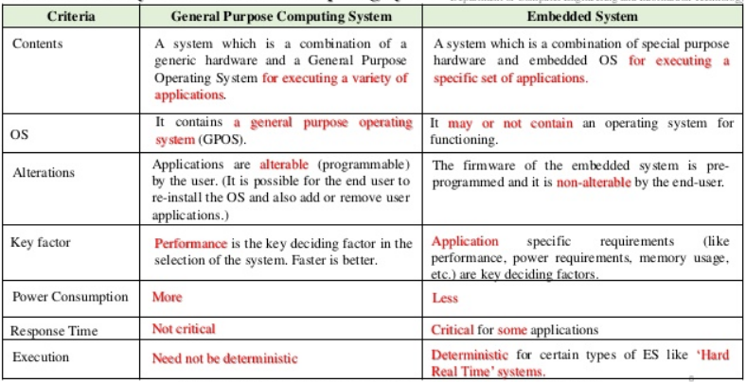

Slide 10
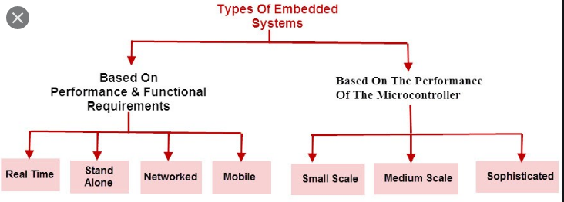
Real-Time Embedded Systems:
Traffic control system
Military usage in defense sector
Medical usage in health sector
Stand Alone Embedded Systems :
MP3 players
Microwave ovens
calculator
Networked Embedded Systems :
Home security systems
ATM machine
Card swipe machine
Mobile Embedded Systems :
MP3 player
Mobile phones
Digital Camera

Slide 11
