Slide 1
Chapter 19
Introduction to macroeconomics
David Begg, Stanley Fischer and Rudiger Dornbusch, Economics,
8th Edition, McGraw-Hill, 2005
PowerPoint presentation by Alex Tackie and Damian Ward

Slide 2
Macroeconomics is ...
the study of the economy as a whole
it deals with broad aggregates
but uses the same style of thinking about economic issues as in microeconomics.
Notes:
See the introduction to chapter 19 in the main text.

Slide 3
Some key issues in macroeconomics
Inflation
  the rate of change of the general price level
Unemployment
  a measure of the number of people looking for work, but who are without jobs
Output
  real gross national product (GNP) measures total income of an economy
    it is closely related to the economy's total output
Notes:
See Section 19-1 in the main text.

Slide 4
More key issues in macroeconomics
Economic growth
  increases in real GNP, an indication of the expansion of the economy’s total output
Macroeconomic policy
  a variety of policy measures used by the government to affect the overall performance of the economy
Notes:
See Section 19-1 in the main text.

Slide 5
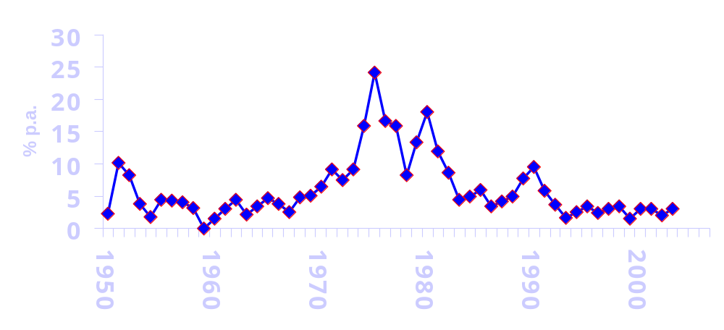
Inflation in the UK, 1950-2003
Source: Economic Trends Annual Supplement, Labour Market Trends
Notes:
See Section 19-2 in the main text, and Figure 19-1.
This version shows a longer period.

Slide 6
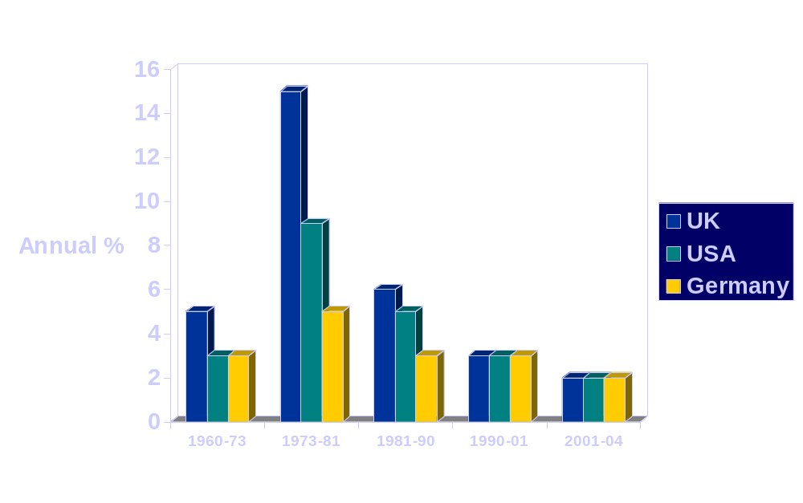
Inflation in UK, USA and Germany
1960 - 2004
Notes:
See data from Table 19-1 in Section 19.2 of the main text.

Slide 7
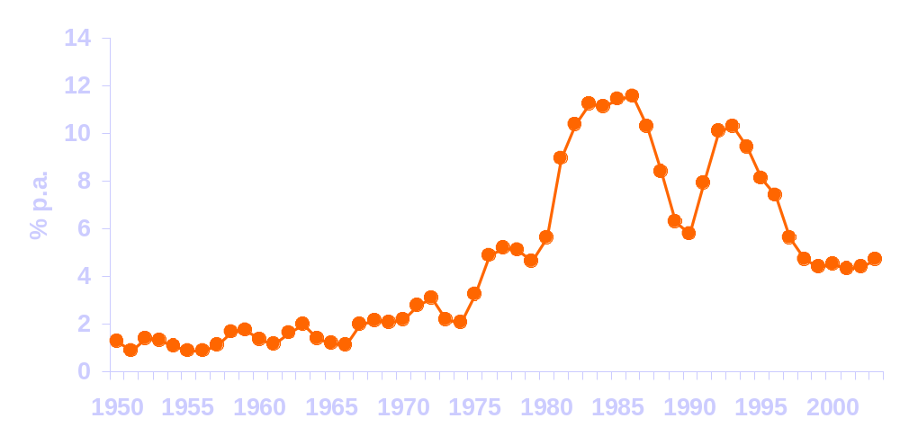
Unemployment in the UK
1950-2003
Source: Economic Trends Annual Supplement, Labour Market Trends
Notes:
Data relate to the claimant count.

Slide 8
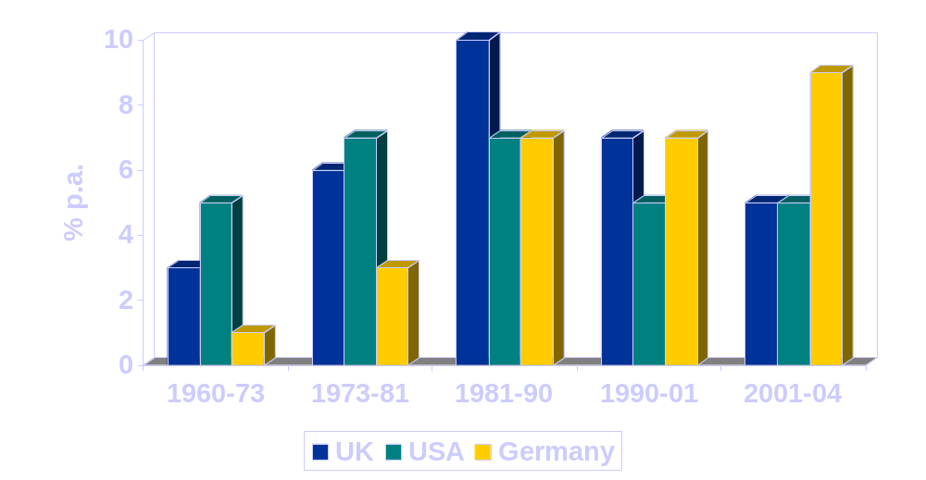
Unemployment in UK, USA and Germany
Notes:
See data from Table 19-1 in Section 19.2 of the main text.

Slide 9
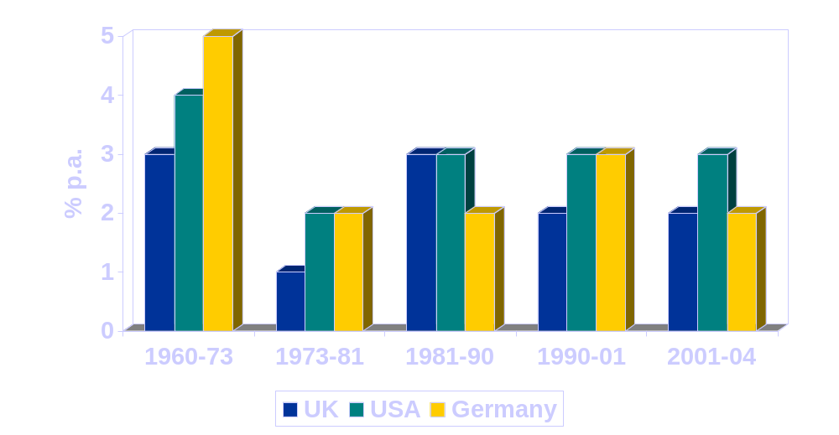
Economic growth in UK, USA and Germany
Notes:
See data from Table 19-1 in Section 19.2 of the main text.

Slide 10
The circular flow of income, expenditure and output
I
C + I
C
S
Households
Firms
Y
Notes:
Animation sequence for the circular flow with no government and no international trade.:
1 begin with two sets of agents, Households and Firms
2 Firms produce output
3 which flows as income to households
4 who allocate their income partly to Consumption and partly to Saving
5 Household C is augmented by Firms' investment, to create total expenditure (C + I).
… so we have the circular flow
This is discussed in Section 19-4 of the main text.

Slide 11
Government in the circular flow
I
C + I + G
C + I + G - T_{e}
C
S
G
T_{e}
Households
Government
Firms
B - T_{d}
Y + B - T_{d}
Y
Notes:
No build-up this time, the whole Figure will spiral in to cue, adding the government into the circular flow. This is also in Section 19-4.

Slide 12
Adding the foreign sector
To incorporate the foreign sector into the circular flow
we must recognise that residents of a country will buy imports from abroad
and that domestic firms will sell (export) goods and services abroad.
Notes:
See Section 19-4 in the main text.

Slide 13
GDP and GNP
Gross domestic product (GDP)
  measures the output produced by factors of production located in the domestic economy
Gross national product (GNP)
  measures the total income earned by domestic citizens
GNP = GDP + net income from abroad
Notes:
See Section 19-4 of the main text.
Income from abroad tends to be relatively small for the UK, but may be substantial for countries such as Egypt or the Philippines where there are large flows of repatriated income from workers abroad.

Slide 14
Three measures of national output
Expenditure
  the sum of expenditures in the economy
  Y = C + I + G + X - Z
Income
  the sum of incomes paid for factor services
  wages, profits, etc.
Output
  the sum of output (value added) produced in the economy
Notes:
See Section 19-4 in the main text.
We use Z for imports because we have used I for investment, and will sue M for money...

Slide 15
National income accounting: a summary
GNP
(and
GNI)
at
market
prices
NYA
NYA
Deprec'n
G
GDP
at
market
prices
NNP
at basic
prices
Indirect
taxes
I
National
income
Profits,
rents
NX
Self-
employment
C
Wages
and
salaries
Notes:
See Figure 19-5 in the main text.
Animation provides one block at a time from the left.

Slide 16
What GNP does and does not measure
Some care is needed:
  to distinguish between real and nominal measurements
  to take account of population changes
  to remember that GNP is not a comprehensive measure of everything that contributes to economic welfare
Notes:
See Section 19-5 of the main text.

