Slide 1

21AI52-Artificial Intelligence and Machine Learning
RV College of
Engineering
Go, change the world
Unit-IV

Slide 2
Contents
Nearest Neighbor Classifiers
Naive Bayes Classifier
Logistic Regression
Ensemble Methods

Slide 3
Nearest Neighbor Classifiers
Basic idea:
If it walks like a duck, quacks like a duck, then it’s probably a duck
Compute Distance
Test Record
Training Records
Choose k of the “nearest” records

Slide 4
Nearest-Neighbor Classifiers
Requires the following:
A set of labeled records
Proximity metric to compute distance/similarity between a pair of records
e.g., Euclidean distance
The value of k, the number of nearest neighbors to retrieve
A method for using class labels of K nearest neighbors to determine the class label of unknown record (e.g., by taking majority vote)

Slide 5

How to Determine the class label of a Test Sample?
Take the majority vote of class labels among the k-nearest neighbors
Weight the vote according to distance
weight factor, $w = 1/d2$

Slide 6
Choice of proximity measure matters
For documents, cosine is better than correlation or Euclidean
1 1 1 1 1 1 1 1 1 1 1 0
0 0 0 0 0 0 0 0 0 0 0 1
vs
0 1 1 1 1 1 1 1 1 1 1 1
1 0 0 0 0 0 0 0 0 0 0 0
Euclidean distance = 1.4142 for both pairs, but the cosine similarity measure has different values for these pairs.

Slide 7
Nearest Neighbor Classification…
Data preprocessing is often required
Attributes may have to be scaled to prevent distance measures from being dominated by one of the attributes
Example:
height of a person may vary from 1.5m to 1.8m
weight of a person may vary from 90lb to 300lb
income of a person may vary from $10K to $1M
Time series are often standardized to have 0 means a standard deviation of 1

Slide 8
Nearest Neighbor Classification…
Choosing the value of k:
If k is too small, sensitive to noise points
If k is too large, neighborhood may include points from other classes

Slide 9
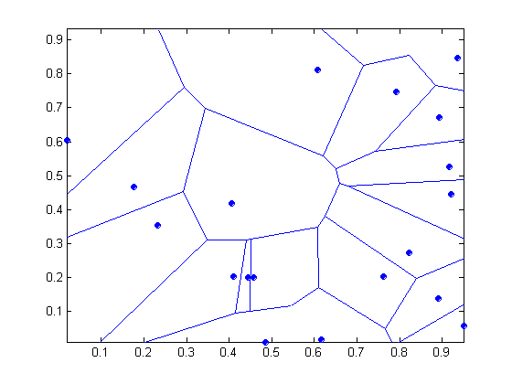
Nearest-neighbor classifiers
Nearest neighbor classifiers are local classifiers
They can produce decision boundaries of arbitrary shapes.
1-nn decision boundary is a Voronoi Diagram

Slide 10
Nearest Neighbor Classification…
How to handle missing values in training and test sets?
Proximity computations normally require the presence of all attributes
Some approaches use the subset of attributes present in two instances
This may not produce good results since it effectively uses different proximity measures for each pair of instances
Thus, proximities are not comparable

Slide 11
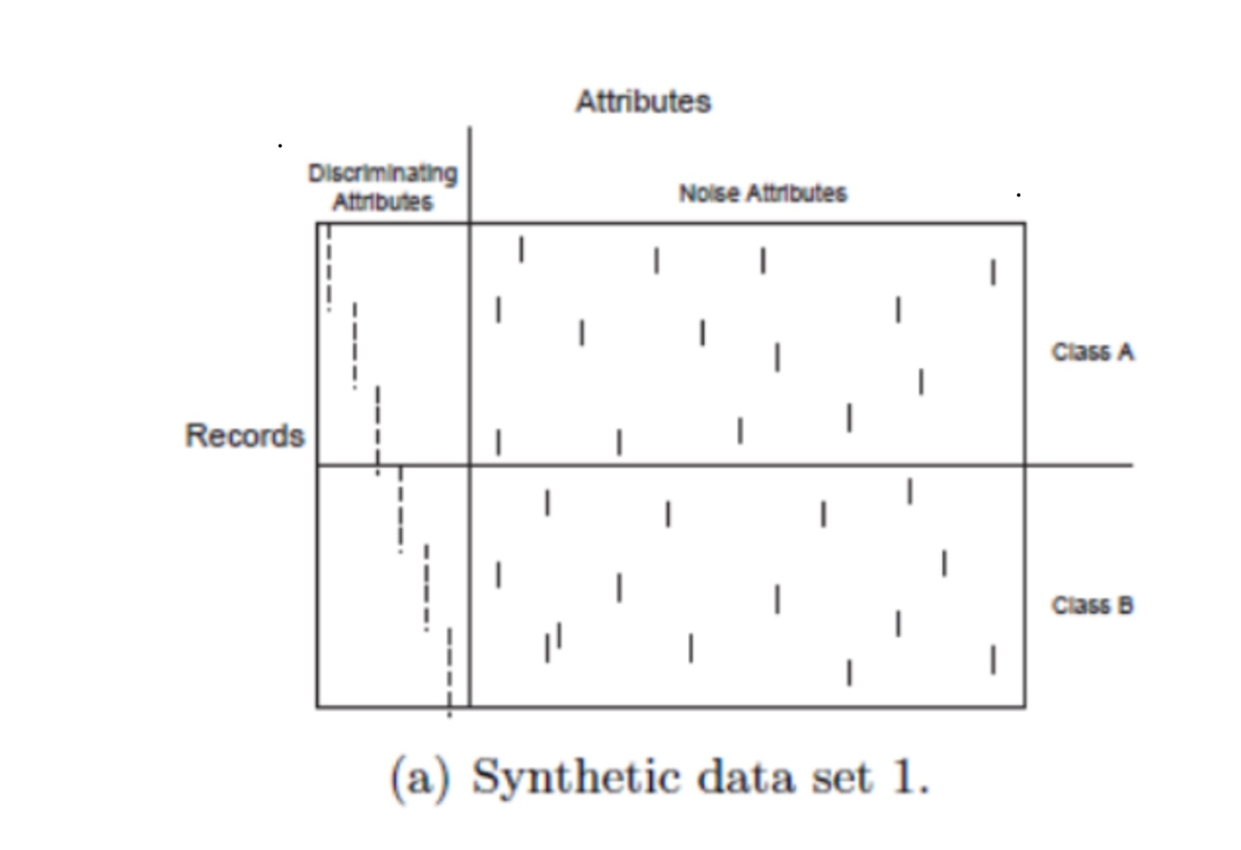
K-NN Classificiers… Handling Irrelevant and Redundant Attributes
Irrelevant attributes add noise to the proximity measure
Redundant attributes bias the proximity measure towards certain attributes

Slide 12
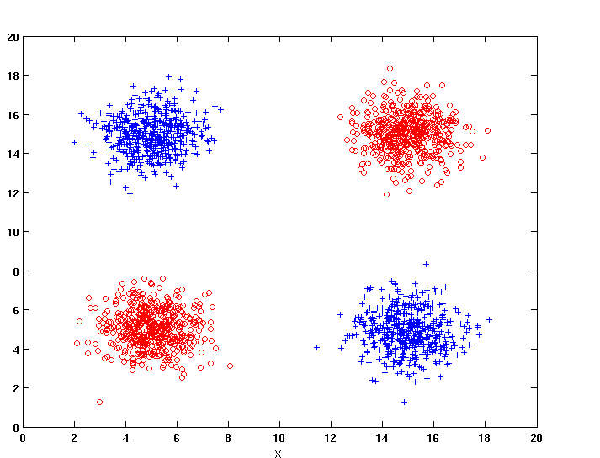
K-NN Classifiers: Handling attributes that are interacting

Slide 13
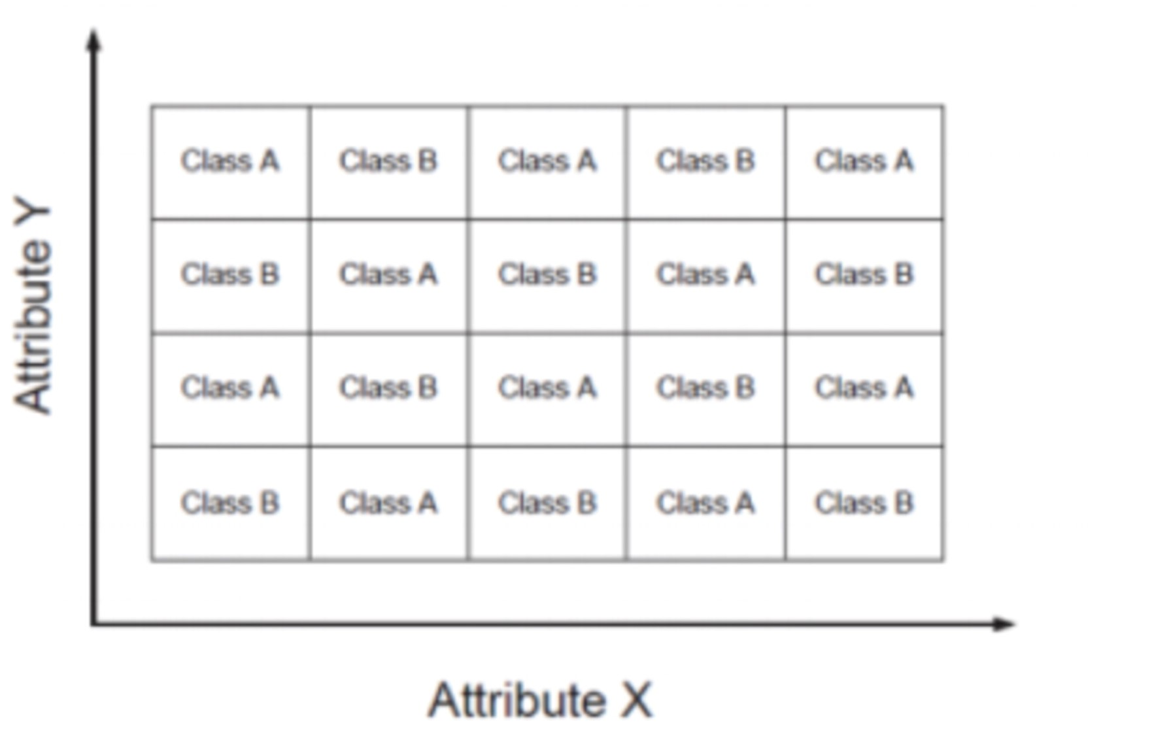
Handling attributes that are interacting

Slide 14
Improving KNN Efficiency
Avoid having to compute distance to all objects in the training set
Multi-dimensional access methods (k-d trees)
Fast approximate similarity search
Locality Sensitive Hashing (LSH)
Condensing
Determine a smaller set of objects that give the same performance
Editing
Remove objects to improve efficiency

Slide 15

Naive Bayes Classifier
$$p_{1}$$

Slide 16
Bayes Classifier
A probabilistic framework for solving classification problems
Conditional Probability:
Bayes theorem:

Slide 17
Using Bayes Theorem for Classification
Consider each attribute and class label as random variables
Given a record with attributes (X₁, X₂,…, X_{d}), the goal is to predict class Y
Specifically, we want to find the value of Y that maximizes P(Y| X₁, X₂,…, X_{d} )
Can we estimate P(Y| X₁, X₂,…, X_{d} ) directly from data?

Slide 18
Using Bayes Theorem for Classification
Approach:
compute posterior probability P(Y | X₁, X₂, …, X_{d}) using the Bayes theorem
Maximum a-posteriori: Choose Y that maximizes P(Y | X₁, X₂, …, X_{d})
Equivalent to choosing value of Y that maximizes P(X₁, X₂, …, X_{d}|Y) P(Y)
How to estimate P(X₁, X₂, …, X_{d} | Y )?

Slide 19
Example Data
Given a Test Record:
We need to estimate
P(Evade = Yes | X) and P(Evade = No | X)
In the following we will replace
Evade = Yes by Yes, and
Evade = No by No

Slide 20
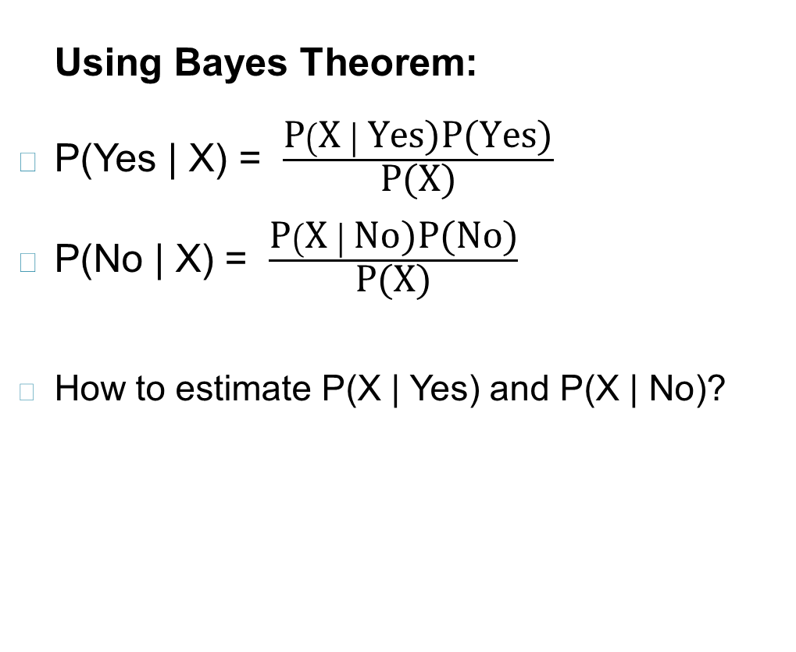
Example Data
Given a Test Record:

Slide 21
Conditional Independence
X and Y are conditionally independent given Z if P(X|YZ) = P(X|Z)
Example: Arm length and reading skills
Young child has shorter arm length and limited reading skills, compared to adults
If age is fixed, no apparent relationship between arm length and reading skills
Arm length and reading skills are conditionally independent given age

Slide 22
Naïve Bayes Classifier
Assume independence among attributes X_{i} when class is given:
P(X₁, X₂, …, X_{d} |Y_{j}) = P(X₁| Y_{j}) P(X₂| Y_{j})… P(X_{d}| Y_{j})
Now we can estimate P(X_{i}| Y_{j}) for all X_{i} and Y_{j} combinations from the training data
New point is classified to Y_{j} if P(Y_{j}) Π P(X_{i}| Y_{j}) is maximal.

Slide 23
Naïve Bayes on Example Data
Given a Test Record:
P(X | Yes) =
P(Refund = No | Yes) x
P(Divorced | Yes) x
P(Income = 120K | Yes)
P(X | No) =
P(Refund = No | No) x
P(Divorced | No) x
P(Income = 120K | No)

Slide 24
Estimate Probabilities from Data
P(y) = fraction of instances of class y
e.g., P(No) = 7/10, P(Yes) = 3/10
For categorical attributes: P(X_{i} =c| y) = n_{c}/ n
where |X_{i} =c| is number of instances having attribute value X_{i} =c and belonging to class y
Examples:
P(Status=Married|No) = 4/7 P(Refund=Yes|Yes)=0

Slide 25
Estimate Probabilities from Data
For continuous attributes:
Discretization: Partition the range into bins:
Replace continuous value with bin value
Attribute changed from continuous to ordinal
Probability density estimation:
Assume attribute follows a normal distribution
Use data to estimate parameters of distribution (e.g., mean and standard deviation)
Once probability distribution is known, use it to estimate the conditional probability P(X_{i}|Y)

Slide 26
Estimate Probabilities from Data
Normal distribution:
One for each (X_{i},Y_{i}) pair
For (Income, Class=No):
If Class=No
sample mean = 110
sample variance = 2975

Slide 27
Example of Naïve Bayes Classifier
Given a Test Record:
Naïve Bayes Classifier:
P(Refund = Yes | No) = 3/7
P(Refund = No | No) = 4/7
P(Refund = Yes | Yes) = 0
P(Refund = No | Yes) = 1
P(Marital Status = Single | No) = 2/7
P(Marital Status = Divorced | No) = 1/7
P(Marital Status = Married | No) = 4/7
P(Marital Status = Single | Yes) = 2/3
P(Marital Status = Divorced | Yes) = 1/3
P(Marital Status = Married | Yes) = 0
For Taxable Income:
If class = No: sample mean = 110
sample variance = 2975
If class = Yes: sample mean = 90
sample variance = 25
P(X | No) = P(Refund=No | No) × P(Divorced | No) × P(Income=120K | No) = 4/7 × 1/7 × 0.0072 = 0.0006
P(X | Yes) = P(Refund=No | Yes) × P(Divorced | Yes) × P(Income=120K | Yes) = 1 × 1/3 × 1.2 × 10⁻⁹ = 4 × 10⁻¹⁰
Since P(X|No)P(No) > P(X|Yes)P(Yes)
Therefore P(No|X) > P(Yes|X) => Class = No

Slide 28
Naïve Bayes Classifier can make decisions with partial information about attributes in the test record
Even in absence of information about any attributes, we can use Apriori Probabilities of Class Variable:
P(Yes) = 3/10
P(No) = 7/10
If we only know that marital status is Divorced, then:
P(Yes | Divorced) = 1/3 x 3/10 / P(Divorced)
P(No | Divorced) = 1/7 x 7/10 / P(Divorced)
If we also know that Refund = No, then
P(Yes | Refund = No, Divorced) = 1 x 1/3 x 3/10 / P(Divorced, Refund = No)
P(No | Refund = No, Divorced) = 4/7 x 1/7 x 7/10 / P(Divorced, Refund = No)
If we also know that Taxable Income = 120, then
P(Yes | Refund = No, Divorced, Income = 120) = 1.2 x10⁻⁹ x 1 x 1/3 x 3/10 / P(Divorced, Refund = No, Income = 120 )
P(No | Refund = No, Divorced Income = 120) = 0.0072 x 4/7 x 1/7 x 7/10 / P(Divorced, Refund = No, Income = 120)
Naïve Bayes Classifier:
P(Refund = Yes | No) = 3/7
P(Refund = No | No) = 4/7
P(Refund = Yes | Yes) = 0
P(Refund = No | Yes) = 1
P(Marital Status = Single | No) = 2/7
P(Marital Status = Divorced | No) = 1/7
P(Marital Status = Married | No) = 4/7
P(Marital Status = Single | Yes) = 2/3
P(Marital Status = Divorced | Yes) = 1/3
P(Marital Status = Married | Yes) = 0
For Taxable Income:
If class = No: sample mean = 110
sample variance = 2975
If class = Yes: sample mean = 90
sample variance = 25

Slide 29
Issues with Naïve Bayes Classifier
Given a Test Record:
X = (Married)
Naïve Bayes Classifier:
P(Refund = Yes | No) = 3/7
P(Refund = No | No) = 4/7
P(Refund = Yes | Yes) = 0
P(Refund = No | Yes) = 1
P(Marital Status = Single | No) = 2/7
P(Marital Status = Divorced | No) = 1/7
P(Marital Status = Married | No) = 4/7
P(Marital Status = Single | Yes) = 2/3
P(Marital Status = Divorced | Yes) = 1/3
P(Marital Status = Married | Yes) = 0
For Taxable Income:
If class = No: sample mean = 110
sample variance = 2975
If class = Yes: sample mean = 90
sample variance = 25
P(Yes) = 3/10
P(No) = 7/10
P(Yes | Married) = 0 x 3/10 / P(Married)
P(No | Married) = 4/7 x 7/10 / P(Married)

Slide 30
Issues with Naïve Bayes Classifier
Consider the table with Tid = 7 deleted
Naïve Bayes Classifier:
P(Refund = Yes | No) = 2/6
P(Refund = No | No) = 4/6
P(Refund = Yes | Yes) = 0
P(Refund = No | Yes) = 1
P(Marital Status = Single | No) = 2/6
P(Marital Status = Divorced | No) = 0
P(Marital Status = Married | No) = 4/6
P(Marital Status = Single | Yes) = 2/3
P(Marital Status = Divorced | Yes) = 1/3
P(Marital Status = Married | Yes) = 0/3
For Taxable Income:
If class = No: sample mean = 91
sample variance = 685
If class = No: sample mean = 90
sample variance = 25
Given X = (Refund = Yes, Divorced, 120K)
P(X | No) = 2/6 X 0 X 0.0083 = 0
P(X | Yes) = 0 X 1/3 X 1.2 X 10⁻⁹ = 0
Naïve Bayes will not be able to classify X as Yes or No!

Slide 31



Issues with Naïve Bayes Classifier
If one of the conditional probabilities is zero, then the entire expression becomes zero
Need to use other estimates of conditional probabilities than simple fractions
Probability estimation:
n: number of training instances belonging to class y
n_{c}: number of instances with X_{i} = c and Y = y
v: total number of attribute values that X_{i} can take
p: initial estimate of (P(X_{i} = c|y) known apriori
m: hyper-parameter for our confidence in p
$$original: P\left(X_{i}=c\right|y)=\frac{n_{c}}{n}$$
$$Laplace Estimate: P\left(X_{i}=c\right|y)=\frac{n_{c}+1}{n+v}$$
$$m−estimate: P\left(X_{i}=c\right|y)=\frac{n_{c}+mp}{n+m}$$

Slide 32
Example of Naïve Bayes Classifier
A: attributes
M: mammals
N: non-mammals
P(A|M)P(M) > P(A|N)P(N)
=> Mammals

Slide 33
Naïve Bayes (Summary)
Robust to isolated noise points
Handle missing values by ignoring the instance during probability estimate calculations
Robust to irrelevant attributes
Redundant and correlated attributes will violate class conditional assumption
Use other techniques such as Bayesian Belief Networks (BBN)

Slide 34
Naïve Bayes
How does Naïve Bayes perform on the following dataset?
Conditional independence of attributes is violated

Slide 35
Bayesian Belief Networks
Provides graphical representation of probabilistic relationships among a set of random variables
Consists of:
A directed acyclic graph (dag)
Node corresponds to a variable
Arc corresponds to dependence relationship between a pair of variables
A probability table associating each node to its immediate parent

Slide 36
Conditional Independence
D is parent of C
A is child of C
B is descendant of D
D is ancestor of A
A node in a Bayesian network is conditionally independent of all of its nondescendants, if its parents are known

Slide 37
Conditional Independence
Naïve Bayes assumption:

Slide 38
Probability Tables
If X does not have any parents, table contains prior probability P(X)
If X has only one parent (Y), table contains conditional probability P(X|Y)
If X has multiple parents (Y₁, Y₂,…, Y_{k}), table contains conditional probability P(X|Y₁, Y₂,…, Y_{k})

Slide 39
Example of Bayesian Belief Network

Slide 40
Example of Inferencing using BBN
Given: X = (E=No, D=Yes, CP=Yes, BP=High)
Compute P(HD|E,D,CP,BP)?
P(HD=Yes| E=No,D=Yes) = 0.55 P(CP=Yes| HD=Yes) = 0.8 P(BP=High| HD=Yes) = 0.85
P(HD=Yes|E=No,D=Yes,CP=Yes,BP=High) ∝ 0.55 × 0.8 × 0.85 = 0.374
P(HD=No| E=No,D=Yes) = 0.45 P(CP=Yes| HD=No) = 0.01 P(BP=High| HD=No) = 0.2
P(HD=No|E=No,D=Yes,CP=Yes,BP=High) ∝ 0.45 × 0.01 × 0.2 = 0.0009
Classify X as Yes

Slide 41
Logistic Regression

Slide 42
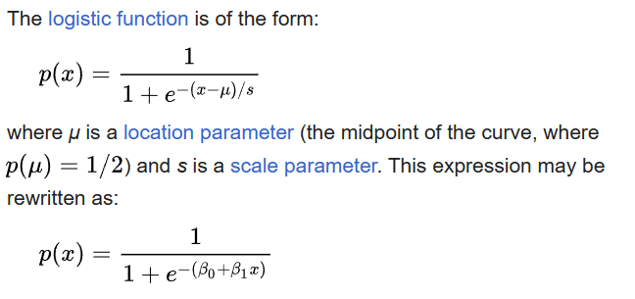
Logistic Model
Logistic model (or logit model) is a statistical model that models the probability of an event taking place by having the log-odds for the event be a linear combination of one or more independent variables.

Slide 43
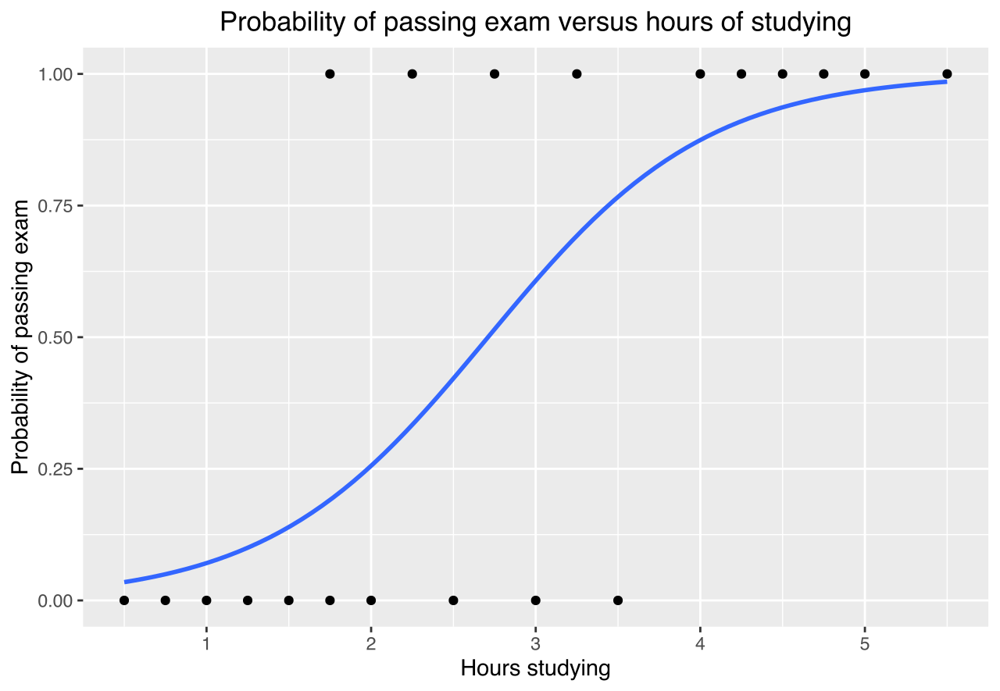
An example curve
Example graph of a logistic regression curve fitted to data. The curve shows the probability of passing an exam (binary dependent variable) versus hours studying (scalar independent variable).

Slide 44

Logistic Regression
Logistic regression is a probabilistic discriminative model that directly estimates the odds of a data instance a using its attribute values.
Basic idea is to use linear predictor, z = wT x + b, for representing the odds of x as follows:
where w and b are the parameters of the model and aT denotes the transpose of a vector a. Note that if wT x + b > 0, then x belongs to class 1 since its odds is greater than 1. Otherwise, x belongs to class 0.

Slide 45


Cont…
Since P(y = 0|x) + P(y = 1|x) = 1, we can re-write
This can be further simplified to express P(y = 1|x) as a function of z.
where the function σ(.) is known as the logistic or sigmoid function

Slide 46


Logistic Regression as a Generalized Linear Model
Logistic regression belongs to a broader family of statistical regression models, known as generalized linear models (GLM).
Even though logistic regression has relationships with regression models, it is a classification model since the computed posterior probabilities are eventually used to determine the class label of a data instance.

Slide 47

Learning Model Parameters
The parameters of logistic regression, (w, b), are estimated during training using a statistical approach known as the maximum likelihood estimation (MLE) method.

Slide 48
Characteristics of Logistic Regression
Discriminative model for classification.
The learned parameters of logistic regression can be analyzed to understand the relationships between attributes and class labels.
Can work more robustly even in high-dimensional settings
Can handle irrelevant attributes
Cannot handle data instances with missing values

Slide 49
Ensemble Techniques

Slide 50
Ensemble Methods
There are techniques for improving classification accuracy by aggregating the predictions of multiple classifiers.
known as ensemble or classifier combination methods.
An ensemble method constructs a set of base classifiers from training data and performs classification
by taking a vote on the predictions made by each base classifier.

Slide 51
Ensemble Methods
Construct a set of base classifiers learned from the training data
Predict class label of test records by combining the predictions made by multiple classifiers (e.g., by taking majority vote)

Slide 52
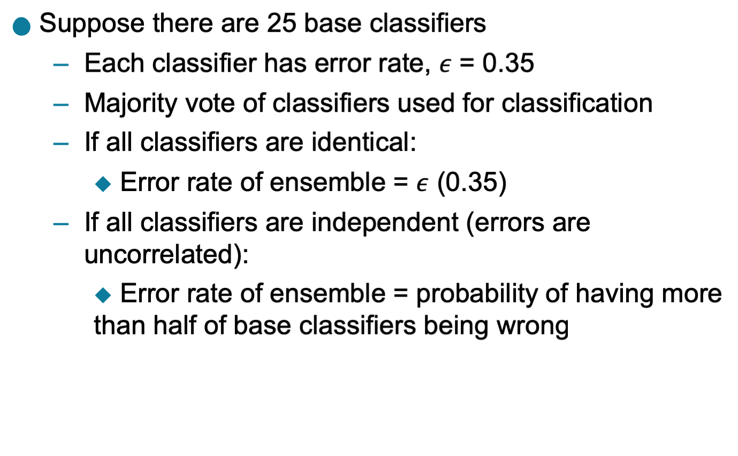
Example: Why Do Ensemble Methods Work?

Slide 53
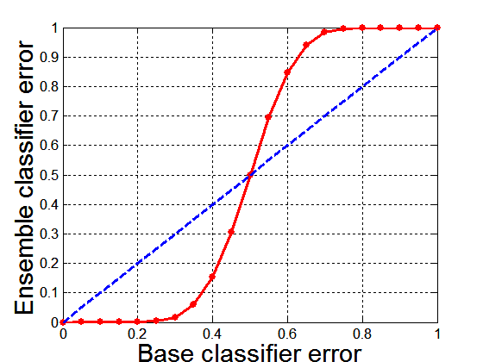
Necessary Conditions for Ensemble Methods
Ensemble Methods work better than a single base classifier if:
All base classifiers are independent of each other
All base classifiers perform better than random guessing (error rate < 0.5 for binary classification)
Classification error for an ensemble of 25 base classifiers, assuming their errors are uncorrelated.
Comparison between errors of base classifiers and errors of the ensemble classifier

Slide 54
Rationale for Ensemble Learning
Ensemble Methods work best with unstable base classifiers
Classifiers that are sensitive to minor perturbations in training set, due to high model complexity
Examples: Unpruned decision trees, ANNs, …

Slide 55
Bias-Variance Decomposition
Analogous problem of reaching a target y by firing projectiles from x (regression problem)
For classification, the generalization error of model $m$ can be given by:
$$gen.error\left(m\right)=c_{1}+bias\left(m\right)+c_{2}×variance(m)$$

Slide 56
Bias-Variance Trade-off and Overfitting
Overfitting
Underfitting
Ensemble methods try to reduce the variance of complex models (with low bias) by aggregating responses of multiple base classifiers

Slide 57
General Approach of Ensemble Learning
Using majority vote or weighted majority vote
(weighted according to their accuracy or relevance)
A logical view of the ensemble learning method.

Slide 58
Constructing Ensemble Classifiers
By manipulating training set
Example: bagging, boosting
By manipulating input features
Example: random forests
By manipulating class labels
Example: error-correcting output coding
By manipulating learning algorithm
Example: injecting randomness in the initial weights of ANN

Slide 59
Constructing Ensemble Classifiers
By manipulating training set
multiple training sets are created by resampling the original data according to some sampling distribution and constructing a classifier from each training set.
The sampling distribution determines how likely it is that an example will be selected for training, and it may vary from one trial to another.
Example: bagging, boosting
By manipulating input features
a subset of input features is chosen to form each training set. The subset can be either chosen randomly or based on the recommendation of domain experts.
this approach works very well with data sets that contain highly redundant features
Example: random forests --ensemble method that manipulates its input features and uses decision trees as its base classifiers

Slide 60
Constructing Ensemble Classifiers
By manipulating class labels
Example: error-correcting output coding
can be used when the number of classes is sufficiently large.
The training data is transformed into a binary class problem by randomly partitioning the class labels into two disjoint subsets, A0 and A1.
Training examples whose class label belongs to the subset A0 are assigned to class 0, while those that belong to the subset A1 are assigned to class 1.
The relabeled examples are then used to train a base classifier.
By repeating this process multiple times, an ensemble of base classifiers is obtained. When a test example is presented, each base classifier Ci is used to predict its class label.
If the test example is predicted as class 0, then all the classes that belongto A0 will receive a vote. Conversely, if it is predicted to be class 1, then all the classes that belong to A1 will receive a vote.
The votes are tallied and the class that receives the highest vote is assigned to the test

Slide 61
Constructing Ensemble Classifiers
By manipulating learning algorithm
Example: injecting randomness in the initial weights of ANN
Many learning algorithms can be manipulated in such a way that applying the algorithm several times on the same training data will result in the construction of different classifiers.
For example, an artificial neural network can change its network topology or the initial weights of the links between neurons.
Similarly, an ensemble of decision trees can be constructed by injecting randomness into the tree-growing procedure. For example, instead of choosing the best splitting attribute at each node, we can randomly choose one of the top k attributes for splitting.
The first three approaches are generic methods that are applicable to any classifier, whereas the fourth approach depends on the type of classifier used.
The base classifiers for most of these approaches can be generated sequentially (one after another) or in parallel (all at once).

Slide 62
Bagging (Bootstrap AGGregatING)
Bootstrap sampling: sampling with replacement
Build classifier on each bootstrap sample
Probability of a training instance being selected in a bootstrap sample is:
1 – (1 - 1/n)^{n} (n: number of training instances)
~0.632 when n is large

Slide 63
Bagging Algorithm

Slide 64
Bagging Example
Consider 1-dimensional data set:
Classifier is a decision stump (decision tree of size 1)
Decision rule: x ≤ k versus x > k
Split point k is chosen based on entropy
x ≤ k
True
False
y_{left}
y_{right}

Slide 65
Bagging Example

Slide 66
Bagging Example

Slide 67
Bagging Example

Slide 68
Bagging Example
Summary of Trained Decision Stumps:

Slide 69
Bagging Example
Use majority vote (sign of sum of predictions) to determine class of ensemble classifier
Bagging can also increase the complexity (representation capacity) of simple classifiers such as decision stumps
Predicted Class

Slide 70
Boosting
An iterative procedure to adaptively change distribution of training data by focusing more on previously misclassified records
Initially, all N records are assigned equal weights (for being selected for training)
Unlike bagging, weights may change at the end of each boosting round

Slide 71
Boosting
Records that are wrongly classified will have their weights increased in the next round
Records that are classified correctly will have their weights decreased in the next round
Example 4 is hard to classify
Its weight is increased, therefore it is more likely to be chosen again in subsequent rounds

Slide 72
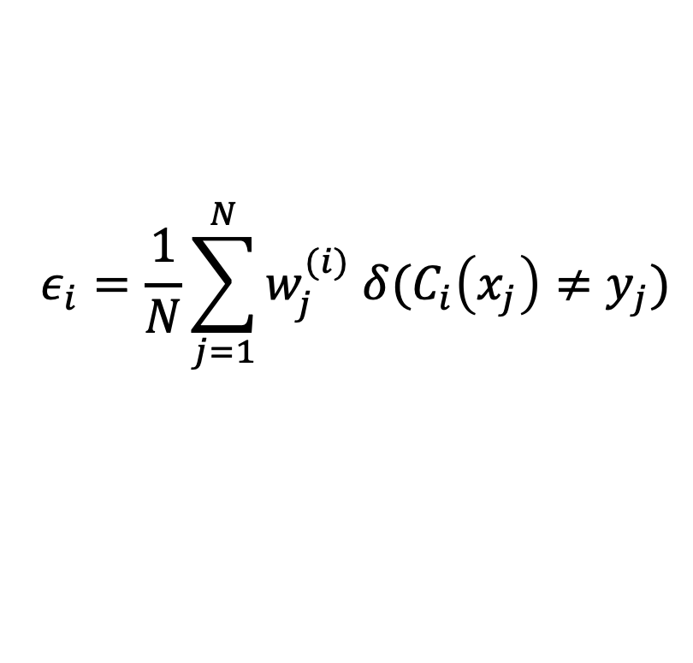
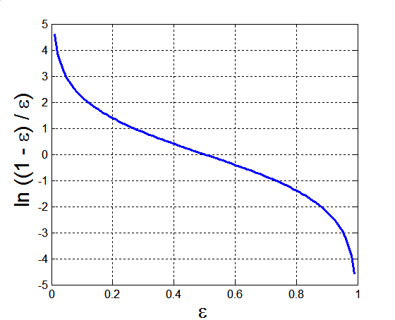
AdaBoost
Base classifiers: C₁, C₂, …, C_{T}
Error rate of a base classifier:
Importance of a classifier:

Slide 73
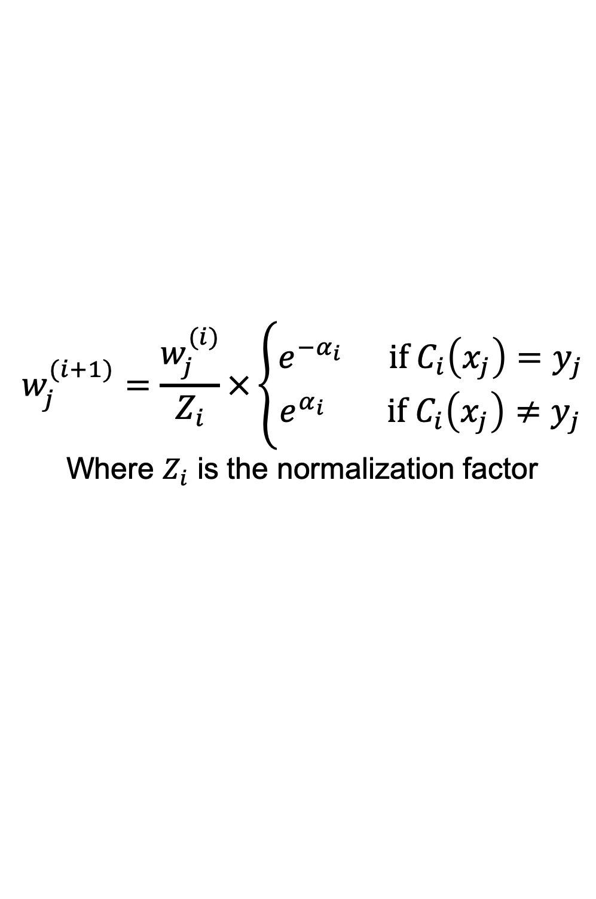
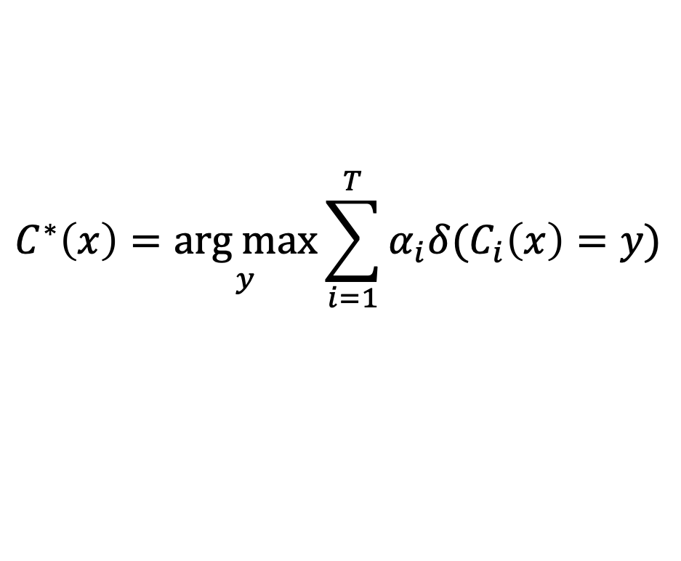
AdaBoost Algorithm
Weight update:
If any intermediate rounds produce error rate higher than 50%, the weights are reverted back to 1/n and the resampling procedure is repeated
Classification:

Slide 74
AdaBoost Algorithm

Slide 75
AdaBoost Example
Consider 1-dimensional data set:
Classifier is a decision stump
Decision rule: x ≤ k versus x > k
Split point k is chosen based on entropy
x ≤ k
True
False
y_{left}
y_{right}

Slide 76
AdaBoost Example
Training sets for the first 3 boosting rounds:
Summary:

Slide 77
AdaBoost Example
Weights
Classification
Predicted Class

Slide 78
Random Forest Algorithm
Construct an ensemble of decision trees by manipulating training set as well as features
Use bootstrap sample to train every decision tree (similar to Bagging)
Use the following tree induction algorithm:
At every internal node of decision tree, randomly sample p attributes for selecting split criterion
Repeat this procedure until all leaves are pure (unpruned tree)

Slide 79
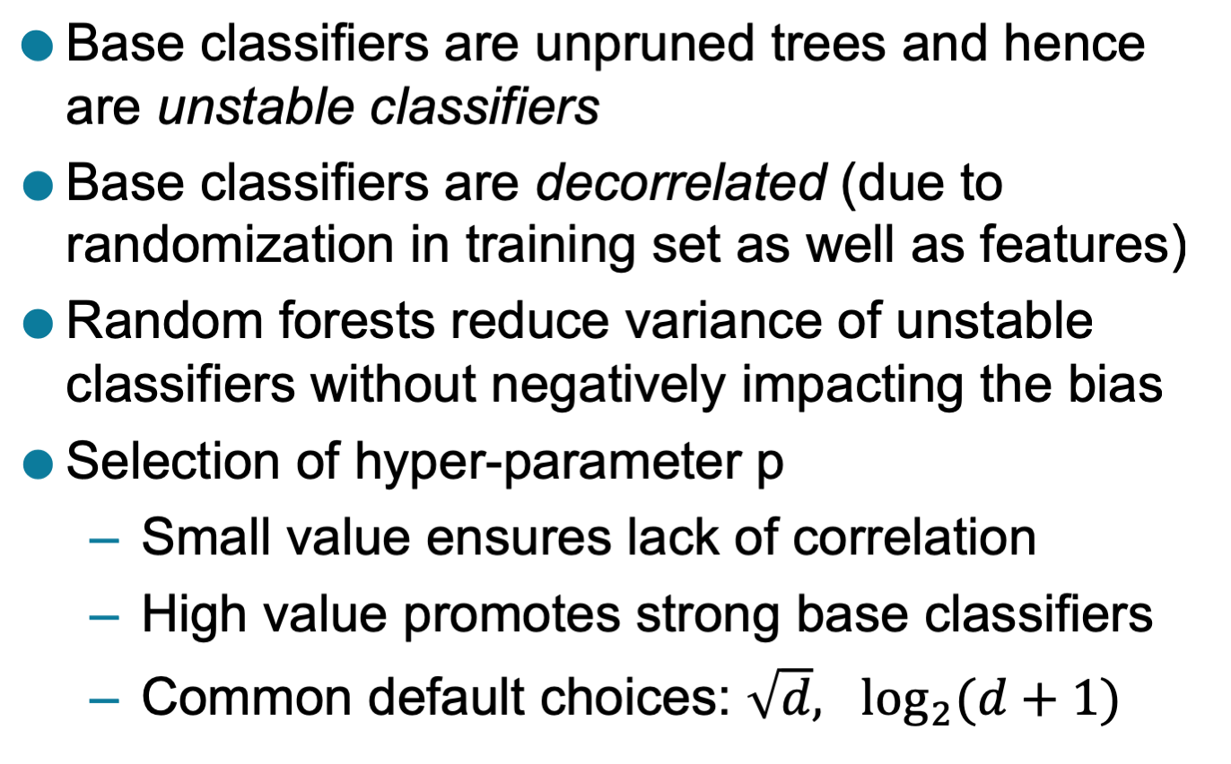
Characteristics of Random Forest

Slide 80
Gradient Boosting
Constructs a series of models
Models can be any predictive model that has a differentiable loss function
Commonly, trees are the chosen model
XGboost (extreme gradient boosting) is a popular package because of its impressive performance
Boosting can be viewed as optimizing the loss function by iterative functional gradient descent.
Implementations of various boosted algorithms are available in Python, R, Matlab, and more.

Slide 81
References:
Introduction to Data Mining ,Pang-Ning Tan, Michael Steinbach, Vipin Kumar,2nd edition, 2019,Pearson , ISBN-10-9332571406, ISBN-13 -978-9332571402
Machine Learning ,Tom M. Mitchell, Indian Edition, 2013, McGraw Hill Education, ISBN – 10 – 1259096955
Jiawei Han and Micheline, Kamber: Data Mining – Concepts and Techniques, 2nd Edition, Morgan Kaufmann, 2006, ISBN 1-55860-901-6

