Slide 1

Unit-2
Artificial Intelligence and Machine learning
21AI52

Slide 2
Outline
Informed Search Methods
Heuristic Functions
A* Search
Beyond Classical Search
Local Search & Optimization
Hill-climbing Search
Simulated Annealing
Local-Beam Search
Genetic Algorithms
Game Playing
Introduction
Game as a Search problem
Perfect Decisions in Two-Persons
Games Imperfect Decisions
Alpha-Beta Pruning

Slide 3
Informed Search Methods

Slide 4
Introduction
Informed Search Strategy
One that uses problem-speciﬁc knowledge beyond the deﬁnition of the problem itself
This ﬁnds the solutions more efﬁciently than uninformed strategy
For example
The search algorithm comprise of the knowledge like how far the goal is, path cost, how to reach to goal node, etc.
This knowledge help agents to explore less to the search space and find more efficiently the goal node

Slide 5
Heuristics Function
Heuristic is a function which is used in Informed Search, and it finds the most promising path.
It takes the current state of the agent as its input and produces the estimation of how close agent is from the goal
The heuristic method, might not always give the best solution, but it guaranteed to find a good solution in reasonable time
Heuristic function estimates how close a state is to the goal
It is represented by h(n), and it calculates the cost of an optimal path between the pair of states
The value of the heuristic function is always positive
Heuristic function is given as:
f(n) = h(n)
Here, f(n) is heuristic cost, and h(n) is the estimated cost. Hence heuristic cost should be less than or equal to the estimated cost.

Slide 6
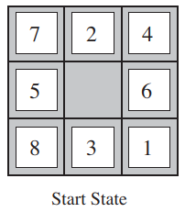
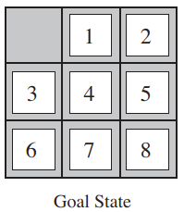
Heuristics Function (Contd.)
The 8-puzzle was one of the earliest heuristic search problems
The objective of the puzzle is to slide the tiles horizontally or vertically into the empty space until the conﬁguration matches the goal conﬁguration
Here, there are two commonly used candidates:
h1 = the number of misplaced tiles, all of the eight tiles are out of position, so the start state would have h1 = 8
h2 = the sum of the distances of the tiles from their goal positions
The distance we will count is the sum of the horizontal and vertical distances. This is sometimes called the city block distance or Manhattan distance
Tiles 1 to 8 in the start state give a Manhattan distance of h2 = 3 + 1 + 2 + 2 + 2 + 3 + 3 + 2 = 18

Slide 7
Heuristics Function (Contd.)
Pure Heuristic Search
Pure heuristic search is the simplest form of heuristic search algorithms
It expands nodes based on their heuristic value h(n)
It maintains two lists, OPEN and CLOSED list
In the CLOSED list, it places those nodes which have already expanded
In OPEN list, it places nodes which have yet not been expanded
On each iteration, each node ‘n’ with the lowest heuristic value is expanded and generates all its successors and ‘n’ is placed to the closed list
The algorithm continues until a goal state is found

Slide 8
Heuristics Function (Contd.)
A* Search Algorithm
A* search is the most commonly known form of best-first search
It uses heuristic function h(n), and cost to reach the node ‘n’ from the start state g(n)
A* search algorithm finds the shortest path through the search space using the heuristic function
This search algorithm expands less search tree and provides optimal result faster
In A* search algorithm, we use search heuristic as well as the cost to reach the node. Hence we can combine both costs as following, and this sum is called as a fitness number

Slide 9
Heuristics Function (Contd.)
A* Search Algorithm
f(x) = g(x)+h(x)
Step1: Place the starting node in the OPEN list.
Step 2: Check if the OPEN list is empty or not,
if the list is empty then return failure and stops.
Step 3: Select the node from the OPEN list which has the smallest value of evaluation function (g+h), if node n is goal node then return success and stop, otherwise
Step 4: Expand node n and generate all of its successors, and put n into the closed list. For each successor n', check whether n' is already in the OPEN or CLOSED list, if not then compute evaluation function for ‘n’ and place into Open list.
Step 5: Else if node n' is already in OPEN and CLOSED, then it should be attached to the back pointer which reflects the lowest g(n') value.
Step 6: Return to Step 2
g(x) - backward cost
h(x) - forward cost

Slide 10
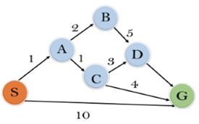
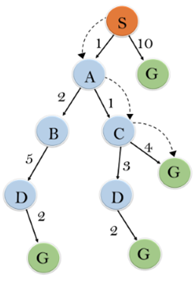
Heuristics Function (Contd.)
A* Search Algorithm
Figure 1
Figure 2
Node | H(n)
S | 5
A | 3
B | 4
C | 2
D | 6
G | 0

Slide 11
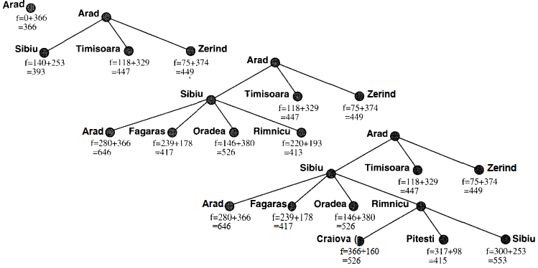
Heuristics Function (Contd.)
A* Search Algorithm

Slide 12
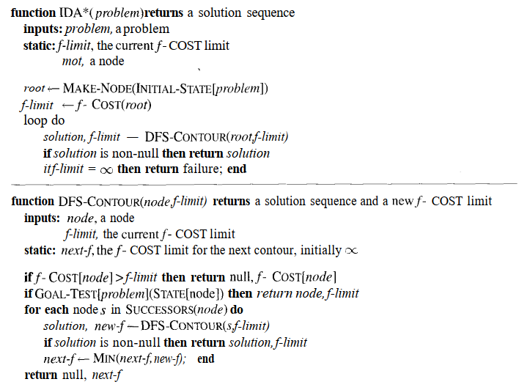
Memory Bounded Search
Iterative deepening A* search (IDA*)
Iterative deepening A* (IDA*) is a graph traversal and path search algorithm
The algorithm can find the shortest path between a designated start node and any member of a set of goal nodes in a weighted graph
It is a variant of iterative deepening depth-first search that borrows the idea to use a heuristic function to evaluate the remaining cost to get to the goal from the A* search algorithm

Slide 13
Iterative Improvement Algorithms (Contd.)
Unlike A*, IDA* doesn’t utilize dynamic programming and therefore often ends up exploring the same nodes many times
It does everything that the A* does, it has the optimal characteristics of A* to find the shortest path but it uses less memory than A*.

Slide 14
Iterative Improvement Algorithms (Contd.)
Simplified Memory-Bounded A*
SMA* is a shortest path algorithm that is based on the A* algorithm.
The difference between SMA* and A* is that SMA* uses a bounded memory, while the A* algorithm might need exponential memory.
SMA* has the following properties:
It will utilize whatever memory is made available to it.
It avoids repeated states as far as its memory allows.
It is complete if the available memory is sufficient to store the shallowest solution path.
It is optimal if enough memory is available to store the shallowest optimal solution path.
Otherwise, it returns the best solution that can be reached with the available memory.
When enough memory is available for the entire search tree, the search is optimally efficient

Slide 15
Iterative Improvement Algorithms (Contd.)
Simplified Memory-Bounded A*
SMA*, just like A* evaluates nodes by combining g(n), the cost to reach the node, and h(n), the cost to get from he node to the goal: f(n) = g(n) + h(n)
Since g(n) → is the path cost from the start node to node n
h(n) → is the estimated cost of the cheapest path from n to the goal
f(n) → estimated cost of the cheapest solution through n
The lower the f value is, the higher priority the node will have
The difference from A* is that the f value of the parent node will be updated to reflect changes to this estimate when its children are expanded
A fully expanded node will have an ‘f’ value at least as high as that of its successors
In addition, the node stores the f value of the best forgotten successor (or best forgotten child). This value is restored if the forgotten successor is revealed to be the most promising successor.

Slide 16
Iterative Improvement Algorithms
Simplified Memory-Bounded A*
In many optimization problems, path is irrelevant
In such cases, can use iterative improvement algorithms; keep a single “current” state, try to improve it
Iterative improvement algorithms divide into two major classes
Hill-climbing (gradient descent)
Simulated annealing
Hill-Climbing (Gradient Descent)
A hill-climbing algorithm is an Artificial Intelligence (AI) algorithm that increases in value continuously until it achieves a peak solution
Simulated Annealing
Simulated Annealing (SA) mimics the Physical Annealing process but is used for optimizing parameters in a model

Slide 17
Beyond Classical Search

Slide 18
Local search and optimization
Local search
Keep track of single current state
Move only to neighboring states
Ignore paths
Advantages:
Use very little memory
Can often find reasonable solutions in large or infinite (continuous) state spaces.
“Pure optimization” problems
All states have an objective function
Goal is to find state with max (or min) objective value
Does not quite fit into path-cost/goal-state formulation
Local search can do quite well on these problems.

Slide 19
Local Classical Algos. and Optimization Problems
Goal Satisfaction
Optimization
reach the goal node
Constraint satisfaction
optimize(objective fn)
Constraint Optimization
You can go back and forth between the two problems
Typically in the same complexity class

Slide 20
Local Classical Algos. and Optimization Problems
In many optimization problems, the path to the goal is irrelevant; the goal state itself is the solution
Local search: widely used for very big problems
Returns good but not optimal solutions in general
The state space consists of "complete" configurations
For example, every permutation of the set of cities is a configuration for the traveling salesperson problem
The goal is to find a “close to optimal” configuration satisfying constraints
Examples: n-Queens, VLSI layout, exam time table
Local search algorithms
Keep a single "current" state, or small set of states
Iteratively try to improve it / them
Very memory efficient since only a few states are stored

Slide 21



Local Classical Algos. and Optimization Problems
Example: 4-queens
Goal: Put 4 queens on an 4 × 4 board with no two queens on the same row, column, or diagonal State space: All configurations with the queens in distinct columns
State transition: Move a queen from its present place to some other square in the same column Local Search: Start with a configuration and repeatedly use the moves to reach the goal
Move queen in Column 4
Move queen in Column 2
The last configuration has fewer conflicts than the first, but is still not a solution

Slide 22
Hill Climbing
A hill-climbing algorithm is a local search algorithm that moves continuously upward (increasing) until the best solution is attained
This algorithm comes to an end when the peak is reached
This algorithm has a node that comprises two parts: state and value. It begins with a non-optimal state (the hill’s base) and upgrades this state until a certain precondition is met
The heuristic function is used as the basis for this precondition. The process of continuous improvement of the current state of iteration can be termed as climbing. This explains why the algorithm is termed as a hill-climbing algorithm
A hill-climbing algorithm has four main features
It employs a greedy approach
No Backtracking: It does not look at the previous states
Feedback mechanism: The algorithm has a feedback mechanism that helps it decide on the direction of movement
Incremental change: The algorithm improves the current solution by incremental changes

Slide 23
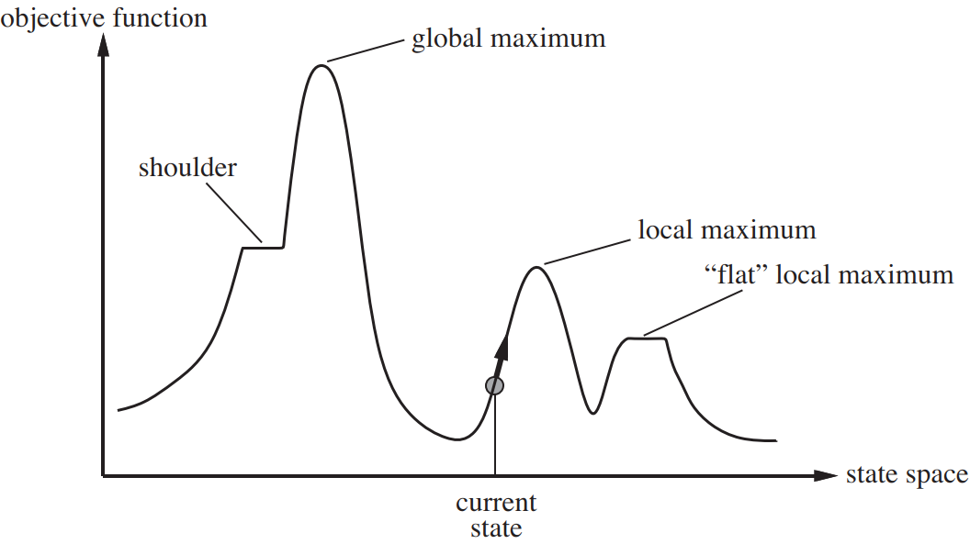
Hill Climbing
The following diagram shows a simple state-space diagram
Local maximum: A local maximum is a solution that surpasses other neighboring solutions or states but is not the best possible solution
Current state: This is the existing or present state
Flat local maximum: This is a flat region where the neighboring solutions attain the same value
Shoulder: This is a plateau whose edge is stretching upwards
Global maximum: This is the best possible solution achieved by the algorithm

Slide 24
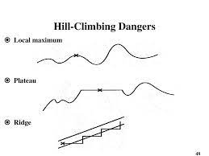
Hill Climbing
Problem with the Hill Climbing
Local maximum: At this point, the neighboring states have lower values than the current state. The greedy approach feature will not move the algorithm to a worse off state. This will lead to the hill-climbing process’s termination, even though this is not the best possible solution
Plateau: In this region, the values attained by the neighboring states are the same. This makes it difficult for the algorithm to choose the best direction
Ridge: The hill-climbing algorithm may terminate itself when it reaches a ridge. This is because the peak of the ridge is followed by downward movement rather than upward movement

Slide 25
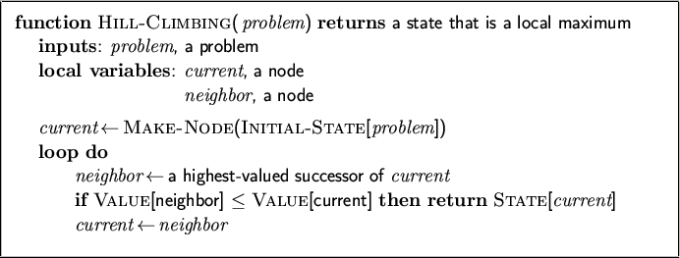
Hill Climbing

Slide 26
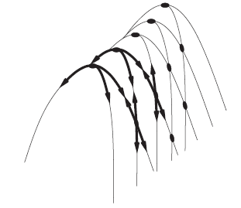
Hill Climbing - Difficulties
Note: these difficulties apply to all local search algorithms, and usually become much worse as the search space becomes higher dimensional
Ridge problem: every neighbor appears to be downhill
But, search space has an uphill (just not in neighbors)
Ridge:
Fold a piece of paper and hold it tilted up at an unfavorable angle to every possible search space step. Every step leads downhill; but the ridge leads uphill.
States / steps (discrete)

Slide 27
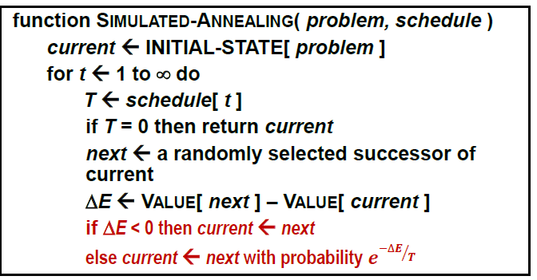
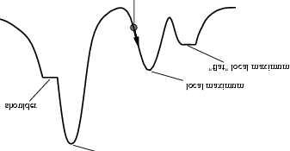
Simulated Annealing
IDEA: Escape local maxima by allowing some "bad" moves but gradually decrease their probability
The probability is controlled by a parameter called temperature
Higher temperatures allow more bad moves than lower temperatures
Annealing: Lowering the temperature gradually Quenching: Lowering the temperature rapidly
Starting state
Flat Local minimum
Local minimum
Shoulder
Global minimum

Slide 28
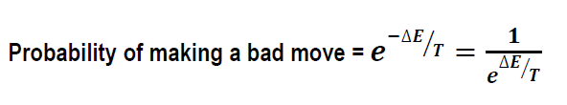

How Simulated Annealing Works ?
B
C
ΔE₁
ΔE₂
A
Since E₁ > E₂ moving from A to C is exponentially more probable than moving from A to B
12

Slide 29
Properties-Simulated Annealing
It can be proven that:
If T decreases slowly enough, then simulated annealing search will find a global optimum with probability approaching 1
Since this can take a long time, we typically use a temperature schedule which fits our time budget and settle for the sub-optimal solution
Simulated annealing works very well in practice
Widely used in VLSI layout, airline scheduling, etc.
12

Slide 30
Local-beam search
Instead of working on only one configuration at any time, we could work on multiple promising configurations concurrently
LOCAL BEAM SEARCH
Maintain k states rather than just one. Begin with k randomly generated states
In each iteration, generate all the successors of all k states
Stop if a goal state is found; otherwise Select the k best successors from the complete list and repeat
12

Slide 31
Genetic Algorithms
GENETIC ALGORITHMS
States are strings over a finite alphabet (genes). Begin with k randomly generated states (population). Select individuals for next generation based on a fitness function.
Two types of operators for creating the next states:
Crossover: Fit parents to yield next generation (offspring)
Mutation: Mutate a parent to create an offspring randomly with some low probability
12

Slide 32
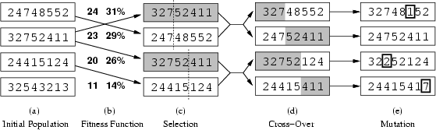
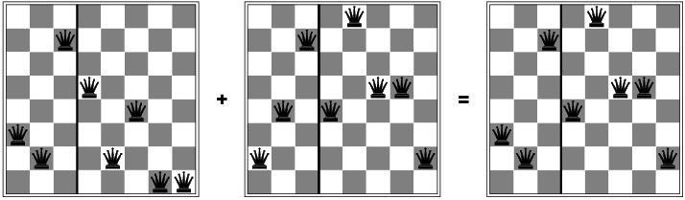
Genetic Algorithms
Fitness function: # non-attacking pairs ( min = 0, max = 8×7 / 2 = 28 )
Population fitness = 24+23+20+11 = 78
P( Gene-1 is chosen )
= Fitness of Gene-1 / Population fitness
= 24 / 78 = 31%
P( Gene-2 is chosen )
= Fitness of Gene-2 / Population fitness
= 23 / 78 = 29%
12
16

Slide 33
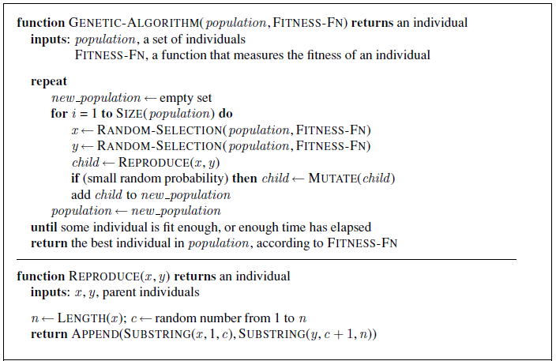
Genetic Algorithms
12

Slide 34
Game Playing

Slide 35
Game Playing
Introduction
A Game playing is one of the oldest areas of endeavor in artificial intelligence
In 1950, almost as soon as computers became programmable, the first chess programs were written by Claude Shannon (the inventor of information theory) and by Alan Turing.
The presence of an opponent makes the decision problem somewhat more complicated than the search problems discussed.
The opponent introduces uncertainty, because one never knows what he or she is going to do. In essence, all game-playing programs must deal with the Contingency Problem

Slide 36
Game Playing
Game as a Search Problem
A game can be defined as a type of search in AI, which can be formalized of the following elements:
Initial state: It specifies how the game is set up at the start
Player(s): It specifies which player has moved in the state space
Action(s): It returns the set of legal moves in state space
Result(s, a): It is the transition model, which specifies the result of moves in the state space.
Terminal-Test(s): Terminal test is true if the game is over, else it is false at any case. The state where the game ends is called terminal states.
Utility(s, p): A utility function gives the final numeric value for a game that ends in terminal states s for player p. It is also called payoff function. For Chess, the outcomes are a win, loss, or draw and its payoff values are +1, 0, ½. And for tic-tac-toe, utility values are +1, -1, and 0

Slide 37
Game Playing (Contd.)
Perfect Decisions in Two-Persons Game
Consider the general case of a game with two players, whom we will call MAX and MIN
MAX moves first, and then they take turns moving until the game is over
At the end of the game, points are awarded to the winning player
A game can be formally defined as a kind of search problem with the following components
The initial state, which includes the board position and an indication of whose move it is.
A set of operators, which define the legal moves that a player can make
A terminal test, which determines when the game is over. States where the game has ended are called terminal states
A utility function (also called a payoff function), which gives a numeric value for the outcome of a game. In chess, the outcome is a win, loss, or draw, which we can represent by the values +1, —1, or 0.

Slide 38
Game Playing (Contd.)
Perfect Decisions in Two-Persons Game
If this were a normal search problem, then all MAX would have to do is search for a sequence of moves that leads to a terminal state that is a winner
From the initial state, MAX has a choice of nine possible moves
Play alternates between MAX placing x's and MIN placing o's until we reach leaf nodes corresponding to terminal states: states where one player has three in a row or all the squares are filled.
The number on each leaf node indicates the utility value of the terminal state from the point of view of MAX; high values are assumed to be good for MAX and bad for MIN (which is how the players get their names).
It is MAX'S job to use the search tree (particularly the utility of terminal states) to determine the best move
Even a simple game like Tic-Tac-Toe is too complex to show the whole search tree

Slide 39
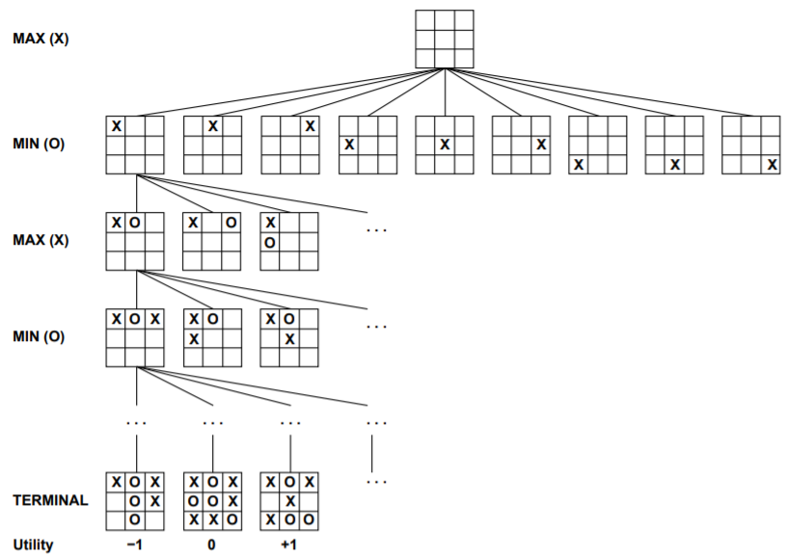
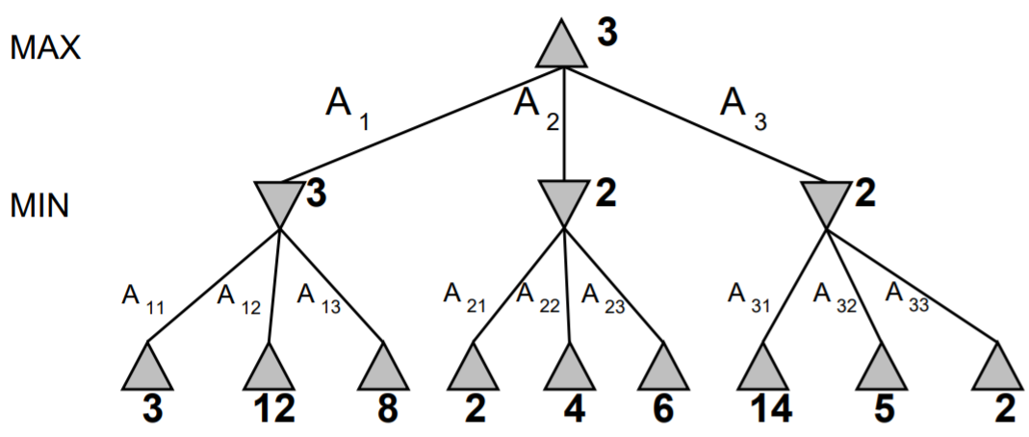
Game Playing (Contd.)
Perfect Decisions in Two-Persons Game

Slide 40
Game Playing (Contd.)
Minimax Algorithm
The minimax algorithm is designed to determine the optimal strategy for MAX, and thus to decide what the best first move is
The algorithm consists of five steps:
Generate the whole game tree, all the way down to the terminal states
Apply the utility function to each terminal state to get its value
Use the utility of the terminal states to determine the utility of the nodes one level higher up in the search tree
Continue backing up the values from the leaf nodes toward the root, one layer at a time
Eventually, the backed-up values reach the top of the tree; at that point, MAX chooses the move that leads to the highest value

Slide 41
Game Playing (Contd.)
Minimax Algorithm
Mini-max algorithm is a recursive or backtracking algorithm which is used in decision-making and game theory
It provides an optimal move for the player assuming that opponent is also playing optimally
Min-Max algorithm is mostly used for game playing in AI. Such as Chess, Checkers, tic-tac-toe, go, and various tow-players game
In this algorithm two players play the game, one is called MAX and other is called MIN
Both Players of the game are opponent of each other, where MAX will select the maximized value and MIN will select the minimized value
The minimax algorithm performs a depth-first search algorithm for the exploration of the complete game tree
The minimax algorithm proceeds all the way down to the terminal node of the tree, then backtrack the tree as the recursion

Slide 42
Game Playing (Contd.)
Minimax Algorithm
The minimax algorithm is designed to determine the optimal strategy for MAX, and thus to decide what the best first move is
The algorithm consists of five steps:
Generate the whole game tree, all the way down to the terminal states
Apply the utility function to each terminal state to get its value
Use the utility of the terminal states to determine the utility of the nodes one level higher up in the search tree
Continue backing up the values from the leaf nodes toward the root, one layer at a time
Eventually, the backed-up values reach the top of the tree; at that point, MAX chooses the move that leads to the highest value

Slide 43
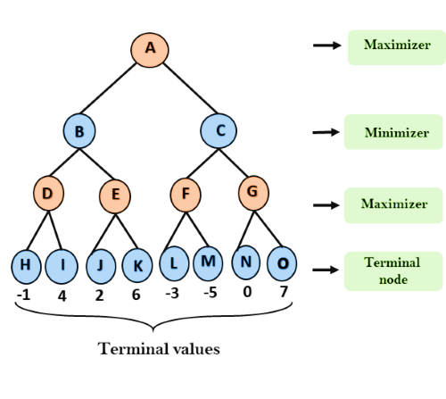
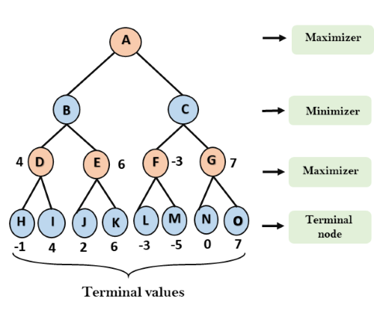
Game Playing (Contd.)
Minimax Algorithm
Step-1
MAX
MIN
Step-2
MAX
MAX
MIN
MIN
MAX
MIN

Slide 44
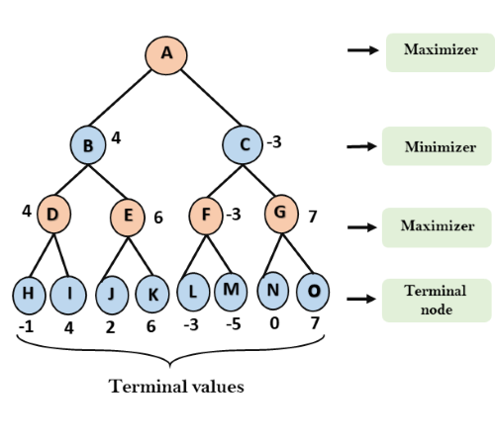
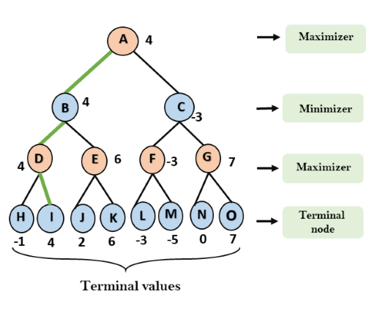
Game Playing (Contd.)
Minimax Algorithm
Step-3
MAX
MIN
Step-4
MAX
MAX
MIN
MIN
MAX
MIN

Slide 45
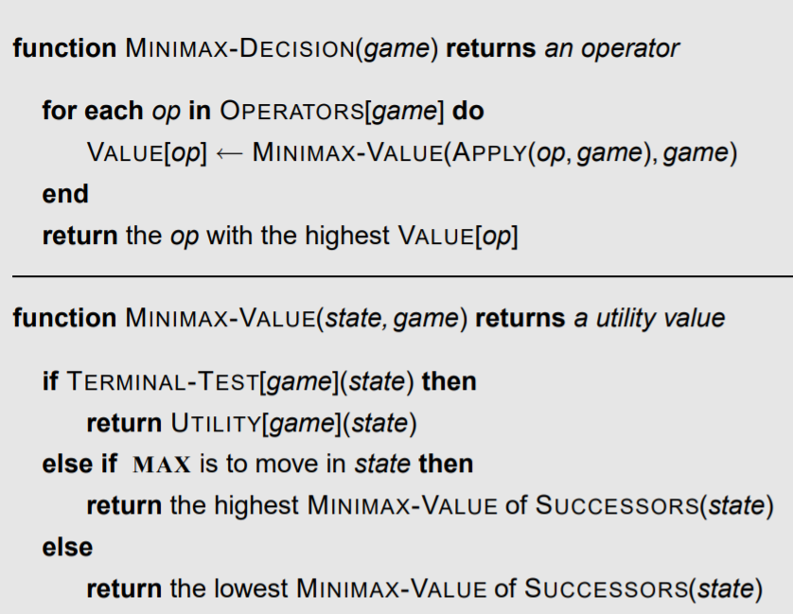
Game Playing (Contd.)
Minimax Algorithm

Slide 46
Game Playing (Contd.)
Imperfect Decisions
The minimax algorithm assumes that the program has time to search all the way to terminal states, which is usually not practical
The program should cut off the search earlier and apply a heuristic evaluation function to the leaves of the tree
In other words, the suggestion is to alter minimax in two ways
The utility function is replaced by an evaluation function EVAL, and the terminal test is replaced by a cutoff test CUTOFF-TEST

Slide 47
Game Playing (Contd.)
Alpha-Beta Pruning
In minimax search algorithm that the number of game states it has to examine are exponential in depth of the tree.
Since we cannot eliminate the exponent, but we can cut it to half
Hence there is a technique by which without checking each node of the game tree we can compute the correct minimax decision, and this technique is called pruning.
This involves two threshold parameter Alpha and beta for future expansion, so it is called alpha-beta pruning. It is also called as Alpha-Beta Algorithm
Alpha-beta pruning can be applied at any depth of a tree, and sometimes it not only prune the tree leaves but also entire sub-tree

Slide 48
Game Playing (Contd.)
Alpha-Beta Pruning
The two-parameter can be defined as:
Alpha: The best (highest-value) choice we have found so far at any point along the path of Maximizer. The initial value of alpha is -∞.
Beta: The best (lowest-value) choice we have found so far at any point along the path of Minimizer. The initial value of beta is +∞.
The Alpha-beta pruning to a standard minimax algorithm returns the same move as the standard algorithm does, but it removes all the nodes which are not really affecting the final decision but making algorithm slow
Hence by pruning these nodes, it makes the algorithm fast
Points to remember
The Max player will only update the value of alpha
The Min player will only update the value of beta
While backtracking the tree, the node values will be passed to upper nodes instead of values of alpha and beta
We will only pass the alpha, beta values to the child nodes

Slide 49
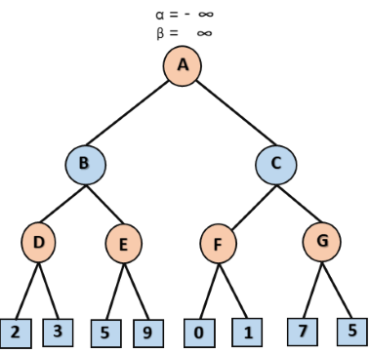
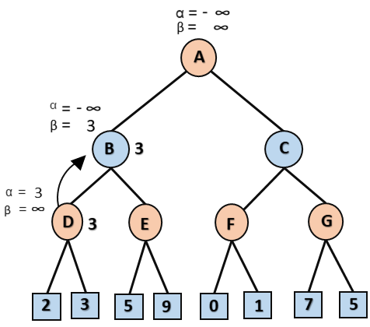
Game Playing (Contd.)
Alpha-Beta Pruning
Step-1
MAX
Step-3
MAX
MIN
MIN
MAX
MAX
Step-2
At Node D, the value of α will be calculated as its turn for Max. The value of α is compared with firstly 2 and then 3, and the max (2, 3) = 3 will be the value of α at node D and node value will also 3

Slide 50
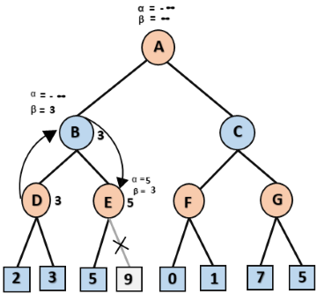
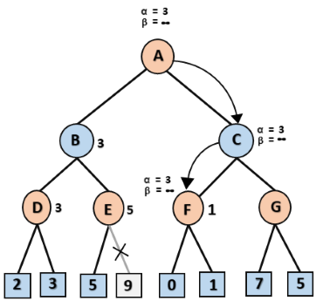
Game Playing (Contd.)
Alpha-Beta Pruning
Step-4
MAX
Step-6
MAX
MIN
MIN
MAX
MAX
Step-5
At next step, algorithm again backtrack the tree, from node B to node A. At node A, the value of alpha will be changed the maximum available value is 3 as max (-∞, 3)= 3, and β= +∞, these two values now passes to right successor of A which is Node C

Slide 51
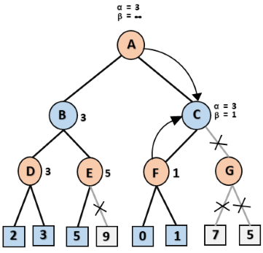
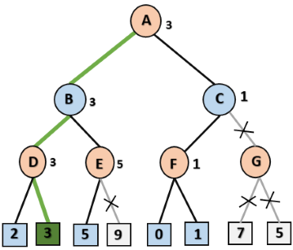
Game Playing (Contd.)
Alpha-Beta Pruning
Step-7
MAX
Step-8
MAX
MIN
MIN
MAX
MAX

Slide 52

Thank You

