Slide 1

Go, change the world
RV College of
Engineering
UNIT -3
Supervised Learning
Decision Tree Classifier
Model Overfitting
Model Selection

Slide 2
UNIT-3 Supervised Learning Basic Concepts, General Framework for Classification

Slide 3
Classification: Definition
Given a collection of records (training set )
Each record is by characterized by a tuple (x,y), where x is the attribute set and y is the class label
x: attribute, predictor, independent variable, input
y: class, response, dependent variable, output
Task:
Learn a model that maps each attribute set x into one of the predefined class labels y

Slide 4
Examples of Classification Task
Task | Attribute set, x | Class label, y
Categorizing email messages | Features extracted from email message header and content | spam or non-spam
Identifying tumor cells | Features extracted from x-rays or MRI scans | malignant or benign cells
Cataloging galaxies | Features extracted from telescope images | Elliptical, spiral, or irregular-shaped galaxies

Slide 5
General Approach for Building Classification Model

Slide 6
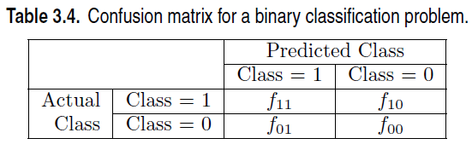



General Approach for Building Classification Model

Slide 7
Classification Techniques
Base Classifiers
Decision Tree based Methods
Rule-based Methods
Nearest-neighbor
Naïve Bayes and Bayesian Belief Networks
Support Vector Machines
Neural Networks, Deep Neural Nets
Ensemble Classifiers
Boosting, Bagging, Random Forests

Slide 8
UNIT-3 : Decision Tree Classifier
A Basic Algorithm to Build a Decision Tree, Methods for Expressing Attribute Test Conditions, Measures for Selecting an Attribute Test Condition, Algorithm for Decision Tree Induction, Characteristics of Decision Tree Classifiers,

Slide 9
Example of a Decision Tree
categorical
categorical
continuous
class
Splitting Attributes
Home Owner
Yes
No
NO
MarSt
Single, Divorced
Married
Income
NO
< 80K
> 80K
NO
YES
Training Data
Model: Decision Tree

Slide 10
Apply Model to Test Data
Test Data
Start from the root of tree.
Home Owner
Yes
No
NO
MarSt
Single, Divorced
Married
Income
NO
< 80K
> 80K
NO
YES

Slide 11
Apply Model to Test Data
Test Data
Home Owner
Yes
No
NO
MarSt
Single, Divorced
Married
Income
NO
< 80K
> 80K
NO
YES

Slide 12
Apply Model to Test Data
Test Data
Home Owner
Yes
No
NO
MarSt
Single, Divorced
Married
Income
NO
< 80K
> 80K
NO
YES

Slide 13
Apply Model to Test Data
Test Data
Home Owner
Yes
No
NO
MarSt
Single, Divorced
Married
Income
NO
< 80K
> 80K
NO
YES

Slide 14
Apply Model to Test Data
Test Data
Home Owner
Yes
No
NO
MarSt
Single, Divorced
Married
Income
NO
< 80K
> 80K
NO
YES

Slide 15
Apply Model to Test Data
Test Data
Home Owner
Yes
No
NO
MarSt
Single, Divorced
Married
Assign Defaulted to “No”
Income
NO
< 80K
> 80K
NO
YES

Slide 16
Another Example of Decision Tree
categorical
categorical
continuous
class
Single, Divorced
MarSt
Married
NO
Home Owner
Yes
No
NO
Income
< 80K
> 80K
NO
YES
There could be more than one tree that fits the same data!

Slide 17
Decision Tree Classification Task
Decision Tree

Slide 18
Decision Tree Induction
Many Algorithms:
Hunt’s Algorithm (one of the earliest)
CART
ID3, C4.5
SLIQ,SPRINT

Slide 19
General Structure of Hunt’s Algorithm
Let D_{t} be the set of training records that reach a node t
General Procedure:
If D_{t} contains records that belong the same class y_{t}, then t is a leaf node labeled as y_{t}
If D_{t} contains records that belong to more than one class, use an attribute test to split the data into smaller subsets. Recursively apply the procedure to each subset.
D_{t}
?

Slide 20
Hunt’s Algorithm
(7,3)
(3,0)
(4,3)
(3,0)
(3,0)
(3,0)
(1,3)
(3,0)
(1,0)
(0,3)

Slide 21
Hunt’s Algorithm
(7,3)
(3,0)
(4,3)
(3,0)
(3,0)
(3,0)
(1,3)
(3,0)
(1,0)
(0,3)

Slide 22
Hunt’s Algorithm
(7,3)
(3,0)
(4,3)
(3,0)
(3,0)
(3,0)
(1,3)
(3,0)
(1,0)
(0,3)

Slide 23
Hunt’s Algorithm
(7,3)
(3,0)
(4,3)
(3,0)
(3,0)
(3,0)
(1,3)
(3,0)
(1,0)
(0,3)

Slide 24
Design Issues of Decision Tree Induction
How should training records be split?
Method for expressing test condition
depending on attribute types
Measure for evaluating the goodness of a test condition
How should the splitting procedure stop?
Stop splitting if all the records belong to the same class or have identical attribute values
Early termination

Slide 25
Methods for Expressing Test Conditions
Depends on attribute types
Binary
Nominal
Ordinal
Continuous

Slide 26
Test Condition for Nominal Attributes
Multi-way split:
Use as many partitions as distinct values.
Binary split:
Divides values into two subsets

Slide 27
Test Condition for Ordinal Attributes
Multi-way split:
Use as many partitions as distinct values
Binary split:
Divides values into two subsets
Preserve order property among attribute values
This grouping violates order property

Slide 28
Test Condition for Continuous Attributes

Slide 29
Splitting Based on Continuous Attributes
Different ways of handling
Discretization to form an ordinal categorical attribute
Ranges can be found by equal interval bucketing, equal frequency bucketing (percentiles), or clustering.
Static – discretize once at the beginning
Dynamic – repeat at each node
Binary Decision: (A < v) or (A ≥ v)
consider all possible splits and finds the best cut
can be more compute intensive

Slide 30
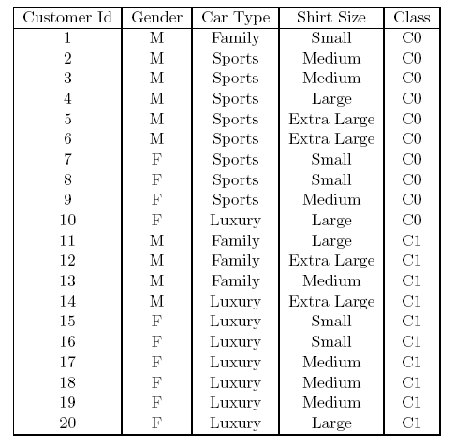
How to determine the Best Split
Before Splitting: 10 records of class 0, 10 records of class 1
Which test condition is the best?

Slide 31
How to determine the Best Split
Greedy approach:
Nodes with purer class distribution are preferred
Need a measure of node impurity:
High degree of impurity
Low degree of impurity

Slide 32
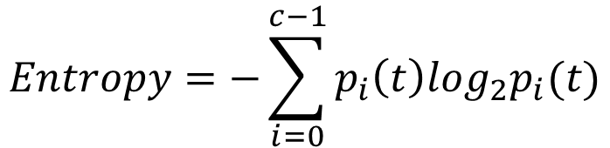
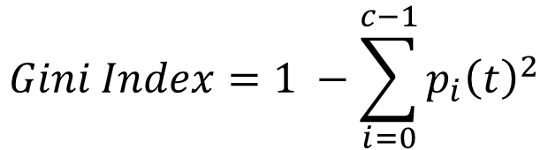
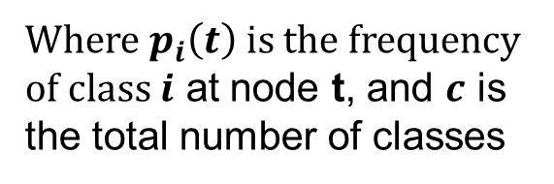
Measures of Node Impurity
Gini Index
Entropy
Misclassification error
$$Gini Index=1 −\sum_{i=0}^{c−1}{p_{i}{\left(t\right)}^{2}}$$
Where $p_{i}\left(t\right)$ is the frequency of class $i$ at node t, and $c$ is the total number of classes
$$Entropy=−\sum_{i=0}^{c−1}{p_{i}\left(t\right)log_{2}p_{i}(t)}$$
$$Classification error={1 −max⁡[p}_{i}(t)]$$

Slide 33
Finding the Best Split
Compute impurity measure (P) before splitting
Compute impurity measure (M) after splitting
Compute impurity measure of each child node
M is the weighted impurity of child nodes
Choose the attribute test condition that produces the highest gain
Gain = P - M or equivalently, lowest impurity measure after splitting (M)

Slide 34
Finding the Best Split
Before Splitting:
P
A?
B?
Yes
No
Yes
No
Node N1
Node N2
Node N3
Node N4
M11
M12
M21
M22
M1
M2
Gain = P – M1 vs P – M2

Slide 35
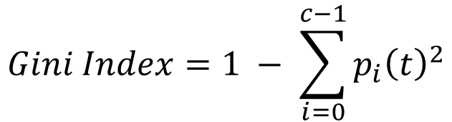
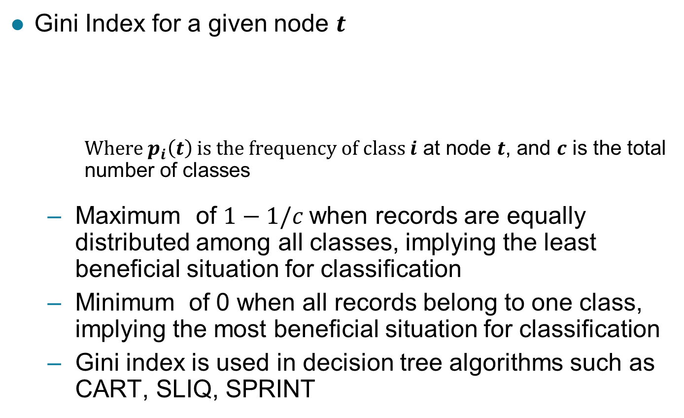
Measure of Impurity: GINI
Gini Index for a given node $t$
Where $p_{i}\left(t\right)$ is the frequency of class $i$ at node $t$, and $c$ is the total number of classes
Maximum of $1−1/c$when records are equally distributed among all classes, implying the least beneficial situation for classification
Minimum of 0 when all records belong to one class, implying the most beneficial situation for classification
Gini index is used in decision tree algorithms such as CART, SLIQ, SPRINT
$$Gini Index=1 − \sum_{i=0}^{c−1}{p_{i}{\left(t\right)}^{2}}$$

Slide 36
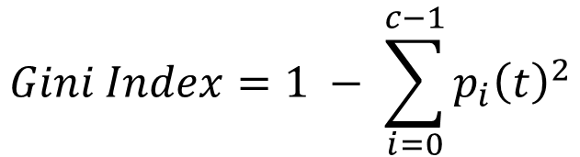
Measure of Impurity: GINI
Gini Index for a given node t :
For 2-class problem (p, 1 – p):
GINI = 1 – p² – (1 – p)² = 2p (1-p)
$$Gini Index=1 − \sum_{i=0}^{c−1}{p_{i}{\left(t\right)}^{2}}$$

Slide 37
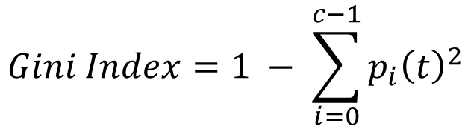
Computing Gini Index of a Single Node
$$Gini Index=1 − \sum_{i=0}^{c−1}{p_{i}{\left(t\right)}^{2}}$$
P(C1) = 0/6 = 0 P(C2) = 6/6 = 1
Gini = 1 – P(C1)² – P(C2)² = 1 – 0 – 1 = 0
P(C1) = 1/6 P(C2) = 5/6
Gini = 1 – (1/6)² – (5/6)² = 0.278
P(C1) = 2/6 P(C2) = 4/6
Gini = 1 – (2/6)² – (4/6)² = 0.444

Slide 38
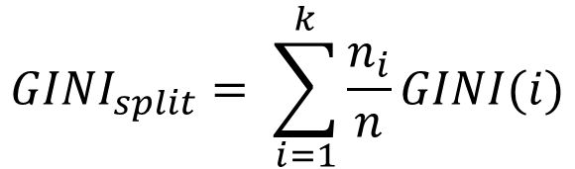

Computing Gini Index for a Collection of Nodes
When a node $p$ is split into $k$ partitions (children)
where, $n_{i}$ = number of records at child $i$,
$n$ = number of records at parent node $p$.
$$GINI_{split}= \sum_{i=1}^{k}{\frac{n_{i}}{n}GINI(i)}$$

Slide 39
Binary Attributes: Computing GINI Index
Splits into two partitions (child nodes)
Effect of Weighing partitions:
Larger and purer partitions are sought
B?
Yes
No
Node N1
Node N2
Gini(N1) = 1 – (5/6)² – (1/6)² = 0.278
Gini(N2) = 1 – (2/6)² – (4/6)² = 0.444
Weighted Gini of N1 N2 = 6/12 * 0.278 + 6/12 * 0.444 = 0.361
Gain = 0.486 – 0.361 = 0.125

Slide 40
Categorical Attributes: Computing Gini Index
For each distinct value, gather counts for each class in the dataset
Use the count matrix to make decisions
Multi-way split
Two-way split
(find best partition of values)
Which of these is the best?

Slide 41
Continuous Attributes: Computing Gini Index
Use Binary Decisions based on one value
Several Choices for the splitting value
Number of possible splitting values = Number of distinct values
Each splitting value has a count matrix associated with it
Class counts in each of the partitions, A ≤ v and A > v
Simple method to choose best v
For each v, scan the database to gather count matrix and compute its Gini index
Computationally Inefficient! Repetition of work.
Annual Income ?
 | ≤ 80 | > 80
Defaulted Yes | 0 | 3
Defaulted No | 3 | 4

Slide 42
Continuous Attributes: Computing Gini Index...
For efficient computation: for each attribute,
Sort the attribute on values
Linearly scan these values, each time updating the count matrix and computing gini index
Choose the split position that has the least gini index
Sorted Values

Slide 43
Continuous Attributes: Computing Gini Index...
For efficient computation: for each attribute,
Sort the attribute on values
Linearly scan these values, each time updating the count matrix and computing gini index
Choose the split position that has the least gini index
Sorted Values
Split Positions

Slide 44
Continuous Attributes: Computing Gini Index...
For efficient computation: for each attribute,
Sort the attribute on values
Linearly scan these values, each time updating the count matrix and computing gini index
Choose the split position that has the least gini index
Sorted Values
Split Positions

Slide 45
Continuous Attributes: Computing Gini Index...
For efficient computation: for each attribute,
Sort the attribute on values
Linearly scan these values, each time updating the count matrix and computing gini index
Choose the split position that has the least gini index
Sorted Values
Split Positions

Slide 46
Continuous Attributes: Computing Gini Index...
For efficient computation: for each attribute,
Sort the attribute on values
Linearly scan these values, each time updating the count matrix and computing gini index
Choose the split position that has the least gini index
Sorted Values
Split Positions

Slide 47
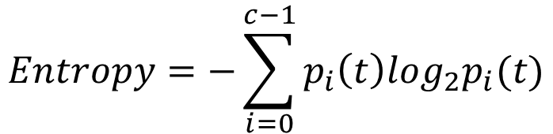
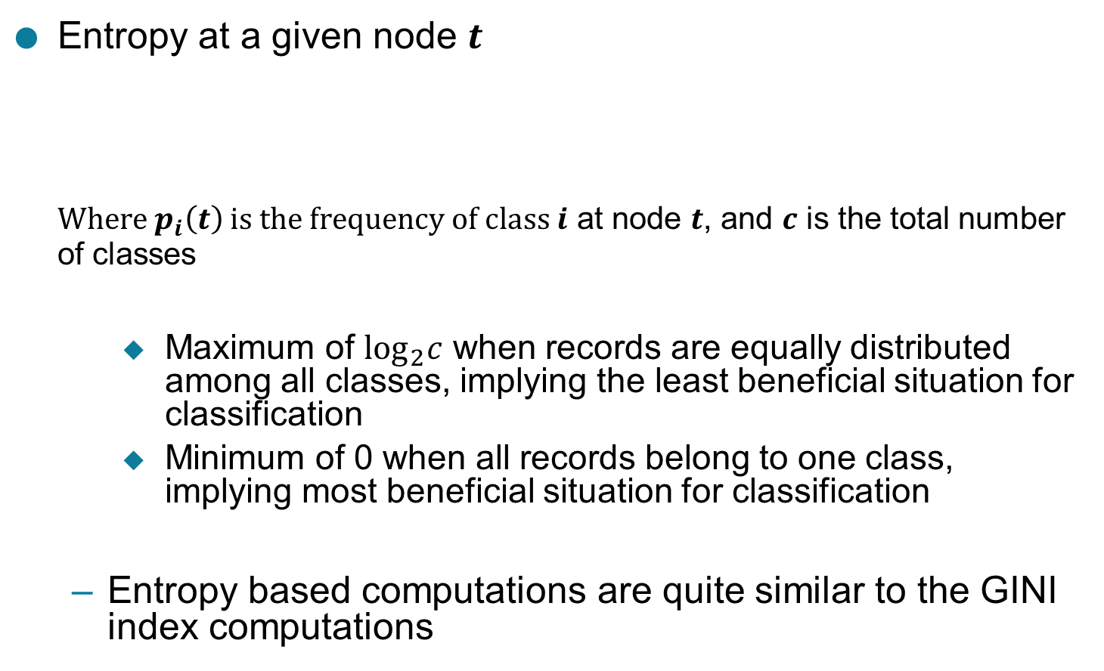
Measure of Impurity: Entropy
Entropy at a given node $t$
Where $p_{i}\left(t\right)$ is the frequency of class $i$ at node $t$, and $c$ is the total number of classes
Maximum of $\log_{2}c$ when records are equally distributed among all classes, implying the least beneficial situation for classification
Minimum of 0 when all records belong to one class, implying most beneficial situation for classification
Entropy based computations are quite similar to the GINI index computations
$$Entropy=−\sum_{i=0}^{c−1}{p_{i}\left(t\right)log_{2}p_{i}(t)}$$

Slide 48
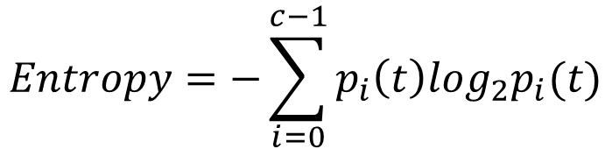
Computing Entropy of a Single Node
$$Entropy=−\sum_{i=0}^{c−1}{p_{i}\left(t\right)log_{2}p_{i}(t)}$$
P(C1) = 0/6 = 0 P(C2) = 6/6 = 1
Entropy = – 0 log 0 – 1 log 1 = – 0 – 0 = 0
P(C1) = 1/6 P(C2) = 5/6
Entropy = – (1/6) log₂ (1/6) – (5/6) log₂ (1/6) = 0.65
P(C1) = 2/6 P(C2) = 4/6
Entropy = – (2/6) log₂ (2/6) – (4/6) log₂ (4/6) = 0.92

Slide 49
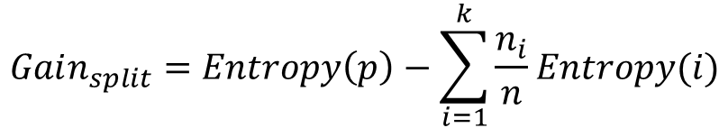
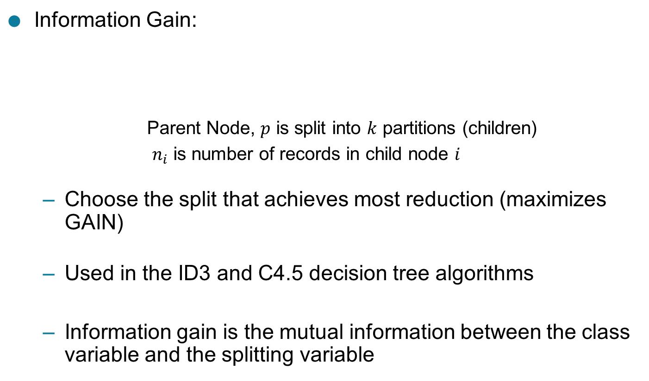
Computing Information Gain After Splitting
Information Gain:
Parent Node, $p$ is split into $k$ partitions (children)
$n_{i}$ is number of records in child node $i$
Choose the split that achieves most reduction (maximizes GAIN)
Used in the ID3 and C4.5 decision tree algorithms
Information gain is the mutual information between the class variable and the splitting variable
$$Gain_{split}=Entropy\left(p\right)−\sum_{i=1}^{k}{\frac{n_{i}}{n}Entropy(i)}$$

Slide 50
Problem with large number of partitions
Node impurity measures tend to prefer splits that result in large number of partitions, each being small but pure
Customer ID has highest information gain because entropy for all the children is zero

Slide 51
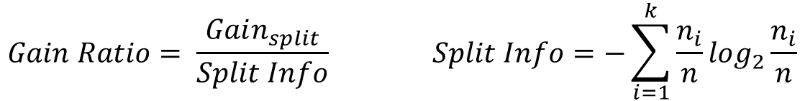
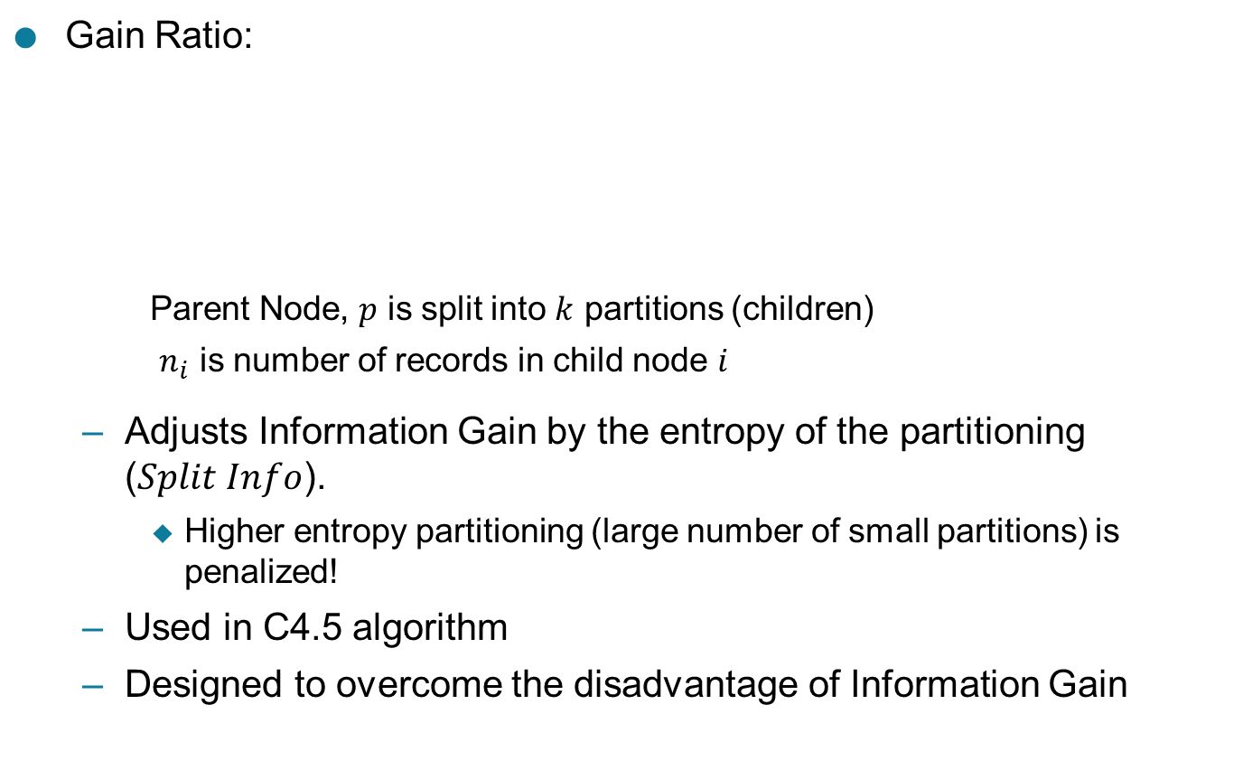
Gain Ratio
Gain Ratio:
Parent Node, $p$ is split into $k$ partitions (children)
$n_{i}$ is number of records in child node $i$
Adjusts Information Gain by the entropy of the partitioning ($Split Info$).
Higher entropy partitioning (large number of small partitions) is penalized!
Used in C4.5 algorithm
Designed to overcome the disadvantage of Information Gain
$$Gain Ratio= \frac{Gain_{split}}{Split Info} Split Info=−\sum_{i=1}^{k}{\frac{n_{i}}{n}log_{2}}\frac{n_{i}}{n}$$

Slide 52

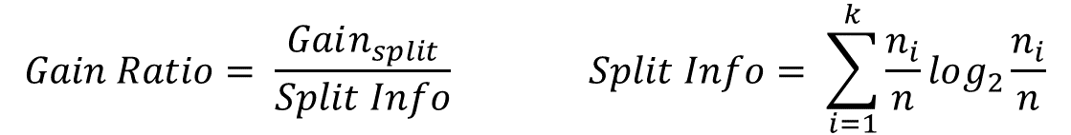
Gain Ratio
Gain Ratio:
Parent Node, $p$ is split into $k$ partitions (children)
$n_{i}$ is number of records in child node $i$
$$Gain Ratio= \frac{Gain_{split}}{Split Info} Split Info= \sum_{i=1}^{k}{\frac{n_{i}}{n}log_{2}}\frac{n_{i}}{n}$$
SplitINFO = 1.52
SplitINFO = 0.72
SplitINFO = 0.97

Slide 53

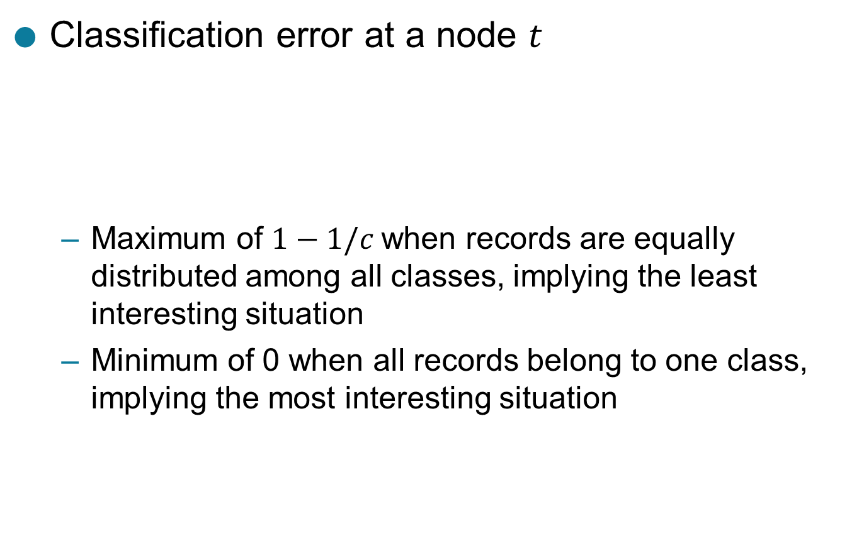
Measure of Impurity: Classification Error
Classification error at a node $t$
Maximum of $1−1/c$when records are equally distributed among all classes, implying the least interesting situation
Minimum of 0 when all records belong to one class, implying the most interesting situation
$$Error\left(t\right)=\underset{ i}{1 −max}⁡[p_{i}\left(t\right)]$$

Slide 54

Computing Error of a Single Node
$$Error\left(t\right)=\underset{ i}{1 −max}⁡[p_{i}\left(t\right)]$$
P(C1) = 0/6 = 0 P(C2) = 6/6 = 1
Error = 1 – max (0, 1) = 1 – 1 = 0
P(C1) = 1/6 P(C2) = 5/6
Error = 1 – max (1/6, 5/6) = 1 – 5/6 = 1/6
P(C1) = 2/6 P(C2) = 4/6
Error = 1 – max (2/6, 4/6) = 1 – 4/6 = 1/3

Slide 55
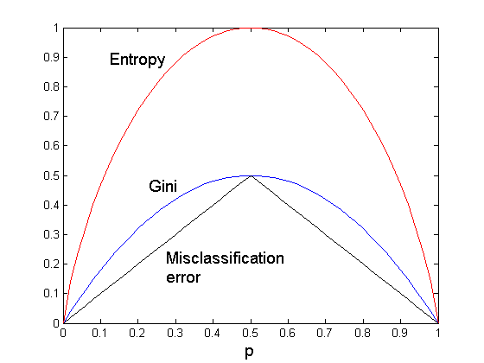
Comparison among Impurity Measures
For a 2-class problem:

Slide 56
Misclassification Error vs Gini Index
A?
Yes
No
Node N1
Node N2
Gini(N1) = 1 – (3/3)² – (0/3)² = 0
Gini(N2) = 1 – (4/7)² – (3/7)² = 0.489
Gini(Children) = 3/10 * 0 + 7/10 * 0.489 = 0.342
Gini improves but error remains the same!!

Slide 57
Misclassification Error vs Gini Index
A?
Yes
No
Node N1
Node N2
Misclassification error for all three cases = 0.3 !

Slide 58
Decision Tree Based Classification
Advantages:
Relatively inexpensive to construct
Extremely fast at classifying unknown records
Easy to interpret for small-sized trees
Robust to noise (especially when methods to avoid overfitting are employed)
Can easily handle redundant attributes
Can easily handle irrelevant attributes (unless the attributes are interacting)
Disadvantages: .
Due to the greedy nature of splitting criterion, interacting attributes (that can distinguish between classes together but not individually) may be passed over in favor of other attributed that are less discriminating.
Each decision boundary involves only a single attribute

Slide 59
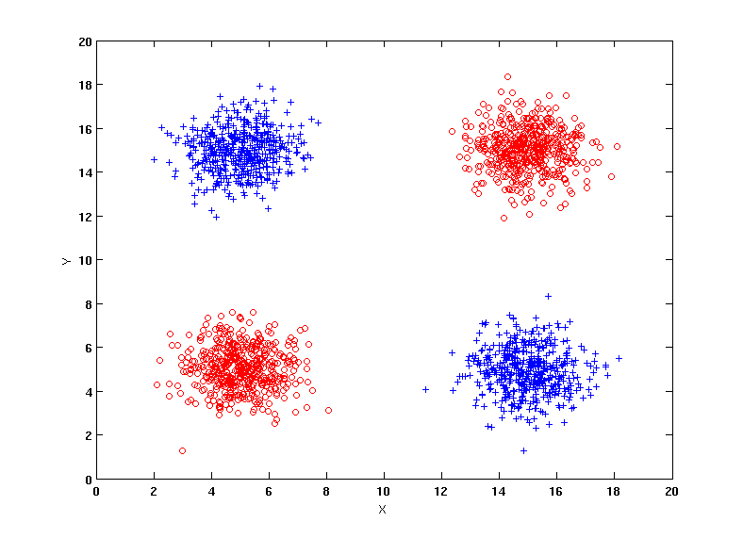
Handling interactions
+ : 1000 instances
o : 1000 instances
Entropy (X) : 0.99
Entropy (Y) : 0.99
Y
X

Slide 60
Handling interactions

Slide 61
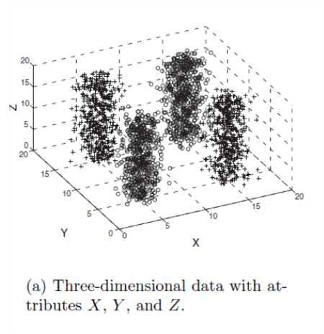
Handling interactions given irrelevant attributes
+ : 1000 instances
o : 1000 instances
Adding Z as a noisy attribute generated from a uniform distribution
Entropy (X) : 0.99
Entropy (Y) : 0.99
Entropy (Z) : 0.98
Attribute Z will be chosen for splitting!
Y
X

Slide 62
UNIT-3: Model Overfitting
Reasons for Model Overfitting

Slide 63
Classification Errors
Training errors: Errors committed on the training set
Test errors: Errors committed on the test set
Generalization errors: Expected error of a model over random selection of records from same distribution

Slide 64
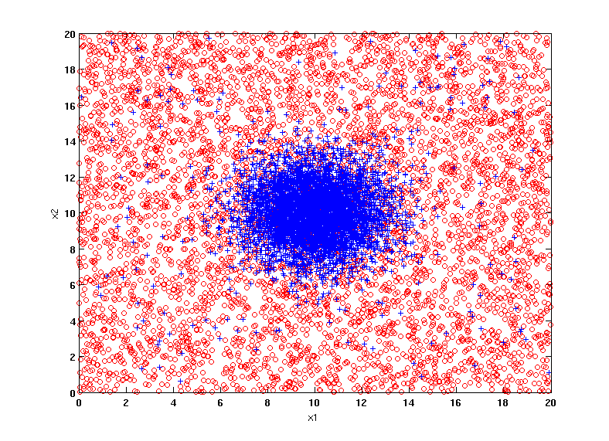
Example Data Set
Two class problem:
+ : 5400 instances
5000 instances generated from a Gaussian centered at (10,10)
400 noisy instances added
o : 5400 instances
Generated from a uniform distribution
10 % of the data used for training and 90% of the data used for testing

Slide 65
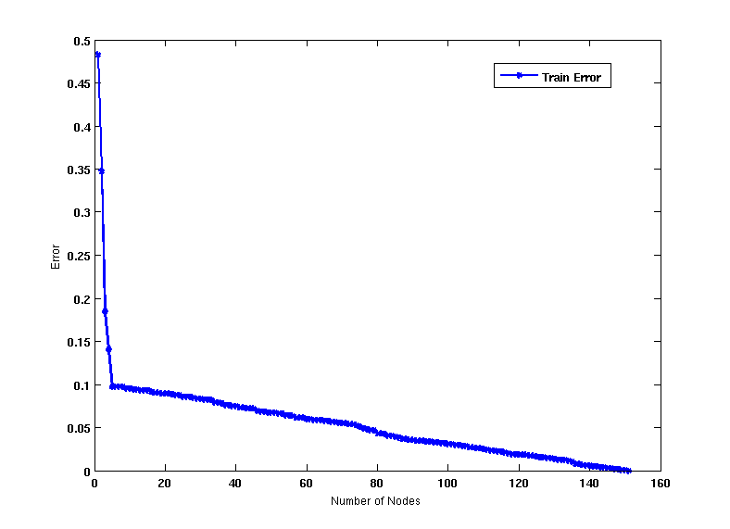
Increasing number of nodes in Decision Trees

Slide 66
Decision Tree with 4 nodes
Decision Tree
Decision boundaries on Training data

Slide 67
Decision Tree with 50 nodes
Decision Tree
Decision Tree
Decision boundaries on Training data

Slide 68
Which tree is better?
Decision Tree with 4 nodes
Which tree is better ?
Decision Tree with 50 nodes

Slide 69
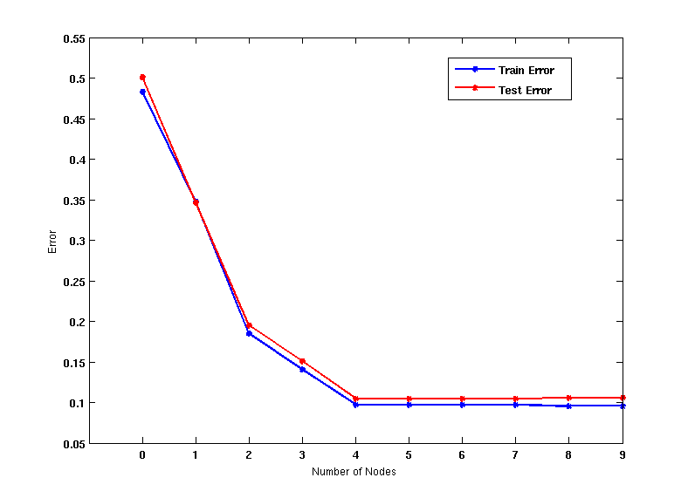
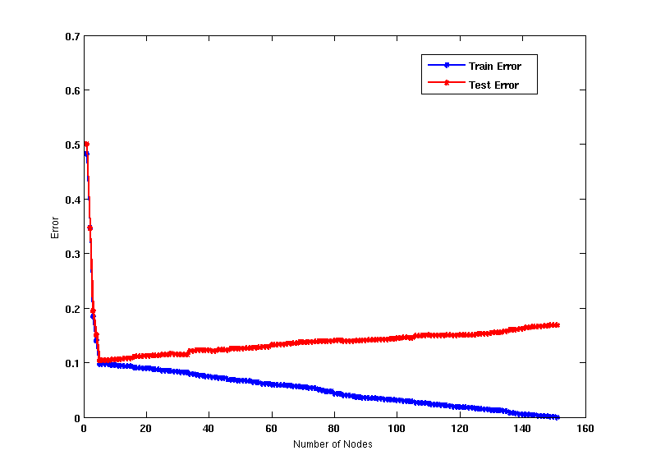
Model Underfitting and Overfitting
As the model becomes more and more complex, test errors can start increasing even though training error may be decreasing
Underfitting: when model is too simple, both training and test errors are large
Overfitting: when model is too complex, training error is small but test error is large

Slide 70
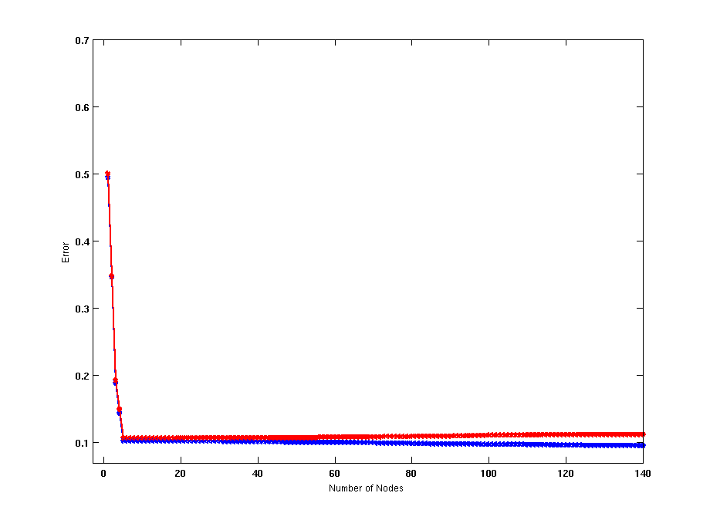
Model Overfitting – Impact of Training Data Size
Using twice the number of data instances
Increasing the size of training data reduces the difference between training and testing errors at a given size of model

Slide 71
Model Overfitting – Impact of Training Data Size
Decision Tree with 50 nodes
Decision Tree with 50 nodes
Using twice the number of data instances
Increasing the size of training data reduces the difference between training and testing errors at a given size of model

Slide 72
Reasons for Model Overfitting
Not enough training data
High model complexity
Multiple Comparison Procedure

Slide 73
Effect of Multiple Comparison Procedure
Consider the task of predicting whether stock market will rise/fall in the next 10 trading days
Random guessing:
P(correct) = 0.5
Make 10 random guesses in a row:
Day 1 | Up
Day 2 | Down
Day 3 | Down
Day 4 | Up
Day 5 | Down
Day 6 | Down
Day 7 | Up
Day 8 | Up
Day 9 | Up
Day 10 | Down

Slide 74
Effect of Multiple Comparison Procedure
Approach:
Get 50 analysts
Each analyst makes 10 random guesses
Choose the analyst that makes the most number of correct predictions
Probability that at least one analyst makes at least 8 correct predictions

Slide 75
Effect of Multiple Comparison Procedure
Many algorithms employ the following greedy strategy:
Initial model: M
Alternative model: M’ = M ∪ γ, where γ is a component to be added to the model (e.g., a test condition of a decision tree)
Keep M’ if improvement, Δ(M,M’) > α
Often times, γ is chosen from a set of alternative components, Γ = {γ₁, γ₂, …, γ_{k}}
If many alternatives are available, one may inadvertently add irrelevant components to the model, resulting in model overfitting

Slide 76
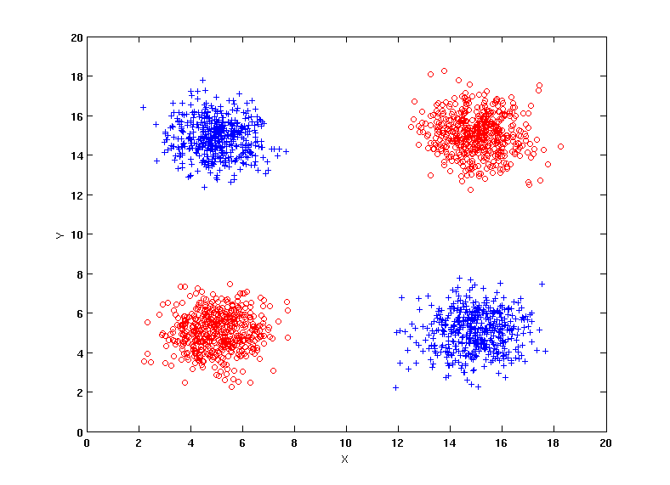
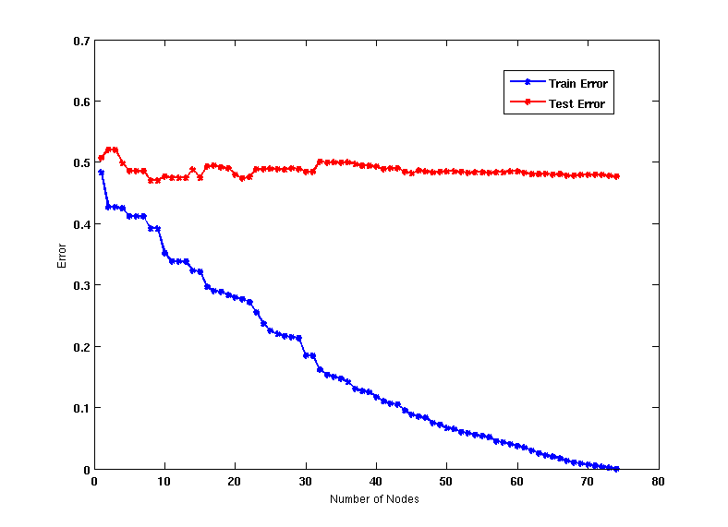
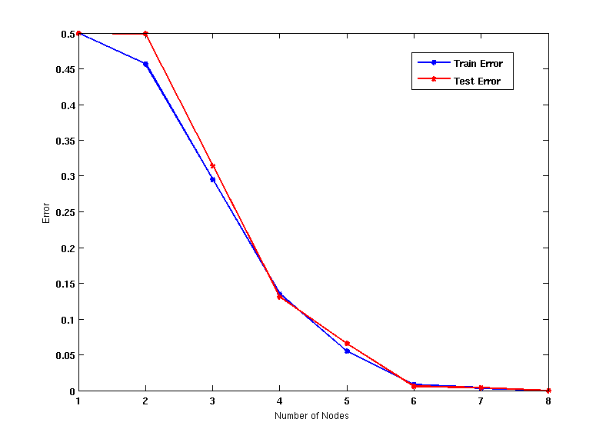
Effect of Multiple Comparison - Example
Use additional 100 noisy variables generated from a uniform distribution along with X and Y as attributes.
Use 30% of the data for training and 70% of the data for testing
Using only X and Y as attributes

Slide 77
Notes on Overfitting
Overfitting results in decision trees that are more complex than necessary
Training error does not provide a good estimate of how well the tree will perform on previously unseen records
Need ways for estimating generalization errors

Slide 78
UNIT-3 : Model Selection
Using a Validation Set, Incorporating Model Complexity, Estimating Statistical Bounds, Model Selection for Decision Trees, Model Evaluation

Slide 79
Model Selection
Performed during model building
Purpose is to ensure that model is not overly complex (to avoid overfitting)
Need to estimate generalization error
Using Validation Set
Incorporating Model Complexity

Slide 80
Model Selection: Using Validation Set
Divide training data into two parts:
Training set:
use for model building
Validation set:
use for estimating generalization error
Note: validation set is not the same as test set
Drawback:
Less data available for training

Slide 81
Model Selection: Incorporating Model Complexity
Rationale: Occam’s Razor
Given two models of similar generalization errors, one should prefer the simpler model over the more complex model
A complex model has a greater chance of being fitted accidentally
Therefore, one should include model complexity when evaluating a model
Gen. Error(Model) = Train. Error(Model, Train. Data) +
x Complexity(Model)

Slide 82
Estimating the Complexity of Decision Trees
Pessimistic Error Estimate of decision tree T with k leaf nodes:
err(T): error rate on all training records
Ω: trade-off hyper-parameter (similar to )
Relative cost of adding a leaf node
k: number of leaf nodes
N_{train}: total number of training records

Slide 83
Estimating the Complexity of Decision Trees: Example
e(T_{L}) = 4/24
e(T_{R}) = 6/24
Ω = 1
e_{gen}(T_{L}) = 4/24 + 1*7/24 = 11/24 = 0.458
e_{gen}(T_{R}) = 6/24 + 1*4/24 = 10/24 = 0.417

Slide 84
Estimating the Complexity of Decision Trees
Resubstitution Estimate:
Using training error as an optimistic estimate of generalization error
Referred to as optimistic error estimate
e(T_{L}) = 4/24
e(T_{R}) = 6/24

Slide 85
Minimum Description Length (MDL)
Cost(Model,Data) = Cost(Data|Model) + x Cost(Model)
Cost is the number of bits needed for encoding.
Search for the least costly model.
Cost(Data|Model) encodes the misclassification errors.
Cost(Model) uses node encoding (number of children) plus splitting condition encoding.

Slide 86
Model Selection for Decision Trees
Pre-Pruning (Early Stopping Rule)
Stop the algorithm before it becomes a fully-grown tree
Typical stopping conditions for a node:
Stop if all instances belong to the same class
Stop if all the attribute values are the same
More restrictive conditions:
Stop if number of instances is less than some user-specified threshold
Stop if class distribution of instances are independent of the available features (e.g., using χ ² test)
Stop if expanding the current node does not improve impurity measures (e.g., Gini or information gain).
Stop if estimated generalization error falls below certain threshold

Slide 87
Model Selection for Decision Trees
Post-pruning
Grow decision tree to its entirety
Subtree replacement
Trim the nodes of the decision tree in a bottom-up fashion
If generalization error improves after trimming, replace sub-tree by a leaf node
Class label of leaf node is determined from majority class of instances in the sub-tree

Slide 88
Example of Post-Pruning
Training Error (Before splitting) = 10/30
Pessimistic error = (10 + 0.5)/30 = 10.5/30
Training Error (After splitting) = 9/30
Pessimistic error (After splitting)
= (9 + 4 × 0.5)/30 = 11/30
PRUNE!
Class = Yes | 20
Class = No | 10
Error = 10/30
Class = Yes | 8
Class = No | 4
Class = Yes | 3
Class = No | 4
Class = Yes | 4
Class = No | 1
Class = Yes | 5
Class = No | 1

Slide 89
Examples of Post-pruning

Slide 90
Model Evaluation
Purpose:
To estimate performance of classifier on previously unseen data (test set)
Holdout
Reserve k% for training and (100-k)% for testing
Random subsampling: repeated holdout
Cross validation
Partition data into k disjoint subsets
k-fold: train on k-1 partitions, test on the remaining one
Leave-one-out: k=n

Slide 91
Cross-validation Example
3-fold cross-validation

Slide 92
Variations on Cross-validation
Repeated cross-validation
Perform cross-validation a number of times
Gives an estimate of the variance of the generalization error
Stratified cross-validation
Guarantee the same percentage of class labels in training and test
Important when classes are imbalanced and the sample is small
Use nested cross-validation approach for model selection and evaluation

