Slide 1
Planning & Decision Making

Slide 2
Planning: An Overview
Planning is a particular kind of decision making that addresses the specific future that managers desire for their organizations.
Planning is the major activity in the management process. It is a locomotive that drives a train of organizing, leading and controlling activities.
Planning is not a single event, with a clear beginning and end. It is an ongoing process that reflects and adapts to changes in the environment surrounding each organization.
Deciding on actions and responses to others’ actions is the continual planning challenge for the managers.
Strategic management is an ongoing practice of establishing a broad program of organizational goals and the means to achieve them.

Slide 3
Planning: An Overview
Goals in an organization are important for four reasons:
Goals provide a sense of direction
Goals focus our efforts
Goals guide our plans and decisions
Goals help us evaluate our process

Slide 4
The Importance of Planning at Organizations
In organizations, planning is the process of setting goals and choosing the means to achieve those goals.
Without a plan;
Managers cannot know how to organize people and resources effectively.
They may not even have a clear idea of what they need to organize.
They cannot lead with confidence or expect others to follow them.
Managers and their followers have little chance of achieving their goals or knowing when and where they stray from their path.
Too often, faulty plans affect the future of the entire organization.

Slide 5
The Hierarchy of Organization Plans
Organizations are typically managed according to two types of plans.
Strategic plans are designed by high-ranking managers and define the broad goals for the organization. They deal with relationships between people at an organization and people acting at other organizations.
Operational plans contain details for carrying out, or implementing, those strategic plans in day-to-day activities. They deal with people within one organization.
Mission statement is a broad goal based on manager’s assumptions about the organization’s purpose, competencies, and place in the world. It is a relatively permanent part of an organization’s identity and can do much to unify and motivate members of the organization.

Slide 6
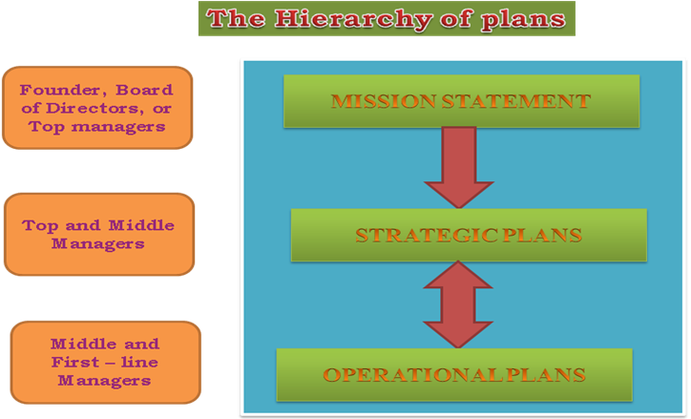

Slide 7
Strategic & Operational Plan
Strategic and operational plans differ in three major ways:
Time Horizons
Strategic plans tend to look ahead several years or even decades.
For operational plans, a year is often the relevant time period.
Scope
Strategic plans affect a wide range of organizational activities, whereas operational plans have a narrow and more limited scope.
The number of relationships involved is the key difference here. Hence it is distinguished as strategic goals and operational objectives.
Degree of Detail
Often strategic goals are stated in terms that look simplistic and generic. But this breadth is necessary to direct people at organizations to think of the whole of their organization’s operations.
On the other hand, operational plans, as derivatives of strategic plans, are stated in relatively finer detail.

Slide 8
The Evolution of the Concept of Strategy
Strategy as the Grand Plan
The concept of strategy is ancient. The word itself comes from the Greek strategeia, which means the art or science of being a General.
Effective Greek generals needed to lead an army, win and hold territory, protect cities from invasion, wipe out the enemy and so forth.
Each kind of objective required a different deployment of resources. Likewise, an army’s strategy could be defined as the pattern of actual actions that it took in response to the enemy.
Effective Generals had to determine the right liens of supply, decide when to fight and when not to fight, and manage the army’s relationship with citizens, politicians and diplomats.
Effective Generals not only had to plan but had to act as well. The concept of strategy had both a planning component and a decision making or action component. Taken together these two concepts form the basis of the ‘grand’ strategy plan.

Slide 9
The Evolution of the Concept of Strategy
The Rise of Strategic Management
Since War II, the idea emerged that strategic planning and acting on those plans constitute a separate management process, the process called as strategic management.
In 1962, business historian Alfred D Chandler proposed that ‘strategy’ be defined as: The determination of the basic long term goals and objective of an enterprise, and the adoption of courses of action and the allocation of resources necessary or carrying out these goals.
Chandler stressed three key elements:
Courses of action for attaining objectives;
The process of seeking key ideas (rather than routinely implementing existing policy); and
How strategy is formulated, not just what that strategy turns out to be.

Slide 10
The Evolution of the Concept of Strategy
The Strategic Management Approach
In 1978, Dan Schendel and Charles Hofer created a composite definition of strategic management. This was based on the principle that the overall design of an organization can be described only if the attainment of objectives is added to policy and strategy as key factors in the strategic management process.
In their synthesis, Hofer and Schendel focused on four key aspects of strategic management.
The first is, Goal Setting.
The next step is Strategy Formulation based on these goals.
Then to implement the strategy, there is a shift from analysis to Administration - the task of achieving predetermined goals. Key factors at this stage are the organization’s internal “political” processes and individual reactions, which can force the revision of strategy.
The final task, Strategic control, gives managers feedback on their progress. Negative feedback of course, can touch off a new cycle of strategic planning.

Slide 11
The Evolution of the Concept of Strategy
The Strategic Management Process
Strategic management provides a disciplined way for managers to make sense of the environment in which their organization operates, and then to act. In broad terms, two phases are involved:
Strategic planning is the name we customarily give to the sense making activity. This includes both the goal setting and the strategy formulation processes.
Strategy implementation is the name we customarily give to actions based on that kind of planning. This stage includes administration and strategic control stages.

Slide 12
The Evolution of the Concept of Strategy
STRATEGIC MANAGEMENT PROCESS
GOAL SETTING
Strategic Planning
STRATEGY FORMULATION
ADMINISTRATION
Strategy Implementation
STRATEGIC CONTROL

Slide 13
Levels of Strategy
Corporate Level Strategy
Corporate level strategy is formulated by top management to oversee the interests and operations of organizations made up of more than one line of business.
The major questions at this level are these:
What kinds of business should the company be engaged in?
What are the goals and expectations for each business?
How should resources be allocated to reach these goals?

Slide 14
Levels of Strategy
Business Unit Strategy
Business unit strategy (also called line of business strategy) is concerned with managing the interest and operations of a particular line of business.
It deals with questions such as:
How will the business compete within its market? What products/services should it offer?
Which customers does it seek to serve?
How will resources be distributed within the business?
Business unit strategy attempts to determine what approach to its market the business should take, and how it should conduct itself, given its resources and the conditions of the market.
One approach to dealing with this problem is to create strategic business units (SBUs).
In this system of organizations various business activities that produce a particular type of product or service are grouped and treated as a single business unit.
The corporate level provides a set of guidelines for the SBUs which develop their own strategies on the business unit level.
The corporate level then reviews the SBU plans and negotiates changes if necessary.

Slide 15
Levels of Strategy
Functional Level Strategy
Functional - level strategies create a framework for managers in each function - such as marketing or production to carry out business unit strategies and corporate strategies.
This functional - level strategy completes the hierarchy of strategies. Operational plans follow from functional level strategies.

Slide 16
Three levels of strategy
MULTIBUSINESS CORPORATION
STRATEGIC BUSINESS UNIT
STRATEGIC BUSINESS UNIT
STRATEGIC BUSINESS UNIT
RESEARCH & DEVELOPMENT
PRODUCTIVITY / OPERATIONS
MARKETING
FINANCE
Corporate – level Strategy
Business unit Strategy
Functional – level Strategy

Slide 17
Hierarchy of strategic and operational plans at a Multi – Business Organization
CORPORATE STRATEGY
BUSINESS UNIT STRATEGY
FUNCTIONAL – LEVEL STRATEGY
STRATEGIC CONTROL

Slide 18
The Content of Corporate Strategy
Corporate strategy is an idea about how people at an organization will interact with people at other organizations overtime.
It is very important to understand that a corporate strategy says something of substance that guides people in their day-to-day work over an extended period of time.
Quality is a part of corporate strategy – Linking Total Quality Management program to a clear strategic goal.

Slide 19
The Corporate Portfolio Approach
In this approach, top management evaluates each of the corporation’s various business units with respect to the marketplace and the corporation’s internal makeup.
When all the business units have been evaluated, an appropriated strategic role is developed for each unit with the goal of improving the overall performance of the organization.
The corporate portfolio approach is rational and analytical, is guided primarily by market opportunities, and tends to be initiated and controlled by top management only.
One of the best-known examples of the corporate portfolio approach is the portfolio framework advocated by the Boston consulting Group. This frame work is also known as the BCG Matrix.
The BCG approach to analyzing a corporate portfolio of businesses focuses on three aspects of each particular businesses unit: its sales, the growth of its market, and whether it absorbs or produces cash in its operations.
Its goal is to develop a balance among business units that use up cash and those that supply cash.

Slide 20




The Corporate Portfolio Approach
THE BCG MATRIX
STAR
Modest
+ or –
Cash flow
QUESTION MARK
Large
Negative
Cash flow
HIGH
MARKET GROWTH RATE
CASH COW
Large
Positive
Cash flow
DOG
Modest
+ or –
Cash flow
LOW
HIGH
LOW
RELATIVE MARKET SHARE

Slide 21
Five Forces Model
Another well known approach to corporate strategy is Michael Porter’s “five forces” model.
In porter’s view, an organization’s ability to compete in a given market is determined by that organization’s technical and economic resources, as well as by five environmental “forces”, each of which threatens the organization’s venture into a new market.
Porter’s five forces exhibits all relationships between the managers at a given organization and people acting at other organizations.
These five forces are:
Threat of new entrants
Bargaining power of buyers (customers)
Bargaining power of suppliers
Threat of substitute products
Rivalry among competitors

Slide 22
PORTER’S SUMMARY OF FORCES GOVERNING INDUSTRIAL COMPETITION
Threat of new entrants
THE INDUSTRY
Jockeying for position among current competitors
Bargaining power of suppliers
Bargaining power of customers
Threat of Substitute products or services

Slide 23
Matching Structure and Strategy
Successful implementation depends in part on how the organization’s activities are divided, organized and coordinated – in short, on the structures of the organization.
The chances that an organization’s strategy will succeed are far greater when its structure matches its strategy.
Chandler’s Thesis
Although, the organizations changed their growth strategies to suit technological, economic, and demographic changes; new strategies created administrative problems and economic inefficiencies.
Structural changes were needed to solve those problems and to maximize economic performance. Thus, Chandler concluded that organizational structure followed and reflected the growth strategy of the firm.

Slide 24
Matching Structure and Strategy
According to Chandler, organizations pass through three stages of development, moving from a unit structure, to a functional structure, and then to a multidivisional structure.
At first, organizations are small. There is usually a single location, a single product, and a single entrepreneurial decision maker.
As an organization grows, however, increased volume and additional locations eventually create new challenges. The organization then becomes a unit firm, with several field units and an administrative office to handle coordination, specialization, and standardization among the units.
The next step is vertical integration. The organization keeps the original product but broadens its scope and strives for economies of scale by acquiring a supplier of raw materials and components or a distributor of finished goods.
However, vertical integration creates new problems in moving goods and materials through the organization’s various functions. Therefore, the organization evolves into a functional organization, with finance, marketing, production, and other subdivisions and formalized budgeting and planning systems.
In the third stage, an organization expands into different industries and diversifies its products. This phenomenon poses a significant new challenge: selecting products and industries in which to invest the organization’s capital. The result is the multidivisional firm, which operates almost as a collection of smaller businesses.

Slide 25
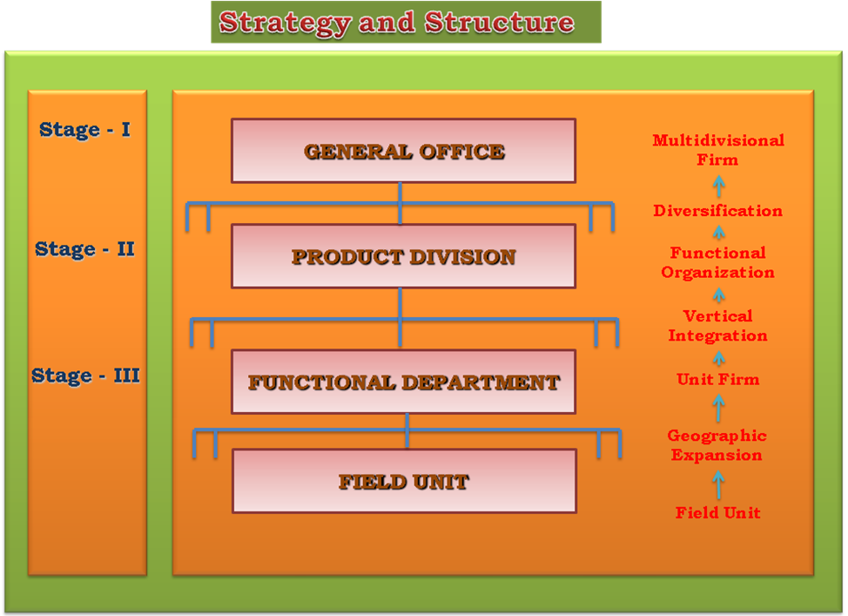

Slide 26
The Seven – S Model
The consulting firm of McKinsey & Co proposed the Seven-S Model for successful strategy implementation. Each of these factors is equally important and interacts with all other factors. Any number of circumstances may dictate, which of the factors will be the driving force in the execution of any particular strategy.
Structure
Strategy
Systems
Style
Staff
Skills
Superordinate Goals

Slide 27
The Seven – S Model
Structure
Strategy
Syatems
Superordinate
Goals
Skills
Style
Staff

Slide 28
Institutionalizing Strategy
To institutionalize a business strategy, business leaders must also develop a system of values, norms, roles and groups that will support the accomplishment of strategic goals.
So, strategy is institutionalized if it is connected to the culture, the quality system, and the other driving forces in the organization.
Another aspect of organizational life that is also undergoing increasing institutionalization is an emphasis on ethics development.
Both shift organizational attention from detection and control to coordination and strategic impact.
The ultimate outcome of this shift in focus is an enhanced quality of work environment for employees and increased quality of products and services for customers.

Slide 29
Institutionalizing Strategy
The Role of the CEO
Chief Executive Officers (CEOs) spend most of their time developing and guiding strategy; their personal goals and values inevitably shape organizational strategy.
Their role in strategy formulation makes CEOs especially important to strategy implementation. First, they interpret strategy, acting as final judges when managers disagree on implementation.
Second, CEOs enact through their words and actions - the seriousness of an organization’s commitment to a strategy.
Third, CEOs motivate, providing intangible incentives beyond pay or bonuses. By appealing to members’ values, beliefs, and loyalties, CEOs can mobilize support for a strategy.

Slide 30
Institutionalizing Strategy
Culture and Strategy
When an organization’s culture is consistent with its strategy, the implementation of strategy is eased considerably.
The concept of “adaptable cultures” is an attempt to build organizational culture on a foundation of paying attention to key stakeholders such as employees and customers, thus ensuring that the culture can change when the organization’s strategy must change.
It is impossible to successfully implement a strategy that contradicts the organization’s culture.

Slide 31
Operationalizing Strategy
If strategies set the general goal and course of action for organizations, operational plans provide the details needed to incorporate strategic plans into the organization’s day to day operations.
Operational plans fall into two general classes:
Single use plans are detailed course of action used once or only occasionally to solve a problem that does not occur repeatedly.
Standing plans, in contrast, are standardized approaches or set of decisions used by managers to deal with recurring or organizational activities.

Slide 32
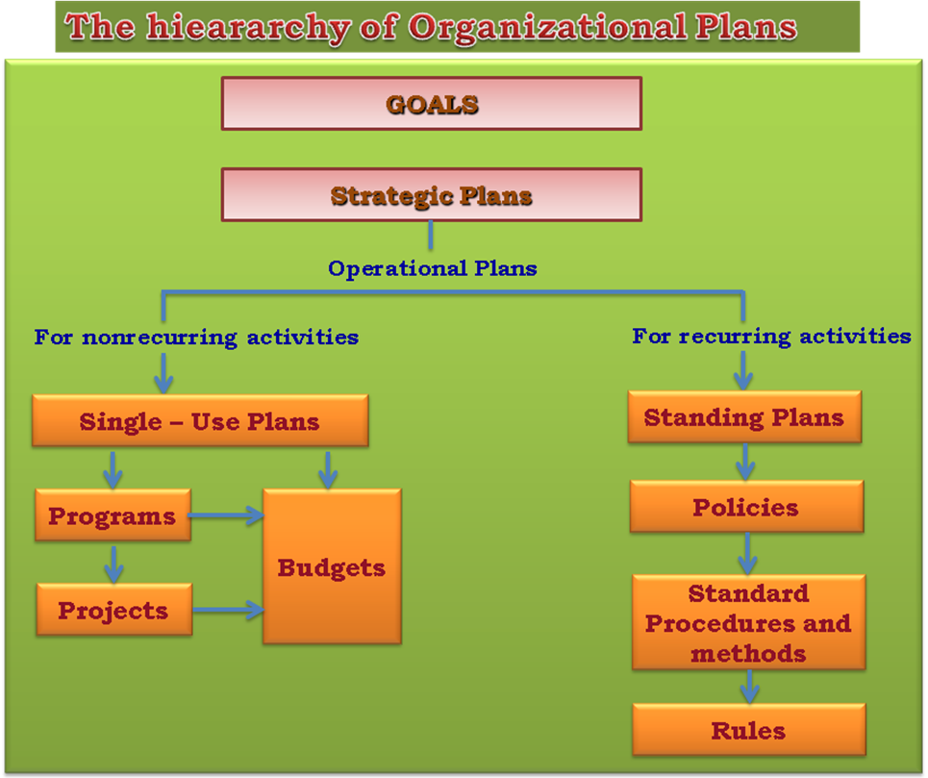

Slide 33
Single Use Plans
Program: A single use plan that covers a relatively large set of organizational activities and specifies major steps, their order and timing, and the unit responsible for each step.
Project: The smaller and separate portions of the programs; they are limited in scope and contain distinct directives concerning assignments and time.
Budgets: Formal quantitative statements of the resources allocated to specific programs or projects for a given period.

Slide 34
Standing Plans
Policy: Establishes general guidelines for decision making.
Procedure: Contains detailed guidelines for handling organizational actions that occur regularly.
Rules: Details specific actions to be taken in a given situation.

Slide 35
Management By Objectives
Management by objectives (MBO) goes beyond setting annual objectives for organizational units to setting performance goals for individual employees.
MBO refers to a formal set of procedures that begins with goal setting and continues through performance review.
Managers and those they supervise act together to set common goals.
Each person’s major areas of responsibility are clearly defined in terms of measurable expected results or “objectives” used by staff members in planning their work, and by both staff members and their managers for monitoring progress.
Performance appraisals are conducted jointly on a continuous basis, with provisions for regular periodic reviews.

Slide 36
Management By Objectives
The heart of MBO is the objectives, which spell out the individual action needed to fulfill the unit’s functional strategy and annual objectives.
MBO provides a way to integrate and focus the efforts of all organization members on the goals of higher management and overall organizational strategy.
Another key to MBO is its insistence on the active involvement of managers and staff members at every organizational level.
Managers at every level help set objectives for those at levels higher than their own, in the belief that this would give them a better understanding of the broader strategy of the company and how their own specific objectives relate to the overall picture.

Slide 37
Elements of the MBO System
Commitment to the program
Top level goal setting
Individual goals
Participation
Autonomy in implementation of plans
Performance review

Slide 38
Evaluation of MBO
This focuses on three key concepts: specific goal setting, feedback on performance, and participation, to determine whether the optimism about MBO was justified.
Individuals, who are successful in achieving the goals they have set, tend to aim for increased performance.
Employees who receive specific and timely feedback perform better, and those who participate in goal setting show higher performance levels.
The very process of participation leads to increased communication and understanding between managers and those they supervise.

Slide 39
Reward Systems
Rewards and incentives contribute to strategy implementation by shaping individual and group behavior.
Well designed incentive plans are consistent with an organization’s objectives and structures.
They motivate employees to direct their performance toward the organization’s goals.

