Slide 1
Leadership
Chapter
17

Slide 2
L E A R N I N G O U T L I N E
Follow this Learning Outline as you read and study this chapter.
Who Are Leaders and What Is Leadership
  Define leaders and leadership.
  Explain why managers should be leaders.
Early Leadership Theories
  Discuss what research has shown about leadership traits.
  Contrast the findings of the four behavioral leadership theories.
  Explain the dual nature of a leader’s behavior.

Slide 3
L E A R N I N G O U T L I N E (cont’d)
Follow this Learning Outline as you read and study this chapter.
Contingency Theories of Leadership
  Explain how Fiedler’s theory of leadership is a contingency model.
  Contrast situational leadership theory and the leader participation model.
  Discuss how path-goal theory explains leadership.
Contemporary Views on Leadership
  Differentiate between transactional and transformational leaders.
  Describe charismatic and visionary leadership.
  Discuss what team leadership involves.

Slide 4
L E A R N I N G O U T L I N E (cont’d)
Follow this Learning Outline as you read and study this chapter.
Leadership Issues in the Twenty-First Century
  Tell the five sources of a leader’s power.
  Discuss the issues today’s leaders face.
  Explain why leadership is sometimes irrelevant.

Slide 5
Leaders and Leadership
Leader – Someone who can influence others and who has managerial authority
Leadership – What leaders do; the process of influencing a group to achieve goals
Ideally, all managers should be leaders
Although groups may have informal leaders who emerge, those are not the leaders we’re studying
Leadership research has tried to answer: What is an effective leader?

Slide 6
Early Leadership Theories
Trait Theories (1920s-30s)
  Research focused on identifying personal characteristics that differentiated leaders from nonleaders was unsuccessful.
  Later research on the leadership process identified seven traits associated with successful leadership:
    Drive, the desire to lead, honesty and integrity, self-confidence, intelligence, job-relevant knowledge, and extraversion.

Slide 7
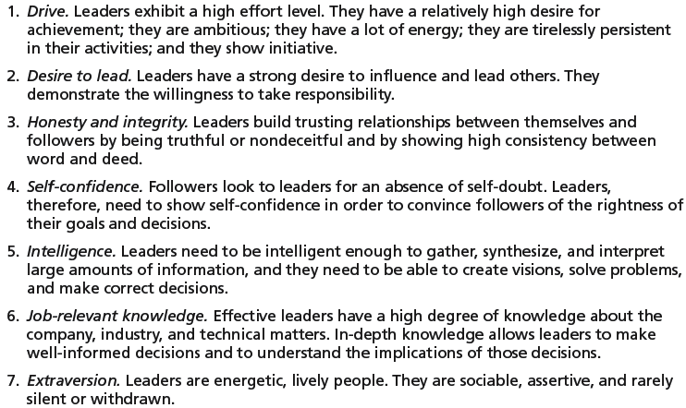
Exhibit 17–1 Seven Traits Associated with Leadership
Source: S. A. Kirkpatrick and E. A. Locke, “Leadership: Do Traits Really Matter?” Academy of Management Executive, May 1991, pp. 48–60; T. A. Judge, J. E. Bono, R. llies, and M. W. Gerhardt, “Personality and Leadership: A Qualitative and Quantitative Review,” Journal of Applied Psychology, August 2002, pp. 765–780.

Slide 8
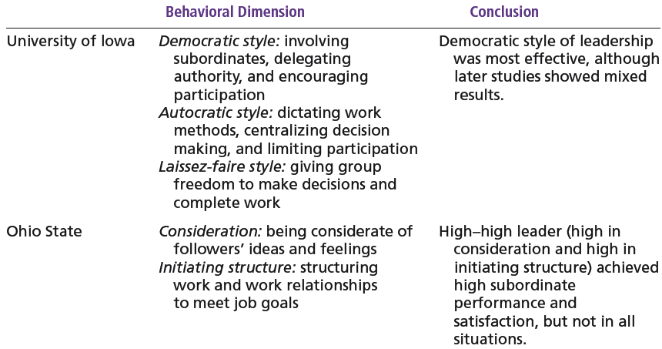
Exhibit 17–2 Behavioral Theories of Leadership

Slide 9
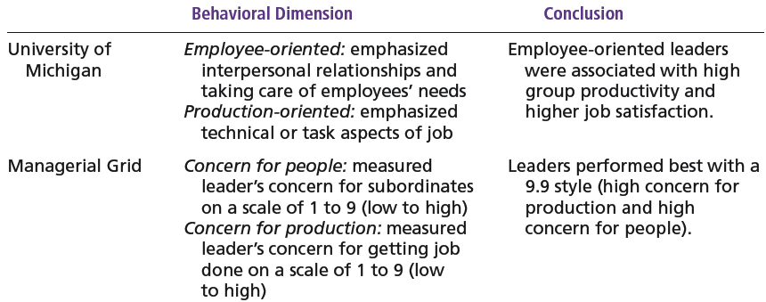
Exhibit 17–2 (cont’d) Behavioral Theories of Leadership

Slide 10
Early Leadership Theories (cont’d)
Behavioral Theories
  University of Iowa Studies (Kurt Lewin)
    Identified three leadership styles:
      Autocratic style: centralized authority, low participation
      Democratic style: involvement, high participation, feedback
      Laissez faire style: hands-off management
    Research findings: mixed results
      No specific style was consistently better for producing better performance
      Employees were more satisfied under a democratic leader than an autocratic leader.

Slide 11
Early Leadership Theories (cont’d)
Behavioral Theories (cont’d)
  Ohio State Studies
    Identified two dimensions of leader behavior
      Initiating structure: the role of the leader in defining his or her role and the roles of group members
      Consideration: the leader’s mutual trust and respect for group members’ ideas and feelings.
    Research findings: mixed results
      High-high leaders generally, but not always, achieved high group task performance and satisfaction.
      Evidence indicated that situational factors appeared to strongly influence leadership effectiveness.

Slide 12
Early Leadership Theories (cont’d)
Behavioral Theories (cont’d)
  University of Michigan Studies
    Identified two dimensions of leader behavior
      Employee oriented: emphasizing personal relationships
      Production oriented: emphasizing task accomplishment
    Research findings:
      Leaders who are employee oriented are strongly associated with high group productivity and high job satisfaction.

Slide 13
The Managerial Grid
Managerial Grid
  Appraises leadership styles using two dimensions:
    Concern for people
    Concern for production
  Places managerial styles in five categories:
    Impoverished management
    Task management
    Middle-of-the-road management
    Country club management
    Team management

Slide 14
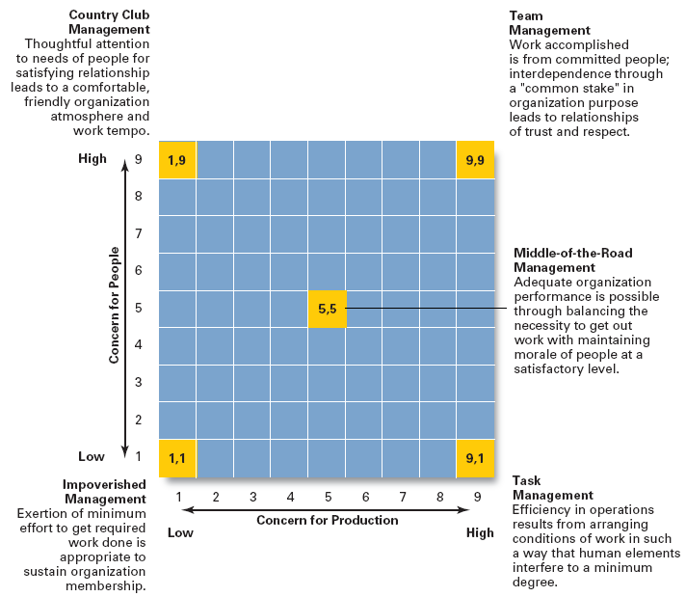
Exhibit 17–3
The
Managerial
Grid
Source: Reprinted by permission of Harvard Business Review. An exhibit from “Breakthrough in Organization Development” by Robert R. Blake, Jane S. Mouton, Louis B. Barnes, and Larry E. Greiner, November–December 1964, p. 136. Copyright © 1964 by the President and Fellows of Harvard College. All rights reserved.

Slide 15
Contingency Theories of Leadership
The Fiedler Model (cont’d)
  Proposes that effective group performance depends upon the proper match between the leader’s style of interacting with followers and the degree to which the situation allows the leader to control and influence.
  Assumptions:
    A certain leadership style should be most effective in different types of situations.
    Leaders do not readily change leadership styles.
      Matching the leader to the situation or changing the situation to make it favorable to the leader is required.

Slide 16
Contingency Theories… (cont’d)
The Fiedler Model (cont’d)
  Least-preferred co-worker (LPC) questionnaire
    Determines leadership style by measuring responses to 18 pairs of contrasting adjectives.
      High score: a relationship-oriented leadership style
      Low score: a task-oriented leadership style
  Situational factors in matching leader to the situation:
    Leader-member relations
    Task structure
    Position power

Slide 17
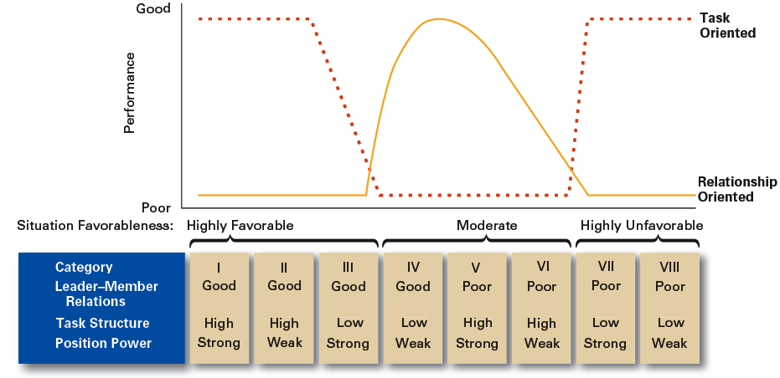
Exhibit 17–4 Findings of the Fiedler Model

Slide 18
Contingency Theories… (cont’d)
Hersey and Blanchard’s Situational Leadership Theory (SLT)
  Argues that successful leadership is achieved by selecting the right leadership style which is contingent on the level of the followers’ readiness.
    Acceptance: leadership effectiveness depends on whether followers accept or reject a leader.
    Readiness: the extent to which followers have the ability and willingness to accomplish a specific task.
  Leaders must relinquish control over and contact with followers as they become more competent.

Slide 19
Contingency Theories… (cont’d)
Hersey and Blanchard’s Situational Leadership Theory (SLT)
  Creates four specific leadership styles incorporating Fiedler’s two leadership dimensions:
    Telling: high task-low relationship leadership
    Selling: high task-high relationship leadership
    Participating: low task-high relationship leadership
    Delegating: low task-low relationship leadership

Slide 20
Contingency Theories… (cont’d)
Hersey and Blanchard’s Situational Leadership Theory (SLT)
  Posits four stages follower readiness:
    R1: followers are unable and unwilling
    R2: followers are unable but willing
    R3: followers are able but unwilling
    R4: followers are able and willing

Slide 21
Contingency Theories… (cont’d)
Leader Participation Model (Vroom and Yetton)
  Posits that leader behavior must be adjusted to reflect the task structure—whether it is routine, nonroutine, or in between—based on a sequential set of rules (contingencies) for determining the form and amount of follower participation in decision making in a given situation.

Slide 22

Contingency Theories… (cont’d)
Leader Participation Model Contingencies:
  Decision significance
  Importance of commitment
  Leader expertise
  Likelihood of commitment
  Group support
  Group expertise
  Team competence

Slide 23
Exhibit 17–5 Leadership Styles in the Vroom Leader Participation Model
Decide: Leader makes the decision alone and either announces or sells it to group.
Consult Individually: Leader presents the problem to group members individually, gets their suggestions, and then makes the decision.
Consult Group: Leader presents the problem to group members in a meeting, gets their suggestions, and then makes the decision.
Facilitate: Leader presents the problem to the group in a meeting and, acting as facilitator, defines the problem and the boundaries within which a decision must be made.
Delegate: Leader permits the group to make the decision within prescribed limits.
Source: Based on V. Vroom, “Leadership and the Decision-Making Process,” Organizational Dynamics, vol. 28, no. 4 (2000), p. 84.

Slide 24
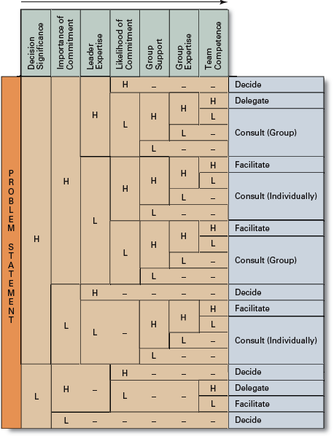
Exhibit 17–6
Time-Driven
Model
Source: Adapted from V. Vroom, “Leadership and the Decision-Making Process,” Organizational Dynamics, vol. 28, no. 4 (2000), p. 87.

Slide 25
Contingency Theories… (cont’d)
Path-Goal Model
  States that the leader’s job is to assist his or her followers in attaining their goals and to provide direction or support to ensure their goals are compatible with organizational goals.
  Leaders assume different leadership styles at different times depending on the situation:
    Directive leader
    Supportive leader
    Participative leader
    Achievement oriented leader

Slide 26
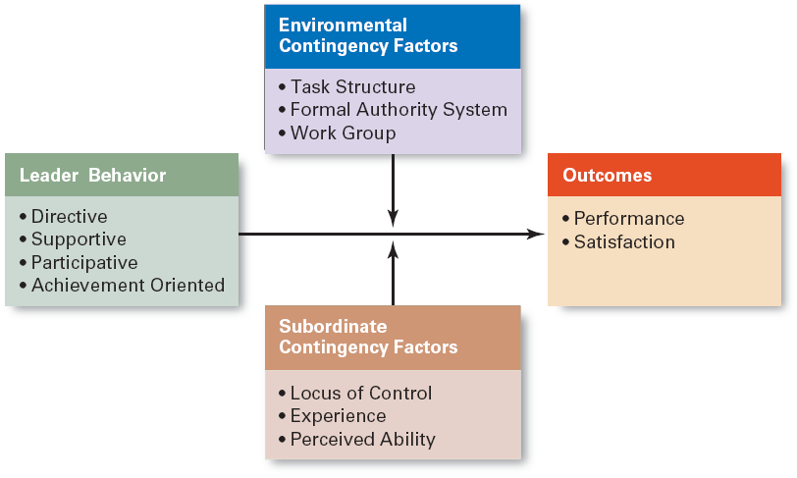
Exhibit 17–7 Path-Goal Theory

Slide 27
Contemporary Views on Leadership
Transactional Leadership
  Leaders who guide or motivate their followers in the direction of established goals by clarifying role and task requirements.
Transformational Leadership
  Leaders who inspire followers to transcend their own self-interests for the good of the organization by clarifying role and task requirements.
  Leaders who also are capable of having a profound and extraordinary effect on their followers.

Slide 28
Contemporary Views…(cont’d)
Charismatic Leadership
  An enthusiastic, self-confident leader whose personality and actions influence people to behave in certain ways.
  Characteristics of charismatic leaders:
    Have a vision.
    Are able to articulate the vision.
    Are willing to take risks to achieve the vision.
    Are sensitive to the environment and follower needs.
    Exhibit behaviors that are out of the ordinary.

Slide 29
Contemporary Views…(cont’d)
Visionary Leadership
  A leader who creates and articulates a realistic, credible, and attractive vision of the future that improves upon the present situation.
Visionary leaders have the ability to:
  Explain the vision to others.
  Express the vision not just verbally but through behavior.
  Extend or apply the vision to different leadership contexts.

Slide 30
Contemporary Views…(cont’d)
Team Leadership Characteristics
  Having patience to share information
  Being able to trust others and to give up authority
  Understanding when to intervene
Team Leader’s Job
  Managing the team’s external boundary
  Facilitating the team process
    Coaching, facilitating, handling disciplinary problems, reviewing team and individual performance, training, and communication

Slide 31
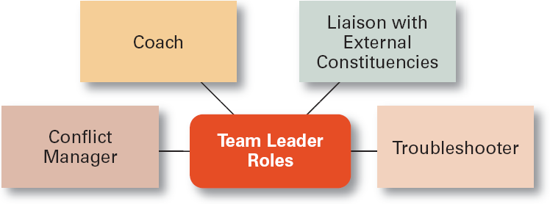
Exhibit 17–8 Specific Team Leadership Roles

Slide 32
Leadership Issues in the 21st Century
Managing Power
  Legitimate power
    The power a leader has as a result of his or her position.
  Coercive power
    The power a leader has to punish or control.
  Reward power
    The power to give positive benefits or rewards.
  Expert power
    The influence a leader can exert as a result of his or her expertise, skills, or knowledge.
  Referent power
    The power of a leader that arise because of a person’s desirable resources or admired personal traits.

Slide 33
Developing Credibility and Trust
Credibility (of a Leader)
  The assessment of a leader’s honesty, competence, and ability to inspire by his or her followers
Trust
  Is the belief of followers and others in the integrity, character, and ability of a leader.
    Dimensions of trust: integrity, competence, consistency, loyalty, and openness.
  Is related to increases in job performance, organizational citizenship behaviors, job satisfaction, and organization commitment.

Slide 34
Exhibit 17–9 Suggestions for Building Trust
Practice openness.
Be fair.
Speak your feelings.
Tell the truth.
Show consistency.
Fulfill your promises.
Maintain confidences.
Demonstrate competence.

Slide 35
Providing Ethical Leadership
Ethics are part of leadership when leaders attempt to:
  Foster moral virtue through changes in attitudes and behaviors.
  Use their charisma in socially constructive ways.
  Promote ethical behavior by exhibiting their personal traits of honesty and integrity.
Moral Leadership
  Involves addressing the means that a leader uses to achieve goals as well as the moral content of those goals.

Slide 36
Empowering Employees
Empowerment
  Involves increasing the decision-making discretion of workers such that teams can make key operating decisions in develop budgets, scheduling workloads, controlling inventories, and solving quality problems.
  Why empower employees?
    Quicker responses problems and faster decisions.
    Addresses the problem of increased spans of control in relieving managers to work on other problems.

Slide 37

Cross-Cultural Leadership
Universal Elements of Effective Leadership
  Vision
  Foresight
  Providing encouragement
  Trustworthiness
  Dynamism
  Positiveness
  Proactiveness

Slide 38
Exhibit 17–10 Selected Cross-Cultural Leadership Findings
Korean leaders are expected to be paternalistic toward employees.
Arab leaders who show kindness or generosity without being asked to do so are seen by other Arabs as weak.
Japanese leaders are expected to be humble and speak frequently.
Scandinavian and Dutch leaders who single out individuals with public praise are likely to embarrass, not energize, those individuals.
Effective leaders in Malaysia are expected to show compassion while using more of an autocratic than a participative style.
Effective German leaders are characterized by high performance orientation, low compassion, low self-protection, low team orientation, high autonomy, and high participation.
Source: Based on J. C. Kennedy, “Leadership in Malaysia: Traditional Values, International Outlook,” Academy of Management Executive, August 2002, pp. 15–17; F.C. Brodbeck, M. Frese, and M. Javidan, “Leadership Made in Germany: Low on Compassion, High on Performance,” Academy of Management Executive, February 2002, pp. 16–29; M. F. Peterson and J. G. Hunt, “International Perspectives on International Leadership,” Leadership Quarterly, Fall 1997, pp. 203–31; R. J. House and R. N. Aditya, “The Social Scientific Study of Leadership: Quo Vadis?” Journal of Management, vol. 23, no. 3, (1997), p. 463; and R. J. House, “Leadership in the Twenty-First Century,” in A. Howard (ed.), The Changing Nature of Work (San Francisco: Jossey-Bass, 1995), p. 442.

Slide 39
Gender Differences and Leadership
Research Findings
  Males and females use different styles:
    Women tend to adopt a more democratic or participative style unless in a male-dominated job.
    Women tend to use transformational leadership.
    Men tend to use transactional leadership.

Slide 40
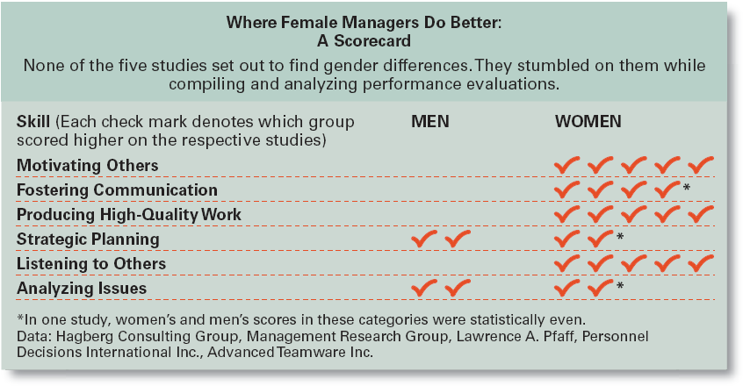
Exhibit 17–11 Where Female Managers Do Better: A Scorecard
Source: R. Sharpe, “As Leaders, Women Rule,” BusinessWeek, November 20. 2000, p. 75.

Slide 41
Basics of Leadership
Give people a reason to come to work.
Be loyal to the organization’s people
Spend time with people who do the real work of the organization.
Be more open and more candid about what business practices are acceptable and proper and how the unacceptable ones should be fixed.

Slide 42
Leadership Can Be Irrelevant!
Substitutes for Leadership
  Follower characteristics
    Experience, training, professional orientation, or the need for independence
  Job characteristics
    Routine, unambiguous, and satisfying jobs
  Organization characteristics
    Explicit formalized goals, rigid rules and procedures, or cohesive work groups

Slide 43
Terms to Know
leader
leadership
behavioral theories
autocratic style
democratic style
laissez-faire style
initiating structure
consideration
high-high leader
managerial grid
Fiedler contingency model
least-preferred co-worker (LPC) questionnaire
leader-member relations
task structure
position power
situational leadership theory (SLT)
readiness
leader participation model
path-goal theory
transactional leaders

Slide 44
Terms to Know (cont’d)
transformational leaders
charismatic leader
visionary leadership
legitimate power
coercive power
reward power
expert power
referent power
credibility
trust
empowerment

