Slide 1
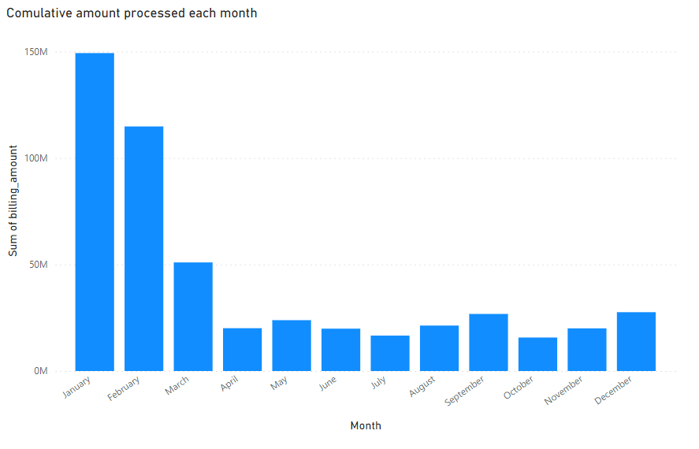
Monthly transactions

Slide 2
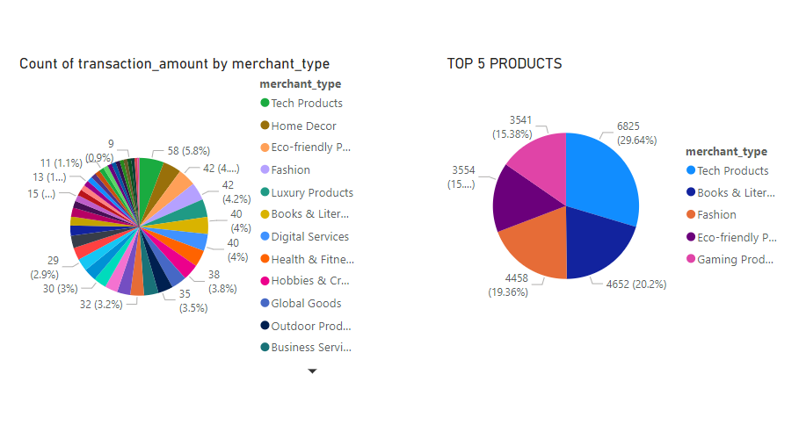
Top 5 most popular products

Slide 3
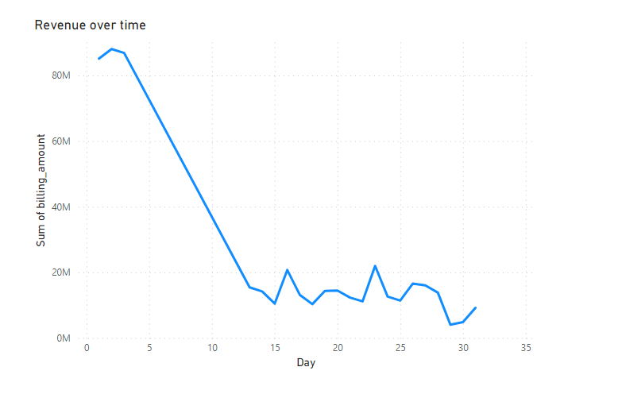
Daily revenue trend over time

Slide 4
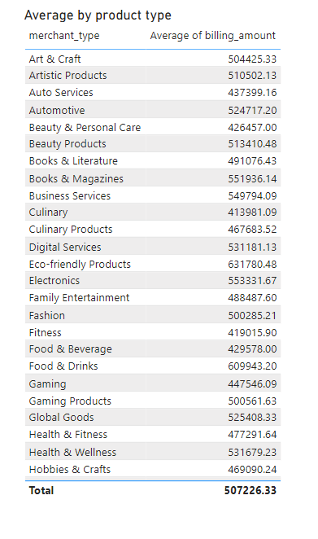
Average transaction amount for each product category

Slide 5
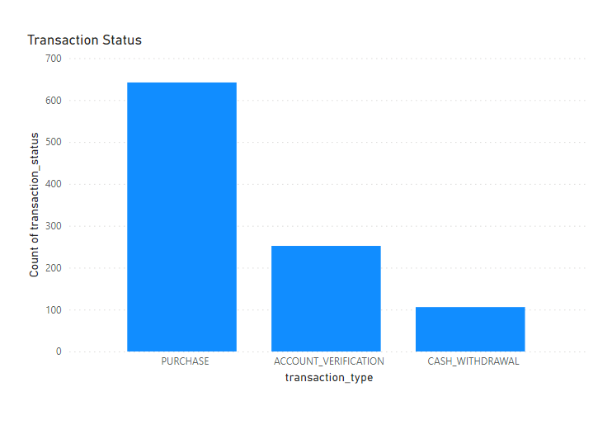
Transaction Details

