Slide 1
Leaky Bucket Algorithm
Network Traffic Management

Slide 2
Introduction
- The Leaky Bucket Algorithm is used in network traffic shaping and congestion control.
- It helps regulate data flow in a consistent manner, preventing bursts of traffic.

Slide 3
Concept of Leaky Bucket
- The algorithm works like a bucket with a small hole.
- Water (data packets) enters the bucket (buffer) at varying rates.
- It leaks out at a constant rate (transmission rate).
- If the bucket overflows, excess packets are discarded.

Slide 4
Working of the Algorithm
1. Data packets arrive in a bursty manner.
2. Packets are stored in a finite-sized buffer (bucket).
3. Data is transmitted at a steady rate.
4. If the buffer is full, incoming packets are dropped.

Slide 5
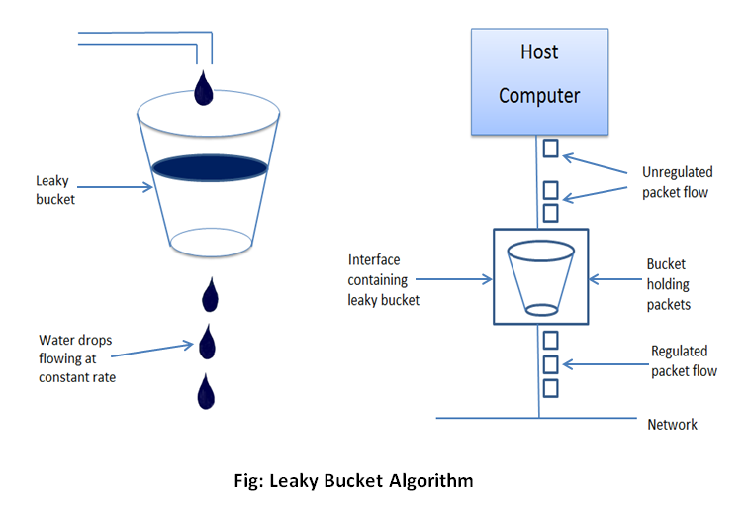

Slide 6
Example 1 - Constant Traffic Rate
- Consider a network sending data at a steady rate of 5 packets/sec.
- The bucket receives and transmits data at the same rate.
- No packets are dropped, ensuring smooth transmission.

Slide 7
Example 2 - Bursty Traffic
- If a network sends data at 10 packets/sec but the bucket leaks at 5 packets/sec:
- Excess packets are stored if space is available.
- If the buffer overflows, packets are discarded.

Slide 8
Comparison with Token Bucket Algorithm
| Feature | Leaky Bucket | Token Bucket |
|---------|-------------|-------------|
| Flow Control | Constant | Variable |
| Packet Dropping | Yes | No (if tokens available) |
| Application | Traffic shaping | Traffic policing |

Slide 9
Example
Initially, the bucket is empty: Remaining = 0
Bucket Capacity = 4
Rate = 3
i | A[i] | Accept by Bucket | Sent | Remaining
1 | 2 | 2 | 2 | 0
2 | 4 | 4 | 3 | 1
3 | 1 | 1 | 2 | 0
4 | 5 | Dropped | 0 | 0
5 | 3 | 3 | 3 | 0

Slide 10
Advantages and Disadvantages
✅ Smoothens traffic flow
✅ Prevents congestion
❌ Can lead to packet loss
❌ Not suitable for bursty traffic without buffering

Slide 11
Real-World Applications
- Used in network routers for congestion control.
- Helps in quality of service (QoS) management.
- Applied in data traffic shaping in telecom networks.

Slide 12
Summary
- The Leaky Bucket Algorithm regulates data flow.
- Ensures a steady transmission rate.
- Prevents network congestion but may discard excess packets.

