Slide 1
Backtracking
Some problems can be solved, by exhaustive search.
Backtracking is a more intelligent variation of this approach.
The principal idea is to construct solutions one component at a time and evaluate such partially constructed candidates as follows.
If a partially constructed solution can be developed, continue.
If there is no legitimate option for the next component, backtrack to replace the last component of the partially constructed solution with its next option.

Slide 2
Backtracking
State-space tree, represents the processing
Its root represents an initial state
The nodes of the first level in the tree represent the choices made for the first component of a solution
The nodes of the second level represent the choices for the second component, and so on.
A node in a state-space tree is said to be promising
if it corresponds to a partially constructed solution that may still lead to a complete solution;
otherwise, it is called nonpromising.
Leaves represent either nonpromising dead ends or complete solutions found by the algorithm.

Slide 3
Backtracking
In the majority of cases, a states-pace tree for a backtracking algorithm is constructed in the manner of depth-first search.
If the algorithm reaches a complete solution to the problem, it either stops (if just one solution is required) or continues searching for other possible solutions.

Slide 4
N-Queens Problem
Problem Definition
The problem is to place n queens on an n × n chessboard so that no two queens attack each other by being in the same row or in the same column or on the same diagonal.
So let us consider the 4-queens problem and solve it by the backtracking technique.

Slide 5
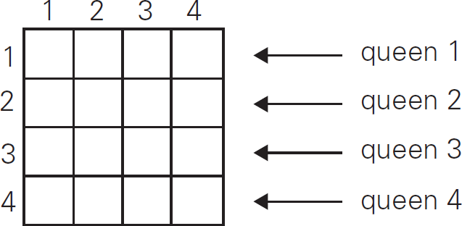
4-Queens problem
Since each of the four queens has to be placed in its own row, all we need to do is to assign a column for each queen on the board presented in figure.

Slide 6
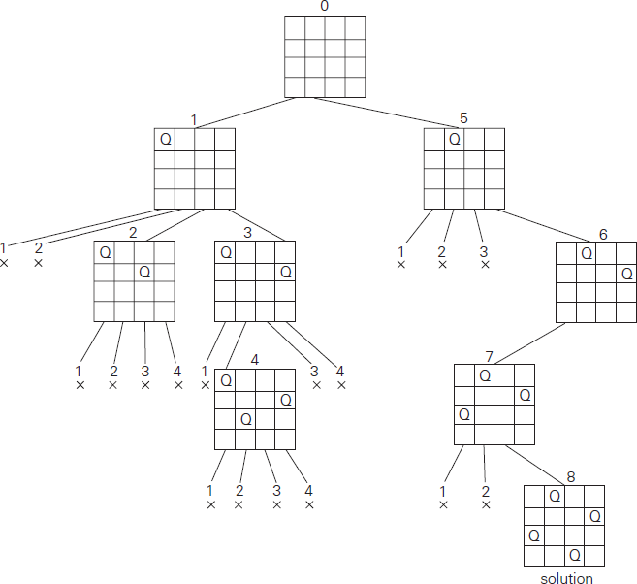
4-Queens problem
The state-space tree of this search is shown in figure.
Note: This tree shows expansion of nodes till it gets a solution. For multiple solutions it need to be expanded further

Slide 7
4-queens problem
If other solutions need to be found, the algorithm can simply resume its operations at the leaf at which it stopped.
Alternatively, we can use the board’s symmetry for this purpose.
Finally, it should be pointed out that a single solution to the n-queens problem for any n ≥ 4 can be found in linear time.

Slide 8
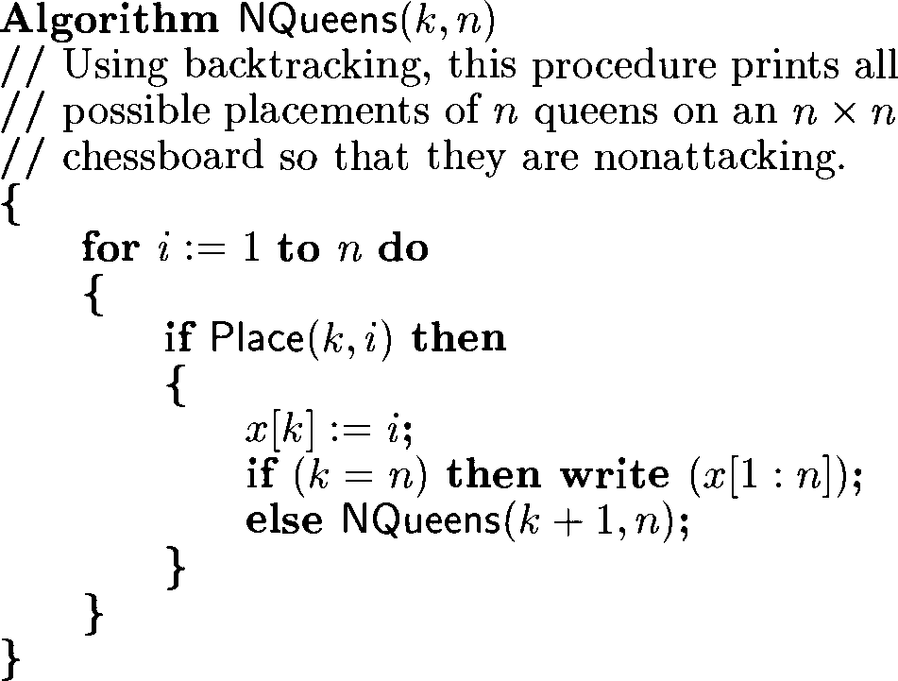
N-queens prblem
Algorithm to find all solutions of n-queens problem

Slide 9
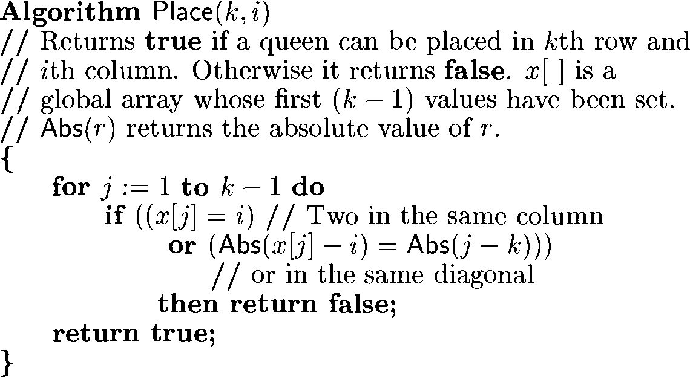
N-queens prblem
is_safe()

Slide 10
Applications
VLSI testing
Traffic control
Parallel memory storage scheme and deadlock prevention
Travelling sales person problem

