Slide 1
MODULE III
GREEDY METHOD

Slide 2
CONTENTS
INTRODUCTION TO GREEDY METHOD
GENERAL METHOD
COIN CHANGE PROBLEM
ASSIGNMENT

Slide 3
INTRODUCTION TO GREEDY METHOD
Greedy method is one of the straightforward design technique which is applicable to wide variety of applications
Greedy algorithms are typically used to solve an optimization problem.
An Optimization problem is one in which, we are given a set of input values, need to obtain subset of inputs as a solution w. r. t. some constraints or conditions.
Generally an optimization problem has n inputs (call this set as input domain or Candidate set, C), we are required to obtain a subset of C (call it solution set, S where S ⊆ C) that satisfies the given constraints or conditions

Slide 4
INTRODUCTION TO GREEDY METHOD [Contd..]
An Optimization Problem usually has 2 solutions: Feasible Solution and Optimal Solution
Solution which contains a subset of inputs that satisfies the given constraints is known as Feasible solution.
A feasible solution that either maximizes or minimizes a given objective function is known as optimal solution

Slide 5
INTRODUCTION TO GREEDY METHOD [Contd..]
The greedy method suggests to devise an algorithm that works in stages (by considering one input at a time)
Where we consider the inputs in an order, based on some selection procedure
Use some optimization measure for selection procedure ,at every stage, examine an input to see whether it leads to an optimal solution
If the inclusion of input into partial solution yields an infeasible solution, discard the input; otherwise, add it to the partial solution

Slide 6
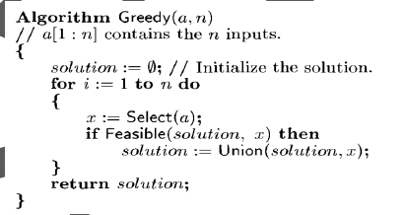
CONTROL ABSTRACTION

Slide 7
CONTROL ABSTRACTION
Here, Select is a function which is used to select an input from the set a[1:n] and removes it. The selected input value is assigned to “x”.
Feasible is a boolean valued function which verifies the constraints and determines whether the “x” can be included into the solution vector or not.
Union is a function which is used to add solution “x” to the partially constructed set and updates the objective function.

Slide 8
COIN CHANGE PROBLEM
Problem Statement
Given coins of several denominations find out a
way to give a customer an amount with fewest
number of coins.

Slide 9
Example
First finding the number of ways of making changes for a particular amount of cents, n, using a given set of denominations C={c1…cd} (e.g, the US coin system: {1, 5, 10, 25, 50, 100})
If n = 4,C = {1,2,3}
The feasible solutions:
4 coins {1,1,1,1},
3 coins {1,1,2}
2 coins {2,2},{1,3}.
Second, minimizing the number of coins returned for a particular quantity of change :
The Optimal Solution will be 2 coins i.e., {2,2} or {1,3}

Slide 10
Example
Available coins are {1, 5, 10, 25} and n= 30 Cents. Then the solutions obtained are shown below:
Solution No | Denomination | No of coins | Amount /Total No of Coins
1 | 1 | 30 | 30/30
2 | 5 | 6 | 30/6
3 | 10 | 3 | 30/3
4 | 25 | 1 | 30/2
 | 5 | 1
Solution 1,2 &3 are feasible solution to the problem where as Solution 4 is the optimal solution

Slide 11
Basic principle is: At every iteration for search of
a coin, take the largest coin which can fit into
remain amount to be changed at that particular
time. At the end you will have optimal solution.

Slide 12
Assignment
Solve coin change problem(Identify feasible and Optimal Solution) :
Suppose you are given the coins {1,5,10} with N = 10 cents, what are the total number of permutations of the coins you can arrange to obtain 10 cents.
Suppose you are given the coins {1,5,10,25} with N = 48 cents, what are the total number of permutations of the coins you can arrange to obtain 48 cents.

Slide 13
Knapsack Problem
Given :
A knapsack (kind of shoulder bag) with limited weight capacity.
Some items each having some weight and profit or value.
The problem states-
Which items should be placed into the knapsack such
that-
The value or profit obtained by placing the items into the knapsack is maximum.
And the weight limit of the knapsack does not exceed.

Slide 14
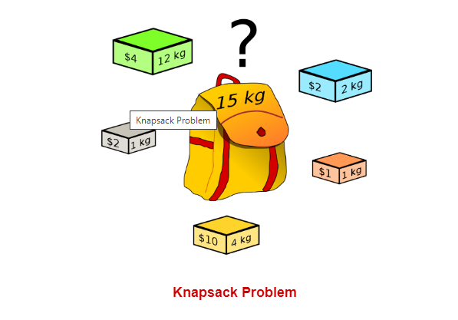
Knapsack Problem

Slide 15
Knapsack Problem Variants
Knapsack problem has the following two
variants-
Fractional Knapsack Problem (Items can be selected partially)-Greedy Method
0/1 Knapsack Problem(Items should be selected completely but not partially)- Dynamic Programming

Slide 16
Fractional Knapsack Problem
Problem Statement:
Given n objects each have a weight w_{i} and a profit p_{i} , and given a knapsack of total capacity m.
The problem is to pack/fill the knapsack with these objects in order to maximize the total value or profit of those objects packed without exceeding the knapsack's capacity.
More formally, let x_{i} denote the fraction of the object i to be included in the knapsack, 0 ≤ x_{i} ≤ 1, for 1 ≤ i≤ n. The problem is to find values for the x_{i.}
If a fraction x_{i} (0 ≤ x_{i} ≤ 1) of the object i is placed in the bag. A profit p_{i} * x_{i} is made.

Slide 17
Fractional Knapsack Problem
The objective in the problem is to obtain the maximum profit by filling the bag with given objects.
If it is not possible to include an object entirely a fraction of the object can be included and accordingly a fraction of the profit is earned.
The knapsack problem can be stated mathematically as follows.
Maximize ∑ p_{i} x_{i} 1 ≤ i ≤ n where n is the number of objects. Such that,
∑ w_{i} x_{i} ≤ m
For every object x_{i} : 0 ≤ x_{i} ≤ 1 and 1 ≤ i ≤ n

Slide 18
Fractional Knapsack Problem-EXAMPLE
Consider 3 objects whose profits and weights are defined as:
Total No of objects : n=3 and Knapsack capacity : m=20
(P₁, P₂, P₃) = ( 25, 24, 15 ) & (W₁, W₂, W₃) = ( 18, 15, 10 )
Problem is to determine the optimum strategy for placing the objects into the knapsack.
The problem can be solved by the greedy approach where in the inputs are arranged according to selection process (greedy strategy) and solve the problem in stages.
The various greedy strategies for the problem could be as follows.

Slide 19
Fractional Knapsack Problem-EXAMPLE
We know that n=3, m=20, listing the objects with
its corresponding weights and profits as below
Object(
i
)
1
2
3
Weight(
w
)
18
15
10
i
Profit(p
)
25
24
15
i

Slide 20
Fractional Knapsack Problem-EXAMPLE
I Strategy ::: Greedy about profit: - Select an object which has highest profit i.e arrange the objects in descending order of profits.
Object(
i
)
1
2
3
Weight(
w
)
18
15
10
i
Profit(p
)
25
24
15
i

Slide 21
Object(i) | 1 | 2 | 3
Weight(w_{i}) | 18 | 15 | 10
Profit(p_{i}) | 25 | 24 | 15
Object(i)
Weight(wi)
Profit(p_{i})
x
w
x
p
x
Remaining Capacity
i
i
i
i
i
-
-
-
-
-
-
20
1
18
25
1
18*1=18
25*1=25
20-18=2
2
15
24
2/15
15*2/15=2
24*2/15=3.2
2-2=0
3
10
15
0
-
-
-
From the above table, we can observe that
(x₁,x_{2,}x₃)=(1,2/15,0)
Max Profit= ∑ p_{i} x_{i} = 25*1+24*2/15=25+3.2=28.2
Max Weight= ∑ w_{i} x_{i} = 18*1+15*2/15=20

Slide 22
Fractional Knapsack Problem-EXAMPLE
II Strategy ::: Greedy about weight: - Select an object
which has least weight i.e arrange the objects in
ascending order of weights.
Object(i)
3
2
1
Weight(w
)
10
15
18
i
Profit(p
)
15
24
25
i

Slide 23
Object(i) | 3 | 2 | 1
Weight(w_{i}) | 10 | 15 | 18
Profit(p_{i}) | 15 | 24 | 25
Object(i)
Weight(w
)
Profit(p
i
)
x
w
x
p
x
Remaining Capacity
i
i
i
i
i
i
-
-
-
-
-
-
20
3
10
15
1
10*1=10
15*1=15
20-10=10
2
15
24
2/3
15*2/3=10
24*2/3=16
10-10=0
1
18
25
0
-
-
-
From the above table, we can observe that
(x₁,x_{2,}x₃)=(0,2/3,1)
Max Profit= ∑ p_{i} x_{i} = 15*1+24*2/3=15+16=31
Max Weight= ∑ w_{i} x_{i} = 10*1+15*2/3=20

Slide 24
Fractional Knapsack Problem-EXAMPLE
III Strategy ::: Greedy about profit per unit
weight: -
Obtain the ratio p_{i} /w_{i} of all objects
Select an object which has highest profit/weight ratio i.e arrange the objects in descending order of the ratio profit/weight.
Object(i) | 1 | 2 | 3
Weight(w_{i}) | 18 | 15 | 10
Profit(p_{i}) | 25 | 24 | 15
p_{i}/w_{i} | 1.38 | 1.6 | 1.5

Slide 25
Object(i) | 2 | 3 | 1
Weight(w_{i}) | 15 | 10 | 18
Profit(p_{i}) | 24 | 15 | 25
p_{i}/w_{i} | 1.6 | 1.5 | 1.38
Object(i) | Weight(w_{i}) | Profit(p_{i}) | x_{i} | w_{i} x_{i} | p_{i} x_{i} | Remaining Capacity
- | - | - | - | - | - | 20
2 | 15 | 24 | 1 | 15*1=15 | 24*1=24 | 20-15=5
3 | 10 | 15 | 1/2 | 10*1/2=5 | 15*1/2=7.5 | 5-5=0
1 | 18 | 25 | 0 | - | - | -
From the above table, we can observe that
(x₁,x_{2,}x₃)=(0,1,1/2)
Max Profit= ∑ p_{i} x_{i} = 24*1+15*1/2=24+7.5=31.5
Max Weight= ∑ w_{i} x_{i} = 15*1+10*1/2=20

Slide 26
Greedy Strategy III: Greedy about
profit per unit weight - always yields
an optimal solution to the knapsack
problem

Slide 27
Assignment
Solve the knapsack problem using greedy method
Number of objects n=4, Knapsack capacity m=10, Weights (w1,w2,w3,w4)=(4,7,5,3) & Profit (p1,p2,p3,p4)= (40,42,25,12) [Jan 2018]
Given n=7, m=15, Weights= (2,3,5,7,1,4,1) , Profits = (10,5,15,7,6,18,3 ) [July 2019]

Slide 28
MODULE III
GREEDY METHOD

Slide 29
RECAP…
INTRODUCTION TO GREEDY METHOD
GENERAL METHOD
COIN CHANGE PROBLEM
KNAPSACK PROBLEM
ASSIGNMENT

Slide 30
AGENDA
KNAPSACK PROBLEM-ALGORITHM AND ANALYSIS
JOB SEQUENCING WITH DEADLINES PROBLEM
ASSIGNMENT

Slide 31
Algorithm- Knapsack Problem
Algorithm Greedy knapsack (m, n)
//p [1:n] and w[1:n] contain the profits and weights
//respectively of the n objects ordered such that p[i]/w[i]=>p[i+1]/w[i+1].
//m is the knapsack size and x [1:n] is the solution vector
{
for i: = 1 to n do
x[i] = 0.0 // initialize x
U : = m;
Profit=0.0
for i: = 1 to n do
{
if (w[i] > U) then // if w[i] > remaining capacity then stop the selection
break;
x[i]: = 1.0; // if w[i]<= remaining capacity then x[i]=1
U: = U-w[i]; //update remaining capacity of the knapsack
Profit+=p[i]*x[i] // update profit
}
if (i ≤ n) then
x[i]: = U/w[i]; //partial selection of object
Profit+=p[i]*x[i]
}

Slide 32
Analysis- Knapsack Problem
If we do not consider the time considered for sorting the inputs then all of the three greedy strategies complexity will be O(n).
If we consider the time considered for sorting the inputs then all of the three greedy strategies complexity will be O(n log n).
Complexity of sorting using any better sorting algorithm O(n log n)
Complexity of selecting objects O(n)
Therefore the time complexity of knapsack problem will be max(O(nlogn),O(n)) i.e., O(n logn)

Slide 33
Job Sequencing with deadlines
Problem Statement:
We are given a set of “n” jobs.
Associated with each job there is an integer dead line d_{i} ≥ 0 and a profit p_{i} > 0.
For any job i the profit p_{i} is earned if and only if the job is completed by its dead line.
To complete a job one has to process the job on a machine for one unit of time.
Only one machine is available for processing the jobs.

Slide 34
Job Sequencing with deadlines
A feasible solution for the problem will be a subset “J” if jobs such that each job in this subset can be completed by its deadline. The value of a feasible solution “J” is the sum of the profits of the jobs in “J”.
An optimal solution is a feasible solution with maximum value of the profit.
The problem involves identification of a subset of jobs which can be completed by its deadline. Therefore the problem suites the subset methodology and can be solved by the greedy method.

Slide 35
Job Sequencing with deadlines - Greedy Strategy
The greedy strategy for obtaining optimal solution is to consider the jobs in decreasing order of profits and solve using Gantt chart.
As there are only n jobs and each job takes one unit of time, it is necessary to consider the time slots [i-1,i] 1 ≤ i ≤ b,
where b = min {n, max {d_{i}}}
The time slots are partitioned into b sets like [0,1][1,2][2,3]…………… [b-1,b]
If job i has not been assigned a processing time, then assign it to slot [α-1, α ], where α is the integer such that 1≤ α ≤ d_{i} where d_{i} is the deadline of the i^{th} job and if the slot [α -1, α] is not free then assign [α -2, α -1] and so on .
If there is no slot, the new job is not included.

Slide 36
Job Sequencing with deadlines - Problem
Given, n = 5, (p₁, p_{2,} p_{3,} p_{4,} p₅) = (20,15,10,5,1)
and (d₁, d_{2,} d_{3,} d_{4,} d₅) = (2,2,1,3,3).
Write the optimal schedule of jobs that gives maximum profit.
Are all the jobs completed in the optimal schedule?
What is the maximum earned profit?

Slide 37
Job Sequencing with deadlines - Problem
Solution-
Step 1: Sort all the given jobs in decreasing order of
their profit
Job | J1 | J2 | J3 | J4 | J5
Deadline(d_{i}) | 2 | 2 | 1 | 3 | 3
Profit(p_{i}) | 20 | 15 | 10 | 5 | 1

Slide 38
Job Sequencing with deadlines - Problem
Step 2:
The maximum number of time slots b=min(n,max(d_{i}))=(5,3)= 3. Therefore the time slots are[0,1],[1,2],[2,3]
So, draw a Gantt chart with maximum time slots on Gantt chart = 3 units as shown below-
0 | 1 | 2 | 3
Take each job one by one in the order they appear in Step 1 and place the job on Gantt chart

Slide 39
Job Sequencing with deadlines - Problem
Step 3: Take job J1, Since its deadline is 2, so we place
it in the slot [1,2] as shown below:
 | (20)
 | J1
0 | 1 | 2 | 3
Step 4: Take job J2, Since its deadline is 2, so we need to place it in the slot [1,2], but since the slot is not free(occupied by J1) we can place J2 in the free slot [0,1] as shown below:
(15) | (20)
J2 | J1
0 | 1 | 2 | 3

Slide 40
Job Sequencing with deadlines - Problem
Step 5: Take job J3, Since its deadline is 1, so
we need to place it in the only one slot [0,1], but
since the slot is not free(occupied by J2) and hence
we cannot allocate the job J3
(15) | (20)
J2 | J1
0 | 1 | 2 | 3

Slide 41
Job Sequencing with deadlines - Problem
Step 6: Take job J4, Since its deadline is 3, so we need
to place it in the slot [2,3] which is free as shown below:
(15) | (20) | (5)
J2 | J1 | J4
0 | 1 | 2 | 3

Slide 42
Job Sequencing with deadlines - Problem
Step 5: Take job J5, Since its deadline is 3, so we can
place it in the slots [2,3] [1,2],[0,1], but since all the
slots are not free(occupied by J4,J2,J1) we cannot
allocate the job J5
(15) | (20) | (5)
J2 | J1 | J4
0 | 1 | 2 | 3

Slide 43
Job Sequencing with deadlines - Problem
(15) | (20) | (5)
J2 | J1 | J4
0 | 1 | 2 | 3
From the above Gantt chart, the optimal solution is:
Jobs selected= {J₁,J₂,J₄}
Processing sequence of jobs={J₂,J₁,J₄}
Profit obtained = 15+20+5=40
Jobs which are not processed= {J₃,J₅}

Slide 44
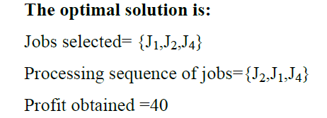
The optimal solution for Job sequencing with deadlines problem is obtained as shown below:
Selected jobs J | Assigned slots | Job considered | Action | Profit
Ø | None | J₁ | Assign J₁ to slot [1, 2] | 0
{ J₁} | [ 1,2] | J₂ | Assign J₂ to slot [0,1] | 20
{J₁,J₂} | [0,1],[1,2] | J₃ | Cannot assign, reject job J₃ As [0,1] slot is not free | 35
{J₁,J₂} | [0,1],[1,2] | J₄ | Assign J₄ to slot [2,3] | 35
{J₁,J₂,J₄} | [0,1],[1,2],[2,3] | J₅ | Cannot assign, reject job J₅ As [0,1],[1,2],[2,3] slots are not free | 40

Slide 45
Job Sequencing with deadlines - Algorithm
Algorithm Greedy Job (d,p,J,n)
//Input: n is the number of jobs and d[1:n] is the deadlines of the jobs
//according to their descending order of profits and p[1:n] be the profits
//Output: J is a set of jobs that can be completed by their dead lines
{
J: = {1};
Profit=p[1]
for i: = 2 to n do
{ if (all jobs in J U {i} can be completed by their dead lines) then
J: = J U { i};
Profit:=Profit+p[i]
}
}

Slide 46
Analysis- Job Sequencing with deadlines
If we do not consider the time considered for sorting the inputs then the time complexity will be O(n).
If we consider the time considered for sorting the inputs then complexity will be O(n log n).
Complexity of sorting using any better sorting algorithm O(n log n)
Complexity of selecting jobs O(n)
Therefore the time complexity of Job Sequencing with deadlines problem will be max(O(nlogn),O(n)) i.e., O(n logn)

Slide 47
Assignment
Find the optimal solution for the job sequencing
with deadlines problem using greedy method:
Let n=5, profits [10,3,33,11,40] and deadlines [3,1,1,2,2] respectively [Jan 2018]
Let n=5, profits [60,100,20,40,20] and deadlines [2,1,3,2,1] respectively

Slide 48
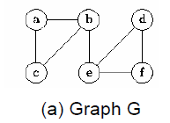
What is a Graph?
Any Graph, G = (V, E) is a collection of set of edges E and Vertices V, it might be a simple, connected, directed/undirected graph that is edge weighted/not edge-weighted.

Slide 49
What is a Spanning tree??
A spanning tree of any undirected connected graph is a connected acyclic subgraph (i.e., a tree) that contains all the vertices of the graph and the number of edges is equal to one less than the number of vertices of the graph.
Thus a minimum spanning tree T for G is a graph, T = (V’, E’) with the following properties:
V’= V
E’=|V|-1
T is connected
T is acyclic.

Slide 50
Spanning Tree
A complete undirected graph can have maximum n^{n-2} number of spanning trees, where n is the number of nodes.
A Non-complete undirected graph can have maximum ^{|E|}C_{|V|-1}-(no of cycles) in the graph

Slide 51
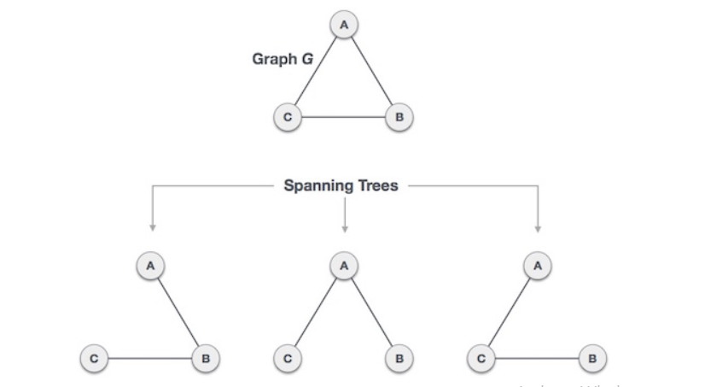
Example of Spanning Tree
Number of Spanning Trees = n^{n-2}=3³⁻²=3¹=3 spanning trees

Slide 52
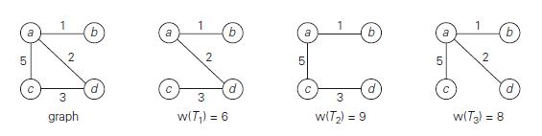
Minimum Cost Spanning Tree
For an edge-weighted , connected, undirected graph, G, the total cost of G is the sum of the weights on all its edges.
A minimum-cost spanning tree for G is a spanning tree of the smallest weight, where the weight of a tree is defined as the sum of the weights on all its edges.
For the given non-complete graph with 4 vertices and 4 edges we have 3 spanning trees i.e., ⁴C₃ -1= 4-1=3.,
FIGURE : Graph and its spanning trees, with T₁ being the minimum spanning tree.

Slide 53
What is a Spanning tree??
A spanning tree of any undirected connected graph is a connected acyclic subgraph (i.e., a tree) that contains all the vertices of the graph and the number of edges is equal to one less than the number of vertices of the graph.
Thus a minimum spanning tree T for G is a graph, T = (V’, E’) with the following properties:
V’= V
E’=|V|-1
T is connected
T is acyclic.

Slide 54
MCST Algorithms
There are two methods to find Minimum Cost
Spanning Tree
Kruskal's Algorithm
Prim's Algorithm

Slide 55
Kruskal's Algorithm
Kruskal‟s Algorithm is another greedy algorithm for the minimum spanning tree problem which is an optimal solution.
It is named Kruskal’s algorithm after Joseph Kruskal, who discovered this algorithm when he was a second-year graduate student.
Kruskal‟s algorithm looks at a minimum spanning tree of a weighted connected graph G = (V, E) as an acyclic subgraph with |V| − 1 edges for which the sum of the edge weights is the smallest.
Consequently, the algorithm constructs a minimum spanning tree as an expanding sequence of subgraphs that are always acyclic but are not necessarily connected on the intermediate stages of the algorithm.

Slide 56
Kruskal's Algorithm
Below are the steps for finding MST using Kruskal’s algorithm
Step 1: List all the edges along with its weight
Step 2: Sort all the edges in ascending order of their weight.
Step 3: Starting with the empty subgraph, Pick the edge from the
sorted list. Check if it forms a cycle with the spanning tree formed
so far. If cycle is not formed, include this edge. Else, discard it.
Step 4: Repeat step 3 until the requires number of edges are
selected for the spanning tree(i.e., |V|-1)

Slide 57
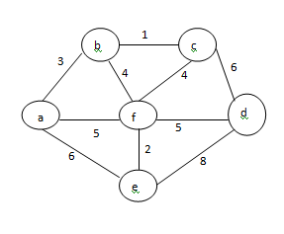
Kruskal's Algorithm
Problem:
Find minimum spanning tree of the below graph
using kruskal’s algorithm
Solution:

Slide 58
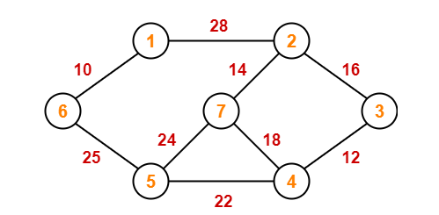
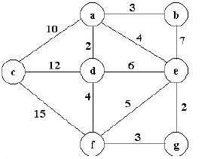
Assignment
Apply kruskal’s algorithm and Find minimum spanning tree for the below graph

Slide 59
THANK YOU….

Slide 60
MINIMUM COST SPANNNING TREES
Graph
Spanning tree
Minimum Cost Spanning Trees(MCST)
MCST Algorithms
Applications

Slide 61
Kruskal's Algorithm
Algorithm Kruskal(G)
//Purpose: Kruskal’s Algorithm to construct minimum spanning tree of graph G
//Input: A weighted undirected connected graph G = <V, E>
//Output: E_{T} --- the set of edges composing MST of G
{
Sort E in ascending order of the edge weight i.e., w(e₁)≤ w(e₂)….≤ w(e_{|E|})
E_{T} = ∅; ecounter = 0 //initialize the set of tree edges and its size
k = 0 //initialize the number of processed edges
while ecounter < |V| - 1 do
k = k+1
if E_{T} ∪ {e_{k}} is acyclic then
E_{T} = E_{T} ∪ {e_{k}};
ecounter = ecounter + 1
return E_{T}
}

Slide 62
Analysis - Kruskal's Algorithm
With an efficient sorting algorithm, the time efficiency
of Kruskal’s algorithm will be in O(|E| log |E|).
Complexity of sorting edges E, using any better sorting algorithm O(|E| log |E|)
Complexity of selecting edges to form MST O(|V|)
Therefore the time complexity of Kruskal’s Algorithm will be max(O(|E|log|E|),O(|V|)) i.e., O(|E| log |E|)(Assuming |V|≈|E|)

Slide 63
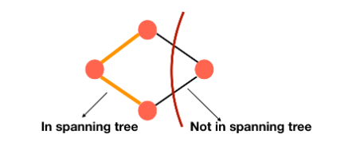
Prim’s Algorithm
We divide the vertices into two parts, one contains the vertices which are in the growing spanning tree and the other part has the rest of the vertices.
V_{T} → Tree Vertices
V- V_{T} → Remaining /Fringe Vertices

Slide 64
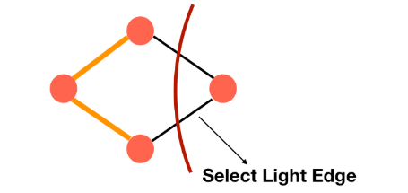
Prim’s Algorithm
We select the least edge each time i.e., e* = (u*,v*) among
all the edges (u, v) such that u is in V_{T} and v is in V – V_{T}
Add the vertex at the end of the least edge i.e., v* into the growing spanning tree
Add the edge e* into the growing spanning tree.

Slide 65
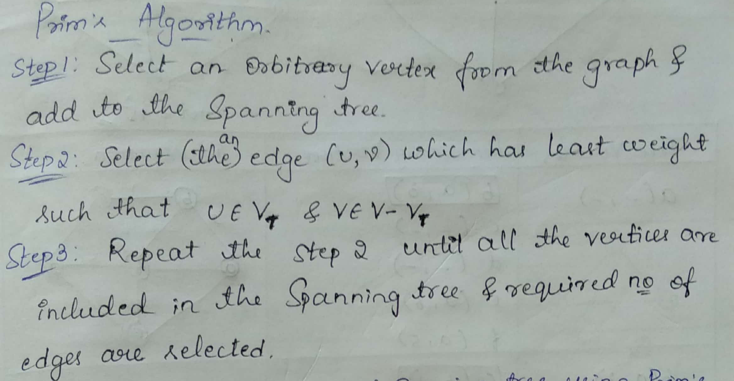
Prim’s Algorithm

Slide 66
Prim’s Algorithm
Prim’s algorithm constructs a minimum spanning tree through a sequence of expanding subtrees.
The initial subtree in such a sequence consists of a single vertex selected arbitrarily from the set V of the graph’s vertices.
On each iteration, the algorithm expands the current tree in the greedy manner by simply attaching to it the nearest vertex not in that tree. (By the nearest vertex, we mean a vertex not in the tree connected to a vertex in the tree by an edge of the smallest weight. Ties can be broken arbitrarily.)
The algorithm stops after all the graph’s vertices have been included in the tree being constructed.
Since the algorithm expands a tree by exactly one vertex on each of its iterations, the total number of such iterations is n − 1, where n is the number of vertices in the graph.
The tree generated by the algorithm is obtained as the set of edges used for the spanning tree

Slide 67
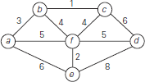
Prim’s Algorithm - Example
Find MST by applying prim’s algorithm for the
below graph
Solution

Slide 68
Prim’s Algorithm
ALGORITHM Prim (G)
//Prim’s algorithm for constructing a MST
//Input: A weighted connected graph G = { V, E }
//Output: E_{T} the set of edges composing a MST of G
{
V_{T} ← {v₀ } //the set of tree vertices can be initialized with any vertex
E_{T} ← ∅ //the edge set of MST is initially empty
for i ← 1 to |V| - 1 do
find a minimum-weight edge e* = (u* , v*) among all the edges (u, v) such that u is in V_{T} and v is in V - V_{T}
V_{T} ← V_{T} ∪ {v*} // add v* to V_{T}
E_{T} ← E_{T} ∪ {e*} // add (u* , v*) to E_{T}
return E_{T} // all vertices included the currently constructed tree
}

Slide 69
Analysis - Prim’s Algorithm
The efficiency of prim’s algorithm depends on the data structures
used to represent
The graph and
the priority queue used for the set V − V_{T} whose vertex priorities are the distances to the nearest tree vertices.
Data structure for Graph | Data structure for Priority queue | Time Efficiency
Weight Matrix | Unordered Array | O (|V |²)
Weight Matrix | Min-heap | O(|V |²)
Adjacency List | Min-heap | O(|E| log |V |)

Slide 70
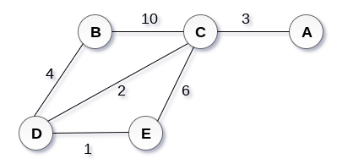
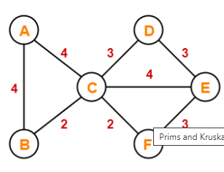
Assignment
Apply prim’s algorithm and Find minimum spanning tree for the below graphs

Slide 71
Applications
Minimum-cost spanning trees have many applications.
Some are:
Building cable networks that join n locations with minimum cost.
Building a road network that joins n cities with minimum cost.
Obtaining an independent set of circuit equations for an electrical network.
In pattern recognition minimal spanning trees can be used to find noisy pixels.

Slide 72
Applications
Consider, city network as a huge graph and now
plans to deploy telephone lines in such a way
that in minimum lines(wires) we can connect to
all city nodes. This is where the spanning tree
comes into picture.

Slide 73
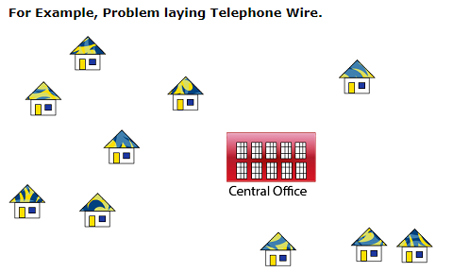
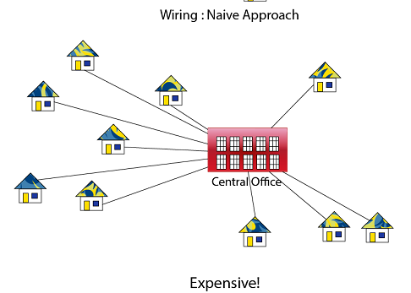
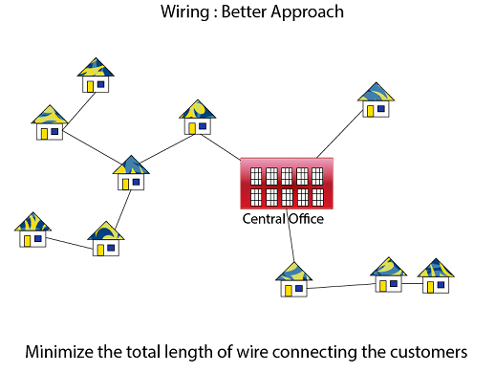

Slide 74
Optimal Tree Problem
Problem is that, we have to encode a text that comprises symbols from some n-symbol alphabet by assigning to each of the text’s symbols some sequence of bits called the codeword
There are two ways of encoding:
Fixed-length encoding and
Variable-length encoding.

Slide 75
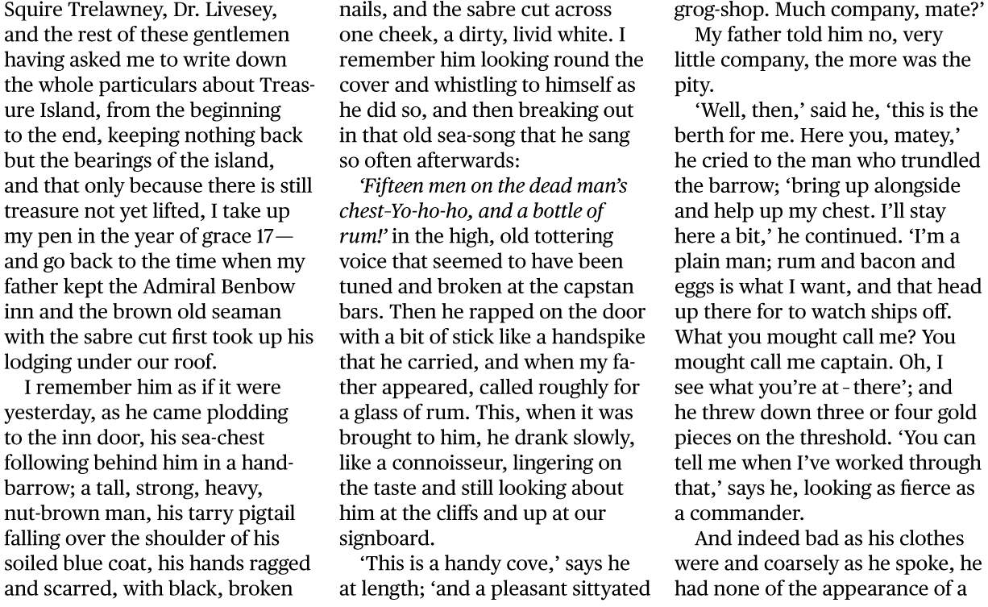
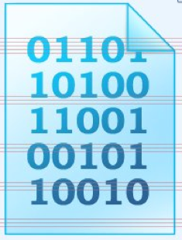
Optimal Tree Problem
Encoding
Compressed file
Original file
A technique to compress data effectively
Usually between 20%-90% compression
Lossless compression
No information is lost
When decompress, you get the original file

Slide 76
Optimal Tree Problem
Huffman coding
Compressed file
Original file
Saving space
Store compressed files instead of original files
Transmitting files or data
Send compressed data to save transmission time and power
Encryption and decryption
Cannot read the compressed file without knowing the “key”

Slide 77
Optimal Tree Problem
Assume in this file only 6 characters appear
E, A, C, T, K, N
The frequencies are:
Character | Frequency
E | 10,000
A | 4,000
C | 300
T | 200
K | 100
N | 100
Option I (No Compression)
Each character = 1 Byte (8 bits)
Total file size = 14,700 * 8 = 117,600 bits
Option 2 (Fixed length encoding- compression)
We have 6 characters, so we need
3 bits to encode them
Total file size = 14,700 * 3 = 44,100 bits
Character | Fixed Encoding
E | 000
A | 001
C | 010
T | 100
K | 110
N | 111

Slide 78
Optimal Tree Problem
Assume in this file only 6 characters appear
E, A, C, T, K, N
The frequencies are:
Character | Frequency
E | 10,000
A | 4,000
C | 300
T | 200
K | 100
N | 100
Option 3 (Variable length encoding - compression)
Variable-length compression
Assign shorter codes to more frequent characters and longer codes to less frequent characters
Total file size:
Char. | Variable Length Encoding
E | 0
A | 10
C | 110
T | 1110
K | 11110
N | 11111
(10,000 x 1) + (4,000 x 2) + (300 x 3) + (200 x 4) + (100 x 5) + (100 x 5) = 20,700 bits

Slide 79
Optimal Tree Problem
A variable-length coding for characters
More frequent characters ➔ shorter codes
Less frequent characters ➔ longer codes
It is not like ASCII coding where all characters have the same coding length (8 bits)
Two main questions
How to assign codes (Encoding process)?
How to decode (from the compressed file, generate the original file) (Decoding process)?

Slide 80
Decoding for fixed-length codes is much easier
Character | Fixed-length Encoding
E | 000
A | 001
C | 010
T | 100
K | 110
N | 111
010001100110111000
Divide into 3’s
010 001 100 110 111 000
Decode
C A T K N E

Slide 81
Decoding for variable-length codes is not that easy…
000001
Character | Variable-length Encoding
E | 0
A | 00
C | 001
… | …
… | …
… | …
It means what???
EEEC
EAC
AEC

Slide 82
Optimal Tree Problem
To avoid this complication, we can limit ourselves to the so-called prefix-free (or simply prefix) codes.
In a prefix code, no codeword is a prefix of a codeword of another symbol.
Hence, with such an encoding, we can simply scan a bit string until we get the first group of bits that is a codeword for some symbol, replace these bits by this symbol, and repeat this operation until the bit string‟s end is reached.
Example: a = 0, b = 101, c = 100
Decode 00100
Translates to “aac”

Slide 83
Optimal Tree Problem
The solution to the problem to create a binary prefix code for some alphabet, is to associate the alphabet’s symbols with leaves of a binary tree in which
all the left edges are labeled by 0
all the right edges are labeled by 1.

Slide 84
Optimal Tree Problem
The codeword of a symbol can then be obtained by recording the labels on the simple path from the root to the symbol’s leaf.
Among the many trees that can be constructed to solve this problem – The optimal one can be done by the greedy algorithm, invented by David Huffman known as Huffman algorithm.

Slide 85
Example
0
1
a
45
0
1
0
0
1
0
1
c
12
b
13
14
d
16
101
0
1
111
100
f
5
e
9
1100
1101

Slide 86
Huffman Algorithm
Step 1: Get Frequencies
Scan the file to be compressed and count the occurrence of each character
Sort the characters based on their frequency
Step 2: Build Tree & Assign Codes
Build a Huffman tree (binary tree)
Traverse the tree to assign codes
Step 3: Encode (Compress)
Scan the file again and replace each character by its code
Step 4: Decode (Decompress)
Huffman tree is the key to decompress the file

Slide 87
How to build Huffman tree ??
Step 1: Initialize ‘n’ one-node trees and label them with the symbols of the alphabet given. Record the frequency of each symbol in its tree’s root to indicate the tree’s weight.
Step 2: Repeat the following operation until a single tree is obtained.
Find two trees with the smallest weight.
Make them the left and right subtree of a new tree and record the sum of their weights in the root of the new tree as its weight.
Rearrange the nodes again in ascending order of weights
A tree constructed by the above algorithm is called as Huffman tree.
The codeword defined using this tree is called as Huffman code.

Slide 88

Huffman Code- Example
Construct the Huffman Code for the following data:
Encode the text DAD and decode the text 10011011011101
Solution

Slide 89
Assignment
Construct the Huffman Code for the following data: [July 2018]
Symbol | A | B | C | D | __
Probability | 0.4 | 0.1 | 0.2 | 0.15 | 0.15
Encode the text ABACABAD and decode the text 100010111001010

Slide 90
MODULE III
GREEDY METHOD

Slide 91
Heaps and Heap Sort
Why to study Heap Sort?
What is a Heap?
Examples
Types of Heaps
Representation of Heaps
Properties of Heaps
Construction of Heaps

Slide 92
Why study HeapSort?
It is a well-known, traditional sorting algorithm
Heapsort is always O(n log n)
Quicksort is usually O(n log n) but in the worst case slows to O(n²)
Quicksort is generally faster, but Heapsort is better in time-critical applications
Heapsort is an sorting algorithm used for real-time (or time-bound where QuickSort doesn’t fit) embedded systems where less space is available (MergeSort doesn’t fit).!

Slide 93


Slide 94
Why study HeapSort?
It uses the algorithm design approach so called Transform-and-conquer approach which work as two-stage procedures.
First, in the transformation stage, the problem‟s instance is modified to be, for one reason or another, more amenable to solution.
Then, in the second or conquering stage, it is solved.
Hence in heap sort, the instance is first transformed to heap and then sorted

Slide 95
What is a “Heap”?
Definitions of heap:
A large area of memory from which the programmer can allocate blocks as needed dynamically, and deallocate them (or allow them to be garbage collected) when no longer needed
A heap is a binary tree with keys assigned to its nodes, one key per node, provided the following two conditions are met:
The shape property—the binary tree is essentially complete (or simply complete), i.e., all its levels are full except possibly the last level, where only some rightmost leaves may be missing.
The parental dominance or heap property—the key in each node is greater than(lesser than) or equal to the keys in its children.
Heapsort uses the second definition

Slide 96
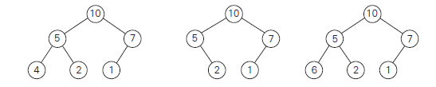
Heap Examples
Property | Heap | Not a Heap | Not a Heap
Shape | Yes | No | Yes
Heap | Yes | Yes | No

Slide 97
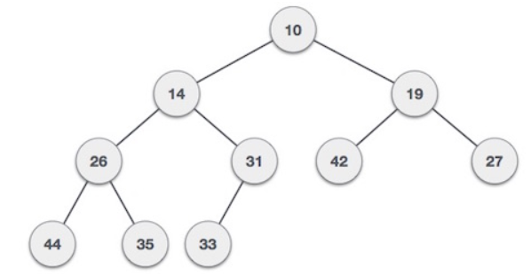
Types of Heaps
Two Types:
Min-Heap − Where the key in each node is lesser
than or equal to the keys in its children.

Slide 98
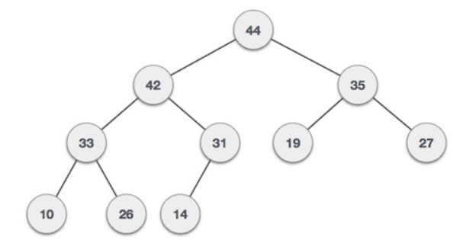
Types of Heaps
Max-Heap − Where the key in each node is greater
than or equal to the keys in its children.

Slide 99
Representation of Heaps
Heap and its array implementation
1
1
3
2
3
2
4
5
6
7
root = 1
Parent(i) = ⎣i/2⎦
Left(i)=2i
Right(i)=2i+1
8
7
29
6
8
9
10
18
14
9
last
H
1
3
2
8
7
29
6
18
14
9
1
2
3
4
5
6
7
8
9
10

Slide 100
Depth of tree nodes
Depth of a node is:
If node is the root - 0
Otherwise - (depth of its parent + 1)
Depth of a tree is maximum depth of its leaves.
0
1
1
2
2
A tree of depth 2

Slide 101
Height of tree nodes
Height of a node is:
If node is a leaf - 0
Otherwise - (maximum height of its children +1)
Height of a tree is the height of the root.
2
1
0
0
0
A tree of height 2

Slide 102
Properties of Heaps
There exists exactly one essentially complete binary tree with n nodes. Its height is equal to
The root of a heap always contains its largest element.
A node of a heap considered with all its descendants is also a heap.
A heap can be implemented as an array of size ‘n’ where n is the number of nodes

Slide 103
Constructions of Heap
There are two principal alternatives for constructing
Heap.
Top-down heap construction
Bottom-up heap construction

Slide 104
siftUp
Given a node that does not have the heap property, you can give it the heap property by exchanging its value with the value of the larger child
12
14
8
14
8
12
Blue node does not have heap property
Blue node has heap property
This is sometimes called sifting up
Notice that the child may have lost the heap property

Slide 105
Constructing a heap-Top down Approach
A tree consisting of a single node is automatically a heap
We construct a heap by adding nodes one at a time:
Add the node as last leaf node in the deepest level
If the deepest level is full, start a new level
Examples:
Add a new node here
Add a new node here

Slide 106
Constructing a heap
Each time we add a node, we may destroy the heap property of its parent node
To fix this, we sift up
But each time we sift up, the value of the topmost node in the sift may increase, and this may destroy the heap property of its parent node
We repeat the sifting up process, moving up in the tree, until either
We reach nodes whose values don’t need to be swapped (because the parent is still larger than both children), or
We reach the root

Slide 107
Constructing a heap
Construct the heap using top-down construction method: 8,10,5,12,14
8
8
10
10
10
8
8
5
1
2
3
10
10
12
8
5
12
5
10
5
12
8
8
4

Slide 108
Constructing a heap
12
12
14
10
5
14
5
12
5
8
14
8
10
8
10
The node containing 8 is not affected because its parent gets larger, not smaller
The node containing 5 is not affected because its parent gets larger, not smaller
The node containing 8 is still not affected because, although its parent got smaller, its parent is still greater than it was originally

Slide 109
A sample heap
Here’s a sample binary tree after it has been heapified
25
22
17
19
22
14
15
18
14
21
3
9
11
Notice that heapified does not mean sorted
Heapifying does not change the shape of the binary tree; this binary tree is balanced and left-justified because it started out that way

Slide 110


Operations on Heap
Build a Heap
Insert Operation
DeleteMax Operation(DeleteMin)
Remove Operation

Slide 111
Insert Operation
The algorithm constructs a heap by inserting a new key
K into a previously constructed heap
First, attach a new node with key K in it after the last leaf of the existing heap.
Then shift K up to its appropriate place in the new heap as follows.
Compare K with its parent’s key: if the parent is greater than or equal to K, stop (the structure is a heap); otherwise, swap these two keys and compare K with its new parent.
This swapping continues until K is not greater than its last parent or it reaches the root.

Slide 112
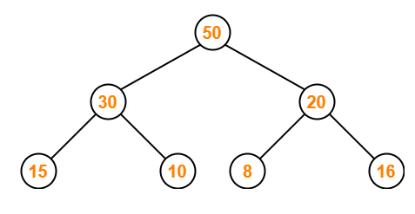
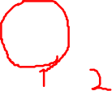


Insert Operation - Example
Consider the following max heap- 50, 30, 20, 15, 10, 8,
16. Insert a new node with value 60.
Solution:
Step-1:
We convert the given array of elements into a heap tree

Slide 113
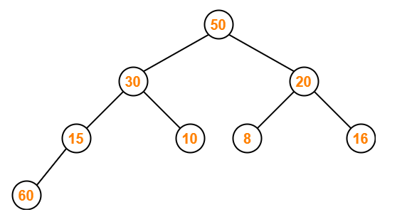
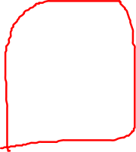
Insert Operation - Example
Step-2:
We insert the new element 60 as the last leaf node in the above
tree. The resulting tree after adding the new node is-

Slide 114
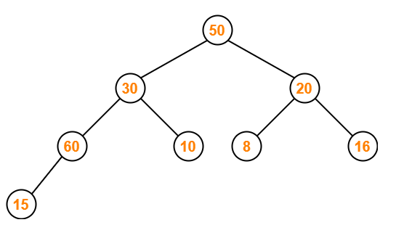
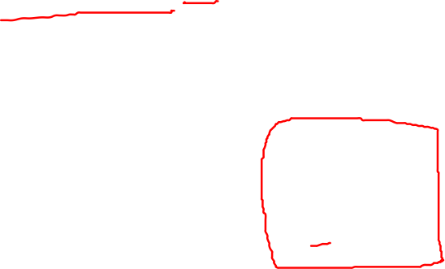
Insert Operation - Example
Step-3:
We must ensure that the resultant tree is a max heap.
Node 15 contains greater element in its left child node.
So, we swap node 15 and node 60.
The resulting tree is-

Slide 115
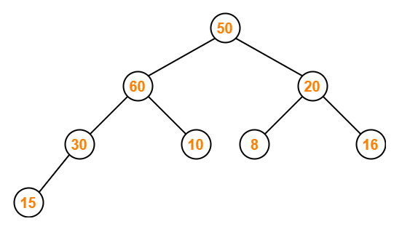

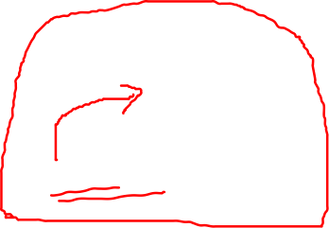
Insert Operation - Example
Step-4:
Node 30 contains greater element in its left child node.
So, we swap node 30 and node 60.
The resulting tree is-

Slide 116
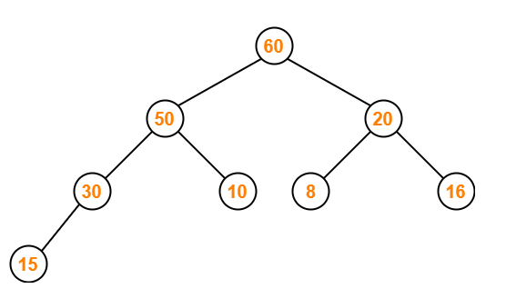
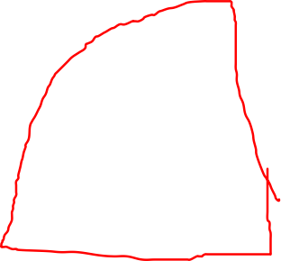


Insert Operation - Example
Step-5:
Node 50 contains greater element in its left child node.
So, we swap node 50 and node 60.
The resulting tree is-

Slide 117



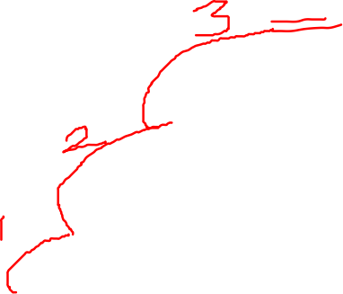
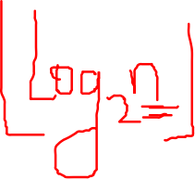

Insert Operation - Example
The resultant max-heap after insertion is 60,50,20,30,10,8,16,15
and its tree representation is shown below:

Slide 118
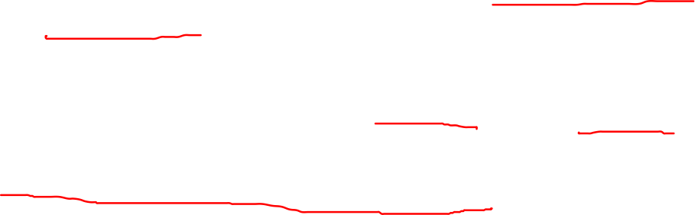
Insert Operation - Analysis
Insertion operation cannot require more key comparisons than the heap’s height.
Since the height of a heap with n nodes is about log₂ n
The time efficiency of insertion operation is O(log n).

Slide 119



Delete Max Operation-Removing the root
Notice that the largest number is now in the root
Suppose we discard the root:
11
22
17
19
22
14
15
18
14
21
3
9
11
How can we fix the problem after removing the root?
Solution: remove the rightmost leaf at the deepest level and use it for the new root

Slide 120

Delete Max Operation-Removing the root
Our tree is complete binary tree, but no longer a heap
However, only the root lacks the heap property
11
22
17
19
22
14
15
18
14
21
3
9
We can siftUp() the root
After doing this, one and only one of its children may have lost the heap property

Slide 121
Delete Max Operation-Removing the root
Now the left child of the root (still the number 11) lacks the heap property
22
11
17
19
22
14
15
18
14
21
3
9
We can siftUp() this node
After doing this, one and only one of its children may have lost the heap property

Slide 122
Delete Max Operation-Removing the root
Now the right child of the left child of the root (still the number 11) lacks the heap property:
22
22
17
19
11
14
15
18
14
21
3
9
We can siftUp() this node
After doing this, one and only one of its children may have lost the heap property —but it doesn’t, because it’s a leaf

Slide 123
Delete Max Operation-Removing the root
Our tree is once again a heap, because every node in it has the heap property
22
22
17
19
21
14
15
18
14
11
3
9
Once again, the largest (or a largest) value is in the root
We can repeat this process until the tree becomes empty
This produces a sequence of values in order largest to smallest

Slide 124
Assignment
Consider the heap 9,6,8,2,5,7. Insert 10
Consider the heap 10,6,9,2,5,7,8.Insert 20
Construct a max heap for the given array of elements-1, 5, 6, 8, 12, 14, 16
Consider the following max heap-50, 30, 20, 15, 10, 8, 16. Delete the root node. After heapifying delete the node 20.

Slide 125
Constructions of Heap
There are two principal alternatives for constructing
Heap.
Top-down heap construction
Bottom-up heap construction

Slide 126
Bottom-up heap construction
The bottom-up heap construction algorithm is illustrated bellow.
It initializes the essentially complete binary tree with n nodes by placing keys in the order given and then “heapifies” the tree as follows.
Starting with the last parental node, the algorithm checks whether the parental dominance holds for the key in this node. If it does not, the algorithm exchanges the node’s key K with the larger key of its children and checks whether the parental dominance holds for K in its new position. This process continues until the parental dominance for K is satisfied. (Eventually, it has to because it holds automatically for any key in a leaf.)
After completing the “heapification” of the subtree rooted at the current parental node, the algorithm proceeds to do the same for the node’s immediate predecessor
The algorithm stops after this is done for the root of the tree.

Slide 127
Bottom-up heap construction-Example
Bottom-up construction of a heap for the list 2,
9, 7, 6, 5, 8 is shown below.
Note: The double headed arrows show key
comparisons verifying the parental
dominance.
Solution:

Slide 128
Solution:
Step 1:Construct the array for the given list of elements and then construct the binary tree by placing the keys in the order given
Array:
[1] | [2] | [3] | [4] | [5] | [6]
2 | 9 | 7 | 6 | 5 | 8
Binary Tree:
2
9
7
6
5
8

Slide 129
Solution:
Step 2: Starting with the last parental node, the algorithm checks
whether the parental dominance holds for the key in this node is
satisfied. If it does not, the algorithm heapifies the subtree rooted
at the current parental node. This continues until we reach the
root
Here, the last parental node is 7
2
2
Exchange 7 and 8
9
7
9
8
6
5
6
5
7
8
After Heapification

Slide 130
Solution:
Step 2 (Continued):
The next last parental node is 9
2
2
No, Exchange required
9
8
9
8
6
5
7
6
5
7
After Heapification

Slide 131
Solution:
Step 2 (Continued):
The next last parental node is 2, which is the root
2
9
Exchange 2 and 9
9
8
2
8
6
5
7
6
5
7
9
Exchange 2 and 6
6
8
After Heapification
2
5
7

Slide 132
Solution:
Step 2(Continued):
The algorithm stops as we have reached the root.
Step 3: Therefore the heap that is constructed is
as below
9
6
8
2
5
7

Slide 133
Assignment
Construct the heap for the list 3,2,4,1,6,5, by using bottom-up algorithm
Construct the heap for the list 1, 5, 6, 8, 12, 14, 16,10, by using bottom-up algorithm

Slide 134
Heap Sort
Heapsort is an interesting sorting algorithm is discovered by
J.W. J. Williams.
This is a two- stage algorithm that works as follows.
Stage 1 (heap construction): Construct a heap(max-heap) for a given array.
Stage 2 (maximum deletions): Apply the root-deletion operation n−1 times to the remaining heap.
As a result, the array elements are eliminated in decreasing order.
But since under the array implementation of heaps an element
being deleted is placed last, the resulting array will be exactly the
original array sorted in increasing order.

Slide 135
Heap Sort- Example

Slide 136
Assignment
Sort the given list of elements using heap sort 2,9,7,6,5,8 [July 2017]
Sort the given list of elements using heap sort 3,2,4,1,6,5 [Jan 2019]

Slide 137
THANK YOU….

