Slide 1
Counting Inversions- Divide and Conquer

Slide 2
Counting Inversions
Music site tries to match your song preferences with others.
You rank n songs.
Music site consults database to find people with similar tastes.
Similarity metric: number of inversions between two rankings.
– My rank: 1, 2, …, n.
Your rank: a₁, a₂, …, a_{n}.
Songs i and j inverted if i < j, but a_{i} > a_{j}.
A B C
D
E
Me You
1
1
2
3
3
4
4
2
5
5
Inversions 3-2, 4-2
Songs
2

Slide 3
Counting Inversions
Two elements a[i] and a[j] form an inversion if a[i]>a[j] and i<j
a
0
1
2
3
4
Inversions
(2,1), (4,1),(4,3)
2
4
1
3
5
Inversion Count for an array indicates:How far (close)the array is from being sorted
if array is already sorted inversion count is ??
if array is sorted in reverse order that inversion count is the ???
D
E
2

Slide 4
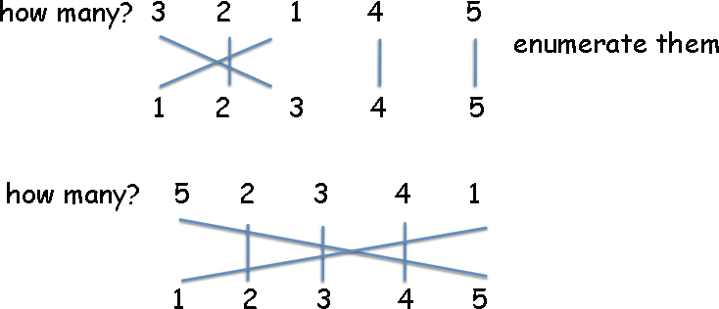
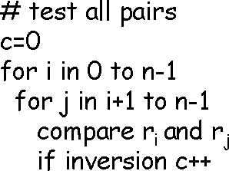
Visualizing inversions
Naive algorithm

Slide 5
Counting Inversions: Divide-and- Conquer
Divide-and-conquer.
1 5 4 8 10 2 6 9 12 11 3 7

Slide 6
Counting Inversions: Divide-and- Conquer
Divide-and-conquer.
– Divide: separate list into two pieces.
1 5 4 8 10 2 6 9 12 11 3 7
Divide: O(1).
1 5 4 8 10 2
6 9 12 11 3 7

Slide 7
Counting Inversions: Divide-and- Conquer
Divide-and-conquer.
Divide: separate list into two pieces.
Conquer: recursively count inversions in each half.
1 5 4 8 10 2 6 9 12 11 3 7
Divide: O(1).
1 5 4 8 10 2
6 9 12 11 3 7
Conquer: 2T(n / 2)
5 blue-blue inversions
8 green-green inversions
5-4, 5-2, 4-2, 8-2, 10-2
6-3, 9-3, 9-7, 12-3, 12-7, 12-11, 11-3, 11-7

Slide 8
Counting Inversions: Divide-and- Conquer
Divide-and-conquer.
Divide: separate list into two pieces.
Conquer: recursively count inversions in each half.
Combine: count inversions where a_{i} and a_{j} are in different halves, and return sum of three quantities.
1 5 4 8 10 2 6 9 12 11 3 7
Divide: O(1).
1 5 4 8 10 2
6 9 12 11 3 7
Conquer: 2T(n / 2)
5 blue-blue inversions
8 green-green inversions
9 blue-green inversions
5-3, 4-3, 8-6, 8-3, 8-7, 10-6, 10-9, 10-3, 10-7
Combine: ???
Total = 5 + 8 + 9 = 22.

Slide 9
Counting Inversions
4 7 6 2 1 5 8 3
Divide into front and back halves
4 | 7 | 6 | 2 |  | 1 | 5 | 8 | 3
 |  |  |  | 4
2 | 4 | 6 | 7 |  | 1 | 3 | 5 | 8
2
Count inversions within each half, and sort each half
Then, count inversions between front and back half

Slide 10
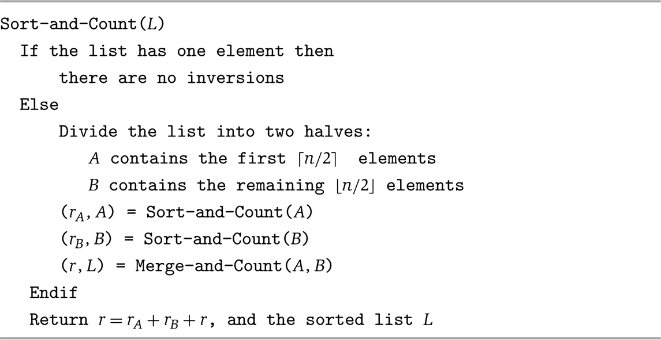
Counting Inversions: Implementation

Slide 11
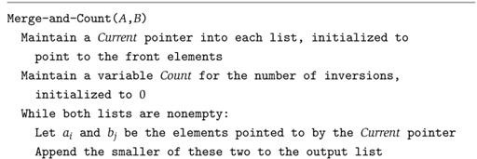


Counting Inversions: Implementation

Slide 12
Counting Inversions
Merge and count step.
Given two sorted halves, count number of inversions where a_{i} and a_{j} are in different halves.
Combine two sorted halves into sorted whole.
i = 6
3 7 10 14 18 19
2 11 16 17 23 25
two sorted halves
auxiliary array
Total:

Slide 13
Counting Inversions
Merge and count step.
Given two sorted halves, count number of inversions where a_{i} and a_{j} are in different halves.
Combine two sorted halves into sorted whole.
i = 6
3 7 10 14 18 19
2 11 16 17 23 25
two sorted halves
6
2
auxiliary array
Total: 6

Slide 14
Counting Inversions
Merge and count step.
Given two sorted halves, count number of inversions where a_{i} and a_{j} are in different halves.
Combine two sorted halves into sorted whole.
i = 6
3 7 10 14 18 19
2
16 17 23 25
11
two sorted halves
6
2
auxiliary array
Total: 6

Slide 15
Counting Inversions
Merge and count step.
Given two sorted halves, count number of inversions where a_{i} and a_{j} are in different halves.
Combine two sorted halves into sorted whole.
i = 6
3
7 10 14 18 19 2 11 16 17 23 25
two sorted halves
6
2 3
auxiliary array
Total: 6

Slide 16
Counting Inversions
Merge and count step.
Given two sorted halves, count number of inversions where a_{i} and a_{j} are in different halves.
Combine two sorted halves into sorted whole.
i = 5
3
7 10 14 18 19 2 11 16 17 23 25
two sorted halves
6
2 3
auxiliary array
Total: 6

Slide 17
Counting Inversions
Merge and count step.
Given two sorted halves, count number of inversions where a_{i} and a_{j} are in different halves.
Combine two sorted halves into sorted whole.
i = 5
3
7 10 14 18 19 2 11 16 17 23 25
two sorted halves
6
2 3 7
auxiliary array
Total: 6

Slide 18
Counting Inversions
Merge and count step.
Given two sorted halves, count number of inversions where a_{i} and a_{j} are in different halves.
Combine two sorted halves into sorted whole.
i = 4
3 7
10
14 18 19
2 11 16 17 23 25
two sorted halves
6
2 3 7
auxiliary array
Total: 6

Slide 19
Counting Inversions
Merge and count step.
Given two sorted halves, count number of inversions where a_{i} and a_{j} are in different halves.
Combine two sorted halves into sorted whole.
i = 4
3 7
10
14 18 19
2 11 16 17 23 25
two sorted halves
6
2 3 7 10
auxiliary array
Total: 6

Slide 20
Counting Inversions
Merge and count step.
Given two sorted halves, count number of inversions where a_{i} and a_{j} are in different halves.
Combine two sorted halves into sorted whole.
i = 3
3 7 10 14
18 19
2 11 16 17 23 25
two sorted halves
6
2 3 7 10
auxiliary array
Total: 6

Slide 21
Counting Inversions
Merge and count step.
Given two sorted halves, count number of inversions where a_{i} and a_{j} are in different halves.
Combine two sorted halves into sorted whole.
i = 3
3 | 7 10 | 14 | 18 | 19 |  |  | 2 |  |  | 11 |  | 16 | 17 | 23 | 25
 |  |  |  |  |  |  | 6 |  |  | 3
two sorted halves
2 3 7 10 11
auxiliary array
Total: 6 + 3

Slide 22
Counting Inversions
Merge and count step.
Given two sorted halves, count number of inversions where a_{i} and a_{j} are in different halves.
Combine two sorted halves into sorted whole.
i = 3
3 | 7 10 | 14 | 18 | 19 |  |  | 2 |  | 11 |  | 16 | 17 | 23 | 25
 |  |  |  |  |  |  | 6 |  | 3
two sorted halves
2 3 7 10 11
auxiliary array
Total: 6 + 3

Slide 23
Counting Inversions
Merge and count step.
Given two sorted halves, count number of inversions where a_{i} and a_{j} are in different halves.
Combine two sorted halves into sorted whole.
i = 3
3 | 7 10 | 14 | 18 | 19 |  |  | 2 |  | 11 | 16 | 17 | 23 | 25
 |  |  |  |  |  |  | 6 |  | 3
two sorted halves
2 3 7 10 11 14
auxiliary array
Total: 6 + 3

Slide 24
Counting Inversions
Merge and count step.
Given two sorted halves, count number of inversions where a_{i} and a_{j} are in different halves.
Combine two sorted halves into sorted whole.
i = 2
3 | 7 10 | 14 | 18 | 19 |  |  | 2 |  | 11 | 16 | 17 | 23 | 25
 |  |  |  |  |  |  | 6 |  | 3
two sorted halves
2 3 7 10 11 14
auxiliary array
Total: 6 + 3

Slide 25
Counting Inversions
Merge and count step.
Given two sorted halves, count number of inversions where a_{i} and a_{j} are in different halves.
Combine two sorted halves into sorted whole.
i = 2
3 | 7 10 | 14 | 18 | 19 |  |  | 2 |  | 11 |  |  | 16 |  | 17 | 23 | 25
 |  |  |  |  |  |  | 6 |  | 3 |  |  | 2
two sorted halves
2 3 7 10 11 14 16
auxiliary array
Total: 6 + 3 + 2

Slide 26
Counting Inversions
Merge and count step.
Given two sorted halves, count number of inversions where a_{i} and a_{j} are in different halves.
Combine two sorted halves into sorted whole.
i = 2
3 | 7 10 | 14 | 18 | 19 |  | 2 | 11 | 16 | 17 | 23 | 25
 |  |  |  |  |  | 6 | 3 | 2
two sorted halves
2 3 7 10 11 14 16
auxiliary array
Total: 6 + 3 + 2

Slide 27
Counting Inversions
Merge and count step.
Given two sorted halves, count number of inversions where a_{i} and a_{j} are in different halves.
Combine two sorted halves into sorted whole.
i = 2
3 | 7 10 | 14 | 18 | 19 |  | 2 | 11 | 16 |  | 17 |  | 23 | 25
 |  |  |  |  |  | 6 | 3 | 2 |  | 2
two sorted halves
2 3 7 10 11 14 16 17
auxiliary array
Total: 6 + 3 + 2 + 2

Slide 28
Counting Inversions
Merge and count step.
Given two sorted halves, count number of inversions where a_{i} and a_{j} are in different halves.
Combine two sorted halves into sorted whole.
i = 2
3 | 7 10 | 14 | 18 | 19 |  | 2 | 11 | 16 | 17 | 23 | 25
 |  |  |  |  |  | 6 | 3 | 2 | 2
two sorted halves
2 3 7 10 11 14 16 17
auxiliary array
Total: 6 + 3 + 2 + 2

Slide 29
Counting Inversions
Merge and count step.
Given two sorted halves, count number of inversions where a_{i} and a_{j} are in different halves.
Combine two sorted halves into sorted whole.
i = 2
3 | 7 10 | 14 | 18 | 19 |  | 2 | 11 | 16 | 17 | 23 | 25
 |  |  |  |  |  | 6 | 3 | 2 | 2
two sorted halves
2 3 7 10 11 14 16 17 18
auxiliary array
Total: 6 + 3 + 2 + 2

Slide 30
Counting Inversions
Merge and count step.
Given two sorted halves, count number of inversions where a_{i} and a_{j} are in different halves.
Combine two sorted halves into sorted whole.
i = 1
3 | 7 10 | 14 | 18 | 19 |  | 2 | 11 | 16 | 17 | 23 | 25
 |  |  |  |  |  | 6 | 3 | 2 | 2
two sorted halves
2 3 7 10 11 14 16 17 18
auxiliary array
Total: 6 + 3 + 2 + 2

Slide 31
Counting Inversions
Merge and count step.
Given two sorted halves, count number of inversions where a_{i} and a_{j} are in different halves.
Combine two sorted halves into sorted whole.
i = 1
3 | 7 10 | 14 | 18 | 19 |  | 2 | 11 | 16 | 17 | 23 | 25
 |  |  |  |  |  | 6 | 3 | 2 | 2
two sorted halves
2 3 7 10 11 14 16 17 18 19
auxiliary array
Total: 6 + 3 + 2 + 2

Slide 32
Counting Inversions
Merge and count step.
Given two sorted halves, count number of inversions where a_{i} and a_{j} are in different halves.
Combine two sorted halves into sorted whole.
first half exhausted i = 0
3 | 7 10 | 14 | 18 | 19 |  | 2 | 11 | 16 | 17 | 23 | 25
 |  |  |  |  |  | 6 | 3 | 2 | 2
two sorted halves
2 3 7 10 11 14 16 17 18 19
auxiliary array
Total: 6 + 3 + 2 + 2

Slide 33
Counting Inversions
Merge and count step.
Given two sorted halves, count number of inversions where a_{i} and a_{j} are in different halves.
Combine two sorted halves into sorted whole.
i = 0
3 | 7 10 | 14 | 18 | 19 |  | 2 | 11 | 16 | 17 |  | 23 |  | 25
 |  |  |  |  |  | 6 | 3 | 2 | 2 |  | 0
two sorted halves
2 3 7 10 11 14 16 17 18 19 23
auxiliary array
Total: 6 + 3 + 2 + 2 + 0

Slide 34
Counting Inversions
Merge and count step.
Given two sorted halves, count number of inversions where a_{i} and a_{j} are in different halves.
Combine two sorted halves into sorted whole.
i = 0
3 | 7 10 | 14 | 18 | 19 |  | 2 | 11 | 16 | 17 | 23 |  | 25
 |  |  |  |  |  | 6 | 3 | 2 | 2 | 0 |  | 0
two sorted halves
2 3 7 10 11 14 16 17 18 19 23 25
auxiliary array
Total: 6 + 3 + 2 + 2 + 0 + 0

Slide 35
Counting Inversions
Merge and count step.
Given two sorted halves, count number of inversions where a_{i} and a_{j} are in different halves.
Combine two sorted halves into sorted whole.
i = 0
3 | 7 10 | 14 | 18 | 19 |  | 2 | 11 | 16 | 17 | 23 | 25
 |  |  |  |  |  | 6 | 3 | 2 | 2 | 0 | 0
two sorted halves
2 3 7 10 11 14 16 17 18 19 23 25
auxiliary array
Total: 6 + 3 + 2 + 2 + 0 + 0 = 13

Slide 36
The e-commerce application
Have you ever noticed on any e-commerce website, they have this section of "You might like", they have maintained an array for all the user accounts and then whichever has the least number of inversion with your array of choices, they start recommending what they have bought or they like

