Slide 1
UNIT-5
Text Book: Horowitz, Sahni, Anderson-Freed: Fundamentals of Data Structures in C, 2nd Edition, Universities Press, 2008.

Slide 2
Contents
Graphs: The Graph Abstract Data Type
Elementary Graph Operations.
Priority Queues: Single- and Double-Ended Priority Queues
Leftist Trees.
Efficient Binary Search Trees: AVL Trees.

Slide 3
Graphs
A Graph is a non-linear data structure consisting of vertices and edges. The vertices are sometimes also referred to as nodes and the edges are lines or arcs that connect any two nodes in the graph. More formally a Graph is composed of a set of vertices( V ) and a set of edges( E ). The graph is denoted by G(E, V).
A graph G consists of two sets
a finite, nonempty set of vertices V(G)
a finite, possible empty set of edges E(G)
G(V,E) represents a graph
An undirected graph is one in which the pair of vertices in a edge is unordered, (v0, v1) = (v1,v0)
A directed graph is one in which each edge is a directed pair of vertices, <v0, v1> != <v1,v0>

Slide 4
Examples for Graph
0
0
0
1
2
1 2
4 5
1
3
3
6
G1
complete graph
2
G3
G2
incomplete graph
V(G1)={0,1,2,3} V(G2)={0,1,2,3,4,5,6} V(G3)={0,1,2}
E(G1)={(0,1),(0,2),(0,3),(1,2),(1,3),(2,3)}
E(G2)={(0,1),(0,2),(1,3),(1,4),(2,5),(2,6)} E(G3)={<0,1>,<1,0>,<1,2>}
complete undirected graph: n(n-1)/2 edges complete directed graph: n(n-1) edges
CHAPTER 6

Slide 5

Adjacent and Incident
If (v0, v1) is an edge in an undirected graph,
v0 and v1 are adjacent
The edge (v0, v1) is incident on vertices v0 and v1
If <v0, v1> is an edge in a directed graph
v0 is adjacent to v1, and v1 is adjacent from v0
The edge <v0, v1> is incident on v0 and v1
CHAPTER 6

Slide 6
*Figure 6.3:Example of a graph with feedback loops and a
multigraph (p.260)
0
0
2
1
3
1
2
self edge
multigraph:
multiple occurrences of the same edge
(a)
(b)
CHAPTER 6

Slide 7
Subgraph and Path
A subgraph of G is a graph G’ such that V(G’)
is a subset of V(G) and E(G’) is a subset of E(G)
A path from vertex vp to vertex vq in a graph G, is a sequence of vertices, vp, vi1, vi2, ..., vin, vq, such that (vp, vi1), (vi1, vi2), ..., (vin, vq) are edges in an undirected graph
The length of a path is the number of edges on it
CHAPTER 6

Slide 8
Figure 6.4: subgraphs of G₁ and G₃ (p.261)
0
0 0 1
1 2
2
0
1
2
3
1
2
3
3
G1
(i)
(ii) (iii)
(a) Some of the subgraph of G₁
(iv)
0
0
0
0
0
單一
1
1
1
1
分開
2
2
2
(i)
(ii) (iii)
(b) Some of the subgraph of G₃
(iv)
G3
CHAPTER 6
8

Slide 9
Simple Path and Style
A simple path is a path in which all vertices, except possibly the first and the last, are distinct
A cycle is a simple path in which the first and the last vertices are the same
In an undirected graph G, two vertices, v0 and v1, are connected if there is a path in G from v0 to v1
An undirected graph is connected if, for every pair of distinct vertices vi, vj, there is a path from vi to vj
CHAPTER 6

Slide 10
Connected Component
A connected component of an undirected graph is a maximal connected subgraph.
A tree is a graph that is connected and acyclic. A directed graph is strongly connected if there is a directed path from vi to vj and also
from vj to vi.
A strongly connected component is a maximal subgraph that is strongly connected.
CHAPTER 6

Slide 11
Degree
The degree of a vertex is the number of edges incident to that vertex
For directed graph,
the in-degree of a vertex v is the number of edges that have v as the head
the out-degree of a vertex v is the number of edges that have v as the tail
if di is the degree of a vertex i in a graph G with n
vertices and e edges, the number of edges is
e = (∑ d_{i} ) / 2
0
n −1
CHAPTER 6

Slide 12
undirected graph
degree
3
0
0
1
3
2
2
3
3
1 2 ₃
3
1
4 5
¹ G2 ¹
6
1
3
G1³
0
in:1, out: 1
directed graph in-degree
out-degree
1
in: 1, out: 2
2
G3
in: 1, out: 0
CHAPTER 6

Slide 13
ADT for Graph
structure Graph is
objects: a nonempty set of vertices and a set of undirected edges, where each edge is a pair of vertices
functions: for all graph ∈ Graph, v, v₁ and v₂ ∈ Vertices
Graph Create()::=return an empty graph
Graph InsertVertex(graph, v)::= return a graph with v inserted. v has no
incident edge.
Graph InsertEdge(graph, v1,v2)::= return a graph with new edge
between v1 and v2
Graph DeleteVertex(graph, v)::= return a graph in which v and all edges
incident to it are removed
Graph DeleteEdge(graph, v1, v2)::=return a graph in which the edge (v1, v2)
is removed
Boolean IsEmpty(graph)::= if (graph==empty graph) return TRUE
else return FALSE
List Adjacent(graph,v)::= return a list of all vertices that are adjacent to v
CHAPTER 6

Slide 14
Graph Representations
Adjacency Matrix Adjacency Lists
CHAPTER 6

Slide 15
Adjacency Matrix
Let G=(V,E) be a graph with n vertices.
The adjacency matrix of G is a two-dimensional n by n array, say adj_mat
If the edge (vi, vj) is in E(G), adj_mat[i][j]=1
If there is no such edge in E(G), adj_mat[i][j]=0
The adjacency matrix for an undirected graph is symmetric; the adjacency matrix for a digraph need not be symmetric
CHAPTER 6

Slide 16
Examples for Adjacency Matrix
0
0
0
4
2 1
5
1
2
3
6
3
⎡0 1 1 1 ⎤
⎢ 0 1 ⎥
⎢1 1 0 1 ⎥
⎣1 1 1 0⎦
G1
1
⎡0 1 0⎤
0
0
⎢₁
₁ ⎥
⎢₁
₁ ⎥
7
⎡0 1 1 0 0 0 0 0⎤
0 0 1 0 0 0
0 0 1 0 0 0
1 1 0 0 0 0
⎢ 0 0 0 0 1 0 ⎥
⎢0 0 0 0 1 0 1 0⎥
⎢ 0 0 0 0 1 0 ⎥
⎢⎣0 0 0 0 0 0 1 0⎥⎦
2
⎢
⎢⎣0
⎥
0⎥⎦
⎢₁
₀⎥
⎢
⎥
⎢
⎢1
⎥
0⎥
⎥
G2
⎢₀
⎢
0
⎥
⎢₀
₀⎥
symmetric
⎢₀
₁ ⎥
undirected: n²/2
directed: n²
CHAPTER 6
G4
16

Slide 17
Merits of Adjacency Matrix
From the adjacency matrix, to determine the connection of vertices is easy
n −1
The degree of a vertex is ∑^{adj_ mat[i][ j]}
j =0
For a digraph, the row sum is the out_degree,
while the column sum is the in_degree
ind (vi) = ∑ A[ j,i]
j =0
n−1 n−1
outd (vi) = ∑ A[i, j]
j =0
CHAPTER 6

Slide 18
Data Structures for Adjacency Lists
Each row in adjacency matrix is represented as an adjacency list.
#define | MAX_VERTICES | 50
typedef | struct node | *node_pointer;
typedef | struct node | {
int | vertex;
struct node *link;
};
node_pointer graph[MAX_VERTICES];
int n=0; /* vertices currently in use */
CHAPTER 6

Slide 19
0
0
4
2
1
5
1
2
3
6
3
7
0
1
2
3
1
2
3
0
1
2
3
4
5
6
7
1
2
0
2
3
0
3
0
1
3
0
3
0
1
2
1
2
G1
0
5
4
6
0
1
2
1
5
7
0
2
1
6
G3
2
CHAPTER 6
G4
An undirected graph with n vertices and e edges ==> n head nodes and 2e list nodes
19

Slide 20
Interesting Operations
degree of a vertex in an undirected graph
–# of nodes in adjacency list
# of edges in a graph
–determined in O(n+e)
out-degree of a vertex in a directed graph
–# of nodes in its adjacency list
in-degree of a vertex in a directed graph
–traverse the whole data structure
CHAPTER 6

Slide 21
Some Graph Operations
Traversal
Given G=(V,E) and vertex v, find all w∈V, such that w connects v.
Depth First Search (DFS) preorder tree traversal
Breadth First Search (BFS) level order tree traversal
Connected Components Spanning Trees
CHAPTER 6

Slide 22
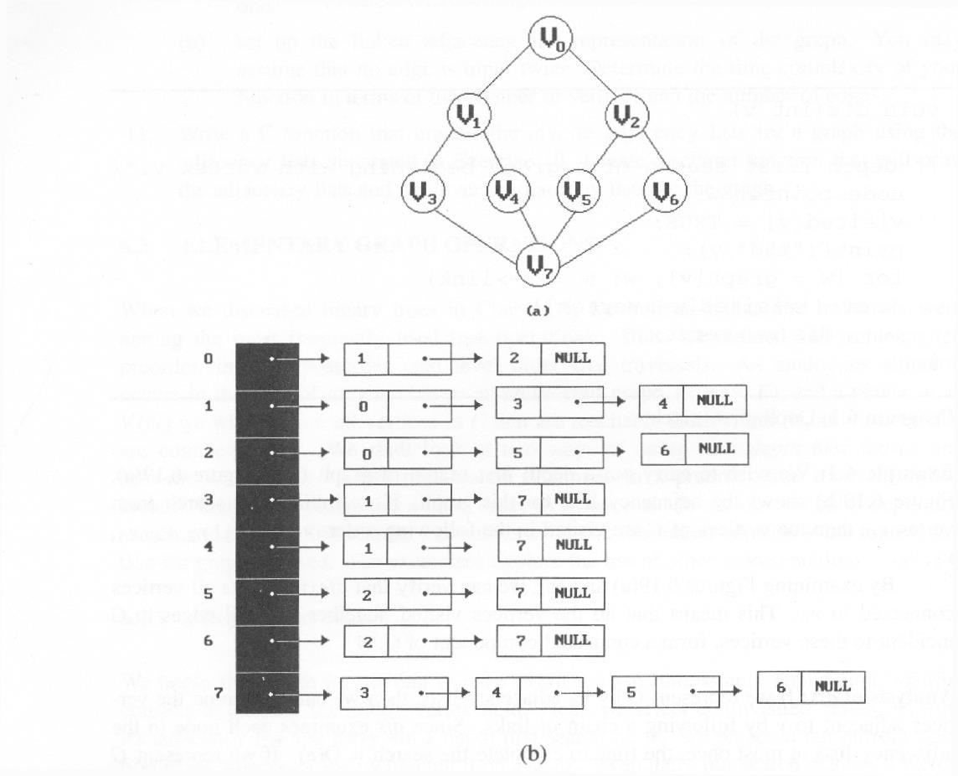
*Figure 6.19:Graph G and its adjacency lists (p.274)
depth first search: v0, v1, v3, v7, v4, v5, v2, v6
breadth first search: v0, v1, v2, v3, v4, v5, v6, v7
CHAPTER 6

Slide 23
Depth First Search
#define FALSE 0
#define TRUE 1
short int visited[MAX_VERTICES];
void dfs(int v)
{
node_pointer w; visited[v]= TRUE; printf(“%5d”, v);
for (w=graph[v]; w; w=w->link) if (!visited[w->vertex])
dfs(w->vertex);
Data structure
adjacency list: O(e) adjacency matrix: O(n²)
}
CHAPTER 6

Slide 24
Breadth First Search
typedef | struct | queue | *queue_pointer;
typedef | struct | queue | {
int | vertex;
queue_pointer link;
};
void addq(queue_pointer *,
queue_pointer *, int);
int deleteq(queue_pointer *);
CHAPTER 6

Slide 25
Breadth First Search (Continued)
void bfs(int v)
{
node_pointer w; queue_pointer front, rear;
front = rear = NULL; printf(“%5d”, v); visited[v] = TRUE;
adjacency list: O(e)
adjacency matrix: O(n²)
addq(&front, &rear, v);
CHAPTER 6

Slide 26
while (front) {
v= deleteq(&front);
for (w=graph[v]; w; w=w->link) if (!visited[w->vertex]) {
printf(“%5d”, w->vertex); addq(&front, &rear, w->vertex); visited[w->vertex] = TRUE;
}
}
}
CHAPTER 6

Slide 27
Connected Components
void connected(void)
{
for (i=0; i<n; i++) { if (!visited[i]) {
dfs(i);
printf(“\n”);
}
}
adjacency list: O(n+e) adjacency matrix: O(n²)
}
CHAPTER 6

Slide 28
Spanning Trees
When graph G is connected, a depth first or breadth first search starting at any vertex will visit all vertices in G
A spanning tree is any tree that consists solely of edges in G and that includes all the vertices
E(G): T (tree edges) + N (nontree edges)
where
T: set of edges used during search N: set of remaining edges
CHAPTER 6

Slide 29
Examples of Spanning Tree
0
0
0
0
1
2 1
2 1
2
1
2
3
3
3
3
G1
Possible spanning trees
CHAPTER 6

Slide 30
Spanning Trees
Either dfs or bfs can be used to create a spanning tree
When dfs is used, the resulting spanning tree is known as a depth first spanning tree
When bfs is used, the resulting spanning tree is known as a breadth first spanning tree
While adding a nontree edge into any spanning tree, this will create a cycle
CHAPTER 6

Slide 31
DFS VS BFS Spanning Tree
0
0
0
1
2
1
2
1
2
3
4
5 6
3
4
5 6 3
nontree edge
cycle
4 5
6
7
7
7
DFS Spanning
BFS Spanning
CHAPTER 6

Slide 32
A spanning tree is a minimal subgraph, G’, of G such that V(G’)=V(G) and G’ is connected.
Any connected graph with n vertices must have at least n-1 edges.
CHAPTER 6

Slide 33
Applications of the Spanning Tree
A spanning tree is preferred to discover the shortest path to link all nodes of the graph. In this section, we will discuss some of the most famous and common applications of the spanning tree:
A spanning tree is very helpful in the civil network zone and planning.
It is used in network routing protocol.

Slide 34
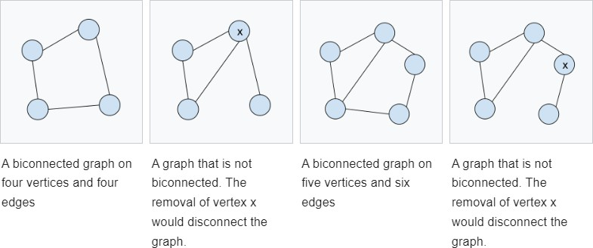
Biconnected Components
A biconnected undirected graph is a connected graph that is not broken into disconnected pieces by deleting any single vertex (and its incident edges).

Slide 35
Articulation Points (or Cut Vertices) in a Graph
A vertex v is an articulation point (also called cut vertex) if removing v increases the number of connected components(graph count).
Articulation points represent vulnerabilities in a connected network – single points whose failure would split the network into 2 or more components. They are useful for designing reliable networks.

Slide 36
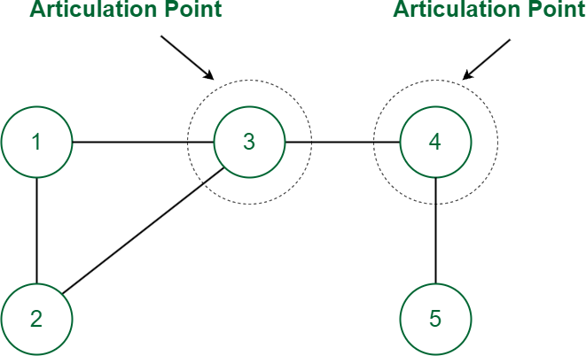

Slide 37
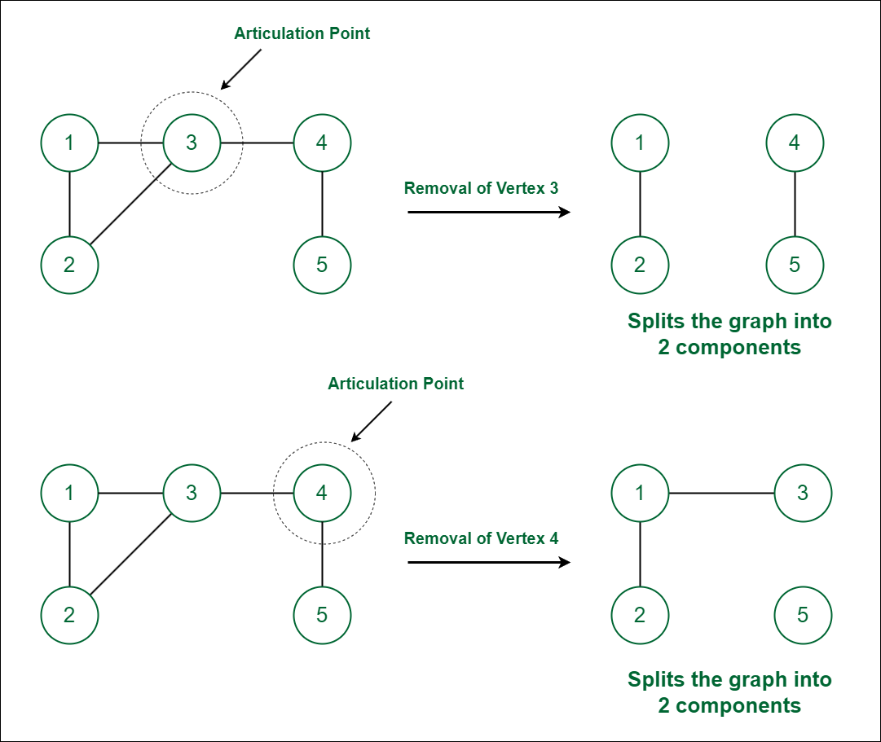

Slide 38
0
8 9
7
1
2
3
5
connected graph
4
two connected components
6
one connected graph
8 9
7
0
8 9
7
0
1
1
2
3
5
2
3
5
4
6
4
6
CHAPTER 6
38

Slide 39
Priority Queues
A priority queue is a type of queue that arranges elements based on their priority values. Elements with higher priority values are typically retrieved before elements with lower priority values.
In a priority queue, each element has a priority value associated with it. When you add an element to the queue, it is inserted in a position based on its priority value. For example, if you add an element with a high priority value to a priority queue, it may be inserted near the front of the queue, while an element with a low priority value may be inserted near the back
Two Varieties:
Single-ended
Double-ended

Slide 40
Single-ended Priority Queue
Operations supported by single ended priority queue:
SP1: Return an element with minimum/maximum priority.
SP2: Insert an element with arbitrary priority.
SP3: Delete an element with minimum /maximum priority.

Slide 41
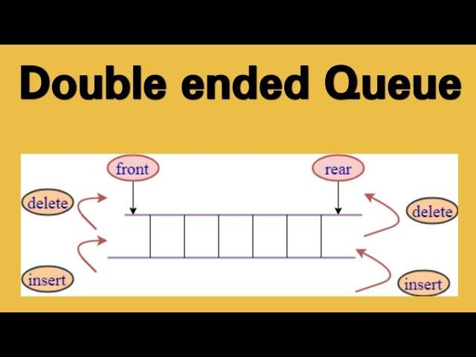

Slide 42
Double-ended Priority Queue
Operations supported by Double ended priority queue:
DP1: Return an element with minimum priority.
DP2: Return an element with maximum priority.
DP3: Insert an element with arbitrary priority.
DP4: Delete an element with minimum priority.
DP5: Delete an element with maximum priority.

Slide 43
DEPQ used as network buffer
The buffer holds the packets that are waiting their turn to be sent out over a network link, each packet as an associated priority.
DeleteMax : When the network link become available, a packet with highest priority is deleted.
Insert : When the packet arrives to the network, added to the buffer.
DeleteMin: If the buffer is full, the packets with minimum priority are dropped.

Slide 44
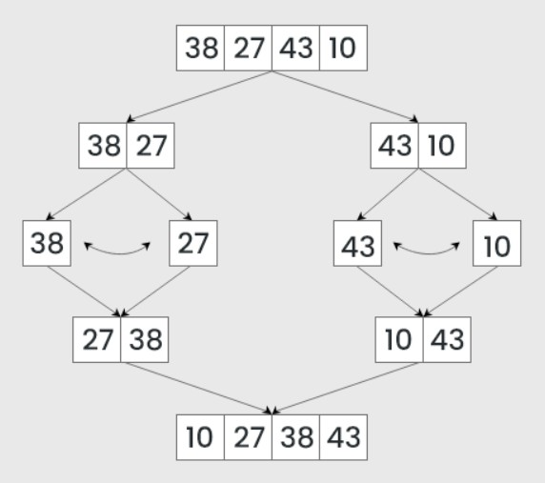
Merge Sort-DEPQ
Read in as many elements as will fit into an internal DEPQ. The elements in the DEPQ will eventually be the middle group of elements.
Process the remaining element one at a time.
Sort the left and right groups recursively.

Slide 45
Leftist Tree
Leftist tree provide an efficient implementation of meldable priority queues.,
Let n be the total number of elements in the two priority queues that are to be melded, if heap are used to represent meldable queues, it takes o(n) time. Usage of leftist tree takes logarithmic time.
It used concept of extended binary tree.
Two Varieties:
Height Biased
Weight Biased

Slide 46
Height Biased Leftist Tree
A
G
B
C
H
I
D
F
J
E
Binary trees

Slide 47
Height Biased Leftist Tree
A
G
B
C
H
I
D
F
J
E
Extended Binary trees

Slide 48
Shortest(x)
Now suppose s(x) be the length of a shortest path from node x to an external node in its subtree. If x is an external node, its s(x) value is 0. If the x is an internal node, the value is −
min{𝑠(𝐿), 𝑠(𝑅)} + 1
A leftist tree is a binary tree such that if it is not empty , then
shortest(leftchild(x)) > shortest(rightchild(x))

Slide 49
Height Biased Leftist Tree
2
A
G
2
B
1
C
H
I
1
1
1
F
J
D
E

Slide 50
Min- Height Biased Leftist Tree
2
2
5
2
1
8
1
1
7
1
50
9
2
1
10
1
1
12
11
80
1
1
1
20
1
18
13
15

Slide 51
Min- Height Biased Leftist Tree
2
2
5
2
1
8
1
1
7
1
50
9
2
1
10
1
1
12
11
80
1
1
1
20
1
18
13
15
Compare root nodes 2 and 5, as 2<5 , 2 must be the root

Slide 52
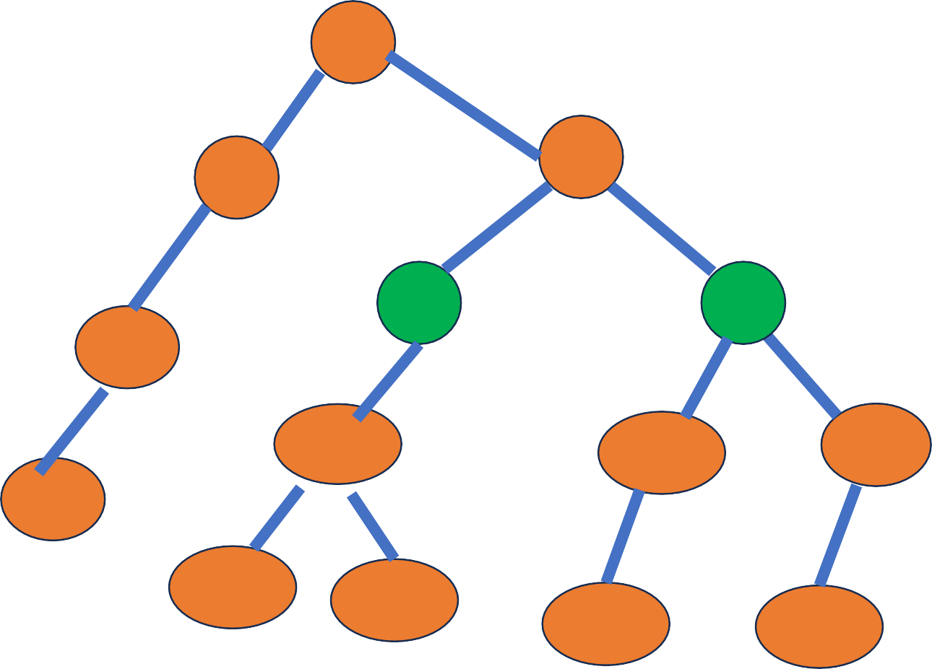
Min- Height Biased Leftist Tree
2
2
After adding , it can be observed that result is not leftist tree, for node 5, leftchild(s(5))<rightchild(s(5))
2
1
7
5
2
8
1
9
1
11
Swap left tree and right tree of node 5
1
10
1
50
2
1
12
13
1
1
20
1
1
18
15
80

Slide 53
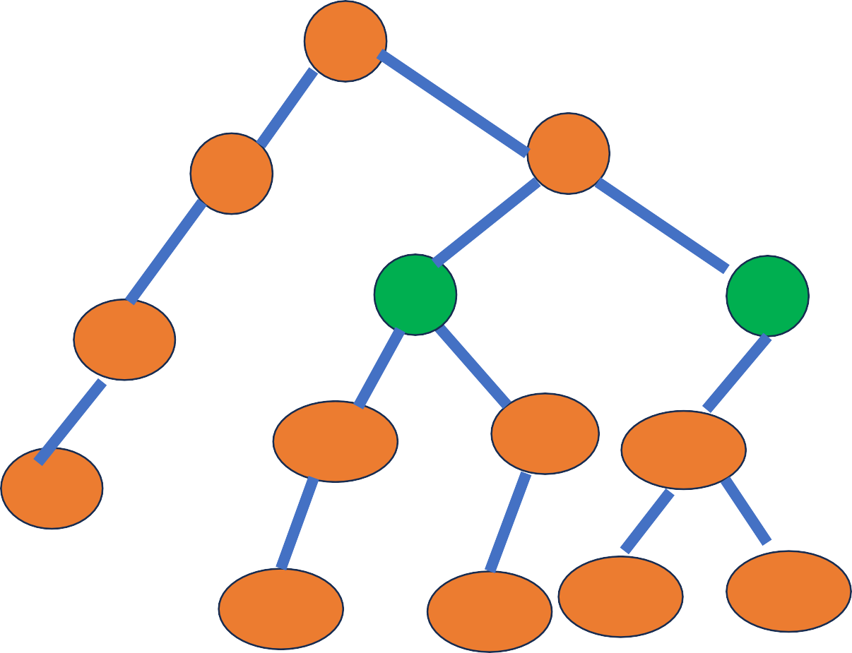
Min- Height Biased Leftist Tree
2
2
Still it needs swap as for node 2,
leftchild(s(2))<rightchild(s(2))
2
1
7
5
2
1
Swap left tree and right tree of node 2
8
9
1
11
1
50
1
2
12
1
10
13
1
1
1
1
15
80
20
18

Slide 54
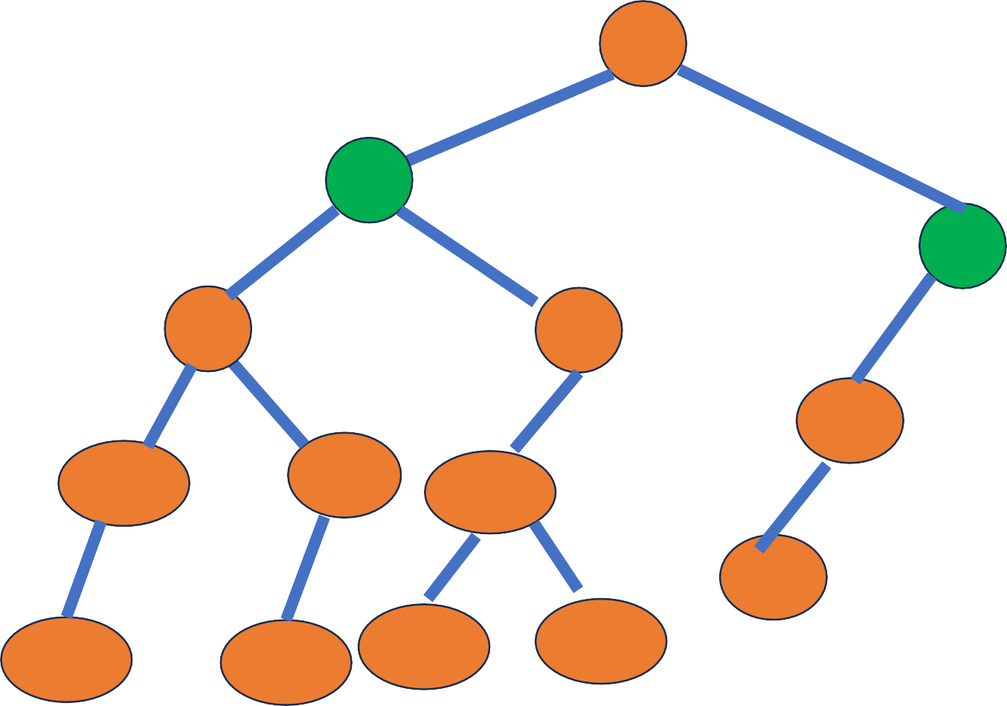
Min- Height Biased Leftist Tree
2
2
2
5
1
2
7
1
8
9
1
10
1
50
1
2
12
11
1
1
13
1
1
1
15
80
20
18

Slide 55
Weight Biased Leftist Tree
6
4
G
A
2
1
3
H
I
B
2
C
1
1
J
1
1
0
F
0
0
0
D
E
0
0 0
0
0
0
If x is an external node, its weight(x) value is 0. If the x is an internal
node, the value is =1+sum of weights of its children. Leftist property must also be satisfied. Only b is leftist

Slide 56
AVL Trees
An AVL tree defined as a self-balancing Binary Search Tree (BST) where the difference between heights of left and right subtrees for any node cannot be more than one(balance factor).
The difference between the heights of the left subtree and the right subtree for any node is known as the balance factor of the node.
The AVL tree is named after its inventors, Georgy Adelson-Velsky and Evgenii Landis, who published it in their 1962 paper “An algorithm for the organization of information”.

Slide 57
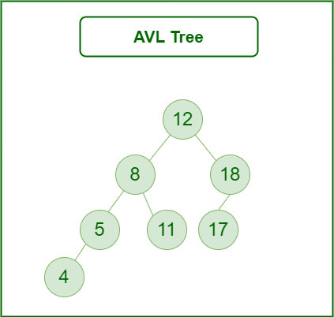
Balance factor
A Balance factor , BF(T) of a node T in a binary tree is defined to be hL-hR. hL-Height of Left subtree.
hR-Height of Right Subtree. For any node T in an AVL tree,
BF(T)=-1,0,1

Slide 58
Rotating the subtrees in an AVL Tree:
Left Rotation
Right Rotation
Left-Right Rotation
Right-Left Rotation

Slide 59
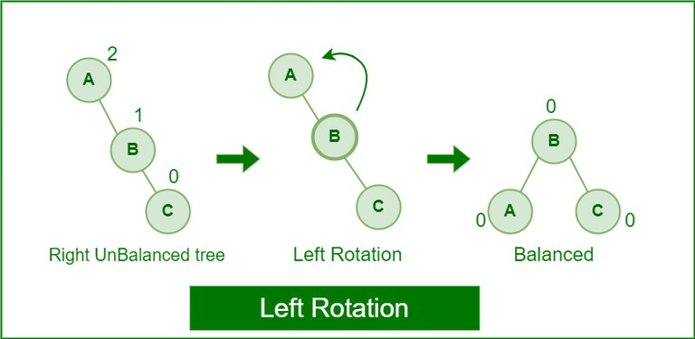
Left Rotation
When a node is added into the right subtree of the right subtree, if the tree gets out of balance, we do a single left rotation.

Slide 60
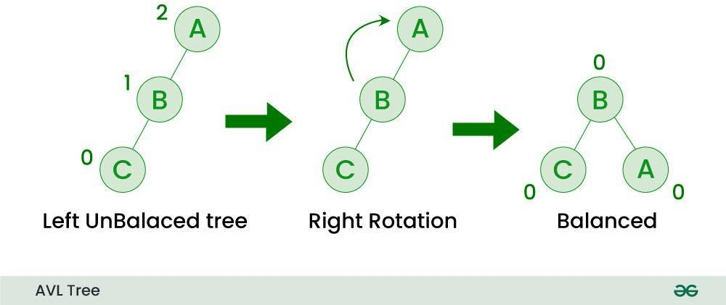
Right Rotation
If a node is added to the left subtree of the left subtree, the AVL tree may get out of balance, we do a single right rotation.

Slide 61
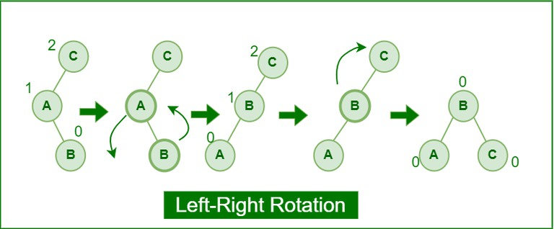
Left-Right Rotation
A left-right rotation is a combination in which first left rotation takes place after that right rotation executes.

Slide 62
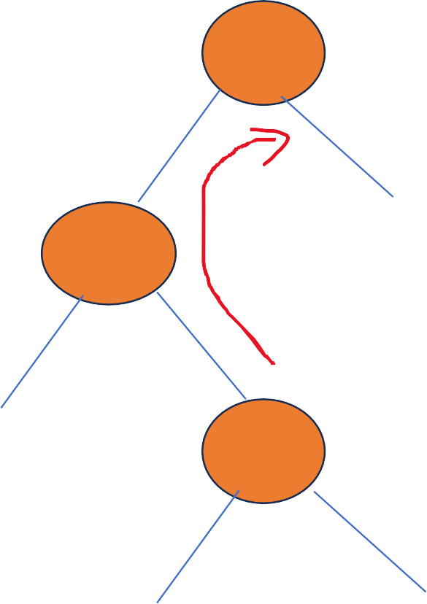
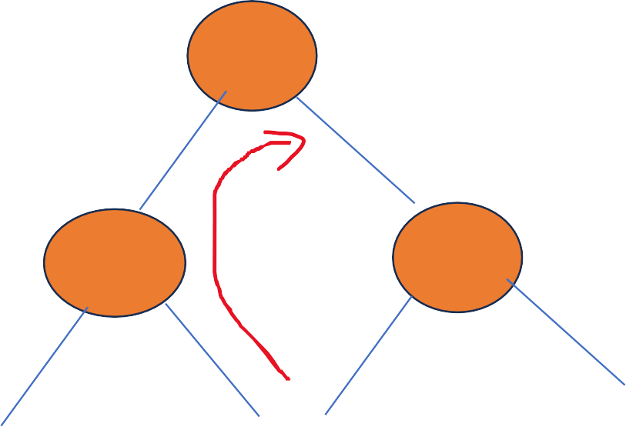
Left-Right Rotation – More Nodes
A
C
AR
A
B
B
BL
BL
CL
CR
AR
C
CL
CR

Slide 63
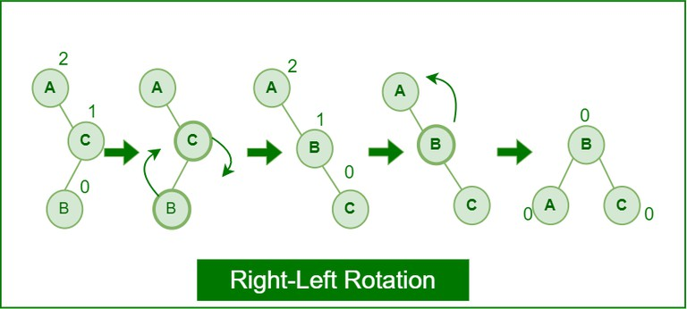
Right-Left Rotation
A right-left rotation is a combination in which first right rotation takes place after that left rotation executes.

Slide 64
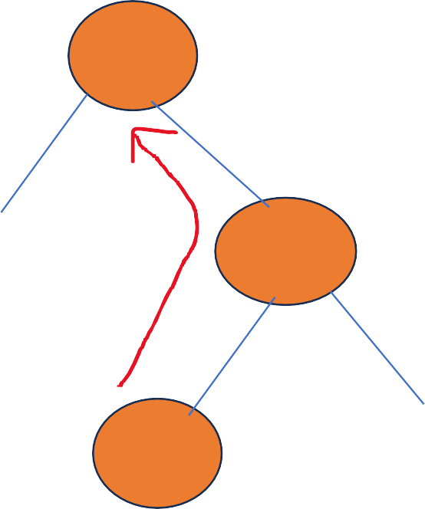
Left-Right Rotation – More Nodes
A
C
AL
B
A
B
BR
AL
CL
CR
BR
C
CL
CR

Slide 65
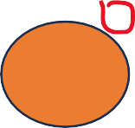
Construction of AVL Trees
40,20,10,25,30,22,50
40

Slide 66
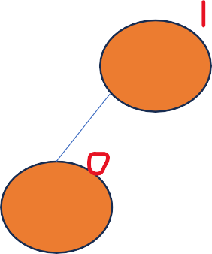
Construction of AVL Trees
40,20,10,25,30,22,50
40
20

Slide 67
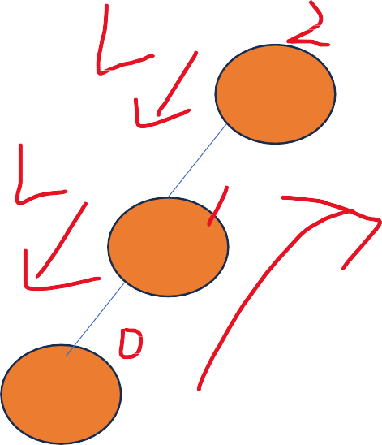
Construction of AVL Trees
40,20,10,25,30,22,50
40
Imbalance , Apply LL Rotation
20
10

Slide 68
Construction of AVL Trees
40,20,10,25,30,22,50
20
10
40

Slide 69
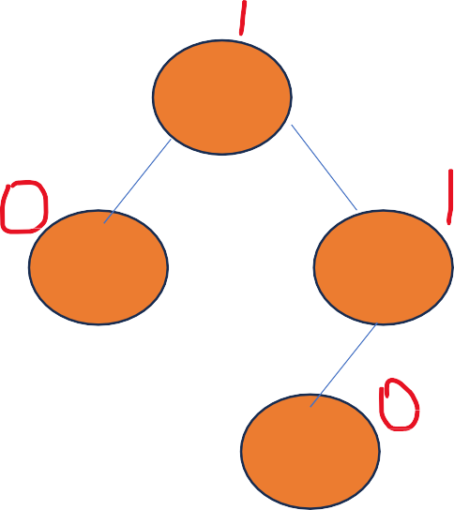
Construction of AVL Trees
40,20,10,25,30,22,50
20
10
40
25

Slide 70

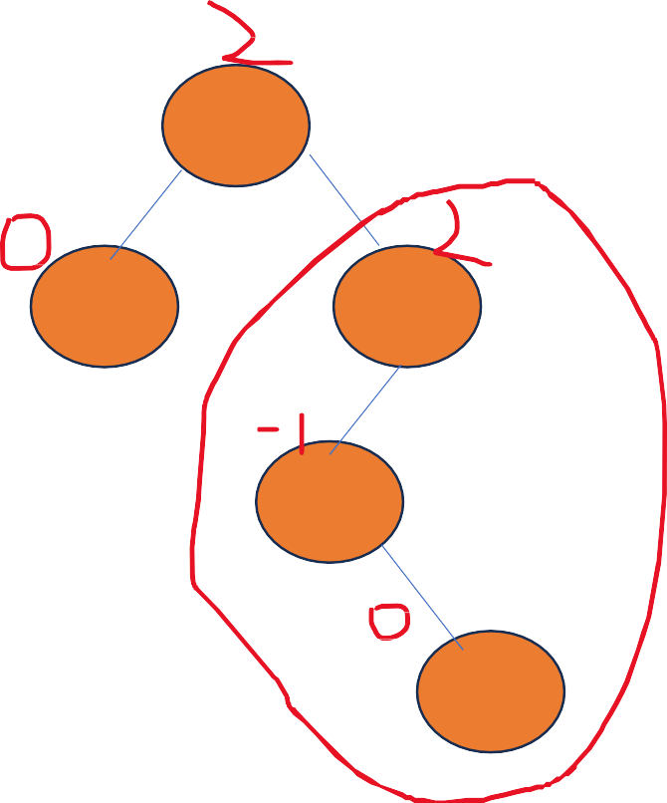
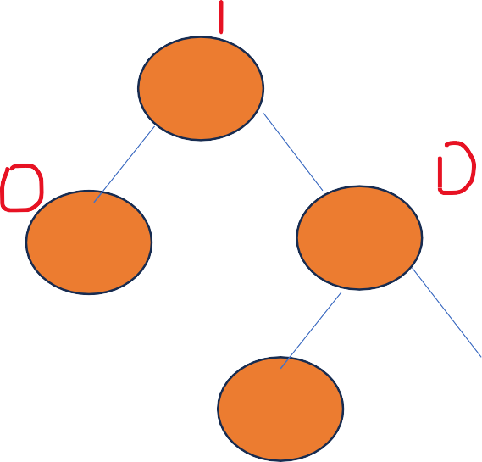


Construction of AVL Trees
40,20,10,25,30,22,50
20
20
10
30
10
40
25
40
25
30

Slide 71


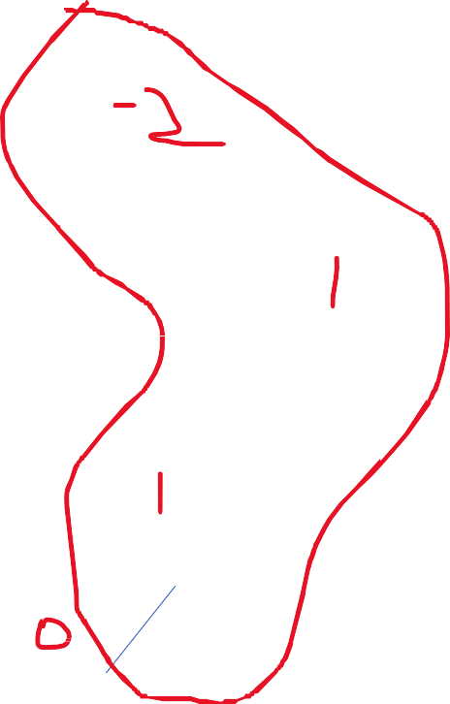
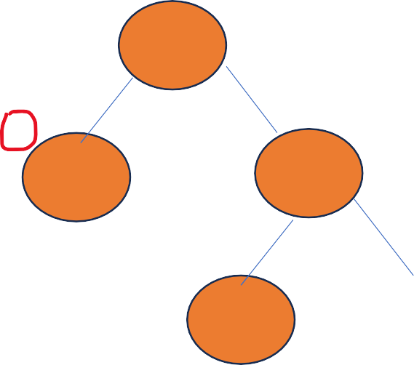

Construction of AVL Trees
40,20,10,25,30,22,50
20
10
30
25
40
22

Slide 72
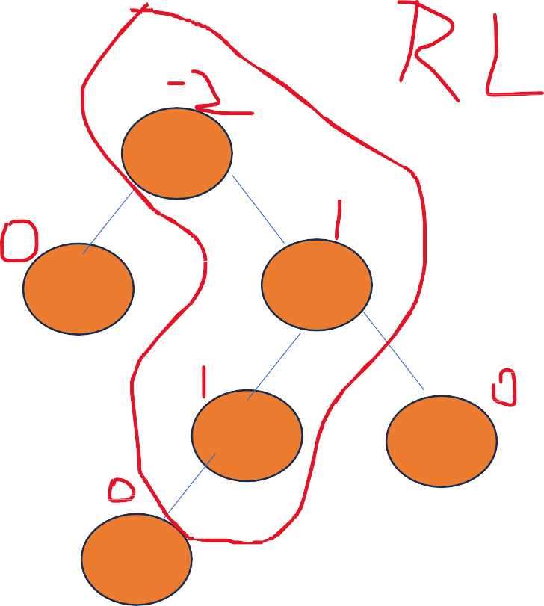
Construction of AVL Trees
40,20,10,25,30,22,50
25
20
20
30
10
30
10
22
40
25
40
22

Slide 73
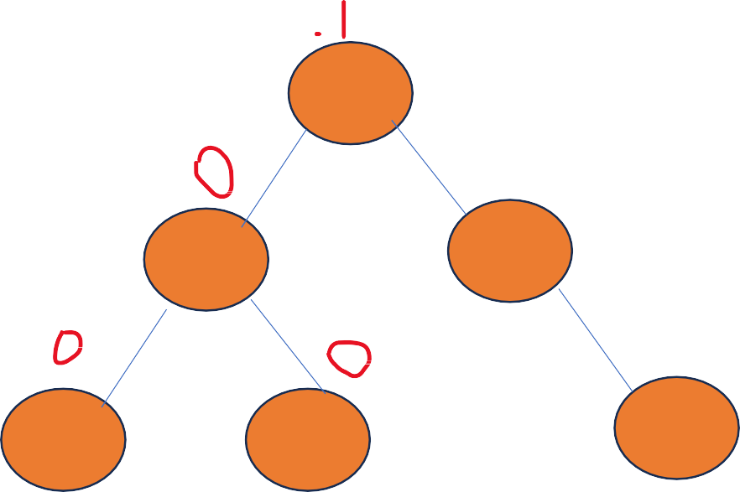
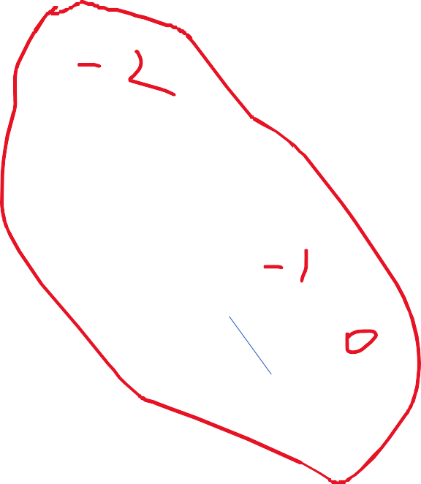
Construction of AVL Trees
40,20,10,25,30,22,50
25
20
30
10
22
40
50

Slide 74
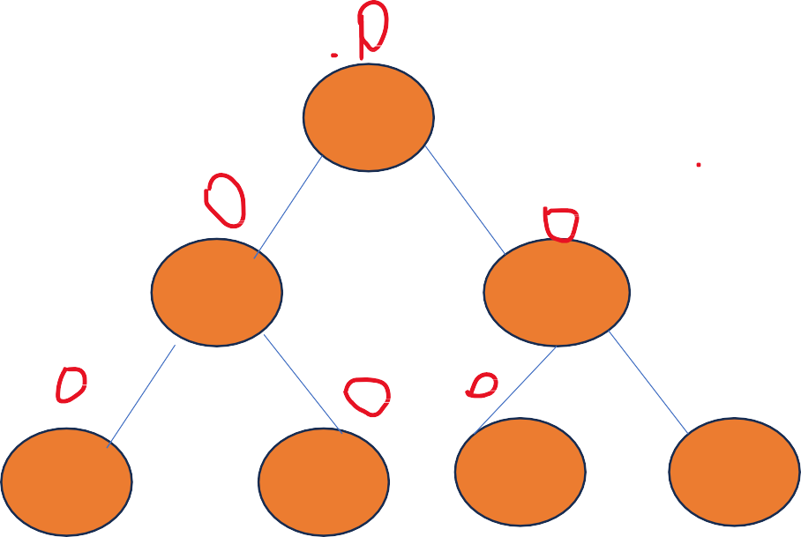

Construction of AVL Trees
40,20,10,25,30,22,50
25
20
40
10
22
30
50

