Slide 1
UNIT-4
Filters

Slide 2
Contents
Filters and Pipes.
Concatenating Files.
Display Beginning and End of Files.
Cut and Paste.
Sorting.
Translating Characters.
Files with Duplicate Lines.
Count Characters, Words, or Lines.
Comparing Files

Slide 3
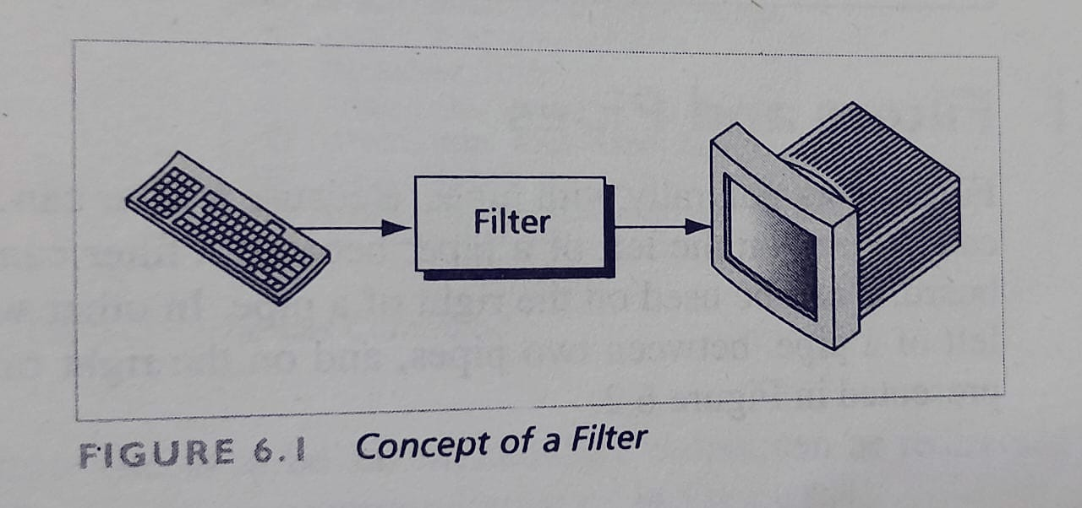
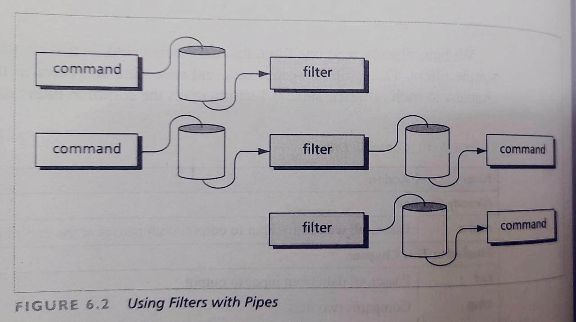
Filters and Pipes.
A filter is any command that gets its input from the standard input stream, manipulates the input, and then sends the result to the standard output stream.
Common filters:
cat- passes all data from input to output.
cmp- Compares two files.
comm-Identifies common lines in two files.
diff- Identifies differences between two files.
head- Passes number of specified lines at
the beginning of the data
tail- Passes number of specified lines at the
end of the data

Slide 4
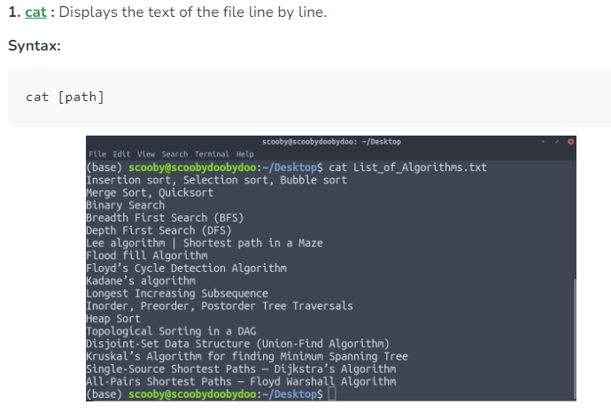

Slide 5
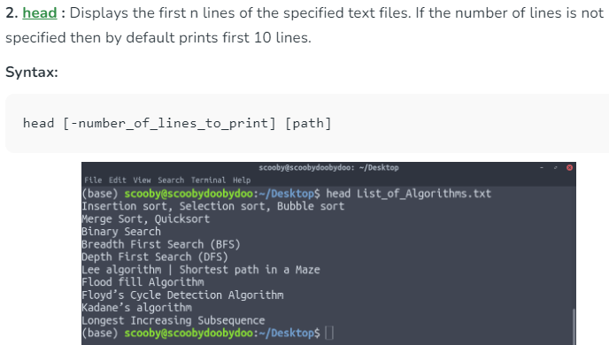

Slide 6
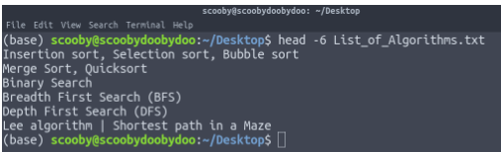

Slide 7
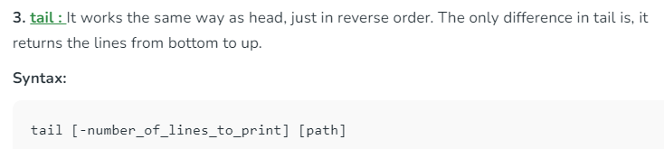

Slide 8
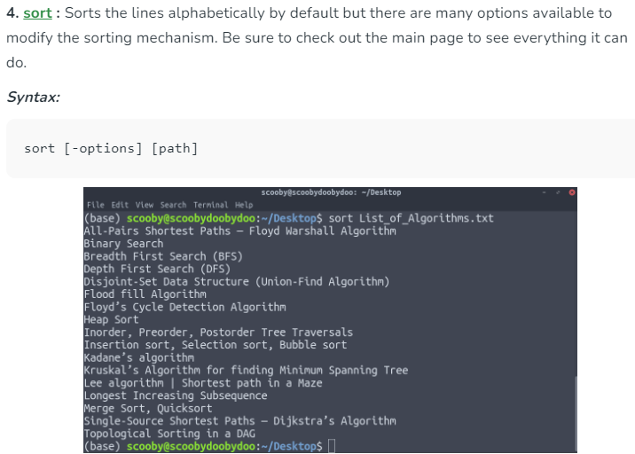

Slide 9
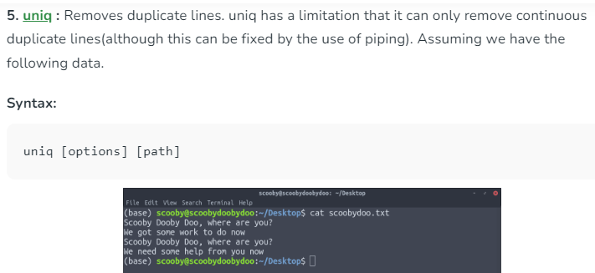

Slide 10
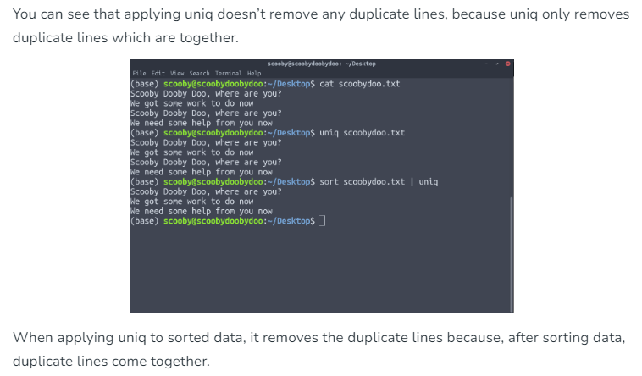

Slide 11
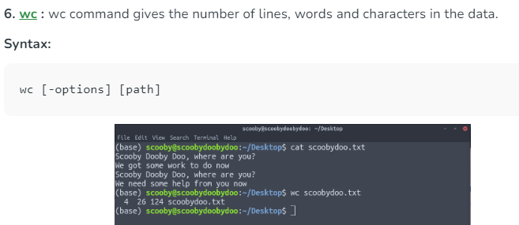
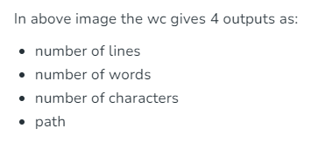

Slide 12
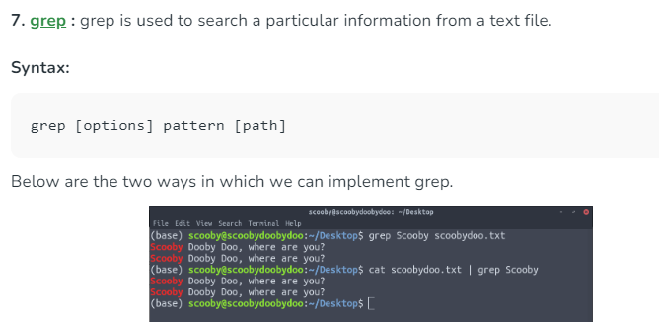

Slide 13
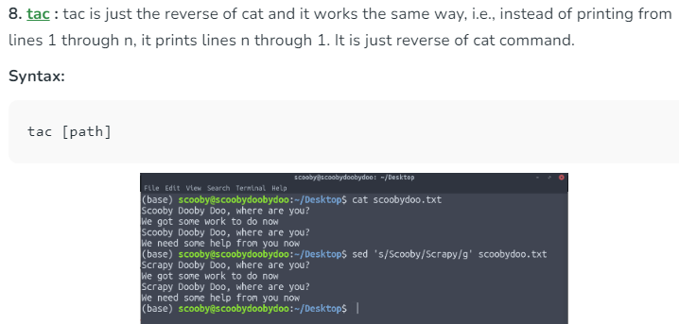

Slide 14
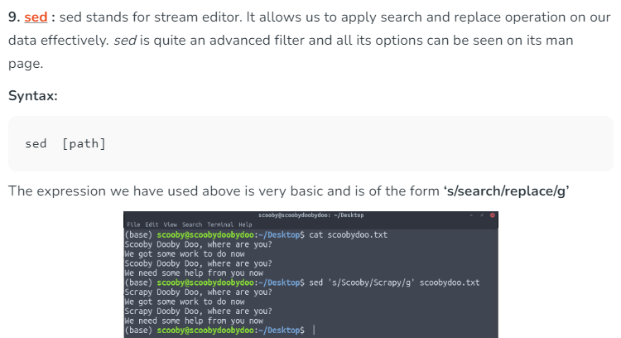
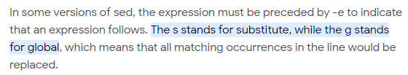

Slide 15
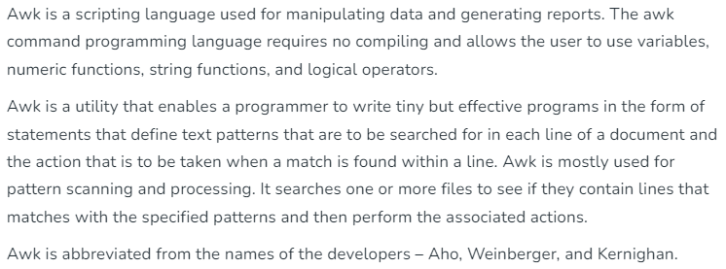

Slide 16
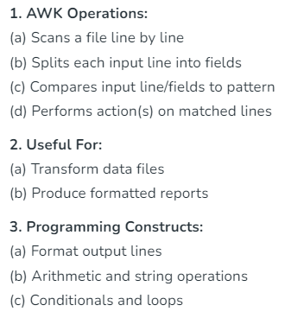
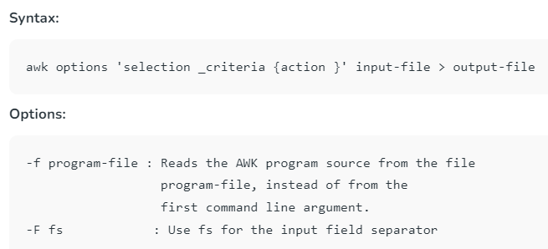

Slide 17
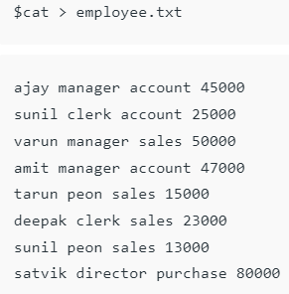

Slide 18
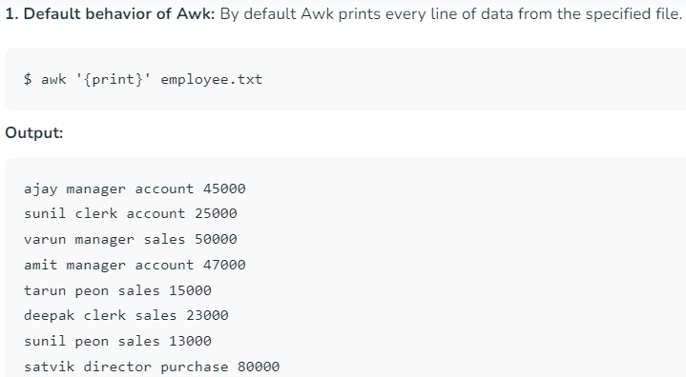


Slide 19
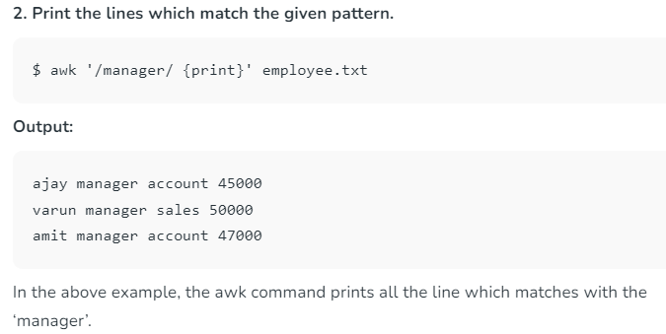

Slide 20
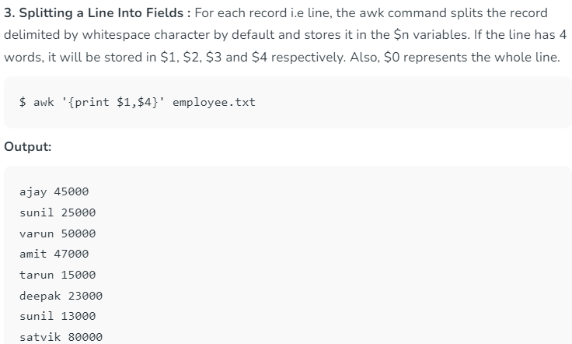

Slide 21
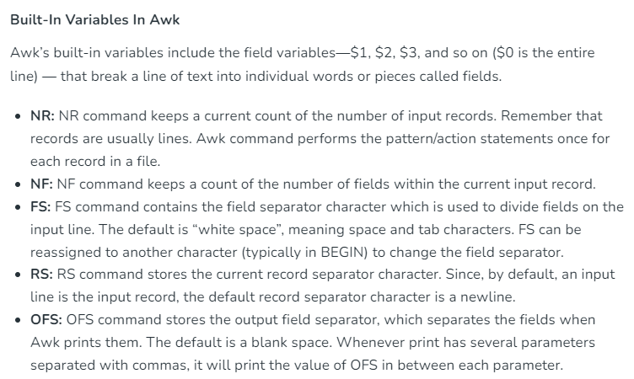

Slide 22
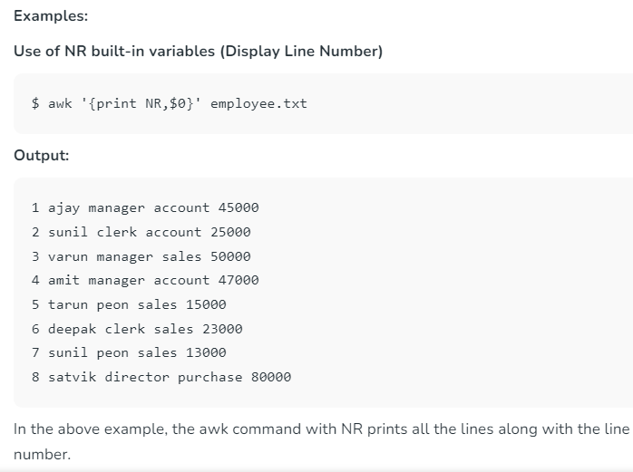

Slide 23
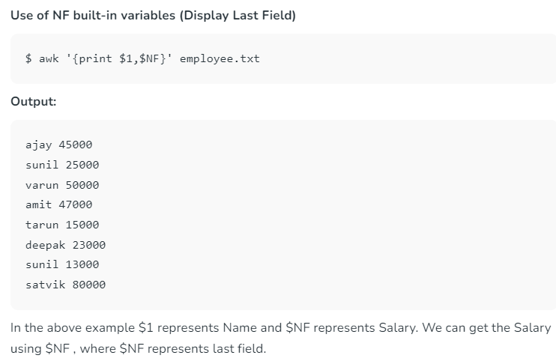

Slide 24
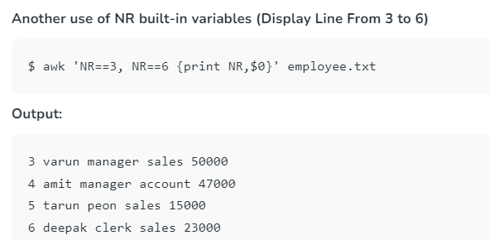

Slide 25
https://www.geeksforgeeks.org/awk-command-unixlinux-examples/

Slide 26
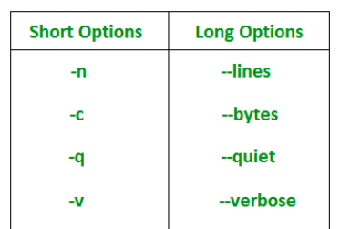
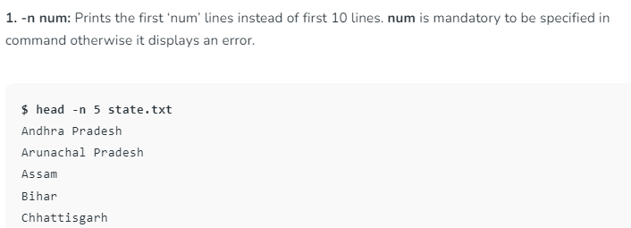

Slide 27
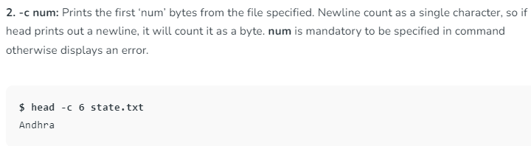

Slide 28
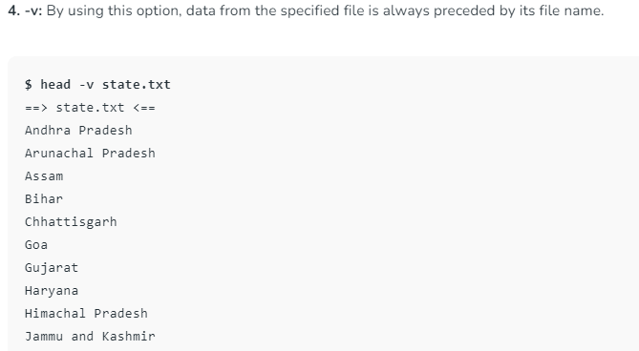

Slide 29
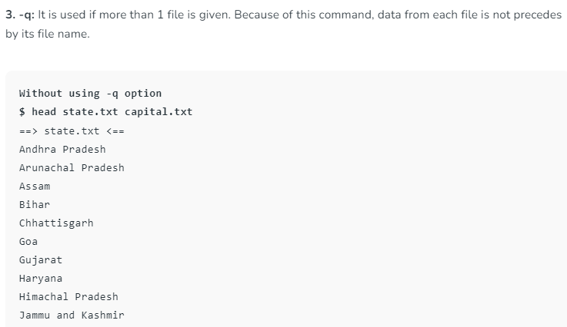
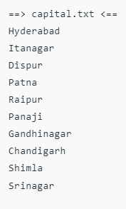

Slide 30
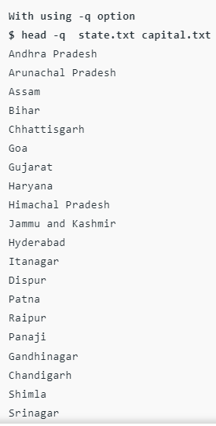

Slide 32
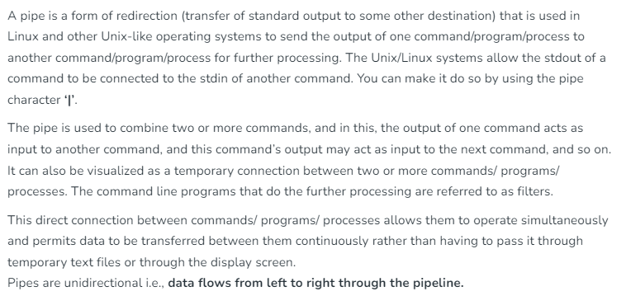


Slide 33
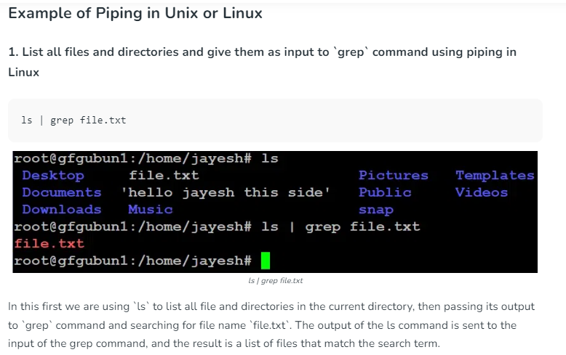

Slide 34

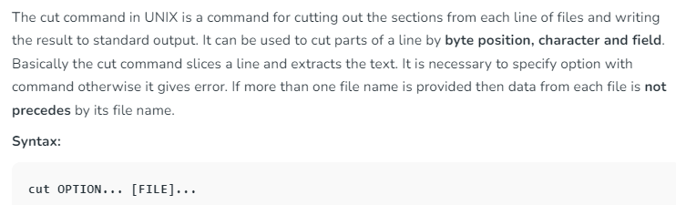

Slide 35
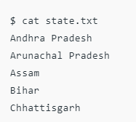
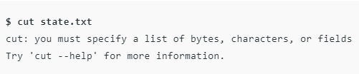

Slide 36
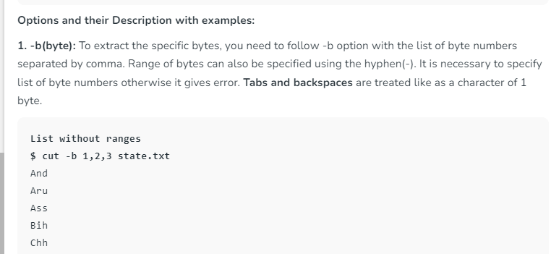

Slide 37
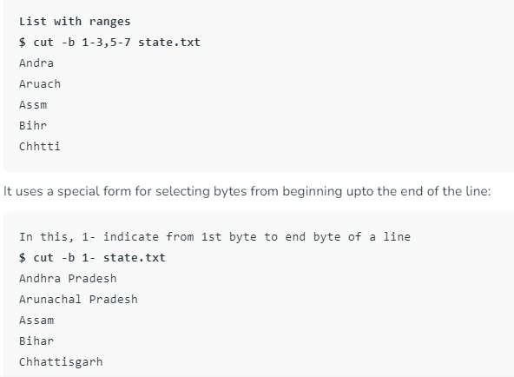

Slide 38
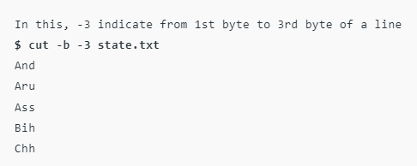

Slide 39
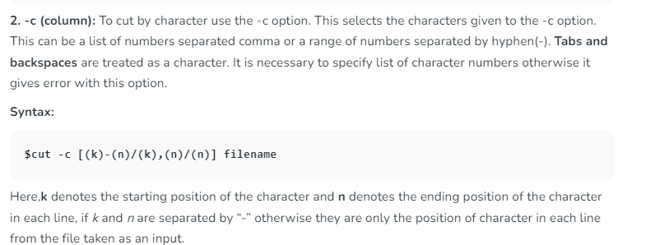

Slide 40
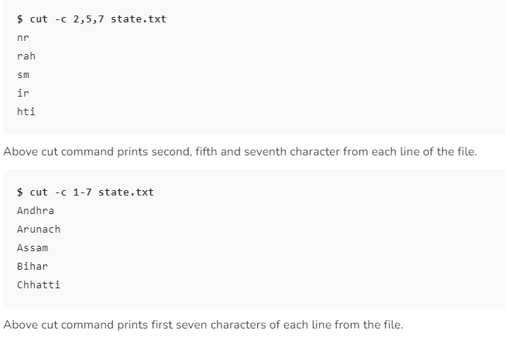

Slide 41
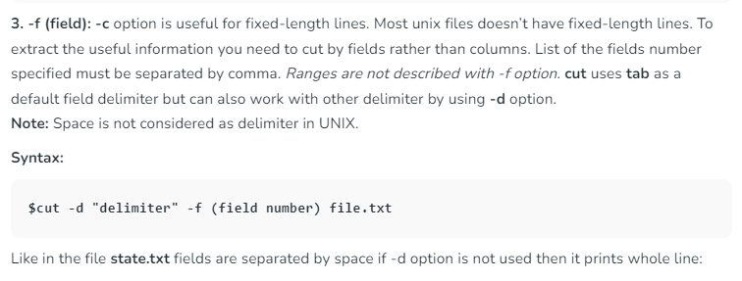

Slide 42
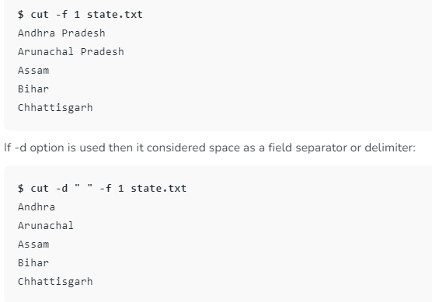

Slide 43
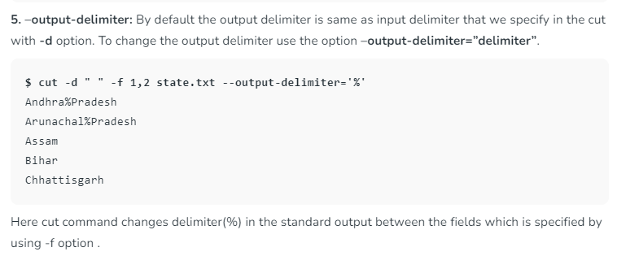

Slide 44
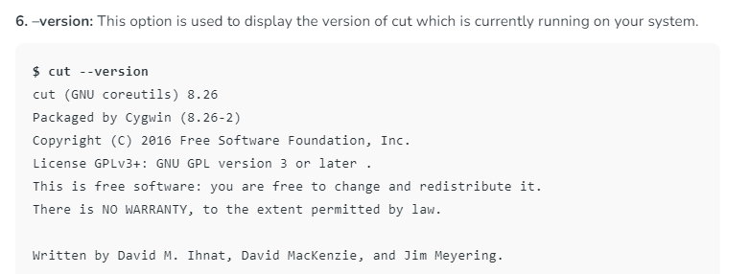

Slide 45
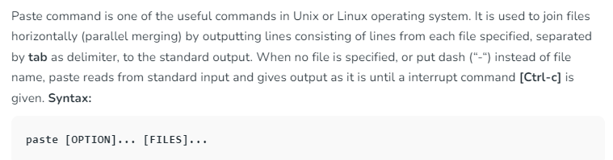

Slide 46
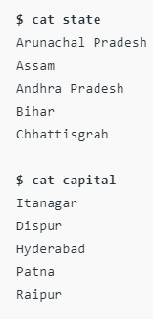
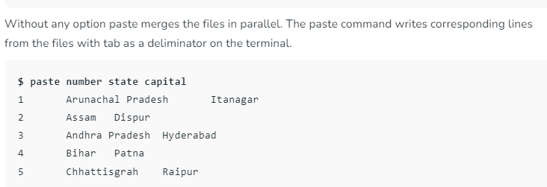

Slide 47



Slide 48


Slide 49


Slide 51
Common Filters:
cut- passes only specified columns.
paste- Combines columns
sort- Arranges the data in sequence
tr- translates one or more characters as specified.
Uniq – deletes duplicate lines.
Wc – counts characters, words, or lines.
Three special filters:
grep – passes only specified lines.
sed – passes edited lines.
awk – passes edited lines and parses lines.

Slide 52


Concatenating files (cat)
Concatenate files:
cat f1,f2
Using cat to display a file:
cat filename
Using cat to create a file:
cat > filename
End of file ctrl+d (abbreviated as ^d)
cat options: There are 6 options,
grouped in to 4 categories.
Visual characters
Buffered output
Missing files
Numbered lines

Slide 53
Concatenating files (cat)
Visual characters:
cat –v ------print control characters
cat –vet filename ----- (-ve) $ sign printed at the end, (-vt) tabs appear as ^I.
Buffered output
cat –u ----- written to the file immediately
Missing files
cat –s-------To avoid error message on output screen when file is missing during concatenation make silent option is used.
Numbered lines
cat –n ------numbered line output

Slide 54
Display beginning and end of files: head command
head command specified number of lines from the beginning of one or more files to the standard output.
head –n------outputs first N lines (default is 10 lines)
When multiple files are included
head –n file1 file2 ------it displays filename before its output.
tail command
Displays the data from the end of the line

Slide 55
Tail command
+N --- Skips N-1 lines, copies rest to end of file.
-N ----- Last N lines
-l ------- counts by line
-c ------- counts by character
-b ------- counts by disk block
-r ------- outputs in reverse order
If we want to extract lines from 8 to 13
head -13 filename | tail +8

Slide 56
Cut and paste
Cut- removes the columns of data from either from standard input or from one or more files.
Paste- combines the columns of data
Specifying character positions
–c----character option
cut –c1-14, 19-25 filename
Field specification
f ------fields
cut –f1,3-5 filename
-d------specifies delimiter if no tab
cut –f1,3-5 –d”/” filename
-s ------not to display any line that does not have delimiter (suppress the output if no delimiter in line)
Paste – combines two files
paste f1 f2
Paste option –d (specifies delimiter between file contents)
paste –d”\t#” file1 file2 file3

Slide 57

Sorting
It is a simple and most powerful organizing technique.
Sort by lines: Arrange data by lines.
Uses ASCII value of each character
Sort by fields: Sort defines a field as a set of characters delimited by a single blank or tab
Field specifier: 1) we need to specify which field or fields are to be used for the sort.
2) set of two numbers that identify the first and last field in a sort key.
+number1 -number2

Slide 58

$ sort +0 -1 filename
$ sort +2 -4 filename
Check sort sequence (-c): verifies that the file is sorted or not, if not sorted, the first out-of-sequence line is displayed.
$ sort –c +0 -1 filename

Slide 59
Delimiter (-t):
Specifies alternate delimiter
The -t Option As mentioned, if you skip over fields, sort assumes that the fields being skipped are delimited by space or tab characters.
The -t option says otherwise. In this case, the character that follows the -t is taken as the delimiter character.
$ sort –t’&’ +1 -2 /etc/passwd ------Sort by user id
Root &3 &1 &The Super User
Cron &1 &2 &Cron Daemon for periodic tasks
Bin &0 &3 &The owner of system files

Slide 60
Numeric sort (-n):
$ sort -n data -------------------Sort numerically
Skipping Field: The +1 says to skip the first field. Similarly, +5n would mean to skip the first five fields on each line and then sort the data numerically.
Fields are delimited by space or tab characters by default.
If a different delimiter is to be used, the -t option must be used.
$ sort +1 -2n data -------------Skip the first field in the sort

Slide 61
Merge files (-m): Combines multiple ordered files into one file that is ordered.
$ sort –m file1 file2
Unique sort fields (-u): $ sort -u names ------The -u option tells sort to eliminate duplicate lines from the output.
$ sort –t’/’ –u +1 -2 filename
$ sort –u –t’/’ +1 -2 filename
$ sort –ut’/’ +1 -2 filename
Ignore Leading blanks (-b):
If we do not ignore leading blanks then each blank is considered as separate null field.
If this option is used fields can have no embedded spaces.
$sort –b +1 -2 filename

Slide 62
Reverse (-r): To order data from largest to smallest
$ sort names
Charlie
Emanuel
Fred
Lucy
Ralph
Tony
Tony
$ sort -nr +2 -3 filename
$ sort -r names --------Reverse sort
Tony
Tony
Ralph
Lucy
Fred
Emanuel
Charlie
Multiple pass sort: $ sort –t’/’ +1 -2 +2n -3 filename
$ sort –t’/’ +1 -2 +2nr -3 filename

Slide 63
Translating characters: tr command
The tr filter is used to translate characters from standard input. The general form of the command is
tr from-chars to-chars
Ex: $ tr e x < file.txt
$ tr '[a-z]' '[A-Z]‘< file.txt
$tr “aeiou” “AE?”
It is easy to use translate
It ?s EAsy t? ?sE translate

Slide 64
Translating characters: tr command
-d -------delete character
$tr –d “aeiou”
It is easy
It s sy
tr –s “ie” “dd”----------squeeze output (deletes consecutive occurrences of same character)
The fiend did dastardly deeds
Thd fdnd d dastardly ds
tr -d '[0-9]' ------------------Delete all digits

Slide 65
Files with duplicate lines: Uniq command
Uniq f1
Uniq –u f1-----------------displays with the message
Uniq –d f1-----------------only duplicate lines
Uniq –c f1-----------------count duplicate lines
$ sort names | uniq
$ sort names | uniq -d ------------------List duplicate lines
$ sort names | uniq –c -------Count line occurrences
1 Charlie
1 Emanuel
2 Tony

Slide 66
Count Characters, words, or lines: wc command
wc –c filename ------counts the number of characters
wc –w filename ----- counts the number of words
wc –l filename ------- counts the number of lines

Slide 67
Comparing files:
Compare (cmp) command
cmp f1 f2----------compares two files byte by byte
Difference (diff) command
diff f1 f2
Common (comm) command
comm f1 f2

Slide 68


Compare (cmp) command

Slide 69


Common (comm) command

Slide 70


Common (comm) command

Slide 71


Difference (diff) command

Slide 72
Explanation of the Output:
The output of diff is structured as follows:
Line Numbers
1c1: The 1c1 indicates that line 1 in file1 needs to be changed to match line 1 in file2.
Difference Details
< Ankur: The < symbol indicates that this line is present in file1 but is different in file2.
---: Separates the contents of file1 from file2.
> Anubhav: The > symbol indicates that this line is present in file2.
Another Change
3c3,4: This indicates that line 3 in file1 needs to be replaced by lines 3 and 4 in file2.
< Ishaan: Indicates the line in file1.
---: Separator.
> Himanshu: Line 3 in file2.
> Vishal: Line 4 in file2.
Summary:
Line 1: Ankur in file1 is replaced by Anubhav in file2.
Line 3: Ishaan in file1 is replaced by Himanshu and Vishal in file2.

Slide 73
THANK YOU

