Slide 1
Counters
Counter is a sequential circuit. A digital circuit which is used for a counting pulses is known counter. Counter is the widest application of flip-flops. It is a group of flip-flops with a clock signal applied.
Counters are of two types.
Asynchronous or ripple counters.
Synchronous counters.

Slide 2
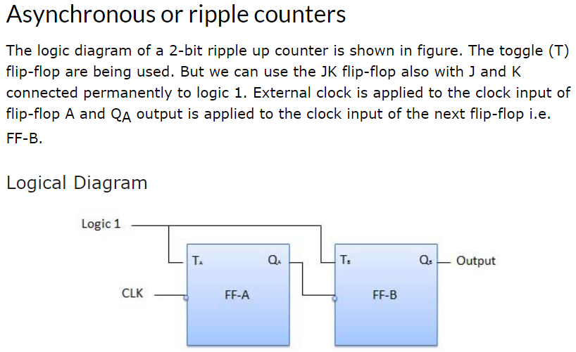
Asynchronous Counter:
These are the counters in which we do not use universal clock, main clock is only applied to the first flip flop and then for rest of flip flops the output of previous flip flop is taken as a clock.

Slide 3
Initially let both the FFs be in the
reset state
Q_{B}Q_{A} = 00 initially
As soon as the first negative clock edge is applied, FF-A will toggle and Q_{A} will be equal to 1.
Q_{A} is connected to clock input of FF-B. Since Q_{A} has changed from 0 to 1, it is treated as the positive clock edge by FF-B. There is no change in Q_{B} because FF-B is a negative edge triggered FF.
Q_{B}Q_{A} = 01 after the first clock pulse.
After 1st negative clock edge
After 2nd negative clock edge
On the arrival of second negative clock edge, FF-A toggles again and Q_{A} = 0.
The change in Q_{A} acts as a negative clock edge for FF-B. So it will also toggle, and Q_{B} will be 1.
Q_{B}Q_{A} = 10 after the second clock pulse.
After 3rd negative clock edge
After 3rd negative clock edge
On the arrival of 3rd negative clock edge, FF-A toggles again and Q_{A} become 1 from 0.
Since this is a positive going change, FF-B does not respond to it and remains inactive. So Q_{B} does not change and continues to be equal to 1.
Q_{B}Q_{A} = 11 after the third clock pulse.
On the arrival of 4th negative clock edge, FF-A toggles again and Q_{A} becomes 1 from 0.
This negative change in Q_{A} acts as clock pulse for FF-B. Hence it toggles to change Q_{B} from 1 to 0.
Q_{B}Q_{A} = 00 after the fourth clock pulse.

Slide 4
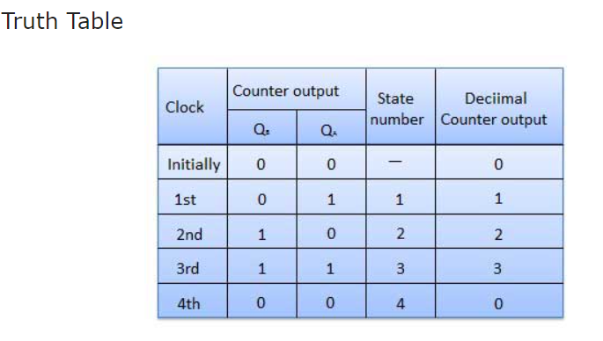

Slide 5
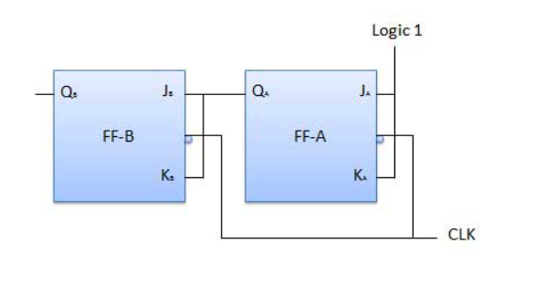
Synchronous counters: If the "clock" pulses are applied to all the flip-flops in a counter simultaneously, then such a counter is called as synchronous counter. Classification of counters Depending on the way in which the counting progresses, the synchronous or asynchronous counters are classified as follows − 1. Up counters 2. Down counters 3. Up/Down counters

Slide 6
Modulus Counter (MOD-N Counter)
The 2-bit ripple counter is called as MOD-4 counter and 3-bit ripple counter is called as MOD-8 counter. So in general, an n-bit ripple counter is called as modulo-N counter. Where, MOD number = 2^{n}.
Type of modulus
2-bit up or down (MOD-4)
3-bit up or down (MOD-8)
4-bit up or down (MOD-16)
Application of counters
Frequency counters
Digital clock
Time measurement
A to D converter
Frequency divider circuits
Digital triangular wave generator.

Slide 7
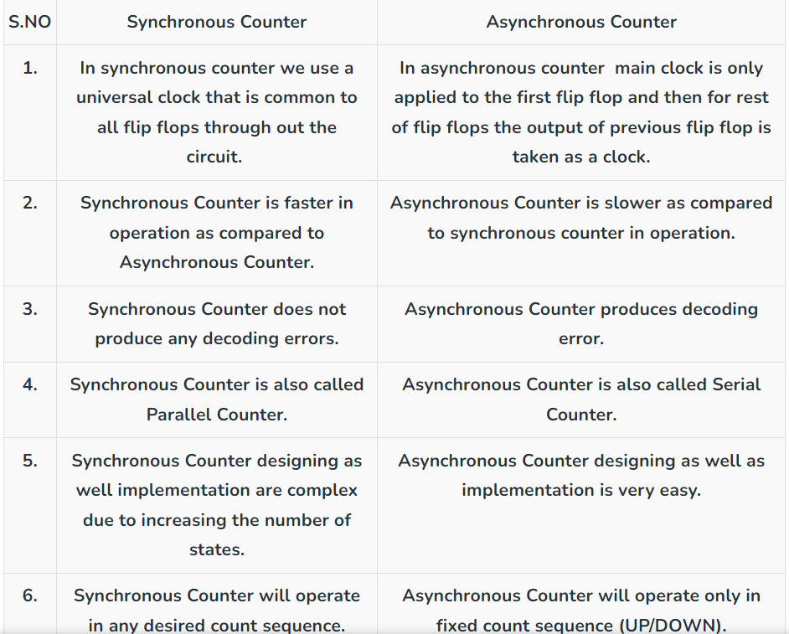

Slide 8
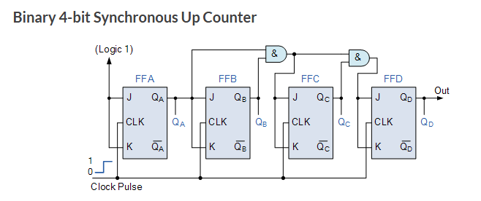
Synchronous Counters are circuits where the clock input of all the individual flip-flops within the counter are all clocked together at the same time by the same clock signal

Slide 9
The external clock pulses (pulses to be counted) are fed directly to each of the J-K flip-flops in the counter chain and that both the J and K inputs are all tied together in toggle mode, but only in the first flip-flop, flip-flop FFA (LSB) are they connected HIGH, logic “1” allowing the flip-flop to toggle on every clock pulse. Then the synchronous counter follows a predetermined sequence of states in response to the common clock signal, advancing one state for each pulse.
The J and K inputs of flip-flop FFB are connected directly to the output Q_{A} of flip-flop FFA, but the J and K inputs of flip-flops FFC and FFD are driven from separate AND gates which are also supplied with signals from the input and output of the previous stage. These additional AND gates generate the required logic for the JK inputs of the next stage.
If we enable each JK flip-flop to toggle based on whether or not all preceding flip-flop outputs (Q) are “HIGH” we can obtain the same counting sequence as with the asynchronous circuit but without the ripple effect, since each flip-flop in this circuit will be clocked at exactly the same time.
Then as there is no inherent propagation delay in synchronous counters, because all the counter stages are triggered in parallel at the same time, the maximum operating frequency of this type of frequency counter is much higher than that for a similar asynchronous counter circuit.

Slide 10
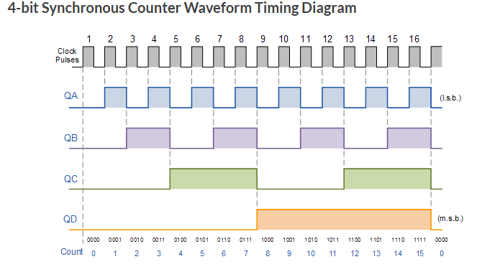

Slide 11

Flip-flop is an electronic component that is used to store one single bit of information.
Diagrammatic Representation of Flip Flop
Since Flip Flop is a sequential circuit its input is based upon two parameters, one is the current input and the other is the output from the previous state.
It has two outputs, both are complements of each other.
It may be in one of two stable states, either 0 or 1.

Slide 12
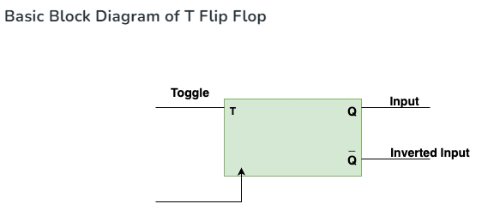
T Flip Flop
T flip flop or to be precise is known as Toggle Flip Flop because it can able to toggle its output depending upon on the input.
T here stands for Toggle.
Toggle basically indicates that the bit will be flipped i.e., either from 1 to 0 or from 0 to 1.
Here, a clock pulse is supplied to operate this flop, hence it is a clocked flip-flop.

Slide 13
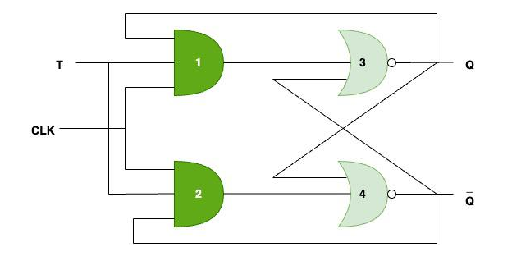
Case 1: Let’s say, T = 0 and clock pulse is high i.e, 1, then output of both, AND gate 1, AND gate 2 will be 0, gate 3 output will be Q and similarly gate 4 output will be Q’ so both the values of Q and Q’ are same as their previous value, which means Hold state.
Case 2: Let’s say, T=1, then output of both AND gate 1 will be (T * clock * Q), and since T and clock both are 1, then the output of AND gate 1 will be Q, and similarly output of AND gate 2 will be (T * clock * Q’) i.e, Q’. Now, gate 3 output will be (Q’+Q)’ and let’s say Q’ is zero, then gate 3 output will be (0+Q)’ which means Q’ and similarly gate 4 output will be (Q+Q’)’ and since Q’ is zero, so gate 4 output will be Q’ which means 0 as Q’ is zero. Hence in this case we can say that the output toggles, because T=1.

Slide 14
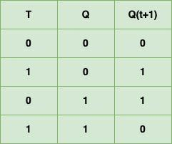
Here, T is the Toggle input, Q is present state input, Qt+1 is the next state output.
From here we can see that, whenever Toggle (T) is 0, next state output (Qt+1) is same as current state input (Q).
Whenever Toggle (T) is 1, next state output (Qt+1) will be complement of current state input (Q) which means it gets toggled.

Slide 15
Applications:
Counters: T Flip Flops used in counters. Counters counts the number of events that occurs in a digital system.
Data Storage: T Flip Flops used to create memory which are used to store data, when the power is turned off.
Synchronous logic circuits: T flip-flops can be used to implement synchronous logic circuits, which are circuits that perform operations on binary data based on a clock signal. By synchronizing the logic circuit’s operations to the clock signal using T flip-flops, the circuit’s behavior can be made predictable and reliable.
Frequency division: It is used to divide the frequency of a clock signal by 2. Flip-flop will toggle its output every time the clock signal transitions from high to low or low to high, hence dividing the clock frequency by 2.
Shift registers: T flip-flops can be used in shift registers which are used to shift binary data in one direction.

Slide 16
The Basic JK Flip-flop
It is one kind of sequential logic circuit which stores binary information in bitwise manner. It consists of two inputs and two outputs. Inputs are Set(J) & Reset(K) and their corresponding outputs are Q and Q’. JK flipflop has two modes of operation which are synchronous mode and asynchronous mode. In synchronous mode, the state will be changed with the clock(clk) signal, and in asynchronous mode, the change of state is independent from its clock signal.

Slide 17
