Slide 1
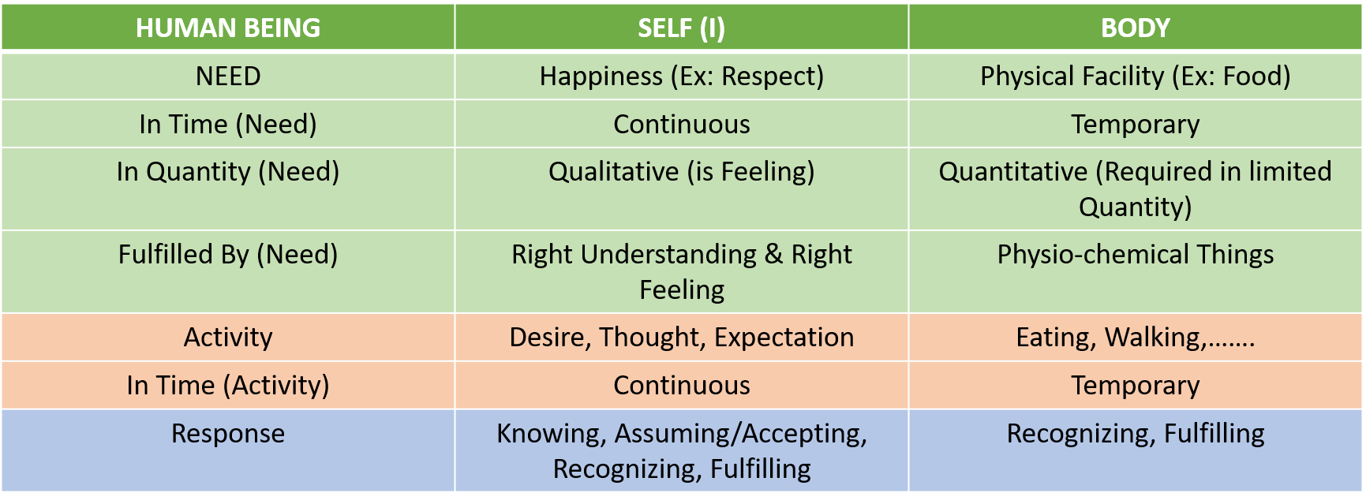
TOPIC 1: UNDERSTANDING THE TWO REALITIES – Needs, Activities, and Response

Slide 2
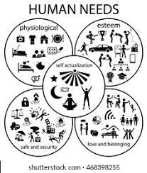
Needs of Human Beings:
Physiological Needs: Breathing, Food, Clothing, Shelter, Sound Sleep, Mental Satisfaction
Safety & Security Needs: Personal Security, Financial Security, Health & Well-being, Accidents/illness, and their adverse impacts
Love and belonging: Friendship, Intimacy, Family (Good & Supportive), and Sense of belonging among large social groups (clubs, office culture, religious groups, professional organizations) or small groups (family members, intimate partners, close colleagues)
Esteem: Have self-esteem and self-respect, be accepted and valued by others, engage themselves to gain recognition, a sense of contribution

Slide 3

TOPIC 6: PROGRAM TO ENSURE SANYAM AND SWASTHYA
SANYAM: “I” take the responsibility of nurturing, protection, and right utilization of the body
Nurturing of the body (posan)
Ingestion (grahan)
Digestion (pachan)
Excretion (nishkasan)
2. Protection of the body (sanraksahan)
Proper upkeep (vihar) of the body
Labour (shram)
Physical exercise (Vvayam)
Asan (pranayama)
Treatment (upchar) of the body
3. Right utilization of the body (sadupyog)
SWASTHYA:
The body is fit according to the self (I)
2. There is harmony among the various parts of the body

Slide 4
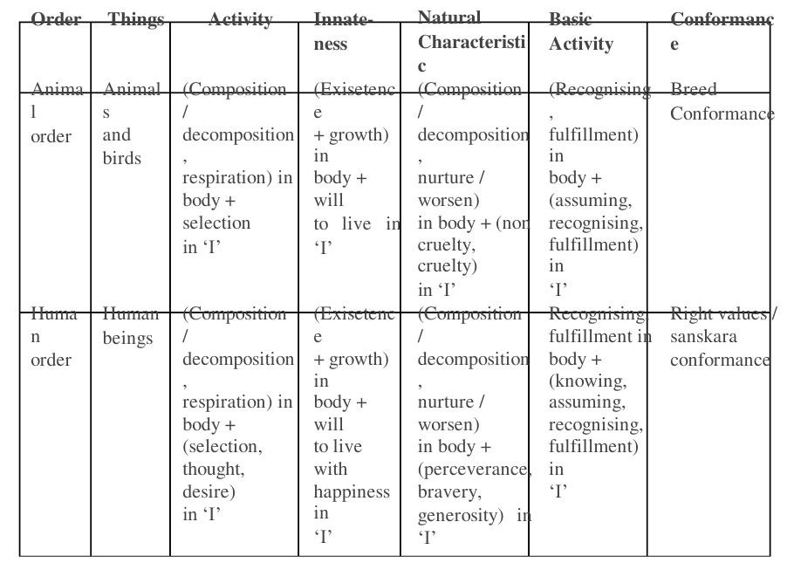

Slide 5
