Slide 1
Category review: Chips
June 2020
Retail Analytics
Brand note: If client logo is not required, use alternate title page layout right click slide thumbnail > Layout > Title

Slide 2
Notes:
To view Privacy video explaining how important data privacy is to Quantium, please click here: https://www.youtube.com/watch?v=Zq1QDAkoRzU
or here Q:\Company Reference\Brand & Design\Brand videos\Q Privacy.mp4
At Quantium, we believe that data is the behavioural footprint of humanity and that it has to be treated with the utmost care and responsibility.
Histories, attitudes, indeed lives are stored within it in ways that aren’t always apparent – and that’s what makes its potential so powerful.
To work with it responsibly, sensitively, we set ourselves the highest data privacy protection and governance standards.
We have spent 17 years perfecting privacy-by-design and secure-by-design principles. Central to this is not holding any personally identifiable information about people –
we neither receive it, and put the necessary protections in place to be unable to decipher it.
Every aspect of handling data is safeguarded: from its de-identification, to its encryption – data security is paramount and of the highest grade.
We pride ourselves on gaining the trust of iconic organisations around the world through years of securely working with their data,
and in turn the trust that builds with their stakeholders.

Slide 3
Executive summary
01
Task 1
High-Level Finding
Mainstream customers, Kettle products, and 175g pack sizes are the key drivers of chip category sales.
Key Callouts
Mainstream customers generated the highest revenue.
Premium Retirees had the highest spend per transaction.
Kettle was the top-performing brand.
175g was the most popular pack size.
02
Task 2
High-Level Finding
The new store layout successfully increased sales and customer purchases.
Key Callouts
Store 77 achieved 29.13% sales uplift.
Store 88 achieved 29.13% sales uplift.
Store 86 achieved 9.76% sales uplift.
Customer numbers increased across all trial stores.

Slide 4
01
Mainstream customers, Kettle products, and 175g packs drive chip category performance.
Metric | Finding
Top Customer Segment | Mainstream
Top Brand | Kettle
Top Pack Size | 175g
Revenue Driver | Mainstream Customers
Category
Metric | Finding
Top Customer Segment | Mainstream
Top Brand | Kettle
Top Pack Size | 175g
Revenue Driver | Mainstream Customers
Callout : The chip category is primarily driven by Mainstream customers who show strong preference for Kettle products and 175g pack sizes.

Slide 5
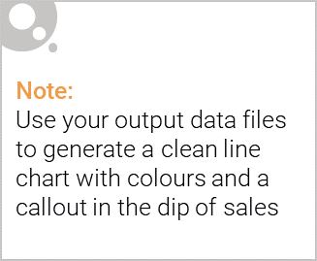
OVERVIEW: KEY CALLOUTS FOR THE CATEGORY
Mainstream customers, Kettle products and 175g packs are the key drivers of category performance.
Customer Segment
Mainstream Customers generated
the highest category revenue,
making them the most valuable customer segment.
Spending Behaviour
Premium Retirees Recorded the
highest average spend
per transaction, indicating premium purchasing behaviour.
Brand Performance
Top-performing brand with over
$390K in sales revenue.
Pack Size
Most popular pack size with over
$485K in sales.
Recommendation:
Focus marketing efforts on Mainstream customers,
maintain strong visibility for Kettle products,
and prioritize 175g packs in promotions.

Slide 6

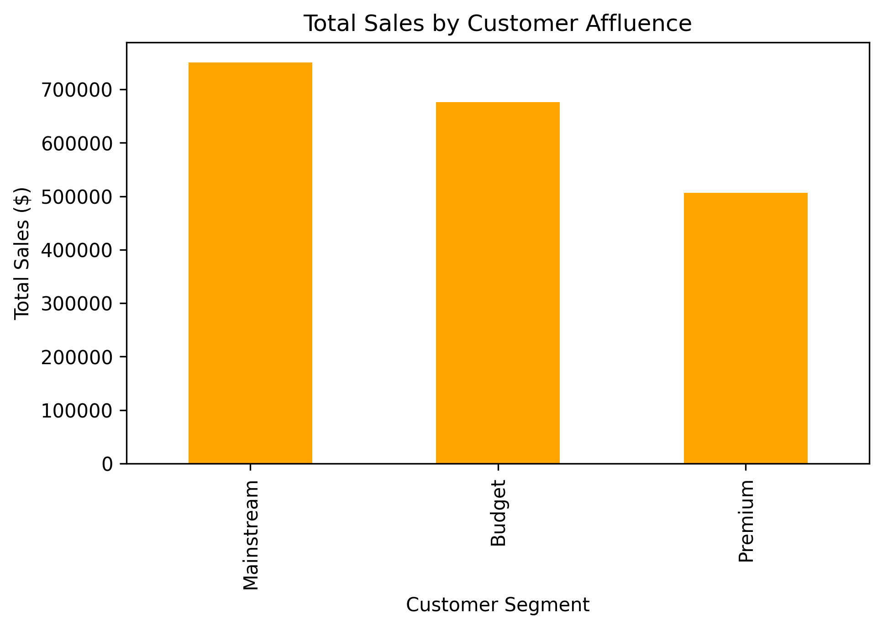
AFFLUENCE AND ITS EFFECT ON CUSTOMER BUYING
Mainstream customers contribute the largest share of chip category sales.
Key Findings
Mainstream Customers
Generated the highest overall sales.
Represent the largest purchasing segment.
Premium Customers
Tend to spend more per transaction.
Show stronger preference for premium products.
Budget Customers
Contribute through frequent purchases.
Important volume-driving segment.
Business Implication
Mainstream customers should remain the primary focus of marketing and promotional activities, while premium products can be targeted toward higher-spending customer groups.

Slide 7
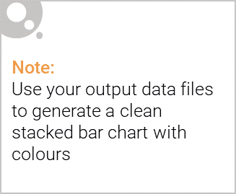
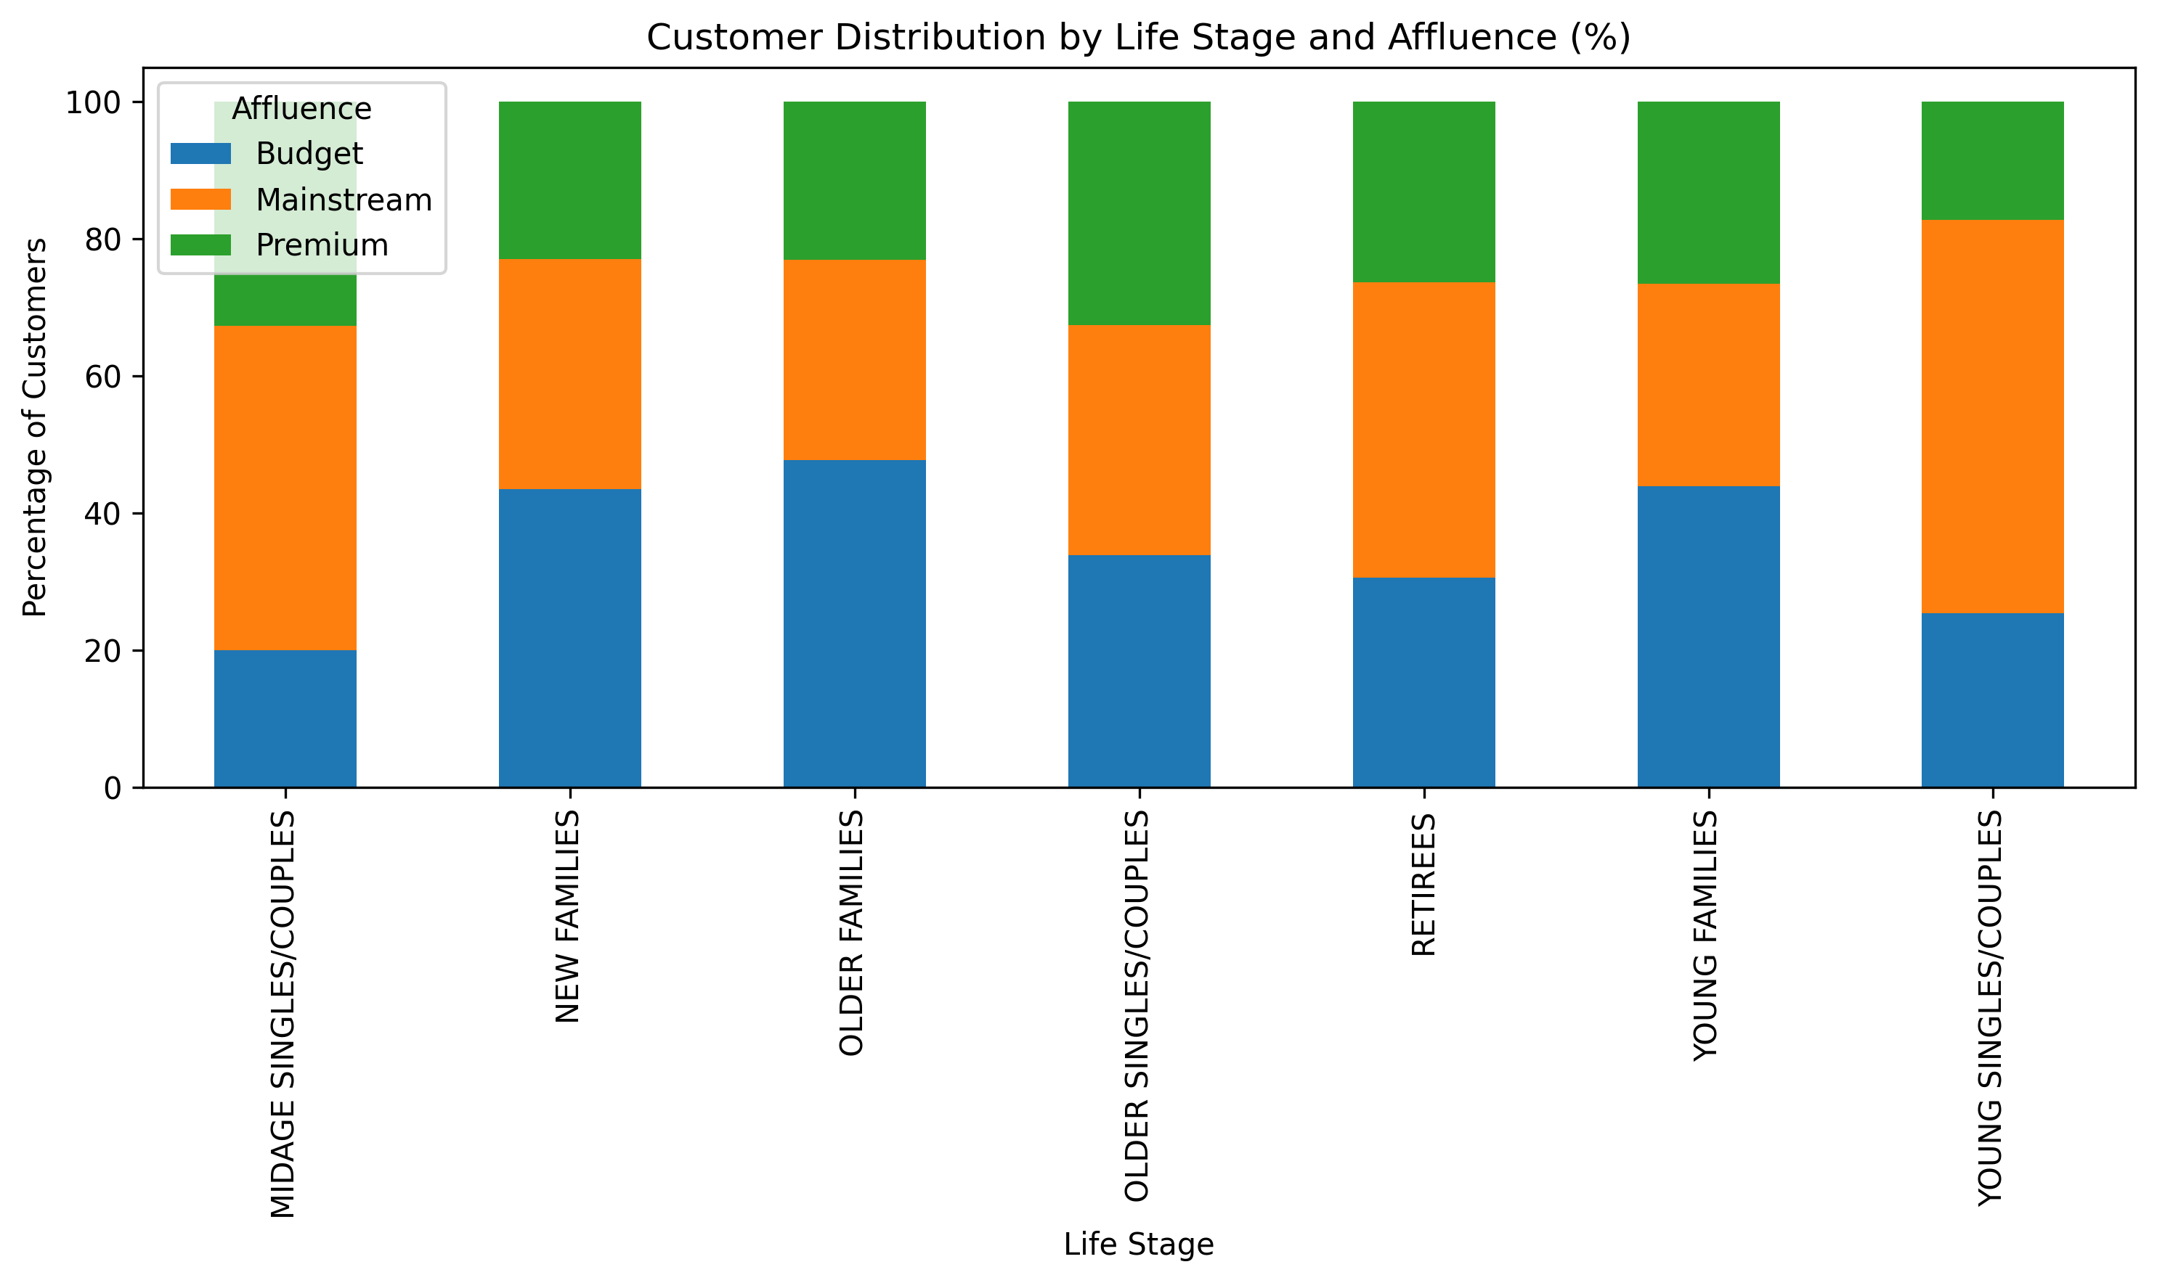
Editable (delete this)
Mainstream customers represent the largest customer group across most life stages.
Key Insights :
Mainstream customers dominate the customer base across multiple life stages
.
Older Families and Retirees account for a significant proportion of customers.
Budget and Premium segments are smaller but provide opportunities for targeted promotions.
Business Implication
Marketing strategies should prioritize Mainstream customers while developing targeted offers for Budget and Premium segments based on life stage characteristics.

Slide 8
02
TRIAL STORE PERFORMANCE
Objective
Evaluate whether the new store layout improved sales performance and customer purchasing behaviour.
Trial Store | Control Store
77 | 233
86 | 155
88 | 125
Pre-Trial Period
↓
Control Store Selection
↓
Trial Period Analysis
↓
Sales & Customer Uplift
Key Message
Three trial stores (77, 86 and 88) were evaluated against comparable control stores to measure the effectiveness of the new store layout.

Slide 9
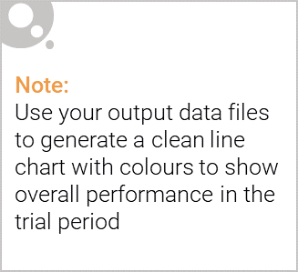
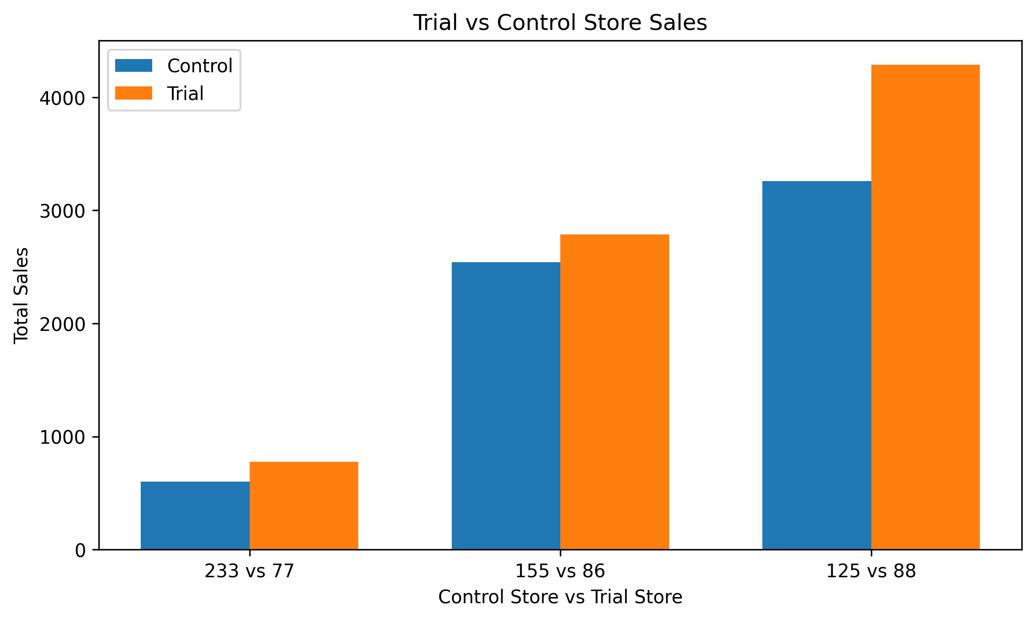
CONTROL STORE VS TRIAL STORE COMPARISON
Control stores closely matched trial store performance before the trial period.
Key Findings
Store 233 showed similar historical sales patterns to Trial Store 77.
Store 155 was selected as the closest match for Trial Store 86.
Store 155 was selected as the closest match for Trial Store 86.
Business Insight :
The selected control stores provided a reliable benchmark for measuring the impact of the trial layout.

Slide 10
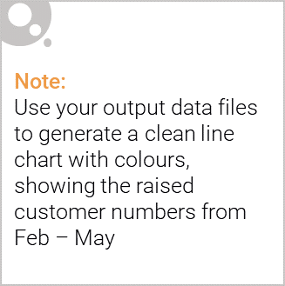
TRIAL PERFORMANCE ASSESSMENT
The trial layout delivered positive sales and customer growth across all trial stores.
Trial Store | Control Store | Sales Uplift | Customer Uplift
77 | 233 | 29.13% | 23.48%
86 | 155 | 9.76% | 13.54%
88 | 125 | 29.13% | 22.54%
Key Callouts :
Store 77
Delivered the strongest performance with
29.13% sales uplift and 23.48% customer uplift.
Store 86
Achieved positive sales growth despite a
more moderate uplift than other trial stores.
Store 88
Recorded significant improvement in both
sales and customer numbers.
Overall Conclusion
All three trial stores recorded positive sales and customer growth compared to their matched control stores, indicating that the new store layout had a positive commercial impact.
Recommendation
Roll out the new store layout to similar stores and continue monitoring performance to validate long-term benefits.

