Slide 1
HSBC Fraud Analysis Report - 2024
AI-Powered Fraud Detection & Data Insights

Slide 2
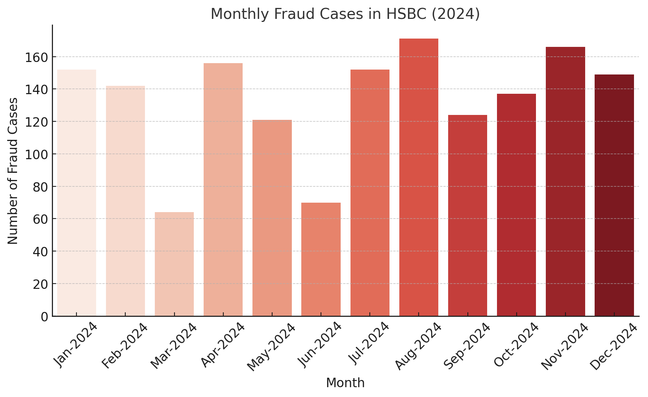
Monthly Fraud Cases in HSBC (2024)

Slide 3
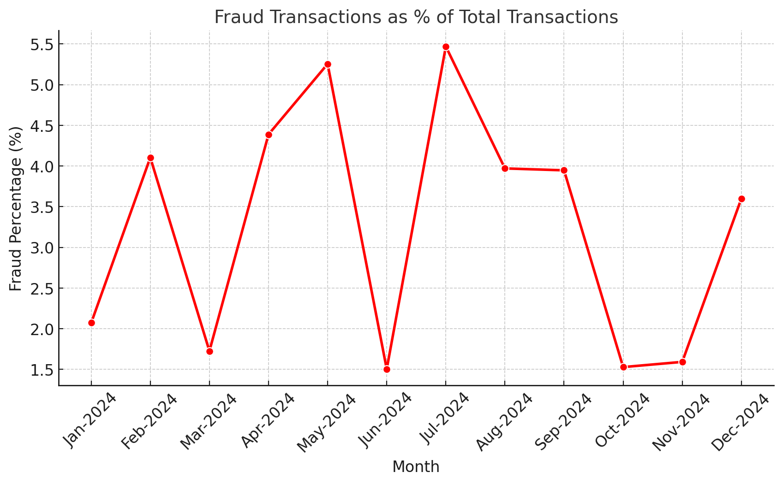
Fraud Transactions as % of Total Transactions

Slide 4
Fraud Data Overview (2024)
Month | Fraud Cases | Fraud Percentage

Slide 5
Fraud Data Overview (2024)
Month | Fraud Cases | Fraud Percentage
Jan-2024 | 152 | 2.07
Feb-2024 | 142 | 4.1
Mar-2024 | 64 | 1.73
Apr-2024 | 156 | 4.39
May-2024 | 121 | 5.25
Jun-2024 | 70 | 1.5
Jul-2024 | 152 | 5.47
Aug-2024 | 171 | 3.97
Sep-2024 | 124 | 3.95
Oct-2024 | 137 | 1.53
Nov-2024 | 166 | 1.59
Dec-2024 | 149 | 3.6

Slide 6
Fraud Analysis Process - Step by Step
1. Transaction Occurs - Customer initiates a transaction.
2. AI Fraud Detection - System analyzes transaction in real-time.
3. Flagging Suspicious Transactions - High-risk transactions get flagged.
4. Investigation - HSBC fraud team reviews flagged cases.
5. Customer Notification - If fraud is confirmed, customer is alerted.
6. Action Taken - Transaction blocked or refunded, and case resolved.

Slide 7
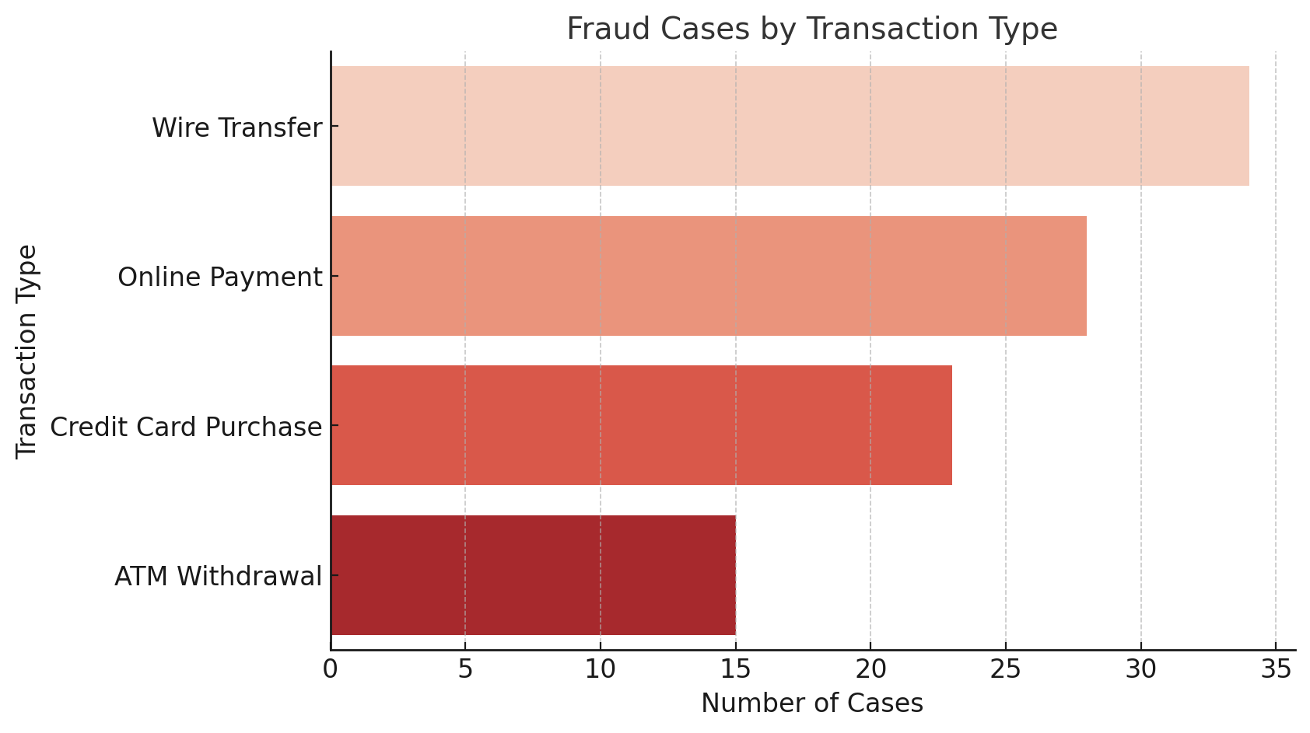
Fraud Cases by Transaction Type

Slide 8
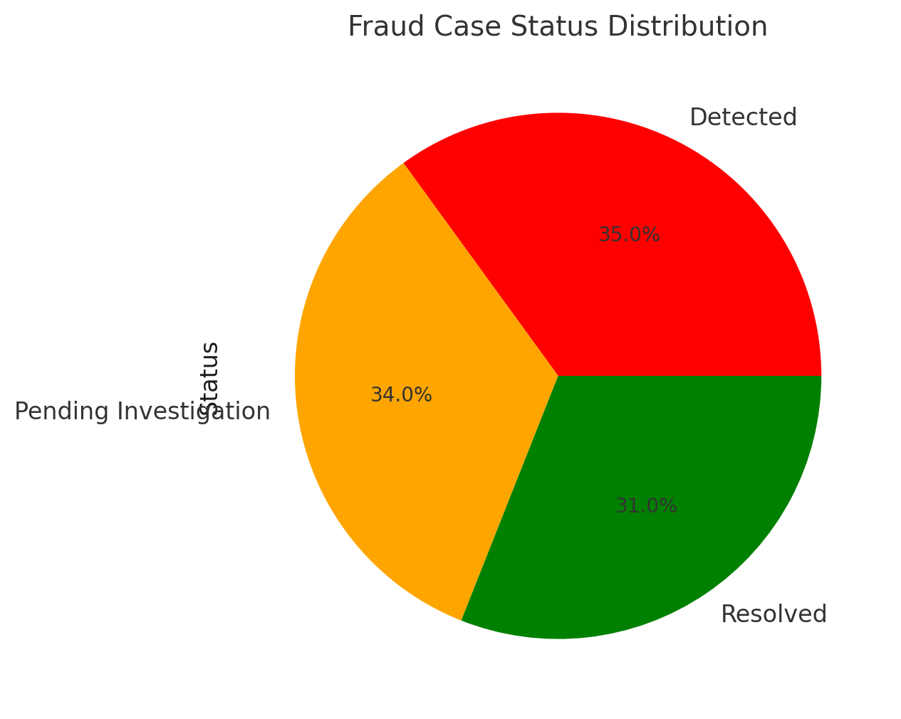
Fraud Case Status Distribution

