Slide 1
Enabling Digital Transformation with MuleSoft

Slide 2

AGENDA
Problem Statement
Solution
Architecture Context
CI/CD Setup & Environments
API Level Security
Key Metrics & Business Outcome
API Growth & Usage
Monitoring, Alerts & Reports
Future RoadMap

Slide 3
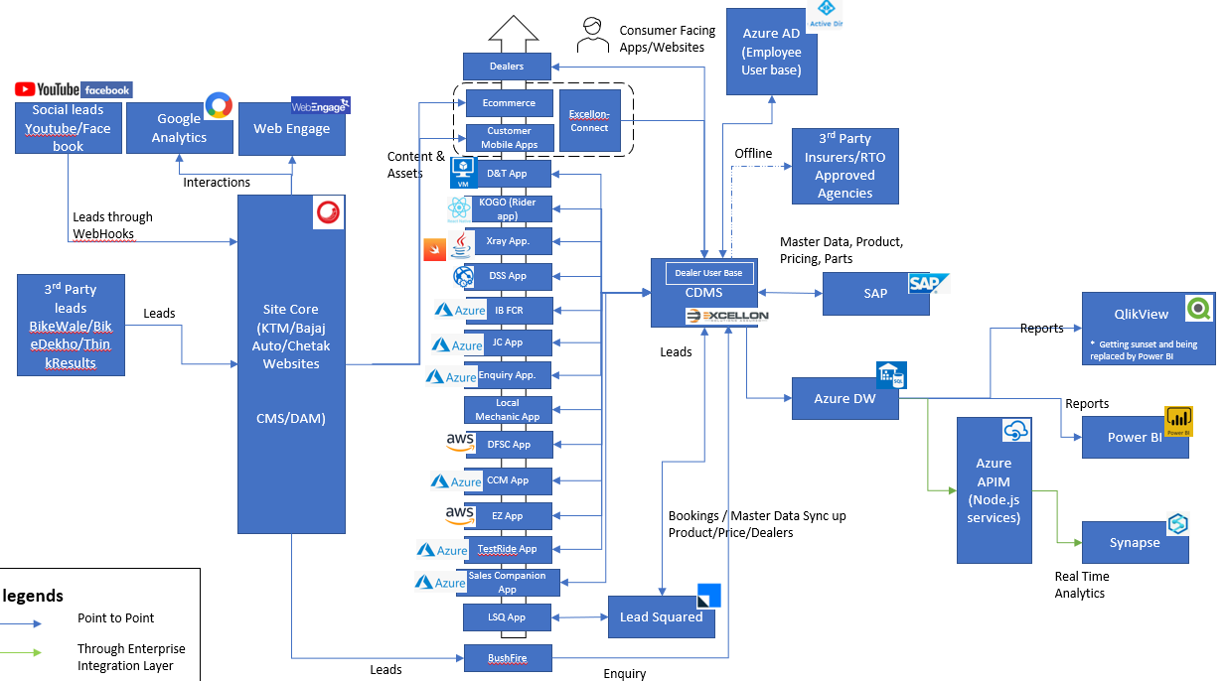
Why Salesforce-Mulesoft?
Problem Statement
Bajaj’s systems use point-to-point connections, causing instability, limited scalability, and security gaps.
No centralized integration layer impacts flexibility and efficiency.
E-commerce expansion needs a robust integration platform.
Current setup delays time-to-market.
Lacks API-led approach and reusability.
Lack of Real-Time Data Integration
Rigid Point-to-Point Connectivity
High Maintenance Efforts
Poor Visibility & Monitoring
Slow Time to Market
Disconnected Systems

Slide 4

Solution
SPAGHETTI INTEGRATION
This is not the desired state.
API-LED APPROACH
Way forward for Bajaj Auto.
Setup
Experience APIs purpose-built APIs for apps
Migration
External
Process APIs
orchestration, composed APIs
Security
Internal
System APIs legacy modernization, connectivity, SaaS APIs
Monitoring
Improved Communication : Improving the communications between the system.
Flexibility : MuleSoft Layer gives flexibility to integrate with wide variety of system including legacy systems, cloud applications and APIs.
Scalability: with the help of MuleSoft integration layer can handle large volume of data and transaction as it can be scaled.
Security : Having added security on services like Oauth, Client secret , encryption and access control.
Speed : MuleSoft Integration layer designed as fast and support caching, there are certain APIs for aggregators where we will have caching which will help retrieval faster.
Agility : With our API layers we can quickly adapt to changing business needs and integrate new systems and applications this gives agility to be competitive.
Analytics :Any point analytics enables to gain insight on their API usage, performance and operational data.
Reusability : APIs can be reused across multiple projects, reducing duplication and effort.

Slide 5
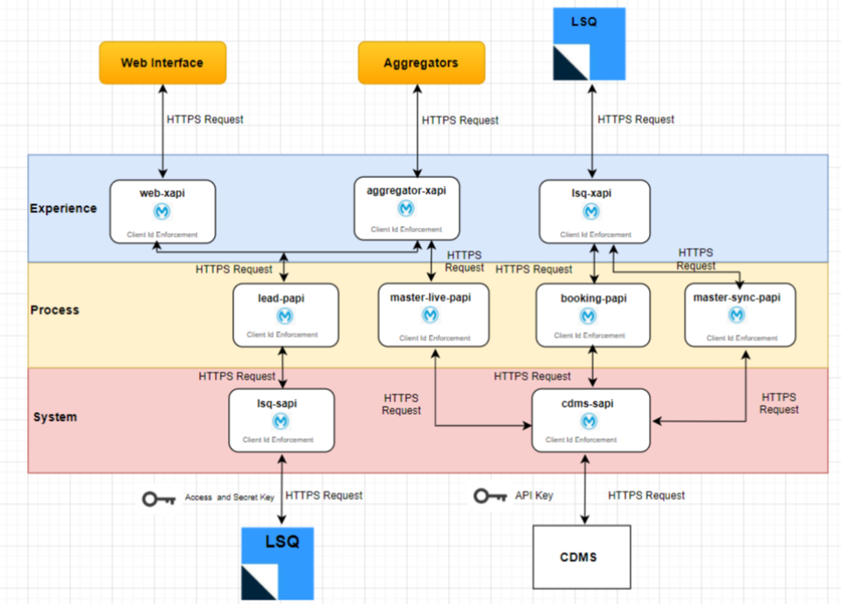
Architecture
MuleSoft Architecture – Bajaj Context
System APIs – these usually access the core systems of record and provide a means of insulating the user from the complexity or any changes to the underlying systems. Once built, many users, can access data without any need to learn the underlying systems and can reuse these APIs in multiple projects.
Process APIs – These APIs interact with and shape data within a single system or across systems (breaking down data silos) and are created here without a dependence on the source systems from which that data originates, as well as the target channels through which that data is delivered.
Experience APIs – Experience APIs are the means by which data can be reconfigured so that it is most easily consumed by its intended audience, all from a common data source, rather than setting up separate point-to-point integrations for each channel. An Experience API is usually created with API-first design principles where the API is designed for the specific user experience in mind.

Slide 6



CI/CD, Environments and Branching Strategy
Environments
DEV
UAT
PROD
Developer Owned Environment
Automated CI/CD Pipeline
Integrator Testing Environment
Automated CI/CD Pipeline
Production
Environment
CI/CD Process Workflow
Checkout SCM
Initialization
Get common config
Generate Settings.xml
Copy secure files
Increment artifact version
Deploy Mulesoft Application
Upload artifact to Anypoint Exchange
SonarQube-cloud
Build Application

Slide 7
API Security Implemented
Security
Description
Extended Security with OAuth Authentication
Enhanced trust and compliance by securing APIs with OAuth authentication, protecting sensitive data and ensuring only authorized access
IP whitelisting
Strengthened API security by allowing access only from trusted and pre-approved IP addresses
Client Id Enforcement
Secured API access by validating requests through unique client ID and secret credentials, generated by the platform.
Encryption and Decryption
Protected sensitive data in transit robust encryption and decryption mechanisms. AES/CBC/PKCS5Padding cipher is used for symmetric encryption-decryption
Schema Validation
Ensured data integrity and consistency by validating API requests and responses against predefined schemas
Rate Limiting
Protected APIs from misuse and ensured fair usage by controlling the number of requests within a defined time frame.

Slide 8






Centralised API architecture
Brand Website + Hyperlocal
(for Digital Enquiries)
Chatbot
(for Lead nurturing)
CRM Platform(LSQ)
Amazon booking (Direct Integration – Digital Enquires)
Aggregator (Direct Integration – Digital Enquires)
MuleSoft Layer
Datawarehouse Integration
Flipkart Booking (Direct Integration – Digital Enquires)
DMS System (Direct Channel via Batch Jobs – Model & Branch Master, Vehicle Allocation & Invoice)

Slide 9
Key Metrics & Business Outcomes
Monthly Traffic to System
Bookings Done Per Month
Bookings From Ecom platform Like Amazon & Flipkart Per Month
Total Cache Hits in a month
Enablers
Cost Saving
> 8 M
More than 25+ Integration Channels
50 % Reduction in Integration Time
> 50% Cost Saving with Caching
Automated Dealer Onboarding for Ecom Platform Resulted in 170 dealers onboarding in just 1 month
35% improvement in operational efficiency
Monthly Cache Hits ~4 M
> 150 K
Monthly Cost Saving =~ Rs 12 Lac
Yearly Saving = ~Rs 1.4 Cr
> 1 K
Security
> 4 M
Enhanced Security & Compliance: Robust API security features ensured compliance with industry standards.

Slide 10
API Usage and Growth
Growth Over Past 2 Years
2X API development
Surge in Platform Traffic
Smart Optimization via Monitoring
Real-time performance insights
Proactive VCore tuning
Cost Control Achieved
VCore Usage Never Exceeded 6 VCore limit
Extra infrastructure costs of ~13 Lacs/Vcore saved
Key KPIS Achieved
API Response Time within 2 Sec.
Under 30 % CPU Utilization
Less Than 0.5 % error rate

Slide 11
Caching
Faster Response Time In milliseconds
Reduced Backend Load and Cost
More Than 60% Requests served by cache
Yearly saving More than Rs 1.4 CR

Slide 12
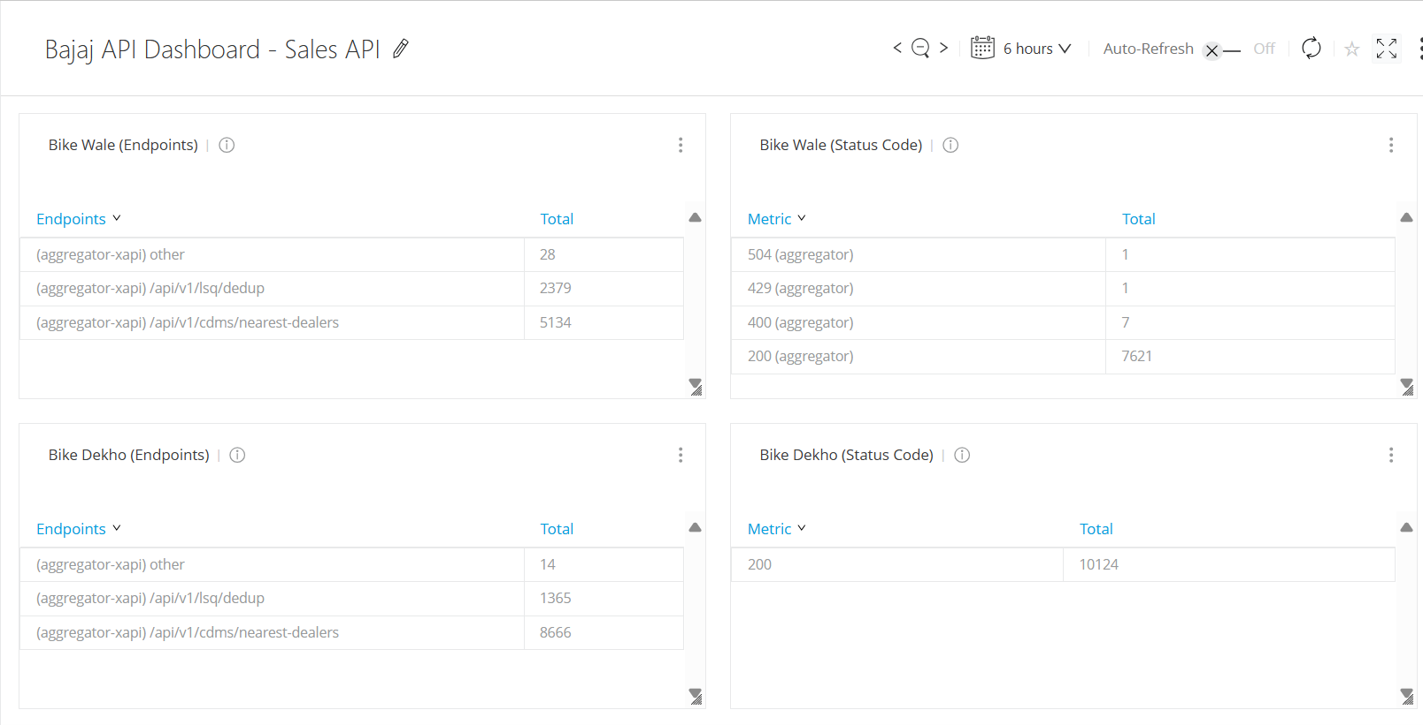
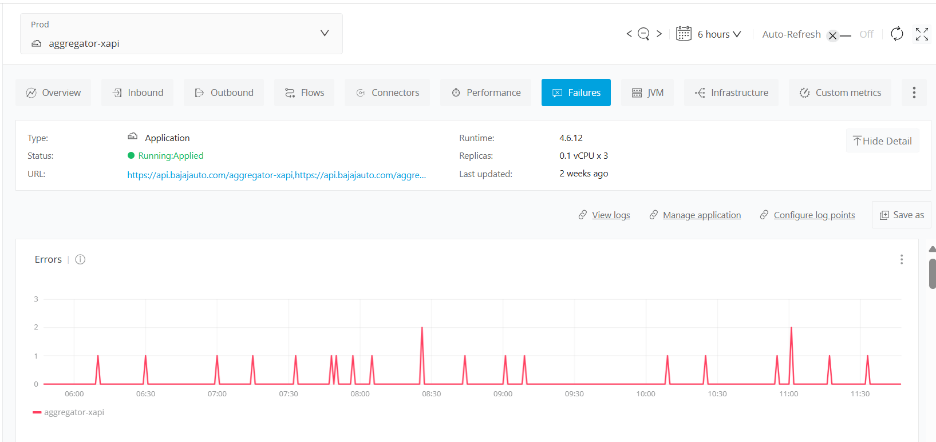
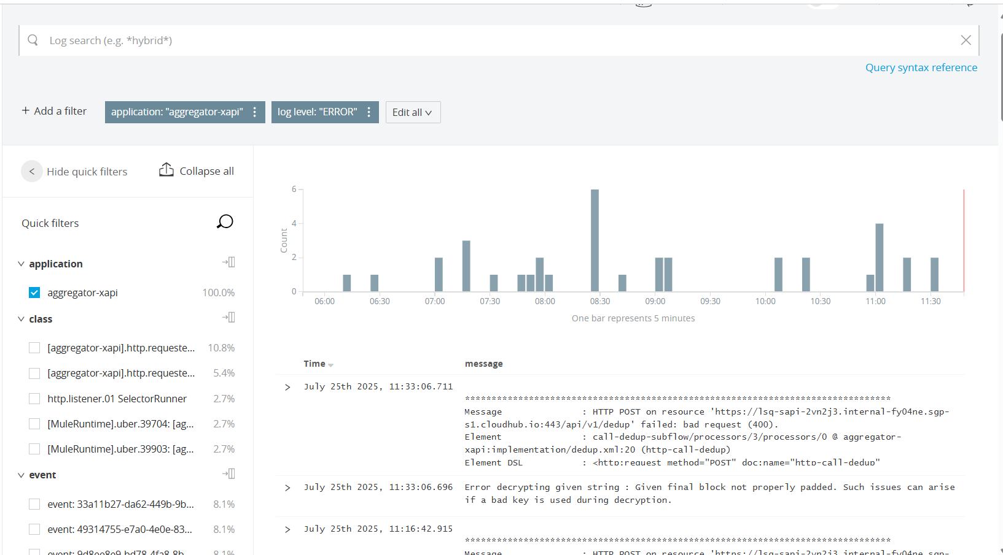
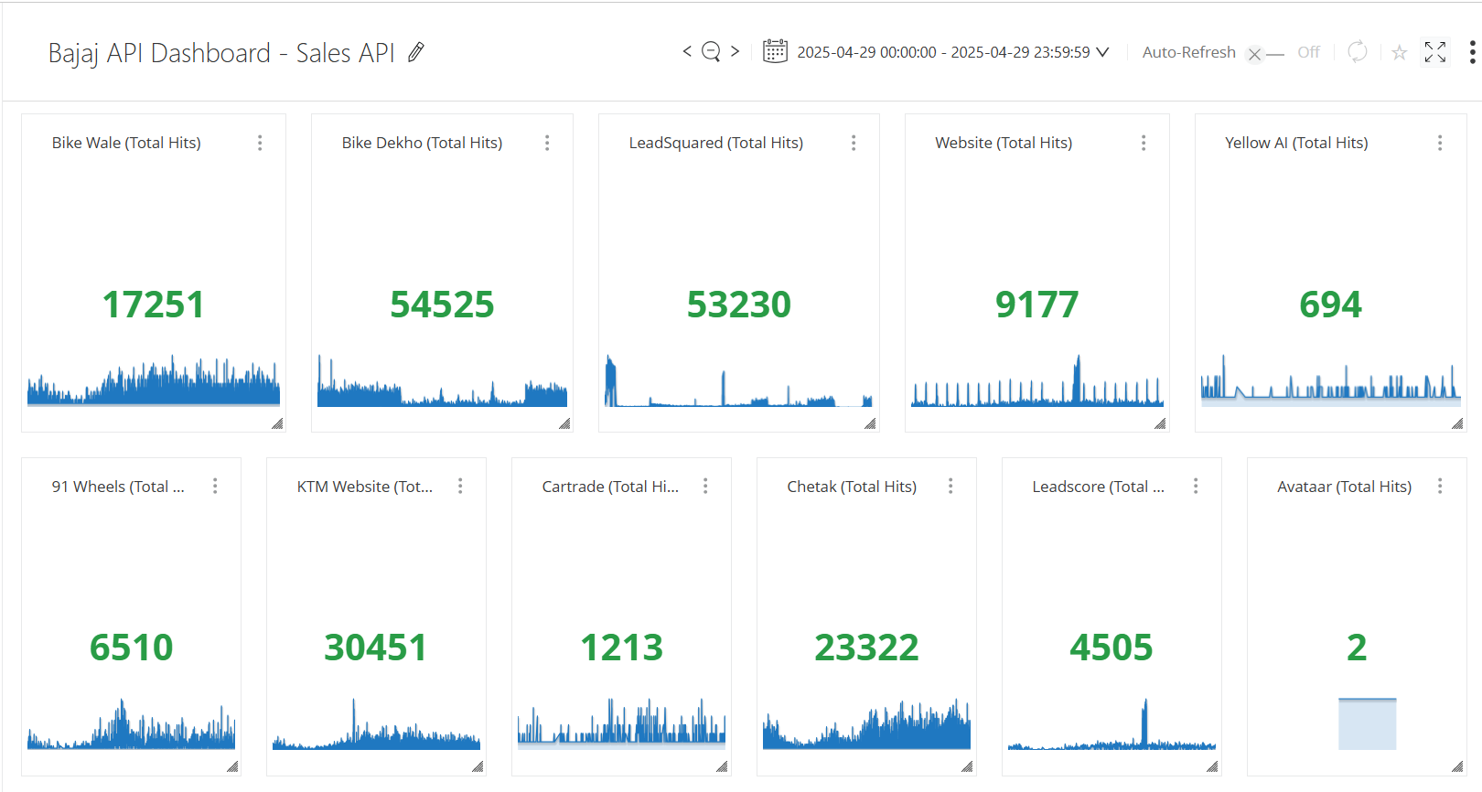
Monitoring, Alerts & Reports
Centralized Logging via Anypoint Monitoring
Advanced Proactive Alert Mechanism
Daily Functional Reporting for Key Business Flows
Monitoring Dashboards

Slide 13
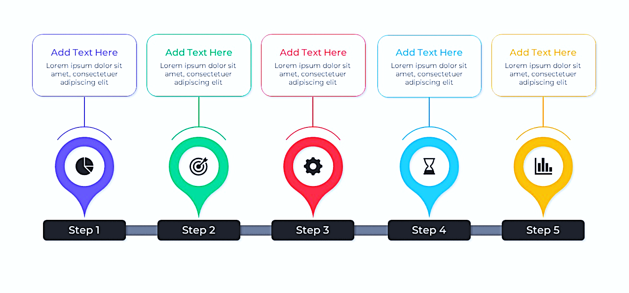
Projects in Pipeline
Flipkart Integration
API Portal Implementation
FOne & Done (Document Upload)
SAP Integration
Data Cloud Integration
Sep - 25
Sep - 25
Oct -25
Nov - 25
Nov - 25

Slide 14
THANK YOU

