Slide 1
Instamart Sales & Operations Analysis
DATA ANALYSIS AND VISUALIZATION REPORT
Tools: SQL, Excel, Power BI
Prepared by: Suraj Sahu (Advanced Certification in Data ScienceAI , Analytixlabs)

Slide 2
Project Overview
Objective: Analyze Instamart order data to understand sales performance, customer trends, and operational efficiency.
Dataset includes order transactions, product categories, delivery details, and locations.

Slide 3
Business Objectives
This project analyzes Instamart grocery delivery data to understand sales trends, customer ordering patterns, and product performance.
The goal is to help the business:
1.Identify total revenue and order trends
2. Analyze product category performance
3. Evaluate city/state level sales performance
4. Track delivery partner activity
5. Support data‑driven decision making
These insights support data-driven decision-making to improve customer experience and increase business growth.

Slide 4
Expected Outcome
After the analysis, Instamart will be able to:
Actionable Insights
Identify top products and categories
Understand regional sales trends
Analyze customer ordering behavior
Business Recommendations
Optimize inventory for high-demand products
Improve delivery efficiency during peak hours
Promote low-performing items
Data-Driven Decisions
Operations → Faster order fulfillment
Marketing → Targeted promotions
Management → Track revenue and order KPIs

Slide 5
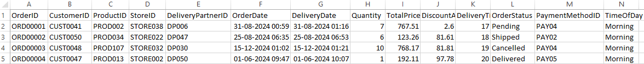
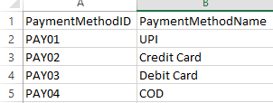
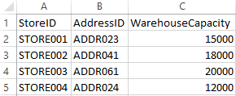
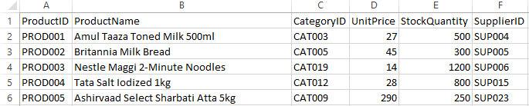
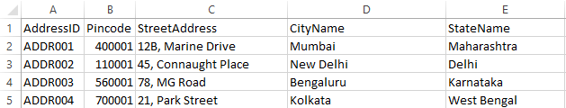
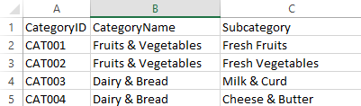
Overview of Table
Orders Table
Payment Table
Store Table
Product Table
Address Table
Category Table
a

Slide 6
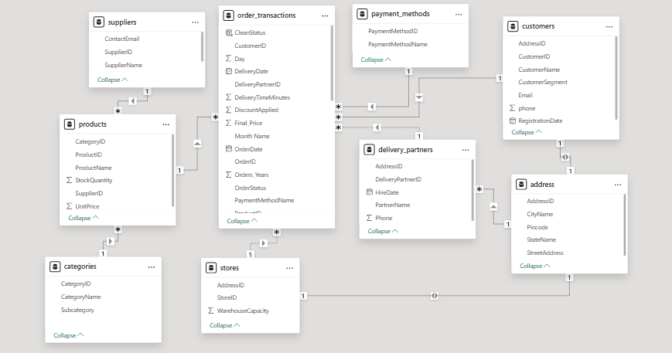
ENTITY RELATIONSHIP DIAGRAM

Slide 7
Key Observations – Instamart Data Analysis
4. Product Category Performance
A few product categories dominate overall sales, while several categories contribute relatively lower revenue and order volume.
Low-performing categories may require pricing strategies, discounts, or improved product visibility.
5. Order Quantity and Revenue Relationship
Products with higher order quantities generally generate higher revenue, but some high-value products generate strong revenue with fewer orders.
6. Operational Insights
Delivery operations appear concentrated in high-demand regions, which can impact delivery efficiency during peak times.
1. Sales Performance
A small number of product categories contribute to the majority of total revenue, indicating strong demand concentration in specific items.
High-performing products consistently generate higher order quantities and revenue, suggesting stable customer demand.
2. Regional Sales Trends
Certain states/cities show significantly higher order volumes, indicating strong market presence in those regions.
Some locations have lower sales despite similar product availability, suggesting potential opportunities for targeted promotions or marketing.
3. Growth Opportunities
Expanding product availability and marketing efforts in high-demand regions can further increase revenue.

Slide 8
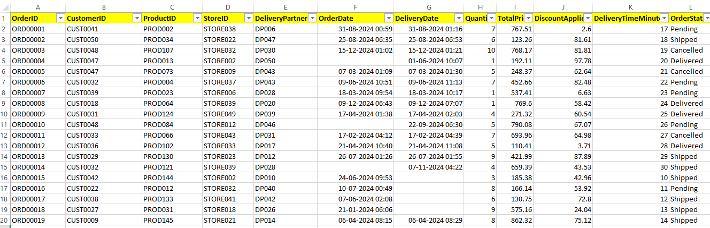
Data Discrepancy
Some records contain incomplete or missing values in important fields such as account name, referral source, and signup date, which can affect segmentation and trend analysis. Additionally, multiple rows show default or incorrect date values like “1900 Jan”, indicating possible data entry or system export errors. There are also inconsistencies in categorical fields such as industry, plan type, and country, where naming formats are not standardized. These issues suggest the need for data validation, standardization of categories, and correction of invalid dates before using the dataset for reporting or business insights.
Missing values

Slide 9
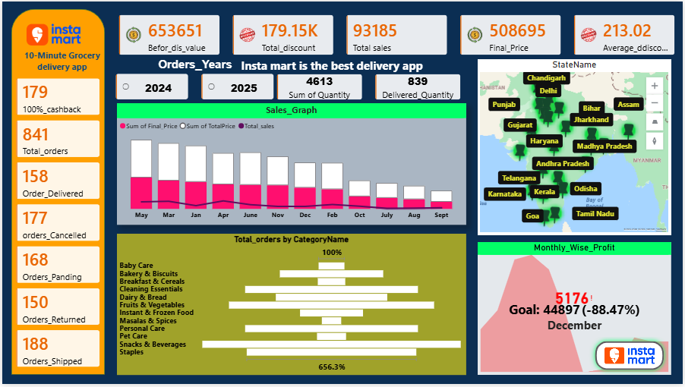
Project Dashboard No.1

Slide 10
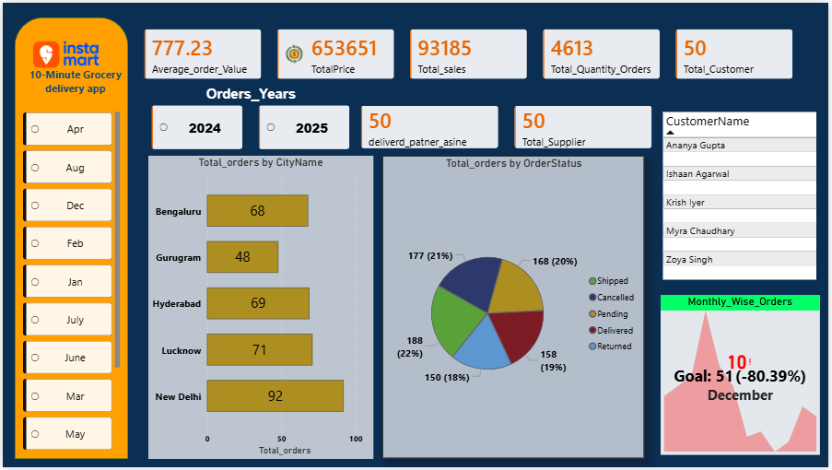
Project Dashboard No.2

Slide 11
Key KPIs
Total Revenue
Total Orders
Average Order Value
Orders per Day
Revenue Growth
Top Performing States

Slide 12
Sales Performance Insights
Revenue trend analysis
Monthly growth tracking
Identification of high demand products
Seasonal order pattern analysis

Slide 13
Product Category Analysis
Top selling product categories
Quantity vs revenue comparison
Identification of slow moving items
Demand distribution across categories

Slide 14
Location Analysis
State-wise revenue comparison
City-level order distribution
Identification of top performing markets

Slide 15
Assumptions
1.Data Accuracy It is assumed that the dataset used for the analysis is accurate and represents real Instamart order transactions without major data entry errors. 2.Complete Order Records Each order record contains correct information such as product, quantity, price, and location, and missing values have been handled during data cleaning. 3.Revenue Calculation Total revenue is calculated based on the product price multiplied by quantity ordered, assuming no additional discounts or taxes unless explicitly included in the dataset.
4.Customer Demand Representation The order data is assumed to reflect actual customer purchasing behavior, helping identify product demand and sales patterns. 5.Location Data Reliability The state and city information in the dataset is assumed to be correct and used for analyzing regional sales performance. 6.Time-Based Analysis Order date and time fields are assumed to be correctly recorded, enabling accurate daily, monthly, and yearly sales trend analysis. 7.Product Category Classification Each product is assumed to belong to the correct category, which is used to analyze category-level sales performance.

Slide 16
Challenges Faced During the Project
1. Data Cleaning and Preprocessing
The dataset contained inconsistent formats, missing values, and duplicate records, which required significant data cleaning before analysis.
2. Data Integration
The project involved multiple tables (orders, products, locations, delivery partners) that needed to be properly connected using relationships in Power BI data modeling.
3. Handling Large Data Volume
The dataset included a large number of order transactions, which required optimized queries and efficient data modeling to ensure smooth report performance.
4. DAX Calculations
Creating advanced metrics such as revenue growth, average order value (AOV), and ranking of top products/states required writing and optimizing DAX formulas. 5. Dashboard Design
Designing a dashboard that is clear, interactive, and visually meaningful while presenting multiple KPIs and insights was a challenge.
6. Insight Generation
Transforming raw data into meaningful business insights required careful analysis of sales trends, product performance, and regional demand patterns.

Slide 17
Operational Insights
Delivery partner performance
Order fulfillment trends
Operational efficiency indicators

Slide 18
Conclusion & Business Impact Recommendations
Focus on high demand categories
Expand operations in top performing cities
Optimize delivery partner allocation
Use dashboards for continuous monitoring
Identify high-performing products and categories
Optimize inventory and stock planning
Improve delivery operations and order fulfillment
Support regional expansion strategies

Slide 19
Thank you 🙏
Suraj sahu

