Slide 1

PYTHON DATA ANALYTICS PROJECT
PhonePe Pulse Data Analysis
Decoding India's Digital Payment Revolution Through Data
Developed By Suraj Sahu
Python • Pandas • NumPy • Matplotlib • Plotly • Squarify
Notes:
Welcome the audience. Introduce the project as an end-to-end Python data analytics project built on the official PhonePe Pulse dataset, covering transactions, users, and insurance data across India from 2018 to 2022. Mention this presentation summarizes the full Jupyter Notebook analysis for submission and portfolio purposes.

Slide 2



THE BIG PICTURE
Project Overview
Introduction
Problem Statement
Why It Matters
Digital payment platforms like PhonePe have transformed how India transacts — making payments faster, safer, and accessible to everyone.
Raw transaction, user, and insurance data across states and years needs to be cleaned and analyzed to reveal usable business patterns.
Understanding digital payment behavior helps businesses, regulators, and fintech players make smarter, data-driven decisions.
PhonePe Pulse Data Analysis
2
Notes:
Digital payments have transformed India's financial landscape by making transactions faster, safer, and more accessible. The PhonePe Pulse dataset provides comprehensive information on transactions, registered users, insurance, mobile brands, districts, and pincodes across India. This project analyzes that dataset to identify payment trends, customer behavior, regional performance, and yearly growth using Python.

Slide 3


WHAT WE SET OUT TO DO
Project Objectives
Project Goals
Business Objectives
Analyze transaction amounts across India
Study yearly and quarterly transaction trends
Identify top-performing states and districts
Analyze registered users and app opens
Discover the most popular mobile brands
Compare insurance transactions across states
Identify high-performing pincodes
Generate business insights from the data
PhonePe Pulse Data Analysis
3
Notes:
The project has two layers of objectives: technical goals (analyzing transactions, trends, users) and business objectives (mobile brand popularity, insurance comparison, high-performing pincodes) that translate the analysis into actionable insight.

Slide 4



UNDERSTANDING OUR DATA SOURCE
Dataset Description
Dataset Source
Dataset Categories
Official PhonePe Pulse dataset covering India's digital payments ecosystem
Aggregate Transaction
Aggregate User
Aggregate Insurance
Map Transaction
Map User
Top Transaction
Top User
Time Period Covered
Key Features Used
2018
2022
State
District
Pincode
Year
Quarter
Transaction Amount
Transaction Count
Registered Users
App Opens
Mobile Brand
36 States/UTs • 727 Districts
PhonePe Pulse Data Analysis
4
Notes:
The dataset spans 2018 to 2022 across 36 states/UTs and 727 districts, organized into seven categories: aggregate transaction, aggregate user, aggregate insurance, map transaction, map user, top transaction, and top user data. Ten key features were used for analysis, including state, district, pincode, transaction amount and count, registered users, app opens, and mobile brand.

Slide 5







OUR TOOLKIT
Technologies Used
Python
Pandas
NumPy
Matplotlib
Core Language
Data Wrangling
Numerical Computing
Static Visuals
Plotly
Squarify
Jupyter Notebook
Interactive Charts
Treemap Plots
Development IDE
PhonePe Pulse Data Analysis
5
Notes:
The project uses Python as the core language with Pandas and NumPy for data manipulation, Matplotlib for static charts, Plotly for interactive visuals, and Squarify for treemap plots — all developed inside Jupyter Notebook.

Slide 6





FROM RAW DATA TO INSIGHT
Project Workflow
1
2
3
4
5
6
7
Data Collection
Data Cleaning
Data Preprocessing
Exploratory Data Analysis
Visualization
Business Insights
Conclusion
A structured seven-stage pipeline transforms raw PhonePe Pulse CSV files into clear, decision-ready business insights.
PhonePe Pulse Data Analysis
6
Notes:
The project follows a structured seven-step workflow: collecting the raw PhonePe Pulse CSV files, cleaning the data, preprocessing and merging datasets, performing exploratory data analysis, building visualizations, extracting business insights, and concluding with a summary of findings.

Slide 7


PREPARING THE DATA FOR ANALYSIS
Data Cleaning & Preprocessing
Missing Values
6,946,258
Detected in Brand, Transaction Count (user) and Percentage columns; rows with nulls were removed for accuracy.
Total records before cleaning
Duplicate Handling
6,836,533
Dataset checked for duplicate rows using duplicated().sum() — confirmed as clean with zero duplicates.
Clean records after removing nulls (16 columns)
Data Type Conversion
Merge Sequence
Transaction Amount converted from formatted string to numeric using pd.to_numeric() for calculations.
Aggregate Transaction + Aggregate User
→ Map Transaction (adds District, Lat/Long)
→ Map User (adds Registered Users, App Opens)
→ Top Transaction Pincode (adds Pincode)
Dataset Merging
Seven separate CSV sources merged step-by-step on State, Year, Quarter and District into one unified table.
PhonePe Pulse Data Analysis
7
Notes:
Data cleaning began by checking for missing values — found in the Brand, Transaction_count_user and Percentage columns — which were removed using dropna(), reducing the dataset from about 6.94 million to 6.83 million clean rows across 16 columns. No duplicate rows were found. Transaction Amount was converted from a formatted string to a numeric type. Seven separate PhonePe Pulse CSV files were merged step by step into a single unified dataframe called 'phonepe' using common keys such as State, Year, Quarter, and District.

Slide 8





UNCOVERING PATTERNS IN THE DATA
Exploratory Data Analysis
With clean, merged data in place, Exploratory Data Analysis (EDA) was performed to understand trends, patterns, and relationships hidden inside the PhonePe Pulse dataset — using grouping, aggregation, pivot tables, and visual charts.
Transaction Analysis
User Analysis
Mobile Brand Analysis
District Analysis
Pincode Analysis
Region Analysis
PhonePe Pulse Data Analysis
8
Notes:
EDA in this project spans six major areas: transaction analysis, user analysis, mobile brand analysis, district analysis, pincode analysis, and region analysis. Each area uses grouping and visualization to surface patterns behind India's digital payment activity. The next several slides walk through each analysis in detail.

Slide 9
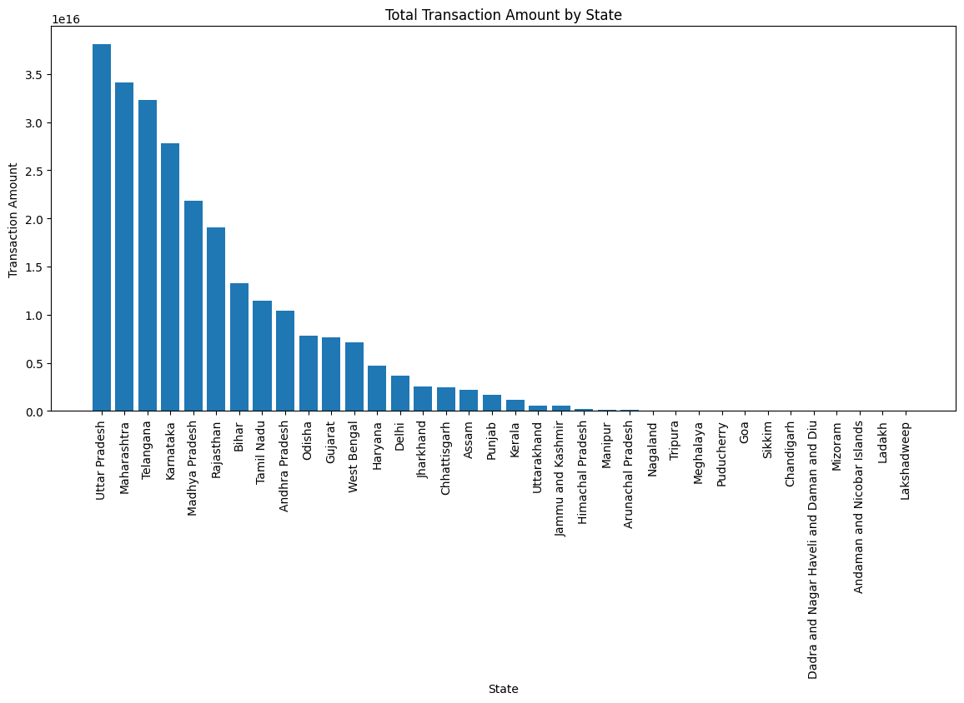

TRANSACTION ANALYSIS
Total Transaction Amount by State
OBJECTIVE
Identify which Indian states generate the highest digital transaction value on PhonePe.
KEY OBSERVATIONS
Uttar Pradesh recorded the highest total transaction amount, followed closely by Maharashtra and Telangana.
Karnataka and Madhya Pradesh round out the top five performing states.
A steep drop-off is visible after the top 10 states, showing concentrated activity.
BUSINESS INSIGHT
Digital payment growth is heavily concentrated in a handful of large states — marketing and infrastructure investment should prioritize these high-value regions.
PhonePe Pulse Data Analysis
9
Notes:
Grouping transaction amount by state shows Uttar Pradesh at the top, followed by Maharashtra, Telangana, Karnataka, and Madhya Pradesh. This bar chart visualizes total transaction amount across all states, highlighting the sharp concentration of activity in the top-performing states.

Slide 10
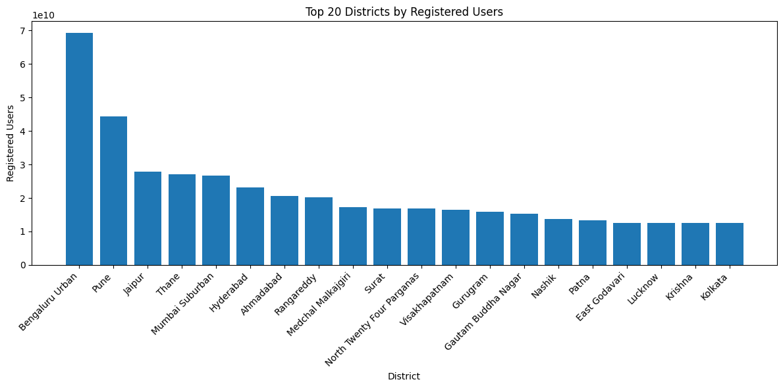
TOP DISTRICT ANALYSIS
Top 20 Districts by Registered Users
OBJECTIVE
Pinpoint the districts driving the highest user registration volumes across India.
KEY OBSERVATIONS
Bengaluru Urban leads all districts with over 69 billion in registered-user activity.
Pune, Jaipur, Thane, and Mumbai Suburban follow as the next top districts.
Urban, metro-adjacent districts dominate the top 20 list.
BUSINESS INSIGHT
Metro and IT-hub districts are PhonePe's strongest user bases, making them ideal candidates for premium features, loyalty programs, and merchant partnerships.
PhonePe Pulse Data Analysis
10
Notes:
This chart shows the top 20 districts ranked by registered users. Bengaluru Urban tops the list at roughly 69.3 billion, ahead of Pune (44.4B), Jaipur (28.0B), Thane (27.1B), and Mumbai Suburban (26.7B) — confirming that urban tech and metro districts drive the platform's user base.

Slide 11
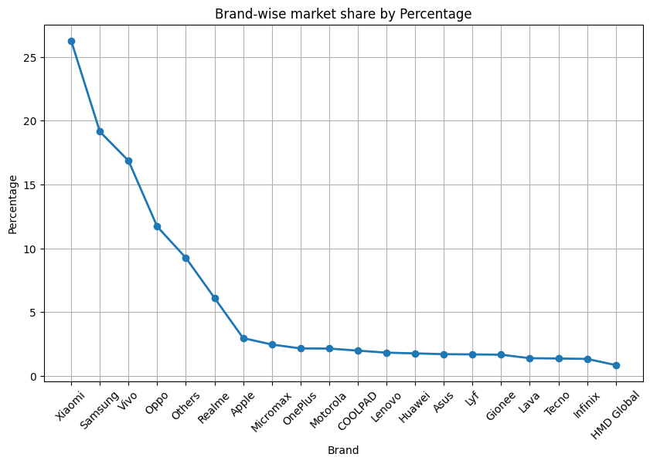
MOBILE BRAND ANALYSIS
Brand-Wise Market Share
OBJECTIVE
Understand which mobile phone brands are most popular among PhonePe users.
KEY OBSERVATIONS
Xiaomi leads with an average market share of about 26.3%.
Samsung (19.1%) and Vivo (16.9%) follow as strong runner-ups.
Oppo (11.7%) and the 'Others' category (9.3%) complete the top five brands.
BUSINESS INSIGHT
Budget and mid-range Android brands (Xiaomi, Samsung, Vivo) dominate the user base — app performance should be optimized for these device segments first.
PhonePe Pulse Data Analysis
11
Notes:
Average percentage share by brand shows Xiaomi leading at 26.25%, followed by Samsung at 19.14%, Vivo at 16.85%, Oppo at 11.71%, and Others at 9.26%. This confirms that affordable Android smartphones are the primary devices used to access PhonePe.

Slide 12
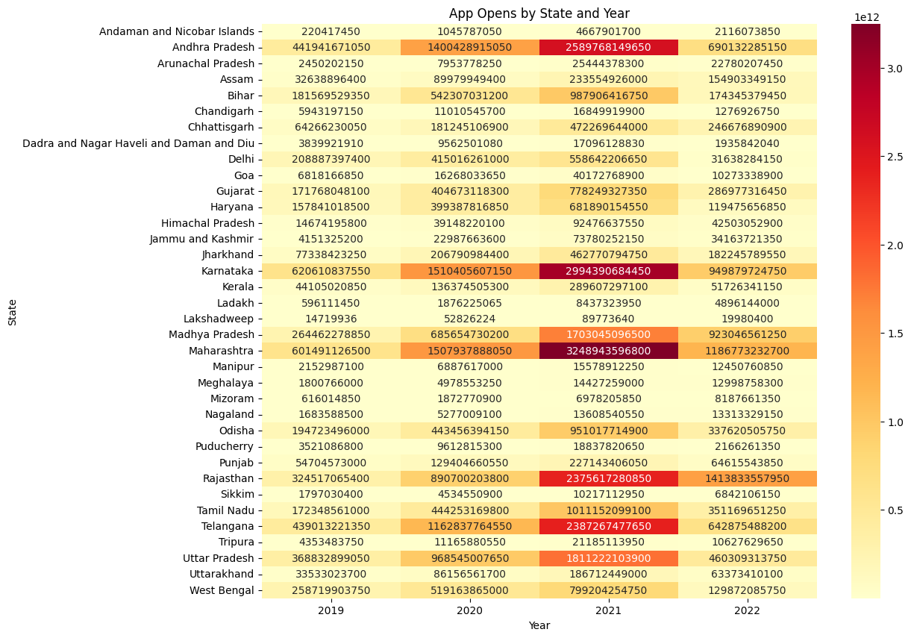
USER ANALYSIS
App Opens by State and Year
OBJECTIVE
Track how user engagement (app opens) has evolved across states and years.
KEY OBSERVATIONS
Maharashtra, Karnataka, and Andhra Pradesh show the darkest (highest) engagement cells.
App opens rise consistently year-over-year for most large states.
Smaller states and union territories show comparatively low, steady engagement.
BUSINESS INSIGHT
Sustained growth in app opens signals strengthening user habit and loyalty — a positive leading indicator for retention-focused product features.
PhonePe Pulse Data Analysis
12
Notes:
This heatmap plots app opens by state (rows) and year (columns), excluding 2018 for cleaner comparison. Maharashtra, Karnataka, and Andhra Pradesh show consistently high engagement, and most states show a rising trend year after year, indicating growing user stickiness.

Slide 13
REGION ANALYSIS
App Opens by Region
OBJECTIVE
Compare user engagement across India's six broad geographic regions.
KEY OBSERVATIONS
The Southern Region leads with roughly 18.45 trillion app opens.
The Western Region follows at about 13.22 trillion.
The North-Eastern Region records the lowest engagement at approximately 740 billion.
BUSINESS INSIGHT
Southern and Western India are PhonePe's engagement strongholds; the North-East represents a high-growth opportunity for targeted expansion campaigns.
PhonePe Pulse Data Analysis
13
Notes:
Grouping app opens by region shows the Southern Region on top with about 18.45 trillion opens, followed by the Western Region (13.22 trillion), Central Region (8.15 trillion), Eastern Region (6.47 trillion), Northern Region (3.79 trillion), and the North-Eastern Region lowest at 740 billion.

Slide 14
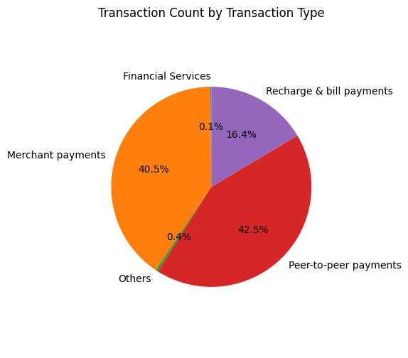
TRANSACTION ANALYSIS
Transaction Count by Transaction Type
OBJECTIVE
Break down PhonePe transactions by category to see what drives platform usage.
KEY OBSERVATIONS
Peer-to-peer payments form the largest share of total transaction count.
Merchant payments are the second-largest contributor.
Recharge & bill payments and financial services make up smaller shares.
BUSINESS INSIGHT
P2P transfers are PhonePe's core habitual use case; growth in merchant payments signals the platform's expanding role in everyday commerce.
PhonePe Pulse Data Analysis
14
Notes:
The pie chart of transaction count by type shows peer-to-peer payments and merchant payments as the two largest categories, consistent with the transaction-amount breakdown: peer-to-peer payments led with about 205.3 trillion, merchant payments at 34.7 trillion, recharge & bill payments at 10.7 trillion, and financial services / others much smaller.

Slide 15
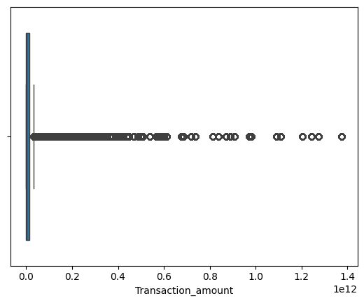
TRANSACTION ANALYSIS
Distribution of Transaction Amount
OBJECTIVE
Examine the spread and outliers in transaction amount values across all records.
KEY OBSERVATIONS
Transaction amounts are heavily right-skewed, with most values clustered near zero.
A number of high-value outliers extend the range significantly.
The median transaction amount is far lower than the maximum recorded value.
BUSINESS INSIGHT
A small number of very large transactions can distort simple averages — median-based and segment-level analysis gives a more reliable picture of typical user behavior.
PhonePe Pulse Data Analysis
15
Notes:
The boxplot of transaction amount reveals a right-skewed distribution: the bulk of transactions are modest in value, while a handful of very large transactions form outliers stretching the axis, with the average transaction amount at about 36.7 billion and a maximum of roughly 1.37 trillion.

Slide 16
USER ANALYSIS
Registered Users by Region
OBJECTIVE
Visualize the proportional share of registered users contributed by each region using a treemap.
KEY OBSERVATIONS
Southern Region contributes the largest share of registered users (~556 billion).
Western Region is second at approximately 469 billion.
North-Eastern Region remains the smallest contributor at about 31 billion.
BUSINESS INSIGHT
User base concentration mirrors engagement patterns — the same regions (South, West) that show high app opens also show the highest registrations, reinforcing them as priority markets.
PhonePe Pulse Data Analysis
16
Notes:
An interactive Plotly treemap was built in the notebook to visualize registered users by region, sized and colored by user count. Southern Region leads at approximately 555.8 billion registered users, followed by Western Region (468.6B), Central Region (324.9B), Eastern Region (304.9B), Northern Region (217.7B), and North-Eastern Region (31.0B). This slide recreates that proportion as a donut chart.

Slide 17
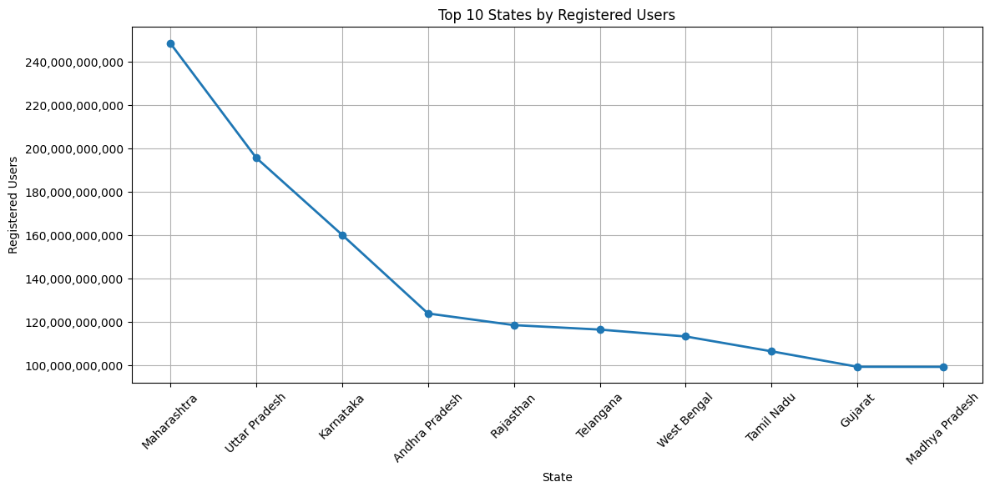
USER ANALYSIS
Top 10 States by Registered Users
OBJECTIVE
Rank the states with the strongest PhonePe user registration base.
KEY OBSERVATIONS
Maharashtra leads with about 248.6 billion registered users.
Uttar Pradesh (195.8B) and Karnataka (160.3B) follow closely behind.
The top 10 states show a smooth, gradual decline rather than a sharp cliff.
BUSINESS INSIGHT
A broad base of high-user states (not just one or two) means growth strategies can be replicated across multiple large markets rather than depending on a single region.
PhonePe Pulse Data Analysis
17
Notes:
The top 10 states by registered users are led by Maharashtra (248.6B), Uttar Pradesh (195.8B), Karnataka (160.3B), Andhra Pradesh (124.0B), Rajasthan (118.6B), Telangana (116.5B), West Bengal (113.4B), Tamil Nadu (106.5B), Gujarat (99.4B) and Madhya Pradesh (99.4B).

Slide 18
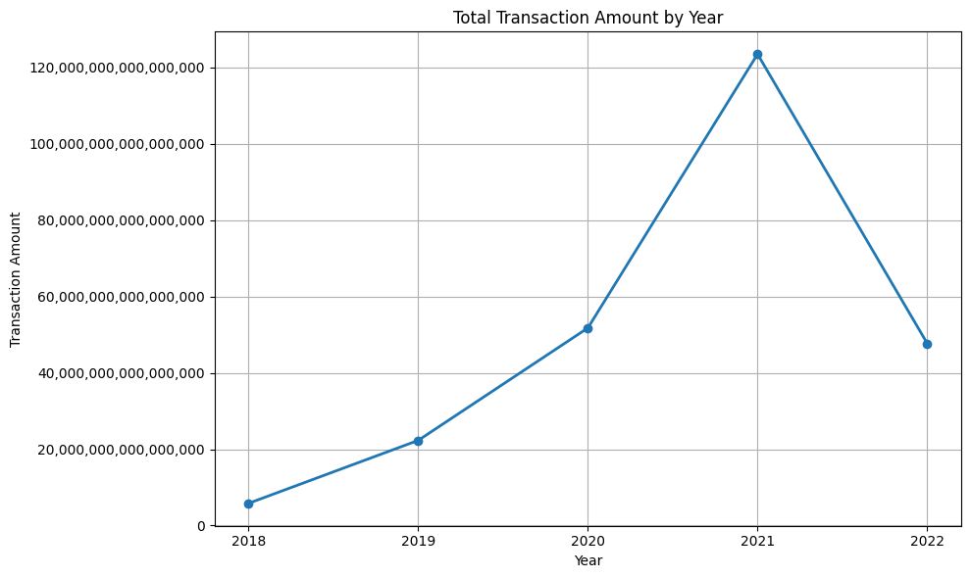
YEAR-WISE ANALYSIS
Total Transaction Amount by Year
OBJECTIVE
Track how total transaction value has grown across the years covered in the dataset (2018–2022).
KEY OBSERVATIONS
Transaction amount rose sharply from 2018 through 2021.
2021 marks the peak year in the dataset at roughly 123.5 trillion.
2022 shows a decline versus 2021, though data for 2022 covers only Quarter 1.
BUSINESS INSIGHT
The multi-year upward trend confirms strong platform adoption; the 2022 dip should be read in context of partial-year data rather than a genuine slowdown.
PhonePe Pulse Data Analysis
18
Notes:
Total transaction amount by year: 2018 (5.82 trillion), 2019 (22.31 trillion), 2020 (51.77 trillion), 2021 (123.49 trillion — the peak), and 2022 (47.71 trillion, but this reflects only Q1 data in the dataset).

Slide 19
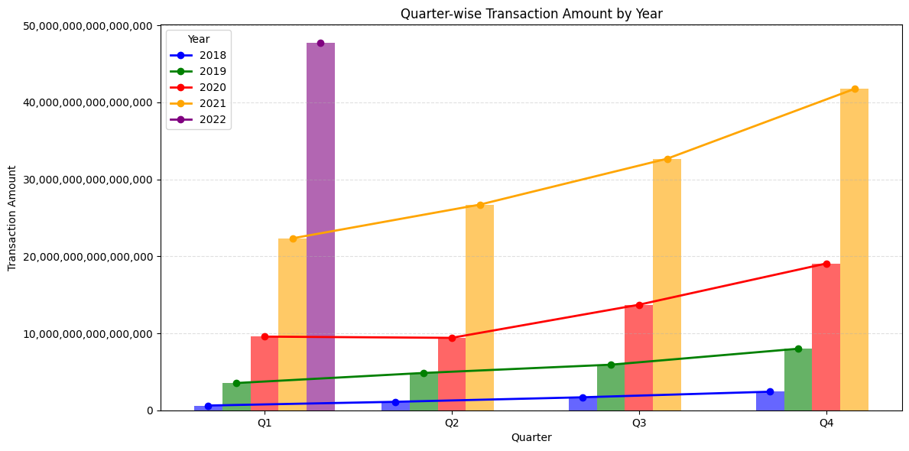
QUARTER-WISE ANALYSIS
Quarter-wise Transaction Amount by Year
OBJECTIVE
Study seasonal and quarterly patterns in transaction value across each year.
KEY OBSERVATIONS
Every year shows a consistent rise from Q1 to Q4.
Q4 is the strongest quarter across nearly all years in the dataset.
The gap between Q1 and Q4 widens as years progress, showing accelerating growth.
BUSINESS INSIGHT
Q4 consistently outperforms other quarters — likely tied to festive season spending — making it the ideal window for merchant offers and campaign pushes.
PhonePe Pulse Data Analysis
19
Notes:
This combined bar-and-line chart shows quarterly transaction amount for each year from 2018 to 2022. Every year follows the same pattern: transaction amount increases from Q1 to Q4, with Q4 being the strongest quarter, and the year-over-year gap widening, reflecting the platform's expanding scale.

Slide 20
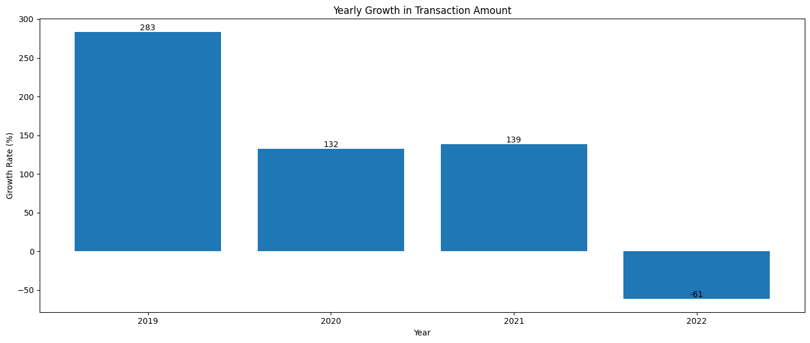
GROWTH ANALYSIS
Yearly Growth in Transaction Amount
OBJECTIVE
Measure year-over-year percentage growth in total transaction amount.
KEY OBSERVATIONS
2019 recorded the highest growth rate at about 283% over 2018.
Growth moderated to 132% in 2020 and 139% in 2021.
2022 shows a negative growth rate of about -61%, driven by partial-year data.
BUSINESS INSIGHT
Explosive early growth (2019) has matured into steadier expansion — a healthy sign of a maturing platform, though the 2022 figure needs full-year data before drawing conclusions.
PhonePe Pulse Data Analysis
20
Notes:
Year-over-year percentage growth in transaction amount: 2019 saw the highest growth at 283.3%, followed by 132.0% in 2020 and 138.6% in 2021. The apparent -61.4% figure for 2022 is a data artifact caused by comparing a full year (2021) against only one quarter of data for 2022, not a genuine decline.

Slide 21
BUSINESS QUESTION 1
Which state has the highest transaction amount?
ANSWER
Uttar Pradesh recorded the highest total transaction amount in the dataset, ahead of Maharashtra and Telangana, based on grouping transaction amount by state and sorting in descending order.
BUSINESS INSIGHT
State-level dominance should guide where PhonePe deepens merchant tie-ups and where regional campaigns can unlock similar growth in mid-tier states.
PhonePe Pulse Data Analysis
21
Notes:
phonepe.groupby('State')['Transaction_amount'].sum().sort_values(ascending=False) shows Uttar Pradesh on top, followed by Maharashtra, Telangana, Karnataka, and Madhya Pradesh.

Slide 22
BUSINESS QUESTION 2
Which district has the highest registered users?
ANSWER
Bengaluru Urban has the highest registered-user count of any district, at approximately 69.3 billion, followed by Pune (44.4B) and Jaipur (28.0B).
BUSINESS INSIGHT
The strongest user districts are also strong candidates for pilot-testing new features before a nationwide rollout.
PhonePe Pulse Data Analysis
22
Notes:
phonepe.groupby('District')['Registered_users'].sum().sort_values(ascending=False).head(10) places Bengaluru Urban first, ahead of Pune, Jaipur, Thane, and Mumbai Suburban.

Slide 23
BUSINESS QUESTION 3
Which transaction type contributes the most revenue?
ANSWER
Peer-to-peer payments contribute the most transaction value by far (~205.3 trillion), followed by merchant payments (~34.7 trillion) and recharge & bill payments (~10.7 trillion).
BUSINESS INSIGHT
PhonePe's core habitual use case remains person-to-person transfers; the growing merchant-payments segment represents the platform's expansion into retail and commerce.
PhonePe Pulse Data Analysis
23
Notes:
phonepe.groupby('Transaction_type')['Transaction_amount'].sum().sort_values(ascending=False) — peer-to-peer payments lead, followed by merchant payments, recharge & bill payments, others, and financial services.

Slide 24
BUSINESS QUESTION 4
Which region has the highest app opens?
ANSWER
The Southern Region records the highest app opens at roughly 18.45 trillion, ahead of the Western Region at about 13.22 trillion.
BUSINESS INSIGHT
Concentrated engagement in the South and West suggests these markets are ready for premium or value-added features ahead of other regions.
PhonePe Pulse Data Analysis
24
Notes:
phonepe.groupby('Region')['App_opens'].sum().sort_values(ascending=False) confirms the Southern Region leads, followed by Western, Central, Eastern, Northern, and North-Eastern regions.

Slide 25
BUSINESS QUESTION 5
Which states show the fastest growth in registered users?
ANSWER
Using year-over-year percentage change, Nagaland recorded the fastest growth at about 161% in 2019, followed by Arunachal Pradesh (156%), Meghalaya (145%), and Mizoram (143%) — mostly smaller, emerging states.
BUSINESS INSIGHT
Smaller states are growing fastest off a low base, signaling untapped headroom; large states remain the volume leaders shown in this chart of top states by total users.
PhonePe Pulse Data Analysis
25
Notes:
growth = phonepe.groupby(['Year','State'])['Registered_users'].sum().reset_index(); growth['Growth_%'] = growth.groupby('State')['Registered_users'].pct_change()*100 — Nagaland, Arunachal Pradesh, Meghalaya, and Mizoram show the highest percentage growth in 2019.

Slide 26
BUSINESS QUESTION 6
What is the relationship between registered users and app opens?
ANSWER
Registered users and app opens show a strong positive correlation of 0.80, meaning states with more registered users also tend to have proportionally more app opens.
0.80
Correlation Coefficient
Strong Positive Correlation
BUSINESS INSIGHT
Because usage scales with registration, acquisition campaigns that grow the registered base will likely drive proportional engagement gains too.
PhonePe Pulse Data Analysis
26
Notes:
correlation = phonepe[['Registered_users','App_opens']].corr() returns a correlation coefficient of approximately 0.803, indicating a strong positive relationship between the two variables.

Slide 27
BUSINESS QUESTION 7
Which states contribute the largest share of national transaction revenue?
ANSWER
The top 10 states together account for the vast majority of national transaction value — Uttar Pradesh alone contributes about 15.2%, followed by Maharashtra (13.6%) and Telangana (12.8%).
BUSINESS INSIGHT
Revenue is concentrated in a small set of states; a 1% improvement in these top markets moves the national number more than gains anywhere else.
PhonePe Pulse Data Analysis
27
Notes:
share = (state/state.sum())*100 computed on state-wise transaction amount — Uttar Pradesh contributes 15.16%, Maharashtra 13.57%, Telangana 12.85%, Karnataka 11.09%, and Madhya Pradesh 8.71% of the national total.

Slide 28
BUSINESS QUESTION 8
Which mobile brand holds the highest average market share?
ANSWER
Xiaomi holds the highest average percentage share among device brands at approximately 26.25%, ahead of Samsung (19.14%) and Vivo (16.85%).
BUSINESS INSIGHT
Since Xiaomi and Samsung devices dominate usage, app performance testing and UI optimization should prioritize these device ecosystems.
PhonePe Pulse Data Analysis
28
Notes:
phonepe.groupby('Brand')['Percentage'].mean() sorted in descending order shows Xiaomi leading at 26.25%, followed by Samsung, Vivo, Oppo, and the Others category.

Slide 29
BUSINESS QUESTION 9
Which pincodes have the highest registered users?
ANSWER
Maharashtra's pincodes 411033, 411057, and 411014 (Pune area) top the list with about 24.86 billion registered users each, followed by pincode 410501 and Uttar Pradesh's 201307 cluster.
BUSINESS INSIGHT
High-density pincodes in Pune and the Delhi-NCR belt (Uttar Pradesh 201xxx) are prime targets for hyperlocal merchant partnerships and localized promotions.
PhonePe Pulse Data Analysis
29
Notes:
phonepe.groupby(['State','Pincode'])['Registered_users'].sum().sort_values(ascending=False).head(20) shows Maharashtra pincodes 411033, 411057, and 411014 at the top, followed by Uttar Pradesh's NCR-region pincodes.

Slide 30
BUSINESS QUESTION 10
Which single state records the maximum app opens?
ANSWER
Maharashtra records the maximum total app opens among all individual states, confirmed using idxmax() on the state-wise app-opens aggregation.
Maharashtra
Highest App Opens of Any Single State
BUSINESS INSIGHT
As both the top state for registered users and app opens, Maharashtra is PhonePe's single most important state market and a benchmark for measuring success elsewhere.
PhonePe Pulse Data Analysis
30
Notes:
phonepe.groupby('State')['App_opens'].sum().idxmax() returns 'Maharashtra' as the state with the highest total app opens.

Slide 31
BUSINESS QUESTION 11
Which district records the highest transaction amount?
ANSWER
Aurangabad recorded the highest total transaction amount among districts, followed by Pratapgarh, Jagtial, Hyderabad, and Adilabad.
BUSINESS INSIGHT
District-level transaction leaders don't always match the districts with the most registered users — showing that transaction value and user count should be tracked as separate KPIs.
PhonePe Pulse Data Analysis
31
Notes:
phonepe.groupby('District')['Transaction_amount'].sum().sort_values(ascending=False).head() shows Aurangabad on top, followed by Pratapgarh, Jagtial, Hyderabad, and Adilabad — a different ranking than the registered-users leaderboard.

Slide 32
BUSINESS QUESTION 12
What is the year-over-year growth trend in transaction amount?
ANSWER
Transaction amount grew 283% year-over-year in 2019, then moderated to 132% (2020) and 139% (2021); 2022 shows -61% because the dataset only includes Q1 of that year.
BUSINESS INSIGHT
Growth-rate trends should always be paired with a check on data completeness — the 2022 figure is a data-coverage artifact, not a real business decline.
PhonePe Pulse Data Analysis
32
Notes:
yearly.pct_change()*100 on transaction amount by year gives 283.26% (2019), 132.03% (2020), 138.56% (2021), and -61.37% (2022, partial-year data).

Slide 33
WHAT THE DATA TOLD US
Key Findings
₹1,375B+
Uttar Pradesh
26.25%
Average transaction value observed, with total volume growing from 2018 to a 2021 peak of ₹123.5T
Top state by transaction amount; Bengaluru Urban leads all districts in registered users
Xiaomi's average market share — the most popular device brand among PhonePe users
0.80
Southern Region
Q4 Every Year
Correlation between registered users and app opens — a strong, consistent relationship
Leads in both app opens (18.45T) and registered users (555.8B) — India's top-performing region
Consistently the strongest quarter for transactions, suggesting a seasonal, festive-driven pattern
PhonePe Pulse Data Analysis
33
Notes:
Summarizing the analysis: total transaction value grew from ₹5.8 trillion in 2018 to a peak of ₹123.5 trillion in 2021. Uttar Pradesh is the top state by transaction amount, while Bengaluru Urban leads all districts in registered users. Xiaomi is the most popular device brand at 26.25% average share. Registered users and app opens are strongly correlated at 0.80. The Southern Region leads India in both engagement and registrations, and Q4 is consistently the strongest quarter every year.

Slide 34

TURNING INSIGHT INTO ACTION
Business Recommendations
Prioritize Top States
Invest In Emerging States
Focus merchant onboarding and marketing spend on Uttar Pradesh, Maharashtra, Telangana, and Karnataka, which drive the largest transaction share.
States like Nagaland, Arunachal Pradesh, and Meghalaya show the fastest user growth — early investment here can compound over time.
Optimize For Leading Devices
Plan Around Q4 Seasonality
Since Xiaomi, Samsung, and Vivo account for the majority of usage, prioritize app performance and testing on these device ecosystems.
Since Q4 consistently outperforms other quarters, plan festive-season promotions and merchant offers to maximize this natural peak.
Expand In The North-East
Leverage the Users–Engagement Link
The North-Eastern Region has the lowest engagement and user base — a clear whitespace opportunity for targeted expansion campaigns.
With a 0.80 correlation between registrations and app opens, user-acquisition campaigns will likely also lift overall engagement.
PhonePe Pulse Data Analysis
34
Notes:
Based on the findings, six practical recommendations emerge: prioritize the top transaction-generating states, invest early in fast-growing smaller states, optimize the app for leading device brands, plan campaigns around the consistent Q4 seasonal peak, target expansion in the under-served North-Eastern Region, and leverage the strong correlation between user registration and engagement when designing acquisition campaigns.

Slide 35
CONCLUSION
From Raw Data To Strategic Insight
This project successfully analyzed the PhonePe Pulse dataset using Python, demonstrating significant growth in digital payments across India and identifying the states, districts, and pincodes contributing the highest transaction volumes. By applying data cleaning, preprocessing, exploratory data analysis, and visualization techniques, meaningful business insights were generated that can support strategic decision-making.
This project also demonstrates practical skills in Python, Pandas, NumPy, and data visualization — making it a strong addition to a data analytics portfolio.
PhonePe Pulse Data Analysis
35
Notes:
This project successfully analyzed the PhonePe Pulse dataset using Python. The analysis demonstrates significant growth in digital payments across India and identifies the states, districts, and pincodes contributing the highest transaction volumes. It also demonstrates practical, portfolio-ready skills in Python, Pandas, NumPy, and data visualization.

Slide 36




WHERE THIS PROJECT CAN GO NEXT
Future Scope
Power BI Dashboard
Tableau Dashboard
Streamlit Web App
Interactive drill-down dashboard for business stakeholders.
Advanced visual analytics with geographic mapping.
A deployable, shareable interactive analytics web app.
ML Prediction
Real-Time Dashboard
Automated Reporting
Machine learning models to forecast future transaction trends.
Live data pipeline integrating real-time APIs.
Scheduled, automated report generation for stakeholders.
PhonePe Pulse Data Analysis
36
Notes:
This project can be enhanced further by developing an interactive Power BI dashboard, creating a Tableau dashboard, building a Streamlit web application, applying machine learning for transaction forecasting, integrating real-time data through APIs, and automating report generation.

Slide 37

WHAT THIS PROJECT SHOWCASES
Skills Demonstrated
Python Programming
Pandas
NumPy
Data Cleaning
Data Visualization
Exploratory Data Analysis
Business Analytics
Problem Solving
PhonePe Pulse Data Analysis
37
Notes:
This project demonstrates a full range of practical data analytics skills: Python programming, Pandas and NumPy for data manipulation, data cleaning, data visualization, exploratory data analysis, business analytics, and problem solving — the core competencies expected of a working data analyst.

Slide 38
Thank You
This project demonstrates practical applications of Python in data analytics, including data preprocessing, exploratory data analysis, and business insight generation using the PhonePe Pulse dataset.
Developed By Suraj Sahu
Python Data Analytics Project • PhonePe Pulse Data Analysis
Notes:
Thank the audience for reviewing the project. Reiterate that it demonstrates practical applications of Python in data analytics — including data preprocessing, exploratory data analysis, and business insight generation — using the PhonePe Pulse dataset, and invite any questions.

