Slide 1
Practical – 02: Basic HTML Tags-II
USCS307: Web Programming (WP)

Slide 2
a) Navigation Tags
<UL> | <OL> | <LI>
<KBD> | <ADDRESS> | <A>

Slide 3
B) Table Tags
<TABLE> | <TR> | <TH>
<TD> | <CAPTION>

Slide 4
C) Form and Form Elements Tags
<FORM> | <INPUT> | <BUTTON>
<OPTION> | <SELECT> | <TEXTAREA>

Slide 5
d) Embedded Multimedia element Tags
<OBJECT> | <PARAM> | <VIDEO>
<SOURCE>

Slide 6
Modify your directories (folder)
D/E [Drive] <as per your list available on your computer>
Class Folder – SYCS
Batch Folder – B5
Roll No Folder – 1111
Course Folder – USCS307
Create your respective Prac_02 folder within your directory.
Open Notepad Editor to type the programs.

Slide 7
Question – 01: (Navigation across multiple pages)
Create a static Web Site using basic text formatting and navigation tags that display the details information about you and your college. The Home page should display the listing of all the links such as Personal Details (Name, Roll No., Class, Batch, Course), Hobbies should display list of your hobbies, About your College, About your Department. Create a Course Details Page that should contain the details of course you are currently enrolled to, which in turn should be linked to Course created in Personal Details Page. All the pages should be inter-linked to provide smooth navigation between them. Give appropriate title to each page.

Slide 8
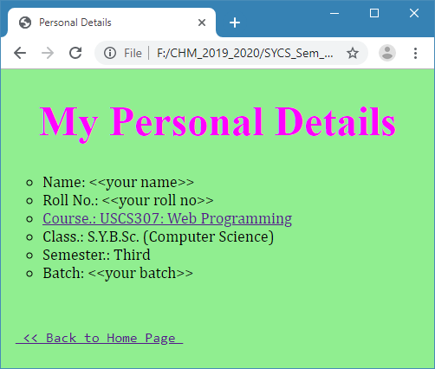
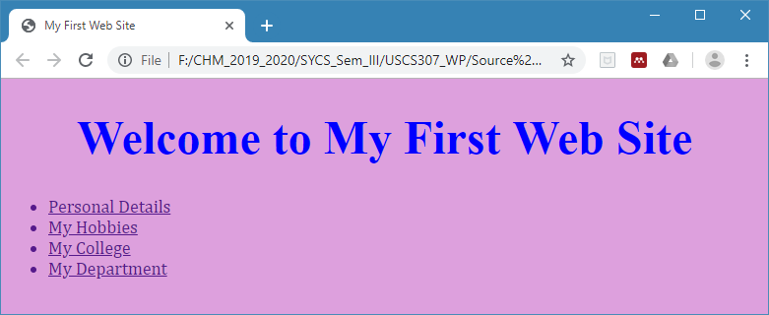

Slide 9
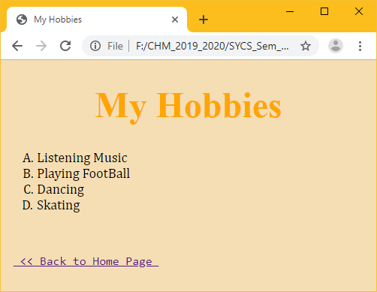

Slide 10
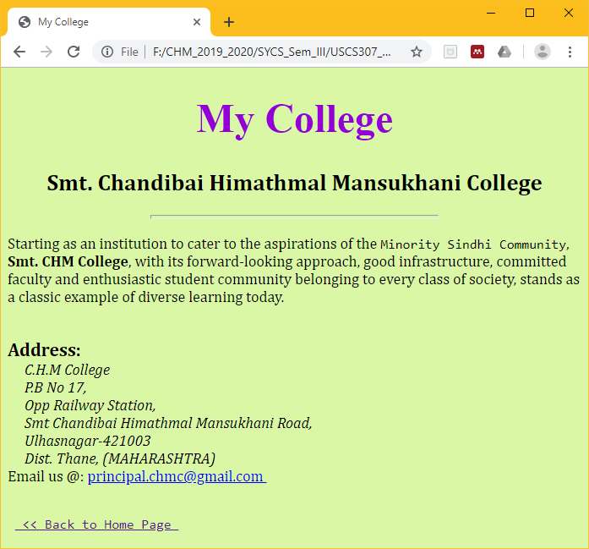

Slide 11
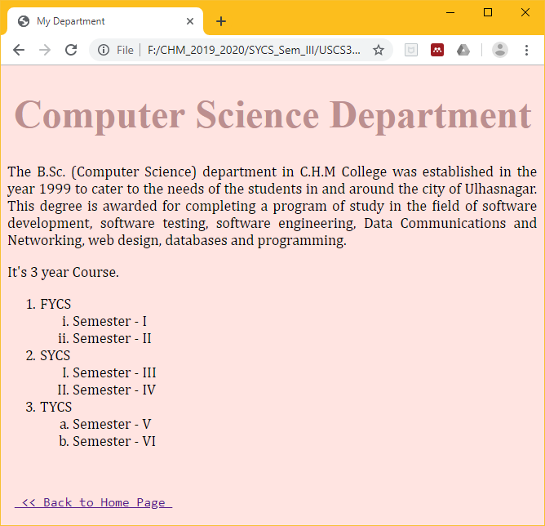

Slide 12
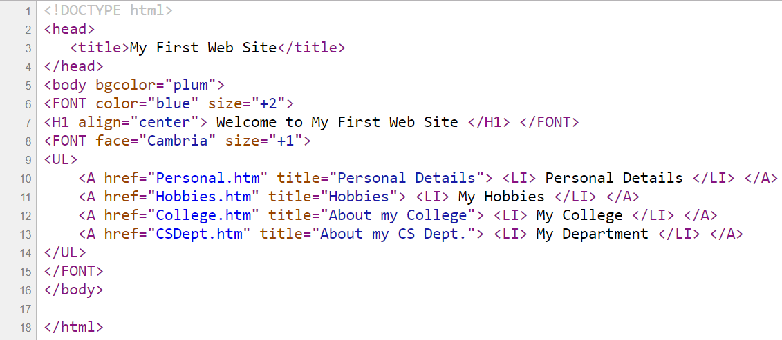
FileName: P2_Q1.html

Slide 13
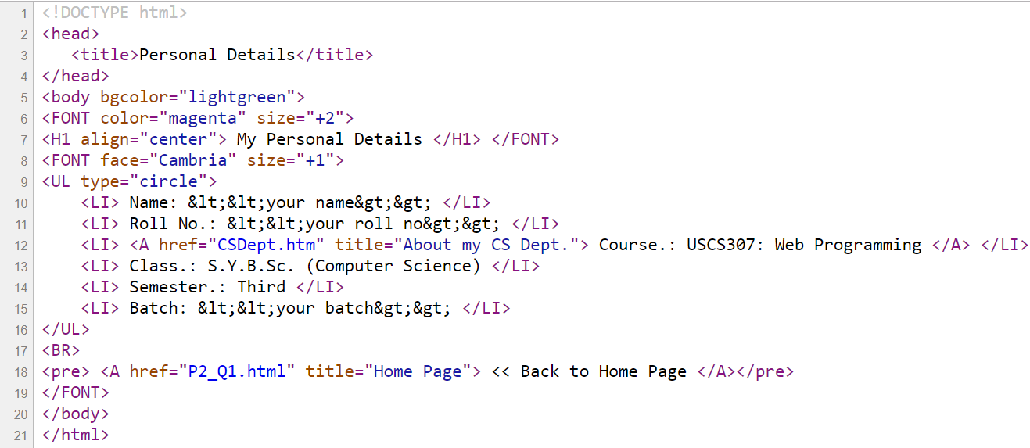
FileName: Personal.htm

Slide 14
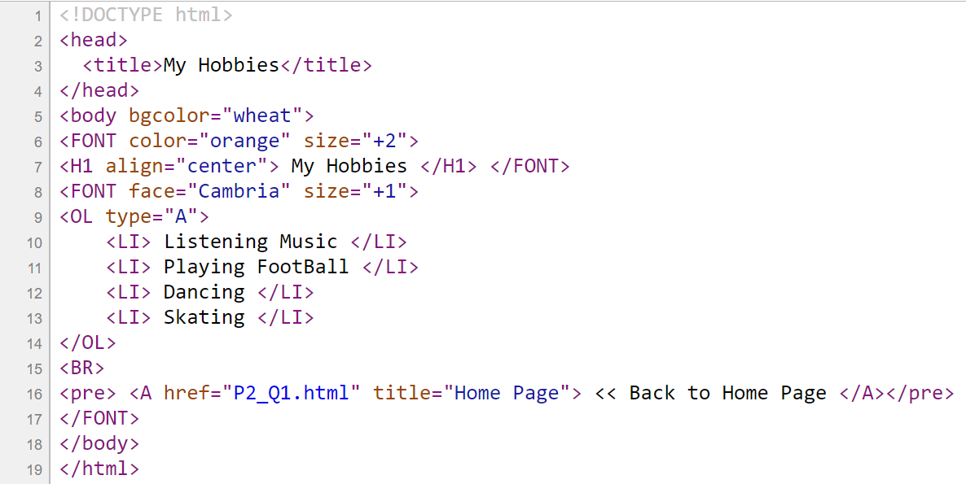
FileName: Hobbies.htm

Slide 15
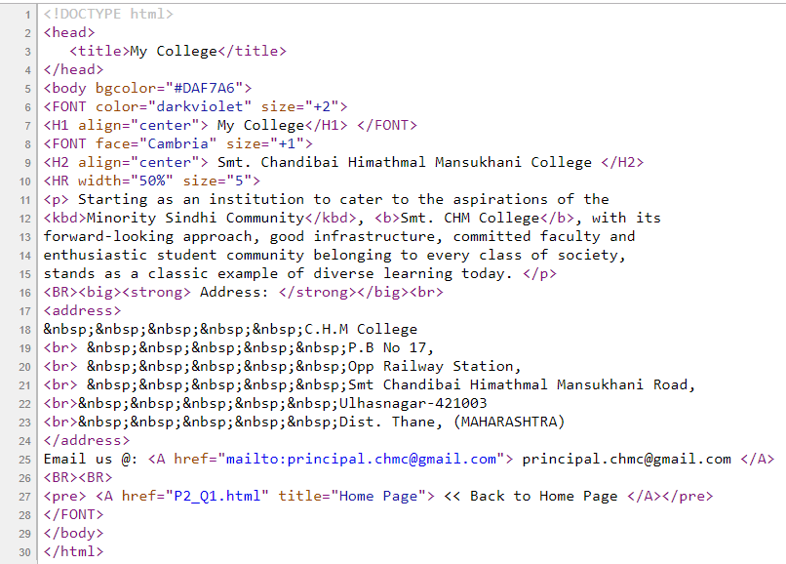
FileName:
College.htm

Slide 16
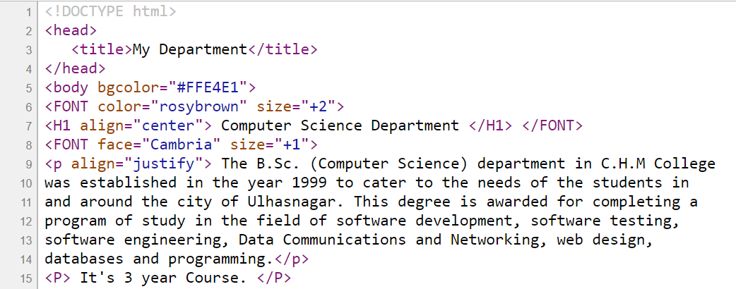
FileName: CSDept.htm

Slide 17
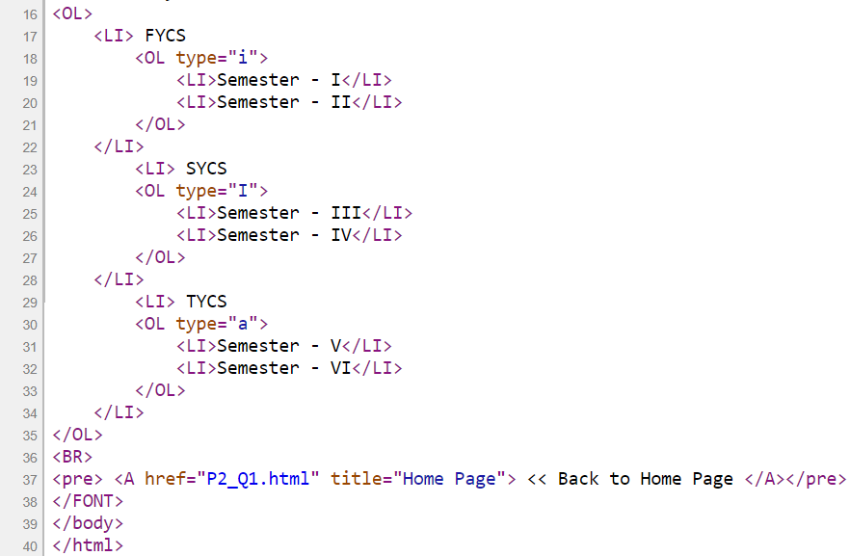
FileName:
CSDept.htm
Save your file and Double click the file “P2_Q1.html” to execute.

Slide 18
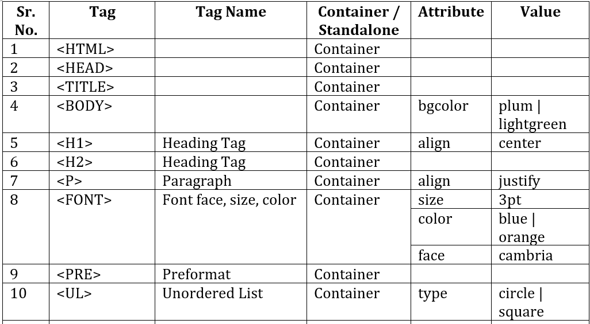
List of Tags Used:

Slide 19
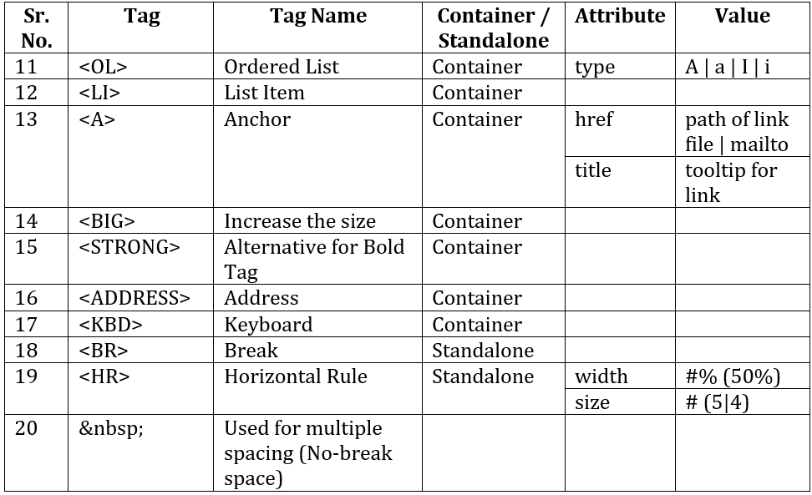
List of Tags Used:

Slide 20
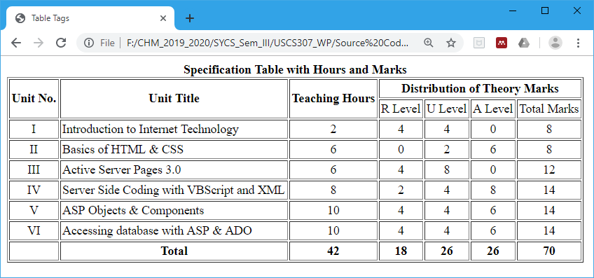
Question – 02: (Table Tags)
Create a static Web Page using table tags that display the following outputs:
A)

Slide 21
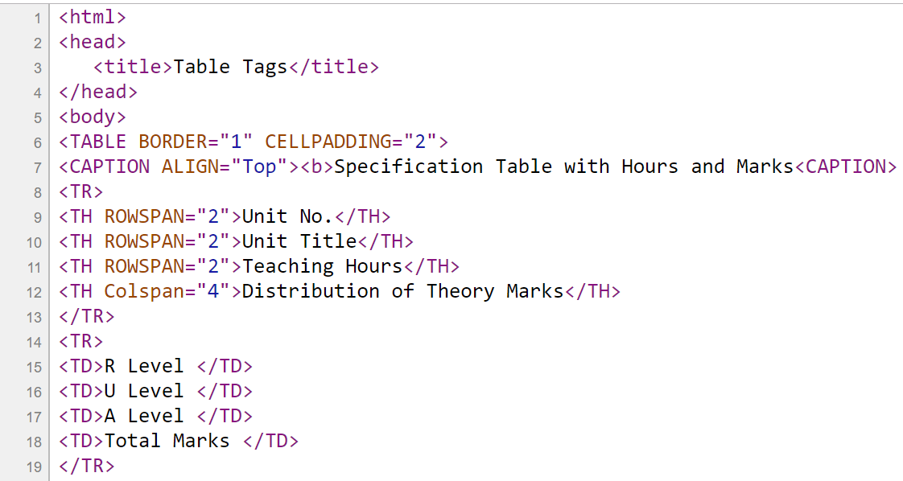
FileName: P2_Q2_A.htm

Slide 22
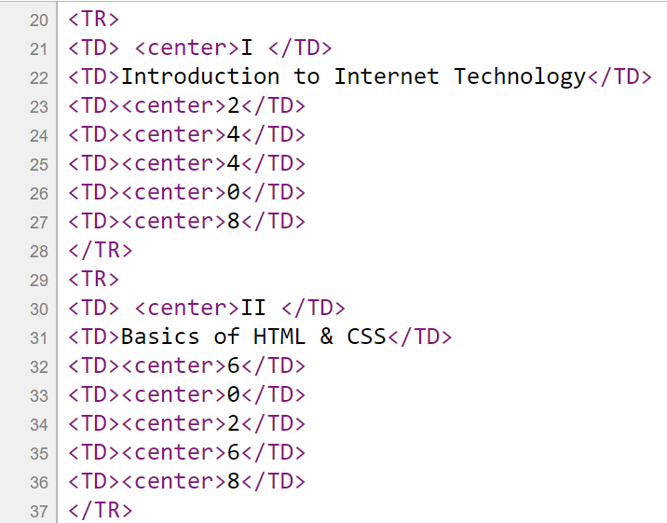
FileName: P2_Q2_A.htm

Slide 23

FileName: P2_Q2_A.htm

Slide 24
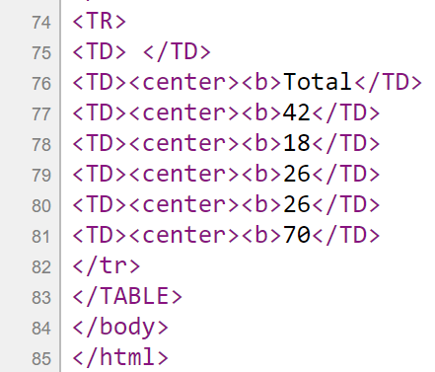
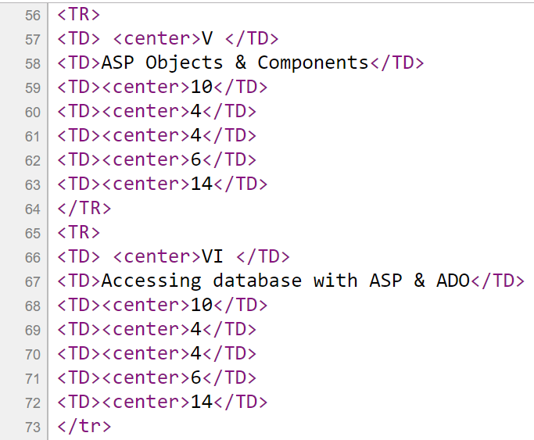
FileName: P2_Q2_A.htm
Save your file and Double click the file “P2_Q2_A.htm” to execute.

Slide 25
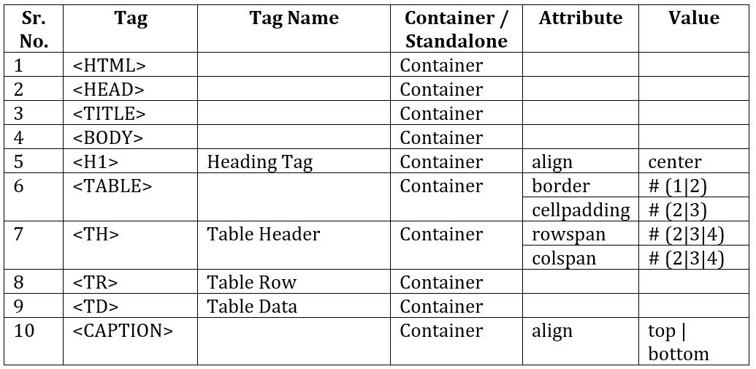
List of Tags Used:

Slide 26
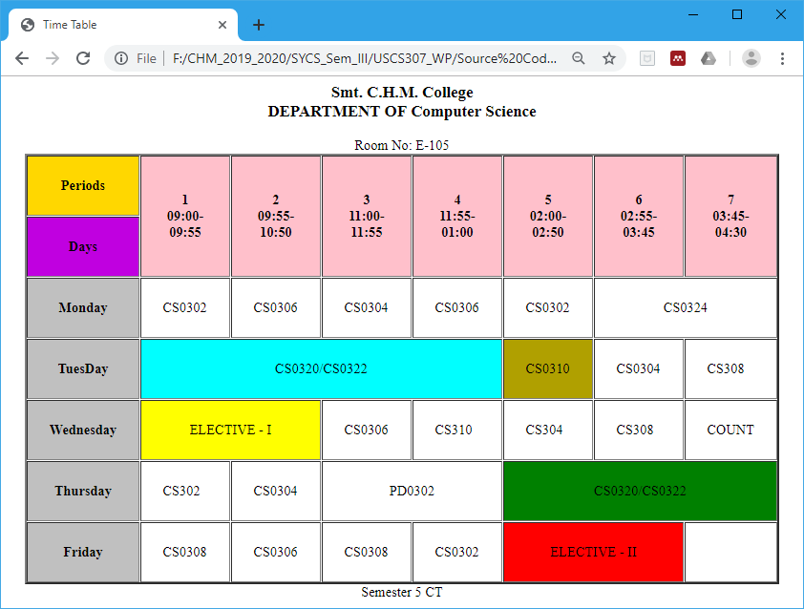
Question – 02: (Table Tags)
B) Create a static Web Page using table tags that display the following outputs:

Slide 27
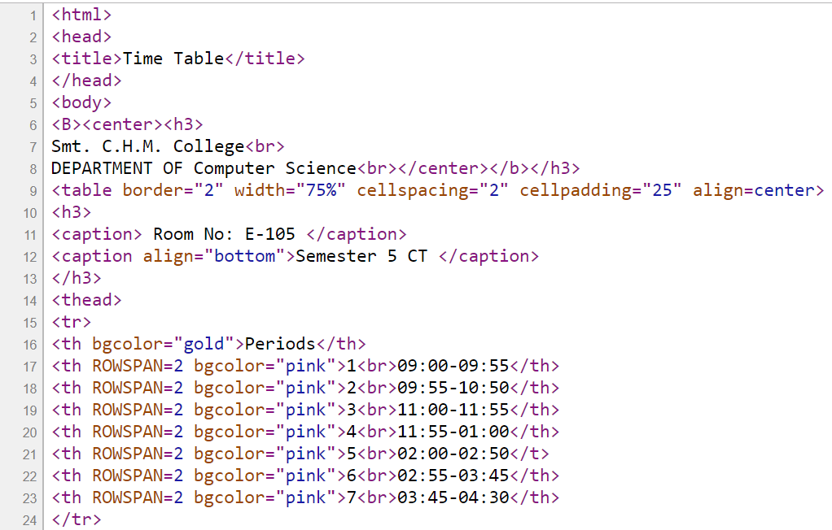
FileName:
P2_Q2_B.htm

Slide 28
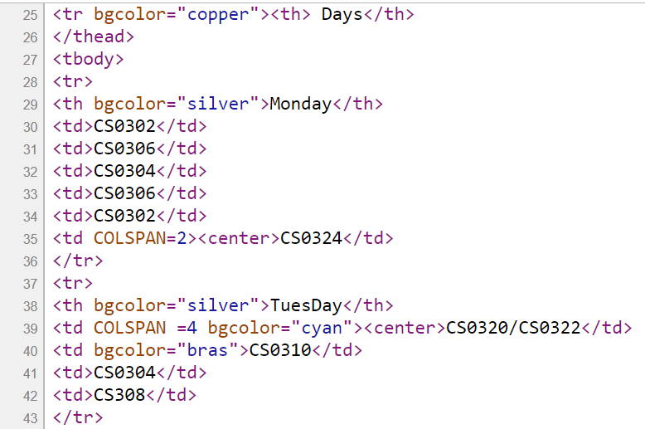
FileName:
P2_Q2_B.htm

Slide 29
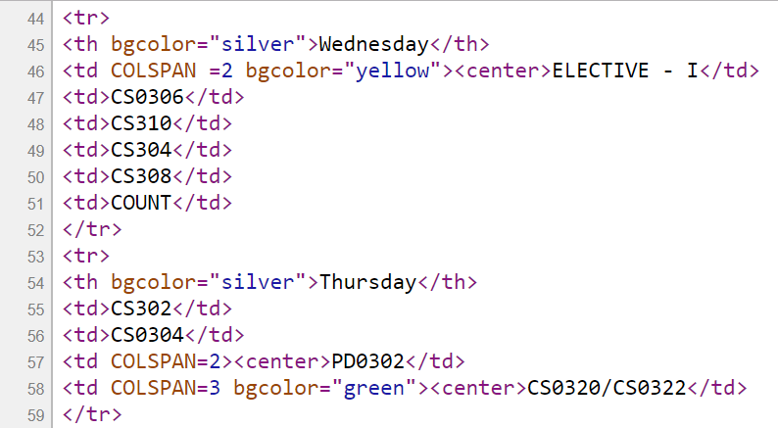
FileName: P2_Q2_B.htm

Slide 30
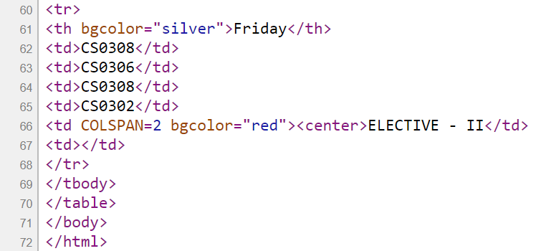
FileName: P2_Q2_B.htm
Save your file and Double click the file “P2_Q2_B.htm” to execute.

Slide 31
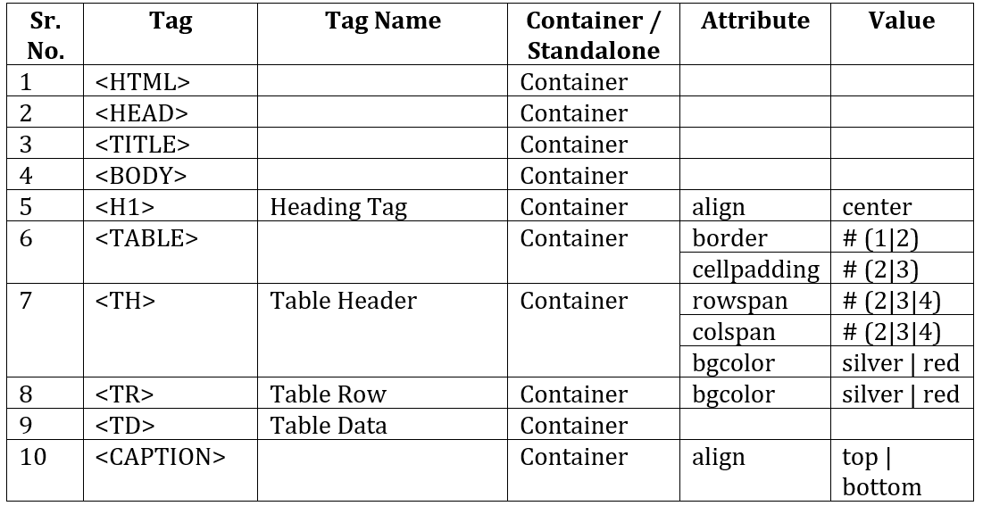
List of Tags Used:

Slide 32
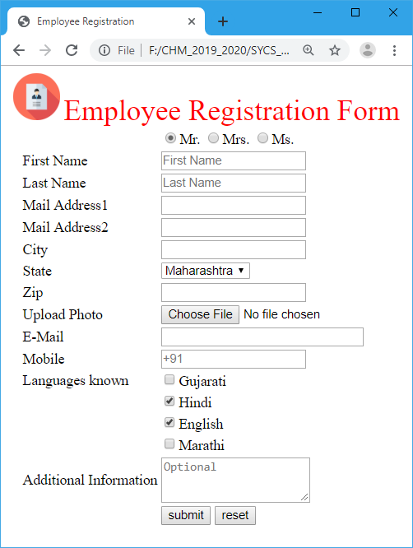
Question – 03: (Form and Form Elements Tags)
Create an Employee Registration Web Page using form and form elements.

Slide 33
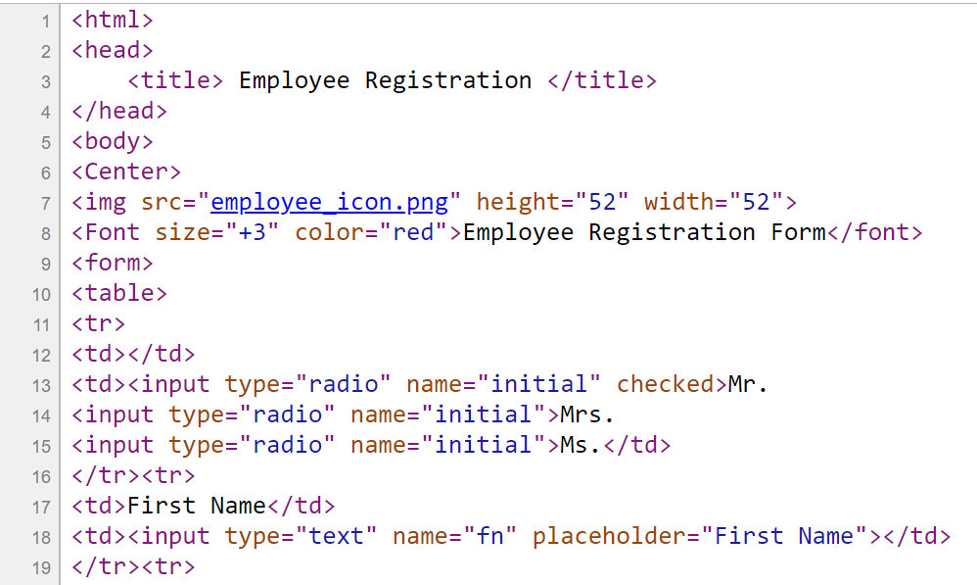
FileName:P2_Q3.htm

Slide 34
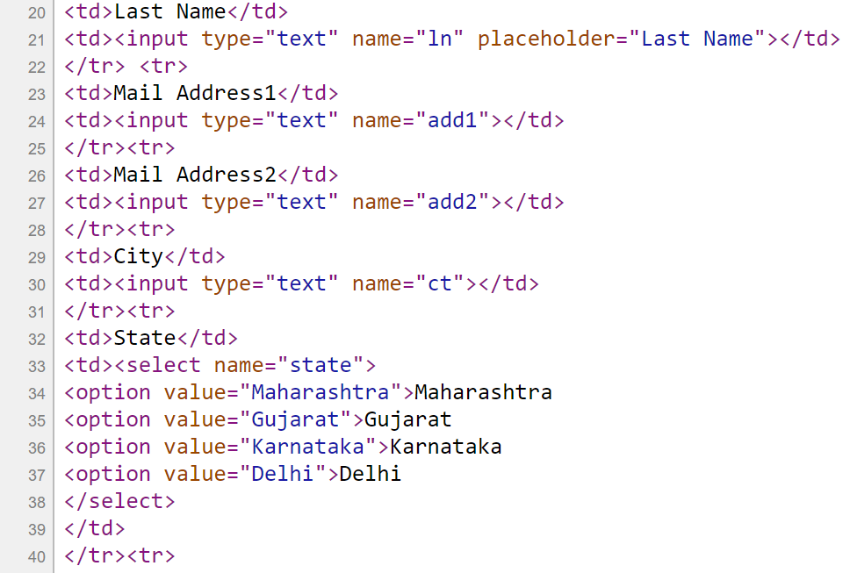
FileName: P2_Q3.htm

Slide 35
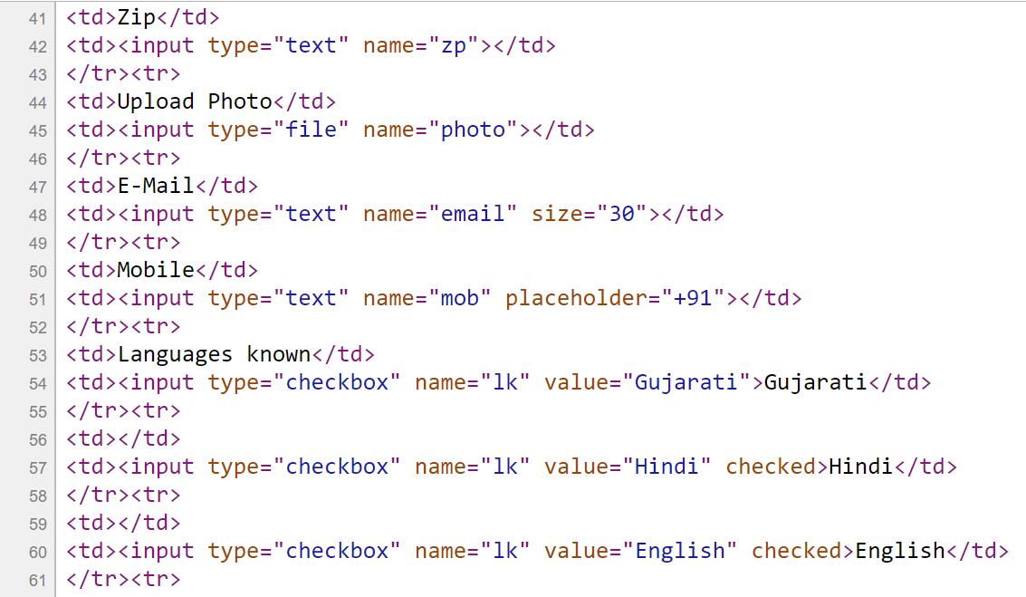
FileName: P2_Q3.htm

Slide 36
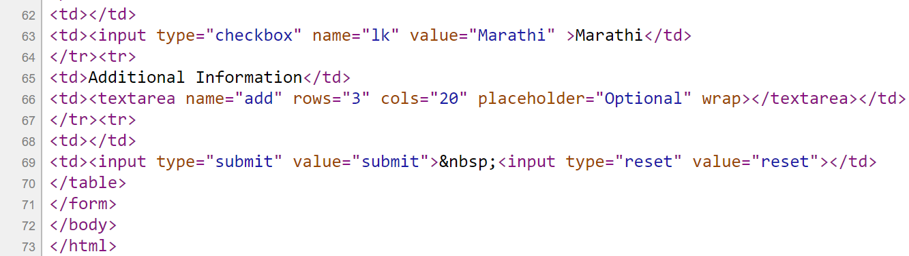
FileName: P2_Q3.htm
Save your file and Double click the file “P2_Q3.htm” to execute.

Slide 37
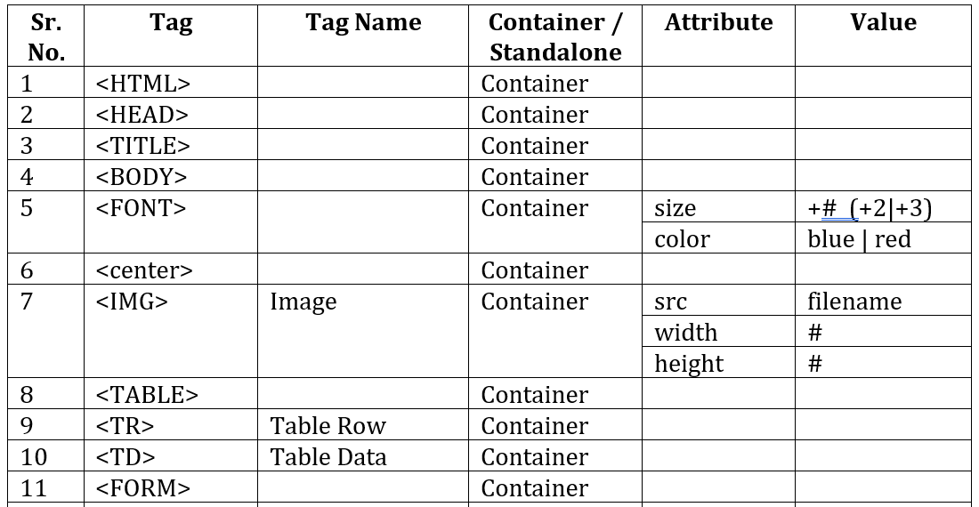
List of Tags Used:

Slide 38
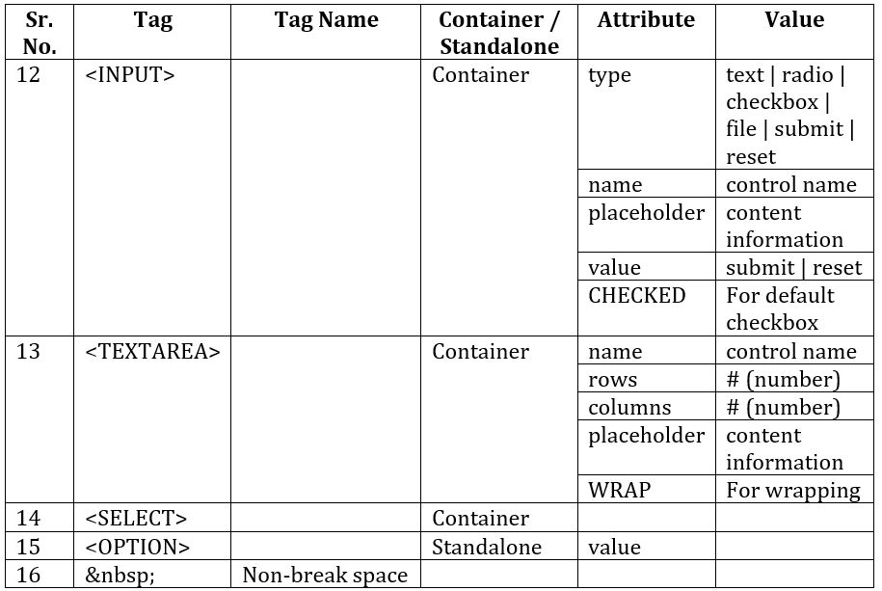
List of
Tags Used:

Slide 39
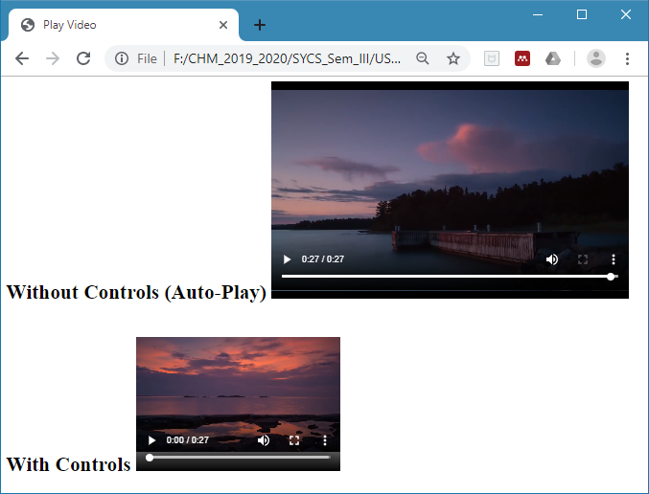
Question – 04: (Embedded Multimedia Tags)
Create a static Web Page to display the embedded video files.

Slide 40
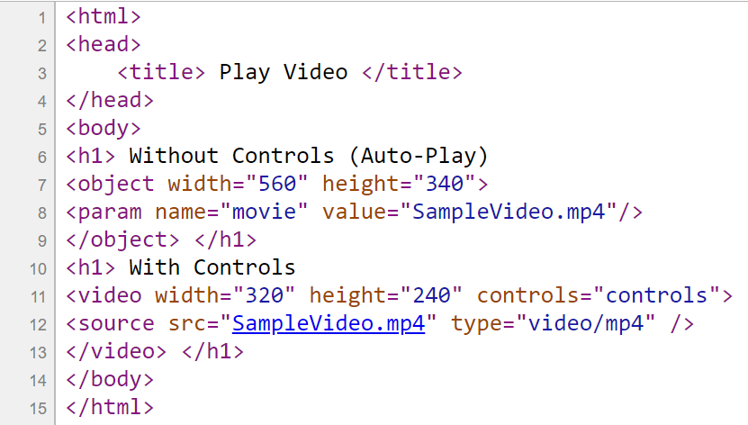
Save your file and Double click the file “P2_Q4.htm” to execute.
FileName:P2_Q4.htm

Slide 41
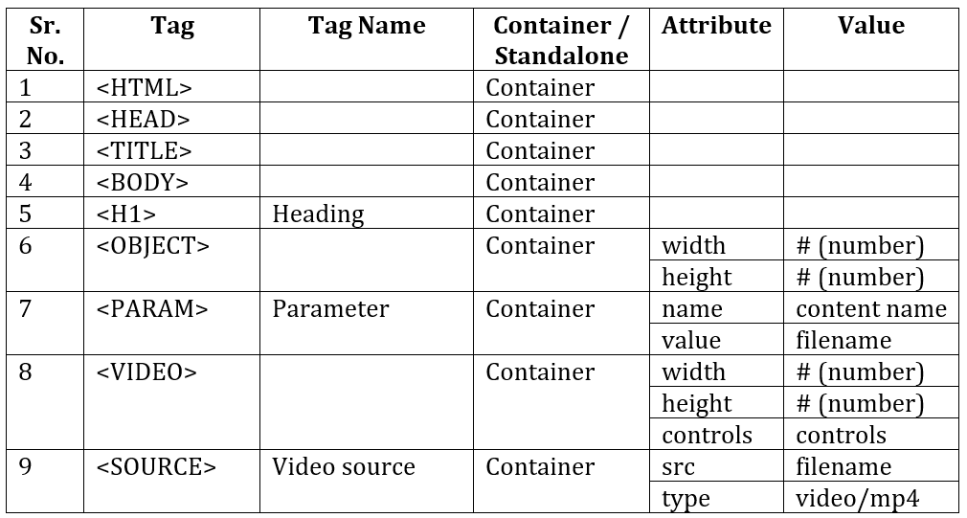
List of Tags Used:

