Slide 1
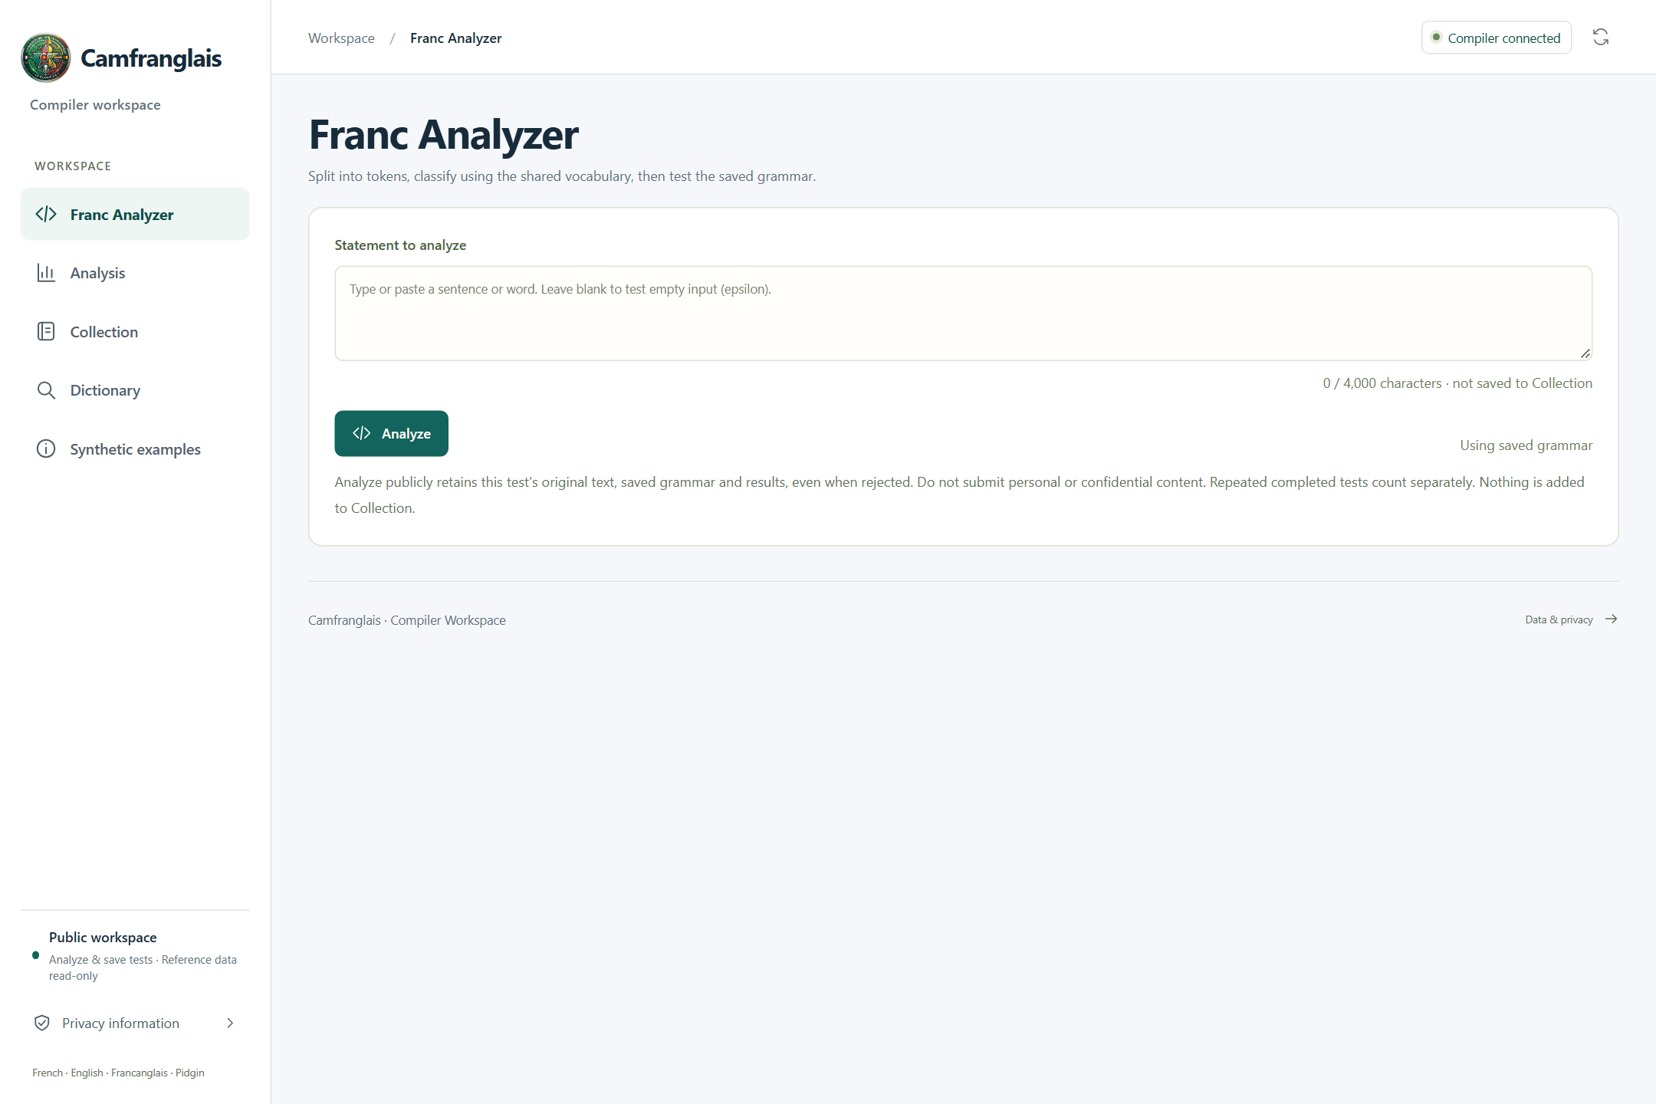
CAMFRANGLAIS / COMPILER WORKSPACE
Camfranglais
camfranglais.duckdns.org
From everyday language to
transparent compiler
decisions.
THE APP. THE RULES. THE FILES.
100-slide technical presentation
CS4110 / Summer 2026 / SET A
IMPLEMENTATION / EVIDENCE
README.md
docs/final-report.tex
CS4110 / SET A / 27 SEP 2026
001 / 100
Notes:
SLIDE 001 / 100 - Camfranglais
Introduce Camfranglais as the group's deterministic lexical and syntactic analyzer. This is a 100-slide reference presentation, not a claim that all 100 slides fit into the ten-minute oral assessment. Slide 99 provides a suggested short route. Screenshots show the real deployed application; no tests were created to capture them.
RESPONSIBLE FILES / EVIDENCE
README.md
docs/final-report.tex
Visuals: real app screenshots or clearly labelled original explanatory artwork. Source paths are repository-relative. No application or VPS change is performed by this presentation.

Slide 2
01 / MEET THE PRODUCT
CAMFRANGLAIS
The group behind the project
Three members. One shared compiler workspace.
01
02
03
Kwete Ngouba
Junior Rayan
Djemtchimo
Noukui Bruno
Jonatan
Amina Boubakary
ICTU20241377
ICTU20241585
ICTU20241870
IMPLEMENTATION / EVIDENCE
docs/document-style.tex
CS4110 / SET A / 27 SEP 2026
002 / 100
Notes:
SLIDE 002 / 100 - The group behind the project
These are the known names and matricules already used in the documentation. No individual contribution assignments are invented. Instructor: Engr. Tanwi Nkiamboh. The group should review who presents each part before the assessment.
RESPONSIBLE FILES / EVIDENCE
docs/document-style.tex
Visuals: real app screenshots or clearly labelled original explanatory artwork. Source paths are repository-relative. No application or VPS change is performed by this presentation.

Slide 3
01 / MEET THE PRODUCT
CAMFRANGLAIS
Three questions this deck answers
Start with the experience. Follow the data. Find the implementation.
01
02
03
USE
TRACE
LOCATE
What can a visitor do on
each of the five pages?
How does a statement
become tokens, verdicts
and a saved result?
Which real source file
owns each part of that
behavior?
IMPLEMENTATION / EVIDENCE
README.md
docs/sdd.tex
CS4110 / SET A / 27 SEP 2026
003 / 100
Notes:
SLIDE 003 / 100 - Three questions this deck answers
Use the small source rail on each slide to find the responsible files. Detailed paths and contextual explanations are also retained in the speaker notes. The presentation moves from the user interface to the algorithms and then to persistence, deployment and evidence.
RESPONSIBLE FILES / EVIDENCE
README.md
docs/sdd.tex
Visuals: real app screenshots or clearly labelled original explanatory artwork. Source paths are repository-relative. No application or VPS change is performed by this presentation.

Slide 4
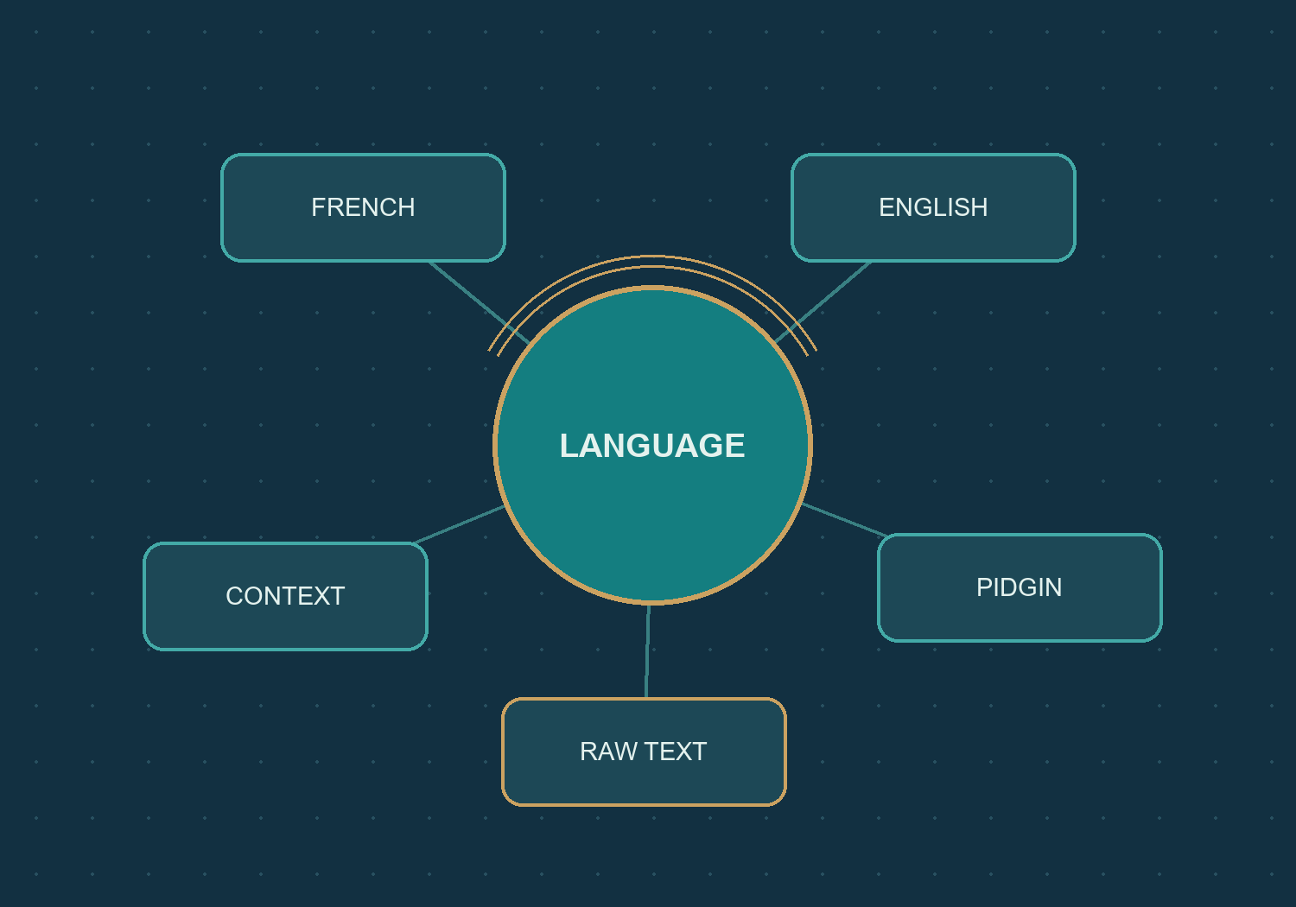
01 / MEET THE PRODUCT
CAMFRANGLAIS
Mixed language. Traceable rules.
A teaching tool for inspecting informal urban communication.
Multiple influences
French, English, Camfranglais and
Pidgin evidence can coexist.
Original wording
Keep spelling, apostrophes and
punctuation visible.
Inspectable decisions
Explain categories and grammar, not
a translation.
IMPLEMENTATION / EVIDENCE
compiler/lexer/tokenizer.py
compiler/lexer/languages.py
CS4110 / SET A / 27 SEP 2026
004 / 100
Notes:
SLIDE 004 / 100 - Mixed language. Traceable rules.
The illustration is original explanatory artwork, not a photograph or evidence of field collection. The application recognizes categories and language clues through rules and reference vocabulary. It is not an AI translator and does not infer a speaker's intent.
RESPONSIBLE FILES / EVIDENCE
compiler/lexer/tokenizer.py
compiler/lexer/languages.py
Visuals: real app screenshots or clearly labelled original explanatory artwork. Source paths are repository-relative. No application or VPS change is performed by this presentation.

Slide 5
01 / MEET THE PRODUCT
CAMFRANGLAIS
Five pages, one connected workflow
Click a page card in the slideshow to jump to its walkthrough.
01
02
03
Franc Analyzer
Analysis
Collection
Enter text and record a test.
Inspect saved results and
statistics.
Browse supplied records,
context and audio.
04
05
ONE SHARED
PUBLIC WORKSPACE
Dictionary
Synthetic examples
Search source-labelled
vocabulary.
Explore clearly constructed
practice material.
IMPLEMENTATION / EVIDENCE
frontend/src/App.tsx
CS4110 / SET A / 27 SEP 2026
005 / 100
Notes:
SLIDE 005 / 100 - Five pages, one connected workflow
App.tsx owns the public page list and hash navigation. The five public routes are compiler, analysis, collection, dictionary and examples. There are no public account, translator, imports or coursework-generation screens.
RESPONSIBLE FILES / EVIDENCE
frontend/src/App.tsx
Visuals: real app screenshots or clearly labelled original explanatory artwork. Source paths are repository-relative. No application or VPS change is performed by this presentation.

Slide 6
01 / MEET THE PRODUCT
CAMFRANGLAIS
From statement to saved evidence
The main journey has five visible outcomes.
01
02
03
04
05
TEXT
TOKENS
GRAMMAR
SNAPSHOT
REVIEW
Preserve the
raw input.
Split and assign
categories.
Run the saved
LL(1) rules.
Retain the
original result.
Inspect tokens,
trace and
statistics.
FOLLOW THE DATA / KEEP EACH RESPONSIBILITY VISIBLE
IMPLEMENTATION / EVIDENCE
frontend/src/FrancAnalyzer.tsx
backend/analyzer.py
backend/analyzer_history.py
006 / 100
CS4110 / SET A / 27 SEP 2026
Notes:
SLIDE 006 / 100 - From statement to saved evidence
This is a simplified explanatory flow, not UML sequence notation. The detailed implementation validates the request and shared grammar before computation and persistence. Analyze in the current UI records an immutable public test, even when the parser rejects it.
RESPONSIBLE FILES / EVIDENCE
frontend/src/FrancAnalyzer.tsx
backend/analyzer.py
backend/analyzer_history.py
Visuals: real app screenshots or clearly labelled original explanatory artwork. Source paths are repository-relative. No application or VPS change is performed by this presentation.

Slide 7
01 / MEET THE PRODUCT
CAMFRANGLAIS
Two verdicts. Different questions.
A familiar word sequence is not automatically a grammatical match.
01
02
VOCABULARY
GRAMMAR
Are any tokens UNKNOWN?
No unknowns means vocabulary
approval.
Does the category sequence fit the
saved CFG?
Known words can still reject.
IMPLEMENTATION / EVIDENCE
frontend/src/VocabularyVerdict.tsx
backend/analyzer_models.py
compiler/parser/predictive.py
007 / 100
CS4110 / SET A / 27 SEP 2026
Notes:
SLIDE 007 / 100 - Two verdicts. Different questions.
Vocabulary approval is based on UNKNOWN occurrences. Recognized slang, AMBIGUOUS and other known categories can pass it. CFG acceptance comes from predictive parsing. Neither result proves standard French correctness, meaning or authentic fieldwork.
RESPONSIBLE FILES / EVIDENCE
frontend/src/VocabularyVerdict.tsx
backend/analyzer_models.py
compiler/parser/predictive.py
Visuals: real app screenshots or clearly labelled original explanatory artwork. Source paths are repository-relative. No application or VPS change is performed by this presentation.

Slide 8
01 / MEET THE PRODUCT
CAMFRANGLAIS
Public does not mean editable
The permission boundary is deliberate.
Action
Public behavior
Analyze and save tests
Allowed; results are retained publicly
Read saved tests
Allowed; original snapshots
Browse Collection and grammar
Read-only
Play existing recordings
Allowed when a matching file exists
Edit reference data or recordings
Denied
Use accounts or private maintenance APIs
Not exposed publicly
IMPLEMENTATION / EVIDENCE
backend/public_access.py
frontend/src/PublicSession.tsx
CS4110 / SET A / 27 SEP 2026
008 / 100
Notes:
SLIDE 008 / 100 - Public does not mean editable
The public session advertises analyze and save_tests capabilities while disabling reference edits. These restrictions are enforced in the backend, not merely by hiding buttons. CSRF protection remains even though login was removed.
RESPONSIBLE FILES / EVIDENCE
backend/public_access.py
frontend/src/PublicSession.tsx
Visuals: real app screenshots or clearly labelled original explanatory artwork. Source paths are repository-relative. No application or VPS change is performed by this presentation.

Slide 9
01 / MEET THE PRODUCT
CAMFRANGLAIS
Every feature has a source
Read the source rail as a map, not just a list of filenames.
frontend/src
backend
App.tsx
analyzer_api.py
Chooses the page and connects navigation.
Receives analyzer HTTP requests.
compiler/lexer
compiler/parser
tokenizer.py
predictive.py
Splits and classifies the input.
Executes the bounded parsing stack.
IMPLEMENTATION / EVIDENCE
frontend/src/App.tsx
backend/analyzer_api.py
compiler/lexer/tokenizer.py
compiler/parser/predictive.py
CS4110 / SET A / 27 SEP 2026
009 / 100
Notes:
SLIDE 009 / 100 - Every feature has a source
The actual code is mostly Python functions and React function components. Do not rename these as imaginary controller or service classes. Paths on the slides are repository-relative; the complete repository accompanies the presentation.
RESPONSIBLE FILES / EVIDENCE
frontend/src/App.tsx
backend/analyzer_api.py
compiler/lexer/tokenizer.py
compiler/parser/predictive.py
Visuals: real app screenshots or clearly labelled original explanatory artwork. Source paths are repository-relative. No application or VPS change is performed by this presentation.

Slide 10
01 / MEET THE PRODUCT
CAMFRANGLAIS
The project at a glance
Different numbers describe different parts of the system.
5
12
Public pages
Statements in the controlled study
938
26
Reference dictionary entries
Constructed practice examples
IMPLEMENTATION / EVIDENCE
frontend/src/App.tsx
docs/evidence/final-analysis-20260927.json
docs/README.md
010 / 100
CS4110 / SET A / 27 SEP 2026
Notes:
SLIDE 010 / 100 - The project at a glance
The twelve statements are the fixed evaluation corpus. The 938 dictionary entries and 26 synthetic examples are not additional collected statements. The Collection snapshot contains those twelve sentences plus one approved Word annotation, choa.
RESPONSIBLE FILES / EVIDENCE
frontend/src/App.tsx
docs/evidence/final-analysis-20260927.json
docs/README.md
Visuals: real app screenshots or clearly labelled original explanatory artwork. Source paths are repository-relative. No application or VPS change is performed by this presentation.

Slide 11
02 / FRANC ANALYZER
CAMFRANGLAIS
Start in Franc Analyzer
No account gate stands between the visitor and the input.
One main input
camfranglais.duckdns.org
Type or paste a sentence
or word.
Saved grammar
The public interface uses the
operator-saved grammar.
Visible retention notice
The interface explains that
tests become public.
REAL DEPLOYED APP / 27 SEP 2026 / crop only where noted
IMPLEMENTATION / EVIDENCE
frontend/src/FrancAnalyzer.tsx
frontend/src/PublicSession.tsx
CS4110 / SET A / 27 SEP 2026
011 / 100
Notes:
SLIDE 011 / 100 - Start in Franc Analyzer
This screenshot is a real deployed page captured on 27 September 2026. The input is empty because the screenshot process did not submit a new test. The real input screen permits an empty-input grammar check.
RESPONSIBLE FILES / EVIDENCE
frontend/src/FrancAnalyzer.tsx
frontend/src/PublicSession.tsx
Visuals: real app screenshots or clearly labelled original explanatory artwork. Source paths are repository-relative. No application or VPS change is performed by this presentation.

Slide 12
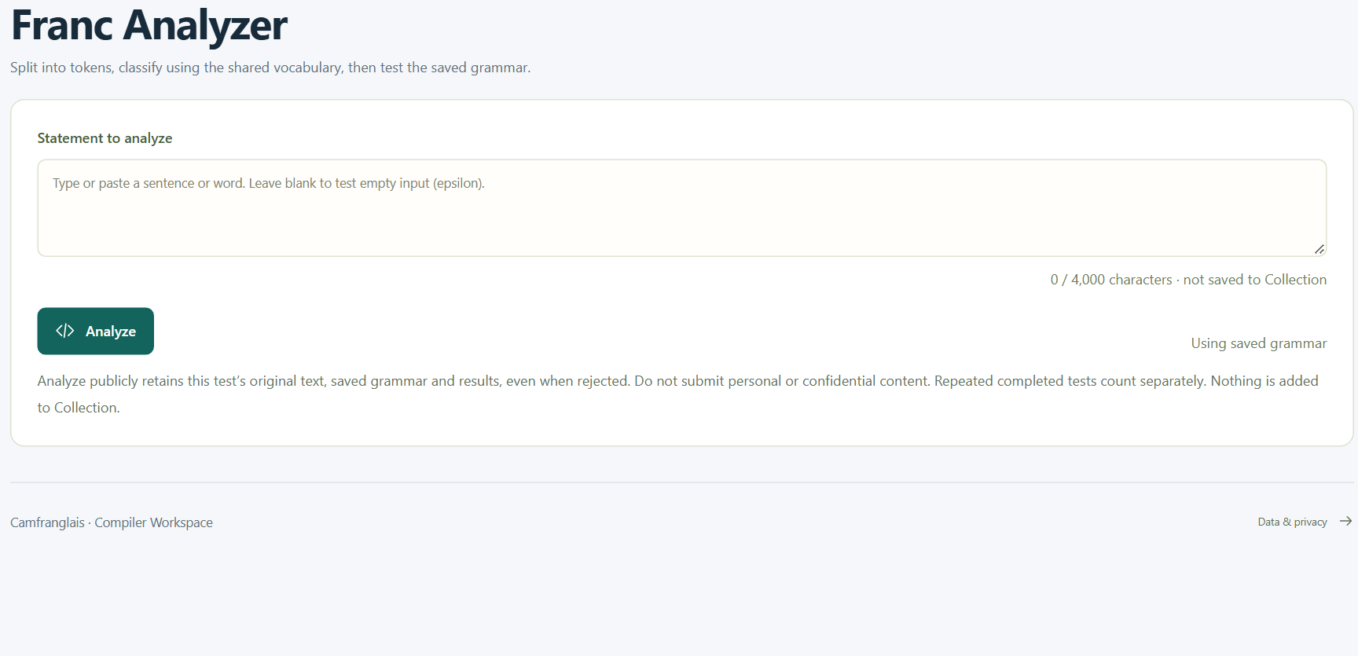
02 / FRANC ANALYZER
CAMFRANGLAIS
Keep the speaker's original text
The input is evidence, not text to silently repair.
4,000 characters
camfranglais.duckdns.org
The UI bounds one
analyzer request.
No hidden correction
Keep case, spelling and
punctuation.
Separate destination
A test is not added to
Collection.
REAL DEPLOYED APP / 27 SEP 2026 / crop only where noted
IMPLEMENTATION / EVIDENCE
frontend/src/FrancAnalyzer.tsx
frontend/src/types.ts
backend/analyzer_models.py
012 / 100
CS4110 / SET A / 27 SEP 2026
Notes:
SLIDE 012 / 100 - Keep the speaker's original text
The visual is a documented crop of the real input panel. Normalization is used later for matching and statistics; it does not replace the stored source text. An intentionally empty request is valid input to the analyzer flow, although the saved corpus grammar rejects it.
RESPONSIBLE FILES / EVIDENCE
frontend/src/FrancAnalyzer.tsx
frontend/src/types.ts
backend/analyzer_models.py
Visuals: real app screenshots or clearly labelled original explanatory artwork. Source paths are repository-relative. No application or VPS change is performed by this presentation.

Slide 13
02 / FRANC ANALYZER
CAMFRANGLAIS
What happens after Analyze?
A click starts a reproducible, server-side workflow.
01
02
03
04
05
PREPARE
VALIDATE
COMPUTE
PERSIST
DISPLAY
Text + saved
grammar +
request ID
Public access
and current
grammar
Lexical report +
grammar trace
Immutable test
in shared
storage
Show the
recorded
snapshot
FOLLOW THE DATA / KEEP EACH RESPONSIBILITY VISIBLE
IMPLEMENTATION / EVIDENCE
frontend/src/FrancAnalyzer.tsx
backend/analyzer_api.py
backend/analyzer_history.py
backend/shared_workspace.py
CS4110 / SET A / 27 SEP 2026
013 / 100
Notes:
SLIDE 013 / 100 - What happens after Analyze?
The endpoint used by the UI is POST /api/analyzer/tests. The request identifier supports safe retry. The public boundary and request models validate the operation before a result is saved. A grammar rejection is still a legitimate recorded result, not a failed network operation.
RESPONSIBLE FILES / EVIDENCE
frontend/src/FrancAnalyzer.tsx
backend/analyzer_api.py
backend/analyzer_history.py
backend/shared_workspace.py
Visuals: real app screenshots or clearly labelled original explanatory artwork. Source paths are repository-relative. No application or VPS change is performed by this presentation.

Slide 14
02 / FRANC ANALYZER
CAMFRANGLAIS
The client sends a reproducible request
Three fields connect the UI to a specific computation.
SOURCE WALKTHROUGH / ABBREVIATED WHERE MARKED
Text
The original string, not a
translation.
POST /api/analyzer/tests
{
"request_id": "<new or reused UUID>",
"text": "je suis kass je go nang",
"grammar": "<exact saved grammar>"
}
Grammar
The saved rule text used for
this test.
Request ID
Identical retry can find the
same result.
IMPLEMENTATION / EVIDENCE
frontend/src/FrancAnalyzer.tsx
backend/analyzer_models.py
backend/analyzer_history.py
014 / 100
CS4110 / SET A / 27 SEP 2026
Notes:
SLIDE 014 / 100 - The client sends a reproducible request
Angle-bracket values are explicitly abbreviated teaching placeholders, not a payload to copy unchanged. The actual request includes a valid UUID and full saved grammar. No CSRF token or private configuration is displayed in this example.
RESPONSIBLE FILES / EVIDENCE
frontend/src/FrancAnalyzer.tsx
backend/analyzer_models.py
backend/analyzer_history.py
Visuals: real app screenshots or clearly labelled original explanatory artwork. Source paths are repository-relative. No application or VPS change is performed by this presentation.

Slide 15
02 / FRANC ANALYZER
CAMFRANGLAIS
Waiting, stopping and retrying
Browser state and server completion are not the same thing.
01
02
03
WAIT
STOP WAITING
RETRY IDENTICALLY
The analyzer allows up to
60 seconds for its request.
Abort the local wait, not a
guaranteed server
rollback.
Keep the request ID to
recover the already-saved
result.
IMPLEMENTATION / EVIDENCE
frontend/src/FrancAnalyzer.tsx
frontend/src/useRequest.ts
frontend/src/api.ts
015 / 100
CS4110 / SET A / 27 SEP 2026
Notes:
SLIDE 015 / 100 - Waiting, stopping and retrying
The general API helper has a shorter default timeout; the analyzer overrides it to 60000 ms. If the browser stops waiting, the server may still commit. Repeated completed tests with deliberately new request IDs count separately.
RESPONSIBLE FILES / EVIDENCE
frontend/src/FrancAnalyzer.tsx
frontend/src/useRequest.ts
frontend/src/api.ts
Visuals: real app screenshots or clearly labelled original explanatory artwork. Source paths are repository-relative. No application or VPS change is performed by this presentation.

Slide 16
02 / FRANC ANALYZER
CAMFRANGLAIS
A test is an immutable snapshot
Opening an old result does not run today's rules again.
SOURCE
RULES
The exact original text.
The grammar used at that time.
RESULT
IDENTITY
Tokens, approval and parser trace.
A stable test ID and recorded time.
IMPLEMENTATION / EVIDENCE
backend/analyzer_models.py
backend/analyzer_history.py
backend/shared_workspace.py
016 / 100
CS4110 / SET A / 27 SEP 2026
Notes:
SLIDE 016 / 100 - A test is an immutable snapshot
Saved tests have no public edit or delete operation. An operator's later grammar or reference update does not rewrite prior lexical and syntactic results. This distinction is important when interpreting dashboard statistics.
RESPONSIBLE FILES / EVIDENCE
backend/analyzer_models.py
backend/analyzer_history.py
backend/shared_workspace.py
Visuals: real app screenshots or clearly labelled original explanatory artwork. Source paths are repository-relative. No application or VPS change is performed by this presentation.

Slide 17
02 / FRANC ANALYZER
CAMFRANGLAIS
An accepted example, token by token
S02: je suis kass je go nang
je suis kass je go nang
je
suis
kass
je
go
nang
FF
VERB
ADJECTIVE
FF
VERB
VERB
6 tokens
No UNKNOWN
Accepted CFG
Every raw word is retained.
Vocabulary approval passes.
All six categories are consumed.
IMPLEMENTATION / EVIDENCE
compiler/lexer/tokenizer.py
compiler/parser/predictive.py
docs/evidence/final-analysis-20260927.json
017 / 100
CS4110 / SET A / 27 SEP 2026
Notes:
SLIDE 017 / 100 - An accepted example, token by token
This slide is generated from the committed computed evidence, not typed token labels. The categories are FRENCH_FUNCTION_WORD, VERB, ADJECTIVE, FRENCH_FUNCTION_WORD, VERB, VERB. FF is used visually as an abbreviation for FRENCH_FUNCTION_WORD.
RESPONSIBLE FILES / EVIDENCE
compiler/lexer/tokenizer.py
compiler/parser/predictive.py
docs/evidence/final-analysis-20260927.json
Visuals: real app screenshots or clearly labelled original explanatory artwork. Source paths are repository-relative. No application or VPS change is performed by this presentation.

Slide 18
02 / FRANC ANALYZER
CAMFRANGLAIS
Rejection keeps the evidence
The two unresolved corpus forms are not erased or repaired.
01
02
S09 / n'ais
S10 / alli
The sixth token is UNKNOWN.
Five tokens are consumed before
rejection.
The sixth token is UNKNOWN.
Later tokens are not silently skipped.
IMPLEMENTATION / EVIDENCE
compiler/tests/yaounde_cases.py
compiler/parser/predictive.py
docs/evidence/final-analysis-20260927.json
018 / 100
CS4110 / SET A / 27 SEP 2026
Notes:
SLIDE 018 / 100 - Rejection keeps the evidence
Both original strings remain unchanged. Each rejected trace contains fourteen recorded rows. The parser reports the undefined table entry instead of treating UNKNOWN as a wildcard. Human review is needed to resolve the linguistic forms.
RESPONSIBLE FILES / EVIDENCE
compiler/tests/yaounde_cases.py
compiler/parser/predictive.py
docs/evidence/final-analysis-20260927.json
Visuals: real app screenshots or clearly labelled original explanatory artwork. Source paths are repository-relative. No application or VPS change is performed by this presentation.

Slide 19
02 / FRANC ANALYZER
CAMFRANGLAIS
Reference, then draft, then explicit Analyze
Opening a library item does not secretly create a test.
01
02
03
04
CHOOSE
HAND OFF
REVIEW
ANALYZE
Collection, Dictionary
or an example
Copy its text to Franc
Analyzer
Inspect the draft and
retention notice
Explicitly run and
save the test
FOLLOW THE DATA / KEEP EACH RESPONSIBILITY VISIBLE
IMPLEMENTATION / EVIDENCE
frontend/src/App.tsx
frontend/src/Collection.tsx
frontend/src/Dictionary.tsx
frontend/src/Examples.tsx
CS4110 / SET A / 27 SEP 2026
019 / 100
Notes:
SLIDE 019 / 100 - Reference, then draft, then explicit Analyze
App.tsx coordinates the openCompiler handoff. It supplies a draft rather than automatically invoking the backend. This lets visitors inspect a source before choosing to publicly retain an analysis.
RESPONSIBLE FILES / EVIDENCE
frontend/src/App.tsx
frontend/src/Collection.tsx
frontend/src/Dictionary.tsx
frontend/src/Examples.tsx
Visuals: real app screenshots or clearly labelled original explanatory artwork. Source paths are repository-relative. No application or VPS change is performed by this presentation.

Slide 20
02 / FRANC ANALYZER
CAMFRANGLAIS
Analyzer: the files to open
Use this map when explaining or debugging the main workflow.
frontend/src
frontend/src
FrancAnalyzer.tsx
api.ts
Input, saved grammar, submit, retry and selected
test.
JSON requests, CSRF headers and error
messages.
backend
backend
analyzer_api.py
analyzer_history.py
Public analyzer endpoints.
Record, retrieve and report saved tests.
IMPLEMENTATION / EVIDENCE
frontend/src/FrancAnalyzer.tsx
frontend/src/api.ts
backend/analyzer_api.py
backend/analyzer_history.py
CS4110 / SET A / 27 SEP 2026
020 / 100
Notes:
SLIDE 020 / 100 - Analyzer: the files to open
Follow the UI event into the API file, then the route and history service. The compiler algorithms are intentionally separate from request orchestration and storage. The next chapter explains the evidence rendered from these saved results.
RESPONSIBLE FILES / EVIDENCE
frontend/src/FrancAnalyzer.tsx
frontend/src/api.ts
backend/analyzer_api.py
backend/analyzer_history.py
Visuals: real app screenshots or clearly labelled original explanatory artwork. Source paths are repository-relative. No application or VPS change is performed by this presentation.

Slide 21
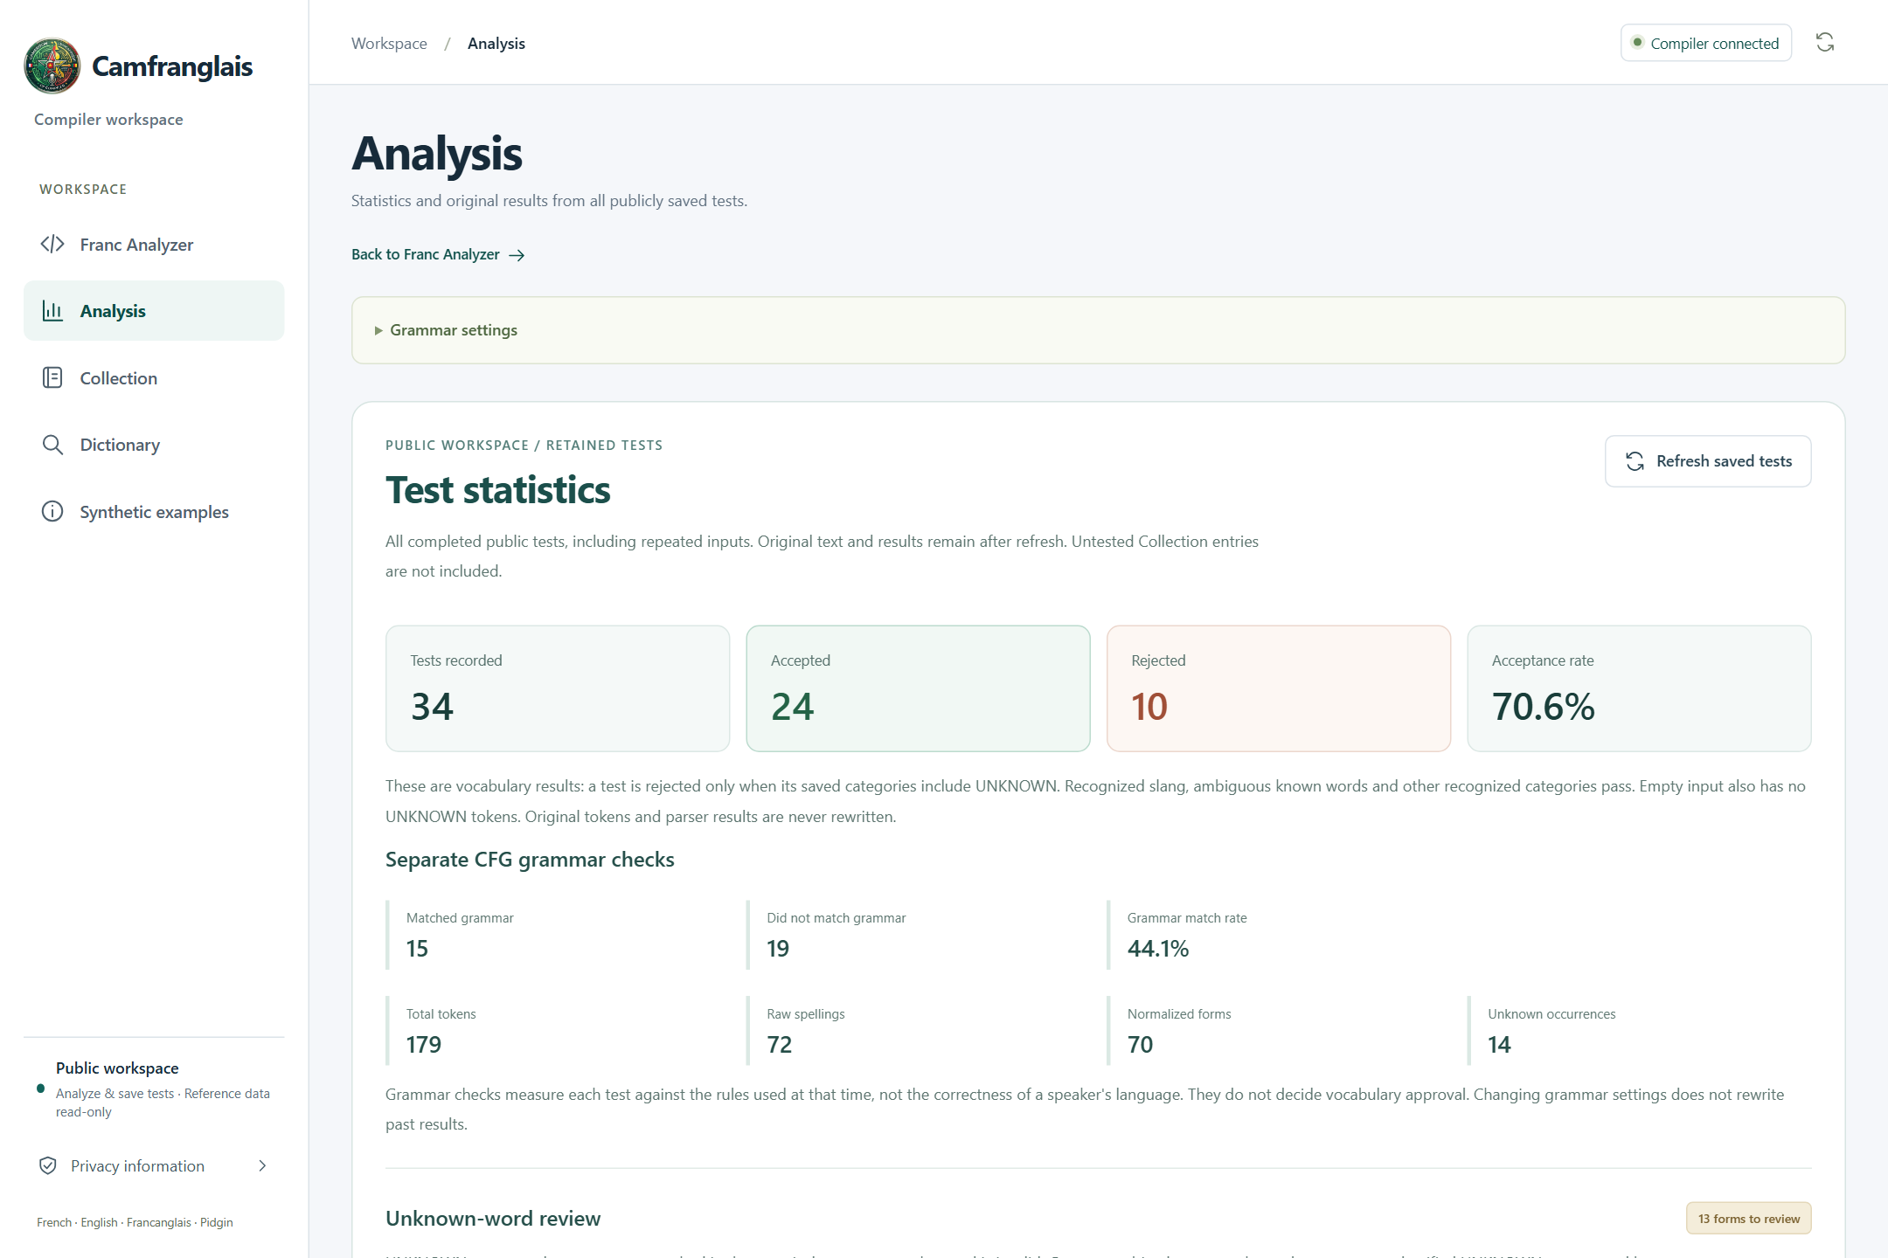
03 / ANALYSIS AND EVIDENCE
CAMFRANGLAIS
Analysis is the evidence desk
Statistics and original results from publicly saved tests.
Dashboard
camfranglais.duckdns.org
View retained-test totals
and verdicts.
Individual result
Inspect the original tokens
and trace.
Rule visibility
Open the read-only
grammar settings.
REAL DEPLOYED APP / 27 SEP 2026 / crop only where noted
IMPLEMENTATION / EVIDENCE
frontend/src/Analysis.tsx
frontend/src/TestStatistics.tsx
frontend/src/CourseworkResults.tsx
021 / 100
CS4110 / SET A / 27 SEP 2026
Notes:
SLIDE 021 / 100 - Analysis is the evidence desk
The screenshot was captured from the live deployed application. Its totals describe the retained history at capture time, not the fixed twelve-statement evaluation. The two sets of numbers must not be merged.
RESPONSIBLE FILES / EVIDENCE
frontend/src/Analysis.tsx
frontend/src/TestStatistics.tsx
frontend/src/CourseworkResults.tsx
Visuals: real app screenshots or clearly labelled original explanatory artwork. Source paths are repository-relative. No application or VPS change is performed by this presentation.

Slide 22
03 / ANALYSIS AND EVIDENCE
CAMFRANGLAIS
Count saved tests, not collected records
A dated history snapshot is different from a controlled study.
34
179
Retained tests in the screenshot
Token occurrences in that history
12
81
Statements in the fixed study
Token occurrences in the fixed study
IMPLEMENTATION / EVIDENCE
frontend/src/TestStatistics.tsx
backend/analyzer_history.py
docs/evidence/final-analysis-20260927.json
022 / 100
CS4110 / SET A / 27 SEP 2026
Notes:
SLIDE 022 / 100 - Count saved tests, not collected records
The first two values are observed on 27 September 2026 and can change as visitors submit new tests. The last two are fixed by the committed study. Untested Collection entries do not enter saved-test statistics.
RESPONSIBLE FILES / EVIDENCE
frontend/src/TestStatistics.tsx
backend/analyzer_history.py
docs/evidence/final-analysis-20260927.json
Visuals: real app screenshots or clearly labelled original explanatory artwork. Source paths are repository-relative. No application or VPS change is performed by this presentation.

Slide 23
03 / ANALYSIS AND EVIDENCE
CAMFRANGLAIS
Vocabulary approval asks one question
Does the saved token stream contain UNKNOWN?
01
02
ZERO UNKNOWN
ONE OR MORE UNKNOWN
Vocabulary ACCEPT.
Slang and AMBIGUOUS are not
automatically rejected.
Vocabulary REJECT.
Keep the unresolved forms visible for
review.
IMPLEMENTATION / EVIDENCE
frontend/src/VocabularyVerdict.tsx
backend/analyzer_models.py
CS4110 / SET A / 27 SEP 2026
023 / 100
Notes:
SLIDE 023 / 100 - Vocabulary approval asks one question
The approval condition is exact: reject when unknown_count is positive. Empty input has no UNKNOWN tokens, so it passes this lexical condition even though the saved corpus grammar cannot derive an empty utterance.
RESPONSIBLE FILES / EVIDENCE
frontend/src/VocabularyVerdict.tsx
backend/analyzer_models.py
Visuals: real app screenshots or clearly labelled original explanatory artwork. Source paths are repository-relative. No application or VPS change is performed by this presentation.

Slide 24
03 / ANALYSIS AND EVIDENCE
CAMFRANGLAIS
Known words may still fail the CFG
Constructed control: je je suis
01
02
LEXICAL VIEW
SYNTACTIC VIEW
All three words have recognized
categories.
Vocabulary approval passes.
The category order is unsupported.
The saved grammar rejects it.
IMPLEMENTATION / EVIDENCE
compiler/parser/yaounde.py
compiler/parser/predictive.py
docs/evidence/final-analysis-20260927.json
024 / 100
CS4110 / SET A / 27 SEP 2026
Notes:
SLIDE 024 / 100 - Known words may still fail the CFG
This is control C06, not an additional collected utterance. It demonstrates why separate verdicts matter. A dictionary-membership test alone could not explain this rejection.
RESPONSIBLE FILES / EVIDENCE
compiler/parser/yaounde.py
compiler/parser/predictive.py
docs/evidence/final-analysis-20260927.json
Visuals: real app screenshots or clearly labelled original explanatory artwork. Source paths are repository-relative. No application or VPS change is performed by this presentation.

Slide 25
03 / ANALYSIS AND EVIDENCE
CAMFRANGLAIS
Nine categories occur in the study
Counts are generated from all 81 token occurrences.
FF
28
VERB
19
NOUN
14
ADVERB
6
AMBIGUOUS
5
EF
3
ADJECTIVE
2
PIDGIN
2
UNKNOWN
2
CONTROLLED STUDY / FF = French function word; EF = English function word
IMPLEMENTATION / EVIDENCE
docs/evidence/final-analysis-20260927.json
tools/build_report_evidence.py
CS4110 / SET A / 27 SEP 2026
025 / 100
Notes:
SLIDE 025 / 100 - Nine categories occur in the study
The lexer supports twenty terminal categories, but only nine occur in the twelve supplied statements. The chart is generated from statistics.category_counts. FF and EF abbreviate French and English function-word categories.
RESPONSIBLE FILES / EVIDENCE
docs/evidence/final-analysis-20260927.json
tools/build_report_evidence.py
Visuals: real app screenshots or clearly labelled original explanatory artwork. Source paths are repository-relative. No application or VPS change is performed by this presentation.

Slide 26
03 / ANALYSIS AND EVIDENCE
CAMFRANGLAIS
Frequency starts with actual tokens
Most frequent forms in the controlled twelve-statement study.
je
7
le
6
depuis
3
suis
3
j'ai
2
pas
2
CONTROLLED STUDY / FF = French function word; EF = English function word
IMPLEMENTATION / EVIDENCE
docs/evidence/final-analysis-20260927.json
tools/build_report_evidence.py
CS4110 / SET A / 27 SEP 2026
026 / 100
Notes:
SLIDE 026 / 100 - Frequency starts with actual tokens
The bars use the first six entries of the computed frequency list. The corpus has 55 case-folded forms. Preserve the distinction between token occurrences and distinct forms, and avoid treating this small convenience corpus as representative of a whole population.
RESPONSIBLE FILES / EVIDENCE
docs/evidence/final-analysis-20260927.json
tools/build_report_evidence.py
Visuals: real app screenshots or clearly labelled original explanatory artwork. Source paths are repository-relative. No application or VPS change is performed by this presentation.

Slide 27
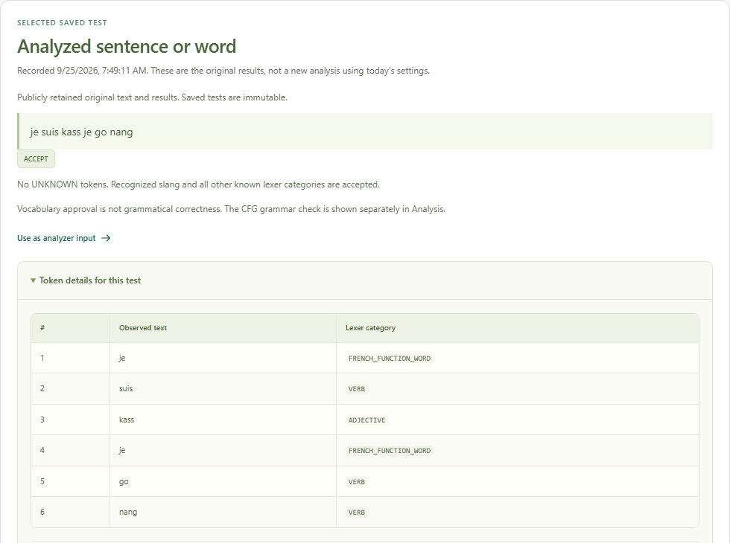
03 / ANALYSIS AND EVIDENCE
CAMFRANGLAIS
Inspect raw text and categories
The selected-test panel makes individual decisions visible.
Original input
camfranglais.duckdns.org
Review exactly what was
recorded.
Token detail
Compare each spelling with
its chosen label.
Historical result
This is a saved snapshot,
not a new computation.
REAL DEPLOYED APP / 27 SEP 2026 / crop only where noted
IMPLEMENTATION / EVIDENCE
frontend/src/CourseworkResults.tsx
frontend/src/VocabularyVerdict.tsx
backend/analyzer_models.py
027 / 100
CS4110 / SET A / 27 SEP 2026
Notes:
SLIDE 027 / 100 - Inspect raw text and categories
This image comes from the genuine selected-S02 capture used in the report. The capture register preserves its original and cropped derivatives. It was opened read-only without submitting a test.
RESPONSIBLE FILES / EVIDENCE
frontend/src/CourseworkResults.tsx
frontend/src/VocabularyVerdict.tsx
backend/analyzer_models.py
Visuals: real app screenshots or clearly labelled original explanatory artwork. Source paths are repository-relative. No application or VPS change is performed by this presentation.

Slide 28
03 / ANALYSIS AND EVIDENCE
CAMFRANGLAIS
A trace is a sequence of decisions
Each row records the stack and remaining input before its action.
Stack (top at right)
Remaining input
Action
[$, Ut]
FF VERB ADJECTIVE FF VERB
VERB $
Apply Ut -> Cl Uf
[$, Uf, Cl]
FF VERB ADJECTIVE FF VERB
VERB $
Apply Cl -> FF St
[$, Uf, St, FF]
FF VERB ADJECTIVE FF VERB
VERB $
Match FF
[$, Uf, St]
VERB ADJECTIVE FF VERB
VERB $
Apply St -> VERB Pt
Stack state / remaining categories / selected action.
Ut = Utterance / Uf = ending helper / Cl = Clause / St = SubjectTail / FF = French function word
IMPLEMENTATION / EVIDENCE
compiler/parser/predictive.py
frontend/src/CourseworkResults.tsx
CS4110 / SET A / 27 SEP 2026
028 / 100
Notes:
SLIDE 028 / 100 - A trace is a sequence of decisions
The displayed rows are the first four S02 trace records from computed evidence. In visual abbreviations: Ut is Utterance, Uf is Utterance_LF1, Cl is Clause, St is SubjectTail, and FF is FRENCH_FUNCTION_WORD. The full names are retained in the underlying evidence.
RESPONSIBLE FILES / EVIDENCE
compiler/parser/predictive.py
frontend/src/CourseworkResults.tsx
Visuals: real app screenshots or clearly labelled original explanatory artwork. Source paths are repository-relative. No application or VPS change is performed by this presentation.

Slide 29
03 / ANALYSIS AND EVIDENCE
CAMFRANGLAIS
Grammar panels reveal the calculation
The UI exposes intermediate results instead of only a green badge.
01
02
03
04
ORIGINAL
TRANSFORMED
SETS
TABLE
The exact supplied
grammar
Before/after rule
rewrites
Computed FIRST
and FOLLOW
LL(1) entries and
conflicts
FOLLOW THE DATA / KEEP EACH RESPONSIBILITY VISIBLE
IMPLEMENTATION / EVIDENCE
frontend/src/CourseworkResults.tsx
compiler/parser/service.py
compiler/parser/analysis.py
029 / 100
CS4110 / SET A / 27 SEP 2026
Notes:
SLIDE 029 / 100 - Grammar panels reveal the calculation
GrammarResults renders the original and transformed grammar, transformation steps, sets and table. Conflicting entries are reported explicitly. These panels are read-only in the public workflow.
RESPONSIBLE FILES / EVIDENCE
frontend/src/CourseworkResults.tsx
compiler/parser/service.py
compiler/parser/analysis.py
Visuals: real app screenshots or clearly labelled original explanatory artwork. Source paths are repository-relative. No application or VPS change is performed by this presentation.

Slide 30
03 / ANALYSIS AND EVIDENCE
CAMFRANGLAIS
Analysis: rendering versus aggregation
Different files own the view, the evidence and the totals.
frontend/src
frontend/src
Analysis.tsx
TestStatistics.tsx
Page wrapper, selected test and loading states.
History metrics, frequencies and pagination.
frontend/src
backend
CourseworkResults.tsx
analyzer_history.py
Token tables, grammar tables and parse traces.
Aggregate saved snapshots and page
summaries.
IMPLEMENTATION / EVIDENCE
frontend/src/Analysis.tsx
frontend/src/TestStatistics.tsx
frontend/src/CourseworkResults.tsx
backend/analyzer_history.py
CS4110 / SET A / 27 SEP 2026
030 / 100
Notes:
SLIDE 030 / 100 - Analysis: rendering versus aggregation
Statistics are computed across saved tests even when only one summary page is returned. Pagination limits the displayed summaries, not the overall totals. Old snapshots are not silently reclassified.
RESPONSIBLE FILES / EVIDENCE
frontend/src/Analysis.tsx
frontend/src/TestStatistics.tsx
frontend/src/CourseworkResults.tsx
backend/analyzer_history.py
Visuals: real app screenshots or clearly labelled original explanatory artwork. Source paths are repository-relative. No application or VPS change is performed by this presentation.

Slide 31
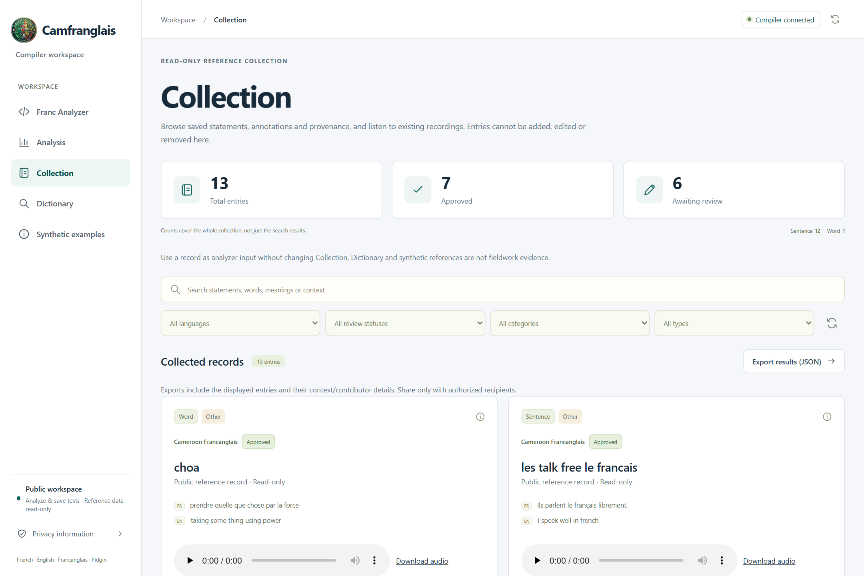
04 / REFERENCE LIBRARIES
CAMFRANGLAIS
Collection preserves supplied evidence
A read-only browser for statements, annotations and context.
Browse
camfranglais.duckdns.org
Read the existing records.
Inspect
Open meanings, notes and
available audio.
Reuse carefully
Copy a record into an
analyzer draft.
REAL DEPLOYED APP / 27 SEP 2026 / crop only where noted
IMPLEMENTATION / EVIDENCE
frontend/src/Collection.tsx
backend/collection.py
CS4110 / SET A / 27 SEP 2026
031 / 100
Notes:
SLIDE 031 / 100 - Collection preserves supplied evidence
The current capture shows thirteen Collection entries: twelve sentences and one Word annotation. Review status is metadata, not proof of authentic original fieldwork. The public interface cannot create, edit or delete Collection records.
RESPONSIBLE FILES / EVIDENCE
frontend/src/Collection.tsx
backend/collection.py
Visuals: real app screenshots or clearly labelled original explanatory artwork. Source paths are repository-relative. No application or VPS change is performed by this presentation.

Slide 32
04 / REFERENCE LIBRARIES
CAMFRANGLAIS
What one Collection record means
Keep content, interpretation and provenance separate.
RAW EXPRESSION
SUPPLIED GLOSSES
The saved statement or word.
Meanings provided with the record.
CONTEXT
EXISTING AUDIO
Location, review state and notes where
present.
Playback or download when a stored file is
available.
IMPLEMENTATION / EVIDENCE
frontend/src/Collection.tsx
backend/schemas.py
backend/audio_api.py
032 / 100
CS4110 / SET A / 27 SEP 2026
Notes:
SLIDE 032 / 100 - What one Collection record means
EntryViewer presents these fields. A gloss is not an independently verified translation, and a recording does not alone establish who collected the original utterance or when. Missing metadata should remain missing rather than be filled with invented details.
RESPONSIBLE FILES / EVIDENCE
frontend/src/Collection.tsx
backend/schemas.py
backend/audio_api.py
Visuals: real app screenshots or clearly labelled original explanatory artwork. Source paths are repository-relative. No application or VPS change is performed by this presentation.

Slide 33
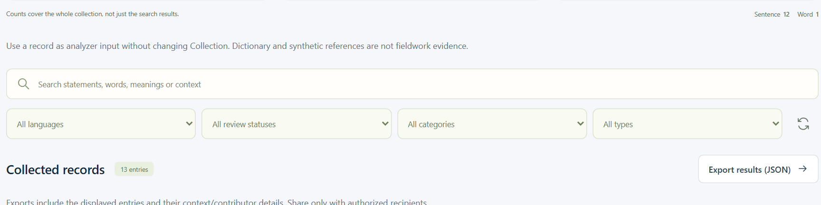
04 / REFERENCE LIBRARIES
CAMFRANGLAIS
Search and filter without rewriting
Read-side tools help visitors find relevant records.
Search and filters
camfranglais.duckdns.org
Filter language, review,
category and type.
JSON export
Download the filtered public
result set.
No mutation
Searching or exporting
does not change a record.
REAL DEPLOYED APP / 27 SEP 2026 / crop only where noted
IMPLEMENTATION / EVIDENCE
frontend/src/Collection.tsx
backend/collection.py
CS4110 / SET A / 27 SEP 2026
033 / 100
Notes:
SLIDE 033 / 100 - Search and filter without rewriting
The screenshot is a crop of the real Collection page. Exported fields can include context and contributor details; the UI cautions users to share only with authorized recipients. The presentation capture did not export private data or mutate any record.
RESPONSIBLE FILES / EVIDENCE
frontend/src/Collection.tsx
backend/collection.py
Visuals: real app screenshots or clearly labelled original explanatory artwork. Source paths are repository-relative. No application or VPS change is performed by this presentation.

Slide 34
04 / REFERENCE LIBRARIES
CAMFRANGLAIS
Twelve statements; provenance still qualified
Software can measure the corpus without certifying its origin.
12
81
Exact supplied statements
Token occurrences
55
UNCONFIRMED
Case-folded forms
Original fieldwork provenance
IMPLEMENTATION / EVIDENCE
docs/evidence/final-corpus-20260927.json
docs/evidence/final-analysis-20260927.json
CS4110 / SET A / 27 SEP 2026
034 / 100
Notes:
SLIDE 034 / 100 - Twelve statements; provenance still qualified
The saved manual_transcription_confirmed flag is false and collection_method is blank. Some locations and audio references exist, but these do not prove collector identities, original dates, speakers or consent. This qualification remains explicit throughout the presentation.
RESPONSIBLE FILES / EVIDENCE
docs/evidence/final-corpus-20260927.json
docs/evidence/final-analysis-20260927.json
Visuals: real app screenshots or clearly labelled original explanatory artwork. Source paths are repository-relative. No application or VPS change is performed by this presentation.

Slide 35
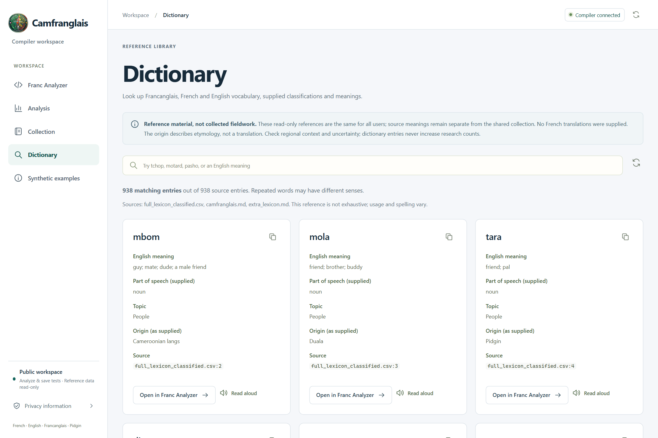
04 / REFERENCE LIBRARIES
CAMFRANGLAIS
Dictionary is a reference library
Search vocabulary, supplied labels and source meanings.
938 entries
camfranglais.duckdns.org
Distinct reference entries,
including retained senses.
Source-labelled
See where a meaning or
category came from.
Not fieldwork
Reference entries never
increase research counts.
REAL DEPLOYED APP / 27 SEP 2026 / crop only where noted
IMPLEMENTATION / EVIDENCE
frontend/src/Dictionary.tsx
backend/dictionary.py
dictionary/full_lexicon_classified.csv
035 / 100
CS4110 / SET A / 27 SEP 2026
Notes:
SLIDE 035 / 100 - Dictionary is a reference library
The dictionary is assembled from the supplied classified CSV and retained Markdown sources. It is reference material, not the shared Collection. The UI separates source meanings and origins rather than inventing missing French translations.
RESPONSIBLE FILES / EVIDENCE
frontend/src/Dictionary.tsx
backend/dictionary.py
dictionary/full_lexicon_classified.csv
Visuals: real app screenshots or clearly labelled original explanatory artwork. Source paths are repository-relative. No application or VPS change is performed by this presentation.

Slide 36
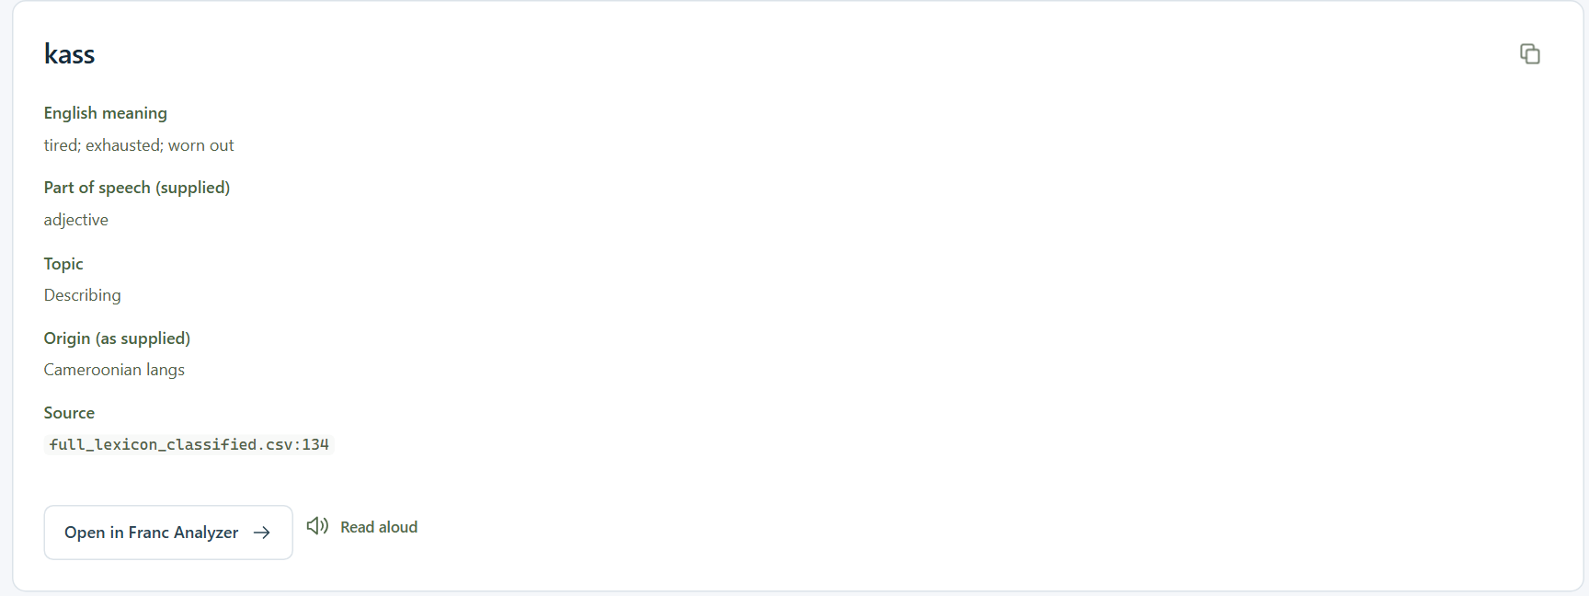
04 / REFERENCE LIBRARIES
CAMFRANGLAIS
Search kass and inspect its source
A concrete lookup connects the interface to the reference data.
Meaning
camfranglais.duckdns.org
tired; exhausted; worn out
Supplied category
adjective
Traceable source
full_lexicon_classified.csv,
line 134
REAL DEPLOYED APP / 27 SEP 2026 / crop only where noted
IMPLEMENTATION / EVIDENCE
frontend/src/Dictionary.tsx
backend/dictionary.py
dictionary/full_lexicon_classified.csv
036 / 100
CS4110 / SET A / 27 SEP 2026
Notes:
SLIDE 036 / 100 - Search kass and inspect its source
This is a genuine current dictionary search, not a fabricated card. Opening the entry copies kass into the analyzer but does not run a test. The meaning and category are displayed as supplied source annotations, not independently validated linguistic facts.
RESPONSIBLE FILES / EVIDENCE
frontend/src/Dictionary.tsx
backend/dictionary.py
dictionary/full_lexicon_classified.csv
Visuals: real app screenshots or clearly labelled original explanatory artwork. Source paths are repository-relative. No application or VPS change is performed by this presentation.

Slide 37
04 / REFERENCE LIBRARIES
CAMFRANGLAIS
Reference lookup does not overrule everything
The classifier uses a defined priority order.
01
02
03
04
05
STRUCTURE
REVIEWED
BUNDLED
SUPPLIED
FALLBACK
Numbers and
punctuation
Compatible
approved word
labels
Explicit lexical
lists
Reference
categories
French forms,
morphology,
UNKNOWN
FOLLOW THE DATA / KEEP EACH RESPONSIBILITY VISIBLE
IMPLEMENTATION / EVIDENCE
compiler/lexer/tokenizer.py
compiler/lexer/reference.py
compiler/lexer/learned.py
037 / 100
CS4110 / SET A / 27 SEP 2026
Notes:
SLIDE 037 / 100 - Reference lookup does not overrule everything
The last card groups several later steps for a readable overview. classify_token checks French forms after the supplied reference and then morphological suffix heuristics. This is deterministic first-applicable-rule classification, not majority voting.
RESPONSIBLE FILES / EVIDENCE
compiler/lexer/tokenizer.py
compiler/lexer/reference.py
compiler/lexer/learned.py
Visuals: real app screenshots or clearly labelled original explanatory artwork. Source paths are repository-relative. No application or VPS change is performed by this presentation.

Slide 38
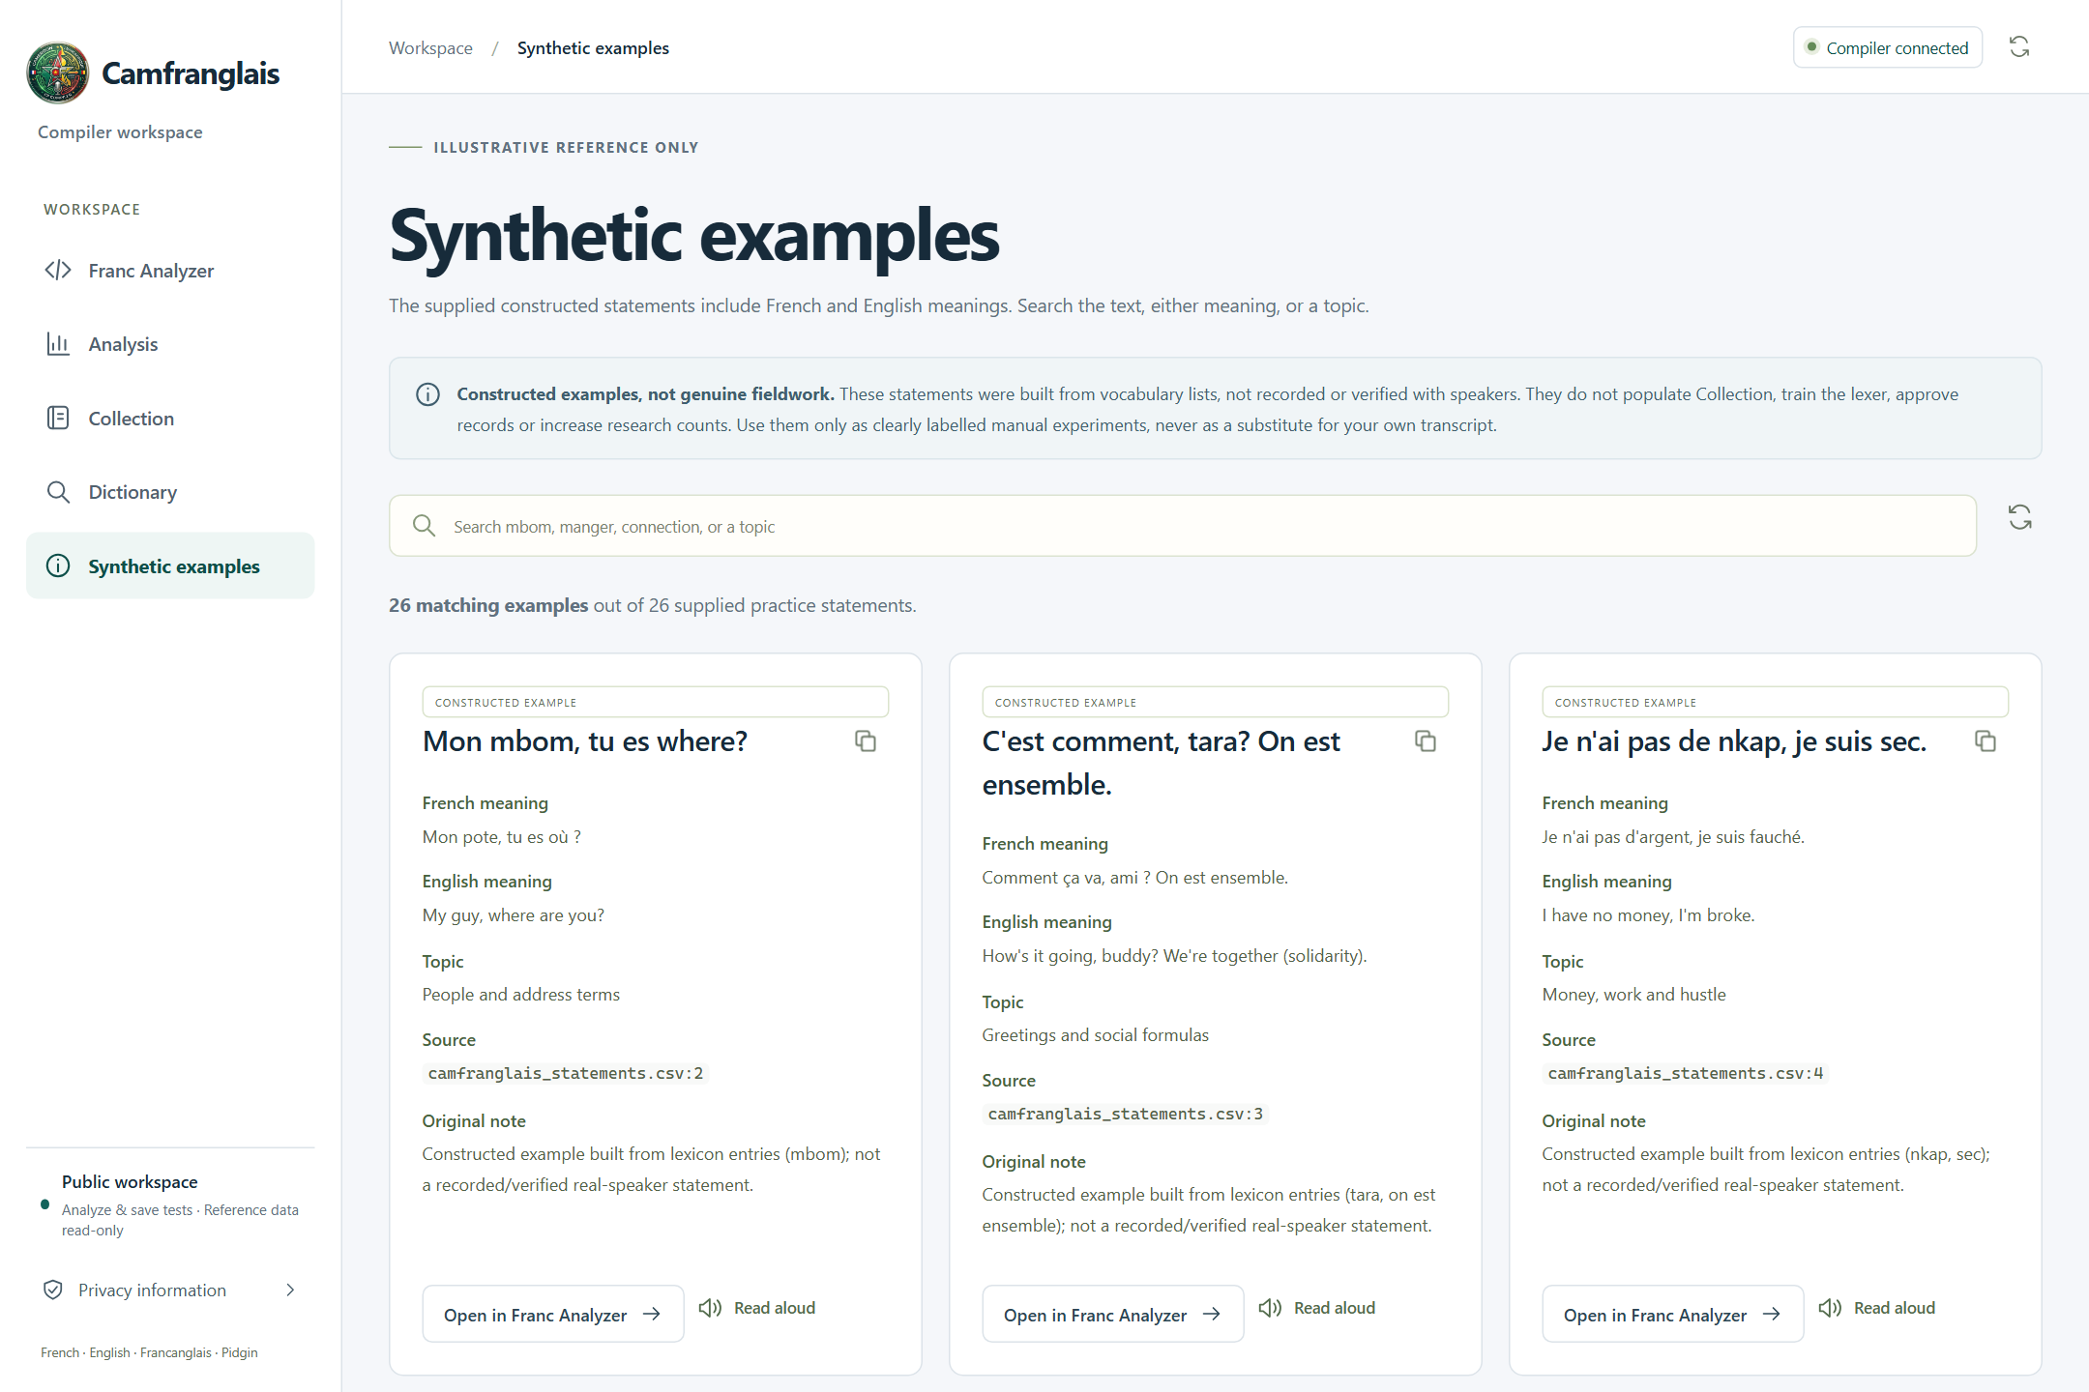
04 / REFERENCE LIBRARIES
CAMFRANGLAIS
Synthetic means constructed, not collected
Practice examples are useful precisely because they are labelled honestly.
26 examples
camfranglais.duckdns.org
A separate practice library.
Search and browse
Inspect topics, meanings
and source labels.
Draft handoff
Try a chosen example
without altering Collection.
REAL DEPLOYED APP / 27 SEP 2026 / crop only where noted
IMPLEMENTATION / EVIDENCE
frontend/src/Examples.tsx
backend/examples.py
CS4110 / SET A / 27 SEP 2026
038 / 100
Notes:
SLIDE 038 / 100 - Synthetic means constructed, not collected
Examples do not train the lexer or count as original field statements. They are explicitly constructed teaching material. Search and page navigation share the reference-search hook with the Dictionary.
RESPONSIBLE FILES / EVIDENCE
frontend/src/Examples.tsx
backend/examples.py
Visuals: real app screenshots or clearly labelled original explanatory artwork. Source paths are repository-relative. No application or VPS change is performed by this presentation.

Slide 39
04 / REFERENCE LIBRARIES
CAMFRANGLAIS
Read-aloud reuses an existing recording
There is no generated speech in the public workflow.
01
02
03
04
REQUEST
LOOK UP
MATCH
PLAY
Choose read-aloud
for a text
Find a compatible
recorded reading
Return its stored
audio reference
Stream existing bytes
in the browser
FOLLOW THE DATA / KEEP EACH RESPONSIBILITY VISIBLE
IMPLEMENTATION / EVIDENCE
frontend/src/RecordedReadings.tsx
frontend/src/voice.ts
backend/readings_api.py
039 / 100
CS4110 / SET A / 27 SEP 2026
Notes:
SLIDE 039 / 100 - Read-aloud reuses an existing recording
POST /api/readings/lookup is a read-only search, despite using POST. Upload, replace and delete are different write operations and are unavailable publicly. If there is no recording, the app must say so rather than synthesize a voice.
RESPONSIBLE FILES / EVIDENCE
frontend/src/RecordedReadings.tsx
frontend/src/voice.ts
backend/readings_api.py
Visuals: real app screenshots or clearly labelled original explanatory artwork. Source paths are repository-relative. No application or VPS change is performed by this presentation.

Slide 40
04 / REFERENCE LIBRARIES
CAMFRANGLAIS
Library features: source ownership
Three libraries share patterns, not the same evidence role.
frontend/src
frontend/src
frontend/src
Collection.tsx
Dictionary.tsx
Examples.tsx
Collection browser and record
viewer.
Reference vocabulary
interface.
Constructed practice interface.
frontend/src
backend
backend
useReferenceSearch.ts
dictionary.py
examples.py
Debounced reference search
and paging.
Reference assembly and
lookup.
Constructed example loading
and lookup.
IMPLEMENTATION / EVIDENCE
frontend/src/Collection.tsx
frontend/src/useReferenceSearch.ts
backend/dictionary.py
backend/examples.py
CS4110 / SET A / 27 SEP 2026
040 / 100
Notes:
SLIDE 040 / 100 - Library features: source ownership
Collection search uses its own dataset-oriented controls. Dictionary and Examples reuse useReferenceSearch with a page size of 25 and a 250 ms debounce. Backend services keep source datasets separate.
RESPONSIBLE FILES / EVIDENCE
frontend/src/Collection.tsx
frontend/src/useReferenceSearch.ts
backend/dictionary.py
backend/examples.py
Visuals: real app screenshots or clearly labelled original explanatory artwork. Source paths are repository-relative. No application or VPS change is performed by this presentation.

Slide 41
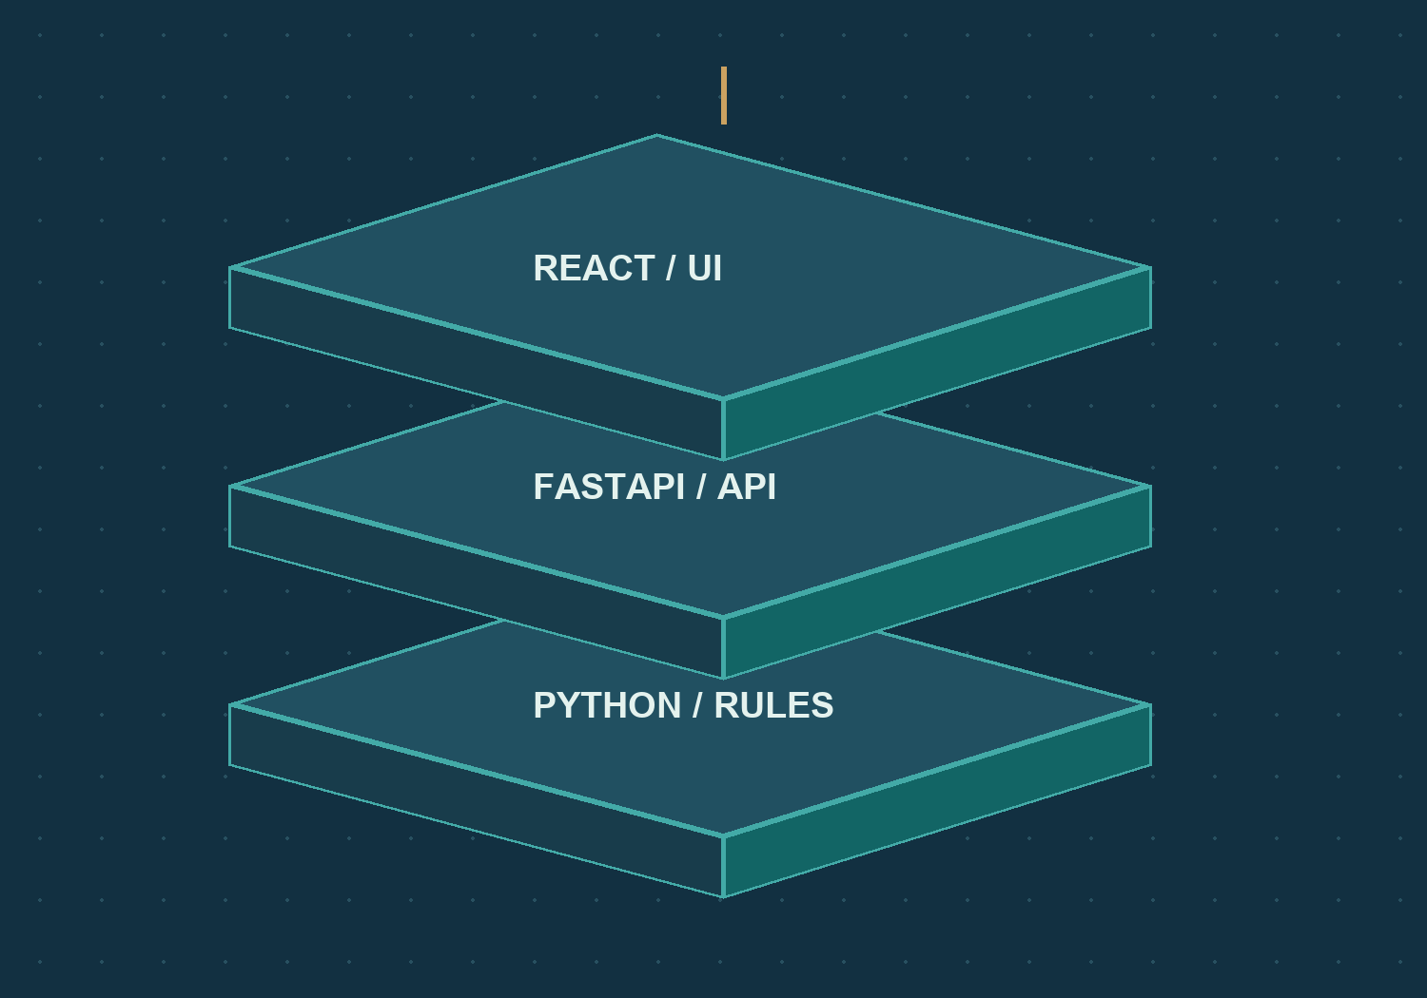
05 / BROWSER TO API
CAMFRANGLAIS
Three working layers, one product
The browser presents. The server coordinates. The compiler decides.
REACT
Pages, inputs, feedback and
evidence panels.
FASTAPI
Validation, public policy, endpoints
and storage.
PYTHON COMPILER
Regex lexing, grammar analysis and
predictive parsing.
IMPLEMENTATION / EVIDENCE
frontend/src/App.tsx
backend/main.py
compiler/parser/service.py
041 / 100
CS4110 / SET A / 27 SEP 2026
Notes:
SLIDE 041 / 100 - Three working layers, one product
Shared persistence supports the server layer. The explanatory illustration is original artwork, not a deployment proof. The current product is a lexical and syntactic analysis workspace; it does not emit machine code.
RESPONSIBLE FILES / EVIDENCE
frontend/src/App.tsx
backend/main.py
compiler/parser/service.py
Visuals: real app screenshots or clearly labelled original explanatory artwork. Source paths are repository-relative. No application or VPS change is performed by this presentation.

Slide 42
05 / BROWSER TO API
CAMFRANGLAIS
Boot without a login
Public-session preparation replaces account authentication.
01
02
03
04
05
MOUNT
BOOTSTRAP
CHECK
CONFIGURE
OPEN
main.tsx loads
PublicSession
Load the public
session
Validate
public-read-only
capabilities
Keep the
anonymous
CSRF token
Render App and
its five pages
FOLLOW THE DATA / KEEP EACH RESPONSIBILITY VISIBLE
IMPLEMENTATION / EVIDENCE
frontend/src/main.tsx
frontend/src/PublicSession.tsx
frontend/src/api.ts
backend/public_access.py
CS4110 / SET A / 27 SEP 2026
042 / 100
Notes:
SLIDE 042 / 100 - Boot without a login
PublicSession rejects incompatible capabilities rather than silently assuming the backend is safe. The cookie and token provide request-origin protection. They are not a user account, fake identity or login session.
RESPONSIBLE FILES / EVIDENCE
frontend/src/main.tsx
frontend/src/PublicSession.tsx
frontend/src/api.ts
backend/public_access.py
Visuals: real app screenshots or clearly labelled original explanatory artwork. Source paths are repository-relative. No application or VPS change is performed by this presentation.

Slide 43
05 / BROWSER TO API
CAMFRANGLAIS
Hash routes select the five pages
Navigation stays inside the same application shell.
URL fragment
Visible page
Principal file
#compiler
Franc Analyzer
FrancAnalyzer.tsx
#analysis
Analysis
Analysis.tsx
#collection
Collection
Collection.tsx
#dictionary
Dictionary
Dictionary.tsx
#examples
Synthetic examples
Examples.tsx
IMPLEMENTATION / EVIDENCE
frontend/src/App.tsx
CS4110 / SET A / 27 SEP 2026
043 / 100
Notes:
SLIDE 043 / 100 - Hash routes select the five pages
All listed component files are under frontend/src. App.tsx chooses the route and handles shared navigation and focus. Unknown or retired fragments fall back to the analyzer rather than exposing removed screens.
RESPONSIBLE FILES / EVIDENCE
frontend/src/App.tsx
Visuals: real app screenshots or clearly labelled original explanatory artwork. Source paths are repository-relative. No application or VPS change is performed by this presentation.

Slide 44
05 / BROWSER TO API
CAMFRANGLAIS
Waiting state and transport are separate
Two shared helpers keep page code focused.
01
02
useRequest.ts
api.ts
Owns pending and error state.
Prevents overlapping runs.
Supports cancel and clearError.
Sends JSON and CSRF headers.
Normalizes errors and timeouts.
Guards against stale sessions.
IMPLEMENTATION / EVIDENCE
frontend/src/useRequest.ts
frontend/src/api.ts
CS4110 / SET A / 27 SEP 2026
044 / 100
Notes:
SLIDE 044 / 100 - Waiting state and transport are separate
These are hooks and functions, not classes. The default transport timeout is 15 seconds; the main analysis request explicitly uses 60 seconds. The UI must distinguish stop-waiting from durable cancellation.
RESPONSIBLE FILES / EVIDENCE
frontend/src/useRequest.ts
frontend/src/api.ts
Visuals: real app screenshots or clearly labelled original explanatory artwork. Source paths are repository-relative. No application or VPS change is performed by this presentation.

Slide 45
05 / BROWSER TO API
CAMFRANGLAIS
One origin connects the UI and API
Production serves the compiled frontend and API together.
01
02
03
04
BROWSER
HTTPS
PROXY
APP
React requests
/api/...
The same public
origin
Nginx forwards the
request
FastAPI serves JSON
and static assets
FOLLOW THE DATA / KEEP EACH RESPONSIBILITY VISIBLE
IMPLEMENTATION / EVIDENCE
backend/web.py
backend/main.py
tools/run_app.py
README.md
CS4110 / SET A / 27 SEP 2026
045 / 100
Notes:
SLIDE 045 / 100 - One origin connects the UI and API
This is the documented deployment topology. Vite is a development and build tool, not the public production server. The presentation makes no new claim of audited VPS configuration or guaranteed uptime.
RESPONSIBLE FILES / EVIDENCE
backend/web.py
backend/main.py
tools/run_app.py
README.md
Visuals: real app screenshots or clearly labelled original explanatory artwork. Source paths are repository-relative. No application or VPS change is performed by this presentation.

Slide 46
05 / BROWSER TO API
CAMFRANGLAIS
Public API, grouped by task
The route reveals which part of the app is involved.
Task
Endpoint
Owner
Session
GET /api/public/session
public_access.py
Record a test
POST /api/analyzer/tests
analyzer_api.py
Test summaries
GET /api/analyzer/tests
analyzer_api.py
Collection
GET /api/dataset
main.py + collection.py
Dictionary
GET /api/dictionary
main.py + dictionary.py
Recorded lookup
POST /api/readings/lookup
readings_api.py
IMPLEMENTATION / EVIDENCE
backend/main.py
backend/analyzer_api.py
backend/public_access.py
backend/readings_api.py
CS4110 / SET A / 27 SEP 2026
046 / 100
Notes:
SLIDE 046 / 100 - Public API, grouped by task
Endpoint names are actual public interfaces. A POST is not automatically a write: recorded-reading lookup is an example of read-only POST. The analyzer test POST does persist a public result.
RESPONSIBLE FILES / EVIDENCE
backend/main.py
backend/analyzer_api.py
backend/public_access.py
backend/readings_api.py
Visuals: real app screenshots or clearly labelled original explanatory artwork. Source paths are repository-relative. No application or VPS change is performed by this presentation.

Slide 47
05 / BROWSER TO API
CAMFRANGLAIS
Bootstrap advertises the public contract
The frontend verifies capabilities before opening the workspace.
SOURCE WALKTHROUGH / ABBREVIATED WHERE MARKED
Allowed
Analyze and retain tests.
{
"access_mode": "public_read_only",
"capabilities": {
"analyze": true,
"save_tests": true,
"edit_collection": false,
"edit_grammar": false,
"edit_recordings": false
}
}
Protected
Reference data, grammar
and recordings.
Anonymous
No account or login is
required.
IMPLEMENTATION / EVIDENCE
backend/public_access.py
frontend/src/PublicSession.tsx
CS4110 / SET A / 27 SEP 2026
047 / 100
Notes:
SLIDE 047 / 100 - Bootstrap advertises the public contract
This is an abridged representation of the response contract. The real response also carries a CSRF token; no actual token is included on the slide. Capability validation is a frontend safeguard in addition to server-side enforcement.
RESPONSIBLE FILES / EVIDENCE
backend/public_access.py
frontend/src/PublicSession.tsx
Visuals: real app screenshots or clearly labelled original explanatory artwork. Source paths are repository-relative. No application or VPS change is performed by this presentation.

Slide 48
05 / BROWSER TO API
CAMFRANGLAIS
Errors tell the user what happened
A failed request is not a success-shaped empty result.
Status
Meaning in this workflow
Next step
403
Forbidden write or invalid Origin/CSRF
Respect the public boundary
404
Missing record or unavailable private API
Check the requested resource
409
Stale grammar or conflicting retry payload
Refresh or reconcile the request
422
Invalid request fields or bounds
Fix the submitted input
429
Rate limit exceeded
Wait for Retry-After
503
Storage temporarily busy
Retry after the service recovers
IMPLEMENTATION / EVIDENCE
backend/public_access.py
backend/analyzer_history.py
frontend/src/api.ts
048 / 100
CS4110 / SET A / 27 SEP 2026
Notes:
SLIDE 048 / 100 - Errors tell the user what happened
A valid grammar rejection is different from these transport and validation failures. It is a successful computation with accepted=false and a trace. This distinction prevents the UI from presenting server failures as linguistic conclusions.
RESPONSIBLE FILES / EVIDENCE
backend/public_access.py
backend/analyzer_history.py
frontend/src/api.ts
Visuals: real app screenshots or clearly labelled original explanatory artwork. Source paths are repository-relative. No application or VPS change is performed by this presentation.

Slide 49
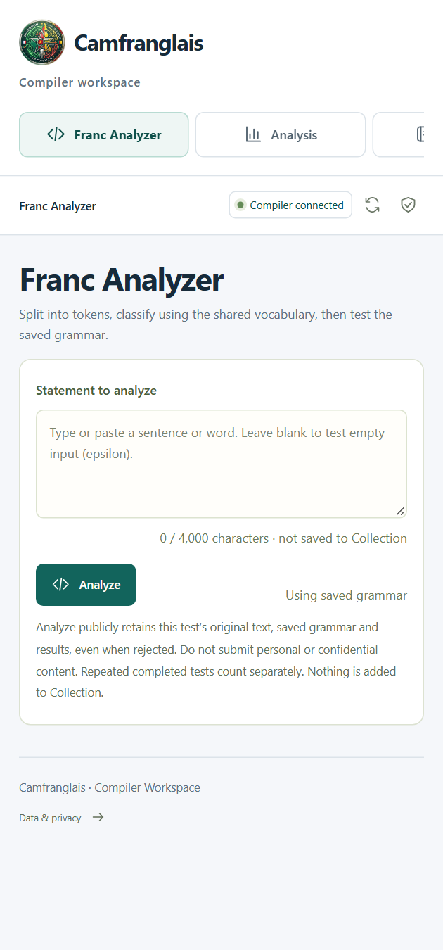
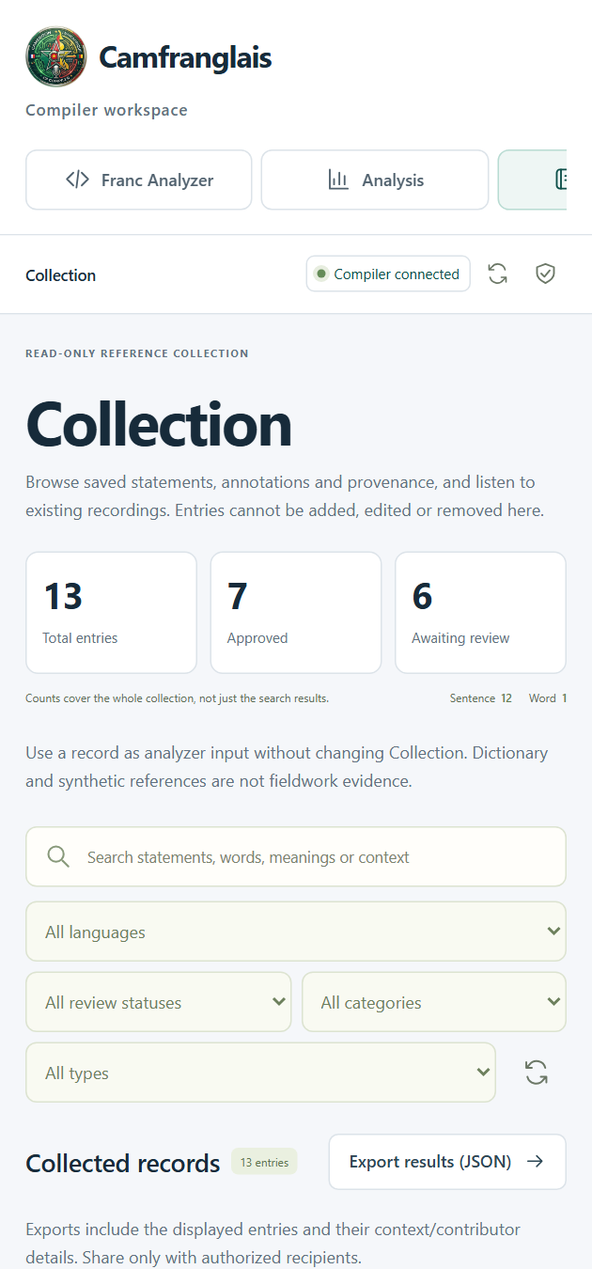
05 / BROWSER TO API
CAMFRANGLAIS
The same workflow on a narrow screen
Responsive presentation without changing the permission model.
Navigate
Page controls remain available.
Read
Inputs and cards adapt to width.
Same policy
Reference data remains
read-only.
IMPLEMENTATION / EVIDENCE
frontend/src/App.tsx
frontend/src/FrancAnalyzer.tsx
frontend/src/Collection.tsx
049 / 100
CS4110 / SET A / 27 SEP 2026
Notes:
SLIDE 049 / 100 - The same workflow on a narrow screen
Both images are real 420-CSS-pixel viewport captures. Some mobile navigation is horizontally scrollable; the screenshot is not a complete list of all off-screen tabs. No special mobile write permissions exist.
RESPONSIBLE FILES / EVIDENCE
frontend/src/App.tsx
frontend/src/FrancAnalyzer.tsx
frontend/src/Collection.tsx
Visuals: real app screenshots or clearly labelled original explanatory artwork. Source paths are repository-relative. No application or VPS change is performed by this presentation.

Slide 50
05 / BROWSER TO API
CAMFRANGLAIS
Frontend file map: find the right layer
Open the smallest responsible surface first.
frontend/src
frontend/src
frontend/src
main.tsx
PublicSession.tsx
App.tsx
Mount the public application.
Validate anonymous
capabilities.
Navigation, handoff and
shared shell.
frontend/src
frontend/src
frontend/src
api.ts
useRequest.ts
CourseworkResults.tsx
HTTP transport and CSRF.
Request lifecycle in React.
Render compiler evidence.
IMPLEMENTATION / EVIDENCE
frontend/src/main.tsx
frontend/src/PublicSession.tsx
frontend/src/App.tsx
frontend/src/api.ts
CS4110 / SET A / 27 SEP 2026
050 / 100
Notes:
SLIDE 050 / 100 - Frontend file map: find the right layer
The lower source rail contains the core entry points, while the cards add the helper and evidence modules. All these files contain React/TypeScript functions except the explicit ApiError class inside api.ts.
RESPONSIBLE FILES / EVIDENCE
frontend/src/main.tsx
frontend/src/PublicSession.tsx
frontend/src/App.tsx
frontend/src/api.ts
Visuals: real app screenshots or clearly labelled original explanatory artwork. Source paths are repository-relative. No application or VPS change is performed by this presentation.

Slide 51
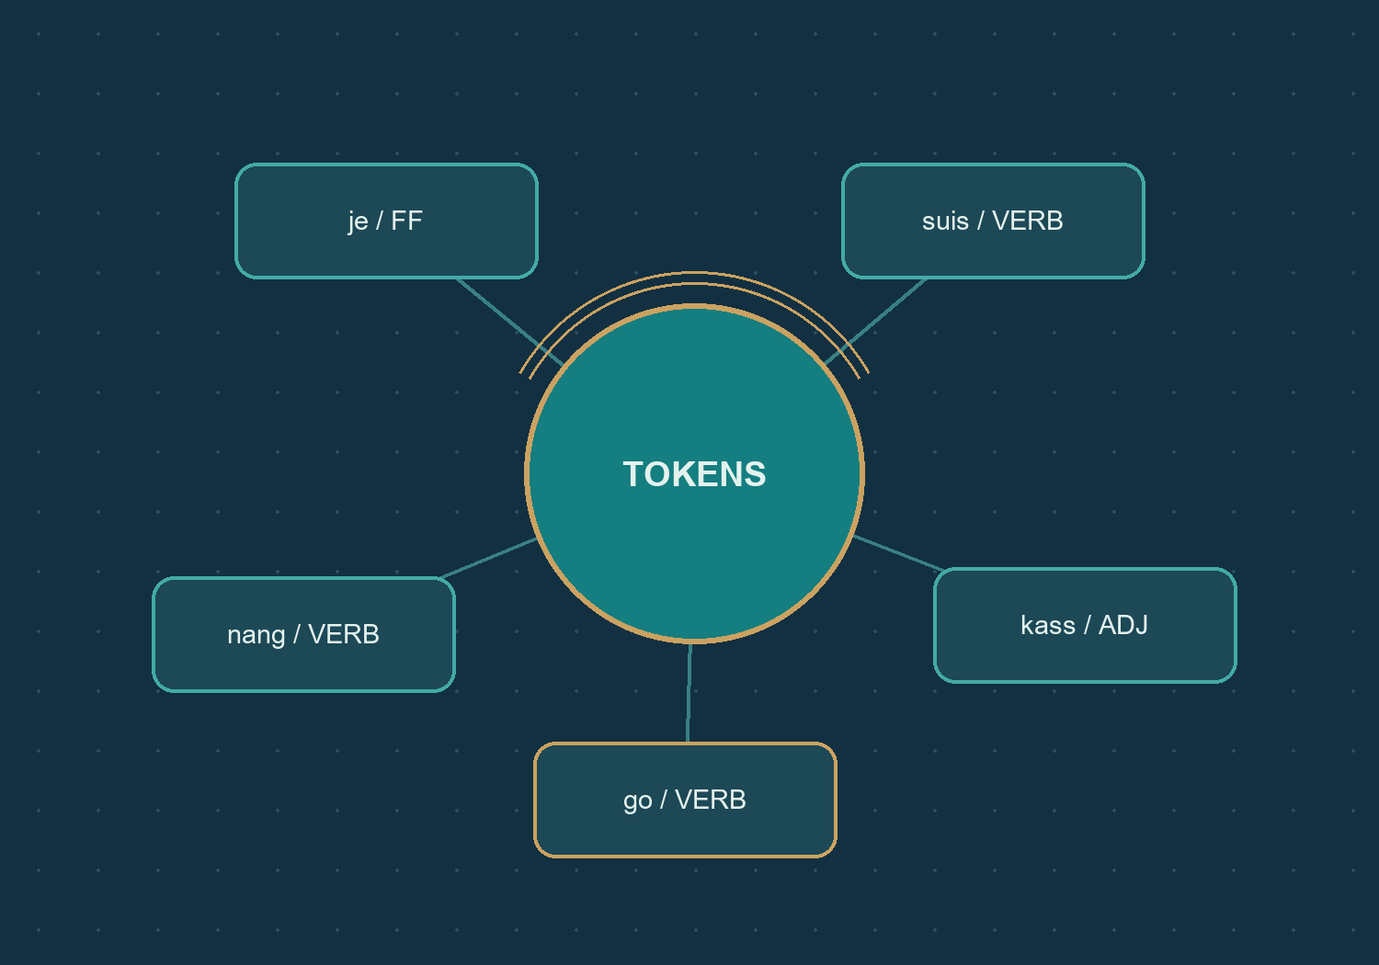
06 / INSIDE THE LEXER
CAMFRANGLAIS
Words become a typed token stream
The lexer is the first algorithmic stage.
SEGMENT
Recognize word forms, numbers and
punctuation.
CLASSIFY
Assign a category using an ordered
rule set.
ANNOTATE
Add language and phrase clues
without deleting tokens.
IMPLEMENTATION / EVIDENCE
compiler/lexer/tokenizer.py
compiler/lexer/lexicon.py
CS4110 / SET A / 27 SEP 2026
051 / 100
Notes:
SLIDE 051 / 100 - Words become a typed token stream
Token is a namedtuple with text and category. tokenize only segments; classify_token chooses labels; analyze_sentence assembles the lexical result. The rest of the compiler consumes the resulting categories.
RESPONSIBLE FILES / EVIDENCE
compiler/lexer/tokenizer.py
compiler/lexer/lexicon.py
Visuals: real app screenshots or clearly labelled original explanatory artwork. Source paths are repository-relative. No application or VPS change is performed by this presentation.

Slide 52
06 / INSIDE THE LEXER
CAMFRANGLAIS
Read the real segmentation branches
TOKEN_SPLIT_RE preserves unsupported non-whitespace input.
SOURCE WALKTHROUGH / ABBREVIATED WHERE MARKED
Ordered alternatives
Words, then numbers,
punctuation and fallback.
WORD: letters + internal joiners
NUMBER: \d+(?:[.,]\d+)?
PUNCT: [.,!?;:\"()]
OTHER: \S
TOKEN_SPLIT_RE.findall(text)
Whitespace
Skipped between matches.
Fallback
An unsupported character
survives for classification.
IMPLEMENTATION / EVIDENCE
compiler/lexer/tokenizer.py
CS4110 / SET A / 27 SEP 2026
052 / 100
Notes:
SLIDE 052 / 100 - Read the real segmentation branches
The WORD line is a readable summary, not the complete source regex. Its exact Unicode and combining-mark definition appears in tokenizer.py. The other branches and findall call match the real code. The fallback prevents silently dropping unknown characters.
RESPONSIBLE FILES / EVIDENCE
compiler/lexer/tokenizer.py
Visuals: real app screenshots or clearly labelled original explanatory artwork. Source paths are repository-relative. No application or VPS change is performed by this presentation.

Slide 53
06 / INSIDE THE LEXER
CAMFRANGLAIS
Internal joiners belong to the word
Small boundary cases make the scanner behavior concrete.
Raw input
Actual tokenization
Reason
j'ai
[j'ai]
Internal apostrophe with
continuation
go-slow
[go-slow]
Internal hyphen with continuation
a-
[a, -]
Dangling hyphen cannot finish a
word
a--b
[a, -, -, b]
Repeated joiners break the word
path
IMPLEMENTATION / EVIDENCE
compiler/lexer/tokenizer.py
tools/tests/test_report_evidence.py
CS4110 / SET A / 27 SEP 2026
053 / 100
Notes:
SLIDE 053 / 100 - Internal joiners belong to the word
These tokenization outputs were executed through the real tokenizer. Tokenization is not classification: the isolated hyphens subsequently become UNKNOWN. No original character is erased to make the example easier to parse.
RESPONSIBLE FILES / EVIDENCE
compiler/lexer/tokenizer.py
tools/tests/test_report_evidence.py
Visuals: real app screenshots or clearly labelled original explanatory artwork. Source paths are repository-relative. No application or VPS change is performed by this presentation.

Slide 54
06 / INSIDE THE LEXER
CAMFRANGLAIS
Numbers are not signed literals
The decimal branch requires digits on both sides of a separator.
Raw input
Actual tokens
Interpretation
3.14
[3.14]
One decimal-number token
3.
[3, .]
Integer followed by punctuation
.5
[., 5]
Leading punctuation and integer
-5
[-, 5]
Other character followed by
integer
IMPLEMENTATION / EVIDENCE
compiler/lexer/tokenizer.py
docs/report-data/lexer-controls.tex
CS4110 / SET A / 27 SEP 2026
054 / 100
Notes:
SLIDE 054 / 100 - Numbers are not signed literals
The lexer also permits comma as the decimal separator. The scanner does not recognize a signed-number syntax. These distinctions are included in the eight generated lexer controls that accompany the final report.
RESPONSIBLE FILES / EVIDENCE
compiler/lexer/tokenizer.py
docs/report-data/lexer-controls.tex
Visuals: real app screenshots or clearly labelled original explanatory artwork. Source paths are repository-relative. No application or VPS change is performed by this presentation.

Slide 55
06 / INSIDE THE LEXER
CAMFRANGLAIS
Unicode details change the boundary
Not every apostrophe-like character takes the same transition.
01
02
U+0027 / U+2018 / U+2019
U+02BC
Pending joiners outside the word
class.
Need a following word character.
Already belongs to Python's
word-character class.
Follows the C edges, even at a
boundary.
IMPLEMENTATION / EVIDENCE
compiler/lexer/tokenizer.py
compiler/lexer/lexicon.py
tools/tests/test_report_evidence.py
055 / 100
CS4110 / SET A / 27 SEP 2026
Notes:
SLIDE 055 / 100 - Unicode details change the boundary
C is [^\W\d_], not simply ASCII letters. Combining marks can continue a word according to the defined ranges. The DFA's joiner edge deliberately says outside C so the outgoing transitions remain deterministic.
RESPONSIBLE FILES / EVIDENCE
compiler/lexer/tokenizer.py
compiler/lexer/lexicon.py
tools/tests/test_report_evidence.py
Visuals: real app screenshots or clearly labelled original explanatory artwork. Source paths are repository-relative. No application or VPS change is performed by this presentation.

Slide 56
06 / INSIDE THE LEXER
CAMFRANGLAIS
Classification is ordered, not voted
The first applicable rule determines the token category.
01 / Structural
NUMBER and PUNCTUATION regex matches.
02 / Reviewed
Compatible approved Word annotations.
03 / Explicit lists
Slang, Pidgin, nouns, verbs and function words.
04 / Supplied reference
One category, or AMBIGUOUS for conflicting labels.
05 / Later fallbacks
Observed French forms, then suffix heuristics.
06 / Unresolved
UNKNOWN if no rule applies.
IMPLEMENTATION / EVIDENCE
compiler/lexer/tokenizer.py
compiler/lexer/learned.py
compiler/lexer/reference.py
056 / 100
CS4110 / SET A / 27 SEP 2026
Notes:
SLIDE 056 / 100 - Classification is ordered, not voted
Within the explicit lists, the source order is slang, Pidgin, noun, verb, French function word, English function word. Approved annotations cannot displace the first structural number and punctuation checks. Suffix labels ending in _LIKE are heuristics, not confirmed parts of speech.
RESPONSIBLE FILES / EVIDENCE
compiler/lexer/tokenizer.py
compiler/lexer/learned.py
compiler/lexer/reference.py
Visuals: real app screenshots or clearly labelled original explanatory artwork. Source paths are repository-relative. No application or VPS change is performed by this presentation.

Slide 57
06 / INSIDE THE LEXER
CAMFRANGLAIS
AMBIGUOUS is not UNKNOWN
Preserve uncertainty instead of pretending all labels mean the same thing.
01
02
AMBIGUOUS
UNKNOWN
The supplied reference has conflicting
categories.
It is a known label, not a wildcard.
No supported classification matched.
It fails vocabulary approval.
IMPLEMENTATION / EVIDENCE
compiler/lexer/tokenizer.py
compiler/parser/yaounde.py
backend/analyzer_models.py
057 / 100
CS4110 / SET A / 27 SEP 2026
Notes:
SLIDE 057 / 100 - AMBIGUOUS is not UNKNOWN
The saved corpus grammar allows AMBIGUOUS in specified positions only. It excludes UNKNOWN. Other explicitly authored grammars could include UNKNOWN as a terminal, but it would still not stand for an arbitrary category.
RESPONSIBLE FILES / EVIDENCE
compiler/lexer/tokenizer.py
compiler/parser/yaounde.py
backend/analyzer_models.py
Visuals: real app screenshots or clearly labelled original explanatory artwork. Source paths are repository-relative. No application or VPS change is performed by this presentation.

Slide 58
06 / INSIDE THE LEXER
CAMFRANGLAIS
Normalize for matching. Preserve for evidence.
A comparison key and the raw text serve different purposes.
01
02
03
04
RAW
MATCHING KEY
LOOKUP
SAVED TEXT
J'ai
j'ai
Apply category rules
J'ai remains
unchanged
FOLLOW THE DATA / KEEP EACH RESPONSIBILITY VISIBLE
IMPLEMENTATION / EVIDENCE
compiler/lexer/vocabulary.py
compiler/lexer/tokenizer.py
backend/analyzer_models.py
058 / 100
CS4110 / SET A / 27 SEP 2026
Notes:
SLIDE 058 / 100 - Normalize for matching. Preserve for evidence.
normalize_word uses lowercasing for ASCII and NFC/casefold plus apostrophe normalization otherwise. normalize_text also normalizes whitespace for comparisons. These functions are not a license to overwrite transcriptions.
RESPONSIBLE FILES / EVIDENCE
compiler/lexer/vocabulary.py
compiler/lexer/tokenizer.py
backend/analyzer_models.py
Visuals: real app screenshots or clearly labelled original explanatory artwork. Source paths are repository-relative. No application or VPS change is performed by this presentation.

Slide 59
06 / INSIDE THE LEXER
CAMFRANGLAIS
Language clues and phrases are annotations
Additional evidence must not collapse the token stream.
01
02
03
LANGUAGE CLUES
SENTENCE
BOUNDARIES
PHRASE MATCHES
Compare
candidate-language sets;
retain uncertainty.
Sentence-ending
punctuation resets the
language run.
Preserve source-ordered
raw spans as extra
annotations.
IMPLEMENTATION / EVIDENCE
compiler/lexer/tokenizer.py
compiler/lexer/languages.py
compiler/lexer/reference.py
059 / 100
CS4110 / SET A / 27 SEP 2026
Notes:
SLIDE 059 / 100 - Language clues and phrases are annotations
S02 includes the clue je ... go. Across the twelve statements there are 26 emitted transition clues, but zero matched verb phrases and zero matched slang phrases. Those zero results are evidence, not missing values to embellish.
RESPONSIBLE FILES / EVIDENCE
compiler/lexer/tokenizer.py
compiler/lexer/languages.py
compiler/lexer/reference.py
Visuals: real app screenshots or clearly labelled original explanatory artwork. Source paths are repository-relative. No application or VPS change is performed by this presentation.

Slide 60
06 / INSIDE THE LEXER
CAMFRANGLAIS
Lexer files and responsibilities
A small set of modules explains the complete lexical path.
compiler/lexer
compiler/lexer
compiler/lexer
tokenizer.py
lexicon.py
reference.py
Segment, classify and
annotate.
Terminal categories and
explicit rules.
Read supplied reference
categories.
compiler/lexer
compiler/lexer
compiler/lexer
learned.py
vocabulary.py
languages.py
Build compatible
reviewed-word overrides.
Normalize matching keys and
aliases.
Return candidate-language
evidence.
IMPLEMENTATION / EVIDENCE
compiler/lexer/tokenizer.py
compiler/lexer/reference.py
compiler/lexer/learned.py
compiler/lexer/vocabulary.py
CS4110 / SET A / 27 SEP 2026
060 / 100
Notes:
SLIDE 060 / 100 - Lexer files and responsibilities
The module name learned does not imply machine learning. It derives a deterministic map from approved lexical annotations. Public visitors cannot edit those shared annotations through this app.
RESPONSIBLE FILES / EVIDENCE
compiler/lexer/tokenizer.py
compiler/lexer/reference.py
compiler/lexer/learned.py
compiler/lexer/vocabulary.py
Visuals: real app screenshots or clearly labelled original explanatory artwork. Source paths are repository-relative. No application or VPS change is performed by this presentation.

Slide 61
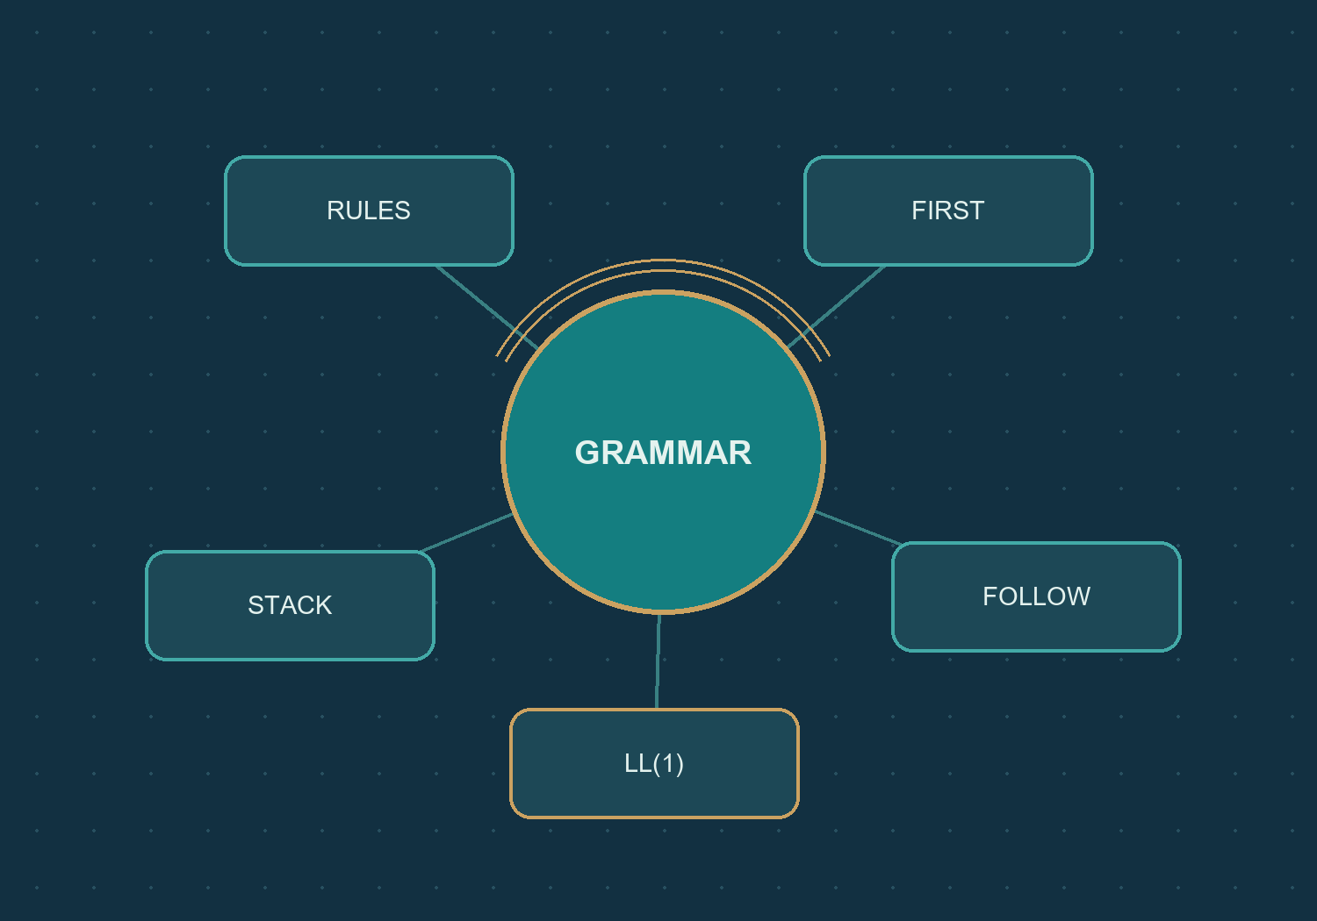
07 / INSIDE THE GRAMMAR
CAMFRANGLAIS
Grammar recognizes category sequences
The parser reads labels, not the meaning of words.
INPUT
A finite stream of lexer categories.
RULES
A context-free grammar of those
categories.
RESULT
Acceptance or an explicit failed
transition.
IMPLEMENTATION / EVIDENCE
compiler/parser/grammar.py
compiler/parser/service.py
compiler/parser/predictive.py
061 / 100
CS4110 / SET A / 27 SEP 2026
Notes:
SLIDE 061 / 100 - Grammar recognizes category sequences
The saved category grammar is intentionally limited. It is not a complete grammar of Camfranglais. A sentence can match categories without being standard French, and meaningful language may fall outside the model.
RESPONSIBLE FILES / EVIDENCE
compiler/parser/grammar.py
compiler/parser/service.py
compiler/parser/predictive.py
Visuals: real app screenshots or clearly labelled original explanatory artwork. Source paths are repository-relative. No application or VPS change is performed by this presentation.

Slide 62
07 / INSIDE THE GRAMMAR
CAMFRANGLAIS
The saved grammar is corpus-derived
Reusable category structures, not a list of accepted sentences.
SOURCE WALKTHROUGH / ABBREVIATED WHERE MARKED
Observed structures
Subject-led, nominal-led and
verb-initial clauses.
Utterance -> Clause
| Clause PUNCTUATION
Clause -> FRENCH_FUNCTION_WORD SubjectTail
| Nominal BareSubjectTail
| VERB PredicateTail
Limited ending
At most one optional
punctuation token.
No forced repair
The two unresolved forms
stay rejected.
IMPLEMENTATION / EVIDENCE
compiler/parser/yaounde.py
docs/evidence/final-corpus-20260927.json
CS4110 / SET A / 27 SEP 2026
062 / 100
Notes:
SLIDE 062 / 100 - The saved grammar is corpus-derived
This is an excerpt of the actual original saved grammar. The full rationale in yaounde.py explains the observed structures and limitations. The saved snapshot is compared with this source by the evidence tests.
RESPONSIBLE FILES / EVIDENCE
compiler/parser/yaounde.py
docs/evidence/final-corpus-20260927.json
Visuals: real app screenshots or clearly labelled original explanatory artwork. Source paths are repository-relative. No application or VPS change is performed by this presentation.

Slide 63
07 / INSIDE THE GRAMMAR
CAMFRANGLAIS
Starter grammar and saved grammar differ
Do not confuse a fresh installation with the documented corpus state.
01
02
TEACHING STARTER
DOCUMENTED CORPUS
DEFAULT_GRAMMAR in service.py.
Illustrative rules for an empty setup.
GRAMMAR in yaounde.py.
The group's saved category-level
rules.
IMPLEMENTATION / EVIDENCE
compiler/parser/service.py
compiler/parser/yaounde.py
docs/evidence/final-corpus-20260927.json
063 / 100
CS4110 / SET A / 27 SEP 2026
Notes:
SLIDE 063 / 100 - Starter grammar and saved grammar differ
The public analyzer loads the stored shared grammar. An empty data directory does not automatically reproduce the documented corpus and grammar. Only the generic starter has an immutable JSON analysis cache; custom grammars are analyzed afresh.
RESPONSIBLE FILES / EVIDENCE
compiler/parser/service.py
compiler/parser/yaounde.py
docs/evidence/final-corpus-20260927.json
Visuals: real app screenshots or clearly labelled original explanatory artwork. Source paths are repository-relative. No application or VPS change is performed by this presentation.

Slide 64
07 / INSIDE THE GRAMMAR
CAMFRANGLAIS
Read, transform, calculate, then parse
Each phase produces inspectable output.
01
02
03
04
READ
TRANSFORM
CALCULATE
PARSE
Validate category-level
notation
Remove supported
recursion and factor
prefixes
FIRST, FOLLOW and
LL(1) table
Run the category
stream on the stack
FOLLOW THE DATA / KEEP EACH RESPONSIBILITY VISIBLE
IMPLEMENTATION / EVIDENCE
compiler/parser/grammar.py
compiler/parser/analysis.py
compiler/parser/service.py
compiler/parser/predictive.py
CS4110 / SET A / 27 SEP 2026
064 / 100
Notes:
SLIDE 064 / 100 - Read, transform, calculate, then parse
read_grammar raises GrammarError for invalid or oversized notation. transform_grammar records before/after snapshots. The table retains only unambiguous cells and reports conflicts separately. Predictive parsing is disabled for non-LL(1) grammars.
RESPONSIBLE FILES / EVIDENCE
compiler/parser/grammar.py
compiler/parser/analysis.py
compiler/parser/service.py
compiler/parser/predictive.py
Visuals: real app screenshots or clearly labelled original explanatory artwork. Source paths are repository-relative. No application or VPS change is performed by this presentation.

Slide 65
07 / INSIDE THE GRAMMAR
CAMFRANGLAIS
Remove the actual left recursion
A noun cluster should not recurse before consuming input.
BEFORE / ORIGINAL RULE
Nominal -> Nominal NOUN | NOUN
AFTER / TRANSFORMED RULES
Nominal -> NOUN Nominal_LR1
Nominal_LR1 -> NOUN Nominal_LR1 | epsilon
MEANING PRESERVED
PREDICTIVE SHAPE
One or more noun categories.
Consume a NOUN before repeating.
IMPLEMENTATION / EVIDENCE
compiler/parser/yaounde.py
compiler/parser/analysis.py
CS4110 / SET A / 27 SEP 2026
065 / 100
Notes:
SLIDE 065 / 100 - Remove the actual left recursion
This is an actual transformation from the corpus grammar, not a generic unrelated textbook example. The helper name is the one produced by the implementation. Epsilon is represented internally by an empty production list.
RESPONSIBLE FILES / EVIDENCE
compiler/parser/yaounde.py
compiler/parser/analysis.py
Visuals: real app screenshots or clearly labelled original explanatory artwork. Source paths are repository-relative. No application or VPS change is performed by this presentation.

Slide 66
07 / INSIDE THE GRAMMAR
CAMFRANGLAIS
Factor the shared Clause prefix
Choose the ending only after the common clause has been parsed.
BEFORE / ORIGINAL RULE
Utterance -> Clause | Clause PUNCTUATION
AFTER / TRANSFORMED RULES
Utterance -> Clause Utterance_LF1
Utterance_LF1 -> epsilon | PUNCTUATION
SHARED PREFIX
FACTORED CHOICE
Both alternatives begin with Clause.
The helper selects no ending or one punctuation
token.
IMPLEMENTATION / EVIDENCE
compiler/parser/yaounde.py
compiler/parser/analysis.py
CS4110 / SET A / 27 SEP 2026
066 / 100
Notes:
SLIDE 066 / 100 - Factor the shared Clause prefix
This is the second actual grammar rewrite used in the report. The syntax layer records it as left_factor. It does not broaden the grammar to accept arbitrary repeated punctuation.
RESPONSIBLE FILES / EVIDENCE
compiler/parser/yaounde.py
compiler/parser/analysis.py
Visuals: real app screenshots or clearly labelled original explanatory artwork. Source paths are repository-relative. No application or VPS change is performed by this presentation.

Slide 67
07 / INSIDE THE GRAMMAR
CAMFRANGLAIS
FIRST tells us what can start
For the transformed study grammar:
FIRST(Utterance)
FRENCH_FUNCTION_WORD
NOUN
VERB
A subject-led clause.
A nominal-led clause.
A verb-initial clause.
IMPLEMENTATION / EVIDENCE
compiler/parser/analysis.py
docs/evidence/final-analysis-20260927.json
CS4110 / SET A / 27 SEP 2026
067 / 100
Notes:
SLIDE 067 / 100 - FIRST tells us what can start
The three displayed categories are the computed FIRST set, not an assumption made from examples. calculate_first grows sets to a fixed point using first_of_sequence and nullable alternatives.
RESPONSIBLE FILES / EVIDENCE
compiler/parser/analysis.py
docs/evidence/final-analysis-20260927.json
Visuals: real app screenshots or clearly labelled original explanatory artwork. Source paths are repository-relative. No application or VPS change is performed by this presentation.

Slide 68
07 / INSIDE THE GRAMMAR
CAMFRANGLAIS
FOLLOW tells us what can come next
End-of-input matters when a production is nullable.
FOLLOW(Utterance) = { $ }
START SYMBOL
NULLABLE RHS
NO EXTRA TOKEN
Its FOLLOW set includes
the end marker.
The LL(1) builder also
uses FOLLOW
lookaheads.
$ is a virtual marker, not a
word typed by the visitor.
IMPLEMENTATION / EVIDENCE
compiler/parser/analysis.py
compiler/parser/grammar.py
CS4110 / SET A / 27 SEP 2026
068 / 100
Notes:
SLIDE 068 / 100 - FOLLOW tells us what can come next
calculate_follow scans productions in reverse while propagating trailers until stable. The dollar marker is appended logically to the category input. It is distinct from EPSILON, which denotes an empty derivation.
RESPONSIBLE FILES / EVIDENCE
compiler/parser/analysis.py
compiler/parser/grammar.py
Visuals: real app screenshots or clearly labelled original explanatory artwork. Source paths are repository-relative. No application or VPS change is performed by this presentation.

Slide 69
07 / INSIDE THE GRAMMAR
CAMFRANGLAIS
The study's transformed grammar
Measured structure after the two recorded rewrites.
12
39
Nonterminals
Productions
47
0
Populated LL(1) cells
Table conflicts
IMPLEMENTATION / EVIDENCE
compiler/parser/analysis.py
docs/evidence/final-analysis-20260927.json
CS4110 / SET A / 27 SEP 2026
069 / 100
Notes:
SLIDE 069 / 100 - The study's transformed grammar
The transformed grammar uses nine distinct terminal categories. These values are calculated from the committed saved grammar. They are not the number of supported categories in the lexer, which is twenty.
RESPONSIBLE FILES / EVIDENCE
compiler/parser/analysis.py
docs/evidence/final-analysis-20260927.json
Visuals: real app screenshots or clearly labelled original explanatory artwork. Source paths are repository-relative. No application or VPS change is performed by this presentation.

Slide 70
07 / INSIDE THE GRAMMAR
CAMFRANGLAIS
Syntax-analysis files: a map
Locate notation, transformations, orchestration and execution.
compiler/parser
compiler/parser
compiler/parser
grammar.py
analysis.py
service.py
Read and validate grammar
notation.
Transform rules; compute sets
and table.
Assemble JSON-serializable
analysis.
compiler/parser
compiler/parser
predictive.py
yaounde.py
Execute the bounded LL(1)
stack.
Corpus grammar, rationale
and limits.
IMPLEMENTATION / EVIDENCE
compiler/parser/grammar.py
compiler/parser/analysis.py
compiler/parser/service.py
compiler/parser/predictive.py
CS4110 / SET A / 27 SEP 2026
070 / 100
Notes:
SLIDE 070 / 100 - Syntax-analysis files: a map
parse_tokens in service.py analyzes a grammar and delegates to parse_analysis. The latter can also consume a previously calculated grammar analysis without recalculation. These functions separate calculation from UI concerns.
RESPONSIBLE FILES / EVIDENCE
compiler/parser/grammar.py
compiler/parser/analysis.py
compiler/parser/service.py
compiler/parser/predictive.py
Visuals: real app screenshots or clearly labelled original explanatory artwork. Source paths are repository-relative. No application or VPS change is performed by this presentation.

Slide 71
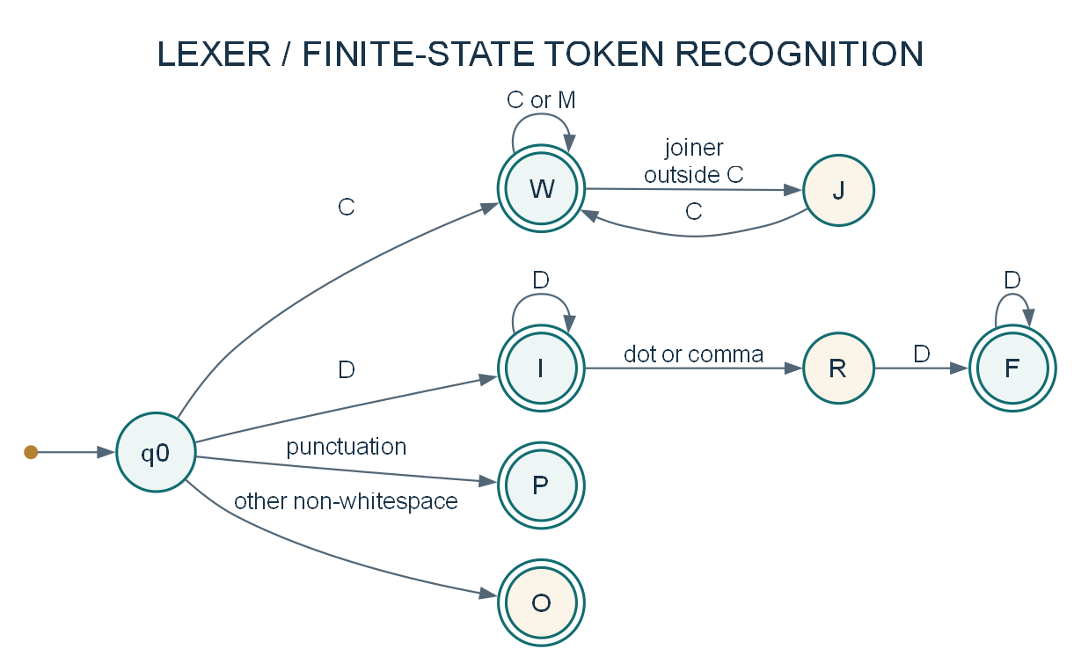
08 / AUTOMATA AND PARSING
CAMFRANGLAIS
Lexer DFA: recognizing token forms
An equivalent formal model of the regex, not a runtime DFA class.
Double circles
Accept a token form.
J and R
Pending joiner or decimal
continuation.
Implicit dead state
Unshown transitions stop
this token path.
IMPLEMENTATION / EVIDENCE
compiler/lexer/tokenizer.py
docs/diagrams/automaton-lexer.puml
CS4110 / SET A / 27 SEP 2026
071 / 100
Notes:
SLIDE 071 / 100 - Lexer DFA: recognizing token forms
W is word, I integer, F fraction, P punctuation and O another non-whitespace character. C is the Unicode word class excluding decimal digits and underscore; D is a decimal digit; M is a supported combining mark. Missing transitions enter an omitted dead state. This is formal automata notation, not UML state-machine notation.
RESPONSIBLE FILES / EVIDENCE
compiler/lexer/tokenizer.py
docs/diagrams/automaton-lexer.puml
Visuals: real app screenshots or clearly labelled original explanatory artwork. Source paths are repository-relative. No application or VPS change is performed by this presentation.

Slide 72
08 / AUTOMATA AND PARSING
CAMFRANGLAIS
A pending state cannot end a token
Compare 3.14 with 3. using the same automaton.
01
02
03
04
I
R
F
RESCAN
Read 3: integer
accepts
Read .: separator is
pending
Read 14: fraction
accepts
With no following digit,
emit 3 then scan .
again
FOLLOW THE DATA / KEEP EACH RESPONSIBILITY VISIBLE
IMPLEMENTATION / EVIDENCE
compiler/lexer/tokenizer.py
docs/diagrams/automaton-lexer.puml
docs/report-data/lexer-controls.tex
072 / 100
CS4110 / SET A / 27 SEP 2026
Notes:
SLIDE 072 / 100 - A pending state cannot end a token
For this particular regex, greedy matching retains the longest accepted prefix. A dangling joiner or separator is not included in a completed word or number. The remaining character is rescanned and preserved by another alternative.
RESPONSIBLE FILES / EVIDENCE
compiler/lexer/tokenizer.py
docs/diagrams/automaton-lexer.puml
docs/report-data/lexer-controls.tex
Visuals: real app screenshots or clearly labelled original explanatory artwork. Source paths are repository-relative. No application or VPS change is performed by this presentation.

Slide 73
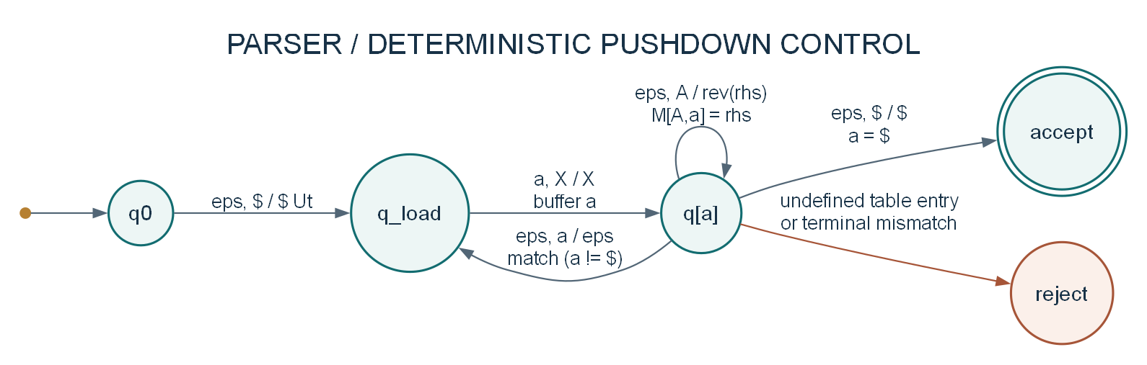
08 / AUTOMATA AND PARSING
CAMFRANGLAIS
The parser adds a stack
Deterministic pushdown control explains the saved LL(1) recognizer.
EXPAND
MATCH
ACCEPT
Use the unique table cell.
Pop a terminal and advance.
Bottom marker and input end agree.
IMPLEMENTATION / EVIDENCE
compiler/parser/predictive.py
docs/diagrams/automaton-parser.puml
CS4110 / SET A / 27 SEP 2026
073 / 100
Notes:
SLIDE 073 / 100 - The parser adds a stack
The diagram uses buffered lookahead states q[a], one finite control state for each possible category or end marker. The implementation inspects categories[position] and advances only when matching. This is an equivalent recognition model, not a literal list of Python classes or a claim of unlimited memory.
RESPONSIBLE FILES / EVIDENCE
compiler/parser/predictive.py
docs/diagrams/automaton-parser.puml
Visuals: real app screenshots or clearly labelled original explanatory artwork. Source paths are repository-relative. No application or VPS change is performed by this presentation.

Slide 74
08 / AUTOMATA AND PARSING
CAMFRANGLAIS
The top of the stack is on the right
S02 begins with a start symbol above the bottom marker.
BEFORE
$
Ut
TOP
AFTER
$
Uf
Cl
TOP
Clause must be handled before the ending helper.
IMPLEMENTATION / EVIDENCE
compiler/parser/predictive.py
docs/evidence/final-analysis-20260927.json
CS4110 / SET A / 27 SEP 2026
074 / 100
Notes:
SLIDE 074 / 100 - The top of the stack is on the right
The actual code initializes stack = [END, analysis['start_symbol']]. Popping the start symbol and extending with reversed(['Clause', 'Utterance_LF1']) leaves Clause at the rightmost top. The slide abbreviates long names only where the visual needs it.
RESPONSIBLE FILES / EVIDENCE
compiler/parser/predictive.py
docs/evidence/final-analysis-20260927.json
Visuals: real app screenshots or clearly labelled original explanatory artwork. Source paths are repository-relative. No application or VPS change is performed by this presentation.

Slide 75
08 / AUTOMATA AND PARSING
CAMFRANGLAIS
One table entry controls expansion
Nonterminal expansion does not consume a category.
SOURCE WALKTHROUGH / ABBREVIATED WHERE MARKED
Lookahead
Choose a unique M[A, a]
entry.
production = table[top][lookahead]
record("Apply ...")
stack.pop()
stack.extend(reversed(production))
Replacement
Push the RHS in reverse
order.
Epsilon
Pop A without consuming
input.
IMPLEMENTATION / EVIDENCE
compiler/parser/predictive.py
compiler/parser/analysis.py
CS4110 / SET A / 27 SEP 2026
075 / 100
Notes:
SLIDE 075 / 100 - One table entry controls expansion
The snippet is a focused excerpt with simplified table access and abbreviated trace text. The actual function checks that the row contains the lookahead and enforces the stack limit before applying the production. Conflicting table cells are never selected.
RESPONSIBLE FILES / EVIDENCE
compiler/parser/predictive.py
compiler/parser/analysis.py
Visuals: real app screenshots or clearly labelled original explanatory artwork. Source paths are repository-relative. No application or VPS change is performed by this presentation.

Slide 76
08 / AUTOMATA AND PARSING
CAMFRANGLAIS
A terminal match consumes one category
The stack and logical input advance together.
BEFORE
$
Uf
St
FF
TOP
AFTER
$
Uf
St
TOP
The next category is VERB.
IMPLEMENTATION / EVIDENCE
compiler/parser/predictive.py
docs/evidence/final-analysis-20260927.json
CS4110 / SET A / 27 SEP 2026
076 / 100
Notes:
SLIDE 076 / 100 - A terminal match consumes one category
This is the first terminal match in S02. FF abbreviates FRENCH_FUNCTION_WORD. Trace snapshots precede their actions, so the next trace row shows the changed stack and remaining input.
RESPONSIBLE FILES / EVIDENCE
compiler/parser/predictive.py
docs/evidence/final-analysis-20260927.json
Visuals: real app screenshots or clearly labelled original explanatory artwork. Source paths are repository-relative. No application or VPS change is performed by this presentation.

Slide 77
08 / AUTOMATA AND PARSING
CAMFRANGLAIS
Walk the first four S02 actions
Expansion and matching leave different fingerprints in the trace.
Stack (top at right)
Remaining input
Action
[$, Ut]
FF VERB ADJECTIVE FF VERB
VERB $
Apply Ut -> Cl Uf
[$, Uf, Cl]
FF VERB ADJECTIVE FF VERB
VERB $
Apply Cl -> FF St
[$, Uf, St, FF]
FF VERB ADJECTIVE FF VERB
VERB $
Match FF
[$, Uf, St]
VERB ADJECTIVE FF VERB
VERB $
Apply St -> VERB Pt
Only Match FF advances the remaining input.
Ut = Utterance / Uf = ending helper / Cl = Clause / St = SubjectTail / FF = French function word
IMPLEMENTATION / EVIDENCE
compiler/parser/predictive.py
docs/evidence/final-analysis-20260927.json
tools/tests/test_report_evidence.py
077 / 100
CS4110 / SET A / 27 SEP 2026
Notes:
SLIDE 077 / 100 - Walk the first four S02 actions
Explain each row while pointing at the rightmost stack item. The regression tests verify consecutive trace transitions, including reversed RHS pushes, non-consuming expansion and one-token matching. See slide 28 for the reading convention.
RESPONSIBLE FILES / EVIDENCE
compiler/parser/predictive.py
docs/evidence/final-analysis-20260927.json
tools/tests/test_report_evidence.py
Visuals: real app screenshots or clearly labelled original explanatory artwork. Source paths are repository-relative. No application or VPS change is performed by this presentation.

Slide 78
08 / AUTOMATA AND PARSING
CAMFRANGLAIS
Acceptance and rejection are explicit
Both outcomes return evidence rather than a guess.
01
02
S02 / ACCEPT
S09 / REJECT
6 consumed tokens.
16 recorded trace rows.
Final stack and input both show $.
5 consumed tokens.
14 recorded trace rows.
UNKNOWN at the sixth token has no
valid table entry.
IMPLEMENTATION / EVIDENCE
compiler/parser/predictive.py
docs/evidence/final-analysis-20260927.json
CS4110 / SET A / 27 SEP 2026
078 / 100
Notes:
SLIDE 078 / 100 - Acceptance and rejection are explicit
The accept path retains the bottom marker; it does not require an empty stack. A rejection includes an error and trace. It is still a valid computational result that the public app can store.
RESPONSIBLE FILES / EVIDENCE
compiler/parser/predictive.py
docs/evidence/final-analysis-20260927.json
Visuals: real app screenshots or clearly labelled original explanatory artwork. Source paths are repository-relative. No application or VPS change is performed by this presentation.

Slide 79
08 / AUTOMATA AND PARSING
CAMFRANGLAIS
Bounds protect the parser
The formal pushdown model is implemented with explicit resource limits.
256
1,000
Input tokens
Characters in one token
2,000
1,024
Recorded parse steps
Stack symbols
IMPLEMENTATION / EVIDENCE
compiler/parser/predictive.py
CS4110 / SET A / 27 SEP 2026
079 / 100
Notes:
SLIDE 079 / 100 - Bounds protect the parser
The parser also rejects malformed token structures, unsupported categories, conflicts, unresolved left recursion and repeated stack/input configurations. The 4,000-character analyzer request bound is a separate UI/API limit.
RESPONSIBLE FILES / EVIDENCE
compiler/parser/predictive.py
Visuals: real app screenshots or clearly labelled original explanatory artwork. Source paths are repository-relative. No application or VPS change is performed by this presentation.

Slide 80
08 / AUTOMATA AND PARSING
CAMFRANGLAIS
Four authored compiler classes, many functions
Model the actual implementation, not invented service objects.
compiler/lexer
compiler/lexer
tokenizer.py
reference.py
Token: namedtuple with text and category.
ReferenceEntry: immutable supplied row.
compiler/parser
compiler/parser
grammar.py
analysis.py
GrammarError: explicit notation failure.
_Transformations: bounded rewrite log.
IMPLEMENTATION / EVIDENCE
docs/diagrams/class-compiler.puml
compiler/lexer/tokenizer.py
compiler/parser/analysis.py
080 / 100
CS4110 / SET A / 27 SEP 2026
Notes:
SLIDE 080 / 100 - Four authored compiler classes, many functions
The class diagram in the SDD verifies these four authored compiler runtime classes. Lexer, Parser and Grammar service classes are not invented. Grammar itself is a dictionary type alias and the main algorithms are module functions.
RESPONSIBLE FILES / EVIDENCE
docs/diagrams/class-compiler.puml
compiler/lexer/tokenizer.py
compiler/parser/analysis.py
Visuals: real app screenshots or clearly labelled original explanatory artwork. Source paths are repository-relative. No application or VPS change is performed by this presentation.

Slide 81
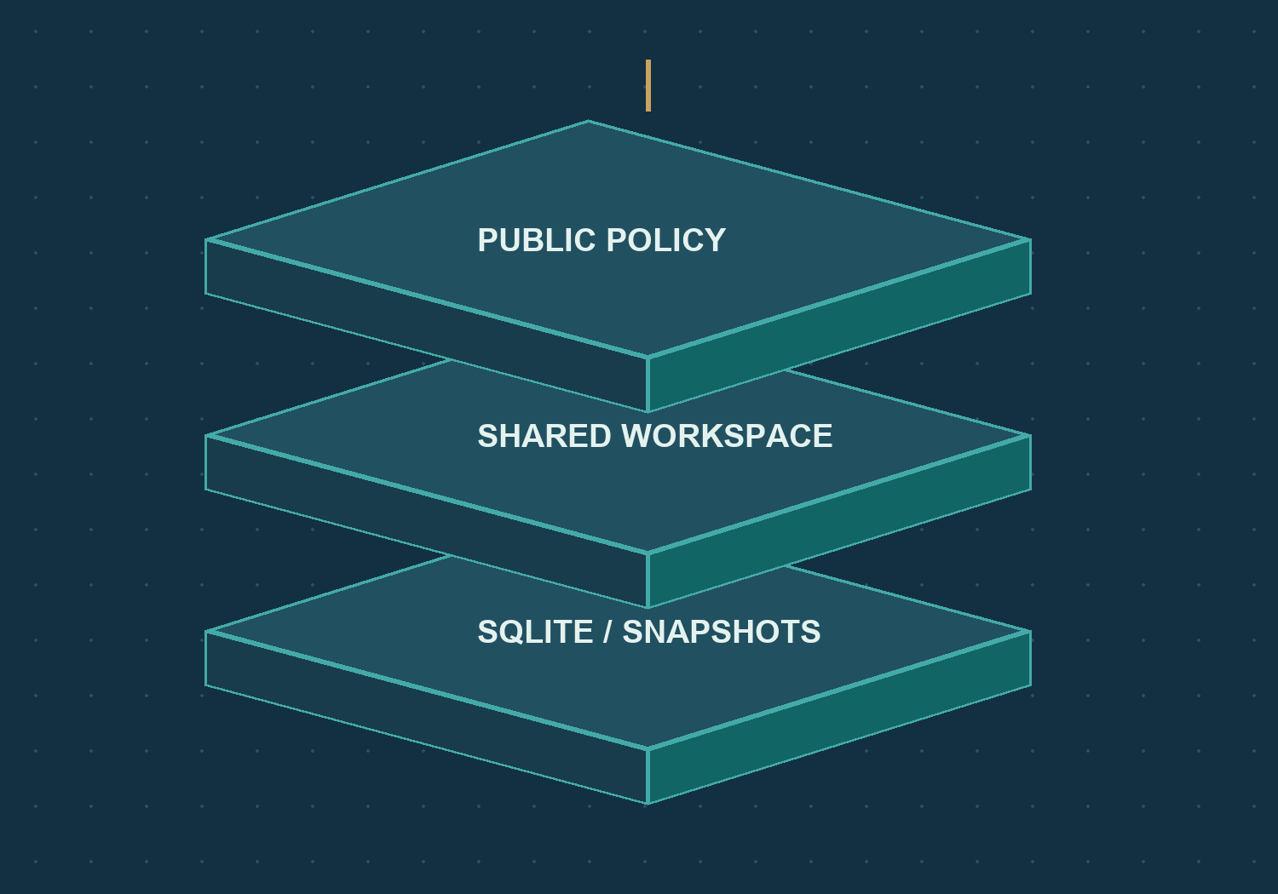
09 / PERSISTENCE AND DEPLOYMENT
CAMFRANGLAIS
Shared storage is not an account
One protected workspace supports all public visitors.
PUBLIC POLICY
PublicWorkspaceStore narrows
allowed writes.
SHARED STORE
SharedWorkspaceStore supplies
common persistence.
SQLITE
workspace.sqlite3 holds shared
records and test snapshots.
IMPLEMENTATION / EVIDENCE
backend/public_access.py
backend/shared_workspace.py
backend/workspaces.py
081 / 100
CS4110 / SET A / 27 SEP 2026
Notes:
SLIDE 081 / 100 - Shared storage is not an account
The active public database is under data_dir/shared-workspace. A stable internal public actor supports identifiers and idempotency, but it is not a fabricated user account. Public responses redact legacy ownership.
RESPONSIBLE FILES / EVIDENCE
backend/public_access.py
backend/shared_workspace.py
backend/workspaces.py
Visuals: real app screenshots or clearly labelled original explanatory artwork. Source paths are repository-relative. No application or VPS change is performed by this presentation.

Slide 82
09 / PERSISTENCE AND DEPLOYMENT
CAMFRANGLAIS
Save once, retry safely
The snapshot and request mapping commit together.
01
02
03
04
LOOKUP
VALIDATE
COMPUTE
TRANSACTION
Check an existing
request ID
Text and grammar
must agree
Build a complete
snapshot
Save test + request
mapping atomically
FOLLOW THE DATA / KEEP EACH RESPONSIBILITY VISIBLE
IMPLEMENTATION / EVIDENCE
backend/analyzer_history.py
backend/shared_workspace.py
CS4110 / SET A / 27 SEP 2026
082 / 100
Notes:
SLIDE 082 / 100 - Save once, retry safely
save_analyzer_request uses a BEGIN IMMEDIATE transaction for analyzer_tests and test_requests. Repeating the same request ID with the same payload returns the existing test. Reusing it with a different payload causes a conflict.
RESPONSIBLE FILES / EVIDENCE
backend/analyzer_history.py
backend/shared_workspace.py
Visuals: real app screenshots or clearly labelled original explanatory artwork. Source paths are repository-relative. No application or VPS change is performed by this presentation.

Slide 83
09 / PERSISTENCE AND DEPLOYMENT
CAMFRANGLAIS
Same retry versus a new stale request
Grammar changes must not destroy the meaning of idempotency.
01
02
IDENTICAL OLD RETRY
NEW STALE REQUEST
Can return its original snapshot after
an offline grammar change.
It is not a new computation.
A new request with outdated grammar
returns 409.
Refresh the shared grammar before
trying again.
IMPLEMENTATION / EVIDENCE
backend/public_access.py
backend/analyzer_history.py
frontend/src/FrancAnalyzer.tsx
083 / 100
CS4110 / SET A / 27 SEP 2026
Notes:
SLIDE 083 / 100 - Same retry versus a new stale request
This subtle distinction preserves recoverability when the first response was lost. An identical retry is allowed to find its previous result. It does not authorize arbitrary new tests against a stale or editable browser grammar.
RESPONSIBLE FILES / EVIDENCE
backend/public_access.py
backend/analyzer_history.py
frontend/src/FrancAnalyzer.tsx
Visuals: real app screenshots or clearly labelled original explanatory artwork. Source paths are repository-relative. No application or VPS change is performed by this presentation.

Slide 84
09 / PERSISTENCE AND DEPLOYMENT
CAMFRANGLAIS
What is stored in a test?
The saved evidence is enough to explain its original result.
TEXT + GRAMMAR
LEXICAL RESULT
The exact input and chosen rule snapshot.
Raw tokens, categories, counts and clues.
PARSE RESULT
METADATA
Accepted flag, consumed count, error and
trace.
Stable ID, recorded time and contextual
summaries.
IMPLEMENTATION / EVIDENCE
backend/analyzer_models.py
backend/shared_workspace.py
CS4110 / SET A / 27 SEP 2026
084 / 100
Notes:
SLIDE 084 / 100 - What is stored in a test?
RecordedTest and related models validate internal consistency, including the relationship between tokens, parser consumption and vocabulary approval. Public snapshots are not replaced just because reference data later changes.
RESPONSIBLE FILES / EVIDENCE
backend/analyzer_models.py
backend/shared_workspace.py
Visuals: real app screenshots or clearly labelled original explanatory artwork. Source paths are repository-relative. No application or VPS change is performed by this presentation.

Slide 85
09 / PERSISTENCE AND DEPLOYMENT
CAMFRANGLAIS
Web SQLite and desktop CSV are different
Avoid explaining the active public store with the wrong persistence helper.
01
02
PUBLIC WEB
RETAINED DESKTOP
SharedWorkspaceStore / WorkspaceStore.
Shared SQLite database.
Public tests append; reference data stays
read-only.
data_collector/dataset.py.
CSV with a lock and atomic replacement.
Local compatibility, not the public write
path.
IMPLEMENTATION / EVIDENCE
backend/shared_workspace.py
backend/workspaces.py
data_collector/dataset.py
085 / 100
CS4110 / SET A / 27 SEP 2026
Notes:
SLIDE 085 / 100 - Web SQLite and desktop CSV are different
Legacy helper modules and private compatibility code remain in the repository. Their existence does not mean public visitors can invoke them. This slide explicitly separates active deployment architecture from retained local tooling.
RESPONSIBLE FILES / EVIDENCE
backend/shared_workspace.py
backend/workspaces.py
data_collector/dataset.py
Visuals: real app screenshots or clearly labelled original explanatory artwork. Source paths are repository-relative. No application or VPS change is performed by this presentation.

Slide 86
09 / PERSISTENCE AND DEPLOYMENT
CAMFRANGLAIS
Read-only rules live on the server
Hiding an edit button is not the enforcement mechanism.
Request family
Public result
Analyzer test create/read
Allowed with request protections
Collection and saved grammar reads
Allowed
Collection / grammar / recording writes
403
Account, workspace, import, private maintenance
404
Invalid Origin or CSRF on protected POST
403
More than 120 requests / 60 seconds / address
429 with Retry-After
IMPLEMENTATION / EVIDENCE
backend/public_access.py
backend/rate_limits.py
backend/tests/test_public_access.py
086 / 100
CS4110 / SET A / 27 SEP 2026
Notes:
SLIDE 086 / 100 - Read-only rules live on the server
Health is excluded from the public rate limit. The backend combines path/method allowlisting, Origin and CSRF validation, rate limiting and storage controls. This is a behavior explanation, not a new security certification.
RESPONSIBLE FILES / EVIDENCE
backend/public_access.py
backend/rate_limits.py
backend/tests/test_public_access.py
Visuals: real app screenshots or clearly labelled original explanatory artwork. Source paths are repository-relative. No application or VPS change is performed by this presentation.

Slide 87
09 / PERSISTENCE AND DEPLOYMENT
CAMFRANGLAIS
Recorded audio is retrieved, not generated
Two read paths serve existing media.
01
02
03
COLLECTION AUDIO
RECORDED READING
HONEST ABSENCE
Play an audio attachment
that already belongs to a
record.
Look up a compatible
text/language reading and
stream its file.
No recording means
unavailable, not a
synthesized substitute.
IMPLEMENTATION / EVIDENCE
backend/audio_api.py
backend/readings_api.py
frontend/src/RecordedReadings.tsx
frontend/src/voice.ts
CS4110 / SET A / 27 SEP 2026
087 / 100
Notes:
SLIDE 087 / 100 - Recorded audio is retrieved, not generated
The public app does not record a microphone, clone a voice, synthesize browser speech or transcribe audio. Retained recorder components and private upload routes must not be presented as current public capabilities.
RESPONSIBLE FILES / EVIDENCE
backend/audio_api.py
backend/readings_api.py
frontend/src/RecordedReadings.tsx
frontend/src/voice.ts
Visuals: real app screenshots or clearly labelled original explanatory artwork. Source paths are repository-relative. No application or VPS change is performed by this presentation.

Slide 88
09 / PERSISTENCE AND DEPLOYMENT
CAMFRANGLAIS
HTTPS outside, port 2021 inside
camfranglais.duckdns.org uses a private loopback upstream.
01
02
03
04
VISITOR
NGINX
UVICORN + FASTAPI
PERSISTENCE
Public DuckDNS
domain
Public HTTPS / port
443
127.0.0.1:2021
/var/lib/camfranglais
FOLLOW THE DATA / KEEP EACH RESPONSIBILITY VISIBLE
DOCUMENTED TOPOLOGY / loopback upstream, public HTTPS
IMPLEMENTATION / EVIDENCE
README.md
backend/web.py
backend/config.py
tools/run_app.py
CS4110 / SET A / 27 SEP 2026
088 / 100
Notes:
SLIDE 088 / 100 - HTTPS outside, port 2021 inside
The documented VPS is 109.199.120.38, with code under /var/www/francanglaiscompiler and camfranglais.service. Port 2021 is the loopback upstream, not the public URL. The source describes the intended topology; the presentation session did not change the VPS or certify recovery and uptime.
RESPONSIBLE FILES / EVIDENCE
README.md
backend/web.py
backend/config.py
tools/run_app.py
Visuals: real app screenshots or clearly labelled original explanatory artwork. Source paths are repository-relative. No application or VPS change is performed by this presentation.

Slide 89
09 / PERSISTENCE AND DEPLOYMENT
CAMFRANGLAIS
Run and configure the application
The launcher checks prerequisites instead of hiding failures.
repository root
tools
backend
start.ps1
run_app.py
config.py
Convenient local Windows
entry point.
Validate launch settings and
serve one origin.
Environment, public URL and
storage settings.
backend
backend
main.py
web.py
Construct the FastAPI
application.
Serve the built frontend and
web policy.
IMPLEMENTATION / EVIDENCE
start.ps1
tools/run_app.py
backend/config.py
backend/main.py
CS4110 / SET A / 27 SEP 2026
089 / 100
Notes:
SLIDE 089 / 100 - Run and configure the application
The local guide requires Python 3.11+ and a supported Node.js version. The launcher can explicitly build the frontend, rejects unsafe production reload and does not silently install dependencies. Do not replace existing shared data with demonstration fixtures.
RESPONSIBLE FILES / EVIDENCE
start.ps1
tools/run_app.py
backend/config.py
backend/main.py
Visuals: real app screenshots or clearly labelled original explanatory artwork. Source paths are repository-relative. No application or VPS change is performed by this presentation.

Slide 90
09 / PERSISTENCE AND DEPLOYMENT
CAMFRANGLAIS
Recovery does not rewrite history
Use the failure message to choose the next safe action.
TIMEOUT
STALE GRAMMAR
Recover an identical pending request
before creating another.
Refresh the saved grammar for a new
computation.
BUSY STORAGE
OLD RESULT
Retry when the service is available.
Inspect the original snapshot; do not
reinterpret it as a rerun.
IMPLEMENTATION / EVIDENCE
frontend/src/FrancAnalyzer.tsx
frontend/src/api.ts
backend/analyzer_history.py
backend/public_access.py
CS4110 / SET A / 27 SEP 2026
090 / 100
Notes:
SLIDE 090 / 100 - Recovery does not rewrite history
These are practical recovery explanations, not actions the presentation generator performed. The screenshots were read-only and all non-read API requests were blocked during capture.
RESPONSIBLE FILES / EVIDENCE
frontend/src/FrancAnalyzer.tsx
frontend/src/api.ts
backend/analyzer_history.py
backend/public_access.py
Visuals: real app screenshots or clearly labelled original explanatory artwork. Source paths are repository-relative. No application or VPS change is performed by this presentation.

Slide 91
10 / EVIDENCE AND DEMONSTRATION
CAMFRANGLAIS
A fixed study, not a live benchmark
The evaluation uses the same twelve original strings.
12
81
Supplied originals
Tokens retained
10
2
Grammar accepts
Explicit grammar rejects
IMPLEMENTATION / EVIDENCE
compiler/tests/yaounde_cases.py
docs/evidence/final-analysis-20260927.json
CS4110 / SET A / 27 SEP 2026
091 / 100
Notes:
SLIDE 091 / 100 - A fixed study, not a live benchmark
The fixed corpus is reproduced from the committed snapshot and exact regression cases. These values are independent of live history totals. The source strings were not corrected to improve the acceptance rate.
RESPONSIBLE FILES / EVIDENCE
compiler/tests/yaounde_cases.py
docs/evidence/final-analysis-20260927.json
Visuals: real app screenshots or clearly labelled original explanatory artwork. Source paths are repository-relative. No application or VPS change is performed by this presentation.

Slide 92
10 / EVIDENCE AND DEMONSTRATION
CAMFRANGLAIS
Ten of twelve fit the saved grammar
83.3% category-grammar match is not linguistic accuracy.
ACCEPTED
10 original statements
83.3%
REJECTED
2 originals with unresolved sixth tokens
INTERPRETATION
A result for this corpus and these rules
only
IMPLEMENTATION / EVIDENCE
docs/evidence/final-analysis-20260927.json
compiler/parser/yaounde.py
CS4110 / SET A / 27 SEP 2026
092 / 100
Notes:
SLIDE 092 / 100 - Ten of twelve fit the saved grammar
The visual is computed from the original-result accepted flags. The ratio does not establish performance on unseen data, correctness of a supplied meaning, or authenticity of collection. A broader independent evaluation is a separate future task.
RESPONSIBLE FILES / EVIDENCE
docs/evidence/final-analysis-20260927.json
compiler/parser/yaounde.py
Visuals: real app screenshots or clearly labelled original explanatory artwork. Source paths are repository-relative. No application or VPS change is performed by this presentation.

Slide 93
10 / EVIDENCE AND DEMONSTRATION
CAMFRANGLAIS
Boundary cases expose the rules
Seven constructed controls supplement the twelve originals.
Control
Constructed input
Saved-grammar result
C01
(empty)
REJECT
C02
school
REJECT
C03
je
REJECT
C04
je suis kass.
ACCEPT
C05
je suis kass?!
REJECT
C06
je je suis
REJECT
C07
je suis alli
REJECT
IMPLEMENTATION / EVIDENCE
docs/evidence/final-analysis-20260927.json
compiler/tests/test_yaounde_grammar.py
CS4110 / SET A / 27 SEP 2026
093 / 100
Notes:
SLIDE 093 / 100 - Boundary cases expose the rules
These inputs are explicitly constructed tests, not field statements. Empty input, a noun fragment, an incomplete subject, repeated punctuation, an unsupported order and UNKNOWN reject; one optional punctuation token accepts. The generator reads their actual outcomes from the evidence.
RESPONSIBLE FILES / EVIDENCE
docs/evidence/final-analysis-20260927.json
compiler/tests/test_yaounde_grammar.py
Visuals: real app screenshots or clearly labelled original explanatory artwork. Source paths are repository-relative. No application or VPS change is performed by this presentation.

Slide 94
10 / EVIDENCE AND DEMONSTRATION
CAMFRANGLAIS
Evidence has a clear boundary
State what is measured and what still needs human confirmation.
01
02
03
VERIFIED
QUALIFIED
UNCONFIRMED
Token outputs, grammar
transformations, traces
and saved-data behavior.
Supplied glosses and
lexical annotations need
linguistic review.
Original fieldwork dates,
collectors, speakers and
consent.
IMPLEMENTATION / EVIDENCE
docs/evidence/final-corpus-20260927.json
docs/final-report.tex
CS4110 / SET A / 27 SEP 2026
094 / 100
Notes:
SLIDE 094 / 100 - Evidence has a clear boundary
The dataset's manual-transcription flag is false and its collection method is blank. Screenshots demonstrate working software but cannot prove the origin of the utterances. This presentation does not invent missing human evidence.
RESPONSIBLE FILES / EVIDENCE
docs/evidence/final-corpus-20260927.json
docs/final-report.tex
Visuals: real app screenshots or clearly labelled original explanatory artwork. Source paths are repository-relative. No application or VPS change is performed by this presentation.

Slide 95
10 / EVIDENCE AND DEMONSTRATION
CAMFRANGLAIS
Tests check different layers
A successful build is not the only form of evidence.
COMPILER
API + STORAGE
Exact tokenization, grammar controls and
trace transitions.
Public permissions, snapshots and safe
retries.
FRONTEND
DOCUMENTS
Page behavior, request states and visible
results.
Diagrams, source coverage and
reproducible report evidence.
IMPLEMENTATION / EVIDENCE
compiler/tests/test_yaounde_grammar.py
backend/tests/test_public_access.py
frontend/tests/unit/FrancAnalyzer.test.tsx
tools/tests/test_report_evidence.py
CS4110 / SET A / 27 SEP 2026
095 / 100
Notes:
SLIDE 095 / 100 - Tests check different layers
The documentation release recorded 33 focused documentation/evidence/corpus passes. Earlier app-release tests are dated evidence, not an uninterrupted run performed for this deck. A known old expected-category regression remains in compiler/tests/test_parser.py; do not claim fully green application CI.
RESPONSIBLE FILES / EVIDENCE
compiler/tests/test_yaounde_grammar.py
backend/tests/test_public_access.py
frontend/tests/unit/FrancAnalyzer.test.tsx
tools/tests/test_report_evidence.py
Visuals: real app screenshots or clearly labelled original explanatory artwork. Source paths are repository-relative. No application or VPS change is performed by this presentation.

Slide 96
10 / EVIDENCE AND DEMONSTRATION
CAMFRANGLAIS
File map: UI and the request path
A compact index for questions during the demonstration.
frontend/src
frontend/src
frontend/src
FrancAnalyzer.tsx
TestStatistics.tsx
Collection.tsx
Where does Analyze begin?
Where are history metrics
displayed?
Where are records browsed?
frontend/src
backend
backend
api.ts
analyzer_api.py
analyzer_history.py
Where are errors and headers
handled?
Where does the request enter?
Where is its snapshot
managed?
IMPLEMENTATION / EVIDENCE
frontend/src/FrancAnalyzer.tsx
frontend/src/api.ts
backend/analyzer_api.py
backend/analyzer_history.py
CS4110 / SET A / 27 SEP 2026
096 / 100
Notes:
SLIDE 096 / 100 - File map: UI and the request path
Use the filenames to answer implementation questions without searching the entire repository. The source paths in the notes are relative to the same checkout that accompanies this deck.
RESPONSIBLE FILES / EVIDENCE
frontend/src/FrancAnalyzer.tsx
frontend/src/api.ts
backend/analyzer_api.py
backend/analyzer_history.py
Visuals: real app screenshots or clearly labelled original explanatory artwork. Source paths are repository-relative. No application or VPS change is performed by this presentation.

Slide 97
10 / EVIDENCE AND DEMONSTRATION
CAMFRANGLAIS
File map: compiler and persistence
The computational core stays separate from the public interface.
compiler/lexer
compiler/parser
compiler/parser
tokenizer.py
analysis.py
predictive.py
How are raw tokens and labels
produced?
How are grammar sets and
tables calculated?
How does the stack accept or
reject?
compiler/parser
backend
backend
yaounde.py
shared_workspace.py
workspaces.py
Why were these grammar
rules chosen?
How are public requests saved
once?
Where is the SQLite
workspace implemented?
IMPLEMENTATION / EVIDENCE
compiler/lexer/tokenizer.py
compiler/parser/analysis.py
compiler/parser/predictive.py
backend/shared_workspace.py
CS4110 / SET A / 27 SEP 2026
097 / 100
Notes:
SLIDE 097 / 100 - File map: compiler and persistence
These files are the key cross-section for understanding the full application. For complete class relationships and activated sequence diagrams, open the SDD and the separate 37-sheet UML and automata atlas.
RESPONSIBLE FILES / EVIDENCE
compiler/lexer/tokenizer.py
compiler/parser/analysis.py
compiler/parser/predictive.py
backend/shared_workspace.py
Visuals: real app screenshots or clearly labelled original explanatory artwork. Source paths are repository-relative. No application or VPS change is performed by this presentation.

Slide 98
10 / EVIDENCE AND DEMONSTRATION
CAMFRANGLAIS
A safe demonstration in five moves
Use an existing saved result for a read-only rehearsal.
01
02
03
04
05
OPEN
INSPECT
EXPLAIN
LOOK UP
CONNECT
Show the public
Analyzer
Choose the
existing S02 test
Compare
tokens, verdict
and trace
Search kass in
Dictionary
Point to the
responsible
source files
FOLLOW THE DATA / KEEP EACH RESPONSIBILITY VISIBLE
IMPLEMENTATION / EVIDENCE
frontend/src/App.tsx
frontend/src/FrancAnalyzer.tsx
frontend/src/Dictionary.tsx
docs/README.md
CS4110 / SET A / 27 SEP 2026
098 / 100
Notes:
SLIDE 098 / 100 - A safe demonstration in five moves
For a live write demonstration, first explain that pressing Analyze publicly retains the text and result. Never submit personal or confidential content. The rehearsal path here avoids new saves while still showing genuine computed evidence.
RESPONSIBLE FILES / EVIDENCE
frontend/src/App.tsx
frontend/src/FrancAnalyzer.tsx
frontend/src/Dictionary.tsx
docs/README.md
Visuals: real app screenshots or clearly labelled original explanatory artwork. Source paths are repository-relative. No application or VPS change is performed by this presentation.

Slide 99
10 / EVIDENCE AND DEMONSTRATION
CAMFRANGLAIS
Present the story; keep the depth
All 100 slides are included. A short oral route is optional.
OPEN / 01, 05
Introduce the product and its five pages.
DEMO / 13, 17, 24, 35
Show a request, a result, two verdicts and lookup.
EXPLAIN / 56, 73, 88
Connect lexer, parser and deployment.
CLOSE / 100
Return to the value and invite questions.
IMPLEMENTATION / EVIDENCE
docs/final-report.tex
docs/README.md
CS4110 / SET A / 27 SEP 2026
099 / 100
Notes:
SLIDE 099 / 100 - Present the story; keep the depth
The coursework calls for a ten-minute presentation: roughly three minutes per member and one shared minute. The group can use this ten-slide route and keep the remaining slides as technical backup. This suggestion does not assign or attest personal contributions.
RESPONSIBLE FILES / EVIDENCE
docs/final-report.tex
docs/README.md
Visuals: real app screenshots or clearly labelled original explanatory artwork. Source paths are repository-relative. No application or VPS change is performed by this presentation.

Slide 100
CAMFRANGLAIS / COMPILER WORKSPACE
From language to evidence.
Your questions, traced to the code.
PRESERVE
EXPLAIN
RETAIN
The original text
The rules and trace
The original result
camfranglais.duckdns.org
IMPLEMENTATION / EVIDENCE
README.md
docs/README.md
CS4110 / SET A / 27 SEP 2026
100 / 100
Notes:
SLIDE 100 / 100 - From language to evidence.
Close by emphasizing transparent rules, two distinct verdicts and immutable evidence. The app is available at https://camfranglais.duckdns.org. The PowerPoint, source files, screenshots and technical documentation accompany one another; no unconfirmed fieldwork or fully green application CI is claimed.
RESPONSIBLE FILES / EVIDENCE
README.md
docs/README.md
Visuals: real app screenshots or clearly labelled original explanatory artwork. Source paths are repository-relative. No application or VPS change is performed by this presentation.

