Slide 1
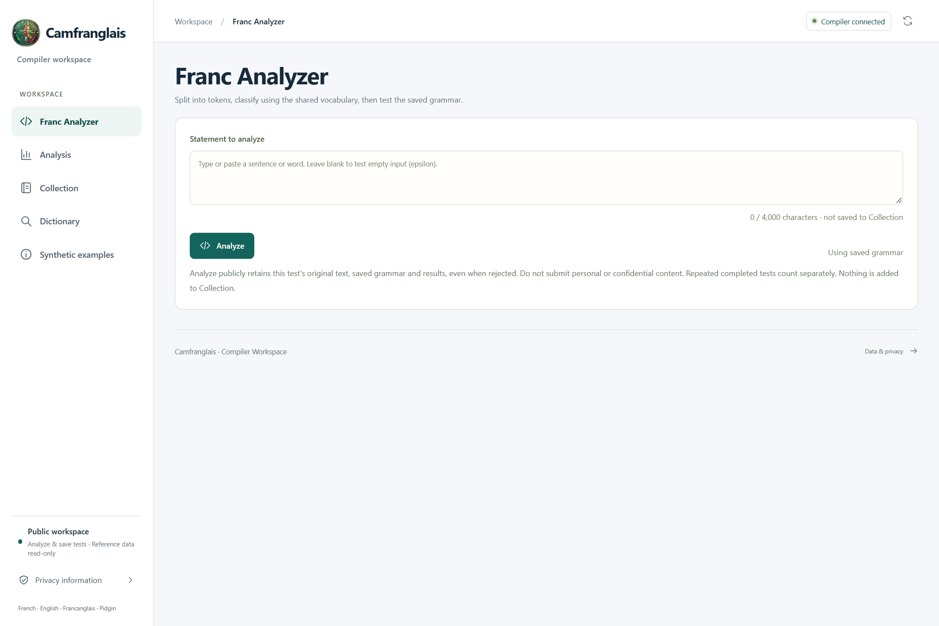
CAMFRANGLAIS / COMPILER WORKSPACE
Camfranglais
camfranglais.duckdns.org
How the app works.
The essential source files.
CS4110 / SUMMER 2026 / SET A
Kwete Ngouba Junior Rayan / ICTU20241377
Djemtchimo Noukui Bruno Jonatan / ICTU20241585
Amina Boubakary / ICTU20241870
IMPLEMENTATION / EVIDENCE
README.md
docs/document-style.tex
CS4110 / SET A / 27 SEP 2026
01 / 12
Notes:
SLIDE 01 / 12 - Camfranglais
Introduce the group and the project. CS4110 Compiler Construction, Summer 2026, SET A. Instructor: Engr. Tanwi Nkiamboh. This concise presentation has twelve slides and is intended for a roughly ten-minute oral presentation. The app is a deterministic lexical and syntactic analyzer, not an AI translator.
RESPONSIBLE FILES / EVIDENCE
README.md
docs/document-style.tex
Visuals: real app screenshots or clearly labelled original explanatory artwork. Source paths are repository-relative. No application or VPS change is performed by this presentation.

Slide 2
THE ESSENTIALS / CS4110
CAMFRANGLAIS
Our goal: make language analysis visible
A transparent teaching tool for Camfranglais statements.
01
02
03
PRESERVE
EXPLAIN
REVIEW
Keep the original words,
spelling and punctuation.
Show token categories
and the grammar decision.
Save the result and
inspect its evidence.
IMPLEMENTATION / EVIDENCE
compiler/lexer/tokenizer.py
compiler/parser/predictive.py
backend/analyzer_history.py
02 / 12
CS4110 / SET A / 27 SEP 2026
Notes:
SLIDE 02 / 12 - Our goal: make language analysis visible
Explain the problem: informal mixed-language statements are difficult to understand through a single accept/reject badge. The app exposes the intermediate decisions. A grammar match is not proof of meaning or standard French correctness. Suggested speaking time: 40 seconds.
RESPONSIBLE FILES / EVIDENCE
compiler/lexer/tokenizer.py
compiler/parser/predictive.py
backend/analyzer_history.py
Visuals: real app screenshots or clearly labelled original explanatory artwork. Source paths are repository-relative. No application or VPS change is performed by this presentation.

Slide 3
THE ESSENTIALS / CS4110
CAMFRANGLAIS
Five pages, one public workspace
No login: analyze and save tests; reference data stays read-only.
01
02
03
Franc Analyzer
Analysis
Collection
Enter a statement and run a
test.
Inspect saved results and
statistics.
Browse supplied statements
and audio.
04
05
ONE SHARED
PUBLIC WORKSPACE
Dictionary
Synthetic examples
Look up reference vocabulary.
Try clearly labelled practice
material.
IMPLEMENTATION / EVIDENCE
frontend/src/App.tsx
frontend/src/PublicSession.tsx
backend/public_access.py
03 / 12
CS4110 / SET A / 27 SEP 2026
Notes:
SLIDE 03 / 12 - Five pages, one public workspace
App.tsx owns the five-page navigation. PublicSession prepares anonymous access; public_access.py enforces the allowed operations. Public visitors cannot edit Collection, the saved grammar or recordings. The cards link to the matching short walkthrough slides. Suggested speaking time: 45 seconds.
RESPONSIBLE FILES / EVIDENCE
frontend/src/App.tsx
frontend/src/PublicSession.tsx
backend/public_access.py
Visuals: real app screenshots or clearly labelled original explanatory artwork. Source paths are repository-relative. No application or VPS change is performed by this presentation.

Slide 4
THE ESSENTIALS / CS4110
CAMFRANGLAIS
What happens when we press Analyze?
One input becomes a traceable, saved result.
01
02
03
04
05
INPUT
LEXER
PARSER
SAVE
DISPLAY
Keep the
original text
Split and
classify tokens
Test the saved
grammar
Retain the
original
snapshot
Show verdicts
and evidence
FOLLOW THE DATA / KEEP EACH RESPONSIBILITY VISIBLE
IMPLEMENTATION / EVIDENCE
frontend/src/FrancAnalyzer.tsx
backend/analyzer_api.py
compiler/lexer/tokenizer.py
compiler/parser/predictive.py
CS4110 / SET A / 27 SEP 2026
04 / 12
Notes:
SLIDE 04 / 12 - What happens when we press Analyze?
Trace the main path from the React input to POST /api/analyzer/tests. The backend validates access and the shared grammar, runs lexical and syntactic analysis, and saves an immutable snapshot. A rejected sentence is still saved as a legitimate test result. Suggested speaking time: 55 seconds.
RESPONSIBLE FILES / EVIDENCE
frontend/src/FrancAnalyzer.tsx
backend/analyzer_api.py
compiler/lexer/tokenizer.py
compiler/parser/predictive.py
Visuals: real app screenshots or clearly labelled original explanatory artwork. Source paths are repository-relative. No application or VPS change is performed by this presentation.

Slide 5
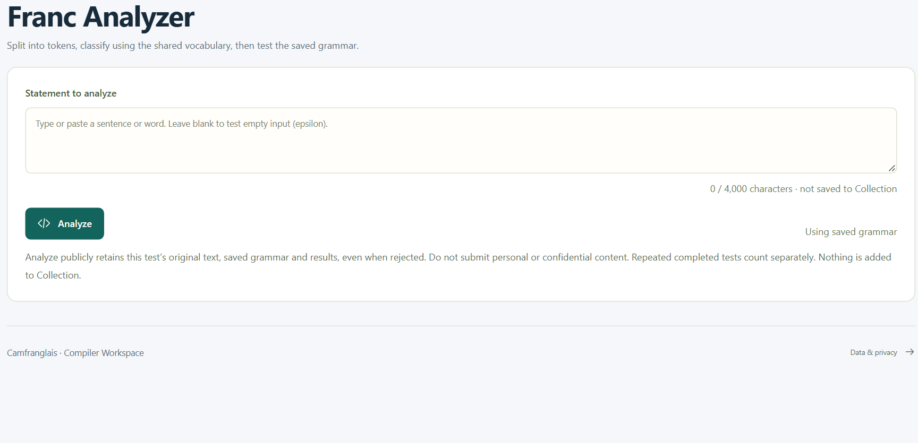
THE ESSENTIALS / CS4110
CAMFRANGLAIS
Franc Analyzer: the main action
Type or paste a statement, then explicitly choose Analyze.
Original text
camfranglais.duckdns.org
No silent spelling
correction.
Saved grammar
The public visitor cannot
edit it.
Public result
The test is retained, not
added to Collection.
REAL DEPLOYED APP / 27 SEP 2026 / crop only where noted
IMPLEMENTATION / EVIDENCE
frontend/src/FrancAnalyzer.tsx
backend/analyzer_api.py
backend/analyzer_history.py
05 / 12
CS4110 / SET A / 27 SEP 2026
Notes:
SLIDE 05 / 12 - Franc Analyzer: the main action
Use the real input screenshot to explain the user action. The main input is limited to 4,000 characters and can intentionally test empty input. Warn that submitting saves the text publicly, even when rejected. The screenshot was captured without submitting a new test. Suggested speaking time: 50 seconds.
RESPONSIBLE FILES / EVIDENCE
frontend/src/FrancAnalyzer.tsx
backend/analyzer_api.py
backend/analyzer_history.py
Visuals: real app screenshots or clearly labelled original explanatory artwork. Source paths are repository-relative. No application or VPS change is performed by this presentation.

Slide 6
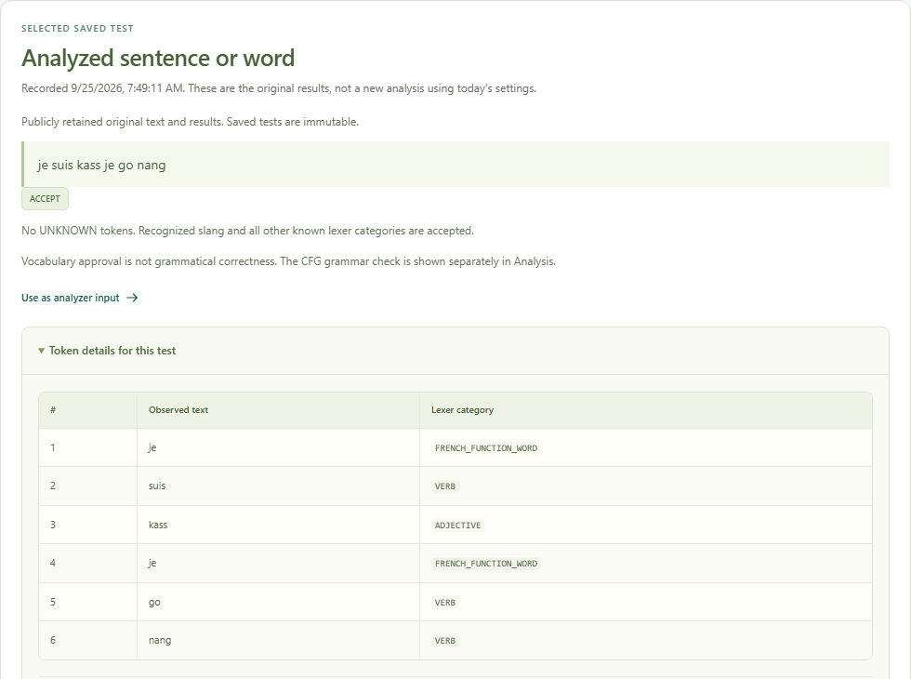
THE ESSENTIALS / CS4110
CAMFRANGLAIS
Two verdicts explain the result
Example: je suis kass je go nang
Vocabulary
camfranglais.duckdns.org
Passes when no token is
UNKNOWN.
Grammar
Passes when categories fit
the saved rules.
Evidence
S02: six tokens consumed;
the CFG accepts.
REAL DEPLOYED APP / 27 SEP 2026 / crop only where noted
IMPLEMENTATION / EVIDENCE
frontend/src/CourseworkResults.tsx
frontend/src/VocabularyVerdict.tsx
compiler/parser/predictive.py
06 / 12
CS4110 / SET A / 27 SEP 2026
Notes:
SLIDE 06 / 12 - Two verdicts explain the result
Show the genuine saved S02 result. Its categories are French function word, verb, adjective, French function word, verb, verb. Known words can still fail grammar: the constructed control je je suis is one example. The trace explains the decision; acceptance does not certify linguistic correctness. Suggested speaking time: 65 seconds.
RESPONSIBLE FILES / EVIDENCE
frontend/src/CourseworkResults.tsx
frontend/src/VocabularyVerdict.tsx
compiler/parser/predictive.py
Visuals: real app screenshots or clearly labelled original explanatory artwork. Source paths are repository-relative. No application or VPS change is performed by this presentation.

Slide 7
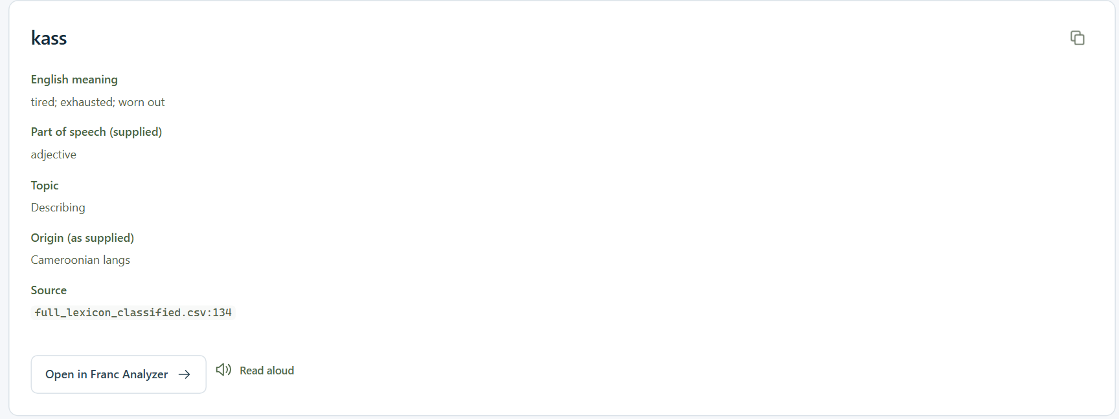
THE ESSENTIALS / CS4110
CAMFRANGLAIS
Reference pages support the analysis
Browse the evidence without changing it.
Collection
camfranglais.duckdns.org
Original statements,
context and existing audio.
Dictionary
938 source-labelled
reference entries.
Examples
26 constructed practice
statements, not fieldwork.
REAL DEPLOYED APP / 27 SEP 2026 / crop only where noted
IMPLEMENTATION / EVIDENCE
frontend/src/Collection.tsx
frontend/src/Dictionary.tsx
frontend/src/Examples.tsx
backend/dictionary.py
CS4110 / SET A / 27 SEP 2026
07 / 12
Notes:
SLIDE 07 / 12 - Reference pages support the analysis
The screenshot is a real search for kass: supplied meaning tired/exhausted/worn out, category adjective. Opening a reference only drafts text in the Analyzer; it does not automatically save a test. Existing recordings can be played, but the public workflow does not generate speech. Suggested speaking time: 50 seconds.
RESPONSIBLE FILES / EVIDENCE
frontend/src/Collection.tsx
frontend/src/Dictionary.tsx
frontend/src/Examples.tsx
backend/dictionary.py
Visuals: real app screenshots or clearly labelled original explanatory artwork. Source paths are repository-relative. No application or VPS change is performed by this presentation.

Slide 8
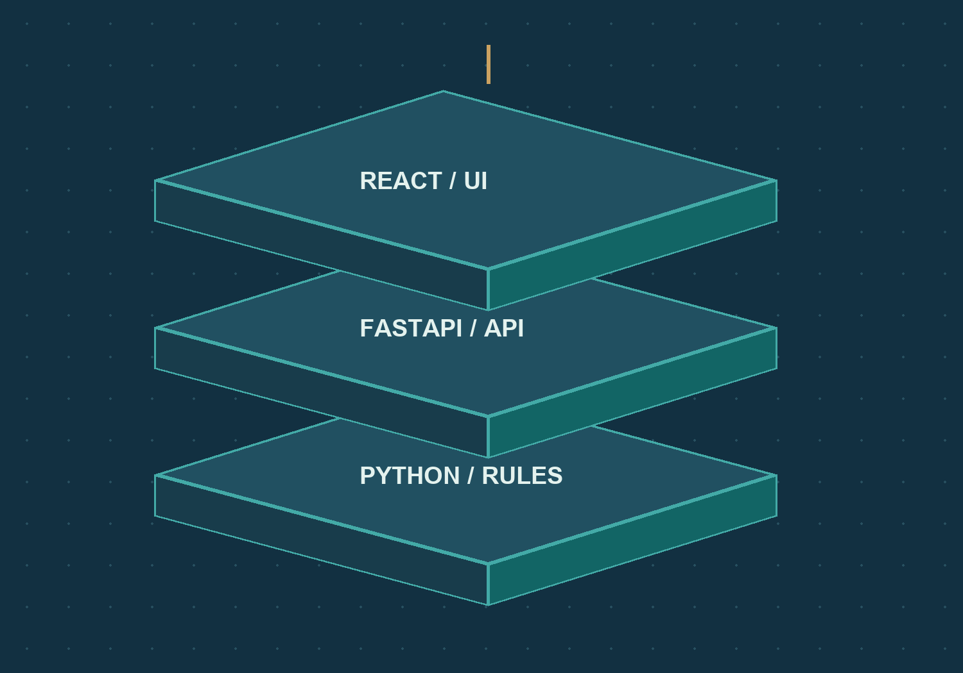
THE ESSENTIALS / CS4110
CAMFRANGLAIS
Three layers and their key files
Each layer has one clear responsibility.
React interface
App.tsx: pages and navigation.
FastAPI backend
main.py: public API wiring.
Python compiler
tokenizer.py and predictive.py: the
analysis rules.
IMPLEMENTATION / EVIDENCE
frontend/src/App.tsx
backend/main.py
compiler/lexer/tokenizer.py
compiler/parser/predictive.py
CS4110 / SET A / 27 SEP 2026
08 / 12
Notes:
SLIDE 08 / 12 - Three layers and their key files
The browser presents the workflow, the backend validates and coordinates requests, and the compiler performs the rule-based computation. SharedWorkspaceStore persists public test snapshots in SQLite. The documented site is https://camfranglais.duckdns.org, with a private 127.0.0.1:2021 upstream behind Nginx. Suggested speaking time: 55 seconds.
RESPONSIBLE FILES / EVIDENCE
frontend/src/App.tsx
backend/main.py
compiler/lexer/tokenizer.py
compiler/parser/predictive.py
Visuals: real app screenshots or clearly labelled original explanatory artwork. Source paths are repository-relative. No application or VPS change is performed by this presentation.

Slide 9
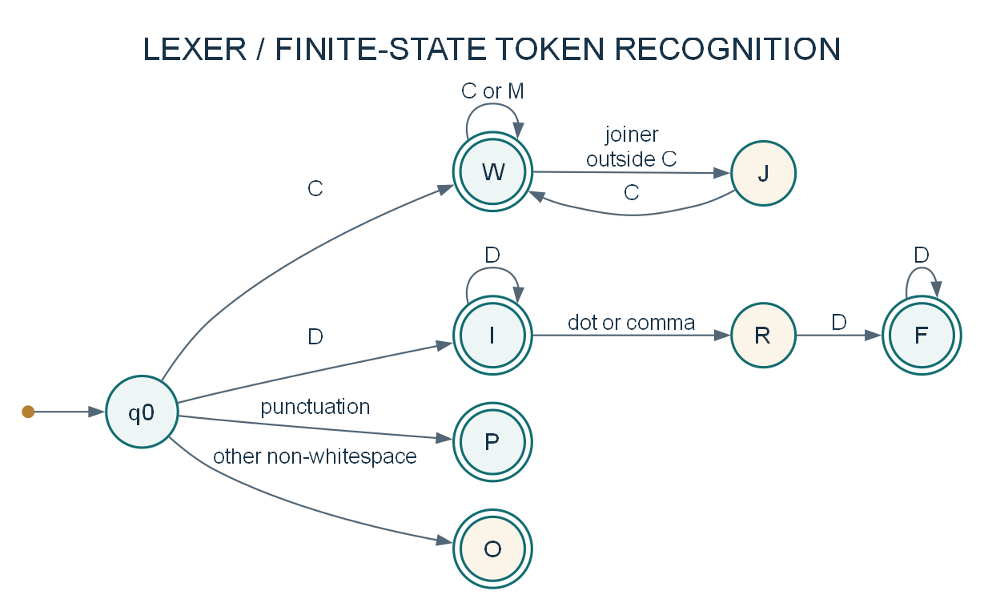
THE ESSENTIALS / CS4110
CAMFRANGLAIS
Lexer: from characters to tokens
An equivalent DFA explains the actual segmentation regex.
Recognize
Word, number and
punctuation forms.
Classify
Apply ordered vocabulary
and regex rules.
Preserve
Unknown characters are
kept, not discarded.
IMPLEMENTATION / EVIDENCE
compiler/lexer/tokenizer.py
compiler/lexer/lexicon.py
docs/diagrams/automaton-lexer.puml
09 / 12
CS4110 / SET A / 27 SEP 2026
Notes:
SLIDE 09 / 12 - Lexer: from characters to tokens
The implementation uses Python's regex matcher, not a hand-written DFA class. Double circles accept token forms. W is word, I integer, F fraction, P punctuation and O other; J and R await continuation. Example: j'ai is one word, while 3. becomes 3 and a punctuation token. A word-shaped token can still receive UNKNOWN. Suggested speaking time: 65 seconds.
RESPONSIBLE FILES / EVIDENCE
compiler/lexer/tokenizer.py
compiler/lexer/lexicon.py
docs/diagrams/automaton-lexer.puml
Visuals: real app screenshots or clearly labelled original explanatory artwork. Source paths are repository-relative. No application or VPS change is performed by this presentation.

Slide 10
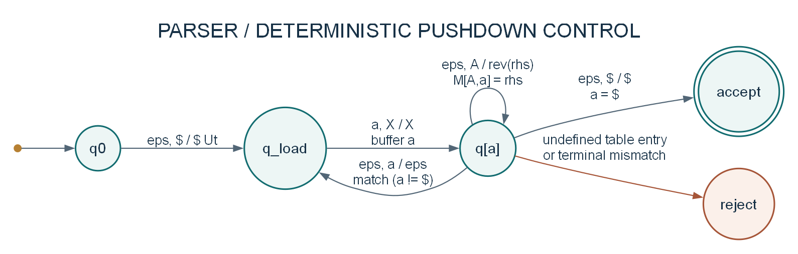
THE ESSENTIALS / CS4110
CAMFRANGLAIS
Parser: categories plus a stack
The saved LL(1) table selects each next action.
EXPAND
MATCH
FINISH
Use the unique table entry.
Consume one matching category.
Accept only at input end.
IMPLEMENTATION / EVIDENCE
compiler/parser/analysis.py
compiler/parser/predictive.py
docs/diagrams/automaton-parser.puml
10 / 12
CS4110 / SET A / 27 SEP 2026
Notes:
SLIDE 10 / 12 - Parser: categories plus a stack
This pushdown model explains the implementation rather than introducing invented classes. Stack top is on the right; expansion pushes the reversed production. FIRST/FOLLOW and the LL(1) table are computed from the grammar. The study's transformed grammar has 39 productions, 47 populated table cells and no conflicts. The implementation has token, trace and stack bounds. Suggested speaking time: 70 seconds.
RESPONSIBLE FILES / EVIDENCE
compiler/parser/analysis.py
compiler/parser/predictive.py
docs/diagrams/automaton-parser.puml
Visuals: real app screenshots or clearly labelled original explanatory artwork. Source paths are repository-relative. No application or VPS change is performed by this presentation.

Slide 11
THE ESSENTIALS / CS4110
CAMFRANGLAIS
What the controlled study shows
Twelve supplied statements, 81 token occurrences.
10 ACCEPTED
The category sequences fit the saved
grammar.
83.3%
2 REJECTED
n'ais and alli remain unresolved.
LIMITATION
Grammar match is not linguistic accuracy
or proven fieldwork.
IMPLEMENTATION / EVIDENCE
docs/evidence/final-analysis-20260927.json
compiler/tests/yaounde_cases.py
compiler/parser/yaounde.py
11 / 12
CS4110 / SET A / 27 SEP 2026
Notes:
SLIDE 11 / 12 - What the controlled study shows
The 83.3 percent match rate applies only to these twelve unchanged originals and this saved grammar. It is not a language-wide accuracy measurement. Original fieldwork provenance and supplied meanings still need human confirmation. The dashboard's live history totals are a different dataset. Suggested speaking time: 55 seconds.
RESPONSIBLE FILES / EVIDENCE
docs/evidence/final-analysis-20260927.json
compiler/tests/yaounde_cases.py
compiler/parser/yaounde.py
Visuals: real app screenshots or clearly labelled original explanatory artwork. Source paths are repository-relative. No application or VPS change is performed by this presentation.

Slide 12
CAMFRANGLAIS / COMPILER WORKSPACE
Transparent rules. Visible evidence.
Thank you. Questions?
PRESERVE
EXPLAIN
RETAIN
The original text
The compiler decision
The original result
camfranglais.duckdns.org
IMPLEMENTATION / EVIDENCE
README.md
docs/README.md
CS4110 / SET A / 27 SEP 2026
12 / 12
Notes:
SLIDE 12 / 12 - Transparent rules. Visible evidence.
Summarize the main value: a public, deterministic application that makes lexical and syntactic decisions inspectable and keeps their original results. Invite questions or demonstrate an existing saved test. The website is https://camfranglais.duckdns.org. Suggested speaking time: 20 seconds, leaving time for transitions and the group handoff.
RESPONSIBLE FILES / EVIDENCE
README.md
docs/README.md
Visuals: real app screenshots or clearly labelled original explanatory artwork. Source paths are repository-relative. No application or VPS change is performed by this presentation.

