Slide 1
自我介紹
(niziima Live)

Slide 2
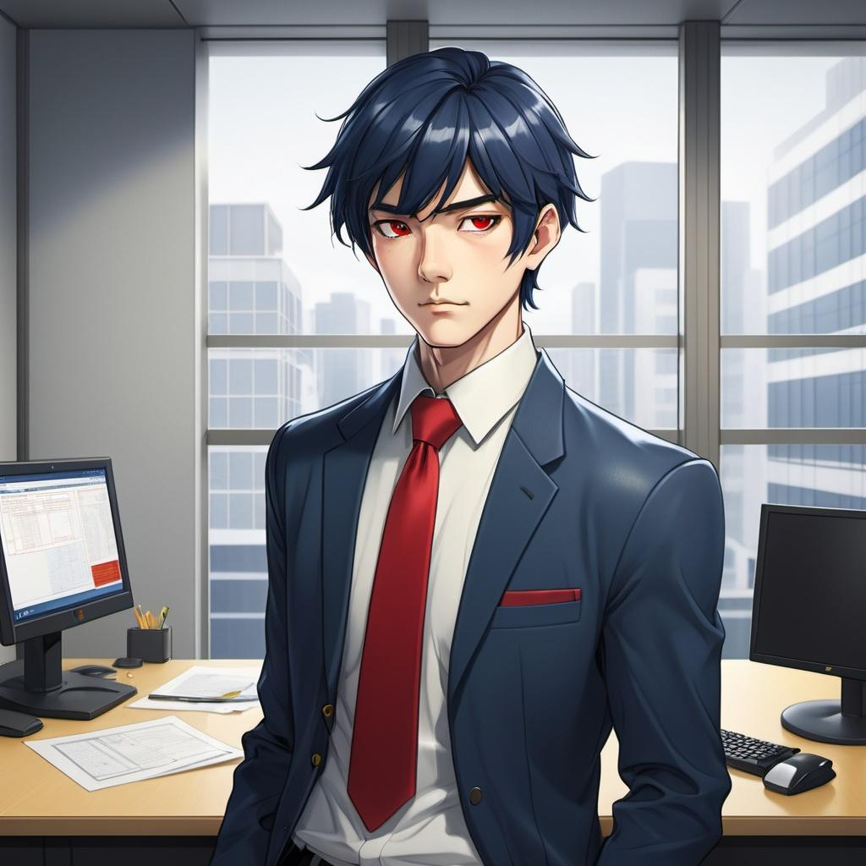
1.目標
Notes:
The character in the illustration is a handsome, Japanese-style office worker. He has dark blue hair, wears a suit, and has a red tie. His eyes are yellow, and his hair features a side-swept fringe. The length of the hair extends past his eyebrows but stays above his eyes, with a neat and tidy appearance. He stood before the office's glass window, gazing at the bustling city, his heart filled with a desire for promotion.

Slide 3
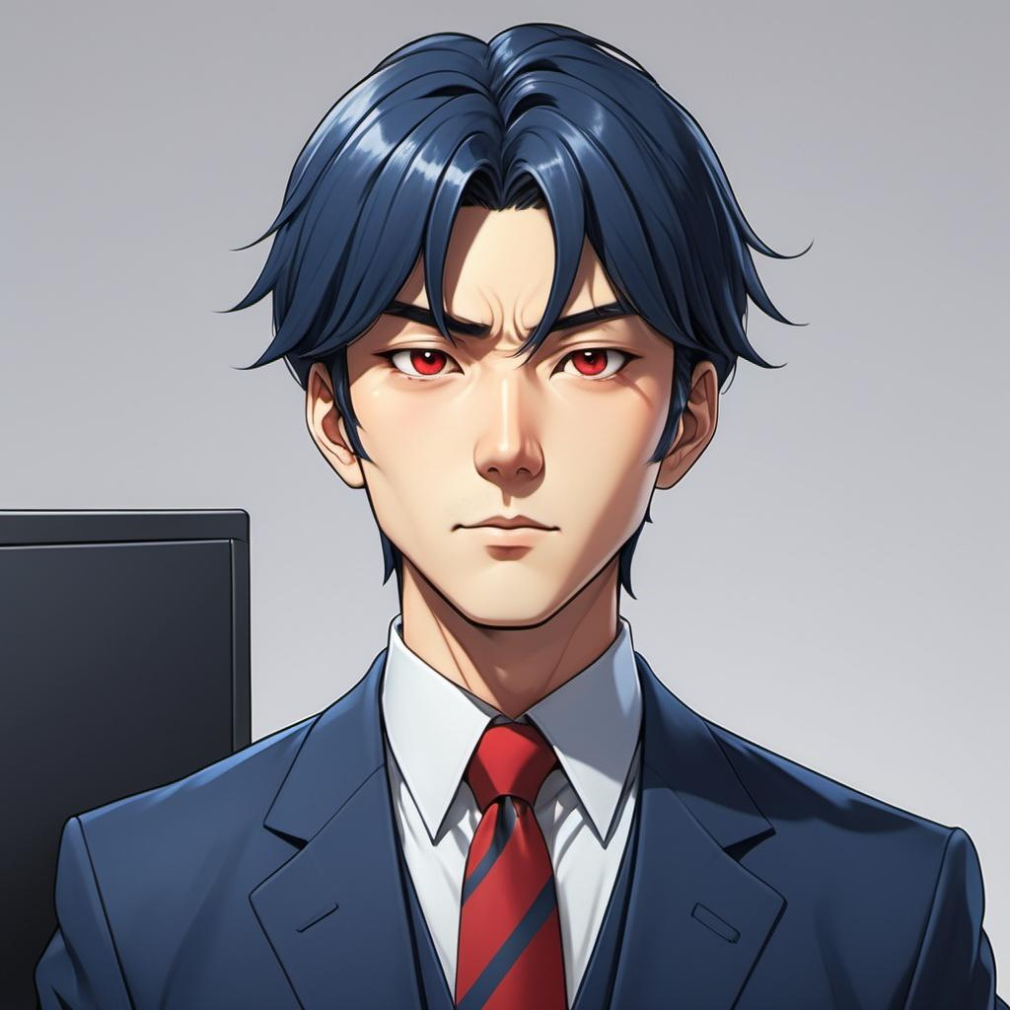
2. 阻礙
Notes:
The character in the illustration is a handsome, Japanese-style office worker. He has dark blue hair, wears a suit, and has a red tie. His eyes are yellow, and his hair features a side-swept fringe. The length of the hair extends past his eyebrows but stays above his eyes, with a neat and tidy appearance. However, his supervisor was a strict boss with little interest in innovation. It makes him feeling isolated and unsupported

Slide 4
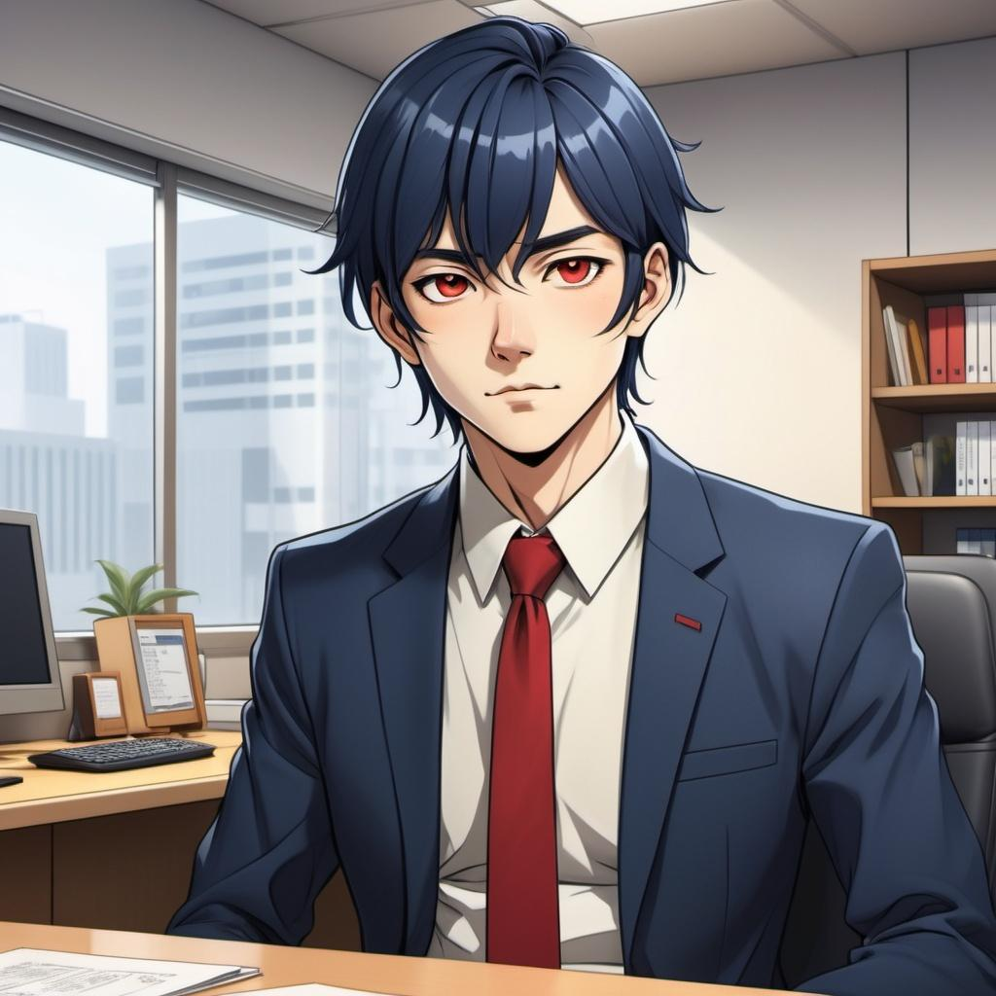
3. 努力
Notes:
The character in the illustration is a handsome, Japanese-style office worker. He has dark blue hair, wears a suit, and has a red tie. His eyes are yellow, and his hair features a side-swept fringe. The length of the hair extends past his eyebrows but stays above his eyes, with a neat and tidy appearance. In a cozy office setting, a hardworking man stays late at his desk, immersed in research with documents, a laptop, and industry reports spread out in front of him. The background shows an evening city skyline through large windows, indicating after-hours dedication. The man looks focused and determined, perhaps glancing at workshop materials or a strategy book. Nearby, colleagues gather in small groups, with one or two occasionally engaging with him, reflecting his efforts to share ideas and seek support. The atmosphere is a mix of determination, collaboration, and personal growth.

Slide 5
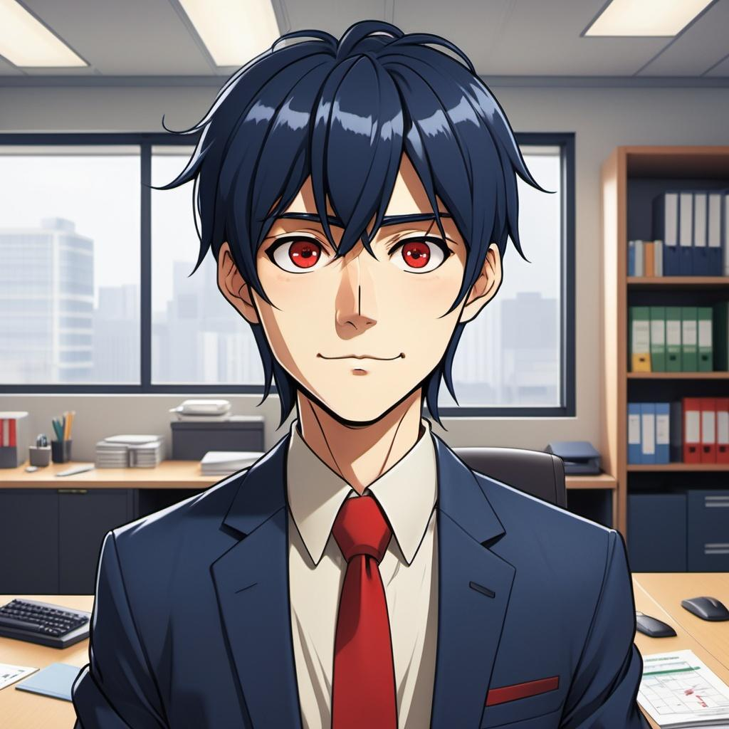
4. 結果
Notes:
The character in the illustration is a handsome, Japanese-style office worker. He has dark blue hair, wears a suit, and has a red tie. His eyes are yellow, and his hair features a side-swept fringe. The length of the hair extends past his eyebrows but stays above his eyes, with a neat and tidy appearance.
He feels very excited in his office because the effort he has put in has finally paid off.

Slide 6
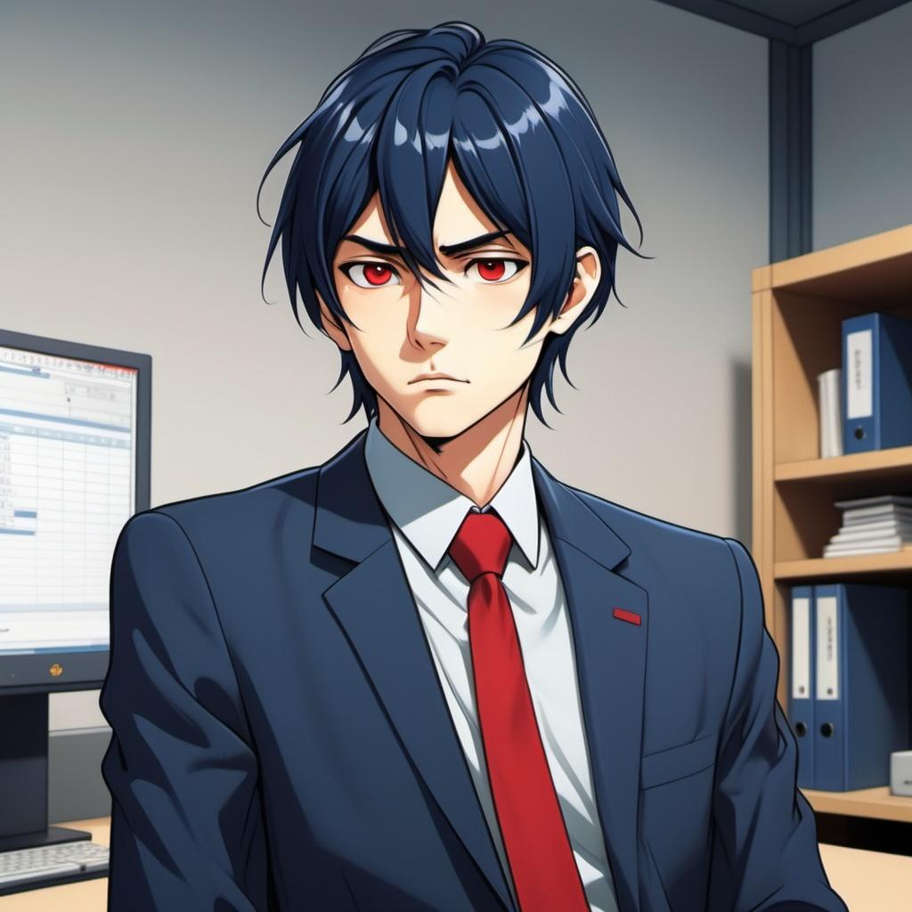
5. 意外
Notes:
The character in the illustration is a handsome, Japanese-style office worker. He has dark blue hair, wears a suit, and has a red tie. His eyes are yellow, and his hair features a side-swept fringe. The length of the hair extends past his eyebrows but stays above his eyes, with a neat and tidy appearance.he feel very upset,in company's conference room

Slide 7
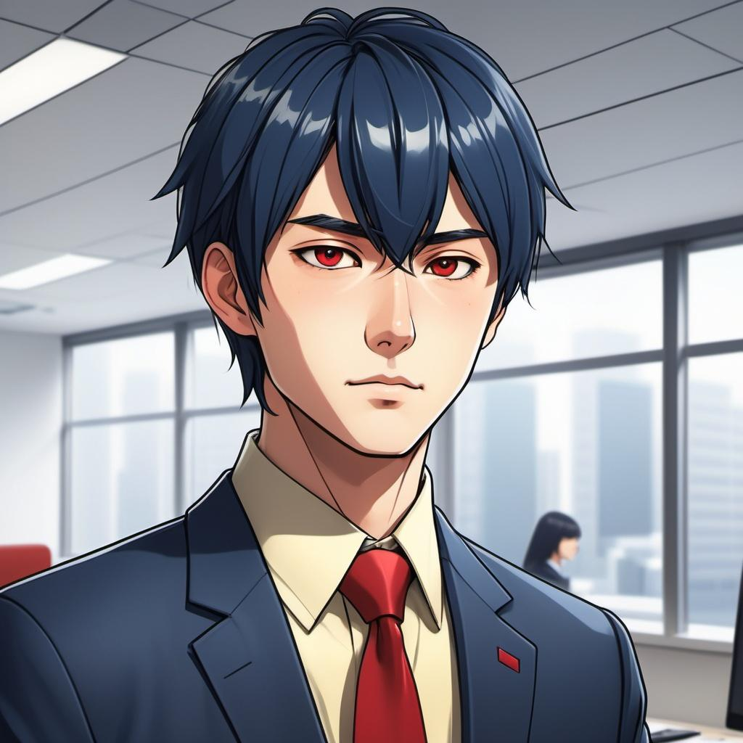
6. 轉彎
Notes:
The character in the illustration is a handsome, Japanese-style office worker. He has dark blue hair, wears a suit, and has a red tie. His eyes are yellow, and his hair features a side-swept fringe. The length of the hair extends past his eyebrows but stays above his eyes, with a neat and tidy appearance.
A modern office setting with a group of diverse employees gathered around a confident man at the center, looking thoughtful and motivated. The office features glass walls, plants, and computers, creating a productive yet challenging atmosphere. The man is presenting a detailed strategy on a whiteboard or a laptop screen, and his supervisor, wearing formal attire, is observing with newfound respect. The scene reflects a sense of teamwork and resilience amidst a business crisis, with subtle lighting that highlights hope and transformation.

Slide 8
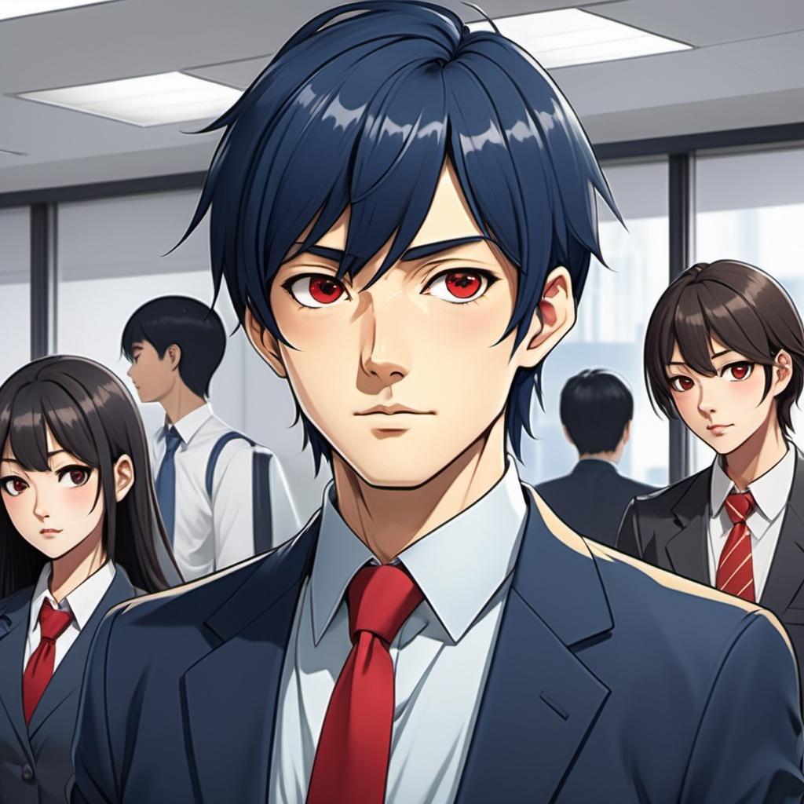
7. 結局
Notes:
The character in the illustration is a handsome, Japanese-style office worker. He has dark blue hair, wears a suit, and has a red tie. His eyes are yellow, and his hair features a side-swept fringe. The length of the hair extends past his eyebrows but stays above his eyes, with a neat and tidy appearance.The other employees gathered around him and lifted him up, cheering enthusiastically.

