Slide 1
校園故事

Slide 2
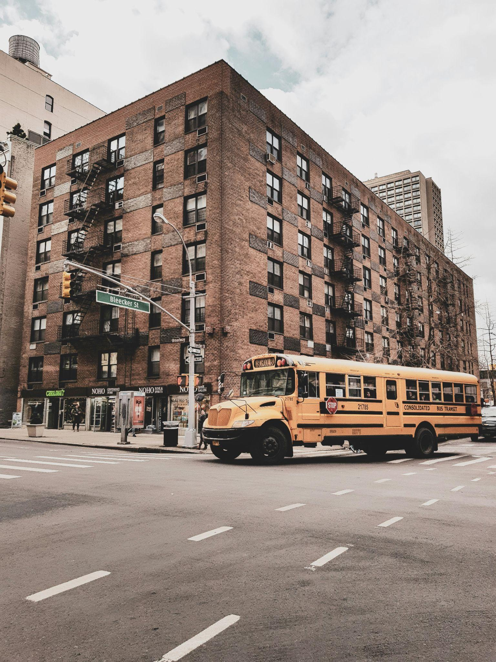
1. 目標
Notes:
https://unsplash.com/photos/school-bus-near-building-7ihLV2KXoHU

Slide 3
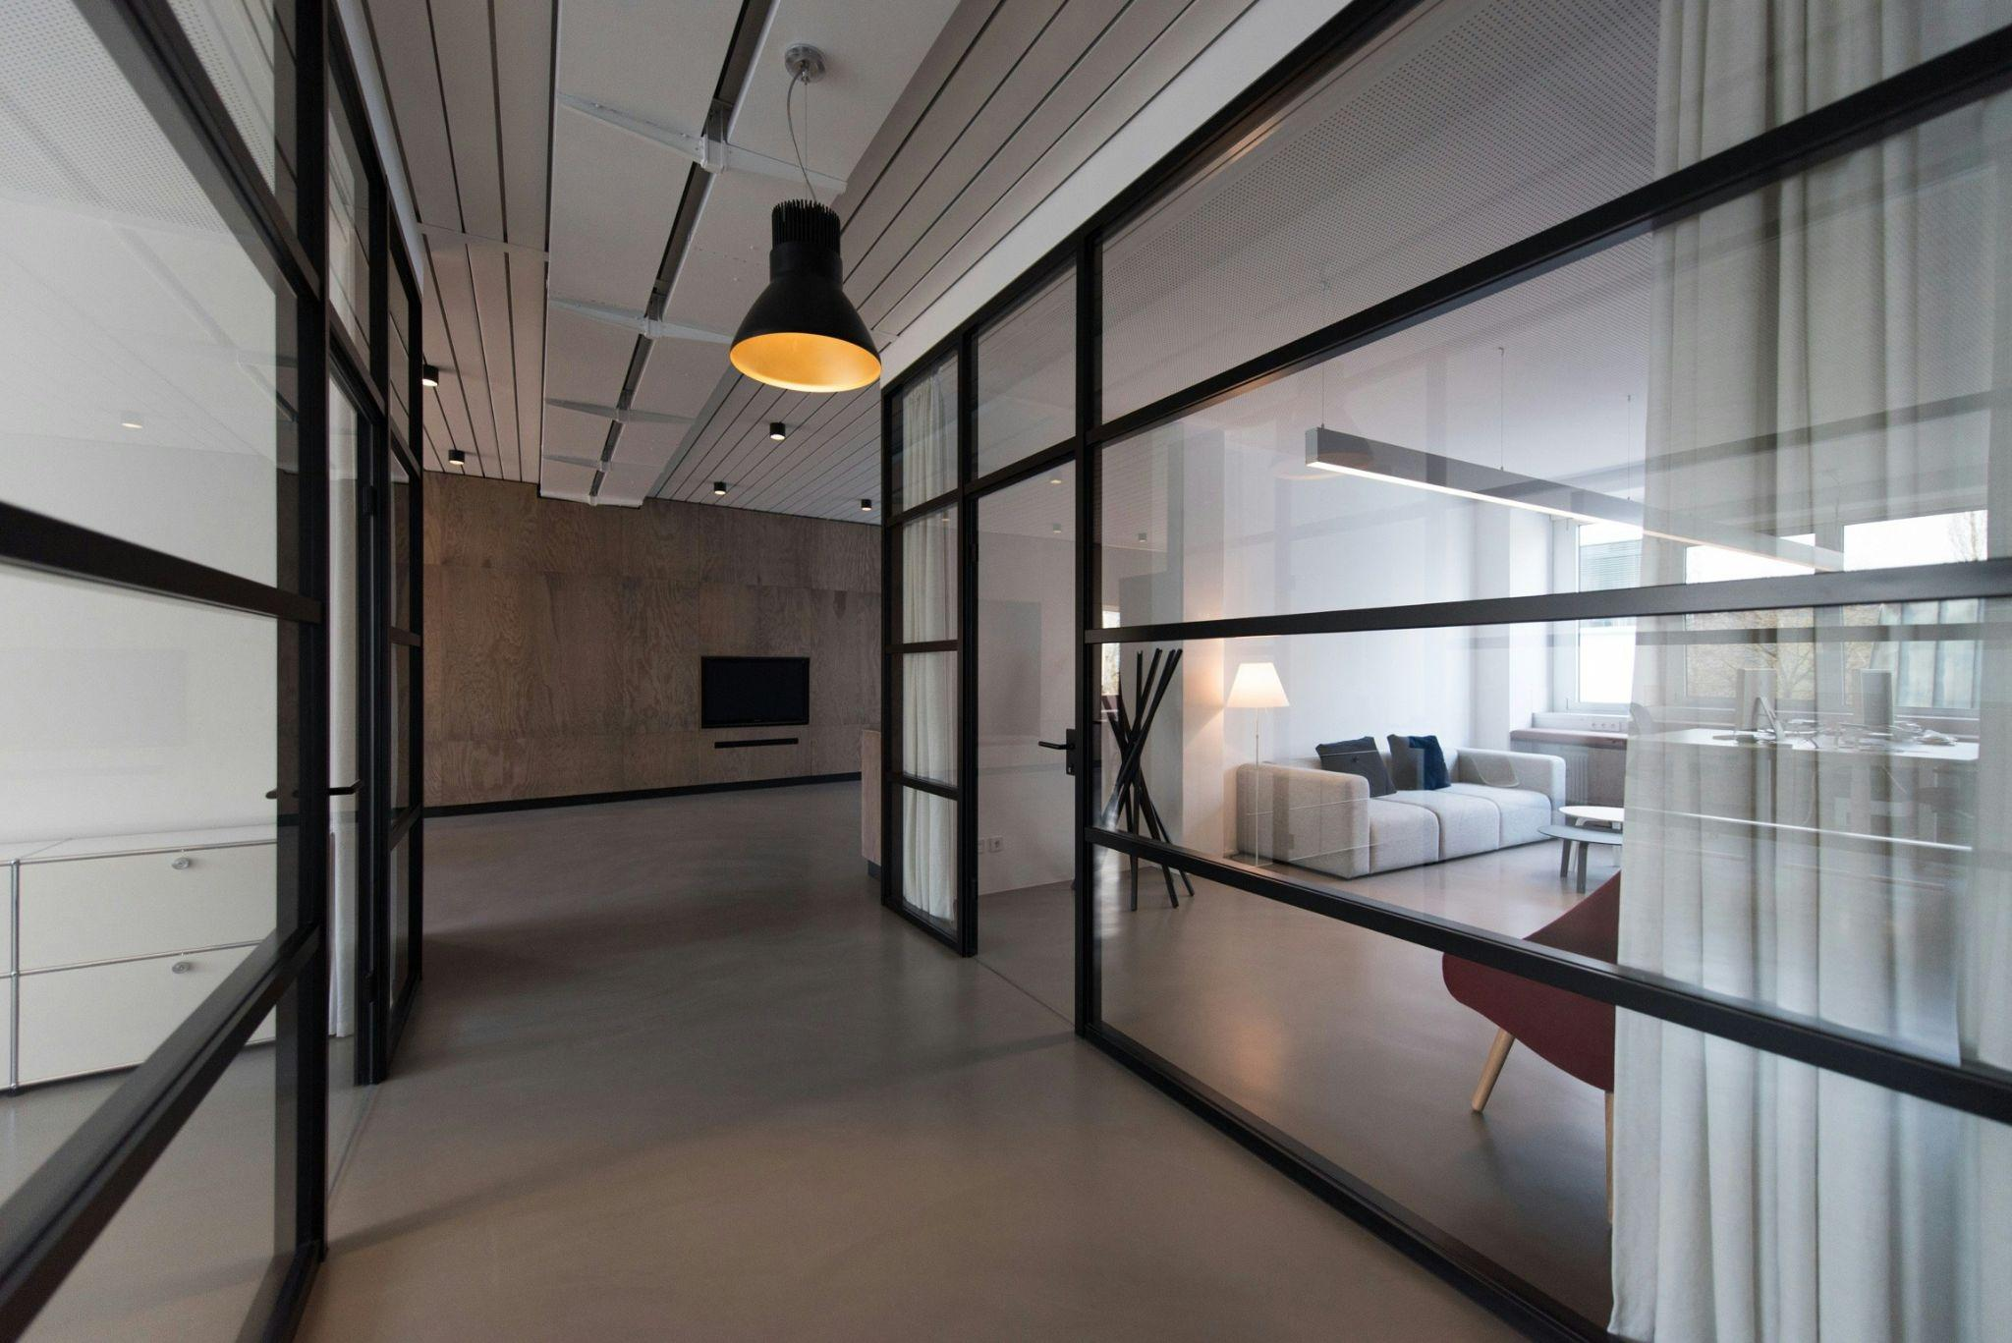
2. 阻礙
Notes:
https://unsplash.com/photos/room-with-glass-divider-and-white-curtain-rSpMla5RItA

Slide 4

3. 努力
Notes:
https://unsplash.com/photos/man-speaking-on-stage-cd7i9vYIyeY

Slide 5

4. 結果
Notes:
https://unsplash.com/photos/man-in-maroon-dress-shirt-lying-on-green-grass-field-eq6EJSdpHUQ

Slide 6
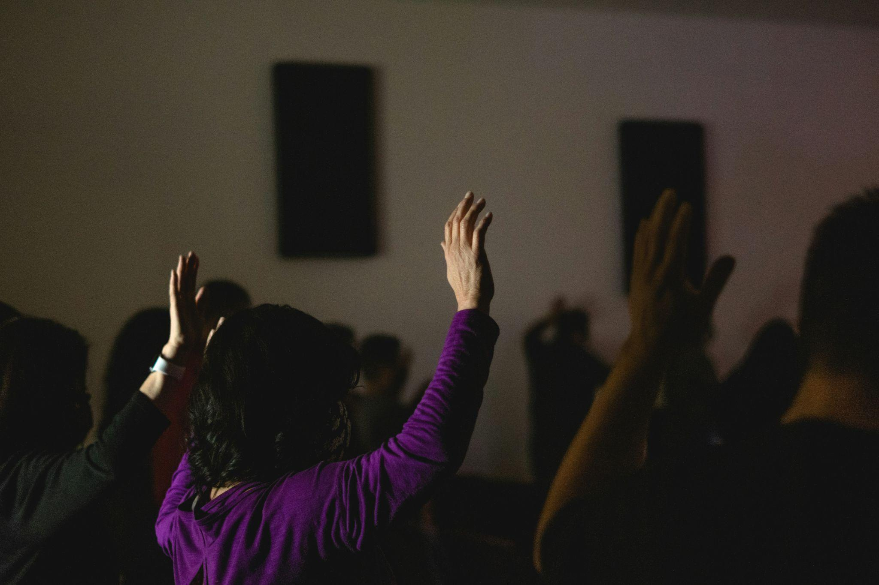
5. 意外
Notes:
https://unsplash.com/photos/woman-in-purple-long-sleeve-shirt-raising-her-hands-G6ftuYoWnpU

Slide 7

6. 轉彎
Notes:
https://unsplash.com/photos/two-person-standing-on-gray-tile-paving-TamMbr4okv4

Slide 8
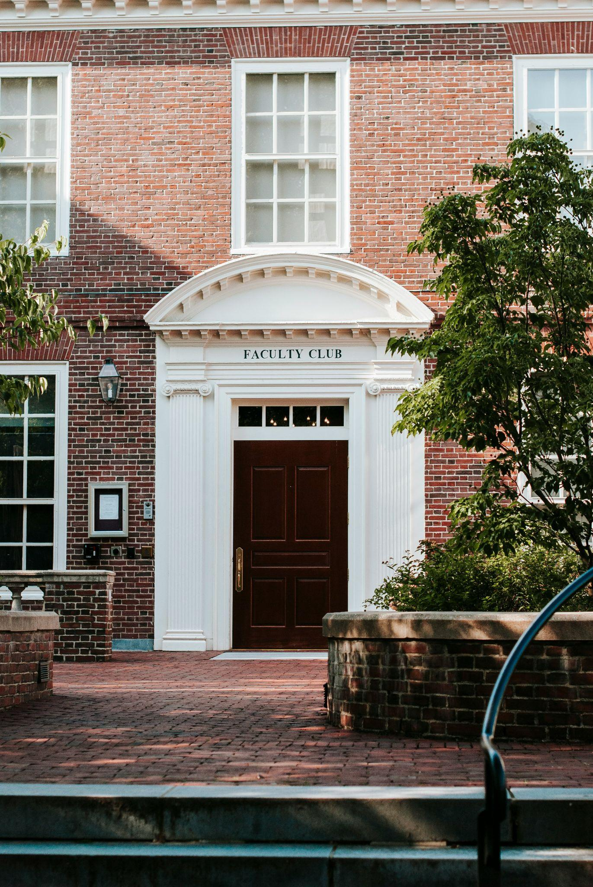
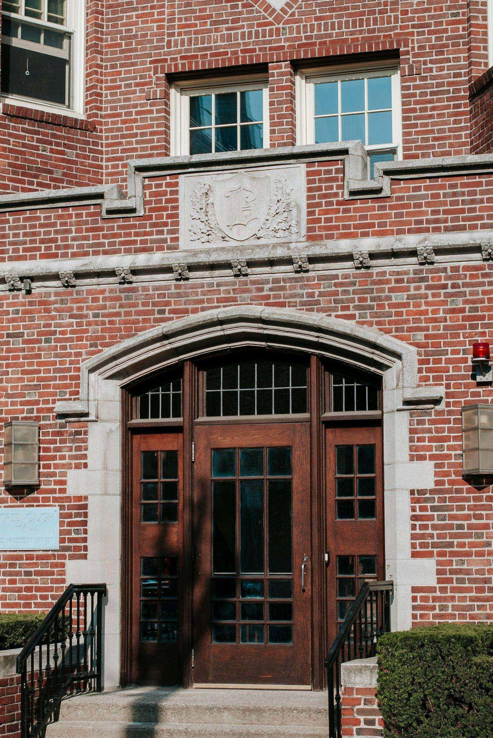
7. 結局
Notes:
https://unsplash.com/photos/white-and-brown-concrete-building-hI8Kdw0CkF0
https://unsplash.com/photos/brown-wooden-door-on-brown-brick-building-UF0WqKWw-es

