Slide 1


Git and Github
Suranjan Poudel
Software Engineer
7suranjanpoudel7@gmail.com

Slide 2
Git
Distributed Version Control System (VCS).
Linus Torvalds is the original author of git.
Developed in 2005.

Slide 3
For the Layman
Avinash created a folder named memes and added a file colz_memes.png
Suresh slightly chaged the file and saved with different name colz_memes(1).png because he does not want to spoil Avinash’s work.
Sabin changed the colz_memes.png and saved with different name colz_memes(2).png because he does not want to spoil both of theri work.
Similary, in 4 years time 500 students changed the meme and saved with different name because they don’t want to spoil others work.

Slide 4

For the Layman (continue ...)
What if there was a system which could remember the history?
What if the system is time machine that can travel to the past?

Slide 5
Git terminology
Repository : Main folder
Branch : Sub Folder
Commits : Changes
Contributor : You or others

Slide 6
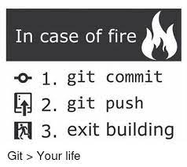
Common git operations
git init
git clone
git status
git branch <branch_name>
git checkout <branch_name>
git add <files>
git commit -m <message>
git push
git pull

Slide 7
Github
It is code hosting platform for version control using Git
It provides an Web UI to ease the pain of using terminal sessions.

Slide 8
Thank you
All course materials are and will be available on https://github.com/Suranjan77/course-materials

