Slide 1
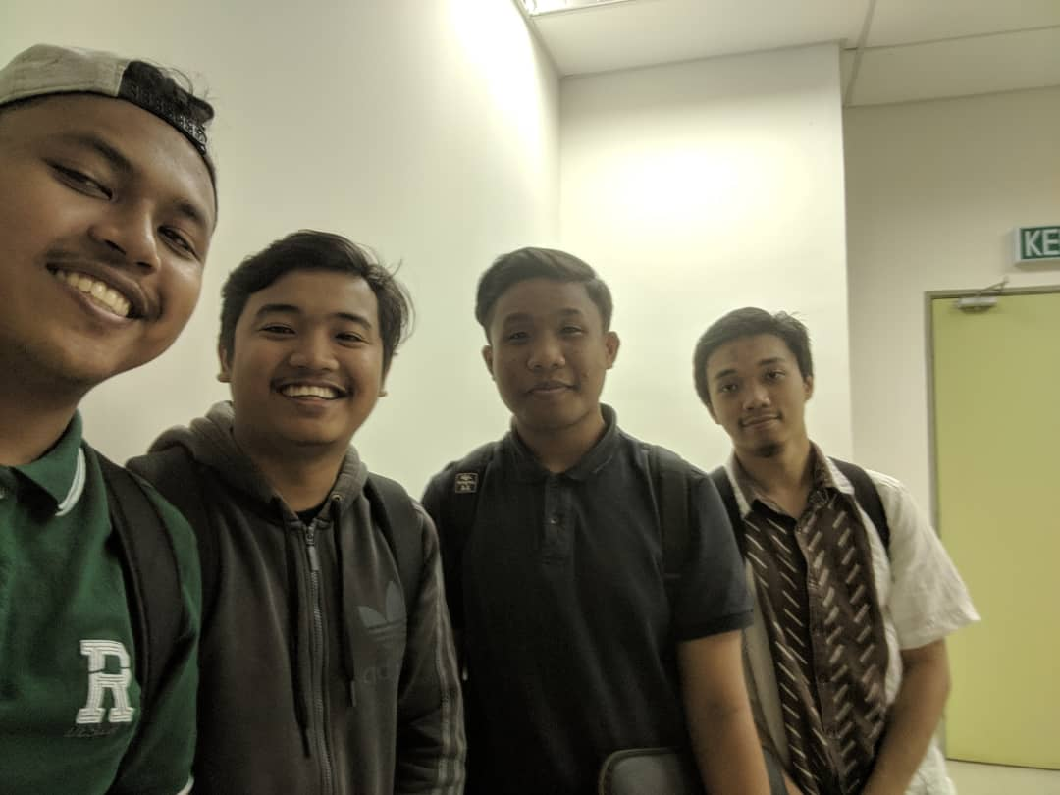
Surau Fatimah Az Zahra Group name : logan
Muhammad Amir Firdaus bin Zaidin (1716549)
Mohd Wajdi Bin Mohd Feham (1813661)
Muhammad Faiq Aiman bin Hermi (1711817)
Faiq Shahmy bin Shalizam (1818897)

Slide 2
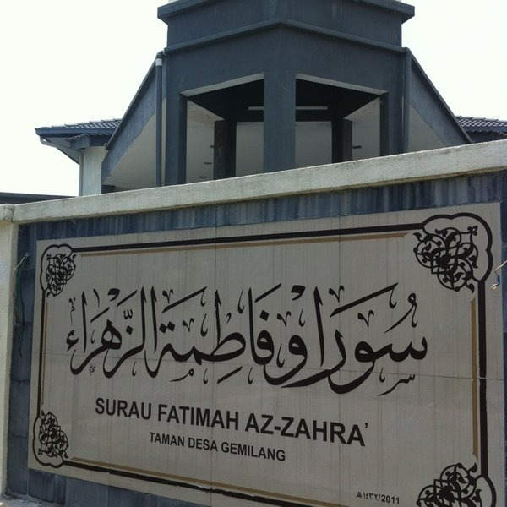
Surau Fatimah Az Zahra
On 20/3/2019, we visited our site, Surau Fatimah Az Zahra.
Our purpose is to collect information about the surau
and take some pictures as evidence.
In 2009, residents around Taman Desa Gemilang have built a house as a surau by setting up 3 canopies to accommodate the population. Later, a resident was generous with giving a site at Lot 4980, Jalan DG1 / 5 as a site to make a surau. All residents make the site a temporary surau. However, there is a shortage there that forces the people to set up committees to make this surau construction a reality. Various obstacles encountered in setting up this surau are financially sound. However, the cooperation of the local people, the surau was successfully established around May 2011.

Slide 3
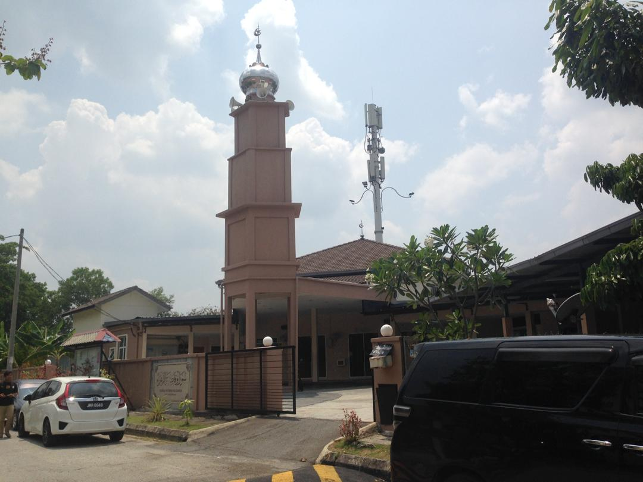
objective
To let people know this mussola
People will know the event that surau do.
To discover the strengthness about this
mussola

Slide 4
Audience for the Website
The audience of this website is :
The residents of Taman Desa Gemilang
Students from Webtech Class Section 4
Our Almighty Lecturer, Encik Sharqawy Hamzah.

Slide 5
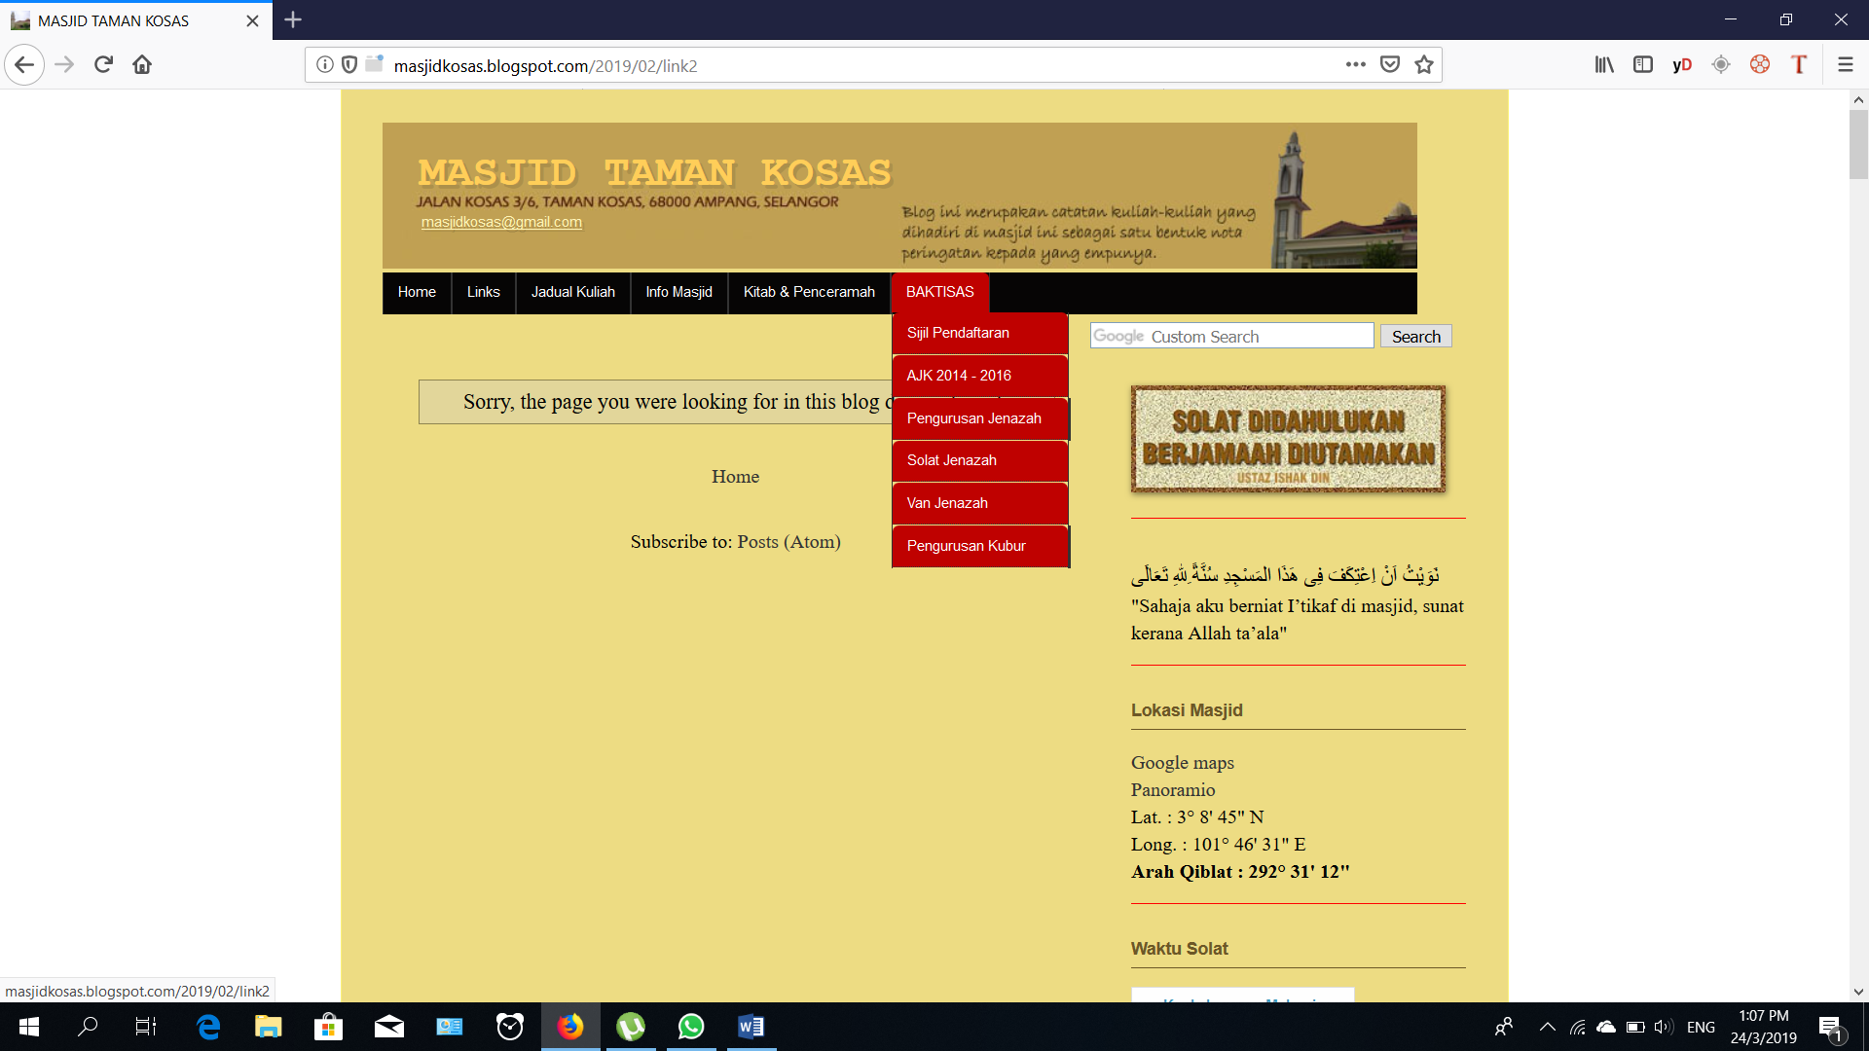
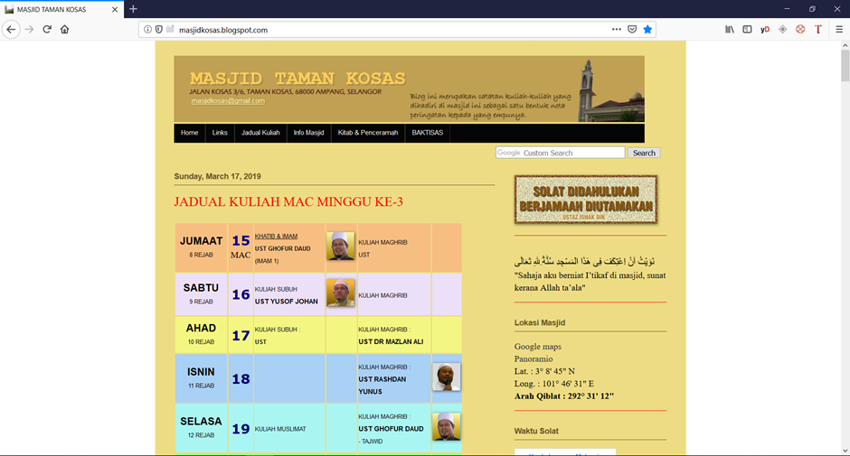
Website mosque Taman Kosas
Strength | Weekness
Presentable banner | Blank page exists from the last two tab.
Drop down menu with move over mouse feature implement to tab as well additional widget. | The background colour mismatch.
A lot of content about Masjid, event program and link. | The presentation of the web is not fully using the space by giving small size presentation.
Source: http://masjidkosas.blogspot.com/

Slide 6
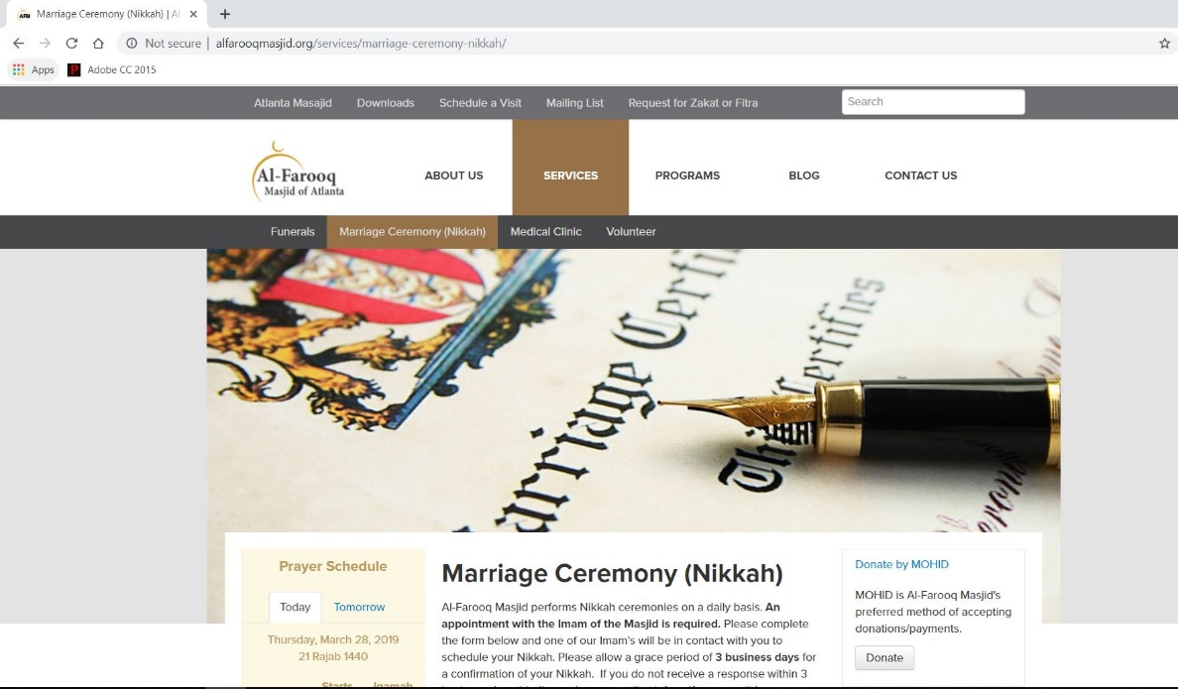
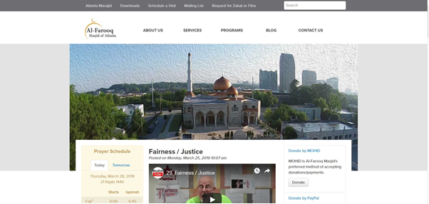
Website AL-FAROOQ Masjid of Atlanta
Strength | Weekness
Website are simple and user friendly | The use of colour in the website
All the informations and events are posted in one page | The events are supposed to be in separate pages as they use many sub menu in the website
History of the Masjid are stated in one of the pages in the website | This website can used a dropdown list to make it more simpler and not take up more spaces in the website
The use of menu list are simple and having sub menu lead to another page of certain objects
The content given in the website is complete
Search bar is used in the website
The use of side bar for any information of donation, prayer times and many more
Footers are used perfectly by put the content in proper position
Source: http://alfarooqmasjid.org/

Slide 7
Implementation on Website AL-FAROOQ Masjid of Atlanta
Using the menu tab concept.
Sidebar are also used in the website.
Sub menu are added based on the menu tab.
Any event or program will be inserted on one page by using sub menu.
Simple and user friendly interface are used in our website

Slide 8
Implementation on Website mosque taman kosas
Make sure the function work as intended
The page design is view able
The utilizes the space for design
Color combination must be proper

Slide 9
SITE MAP Surau Fatimah Az-Zahra'
Home page
About surau
History
Time table kuliah
Program
Video image about surau
Volunteer
Service
Time prayer
Marriage caremony
Organization
Donate
Contact us

Slide 10

css
Position time prayer static
Time table kuliah
Word for text “times new roman” and border design
Header and footer design
Video kuliah and image position
Form design
we refer our website styling from http://alfarooqmasjid.org.

Slide 11
Java script
Time prayer
Video kuliah
Video images
Surau mapping
Calender
Denote

Slide 12
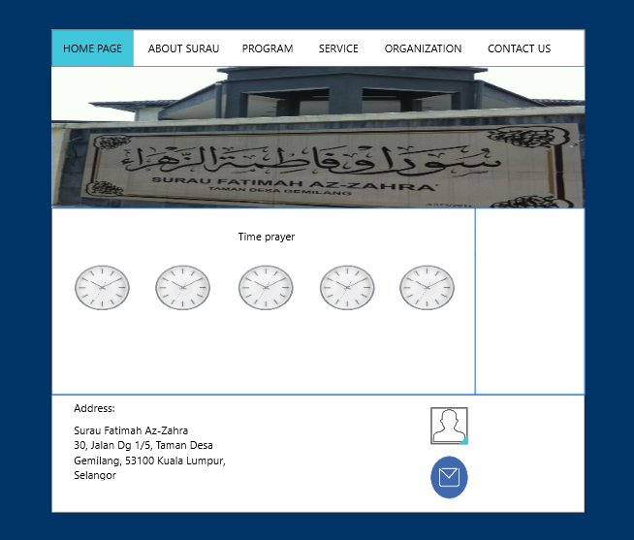
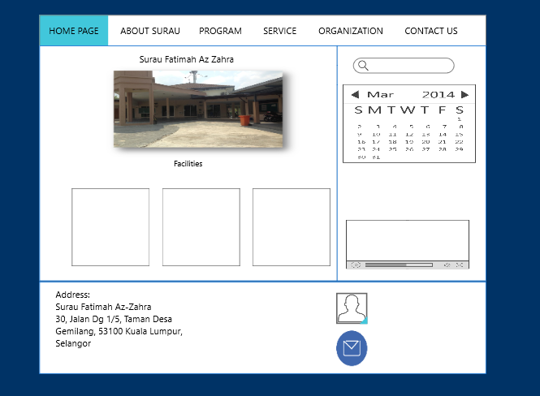
Wire frame

Slide 13
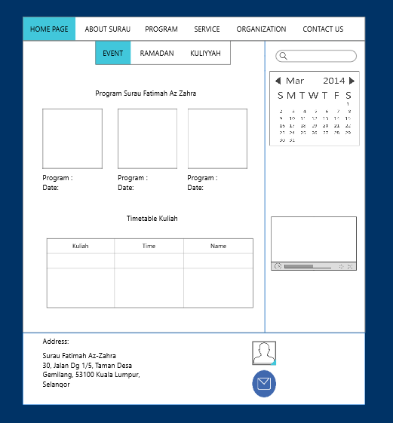
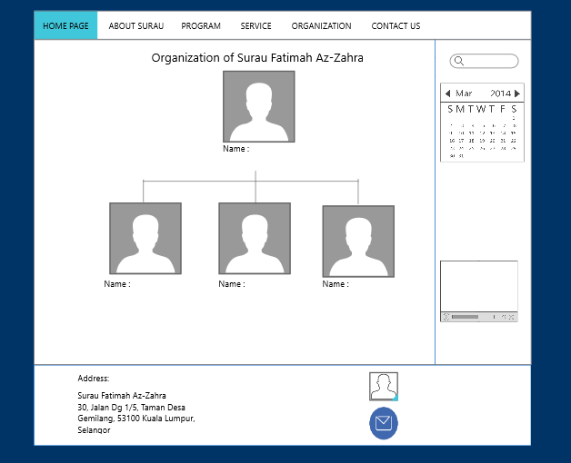

Slide 14
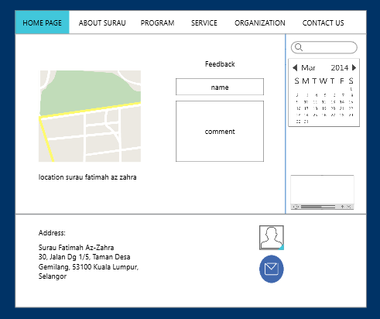

Slide 15
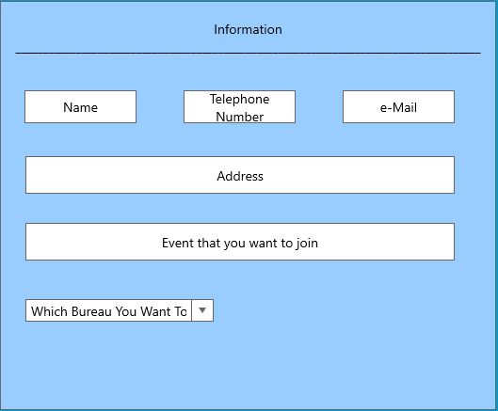
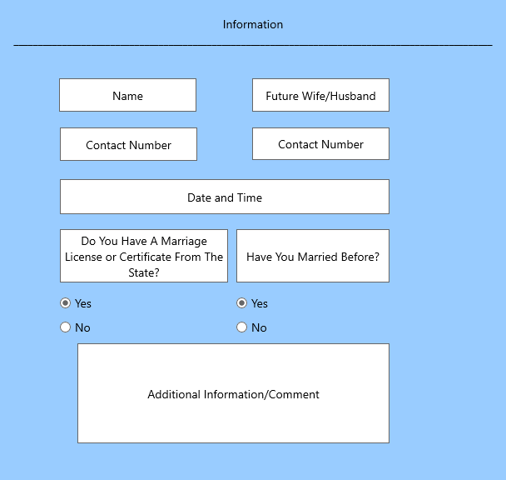
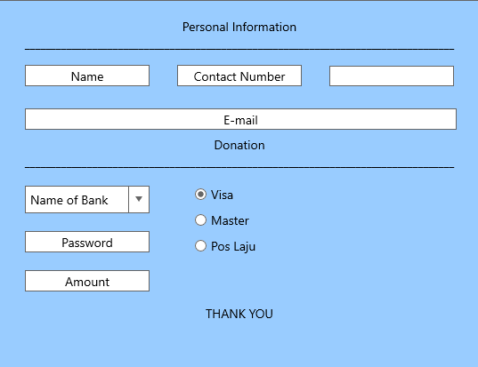
service

Slide 16
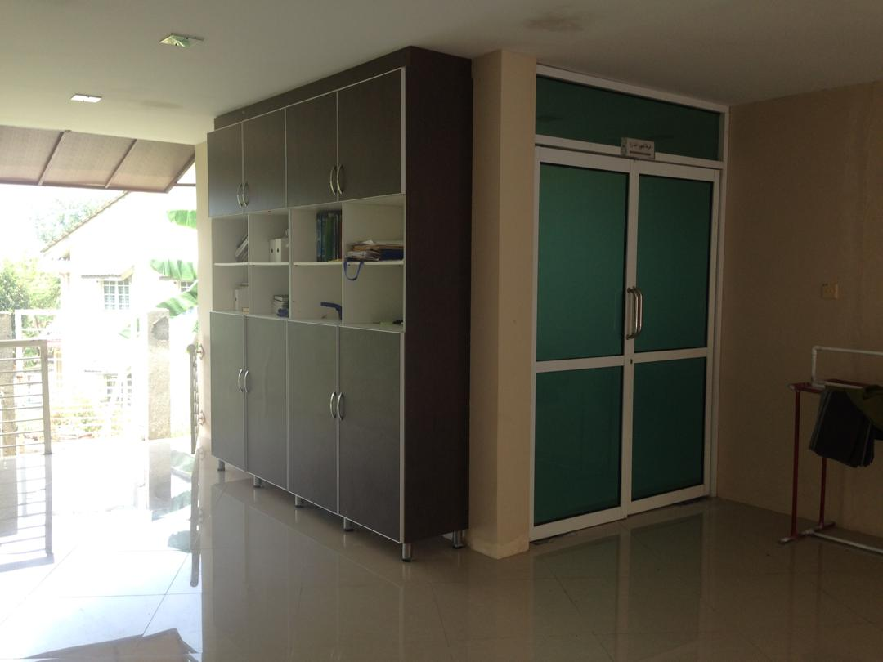
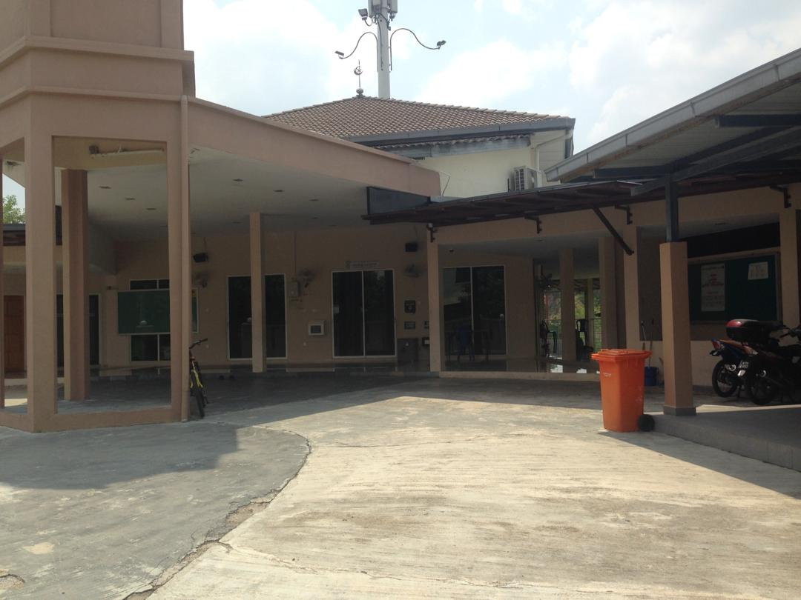
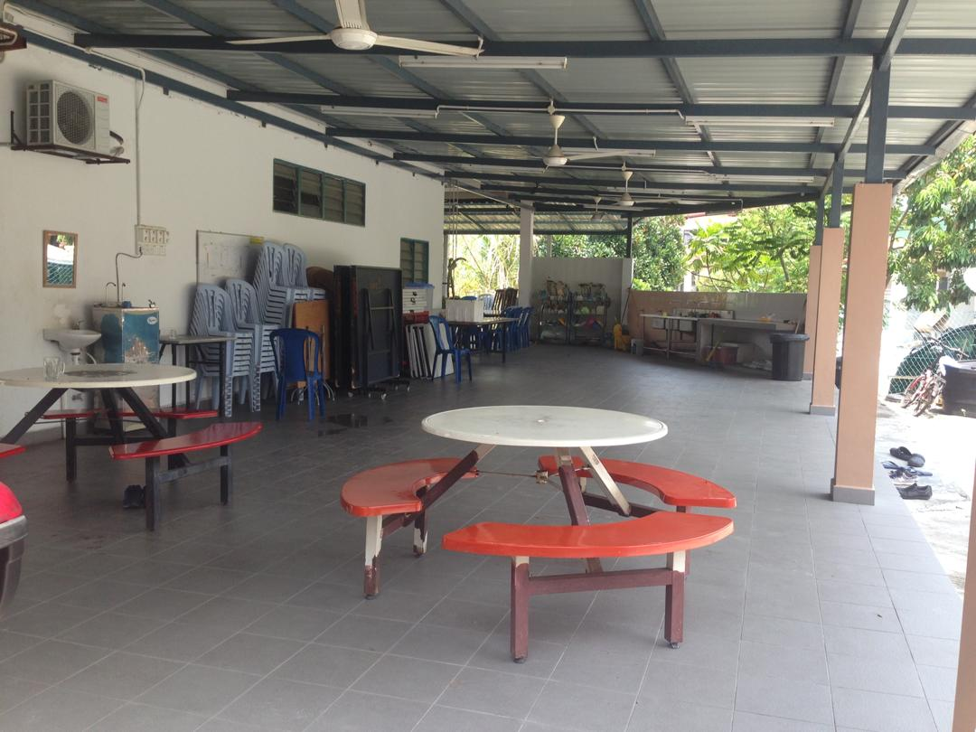
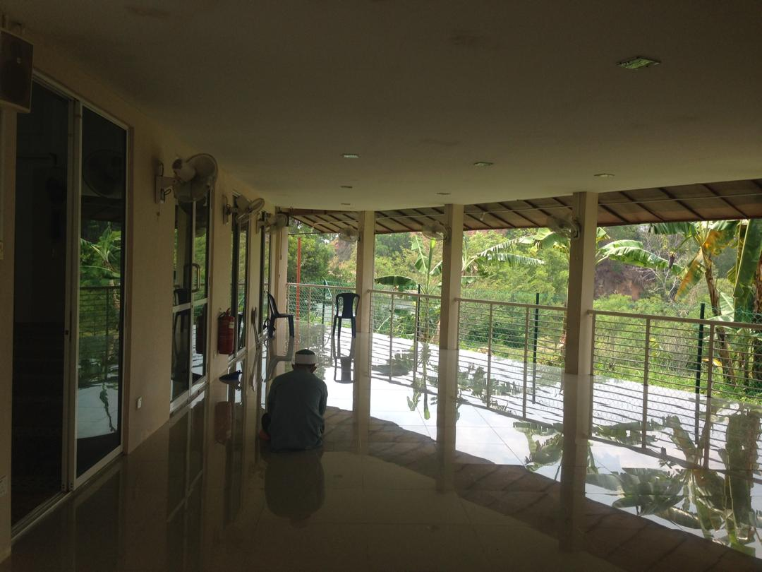
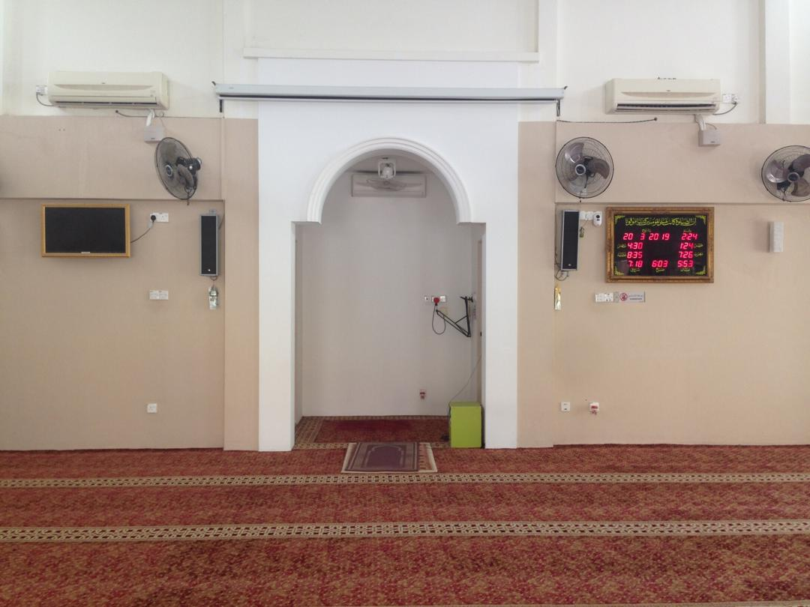
Evidence
surau Fatimah az Zahra

Slide 17
THE END

