Slide 1
EcoVision AI: An Integrated Artificial Intelligence Framework for Brick Kiln Classification and Environmental Pattern Analysis Using Multi-Spectral Satellite Imagery
Suravi Poudel
  BSc CSIT, St. Xavier’s College, Maitighar
    ICSXC 2026 · 24–25 September 2026

Slide 2
Introduction
A major, under-monitored source of air pollution in the Kathmandu Valley
  ~600 premature deaths/year in Nepal; ~$28M/year in healthcare costs in the Valley (Eil et al., 2020)
  Field-based monitoring campaigns such as NAMaSTE are valuable but difficult to scale and repeat frequently.
  Kiln detection works well in Bangladesh (94.2% accuracy, Lee et al. 2021) — but Kathmandu-specific cross-regional evaluation remains underexplored
  Free Sentinel-2 imagery + Google Earth Engine enable automated, low-cost monitoring

Slide 3
Objectives of the Study
This study asks two questions
Question 1
Does a Bangladesh-trained kiln classifier transfer to the Kathmandu Valley?
Question 2
Is there a measurable link between kiln locations and vegetation health (NDVI/EVI)?
Contribution: EcoVision AI — a two-stage, reproducible framework using only free, open data

Slide 4
Methodology
Two research designs, each testing a different kind of validity
Cross-Regional Transfer Design
Train on Bangladesh data; evaluate on an unseen Kathmandu dataset
Measures real generalization, not just in-domain accuracy
Kathmandu locations reviewed against current satellite imagery, not just a held-out split
Spatial Environmental Design
Compare vegetation at kilns AND with increasing distance from them
Captures a spatial gradient, not just a yes/no difference
Prediction-based sensitivity check

Slide 5
Methods
Classification pipeline (Bangladesh training → Kathmandu transfer)
Sentinel-2
RGB only
2–98%
normalize
Resize
128×128
EfficientNetB0
frozen
Dense 64
+ Dropout
Kiln /
Non-kiln
Classifier input: RGB only | NDVI/EVI: B2 (Blue), B4 (Red), B8 (NIR)
GEO-Bench m-brick-kiln (Bangladesh)
Train: 15,063 patches (5,063 kiln)
Validation: 999
Test: 999 (336 kiln)
Kathmandu External Evaluation
108 kiln + 108 non-kiln reference points (216 total)
Non-kiln points sampled outside 300 m kiln-exclusion zones
Sentinel-2: 1 Dec 2025 – 1 May 2026
No Kathmandu-specific fine-tuning (zero-shot)

Slide 6
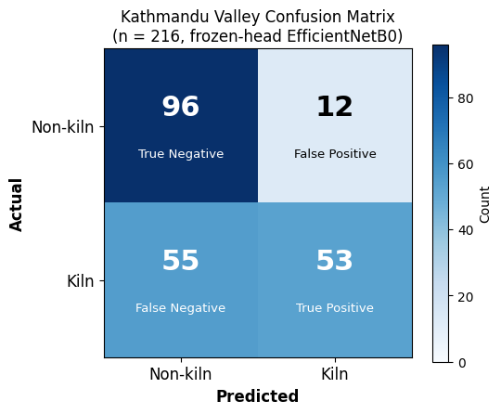
Results/Findings
Metric | Bangladesh | Kathmandu
Accuracy | 95% | 69%
Kiln precision | 91% | 82%
Kiln recall | 93% | 49%
Kiln F1 | 0.92 | 0.61
By type: Zig-Zag (n=63) 54% · FCBTK (n=42) 40%
Hoffman, VSBK excluded from comparison (n=2, n=1) — too small to compare

Slide 7
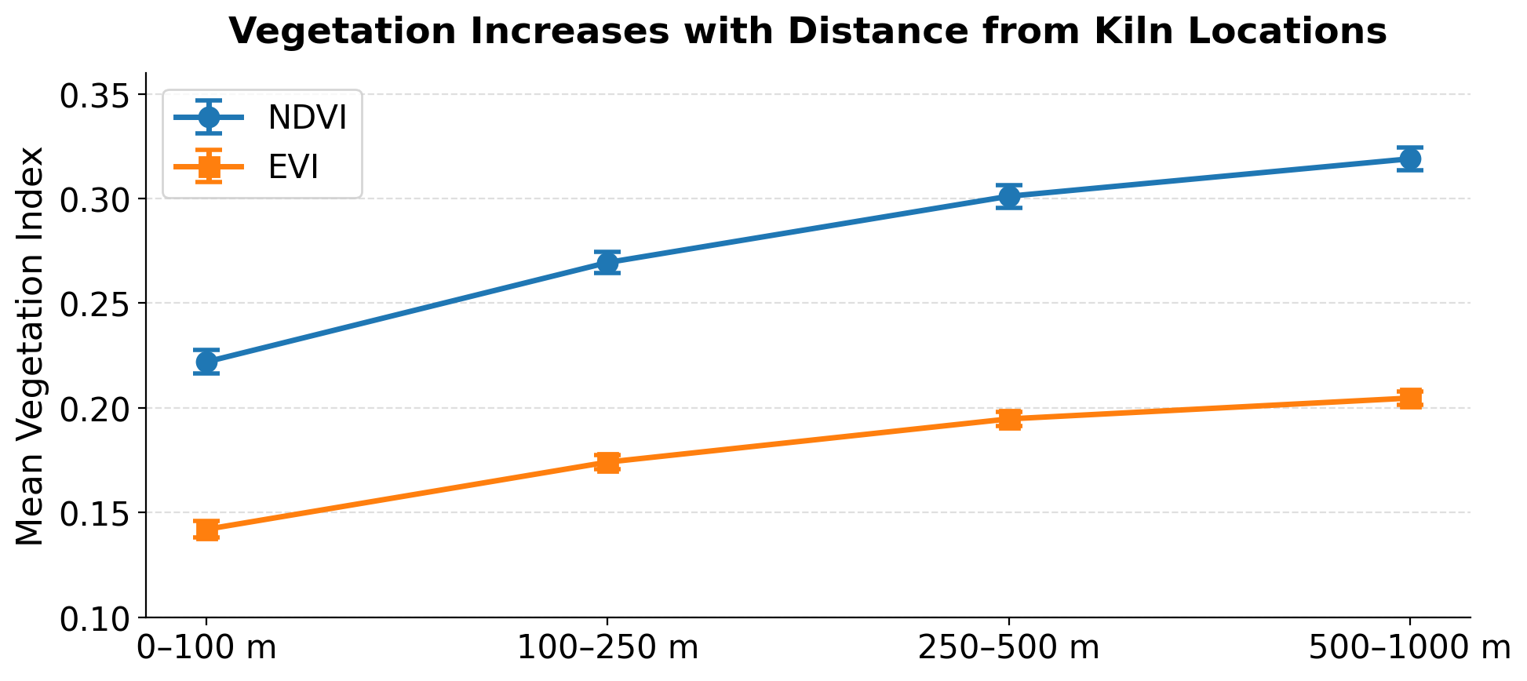
Results/Findings
Kiln locations vs. non-kiln reference points: NDVI 0.22 vs 0.52 · EVI 0.14 vs 0.32
By distance: NDVI 0.22 → 0.32 · EVI: 0.14 → 0.20
Repeated-measures ANOVA: F(3, 321) = 134.88, p < .001
A strong spatial association — holds even on the classifier’s own predictions — but not proof of causal impact

Slide 8
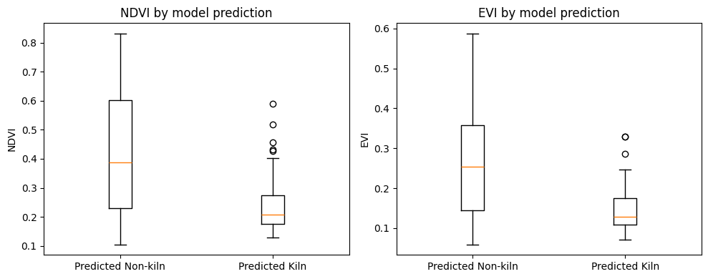
Results/Findings
The environmental association persists using the model’s own predictions
Predicted kiln (n=65)
NDVI 0.235 · EVI 0.146
Predicted non-kiln (n=151)
NDVI 0.427 · EVI 0.268
Effect size
NDVI d = 1.05 · EVI d = 1.06
Prediction-based analysis is a sensitivity check — environmental association is not causal

Slide 9
Conclusions
69%
Cross-regional accuracy (50% = chance)
d = 2.14 / 1.97
NDVI / EVI effect size
108
Kathmandu kiln reference locations
re-checked against current imagery
A reproducible proof-of-concept framework for satellite-based kiln monitoring and environmental screening
Demonstrates feasibility of cross-regional kiln classification and reveals strong spatial associations with vegetation indices
Prediction-based screening confirms the same directional environmental signal
Limitations
69% accuracy — notable domain shift
Small Kathmandu sample (108 + 108)
Spatial association, not proven causal
Spatial autocorrelation not modeled
Zero-shot — no Kathmandu fine-tuning
Next: Kathmandu fine-tuning · spatially controlled modeling · newer benchmarks (e.g., SentinelKilnDB) · multi-year tracking

Slide 10
Acknowledgements/ References
Acknowledgements
  Department of Computer Science and Information Technology, St. Xavier's College, Maitighar
Key References
  Eil, A., et al. (2020). Dirty Stacks, High Stakes: An Overview of Brick Sector in South Asia. World Bank.
  Zhong, M., et al. (2019). Nepal Ambient Monitoring and Source Testing Experiment (NAMaSTE): Emissions of Particulate Matter and Sulfur Dioxide from Vehicles and Brick Kilns and Their Impacts on Air Quality in the Kathmandu Valley, Nepal. Atmospheric Chemistry and Physics, 19(12), 8209–8228.
  Lee, J., et al. (2021). Scalable deep learning to identify brick kilns and aid regulatory capacity. PNAS, 118(17).
  Lacoste, A., et al. (2023). GEO-Bench: Toward Foundation Models for Earth Monitoring. NeurIPS 36.
  Gorelick, N., et al. (2017). Google Earth Engine: Planetary-scale geospatial analysis for everyone. Remote Sensing of Environment, 202, 18–27.
  Mondal, R., et al. (2025). SentinelKilnDB: A Large-Scale Dataset and Benchmark for OBB Brick Kiln Detection in South Asia Using Satellite Imagery. NeurIPS 38.

Slide 11
Thank You!

