Slide 1
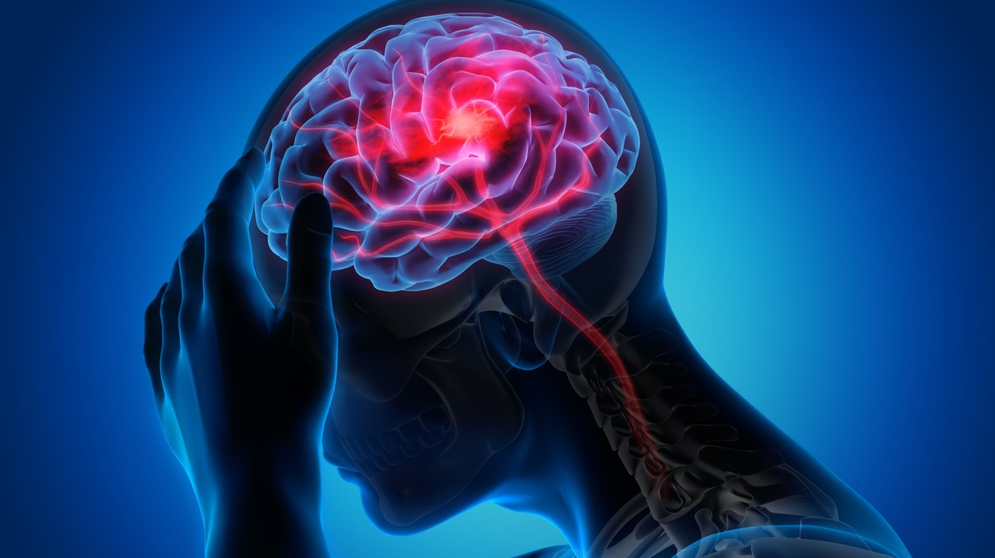
Descriptive Analytics for Stroke
Surayyi Alqahtani
Health Informatics specialist

Slide 2
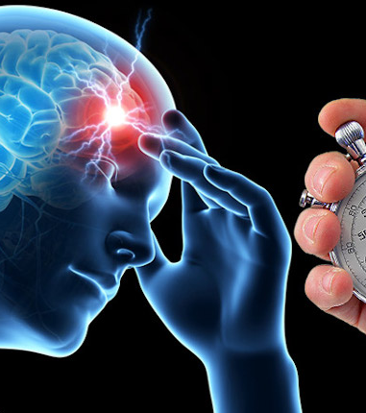
Outline:
Introduction to Stroke.
Question/Problem statement.
Data Structure.
Data Cleaning.
Data Analysis.
Conclusion.

Slide 3
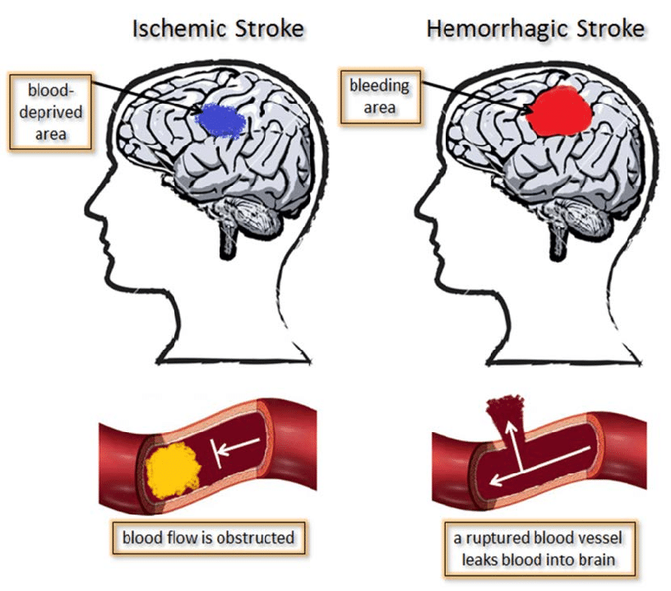
Introduction to Stroke:
A stroke occurs when the blood supply to part of brain is interrupted or reduced, preventing brain tissue from getting oxygen and nutrients.
What Are the Types of Strokes?
● - Ischemic Stroke.
● - Hemorrhagic Stroke.

Slide 4
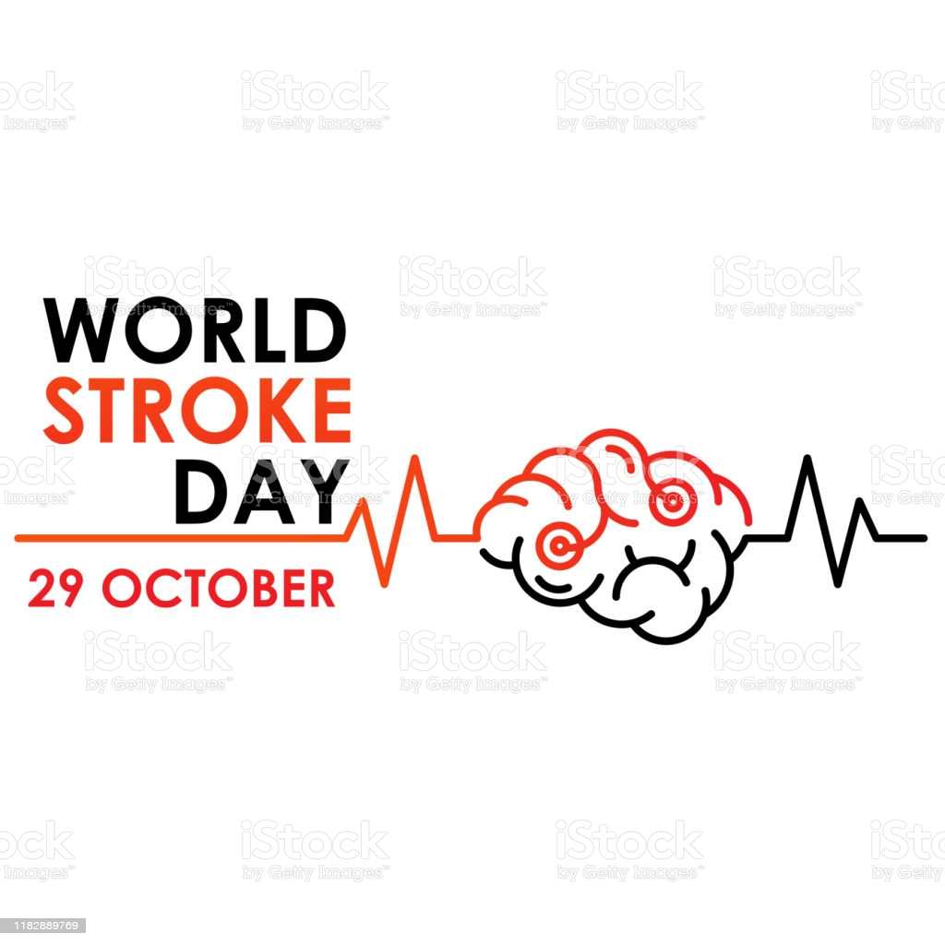
Question/Problem statement:
Scenario: The Ministry of Health intends to establish an awareness campaign to raise awareness about the risk of stroke and wants to choose the right clinic that contributes to reaching the largest possible number of patients likely to have a stroke.
Q\What are the most common diseases that associated with stroke?

Slide 5
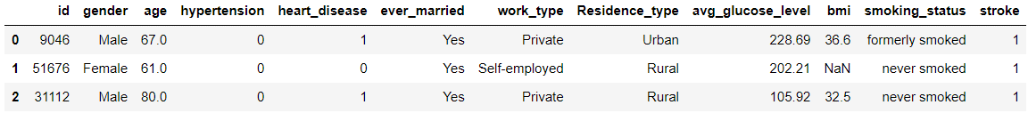
Data Structure:
The Dataset is form Kaggle (Stroke Prediction Dataset) .
It is consisted of 12 columns and 5111 rows.
df.head(3)

Slide 6
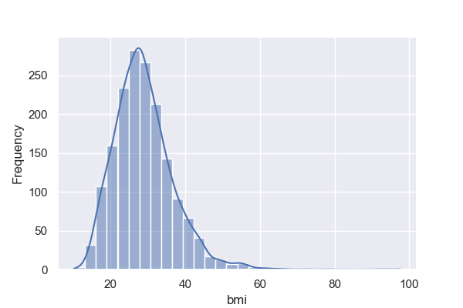
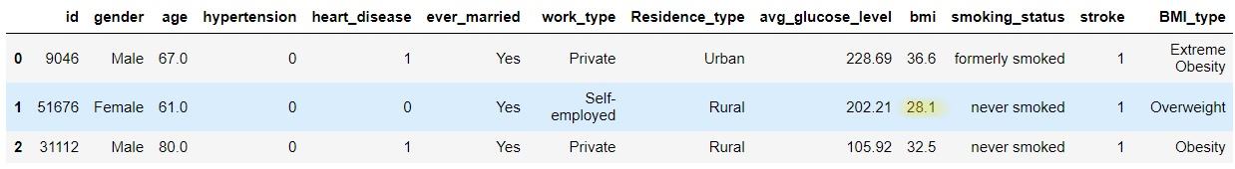
Data Cleaning:
We have around 200 missing values in BMI column.
First, We want to see the distribution of BMI to decide by which we will Replace the NaN values. mean or median ?
It is Skewed distribution , so the median is the best.
The median = 28.1
After cleaning: df.head(3)

Slide 7
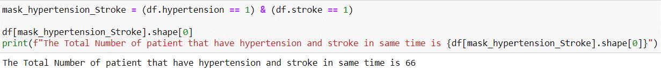
Data Analysis:
Correlation is not the proper way to our project because most of data is categorical data not numerical .
The best way is counting patients by each disease with stroke using mask method.
For example, when we want to count the number of patients who have hypertension and stroke:
We will apply this method to all diseases to count the total number of patients in each.

Slide 8
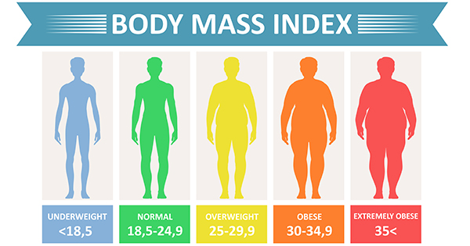
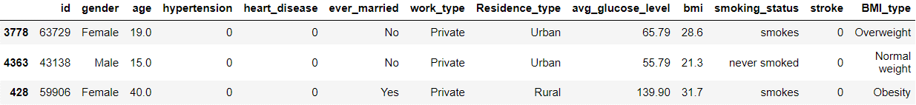
Data Analysis (part2):
In BMI , we will generate new column based on BMI type as following picture:
df.sample(3)
After that we are focusing on obesity and extreme obesity and do mask also.

Slide 9
Data Analysis (part3):
In heart disease, we follow same technique as hypertension
In smoking status , we are focusing just on smokers' patients, without patients who was formerly smoked .
Last, average glucose level we can't decide if the patient is diabetic or not. why? there is important missing information which is when the test was taken and is the patient fasting or after meal ?

Slide 10
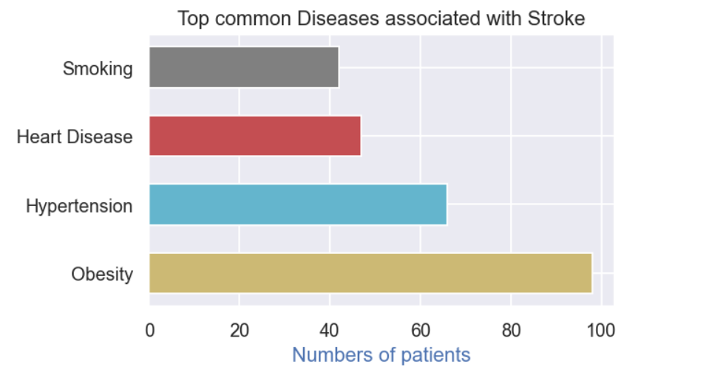
The Result:
This is bar graph showing the top common diseases associated with stroke

Slide 11
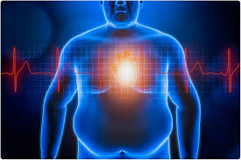
Conclusion:
Finally, Stroke is a life-threatening condition that is caused by a lack of blood and oxygen flow to the brain cells.
We can order the diseases that associated with stroke based on analysis phase as follow:
1- Obesity.
2- Hypertension.
3- Heart Disease.
4- Smoking.
In conclusion, the most disease that can cause the stroke is obesity.

