Slide 1


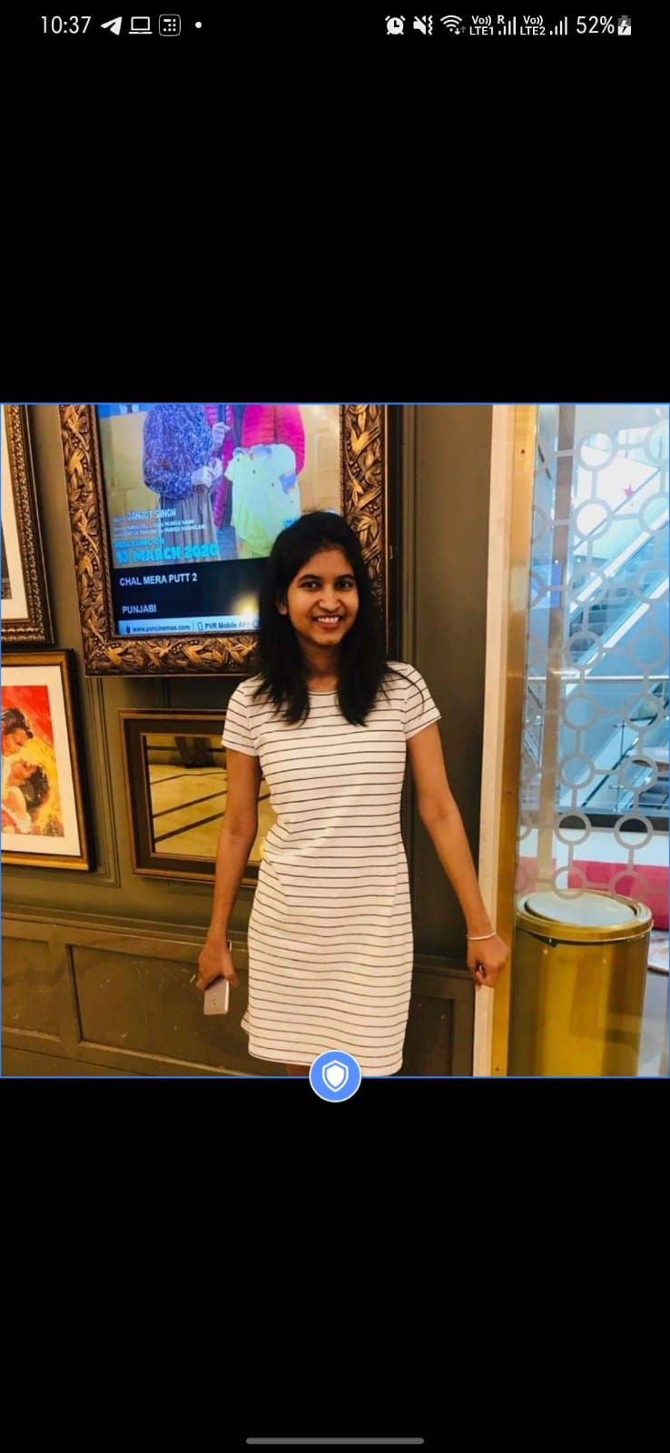


Covid-19 Outbreak Management System
Research & Industrial Conclave 2022 Hackathon Event
Surbhi Jain
Anurag Tiwari
Surbhi Jain

Slide 2
Problem Statement
How to manage to contain COVID-19 in an academic residential campus in the event of outbreak?
Long Queues outside covid test centre because of No Slot Arrangement
Nurse Time Engagement Due to Non-Compliance and Records Analysis
Ambulance and Drop Services Request Issues and Management
Food Delivery Issues
Contact tracing in Case of Patient is tested Positive
Recording and Solving Residents Complaints
Digital Easy to Use Platform to be accessed By Campus Residents

Slide 3
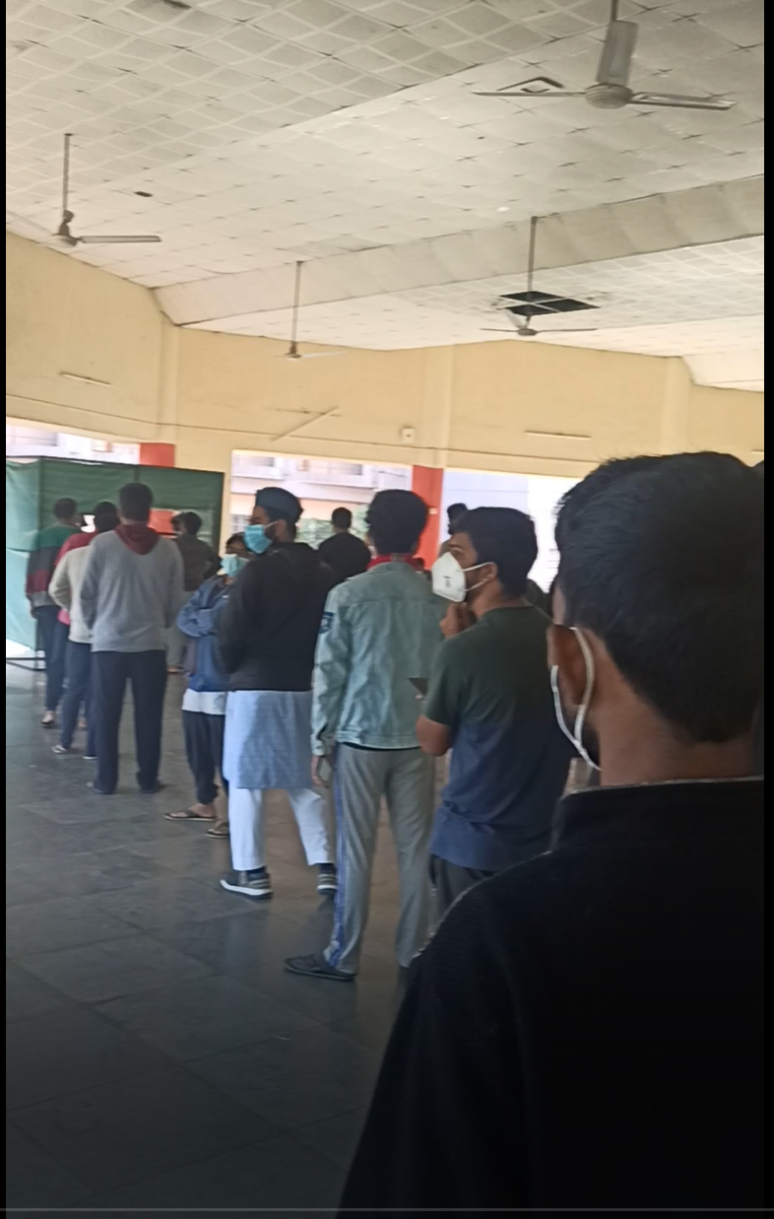

Slide 4
Problem Statement
How to manage to contain COVID-19 in an academic residential campus in the event of outbreak?
Long Queues outside covid test centre because of No Slot Arrangement
Nurse Time Engagement Due to Non-Compliance and Records Analysis
Ambulance and Drop Services Request Issues and Management
Food Delivery Issues
Contact tracing in Case of Patient is tested Positive
Recording and Solving Residents Complaints
Digital Easy to Use Platform to be accessed By Campus Residents

Slide 5
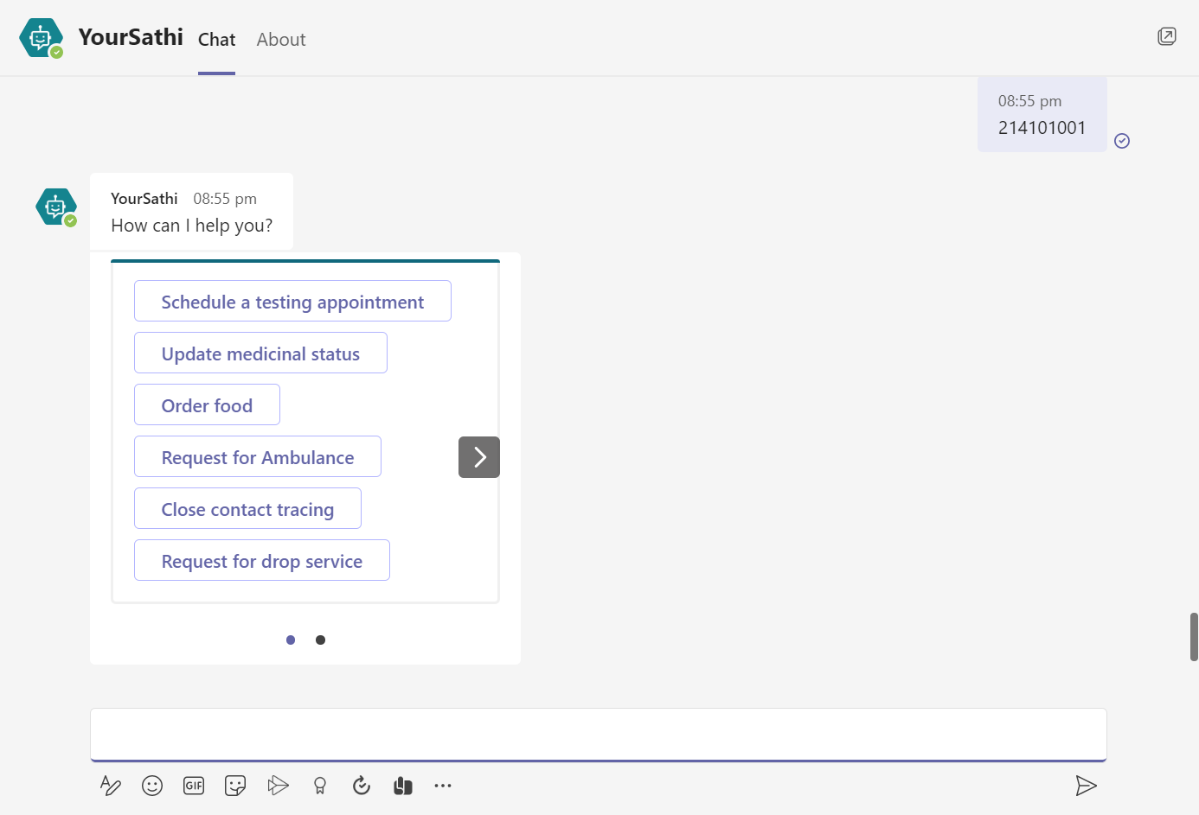

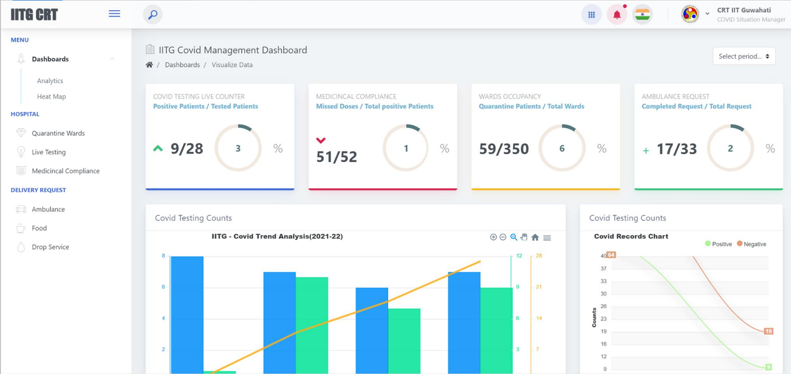





System Architecture
Data
Server
Web Based Dashboard Users:
CRT Team
Hospital Management Staff
Doctors and Nurses
Caterers
Delivery Management Bodies
Interactive Online Chatbot
Users:
Campus Residents
IITG Staffs
Visitors
Sharable Platforms

Slide 6
Solution and Functionalities
YourSathi Chatbot
Web Dashboard
Live Counters of Covid Testing, Compliance, Room Allocation and Ambulance Requests
Manages Slots for New Request using various Algorithms and Cases
Record Compliance Data to Save Nurse Time
Show Covid Trends Based on Historical Data
Heat Map Visualization to decide Quarantine Areas
Real time Covid Record Update and Room Allocation
Tools Manage Ambulance Request and Drop Services in Real Time
Manages Hostel and Guest House Room Allocation Services
Easy Excel Based Data Upload
Manages Food Delivery Requests
Records Complaints
12) Show Real Time Alerts and Notifications
1) Schedule Online Covid Testing Appointment
2) Update Medical Compliance Data
3) Request For Ambulance and Drop Services
4) Update Close Contact Details in Case of Tested Positive
5) Log a Complaint
6) Request For Food Delivery to Caterer
7) Platform Independent and Easily Accessible (Specially for IIT Guwahati Users due to Large Presence in MS Teams)

Slide 7

Thank You

