Slide 1
TECHMENTOR: Mr. Niyaz Ahmed
PRESENTED BY:
Surbhi Bagora
R181106800043
H1B VISA APPLICANTS DATA ANALYSIS USING HADOOP

Slide 2
Introduction to BIG_DATA
Big data is a term for data sets that are so large or complex that traditional data processing application software is inadequate to deal with them.
Big data challenges include capturing data, data storage, data analysis, search, sharing, transfer, visualization, querying, updating and information privacy.

Slide 3
Fields that comes under BIG DATA
Search Engine Data
Stock Exchange Data
Social Media
Security Data
Bank Data and many more..
FIELDS THAT COME UNDER BIGDATA:

Slide 4
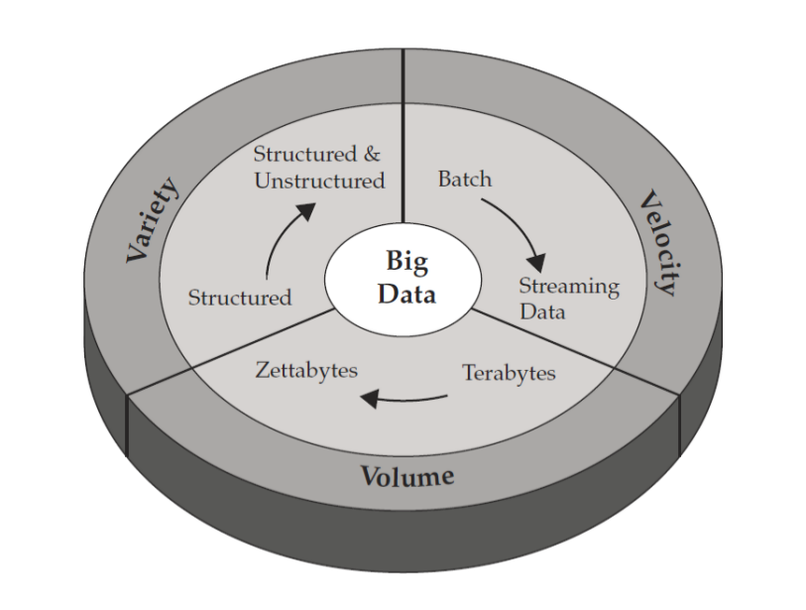
BIG DATA contains 3 V’s

Slide 5
Types of DATA
STRUCTURED DATA
UNSTRUCTURED DATA
SEMI STRUCTURED DATA

Slide 6
Importance of BIG DATA
Cost reduction and time reduction
New product development and optimized offerings
Smart decision making
Determining root causes of failures, issues and defects in real time
Generating coupons at the point of sale data,based on customers buying habits.

Slide 7
Hadoop (Apache)
Open source software framework designed for storage and processing of large scale data on cluster of commodity hardware.
Created by Doug Cutting and Mike Carafella in 2005.
Cutting named the program after his Son’s Toy ELEPHANT.

Slide 8
The Hadoop Ecosystem
Hadoop Common : Contains JAVA Libraries and Utilities used by other modules.
HDFS : Hadoop Distributed File System.
Hadoop YARN : Yet Another Resource Negotiator.
Hadoop MapReduce : A YARN based programming model for processing large sets.

Slide 9
HDFS (Hadoop Distributed File System)
HDFS is a file system written in Java based on the google’s GFS.
Runs on Commodity Hardware.
HDFS is highly fault tolerant and designed using low cost hardware.
HDFS holds very large amount of data and provide easier access.
Files are stored in redundant fashion to rescue the system from possible data looses in case of failure.

Slide 10
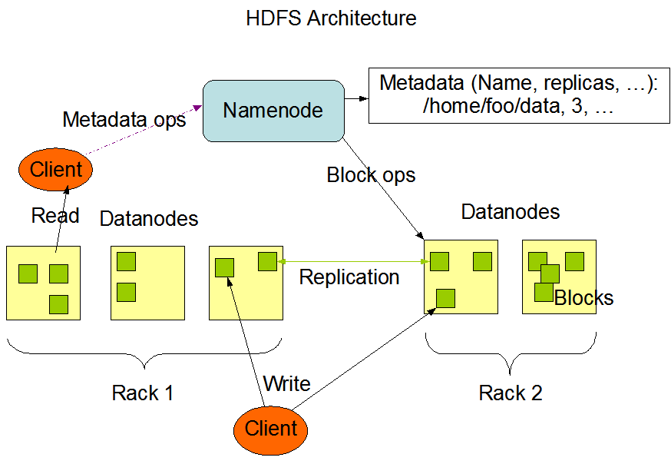
HDFS Architecture

Slide 11
MAPREDUCE Overview
A method for distributing computation across multiple nodes.
Each node processes the data that is stored at that node.
Consists of TWO main Phases:
1.MAP
2.REDUCE.

Slide 12
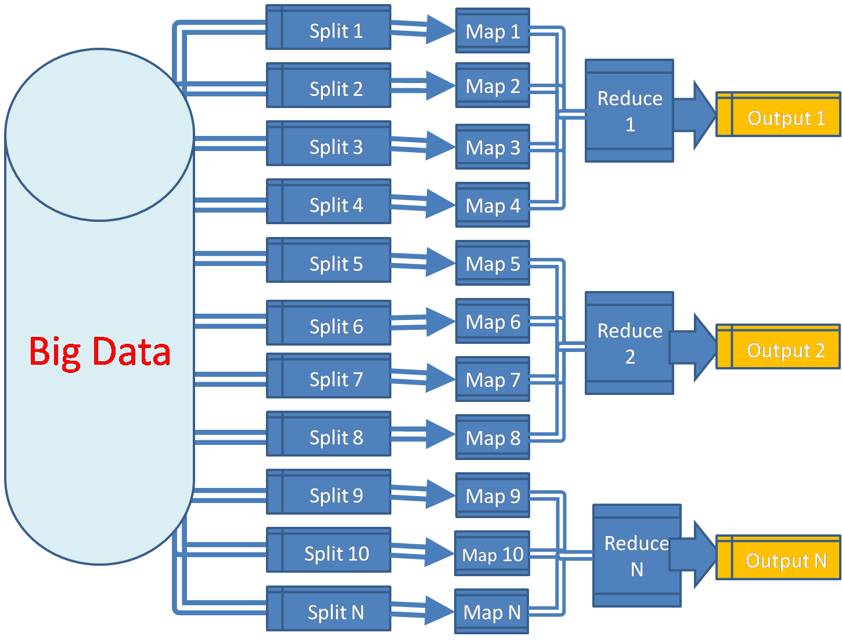

Slide 13
Functions
The Mapper : Reads the data as KEY/VALUE pair. The key is often discarded. Output Xero or More key value pair.
Sort and Shuffle : Output from the mapper is sorted by key , All values with the same key are guaranted to go to the same machine.
The Reducer : The reducer code reads the output generated by the different mappers as pairs and emits the key value pair. The reducer output zero or more final key value pair.

Slide 14
Other tools in HADOOP Framework
Hive : Hadoop processing with SQL
Pig : Hadoop processing with scripting
Sqoop : for importing and exporting data from RDBMS to HDFS and VICE VERSA.
Hbase : Database model build on top of hadoop
Oozie : Scheduler system to run and manage Hadoop Jobs.
Zookeeper : Coordinate and manage service in a distirbuted environment.
Flume : Designed for large scale dataset movements.

Slide 15
Project Prerequisites
An analysis has done on data set of H1B_Visa applicants.
For processing further with the project we first need to import the data and we used HIVE for this , its needed to convert the data in hadoop file system.

Slide 16
THANKYOU!

