Slide 1

EPM5740 PROJECT RISK MANAGEMENT INDIVIDUAL ASSIGNMENT - PRESENTATION RISK CULTURE AND RISK ATTITUDE
Submitted By : Surbhi Dhawan ( s4608520)
Submitted to : Farhad Daneshgar

Slide 2
Table Of Contents
Introduction
Risk Culture
Risk Attitude
Influence of Risk Attitude and Culture on each other
Explanation
Importance of Risk Culture
Developing Risk-Mature Risk culture
Good Risk Culture
Conclusion
References

Slide 3
Introduction
Project risk is dubious condition that have direct impact on project scope and objective which results in success or failure of the project
Risk management helps in identifying the risk and their assessment to manage and minimize the outcome of risk

Slide 4
Introduction
The risk management has 6 steps:
Risk Identification
Qualitative Risk analysis
Quantitative Risk Analysis
Risk Response Planning
Risk monitoring and Control
Risk Planning

Slide 5
Risk Culture
Risk Culture portrays the qualities, knowledge and information, convictions, understanding and perceptive shared with common group of people who have same objectives which includes public and private companies, non-profit-organisations and government
it can be created by individual in an organisation, addressed and conveyed to all levels of company which will lead to a coherent culture (Hillson, D, 2013).

Slide 6
Risk Attitude
Attitude is characterized as picked viewpoint, mental view or way concerning a reality or state
In risk management combining both of them gives risk attitude which means that picked perceptive (chosen state of mind) with respect to the uncertainties or dubious conditions which gives an outcome to a project, that may be a success or a failure

Slide 7

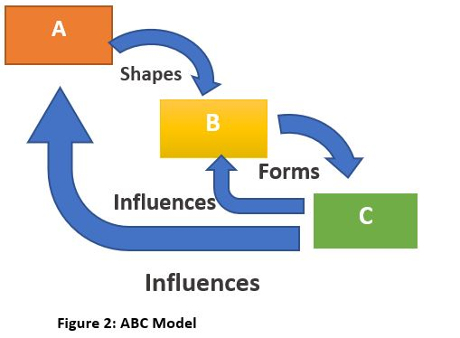
Influence of Risk Attitude and Culture on each other
Too much risk for an organisation will be harmful and too less risk will not allow company to work in new innovations and technology (Atkinson, P., 2013)
The balance is needed to be maintained in the company for risk
Where A : Attitude
B: Behaviour
C: Culture

Slide 8
Explanation
the Culture is formed by the Behaviour of the members in organisation.
The Behaviour is formed by Attitude of a members of organisation.
Culture influences both Attitude and Behaviour.
In the context to risk:
Risk attitude is picked perceptive (chosen state of mind) with respect to the uncertainties.
Risk behaviour is about risk related actions we take when risk arises.
Risk culture is understanding and knowledge about risk

Slide 9

Importance of Risk Culture
Forming a good and strong risk culture is very important in an organisation for few reasons.
Risk culture has huge impact on
Consistence or compliance
risk management effectiveness
organisational performance

Slide 10
Developing Risk-Mature Risk culture
Risk culture can be formed by setting it from scratch or developing it naturally as organisation grows.
The two approaches are:
top to bottom
bottom to up approach

Slide 11
Good Risk Culture
A good risk culture is more about liability and possession (McCafferty,j.,2016).
An appropriate tone of risk taking from top.
Leadership pledge to take risk is important
Follow the ethical procedures and policies of organization (Culture, R., 2012)
Senior administration effectively engaged with the improvement of risk management capabilities.
Experience from previous risk and apply on new.
Middle administration and junior level staff can have a significant effect through casual impact.
The practices of risk taking are tested and rewarded.
Management of resources.
Abilities of managing risk are empowered and created.

Slide 12
Conclusion
The ABC model of risk culture explains how risk attitude influences risk behaviour and vice versa.
The ABC model can be applied to teams, small groups or even to organisations.
A good risk culture can solve many problems whereas a bad risk culture can create many problems.
Too little and too much risk both are harmful for company.
It is also clear that we can easily manage risk attitude as well to manage risk culture

Slide 13
References
Hillson, D., 2013. The ABC of risk culture: how to be risk mature. Project Management Institute.
de Bakker, K. and Somani, S., 2006. Establishing Cultural Influences on Risk Management. In 2006 PMI Global Congress Proceedings.
Richardson, P & Fenech, J .2012.Risk culture: under the microscope guidance for boards, Institute of Risk management.[ONLINE] Available at: https://www.theirm.org/what-we-say/thought-leadership/risk-culture/ [Accessed 19 May 2020].
Atkinson, P., 2013. Managing change and building a positive risk culture. Management Services, 57(2), pp.9-13
Australia, D., 2012. Cultivating an intelligent risk culture: a fresh perspective. Sydney, AU: Deloitte Touche Tohmatsu Ltd. https://www2.deloitte.com/content/dam/Deloitte/au/Documents/financial-services/deloitte-au-fs-cultivating-risk-intelligent-culture-1012.pdf
Hillson, D. and Murray-Webster, R., 2006, May. Managing risk attitude using emotional literacy [ONLINE] Available at: https://www.pmi.org/learning/library/managing-risk-attitude-using-emotional-literacy-8156 [Accessed 19 May 2020]
Murray-Webster, R. and Hillson, D., 2008. Managing group risk attitude. Gower Publishing, Ltd..
Culture, R., 2012. Under the Microscope Guidance for Boards. Institute of risk management.
McCafferty,j.,2016. What constitutes a good risk culture?[ONLINE] Available at https://misti.com/internal-audit-insights/what-constitutes-a-good-risk-culture [Accessed 21 may 2020

