Slide 1

SAMSUNG PRISM
Generative AI
Hackathon
3rd Edition 2026 – 27
Theme ID - 05: Interruptible Real-Time Agents
Team Name - Node
College Name – SRM Institute of Science and Technology
Member Name & Email 1 – Surbhi Kaushal & sk7391@srmist.edu.in
Member Name & Email 2 – M. Veada Sri & vs2229@srmist.edu.in
Member Name & Email 3 – Anushka & az5921@srmist.edu.in
Submission Github link - https://github.com/SurbhiKaushal/FlowGuard

Slide 2
Theme
FLOWGUARD focuses on one question:
When should an autonomous agent actually demand the user's attention?
Problem
Background agents may interrupt too often and break focus.
Important events may be missed if the agent never interrupts.
User intent can change while multi-step work is still running.
Results produced from an older instruction can become stale.
Our focus
Protect the user's attention while allowing the agent to continue useful background work.

Slide 3
Existing Solutions & Gaps
Existing solutions and gaps
Current agent experiences can perform proactive tasks, cross-app actions and background work.
Gap addressed by FLOWGUARD
There is still a need for explicit attention management during autonomous execution.
The user needs a way to say when interruptions are acceptable.
A changed instruction should invalidate affected old work.
Late results from an old intent should not silently overwrite a newer decision.
FLOWGUARD adds an Attention Contract + intent versioning + stale-result protection layer.

Slide 4
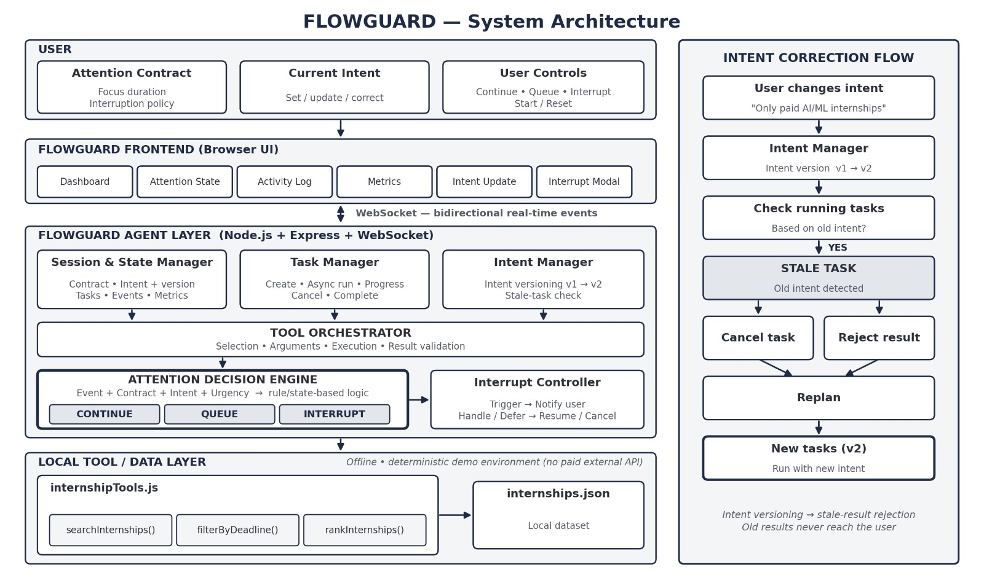
Our Solutions & Architecture Diagram

Slide 5
Demo & Product Walkthrough
1. Start the FLOWGUARD dashboard and begin background work.
2. The agent runs asynchronous tasks while the user's attention is protected.
3. Background events can be handled as CONTINUE, QUEUE or INTERRUPT.
4. Change the instruction:
Find AI/ML internships” → “Only paid AI/ML internships”.
5. FLOWGUARD changes intent version v1 → v2.
6. Tasks using the old intent become stale; affected results are rejected.
7. New work is replanned using the updated intent.
8. Dashboard shows task progress, activity and runtime metrics.

Slide 6
Tools and tech stack used
Frontend
HTML
CSS
JavaScript
Browser real-time dashboard
Backend
Node.js
Express.js
WebSocket (ws)
Asynchronous JavaScript task execution
Data
Local deterministic internships.json
Development
Visual Studio Code
Git / GitHub
No paid API is required to run the current prototype
Local tool layer
internshipTools.js
searchInternships()
filterByDeadline()
rankInternships()

Slide 7
Impact & Use case
Use case: internship search while studying
A student asks the agent to find AI/ML internships but does not want constant interruptions while studying.
FLOWGUARD:
• Keeps background work running.
• Protects the user's focus window.
• Queues non-urgent events.
• Requests attention only when needed.
• Accepts a changed requirement without blindly continuing old work.
• Prevents stale results from overwriting the current intent.
Impact
The goal is not simply to make agents more autonomous, but to make their autonomy respectful of human attention.

Slide 8
Innovation highlights, results and limitations
Demonstrated results
Real-time WebSocket communication
Asynchronous background tasks
Continue / Queue / Interrupt controls
Intent correction v1 → v2
Stale task/result handling
Runtime metrics and activity log
Innovation
Attention Contract treats user attention as a controlled resource.
Intent versioning tracks changes during execution.
Stale-task detection identifies work based on old intent.
Stale-result rejection protects the latest user decision.
Automatic replanning continues work using the new intent.
Limitations
Local deterministic internship dataset
Prototype decision logic
Browser-based demonstration
No direct Galaxy hardware integration
FDB-v3 benchmark evaluation not claimed in the current prototype

Slide 9
What’s next
• Full-duplex voice interaction
• More sophisticated interruption policies
• Live external tools and APIs
• Multimodal interruption signals
• Device-level attention management
• Galaxy device integration
• Persistent task recovery
• Multi-agent arbitration
• Cross-device agent coordination
• Evaluation against FDB-v3 and other interruptible-agent benchmarks

Slide 10
Brownie points slide( differentiation)
FLOWGUARD is not only a notification system
1. Attention Contract
The user explicitly defines when the agent is allowed to demand attention.
2. Intent Versioning
A user correction creates a new intent version while background work may still be running.
3. Stale-Result Protection
Results from an older intent are rejected instead of silently changing the current state.
4. User Control
The user can continue, queue, interrupt, defer or handle an event.
Core principle:
“Let the agent do the work. Let the user decide when their attention matters.”

Slide 11
Checklist- Updated on Public GitHub
Working prototype code — YES
Public GitHub repo — YES
README with reproducible setup instructions — YES
Demo video — YES
Presentation file — YES
AI Disclosure — YES in README
APK / SDK — N/A (browser-based Node.js prototype)
GitHub Tag — PRISM_GENAI_HACKATHON_Y2026
GitHub:
https://github.com/SurbhiKaushal/FlowGuard

Slide 12
Thank you
FLOWGUARD — Attention-aware interruptible agents
Organised by the Language AI Team and the PRISM Team, Samsung R&D Institute India
Notes:
Closing slide. Add the Google Form URL and a contact email before sharing. Edition 2 organising team for reference: Language AI - Sourabh Tiwari, Gaurav, Sanjeeth Pothireddy, Gorang Maniar; PRISM - Binny Lakra, Prakhar Chandrakar, Vishu Kumar; Kick-off and mentors - Giridhar Jakki, Deepraj Prabhakar Patkar (Language AI), Srimanu Prasad Nagaraju, Ashish Kumar (Tech Strategy).

