Slide 1
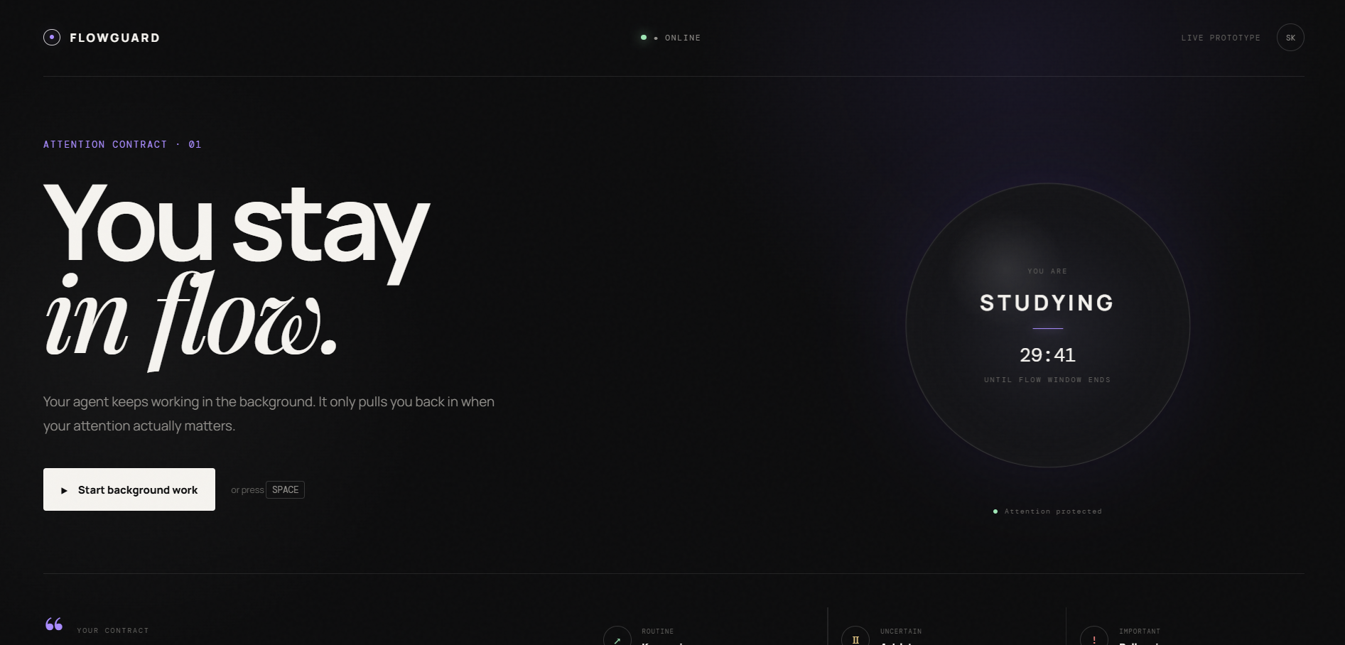
FLOWGUARD
An Attention Contract Layer for Interruptible Real-Time Agents
Agents should know when to work, when to wait, and when to ask.
Theme 05 — Interruptible Real-Time Agents
Team: [Team Name]
Samsung PRISM GenAI Hackathon 2026

Slide 2
The Problem
Autonomous Agents Can Consume User Attention
Current agents can perform multi-step tasks asynchronously, but real-world interaction creates three problems:
1. Unnecessary interruptions
Routine events don't always require immediate user attention.
2. Stale intent
Users can change their requirements while an agent is still working.
3. Interrupted workflows
When the user changes direction or interrupts, unfinished work may continue based on outdated assumptions.
Core question
How can an agent decide whether an event should reach the user at all?
Background Agent
Something happens
Should I interrupt?
???

Slide 3
Our Solution
FLOWGUARD: an attention-control layer between the agent and the user
FLOWGUARD introduces a temporary Attention Contract that defines when the agent is allowed to demand the user's attention.
The agent evaluates every background event using the contract, the current intent, and the event's importance, then decides what to do with it.
Key principle
Autonomy is the default. User attention is requested only when necessary.
BACKGROUND EVENT
Attention Contract
+ Current Intent
+ Event Importance
DECISION ENGINE
CONTINUE
QUEUE
INTERRUPT

Slide 4
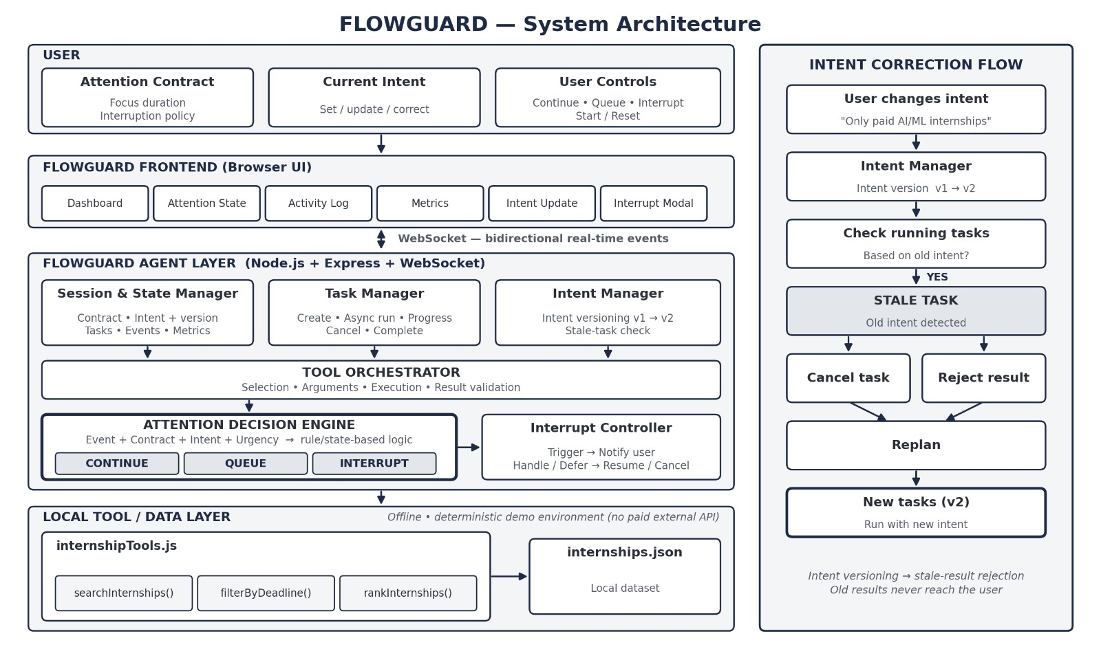
System Architecture
Notes:
Architecture diagram goes on this slide (keep text minimal).
Labels to place underneath:
Frontend: browser-based real-time dashboard; attention contract; decision controls; activity + metrics.
Backend: Node.js; Express; WebSocket; async task execution; intent/state management.
Tool layer: internship search; filtering; ranking; local deterministic dataset.
Technical flow: User -> WebSocket -> FLOWGUARD Backend -> Task Manager -> Tool Orchestrator -> Attention Decision Engine -> CONTINUE / QUEUE / INTERRUPT.

Slide 5
Interruptibility + Self-Correction
What Happens When the User Changes Their Mind?
INTENT v1
"Find AI/ML internships"
Background tasks running
User corrects intent
"Only paid AI/ML internships"
INTENT v2
Running tasks checked
Tasks based on v1 marked STALE
Cancel / reject result
Replan
Execute using Intent v2
Key technical mechanisms
Intent versioning
Stale-task detection
Stale-result rejection
Task cancellation
Automatic replanning
Takeaway
A late result from an old intent must never overwrite a newer user decision.

Slide 6
Real-Time Decision Flow
Every Event Must Earn the User's Attention
Event | FLOWGUARD decision | Result
Routine background progress | CONTINUE | Agent handles it
Non-urgent uncertainty | QUEUE | Wait for a better moment
Time-critical / important event | INTERRUPT | User is notified
EVENT
CLASSIFY
ATTENTION
CONTRACT
DECISION
CONTINUE → Keep working
QUEUE → Defer event
INTERRUPT → Request attention
Real-time implementation
WebSocket bidirectional communication
User Action → Agent
Agent State / Event → User

Slide 7
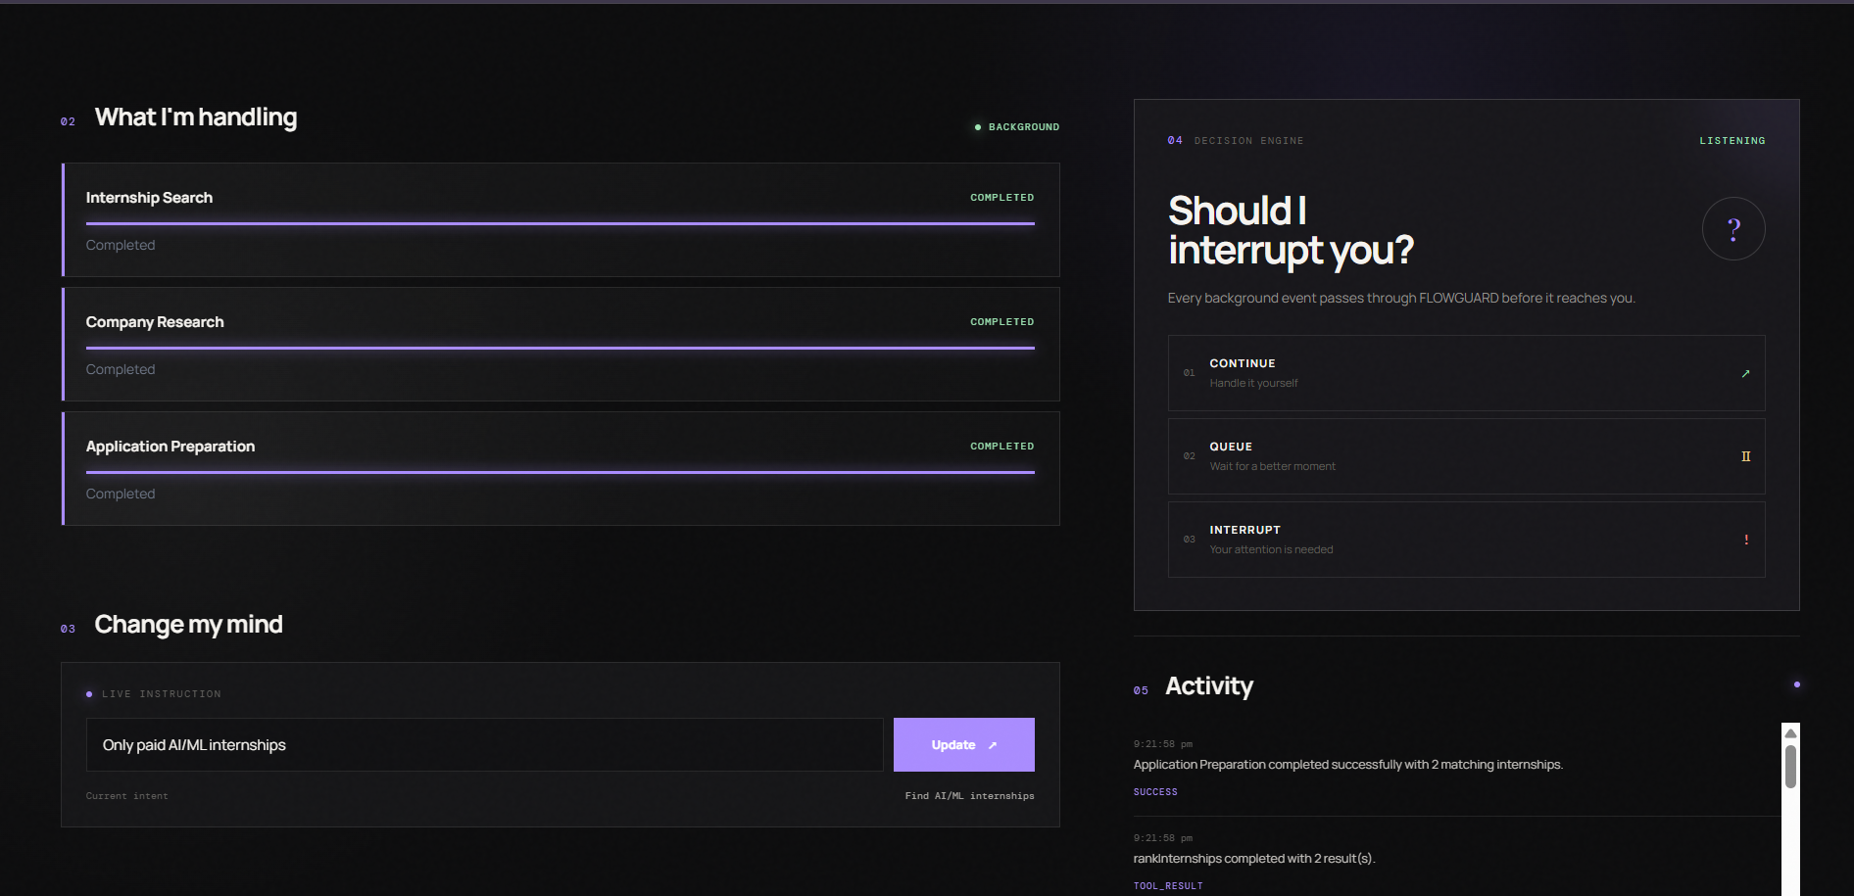
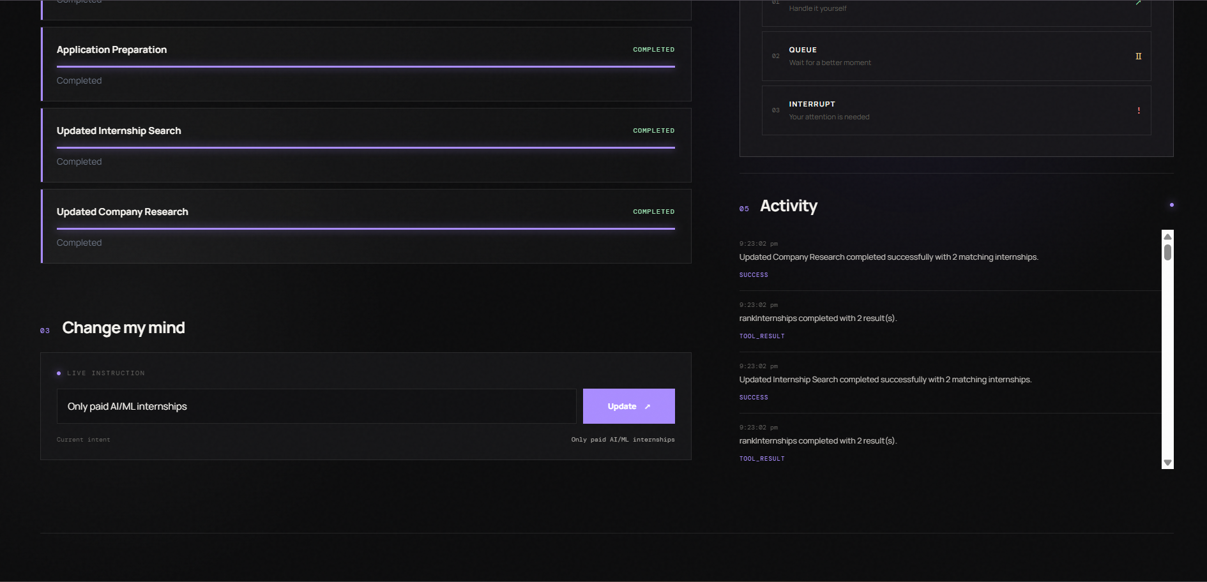
Working Prototype & Metrics
Runtime metrics
Total events
Continued
Queued
Interrupted
Corrections
Stale tasks
Interrupt latency
Current implementation
Node.js + Express
WebSocket
Async task execution
Local tool layer
Browser dashboard

Slide 8
Impact / Future Scope
From Reactive Agents → Attention-Aware Agents
What FLOWGUARD demonstrates
Autonomous execution
→ Agent continues background work.
Interruptibility
→ User can interrupt or defer the workflow.
Intent awareness
→ New instructions invalidate outdated work.
Stale-result protection
→ Old results cannot overwrite newer intent.
Attention management
→ The agent explicitly decides whether an event deserves user attention.
Future extensions
Full-duplex voice interaction
Multimodal events from camera/device sensors
More sophisticated interruption policies
Multi-agent attention arbitration
Benchmark evaluation on FDB-v3
Deployment as a device-level attention layer
FLOWGUARD: Let the agent do the work. Let the user decide when their attention matters.

