Slide 1

G2M Cab Insights
Virtual Internship
2-Feb-2023

Slide 2
Problem Description
The Client
XYZ is a private firm in US. Due to remarkable growth in the Cab Industry in last few years and multiple key players in the market, it is planning for an investment in Cab industry and as per their Go-to-Market(G2M) strategy they want to understand the market before taking final decision.
Project delivery:
Multiple data sets that contains information on 2 cab companies have been provided. Each file (data set) provided represents different aspects of the customer profile. XYZ is interested in using the provided actionable insights to help them identify the right company to make their investment.

Slide 3
Profit Analysis
Dataset
4 individual data sets. Time period of data is from 31/01/2016 to 31/12/2018.
Below are the list of datasets which are provided for the analysis:
Cab_Data.csv – this file includes details of transaction for 2 cab companies
Customer_ID.csv – this is a mapping table that contains a unique identifier which links the customer’s demographic details
Transaction_ID.csv – this is a mapping table that contains transaction to customer mapping and payment mode
City.csv – this file contains list of US cities, their population and number of cab users

Slide 4
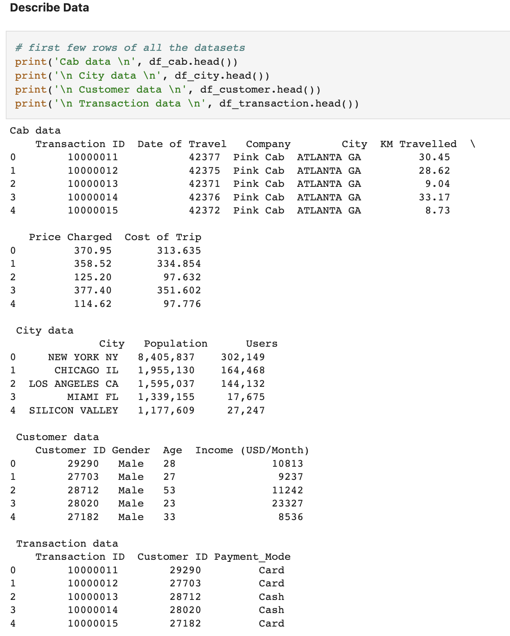
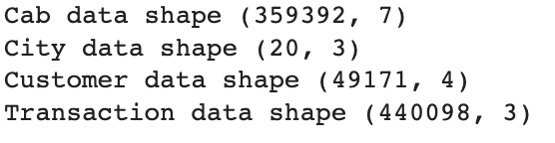

Slide 5
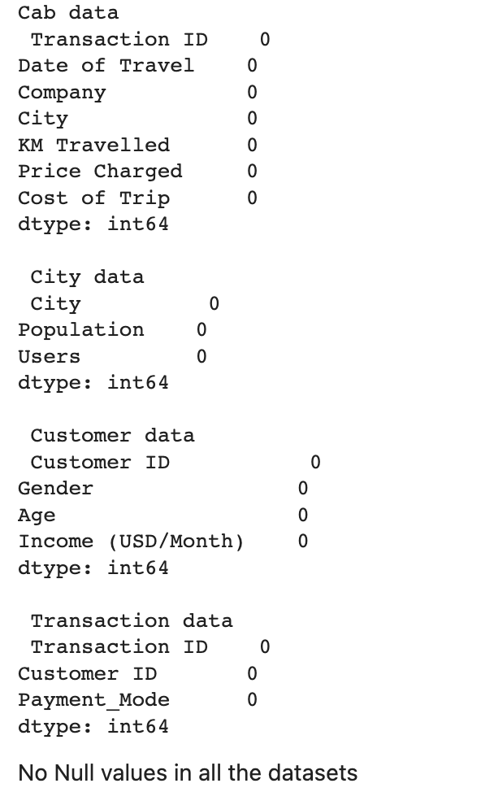
Null values
This dataset has no null values.

Slide 6
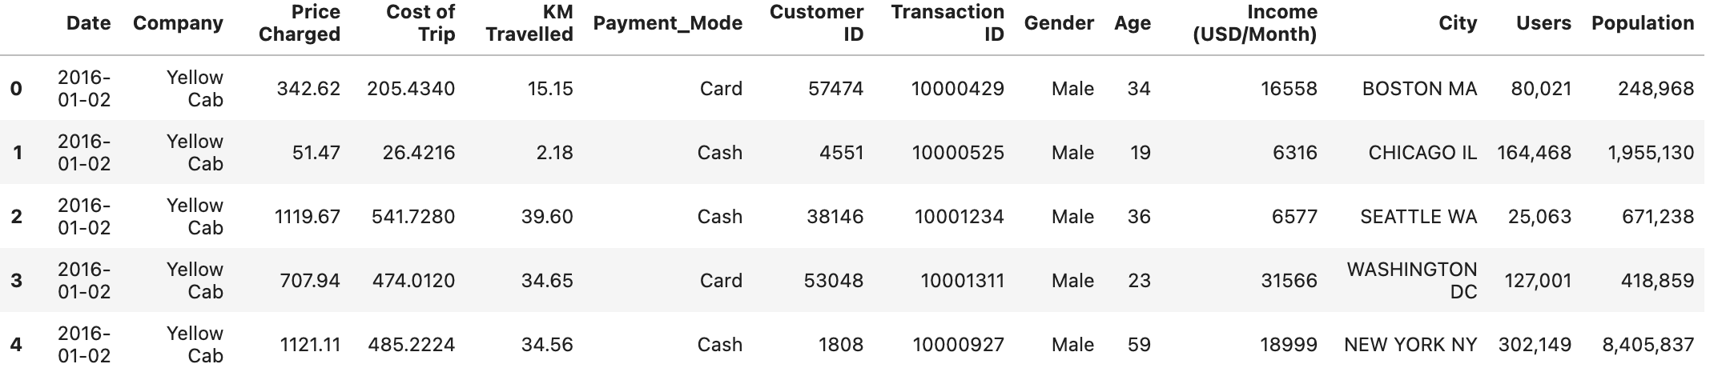
Data Merging
Merging cab data with transaction data with Transaction_ID as primary key and then mergin with customer and city data.
Merged Data:

Slide 7
Hypothesis and Visualizations
Following visualizations has been performed:
Data Correlation for both the cabs
Month-wise profit distribution of both cabs
Year-wise profit distribution of both cabs
City-wise profit distribution of both cabs
Annual profit rate
Price vs Distance and Cost vs Distance comparison
Gender and Year wise cab usage
Age and year wise can usage
Income wise Cab usage

Slide 8
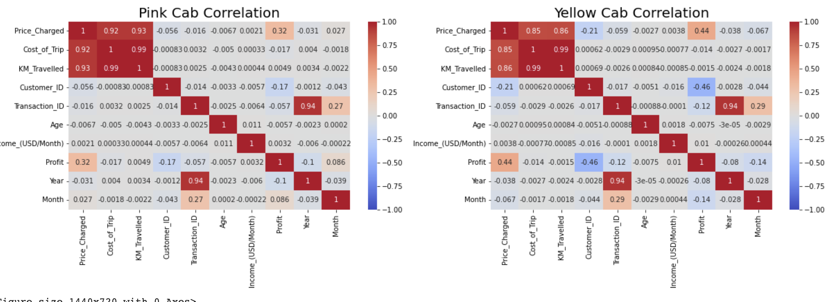
Data Correlation for both the cabs
There is a strong correlation between cost, price and KM_travelled. There is also a strong correlation between year and transactions

Slide 9
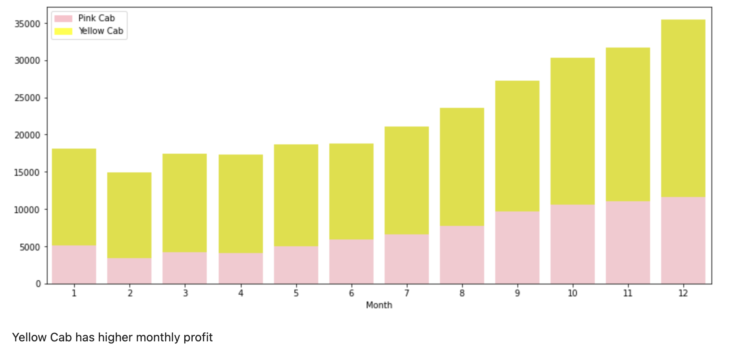
Month-wise profit distribution of both cabs

Slide 10
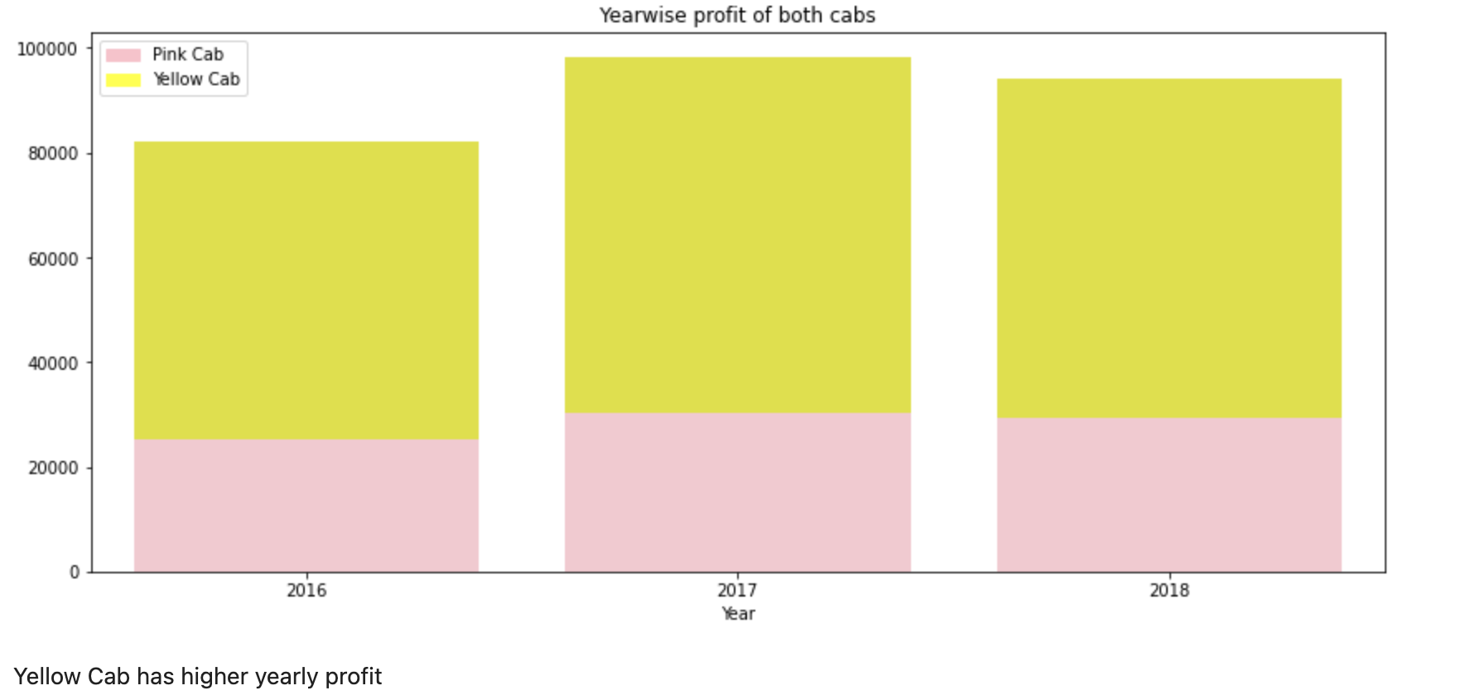
Year-wise profit distribution of both cabs

Slide 11
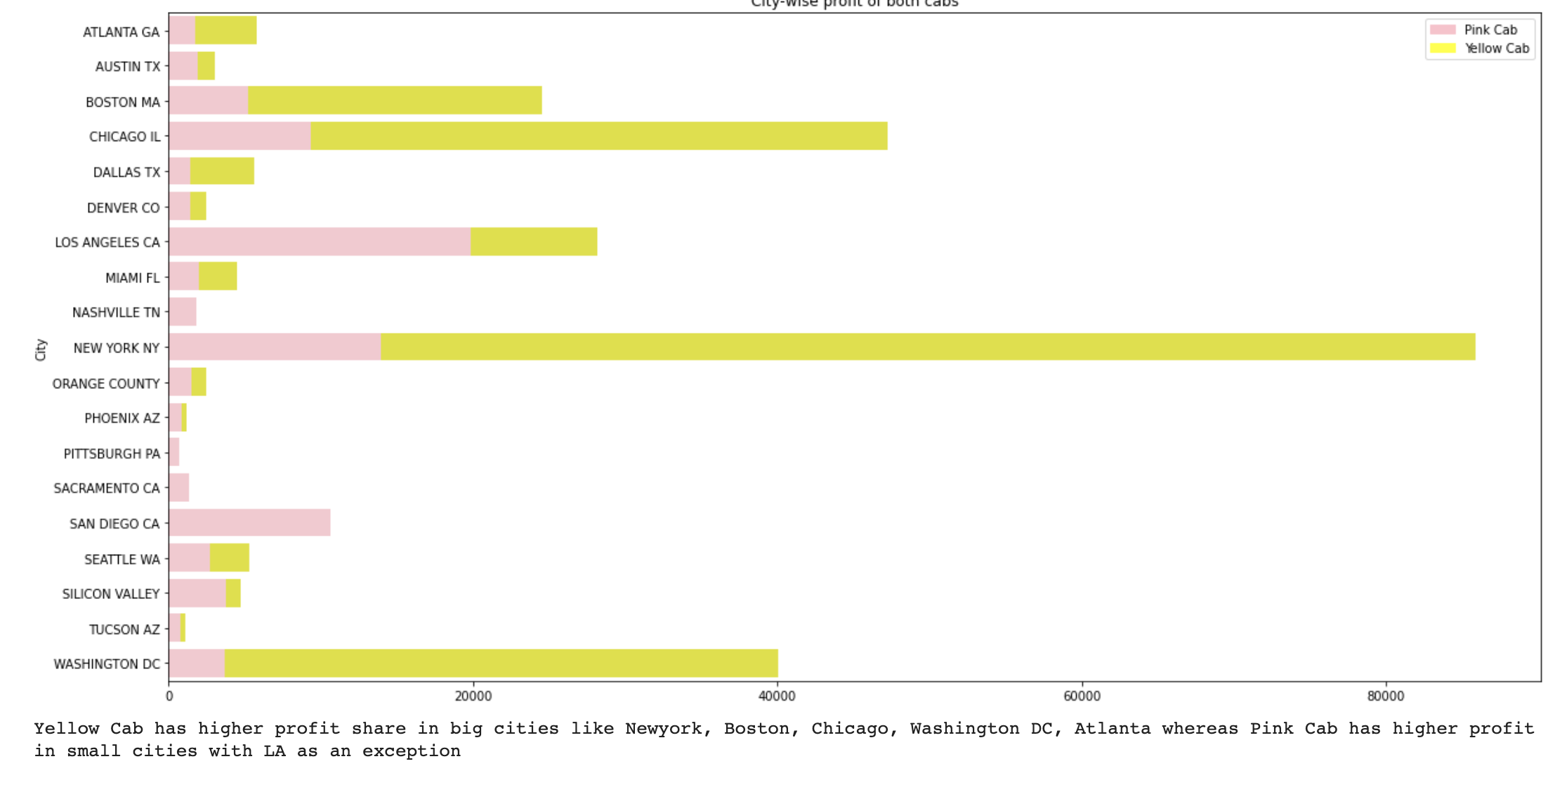
City-wise profit distribution of both cabs

Slide 12
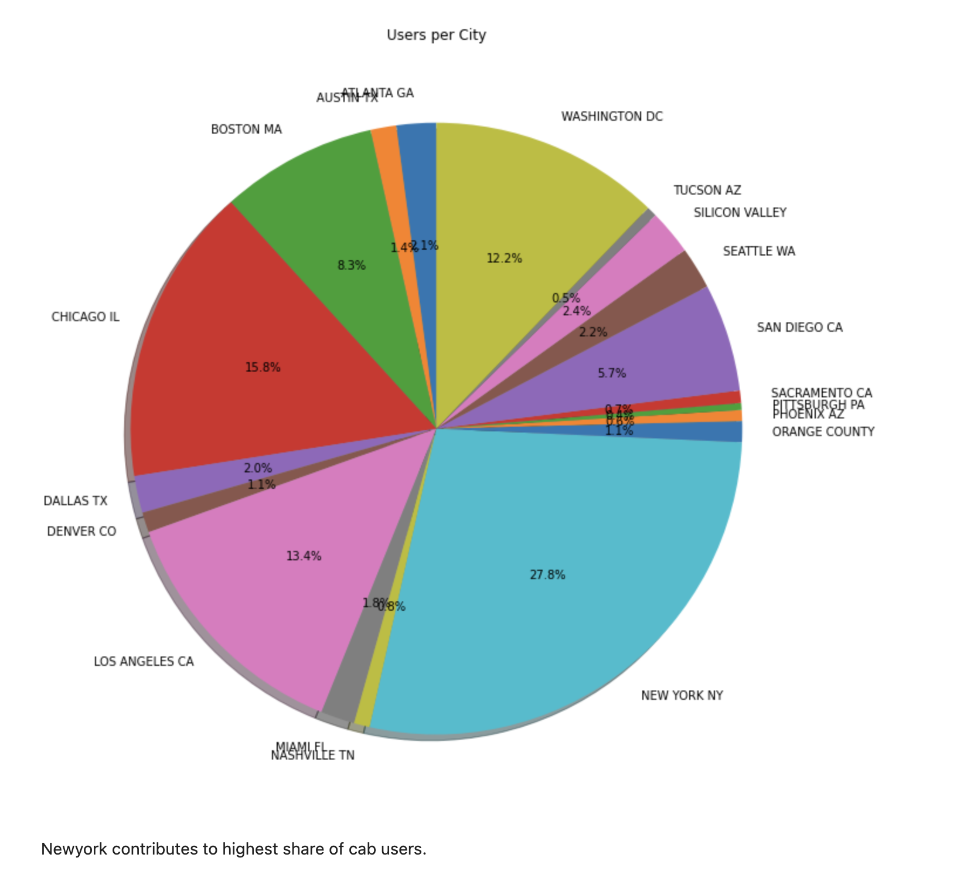
Users Per City

Slide 13
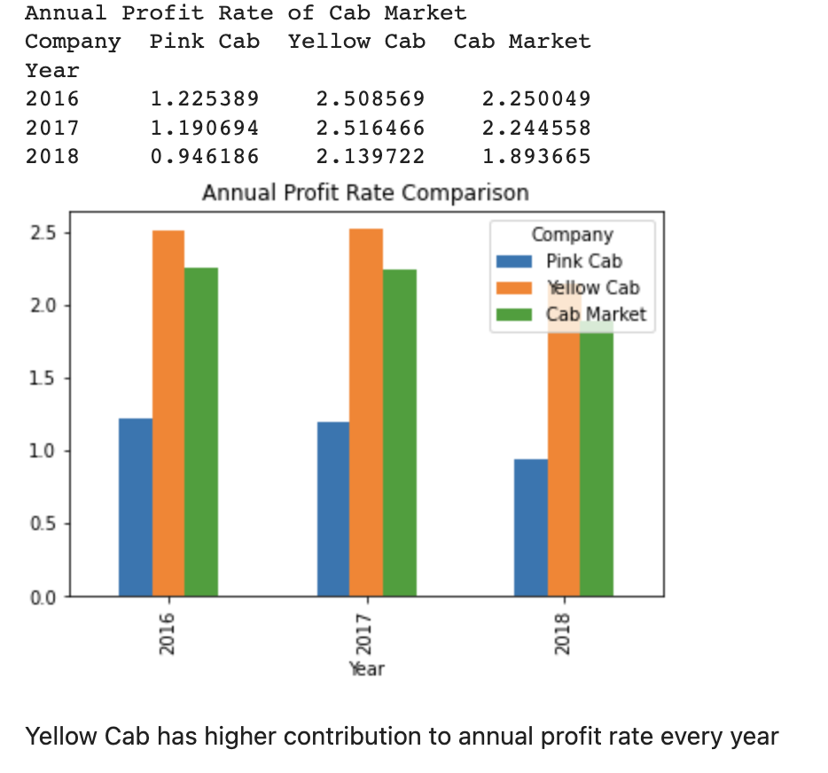
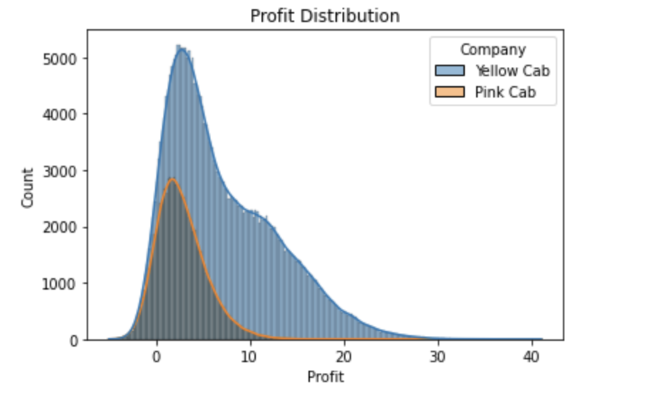
Annual profit rate

Slide 14
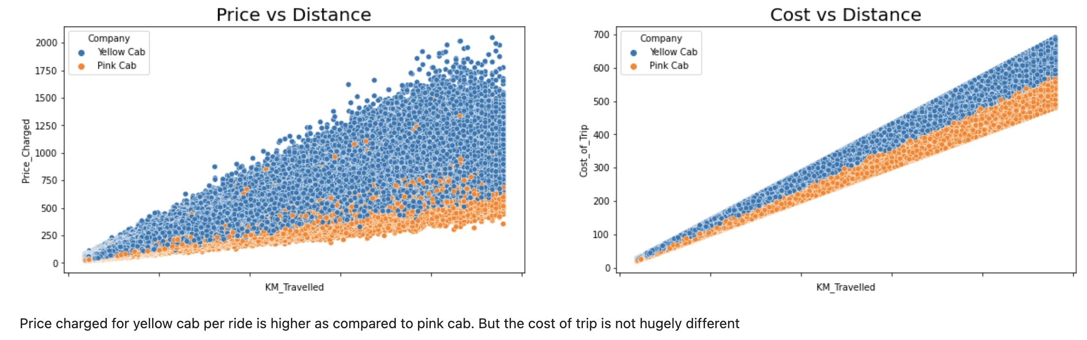
Price vs Distance and Cost vs Distance comparison

Slide 15
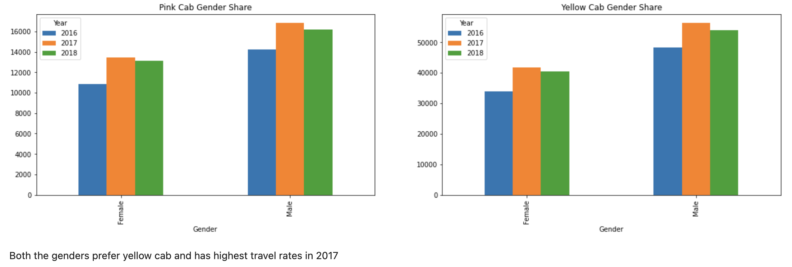
Gender and Year wise cab usage

Slide 16
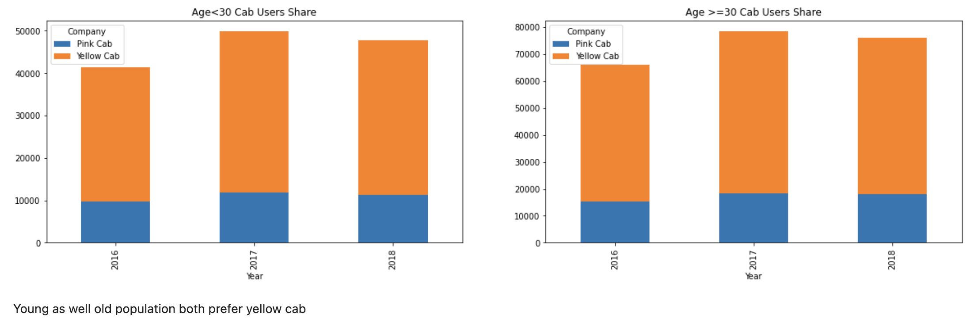
Age and year wise cab usage

Slide 17
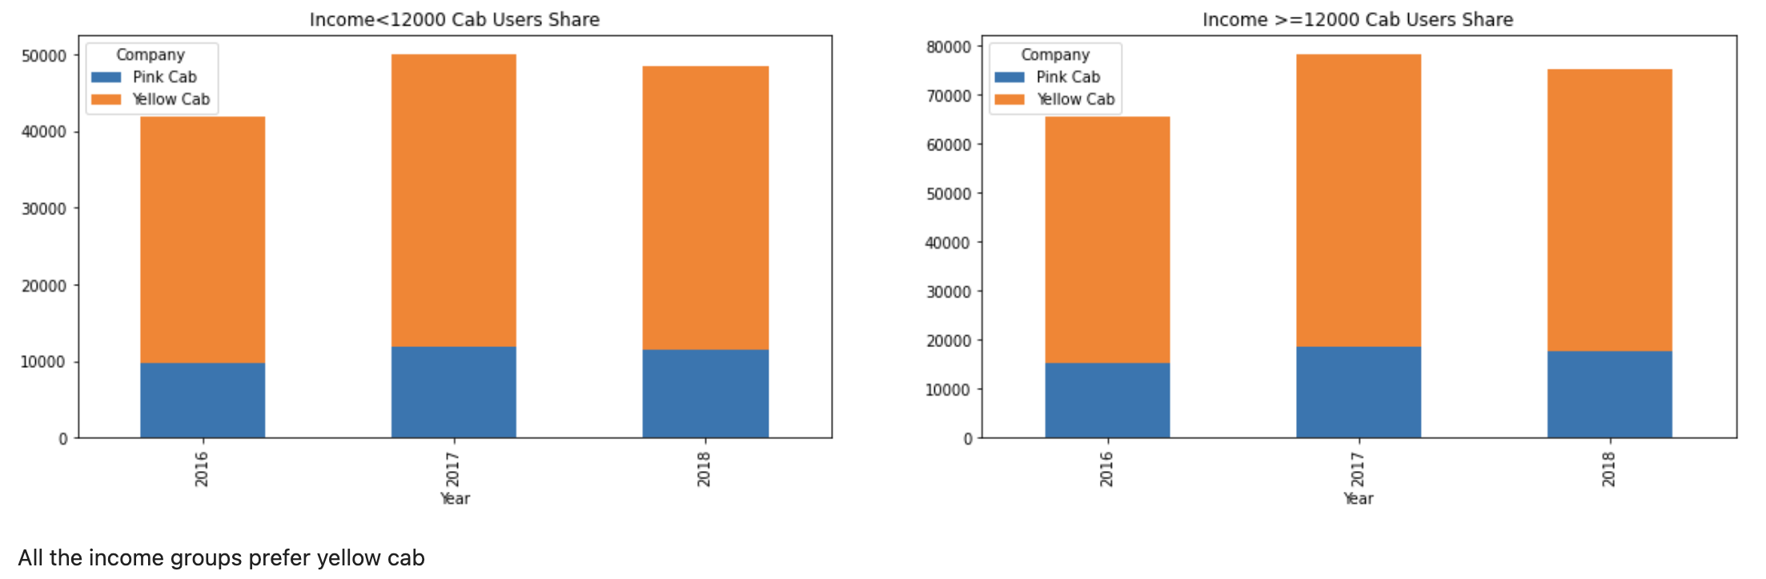
Income wise Cab usage

Slide 18
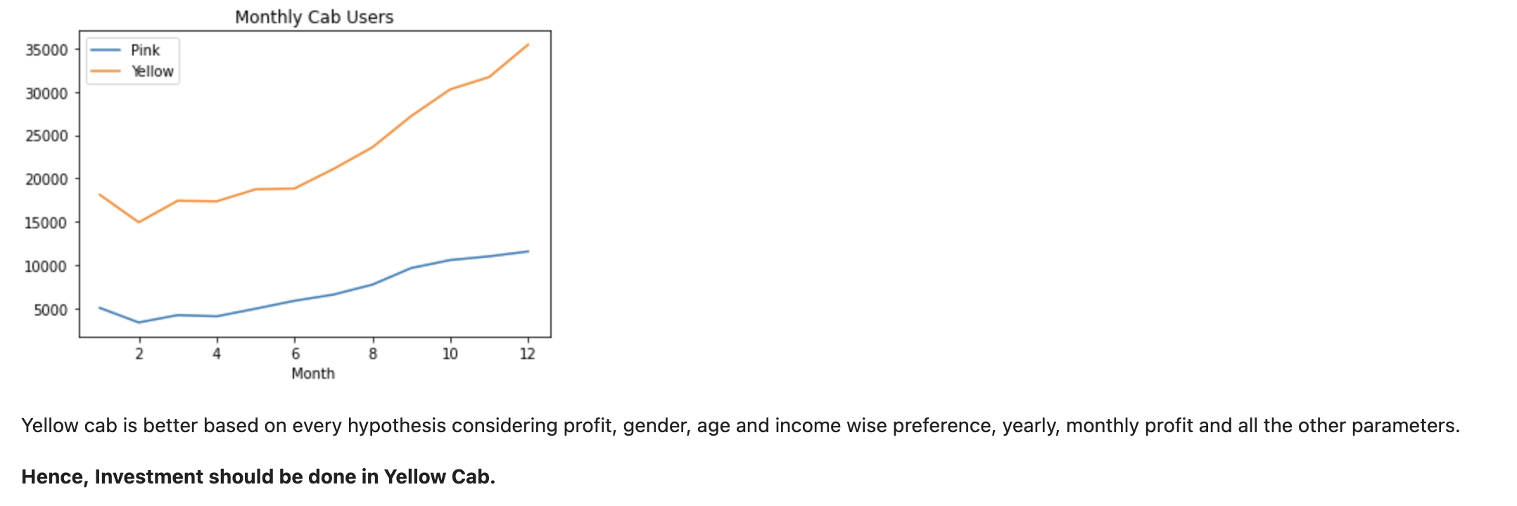
Final Recommendation

Slide 19
Thank You

