Slide 1

Hate Speech Classification
Virtual Internship
31-Mar-2023

Slide 2
Contents
Problem Description and business understanding
Dataset
Data types
Data Problem
Data Transformations
Model Development
Final Recommendations
Conclusion

Slide 3
Problem Description
The term hate speech is understood as any type of verbal, written or behavioural communication that attacks or uses derogatory or discriminatory language against a person or group based on what they are, in other words, based on their religion, ethnicity, nationality, race, colour, ancestry, sex or another identity factor.
With the social media usage at its peak, identifying such tweets have become extremely crucial for every social media platform.
Hate speech on social media can have harmful effect on a person/community. Hate speech is often used to spread hate and bigotry. It can also be used to intimidate and threaten people. It can make people feel isolated, anxious, and scared. It can also lead to hate crimes. Hate speech can also damage relationships between different groups of people.

Slide 4
Business understanding
Detection of hate speech is important because it can help prevent these harmful effects.
In this problem, we will create a hate speech detection model with Machine Learning and Python. Hate Speech Detection is generally a task of sentiment classification.
So for training, a model that can classify hate speech from a certain piece of text can be achieved by training it on a data that is generally used to classify sentiments. So for the task of hate speech detection model, we will use the Twitter tweets to identify tweets containing Hate speech.

Slide 5
Approaches taken
Approaches
Data was taken from Kaggle and analysed
Problem understanding
Data Understanding
Data Cleaning and Feature engineering
Model Development
Model Selection
Model Evaluation

Slide 6
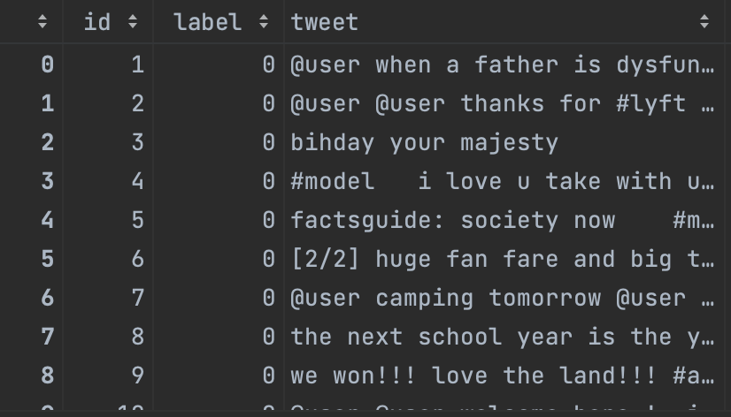
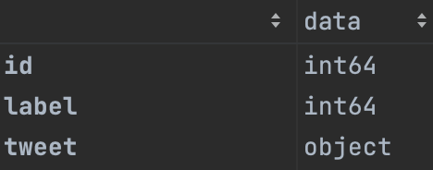
Profit Analysis
Dataset
Data has 3 columns: id(id of the tweet), label(=0 if not a hate speech and =1 if it is a hate speech) and tweet(the string containing the tweet. Following is a snapshot of first few rows of the dataset.
The datatype of id and label is int64 (integer). The data type of tweet is string.

Slide 7
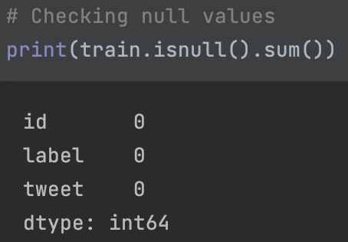
Null values
This dataset has no null values.
Test data csv file does not have label column. Hence, we cannot use it for further analysis.

Slide 8
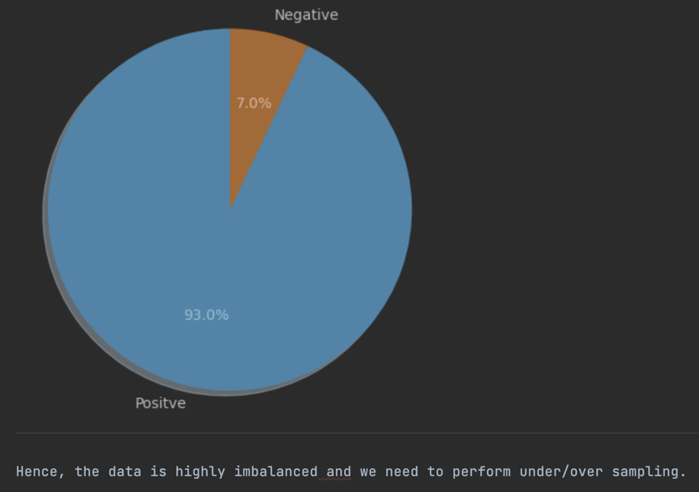
Data imbalance
There is a heavy imbalance in the data as shown in the figure below. There are only 7% hate tweets as compared to 93% positive(non-hate) tweets. Hence when sampling the data for model building we need to apply under/over sampling technique.
Firstly, data has been split into train(80%) and test sets(20%) and then oversampling has been performed for the training dataset.

Slide 9
Data transformation
The ids will not be used for model building and labels have only 0 and 1 values. Hence these two columns need not to be transformed. However, the tweets need to be preprocessed. The data needs to be cleaned by removing urls or any special characters which doesn’t make sense.
Data preprocessing is one of the critical steps in any machine learning project. It includes cleaning and formatting the data before feeding it into any ML algorithm. For NLP, following task needs to be performed for pre-processing:
Tokenizing the string
Lowercasing
Removing stop words and punctuations
Stemming

Slide 10
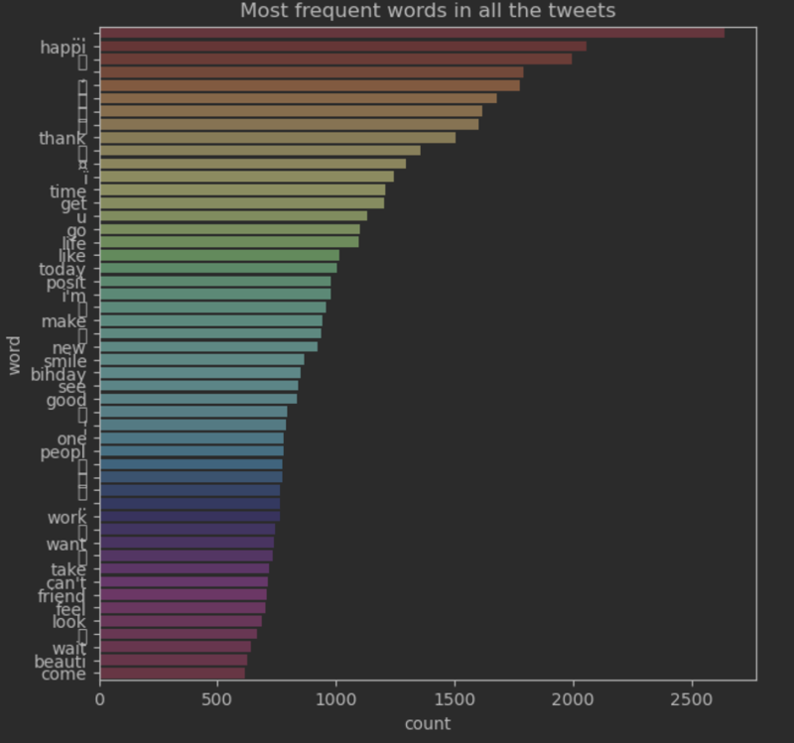
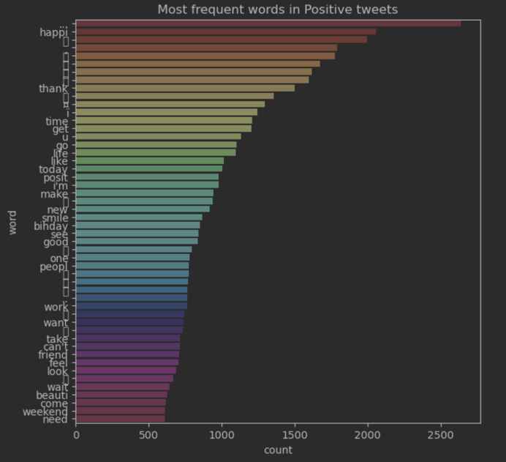
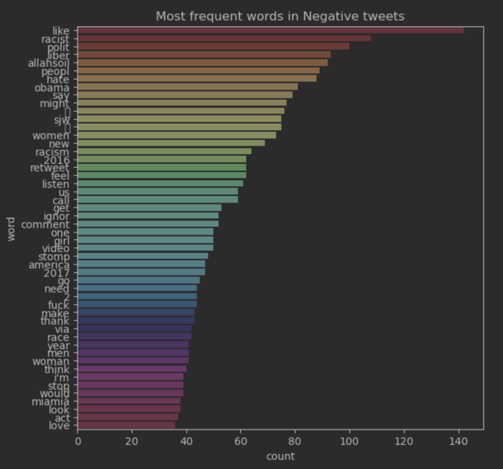
Data transformation
Most frequent words across all the tweets
Most frequent words in positive tweets
Most frequent words in negative tweets

Slide 11
Model Development
Following model have been trained and analysed for the given problem:
Logistic Regression
Support Vector Machines
Naïve Bayes
Random Forest
Transformers

Slide 12
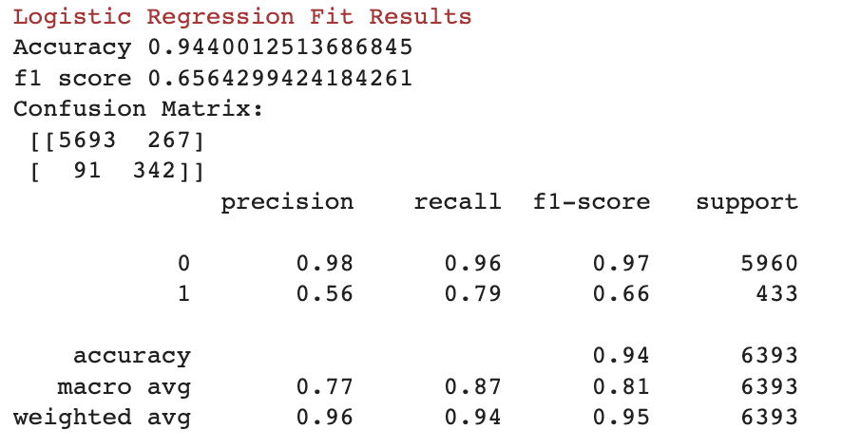
Logistic Regression

Slide 13
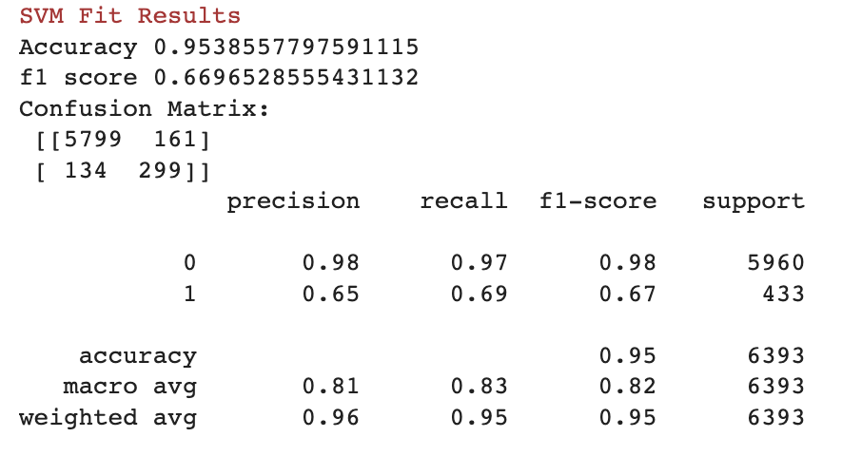
SVM

Slide 14
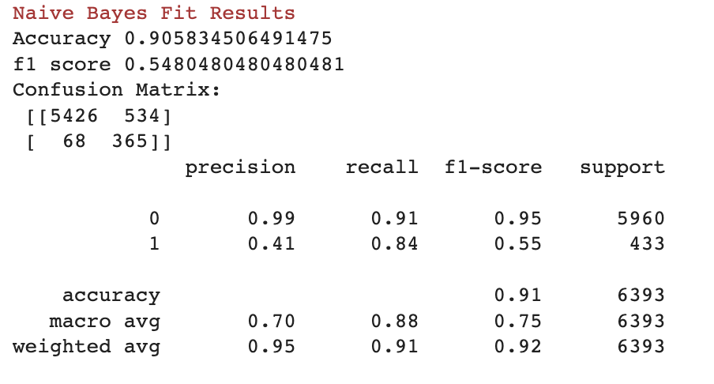
Naïve Bayes

Slide 15
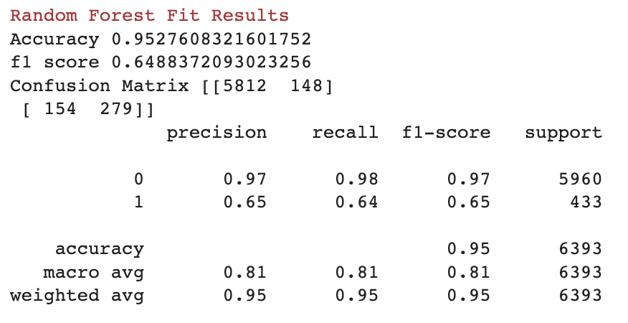
Random Forest

Slide 16
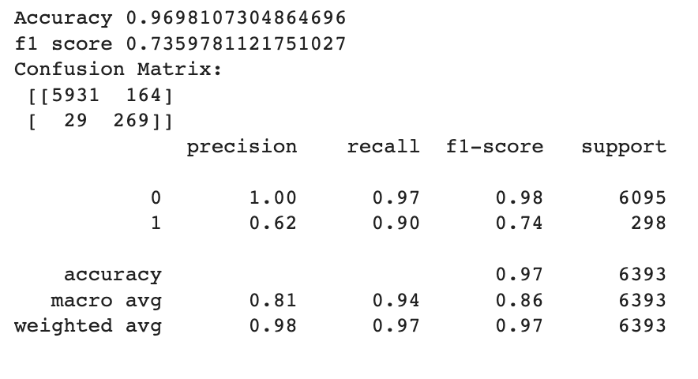
Transformers
A pretrained model ‘DistilBertForSequenceClassification’ has been retrained for the sentiment analysis. The data is tokenized using distilbert-base-uncased tokenizer. Following result has been obtained for the transformer model fitted for twitter data:

Slide 17
Final Recommendation
The following results show that transformers provide the highest accuracy as well as f1 score for this use case.
Model | LR | SVM | NB | RF | Transformers
Accuracy | 0.94 | 0.95 | 0.90 | 0.95 | 0.97
F1 score | 0.65 | 0.66 | 0.54 | 0.65 | 0.74

Slide 18
Thank You

