Slide 1
PathPartner
connecting journeys
Presented by
R Suriyamoorthy BE.,ECE III -AAACET
R Sivabalan BE.,ECE III -AAACET
AAA COLLEGE OF ENGINEERING & TECHNOLOGY
Accredited by NAAC with Grade ‘A’,
Accredited by NBA ( CSE, EEE, ECE& MECH)
Approved by AICTE, New Delhi & Affiliated to Anna University, Chennai
Amathur, Sivakasi - 626 005

Slide 2
Table of contents
01
02
03
04
05
06
Objective
Design methodology
Algorithm
Results and Discussions & Challenges we faced
Future Framework & Conclusion
Workflow

Slide 3
Objective
The objective of Smart Carpool Connect is to revolutionize shared mobility by seamlessly integrating dynamic carpooling with a car rental marketplace. It aims to provide users with an intuitive platform for efficient navigation, optimizing real-time ride-sharing based on preferences and schedules, and ensuring secure transactions and background checks. By merging these functionalities, Smart Carpool Connect seeks to redefine how people commute and rent vehicles, offering a versatile solution that enhances convenience, affordability, and trustworthiness in shared mobility. Ultimately, the platform aims to streamline daily commutes and occasional rentals while contributing to a more sustainable and interconnected transportation ecosystem.

Slide 4
Abstract
Smart Carpool Connect is a transformative platform merging dynamic carpooling and a car rental marketplace. It offers an intuitive interface facilitating efficient navigation for users, optimizing real-time ride-sharing through advanced algorithms, and ensuring secure transactions and background checks. Challenges included data privacy, algorithm refinement, and user engagement amidst market competition. Future plans involve integrating autonomous vehicles, global expansion, and aligning with sustainable transportation modes. The platform aims to revolutionize shared mobility, offering a versatile solution for daily commutes and occasional rentals while evolving to meet evolving user needs.
Keywords: Smart Carpool Connect, dynamic carpooling, car rental marketplace, real-time ride-sharing, secure transactions, background checks, algorithm optimization, user engagement, autonomous vehicles, global expansion, sustainable transportation, shared mobility.

Slide 5
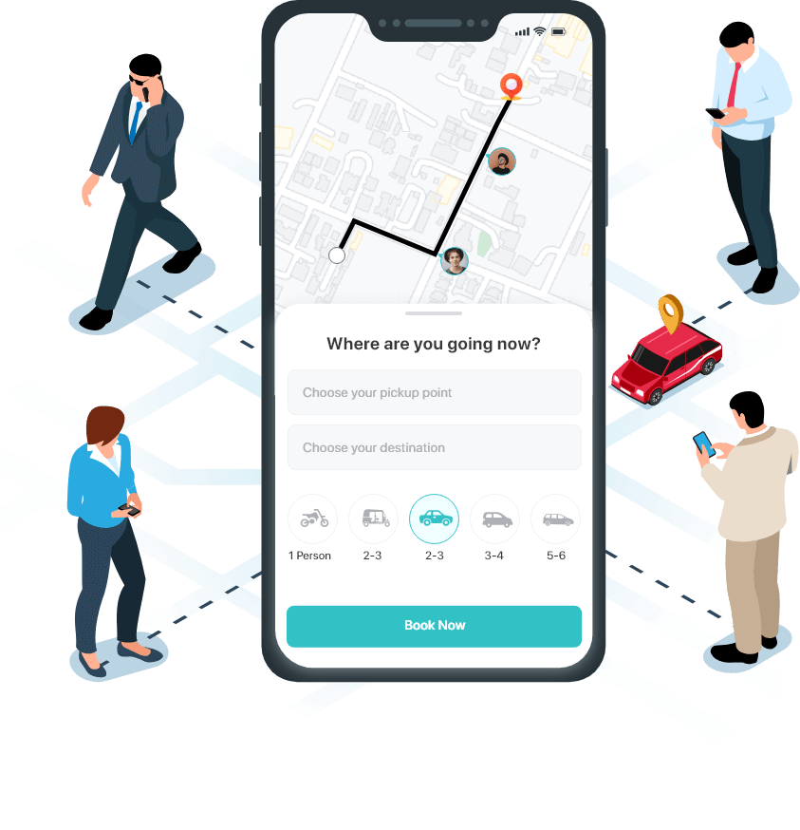
Car pooling
User registration
Profile creation
Matching notification
Accept/Reject match
Shared ride
Flexible scheduling

Slide 6
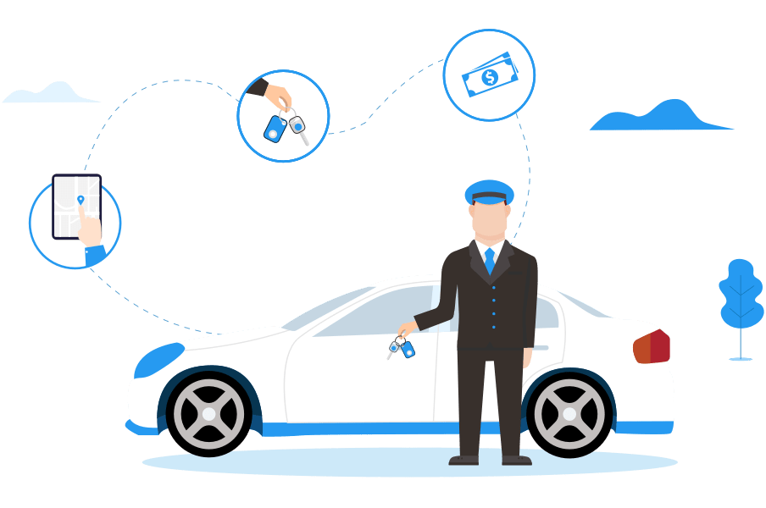
Car Rental
Owner lists car
Renters browse
Booking process
Rental confirmation
Rental period
Return process

Slide 7
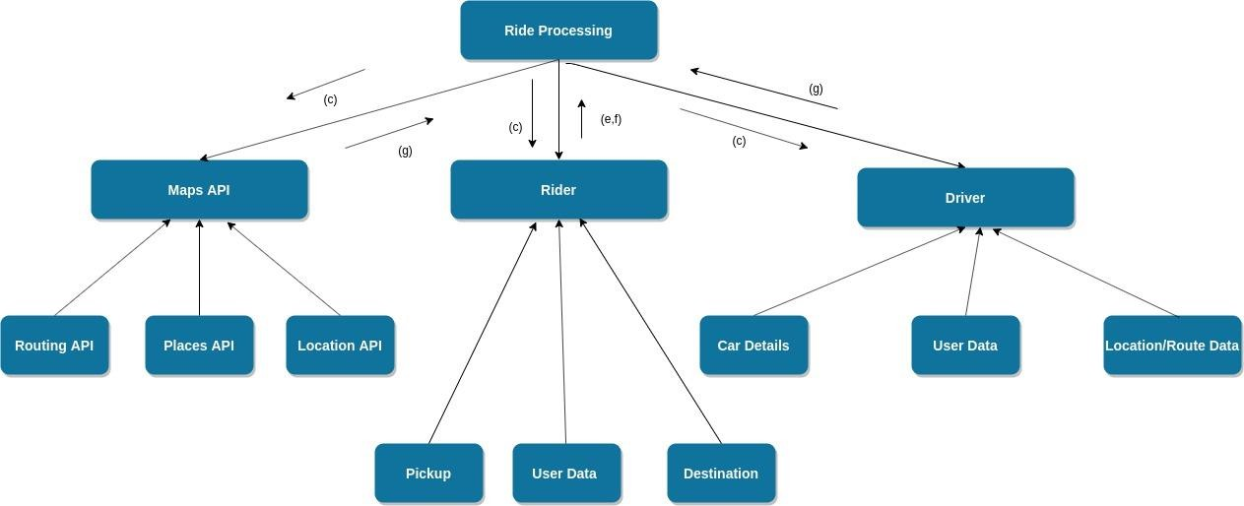
Proposed workflow
Car pooling system

Slide 8
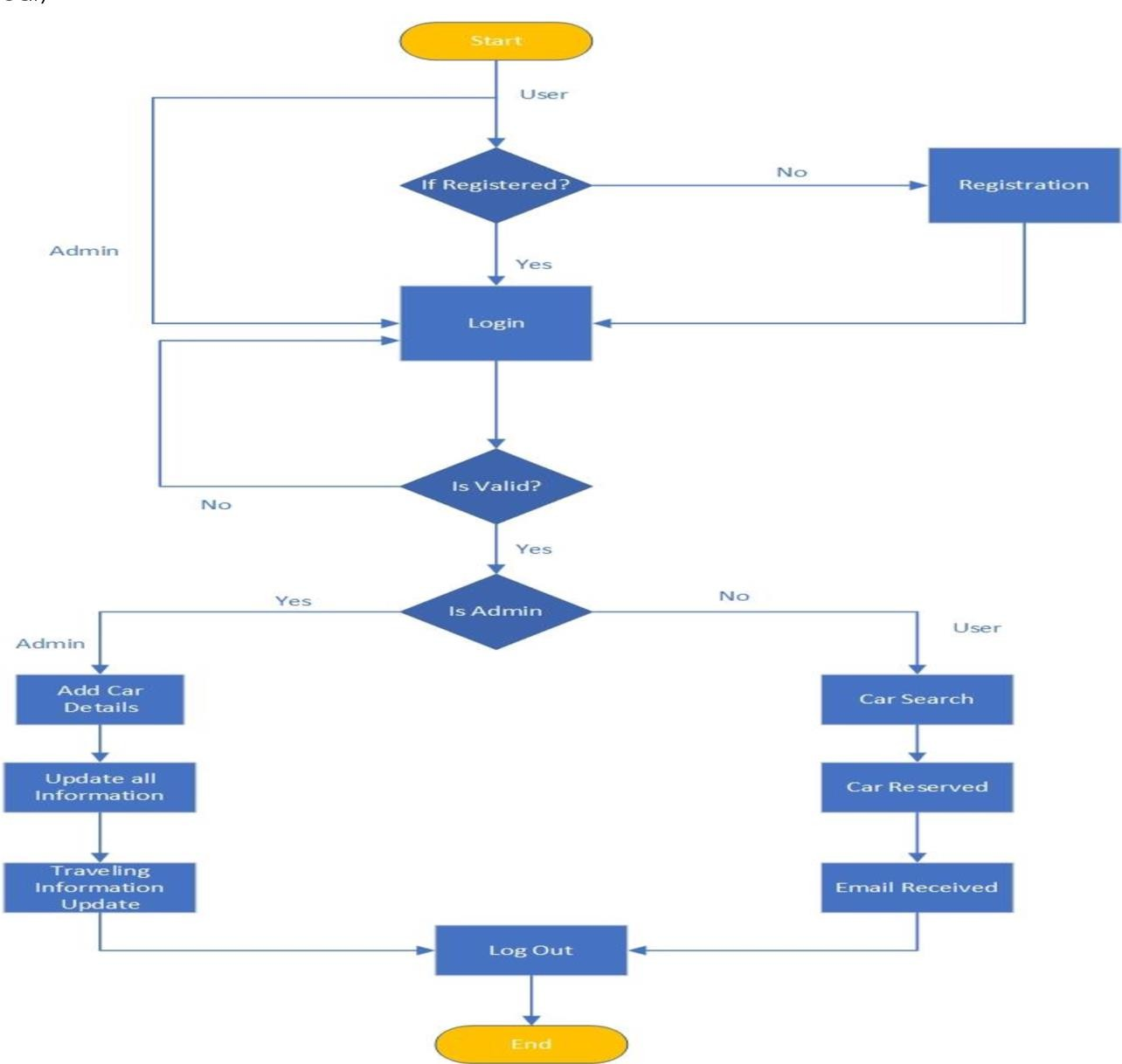
Car Rental system

Slide 9
Proposed Design Methodology
User Experience Design:
Algorithm Design:
Security Measures
user-friendly interface for easy navigation and efficient interaction between car owners and renters
advanced algorithm to optimize real-time ride-sharing based on preferences, schedules, and route compatibility.
Implemented secure transactions and robust background checks to ensure a trustworthy environment for users
01
02
03

Slide 10
Algorithms
Matching Algorithm
location, destination, schedule, and preferences.
Algorithm
Availability Scheduling
considering factors like traffic, time, and detours.
Safety and Security
verifying identities, and ensuring the safety
Payment and Transaction
demand, time of day, distance, vehicle type, and availability.

Slide 11
Proposed potential offers
01
4
6
Environmental Impact Tracking
Community Events
Dynamic Pricing
7
2
Integrated Payment Options
Reward System
5
8
3
Emergency Assistance
Feedback and Ratings
Customized Notifications

Slide 12
Proposed Workplan Timeline
Activities | Weeks
 | 1 - 2 | 2-4 | 4-6 | 6-8 | 8-10
Literature survey & Procurement of components required for the projects
Development of necessary software programming
Flow diagram design
Developing a Proposed Model
Testing and Performance evaluation
Project Validation Documentation

Slide 13
Results and Discussions
In conclusion, SmartCarpool Connect has successfully redefined shared mobility by seamlessly integrating dynamic carpooling with a car rental marketplace. Despite challenges faced during development, the platform has achieved significant user adoption and positive feedback. With continuous innovation and integration of future technologies, SmartCarpool Connect is poised to evolve and meet the ever-changing needs of users in the dynamic landscape of shared mobility.

Slide 14
Learning outcomes
1. Literature Survey and Research Analysis
Conducted an in-depth review of existing literature and research to inform the development of SmartCarpool Connect, ensuring alignment with current industry trends and best practices.
2. Software Implementation:
Implemented advanced algorithms and robust software architecture to optimize real-time ride-sharing, user authentication, secure transactions, and background checks within the SmartCarpool Connect platform.
Continue …..

Slide 15
3. Teamwork
Throughout the project we worked as a team and each person contributed their research findings and knowledge to other team members
4. Product Development
Iteratively developed and refined SmartCarpool Connect based on user feedback and market validation, prioritizing features and enhancements to deliver maximum value to stakeholders while ensuring a seamless user experience

Slide 16

Glimpses Proposed Algorithm

Slide 17
Future vision
Integration with Autonomous Vehicles: Smart Carpool Connect envisions integrating autonomous vehicles to offer an even more seamless and efficient mobility experience in the future.
Global Expansion: The platform aims to expand globally, fostering a connected network of users sharing rides and renting cars across different regions.
Sustainable Transportation Integration: Integration with sustainable transportation modes such as electric vehicles and bikes aligns with Smart Carpool Connect's commitment to eco-friendly solutions.

Slide 18
Why should our project win
1. Innovation: Our project stands out for its innovative approach to integrating dynamic carpooling with a car rental marketplace, offering a unique solution that addresses the evolving needs of shared mobility in a seamless and efficient manner.
2. User-Centric Design: With a focus on user experience, our platform prioritizes intuitive navigation, real-time matching based on preferences, and secure transactions, ensuring a user-friendly interface that enhances convenience and trust among users.
Continue …..

Slide 19
3. Impact: By revolutionizing shared mobility, our project contributes to a more sustainable transportation ecosystem by promoting carpooling, optimizing vehicle utilization, and fostering community engagement, ultimately leading to reduced traffic congestion and carbon emissions.
4. Scalability: Our platform is designed to scale globally, with plans for integration with autonomous vehicles and expansion into sustainable transportation modes, positioning us for long-term success and growth in the evolving landscape of shared mobility.
5. Social Benefit: Winning this project event would enable us to further develop and promote our platform, creating tangible social benefits by improving access to affordable transportation, enhancing connectivity among communities, and empowering individuals to make environmentally conscious choices in their daily travel.

Slide 20
Thanks!
Do you have any questions?
pricelessbrains@gmail.com

