Slide 1

Basic Details of the Team and Problem Statement
Ministry/Organization Name/Student Innovation : AICTE, MIC-Student Innovation
PS Code: SIH1475
Problem Statement Title: STUDENT INNOVATION
Revolutionizing Response Drone Creating Versatile Solutions for India's Critical Needs like flood
Team Name: Priceless-Brains
Team Leader Name: R SURIYAMOORTHY Institute Code (AISHE): C-49143
Institute Name : AAA College Of Engineering And Technology
Theme: Hardware

Slide 2
Idea/Approach Details
The primary focus is on serving human needs efficiently in the pandemic situations like flood. An average every year in India 1600 lives are lost due to the Flood. We can serve the basic medical resources and basic need for the peoples in the critical situations. We use drones for delivering the medical needs alternative for the helicopters.
Technology stack:
Payload: Raspberry pi , Ardruino
Cameras (thermal) for visual perception.
GPS module V3.0 for navigation and positioning.
LORA network Chip RA20
Control and Navigation: ROS (Robot Operating System) for Drone control and communication. SLAM (Simultaneous Localization and Mapping) algorithms for mapping and navigation.
INput
INPUTS
Process
Output
Request message “Location:
Raspberry pi ,Arduino
GPS/GPRS/GSM MODULE V3
Reply
Transmitter
Flight controller
Quadcopter control
Camera
Receiver
Monitor
Figure 2: System Model for Search and Rescue Drone

Slide 3
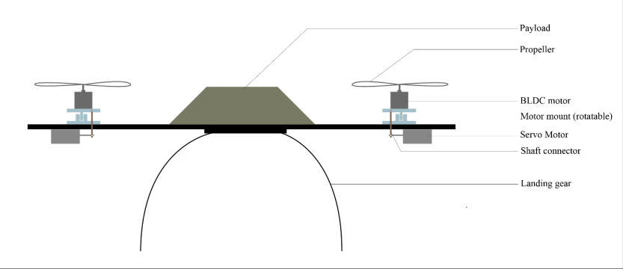
Idea/Approach Details
Idea Approach :
Resource camp
Resource request
Accordingly, this system is proposed to help monitor real-time emergency and industrial situations for human needs. It will be achieved by automating the inspection process, GPS location, and picture confirmation for goods delivery as well as reducing human interaction. Visual inspection can be easily replaced with a live video streaming camera carried by a drone. On the other hand, the manual process of hospital-side confirmation can be done, and, Camp side, any accidental case can be covered with medical support. The detection process will be replaced by the proposed payload (Raspberry Pi 3)mounted on the drone.
If
No
yes
Lora Network
SLAM
MQTT
Rescue Camp
Figure 3 : Proposed prototype

Slide 4
Team Member Details
Team Leader Name: R SURIYAMOORTHY
Branch (Btech/Mtech/PhD etc): BE Stream (ECE, CSE etc): ECE Year : III
Team Member 1 Name: R SIVABALAN
Branch (Btech/Mtech/PhD etc): BE Stream (ECE, CSE etc): ECE Year :III
Team Member 2 Name: AM JANANI
Branch (Btech/Mtech/PhD etc): BE Stream (ECE, CSE etc): ECE Year : III
Team Member 3 Name: V POONKODI
Branch (Btech/Mtech/PhD etc): BE Stream (ECE, CSE etc): ECE Year : III
Team Member 4 Name: A. YOGESHWARAN
Branch (Btech/Mtech/PhD etc): BE Stream (ECE, CSE etc): ECE Year III
Team Member 5 Name: R HEMAND
Branch (Btech/Mtech/PhD etc): BE Stream (ECE, CSE etc): EEE Year I
Team Mentor Name:Dr.S. Sevugarajan, M.Sc., M. Sc.[Engg] (IISc.), Ph. D (IISc) Prof. & Head Dept. of ECE, AAACET
Category (Academic/Industry): Domain Experience (in years):

