Slide 1

Basic Details of the Team and Problem Statement
Ministry/Organization Name/Student Innovation: ISRO
Problem Statement Title: Change detection due to human activities
PS Code :SIH1518
Team Name: Priceless Brains
Team Leader Name:Mr.R . Suriyamoorthy
Institute Code (AISHE): C-49143
Institute Name: AAA College of Engineering & Technology
Theme Name: Space Technology

Slide 2
Idea/Approach Details
Flowchart
Project Title: AquaEdify - Collaborative Water Monitoring Android App with Space-Tech Integration and Digital Clock
Objective: Develop an Android app named AquaEdify, in collaboration with the Indian Space Research Organisation (ISRO), leveraging Python, Kivy, and open-source API keys for a unique technological approach to space-related water monitoring. The app aims to provide real-time data visualization of freshwater resources, fostering community engagement, sustainable practices, and an innovative digital clock feature.
Start
Kivy
API
Technology Stack
Solution
App Architecture
Real-Time Data Visualization with ISRO Satellite Data: Integrate Python and Kivy for the Android app development, ensuring compatibility with smartphones and smartwatches. Utilize open-source API keys to seamlessly access and display real-time satellite data from ISRO, providing users with an aerial view of local freshwater tanks.
Community-Centric Data Insights: Leverage Python's data visualization libraries for enhanced data insights.Enable communities to monitor changes in local freshwater resources, track trends, and make informed decisions related to water usage and conservation.
3. Digital Clock Integration: Implement a digital clock feature within the app for users to conveniently track time while engaging with water monitoring data. Enhance the app's usability by providing both real-time water information and the current time..
4. Educator Collaboration Platform with ISRO API Integration: Develop a web-based platform for educators using open-source API keys, offering additional resources and lesson plans. Integrate ISRO's educational resources through APIs for an enriched learning experience.
Testing ,QA
User Feedback Analysis
End
Technological Components:
App Development with Python and Kivy
Open-Source API Keys for Satellite Data Access
Data Visualization with Python Libraries:
Space-Inspired Graphic Design
Integration of ISRO API for Educational Content:

Slide 3
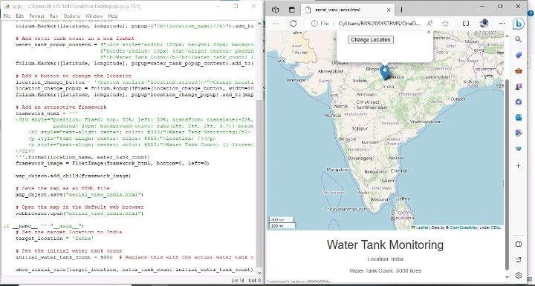
Idea/Approach Details
Describe your Dependencies / Show stopper here
Significance:
This project's significance lies in its innovative use of Python, Kivy, and open-source API keys, combined with ISRO's data and educational resources. AquaEdify becomes a pioneering tool for societal water monitoring, blending technology and space-related insights for a sustainable future.
Describe your Use Cases here
Collaboration and Impact:
By combining Python, Kivy, open-source API keys, and ISRO's satellite data and educational resources, AquaEdify becomes a uniquely powerful tool. This collaboration aims to empower communities with space-tech-enhanced insights for effective water monitoring and conservation.
Expected Outcomes:
Unique space-themed graphical elements and real-time data visualization.
Enhanced community engagement through space-tech-inspired educational content.
Empowerment of communities through space-tech-integrated water monitoring.

Slide 4
Team Member Details
Team Leader Name: R SURIYAMOORTHY
Branch (Btech/Mtech/PhD etc): BE Stream (ECE, CSE etc): ECE Year : III
Team Member 1 Name: R SIVABALAN
Branch (Btech/Mtech/PhD etc): BE Stream (ECE, CSE etc): ECE Year :III
Team Member 2 Name: AM JANANI
Branch (Btech/Mtech/PhD etc): BE Stream (ECE, CSE etc): ECE Year : III
Team Member 3 Name: V POONKODI
Branch (Btech/Mtech/PhD etc): BE Stream (ECE, CSE etc): ECE Year : III
Team Member 4 Name: K Rithik
Branch (Btech/Mtech/PhD etc): BE Stream (ECE, CSE etc): CSE Year II
Team Member 5 Name: R HEMAND
Branch (Btech/Mtech/PhD etc): BE Stream (ECE, CSE etc): EEE Year I
Team Mentor Name 1 :Dr.S. Sevugarajan, M.Sc., M. Sc.[Engg] (IISc.), Ph. D (IISc)
Team Mentor Name 1 : Dr. M. Sekar

