Slide 1

Basic Details of the Team and Problem Statement
Ministry/Organization Name/Student Innovation: AICTE, MIC-Student Innovation
Problem Statement Title: Student Innovation
PS Code : SIH1491
Team Name: Priceless Brains
Team Leader Name:Mr.R . Suriyamoorthy
Institute Code (AISHE): C-49143
Institute Name: AAA College of Engineering & Technology
Theme Name: Software

Slide 2
Idea/Approach Details
Flowchart
Project Title: AquaEdify - Collaborative Water Monitoring Android App with Space-Tech Integration and Digital Clock
Objective: Develop an Android app named AquaEdify, in collaboration with the Indian Space Research Organisation (ISRO), leveraging Python, Kivy, and open-source API keys for a unique technological approach to space-related water monitoring. The app aims to provide real-time data visualization of freshwater resources, fostering community engagement, sustainable practices, and an innovative digital clock feature.
Image Acquisition
Image Preprocessing
Solution
Image segmentation
Feature Extraction
Statistical Analysis
Technological Components:
App Development with Python and Kivy
Open-Source API Keys for Satellite Data Access
Data Visualization with Python Libraries:
Space-Inspired Graphic Design
Integration of ISRO API for Educational Content:

Slide 3
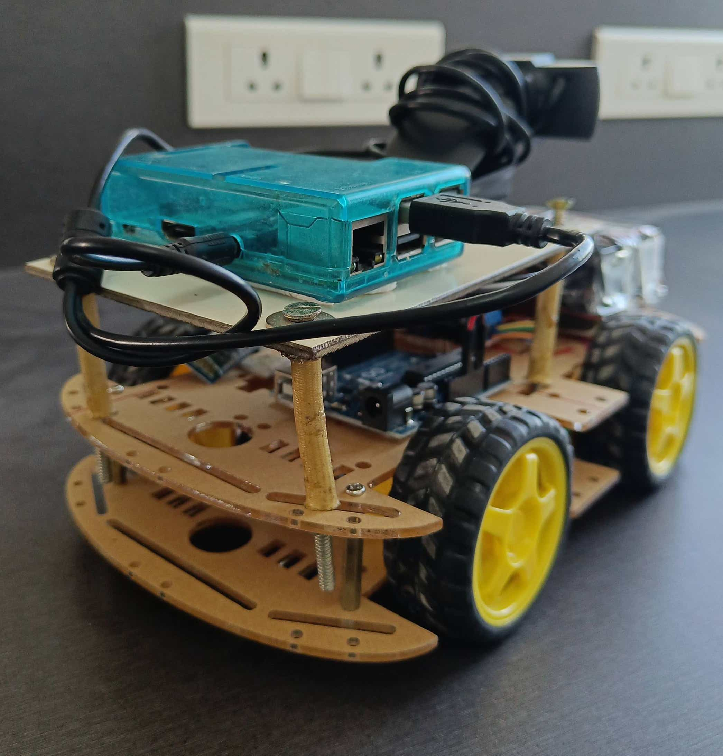
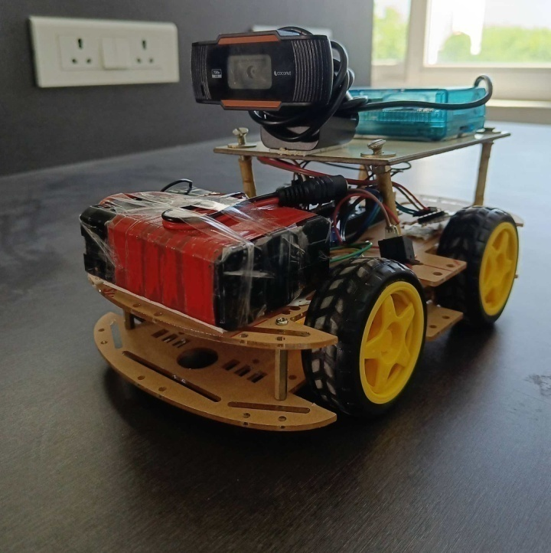
Idea/Approach Details
Describe your Dependencies / Show stopper here
Significance:
This project's significance lies in its innovative use of Python, Kivy, and open-source API keys, combined with ISRO's data and educational resources. AquaEdify becomes a pioneering tool for societal water monitoring, blending technology and space-related insights for a sustainable future.
Describe your Use Cases here
Collaboration and Impact:
By combining Python, Kivy, open-source API keys, and ISRO's satellite data and educational resources, AquaEdify becomes a uniquely powerful tool. This collaboration aims to empower communities with space-tech-enhanced insights for effective water monitoring and conservation.
Expected Outcomes:
Unique space-themed graphical elements and real-time data visualization.
Enhanced community engagement through space-tech-inspired educational content.
Empowerment of communities through space-tech-integrated water monitoring.
Proposed set up

Slide 4
Team Member Details
Team Leader Name: R SURIYAMOORTHY
Branch (Btech/Mtech/PhD etc): BE Stream (ECE, CSE etc): ECE Year : III
Team Member 1 Name: R SIVABALAN
Branch (Btech/Mtech/PhD etc): BE Stream (ECE, CSE etc): ECE Year :III
Team Member 2 Name: AM JANANI
Branch (Btech/Mtech/PhD etc): BE Stream (ECE, CSE etc): ECE Year : III
Team Member 3 Name: V POONKODI
Branch (Btech/Mtech/PhD etc): BE Stream (ECE, CSE etc): ECE Year : III
Team Member 4 Name: K Rithik
Branch (Btech/Mtech/PhD etc): BE Stream (ECE, CSE etc): CSE Year II
Team Member 5 Name: R HEMAND
Branch (Btech/Mtech/PhD etc): BE Stream (ECE, CSE etc): EEE Year I
Team Mentor Name 1 :Dr.S. Sevugarajan, M.Sc., M. Sc.[Engg] (IISc.), Ph. D (IISc)
Team Mentor Name 1 : Dr. M. Sekar

