Slide 1


Roadmap for Aptitude Round

Slide 2


Alert!!!
If you are preparing for a Specific company .
Search for the Particular Aptitude topics asked for those companies using PrepInsta or How to Crack Series

Slide 3

APTITUDE
Quantitative Aptitude
Logical Reasoning
Verbal Ability
Arithmetic
Algebra
Number System
Geometry
Graphs
Reading Comprehension
Vocabulary
Grammar
Sentence Correction
Critical
Analytical
Non – Verbal Puzzle

Slide 4
Quantitative Aptitude

Slide 5

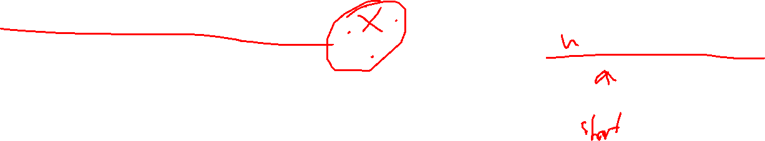
Number System :
Prime Numbers
Divisibility Rules
HCF and LCM
Factors and Multiples

Slide 6


Arithmetic
Percentages
Profit and Loss
Simple and Compound Interest
Ratio and Proportion
Averages
Time, Speed, and Distance
Time and Work
Mixtures and Allegations
Boats and Stream
Probability
Permutations and Combination

Slide 7
Algebra
Simplification
Linear Equations
Quadratic Equations
Polynomials

Slide 8
Geometry and Mensuration
Basic Geometrical Shapes and Properties
Area and Perimeter
Volume and Surface Area

Slide 9
Data Interpretation
Bar Graphs
Line Graphs
Pie Charts
Tables

Slide 10
Logical Reasoning

Slide 11

Analytical Reasoning:
Series and Sequences
Analogies
Classification
Pattern Recognition

Slide 12



Critical Reasoning:
Statements an Assumptions
Statements and Conclusions
Statements and Arguments
Cause and Effect

Slide 13
Non-Verbal Reasoning
Image Series
Mirror Images
Water Images
Paper Folding

Slide 14

Puzzle Solving:
Seating Arrangements
Blood Relations
Syllogisms
Venn Diagrams

Slide 15
Verbal Ability

Slide 16

Reading Comprehension:
Grammar:
Spotting errors,
sentence improvement
sentence correction questions are frequently asked.
Vocabulary:
Synonyms,
antonyms,
idioms/phrases questions are part of many verbal ability sections.
Sentence Correction:
Questions where you need to identify grammatical errors and correct sentences are prevalent.

Slide 17

HOW TO LEARN
Search for Videos in mother tongue
Working > Watching

Slide 18

WHERE TO LEARN
FEEL FREE TO LEARN
IndiaBix
Geeks for Geeks
PrepInsta
ApsClub Channel

Slide 19
IMPORTANT TOPICS TO STRESS
HCF and LCM
Divisibility Rules
Factors and Multiples
Percentages
Profit and Loss
Simple and Compound Interest
Ratio and Proportion
Averages
Time, Speed, and Distance
Time and Work
Mixtures and Allegations
Boats and Stream
Probability
Permutations and Combination
Pie Chart
Simplification
Area and Perimeter
Bar Graph
Series and Sequences
Analogies
Statements an Assumptions
Statements and Conclusions
Statements and Arguments
Cause and Effect
Image Series
Seating Arrangements
Blood Relations
Syllogisms
Directions

Slide 20
CLARIFICATION
To make the videos content available for general audience
To improve my communication skill
***This PPT file is available in Placement preparation GitHub Repo , the repo link is available in the description
**Aptitude Formula pdf is also Added to that repository.

Slide 21
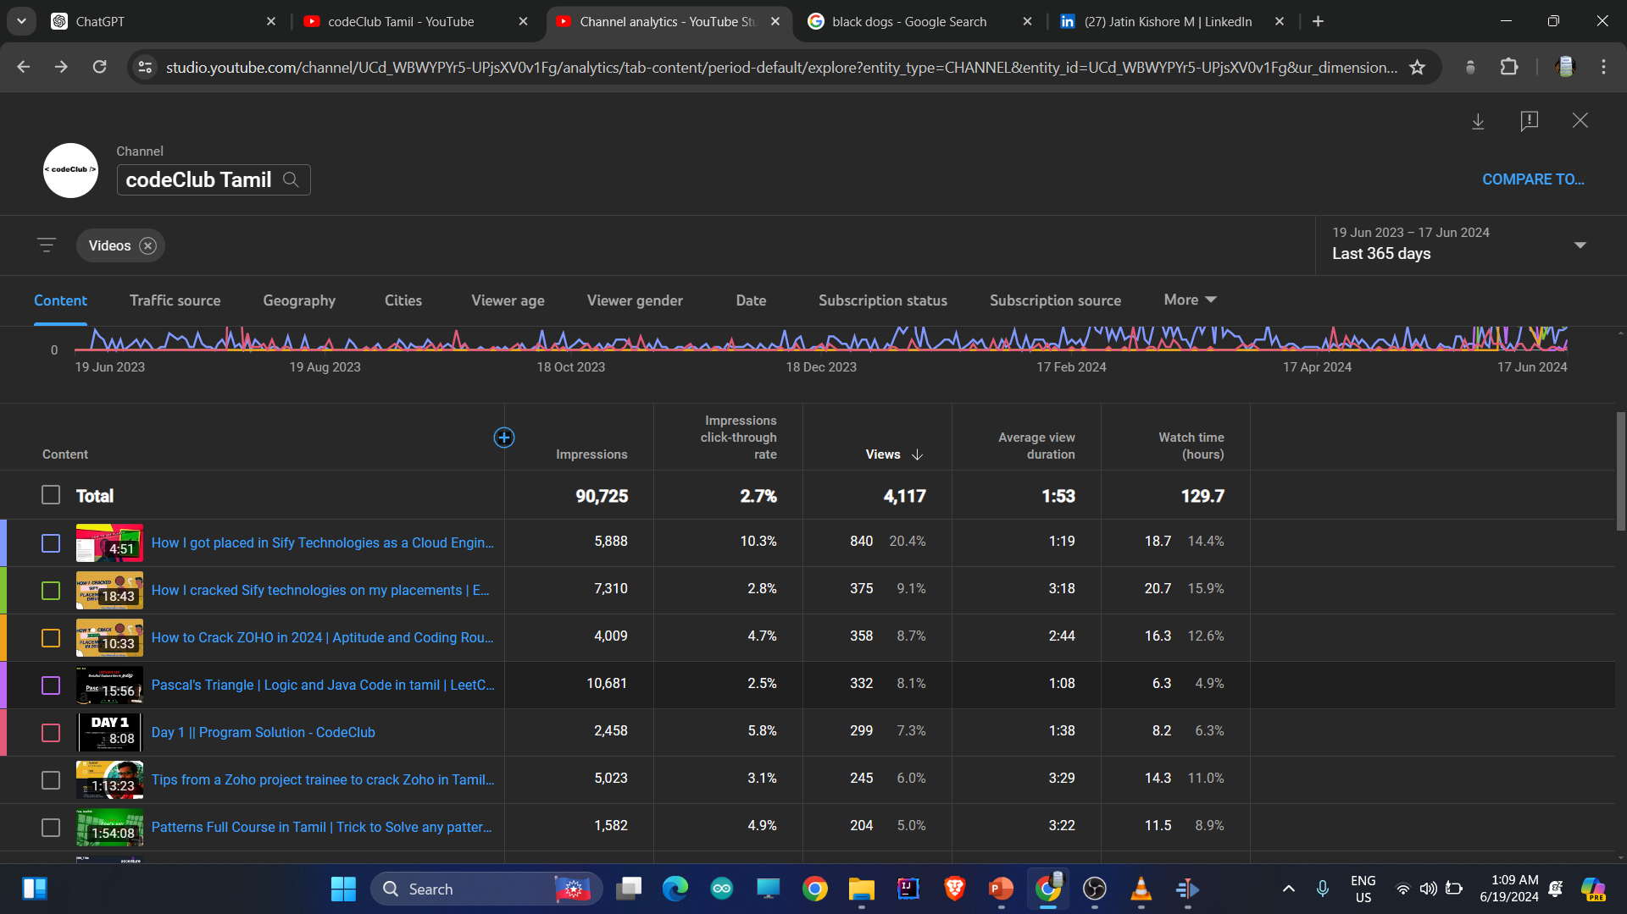


English with ROBO voice , with medium quality content, to crack sify technologies
Tamil Video with own voice, with high quality content, to crack sify technologies

