Slide 1
preparing effective illustration
An illustrated study overview

Slide 2
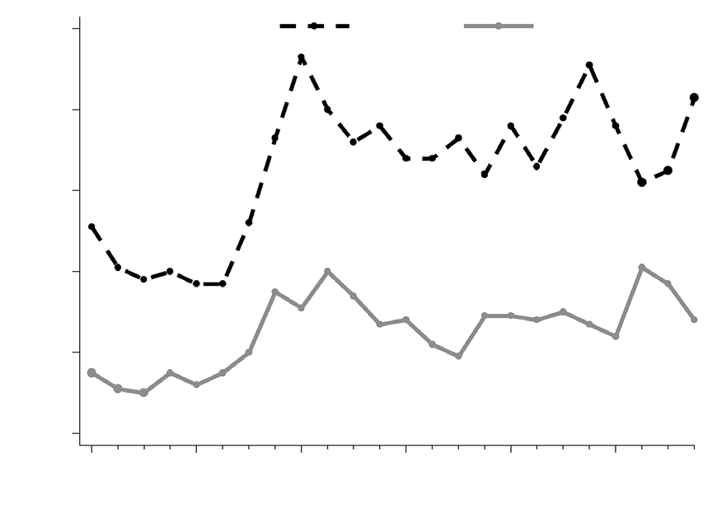
Introduction
• This presentation covers the topic: preparing effective illustration.
• We will explore its key concepts, subtopics, and practical examples.
• Graphs are a common type of illustration that are often used in scientific papers to present information clearly and effectively, as well…
• The purpose of graphs is to present data that is too numerous or complicated to be described adequately in the text and/or…
preparing effective illustration · Generated Presentation

Slide 3
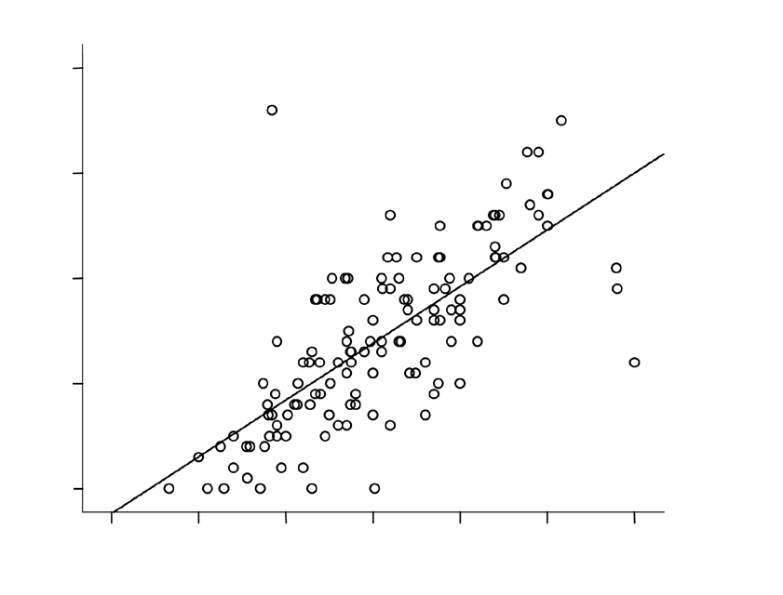
Part 1: graphs
• Graphs are a common type of illustration that are often used in scientific papers to present information clearly and effectively, as well…
• Keywords: figures, graphs, illustrations, medical writing, scientific paper Singapore Med J 2009; 50(3): 245-249 INTRODUCTION Illustrations (also known as figures) are visual…
• The purpose of graphs is to present data that is too numerous or complicated to be described adequately in the text and/or…
• One rule of thumb that can help us decide whether the data is best presented within the text or in a table…
• When to present data in graphs: • Show trends and patterns in the data.
preparing effective illustration · Generated Presentation

Slide 4
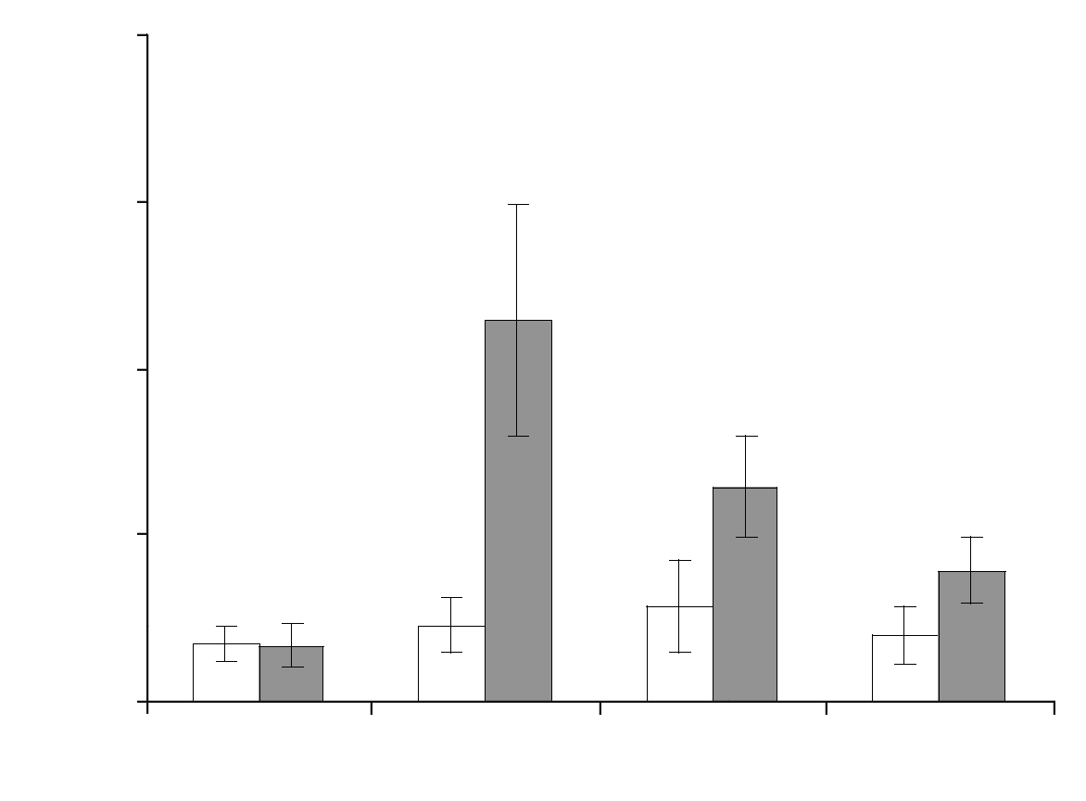
☐
• C) Ensure that the size of the font and symbols are appropriate so that they can be read when the graphs are…
• D) They should provide an interpretation of the results.
• Based on this graph, answer the following questions: (a) The graph is most appropriate for inclusion in the text.
• C) The graph should be replaced by a table.
• The following statements regarding types of graphs are true: (a) Box plots show a distribution of data.
preparing effective illustration · Generated Presentation

Slide 5
Key Takeaways
• Graphs are a common type of illustration that are often used in scientific papers to present information clearly and effectively, as well…
• C) Ensure that the size of the font and symbols are appropriate so that they can be read when the graphs are…
preparing effective illustration · Generated Presentation

Slide 6
Conclusion
• preparing effective illustration is a rich area with several interconnected ideas.
• Part 1: graphs: Graphs are a common type of illustration that are often used in scientific papers to present information clearly and effectively, as well…
• ☐: C) Ensure that the size of the font and symbols are appropriate so that they can be read when the graphs are…
• Review the subtopics above to build a complete understanding.
preparing effective illustration · Generated Presentation

